Slide 1
Yield Curve Estimation

Slide 2
Main uses of using the yield curve…
Setting the yield for all debt market instruments.
Acting as an indicator of future yield levels.
Measuring and comparing returns across the maturity spectrum.
Indicating relative value between different bonds of similar maturity.
Pricing interest rate derivative securities.

Slide 3
Example…
A bank is having 10,000 8% GOI dated security going to be matured in the next 5 years with a face value of Rs. 1,000.
Assume that it is not listed and coupon is paid half-yearly.
We want to determine its price as on March 31, 2022 for the purpose of Balance Sheet.

Slide 4
Relevant part of the ZCYC as on March 31, 2022 is given below:

Slide 5
Case#3: When bond is unlisted/not actively traded and on the valuation date we do not get the spot rates for the required period
In such, we use – Matrix Pricing

Slide 6
Matrix Pricing
Matrix Pricing is an estimation procedure that involves –
  Use of the market discount rate and price based on the quoted prices of more frequently traded comparable bonds.
  These comparable bonds have similar times-to-maturity, coupon rates, and credit quality.

Slide 7
Example…
An insurance company needs to value a 3-year, 8% annual coupon paid half-yearly with a face value of Rs. 1,000.
Assume that the bond is not actively traded and that there are no recent transactions reported for this particular security.
However, there are quoted prices for four bonds that have very similar credit quality:
  Bond A: two-year, 6% semiannual coupon payment bond trading at a price of Rs. 98.50
  Bond B: two-year, 10% semiannual coupon payment bond trading at a price of Rs. 102.25
  Bond C: five-year, 5% semiannual coupon payment bond trading at a price of Rs. 90.25
  Bond D: five-year, 7% semiannual coupon payment bond trading at a price of Rs. 99.125

Slide 8
Matrix Pricing…(continued)
If the market prices/yields of the comparable bonds are available for all time period, then we can use them as it is.
But, if they are not available then…
  We fill the gap by taking some linear or average estimate of the available rates.

Notes:


Slide 9

I am really wondering whether I can estimate a Yield Curve from the actual data related to maturity and yield of bonds. I need some help in this regard. Can you help me?

Slide 10
How to estimate Zero-Coupon Yield Curve from real market data?
Think!!!

Slide 11
Trade Date | ISIN | Last Trade Price (in Rs.) | Last Trade Yield (YTM) (Annualized) (%)
28-Aug-18 | INE062A08157 | 97.720 | 8.850
28-Aug-18 | INE537P08016 | 100.390 | 8.960
28-Aug-18 | INE296A08656 | 104.410 | 8.850
28-Aug-18 | INE523E08NH8 | 103.060 | 8.890
28-Aug-18 | INE121A07NW0 | 99.210 | 8.680
28-Aug-18 | INE020B08AT3 | 97.632 | 8.620
28-Aug-18 | INE001A07PU3 | 99.179 | 8.500
28-Aug-18 | INE694L07123 | 99.787 | 9.295
28-Aug-18 | INE040A08377 | 99.080 | 9.120
28-Aug-18 | INE062A08140 | 98.448 | 8.950
28-Aug-18 | INE148I07JC6 | 99.959 | 8.800
28-Aug-18 | INE601U08010 | 94.450 | 9.255
28-Aug-18 | INE134E08JP5 | 96.350 | 8.580
28-Aug-18 | INE001A07QJ4 | 103.155 | 8.896
28-Aug-18 | INE115A07ID2 | 99.804 | 8.500
I have collected data about trading bonds from the market.

Slide 12
The Chart of the data looks like...
The challenge is ‘how to fit the yield curve to the data?’

Slide 13
For that… let’s move to...

Slide 14
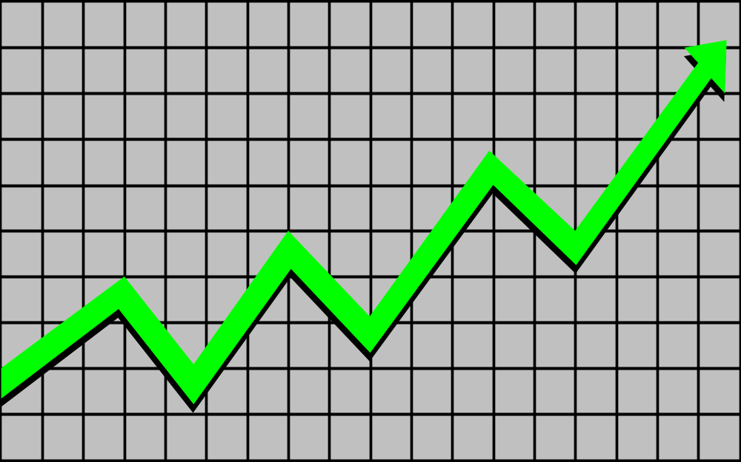
EMPIRICAL ESTIMATION OF ZERO-COUPON YIELD CURVE

Slide 15
WHY TO ESTIMATE…?
The term structure of interest rates is a relationship between interest rates in the economy and the term to maturity. It forms the basis for the valuation of all assets and liabilities in bank.
The underlying price of a fixed income security can be calculated as the net present value of the future stream of cash flows. For this, each cash flow is to be discounted using the interest rate for the associated term to maturity. Arriving at the appropriate set of interest rates is the task of empirically determining the term structure of interest rates.

Slide 16
Remember …...
Since the yield to maturity changes every day, the estimated yield curve is valid only for that particular day. That is to say, for different days, one shall have different estimated yield curves.

Slide 17
METHODS OF ESTIMATING AND FITTING THE YIELD CURVE
Whatever method one chooses to estimate and fit a Yield Curve to the observed data, the curve chosen must essentially fulfill the following criteria:
  ACCURACY: Is the curve a reasonable fit of the market curve?
  CONSISTENCY: Is the curve-fitting method consistent with the underlying theoretical model(s)?
  SIMPLICITY: Is the curve reasonably straightforward to compute?

Slide 18
What is expected from the fitted yield curve?
The fitted yield curve should be –
  Smooth
  Continuous; and
  Differential.
To ensure these characteristics of a fitted yield curve is a challenge.

Slide 19
One Method is - Bootstrapping
This method makes use of the Expectation Hypothesis in deriving Spot Rates/Yield on Zero Coupon Bonds using market related data.
In this method, one works out spot rate for period, say, 1 and using it to calculate for period 2, then using spot rates for period 1 and period 2, find that for period 3, like this we calculate spot rates for each period.

Slide 20
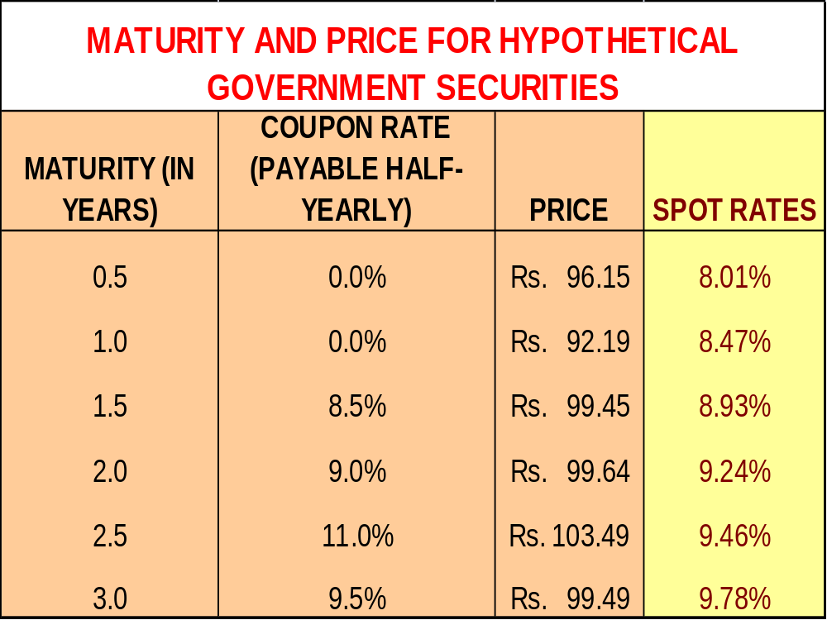
An Example...

Slide 21
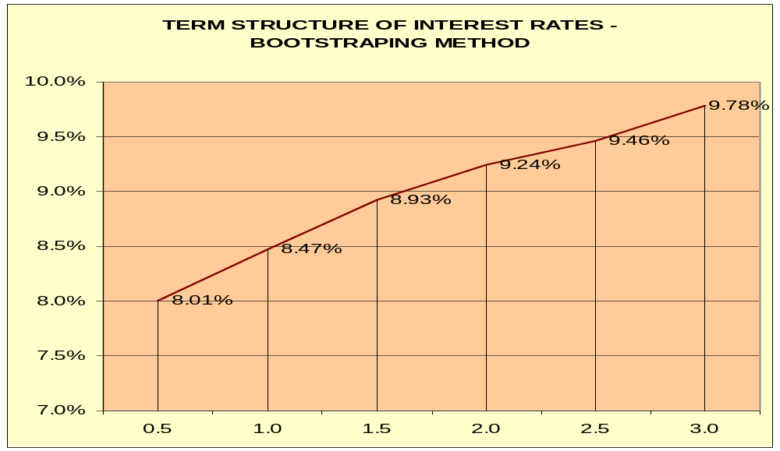
The Graph of Estimated Yields on Zero-Coupon Bonds...

Slide 22
Exercise - Bootstrapping
MATURITY | COUPON RATE | PRICE
1 | 8.75% | Rs. 1,021.13
2 | 9.00% | Rs. 1,041.02
3 | 9.25% | Rs. 1,059.83
4 | 7.00% | Rs. 993.01
5 | 10.00% | Rs. 1,105.08
Find Spot Rates

Slide 23
Have a SERIOUS look at this curve and THINK…
Is this fitted curve – Smooth, Continuous and Differentiable?
Is the yield curve continuous and differentiable at these points?

Slide 24
Bootstrapping method…
… is simple to calculate and simple to understand; but
… does not ensure that the fitted yield curve will be –
      Smooth;
      Continuous; and
      Differentiable.
So, what’s the solution?

Slide 25

Understanding the problem…
Knot Points
What are the knot points and what are the issues related to them?

Slide 26
Knot Points…
These are the points where it is believed that a yield curve change its behaviour and due that it may be possible that the yield curve is NOT…
  Continuous; and
  Differentiable.
These are the points which are creating challenge for us – ‘how to get a continuous and differentiable yield curve’?

Slide 27
One of the way to take care of these knots on a yield curve is…
…Piece-wise interpolation using SPLINE METHODS.
Spline Methods fits some functional form of a graph between the points called the kont points.
It is a numeric function that is piecewise-defined by polynomial functions.
A spline possesses a high degree of smoothness at the places where the polynomial pieces connect – called the knot points.

Slide 28
Spline Method …
A spline fits polynomial functions between the knot points and tries to ensure continuity and differentiability of the overall yield curve.
The most simple spline method is – piece-wise linear interpolation
And, the most widely used spline method is CUBIC.

Slide 29
Go to EXCEL to appreciate …
Spline Method!

Slide 30
Another sets of methods for fitting a yield curve is …
Parametric Methods…

Slide 31
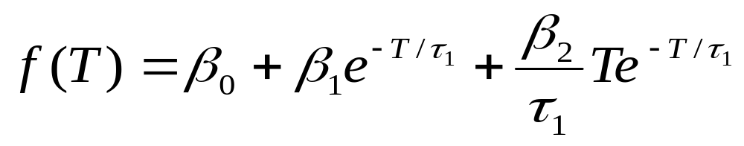
One such model is -
THE NELSON-SIEGEL MODEL
Nelson-Seigel (1987) proposed the following parametric model for empirical estimation of the forward rate curve.
  Where β₀, β₁, β₂ and τ₁ are the parameters to be estimated.
The parameters of the model are determined econometrically.
With the help of the forward rates, one can easily determine the spot interest rates as they are simply the average of forward interest rates.

Slide 32
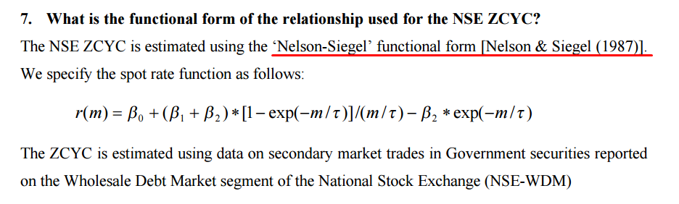
One such model is -
THE NELSON-SIEGEL MODEL
NSE uses Nelson-Siegel Model to estimate the yield curve in India.

Slide 33
THE NELSON-SIEGEL MODEL(continued…)
It is expected that this formulation of forward interest rates can rise to practically all shapes of spot curves observed on the markets.

Slide 34
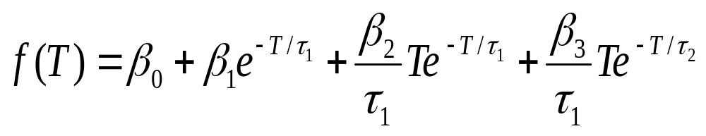
An extension of Nelson-Siegel Model: The Svensson Model
The Svensson Model adds flexibility to the Nelson-Siegel Model by adding a potential extra hump in the forward curve. The model is -
This model was used from 1995 onwards by many central bank, most notably the Bank of England.

Slide 35
The Clearing Corporation of India Limited uses…
Nelson-Siegel - Svensson Model

Slide 36
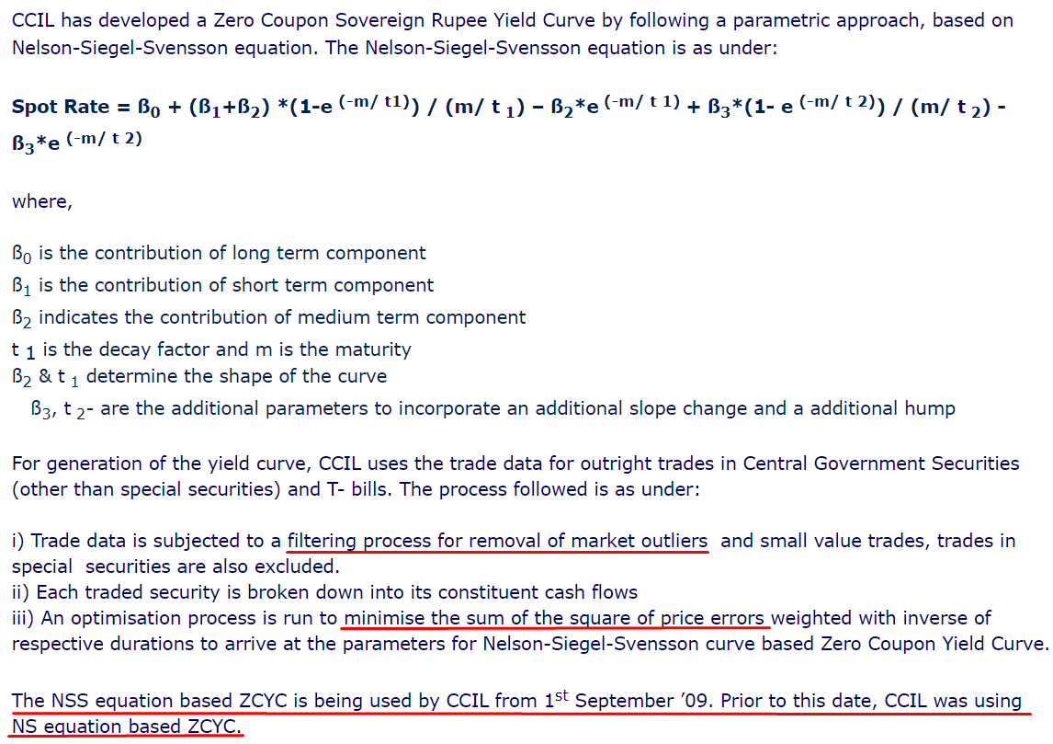
The Clearing Corporation of India Limited

Slide 37
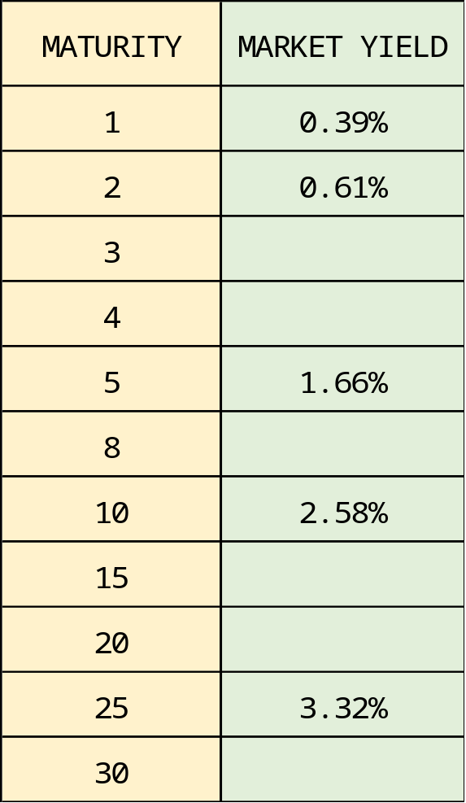
Estimating ZCYC using Nelson-Siegel-Svensson Method
We have the following data:

Slide 38
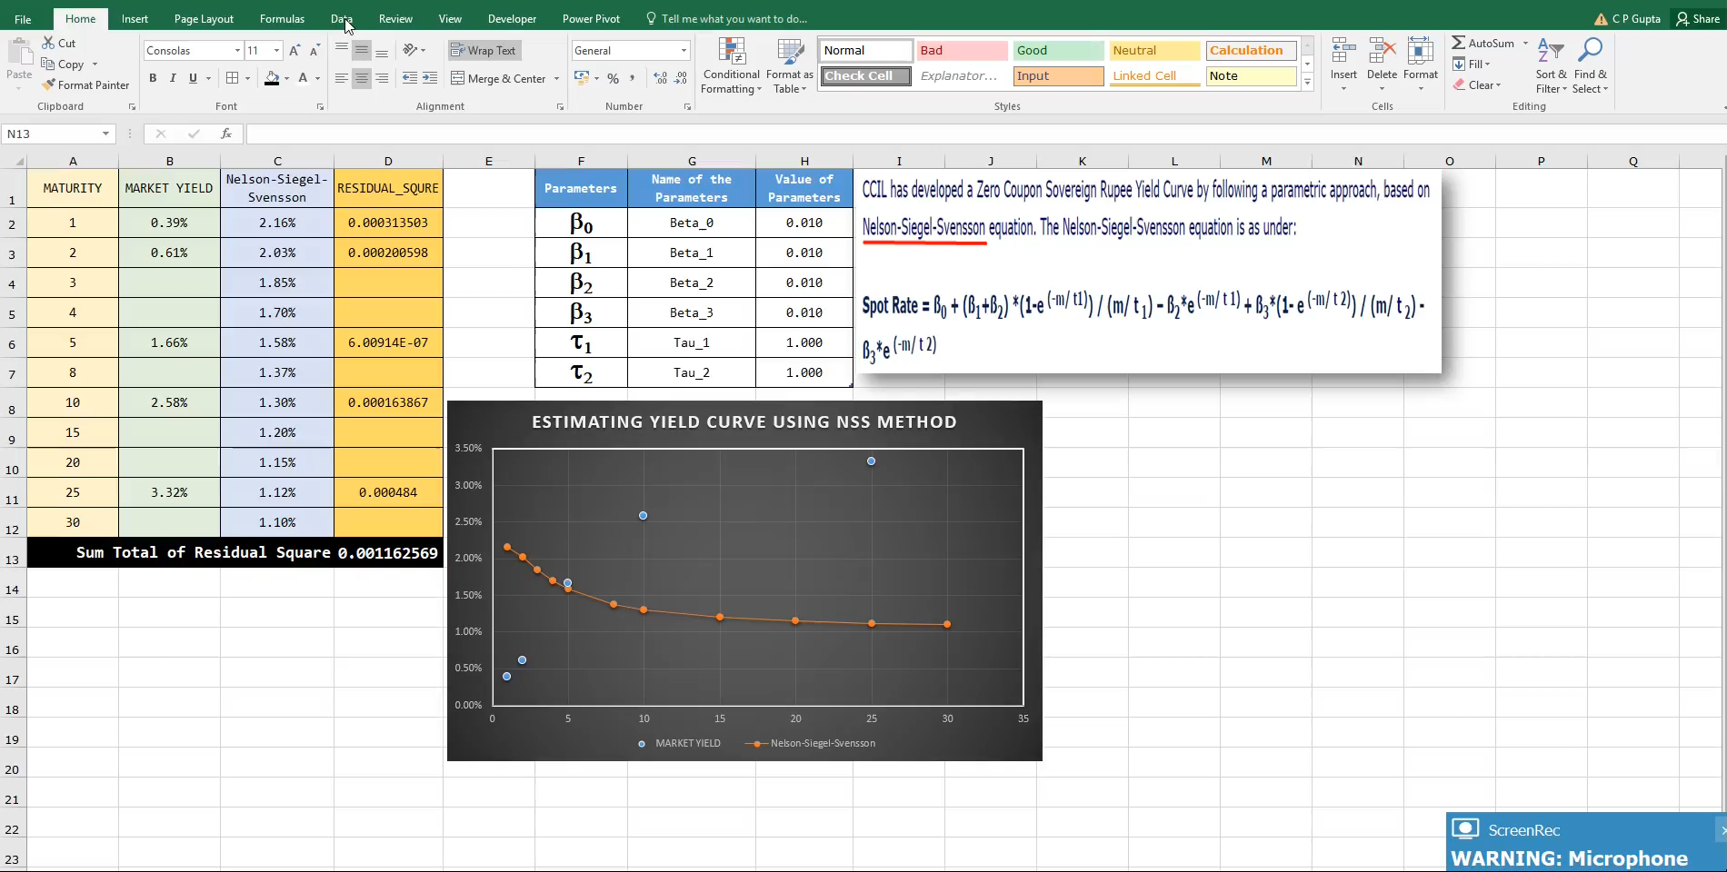
Fitting the Yield Curve using Nelson-Siegel-Svensson

Slide 39
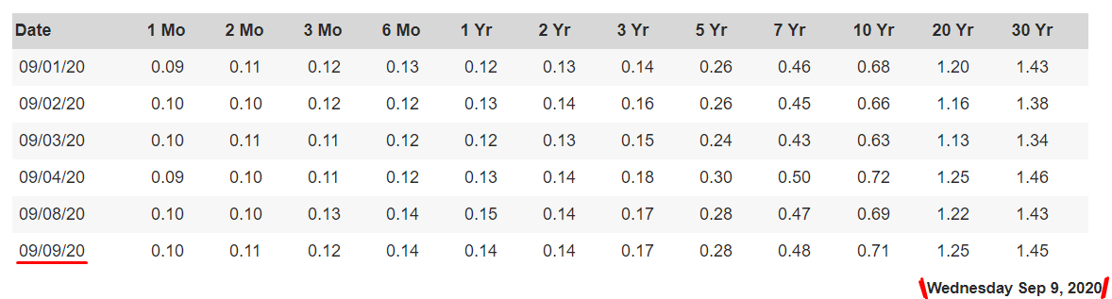
Estimating ZCYC for US Treasury using Nelson-Siegel-Svensson Method

Slide 40
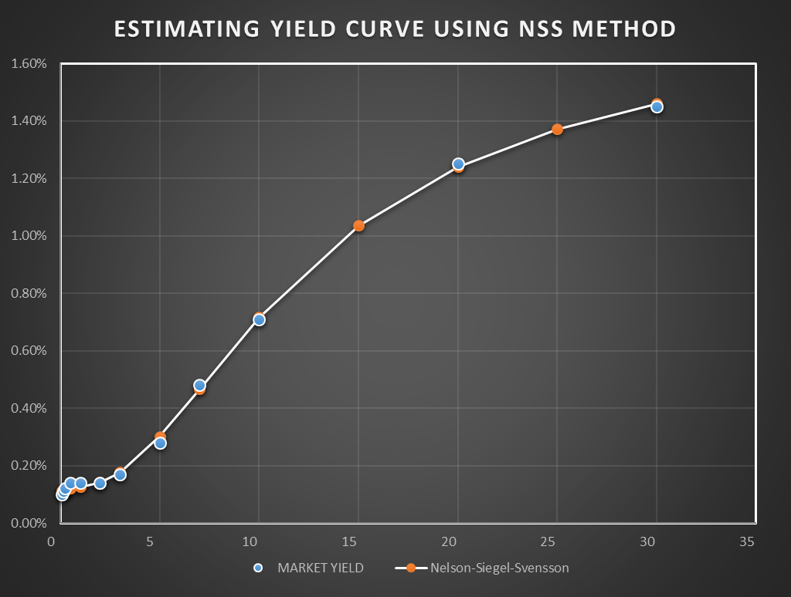
Estimating ZCYC for US Treasury using Nelson-Siegel-Svensson Method

Slide 41
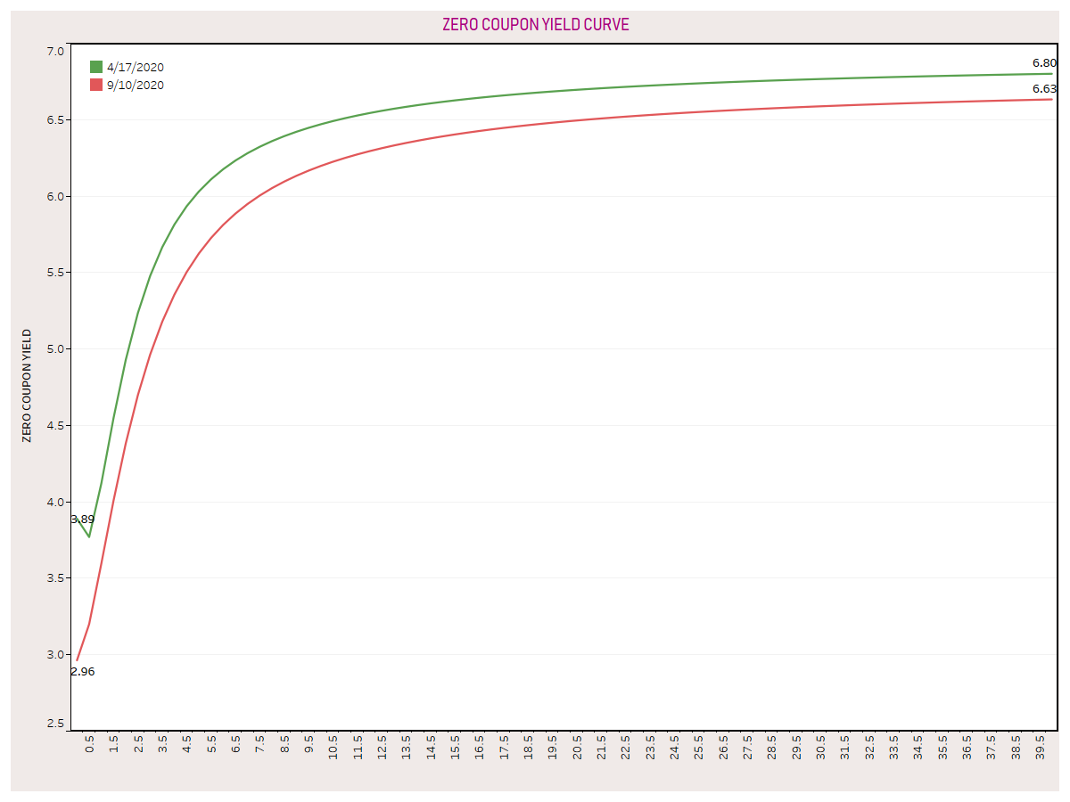
Just want to show you declining yields over the COVID period

Slide 42
Estimation of Parameters of the ZCYC by CCIL…
Current Dt. |  | September 10, 2020
ZCYC Parameters
Beta 0 | Beta 1 | Beta 2 | Tau
6.7777 | -3.8146 | -3.5901 | 0.7843

Slide 43
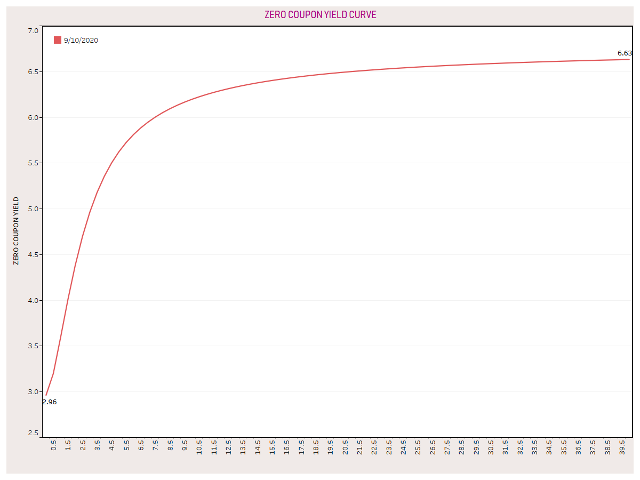
Using these parameters, we get the estimate of the following ZCYC

Slide 44
What do you think…
Is the estimation of a yield curve a real challenging job?
Take data from CCI site and use Spline Method for fitting a ZCYC.

Slide 45
That’s all for the day…!!!

