Slide 1
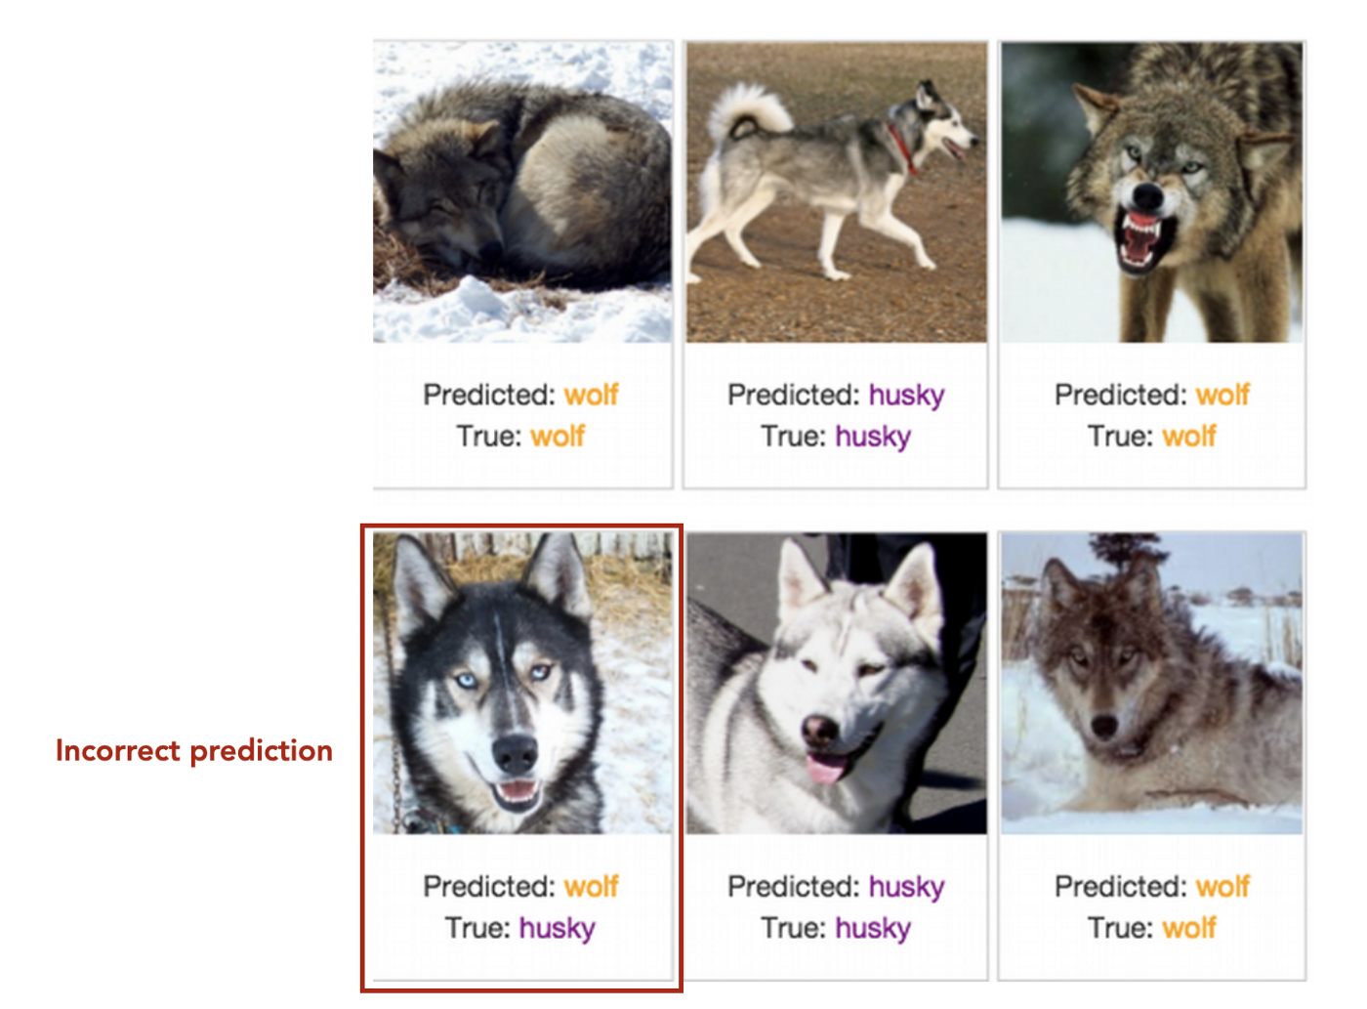

Slide 2
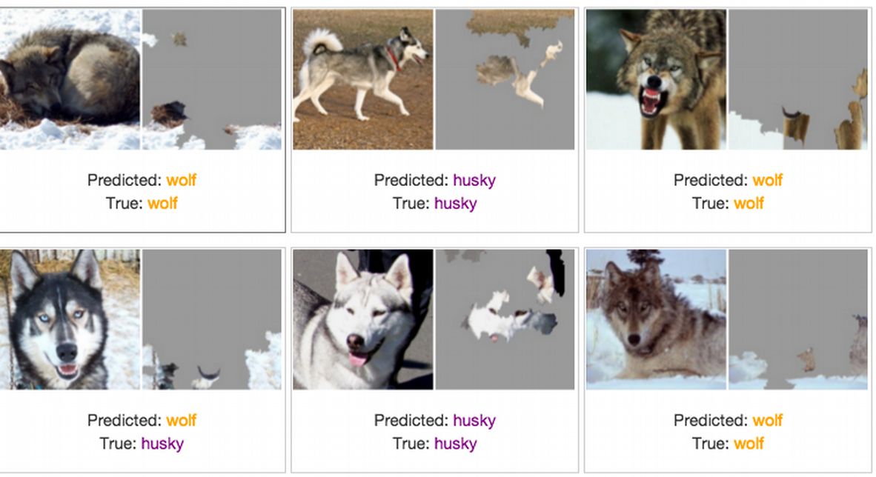

Slide 3

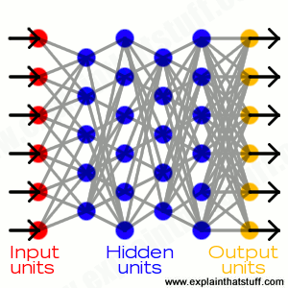
The Need for Explainable AI
AI
System
User
We are entering a new age of AI applications
Machine learning is the core technology
Machine learning models are opaque, non-intuitive, and difficult for people to understand
Why did you do that?
Why not something else?
When do you succeed?
When do you fail?
When can I trust you?
How do I correct an error?
The current generation of AI systems offer tremendous benefits, but their effectiveness will be limited by the machine’s inability to explain its decisions and actions to users.
Explainable AI will be essential if users are to understand, appropriately trust, and effectively manage this incoming generation of artificially intelligent partners.
Notes:
Dramatic success in machine learning has led to an explosion of new AI capabilities.
These systems offer tremendous benefits, but their effectiveness will be limited by the machine’s inability to explain its decisions and actions to human users.
This is especially important for the Department of Defense (DoD), who is facing challenges that demand the development of more intelligent, autonomous, and symbiotic systems.
Explainable AI will be essential if users are to understand, appropriately trust, and effectively manage this incoming generation of artificially intelligent partners.
By creating new machine learning methods to produce more explainable models and combining them with explanation techniques, XAI aims to help users understand, appropriately trust, and effectively manage the emerging generation of AI systems

Slide 4

XAI Concept
Today
Task
Why did you do that?
Why not something else?
When do you succeed?
When do you fail?
When can I trust you?
How do I correct an error?
Training Data
Machine Learning
Process
Learned
Function
Decision or
Recommendation
User
XAI
Task
Training Data
New Machine Learning
Process
Explainable Model
Explanation Interface
I understand why
I understand why not
I know when you succeed
I know when you fail
I know when to trust you
I know why you erred
User

Slide 5
XAI Concept
XAI
Task
Training Data
New Machine Learning
Process
Explainable Model
Explanation Interface
I understand why
I understand why not
I know when you succeed
I know when you fail
I know when to trust you
I know why you erred
User
The target of XAI is an end user who:
  depends on decisions, recommendations, or actions of the system
  needs to understand the rationale for the system’s decisions to understand, appropriately trust, and effectively manage the system
The XAI concept is to:
  provide an explanation of individual decisions
  enable understanding of overall strengths & weaknesses
  convey an understanding of how the system will behave in the future
  convey how to correct the system’s mistakes (perhaps)

Slide 6
Emphasis and Scope of XAI Research
End User
Explanation
Visual
Analytics
Question
Answering
Dialogs
XAI
Emphasis
Human
Computer
Interaction
Machine
Learning
Interactive
ML

