Slide 1
WORKPLACE CULTURE - I
GPHR

Slide 2
Culture Definition
"Culture” refers to the complex collection of knowledge, folklore, language, rules, rituals, habits, lifestyles, attitudes, beliefs, and customs that link and give a common identity to a particular group of people at a specific point in time.

Slide 3
Characteristics of Culture
Cultures are subjective
Cultures change over time
Cultures are largely invisible
Cultures are influenced by media
Cultures depend on communication
Cultures are shaped by communication
Cultures depend on communication

Slide 4
Organization Culture
According to Edgar Schein, organizational culture mainly consists of three domains:
Basic underlying assumptions (unconscious taken for granted beliefs and values: these are not visible)
Espoused values (may appear through surveys)
Artifacts (visible behaviour)

Slide 5
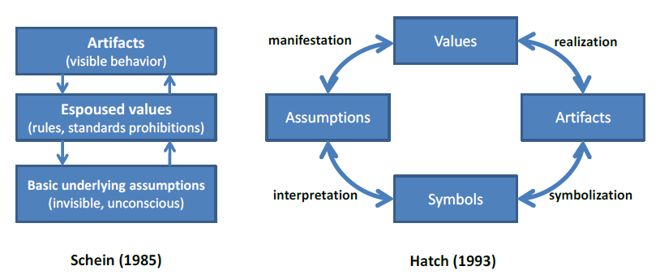
Organization Culture

Slide 6
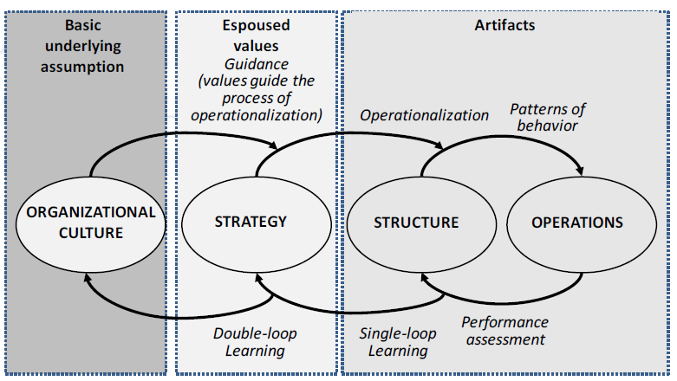
Relationship between culture, strategy, structure, and operations

Slide 7
Relationship between culture, strategy, structure, and operations
Understanding organizational processes = understanding organizational (culture) change = understanding organizational (culture) dynamics
(a) Operationalization has to stand in line with corporate values.
(b) All domains—strategy, structure, and operations—are indirectly affected by culture.
(c) Organizational values constitute the shared “ethics” of doing business.

Slide 8
National Culture
The values that distinguished countries (rather than individuals) from each other grouped themselves statistically into four clusters. They dealt with four anthropological problem areas that different national societies handle differently:
ways of coping with inequality
ways of coping with uncertainty
the relationship of the individual with her or his primary group
the emotional implications of having been born as a girl or as a boy.

Slide 9
Hofstede Six Dimensions
Geert Hofstede dimensions of national culture:
Power Distance
Uncertainty Avoidance
Individualism versus Collectivism
Masculinity versus Femininity
Time Perspective
Indulgence/Restraint

Slide 10

Hofstede’s Cultural Dimensions

Slide 11
Individualism vs. Collectivism
Individualism is the tendency of people to look after themselves and their immediate family only; Individualism is the preference of people to belong to a loosely knit society where importance is placed on the self and autonomy.
In opposition, collectivism is the tendency of people to belong to groups or collectives and to look after each other in exchange for loyalty. Collectivist structures place importance on interdependent social units such as the family, rather than on the self. In individualist societies, employees require the freedom to work independently and desire challenging work (which is more important than personal relationships) that will help them reach self-actualization. In collectivist cultures, unquestioned management structures are responsible for the organization of teams of employees and the cohesion of the collective.

Slide 12
Masculinity vs. Femininity
Masculinity is a culture in which the dominant values in society are success, money, and that score high on masculinity; masculinity represents cultures with distinct gender roles where men focus on success, competition and rewards while women focus on tender values such as quality of life and modesty. Femininity represents cultures where gender roles overlap. Femininity is a culture in which the dominant values in society are caring for others and quality of life scores high on femininity. In masculine cultures managers are defined as more assertive and decisive, whereas feminine cultures breed more intuitive managers who negotiate disputes and encourage participation in decisions.

Slide 13
Uncertainty Avoidance
Uncertainty avoidance is the degree to which members of a culture feel threatened or uncertain in unfamiliar situations. Thus in high uncertainty avoidance cultures, people prefer a structured environment with rules and policies in place. Hard work is embraced, and there is a greater sense of anxiety amongst the workforce. In contrast, in weak uncertainty avoidance cultures rules create discomfort, almost fear, and exist only where absolutely necessary. People tend to be more relaxed in these cultures, and work at a slower pace. High uncertainty avoidance favors precise rules, teachers who are always right and superiors who should be obeyed without question. Low uncertainty avoidance favors flexibility, discussion and delegation of decision making

Slide 14
Power distance
Power distance is the extent to which less powerful members of institutions and organizations accept that power is distributed unequally. In high power distance cultures, children are raised with a great emphasis on respecting elders, which is carried through to adulthood. Therefore organizations are more centralized, employees prefer a more autocratic leadership style where subordinates are expected to be told what to do and there are wide wage gaps in the hierarchical structure. On the other hand, in low power distance cultures inequality is not desired, employees prefer to be consulted with regards to decision making and thus prefer a more resourceful and democratic leader.

Slide 15
Time Perspective
Following Hofstede, a subsequent study based on Chinese Confucian Theory revealed a fifth dimension referred to as long-term orientation. This describes the extent to which people have a dynamic, future-oriented perspective. It describes societies' time horizon. Long-term oriented societies attach more importance to the future. They foster pragmatic values oriented towards rewards, including persistence, saving and capacity for adaptation. In short term oriented societies, values promoted are related to the past and the present, including steadiness, respect for tradition, preservation of one's face, reciprocation and fulfilling social obligations.

Slide 16
Indulgence/Restraint
Indulgence societies tend to allow relatively free gratification of natural human desires related to enjoying life and having fun whereas Restraint societies are more likely to believe that such gratification needs to be curbed and regulated by strict norms.
Indulgent cultures will tend to focus more on individual happiness and well-being, leisure time is more important and there is greater freedom and personal control. This is in contrast with restrained cultures where positive emotions are less freely expressed and happiness, freedom and leisure are not given the same importance.

Slide 17

Cultural Dimensions

Slide 18

Trompenaars and Hampden-Turner's Seven Dimensions of Culture

Slide 19
Universalism vs. Particularism (Rules Versus Relationships)
Universalism implies that correct behaviour can be defined and always applies, while particularism suggests that relationships are more important than abstract social codes.
In universalistic cultures, people place a high importance on laws, rules, values, and obligations. On the contrary, in a particularistic culture, People believe that each circumstance, and each relationship, dictates the rules that they live by.
Typical universalistic cultures include the U.S., Canada, the U.K, the Netherlands, Germany, Scandinavia, New Zealand, Australia, and Switzerland. Typical particularistic cultures include Russia, Latin-America, and China.

Slide 20
Individualism vs. Communitarianism (The Individual Versus The Group)
Individualism refers to people as individuals; Communitarianism (Collectivism) refers to people regard themselves as part of a group. In individualistic cultures, People believe in personal freedom and achievement. They believe that you make your own decisions, and that you must take care of yourself. In the second case, people believe that the group is more important than the individual. The group provides help and safety, in exchange for loyalty. The group always comes before the individual.
Typical individualist cultures include the U.S., Canada, the U.K, Scandinavia, New Zealand, Australia, and Switzerland. Typical communitarian cultures include countries in Latin-America, Africa, and Japan.

Slide 21
Neutral vs. Emotional (How People Express Emotions)
Neutral refers to culture in which emotions are not shown; Emotional refers to emotions are expressed openly and naturally. In neutral culture, people make a great effort to control their emotions. Reason influences their actions far more than their feelings. People don't reveal what they're thinking or how they're feeling. In emotional culture, people want to find ways to express their emotions, even spontaneously, at work. In these cultures, it's welcome and accepted to show emotion.
Typical neutral cultures include the U.K., Sweden, the Netherlands, Finland, and Germany. Typical emotional cultures include Italy, France, Spain, and countries in Latin-America.

Slide 22
Specific vs. Diffuse (How Far People Get Involved)
Specific refers to large public space shared with others and small private space guarded closely. In specific culture, people keep work and personal lives separate. As a result, they believe that relationships don't have much of an impact on work objectives, and, although good relationships are important, they believe that people can work together without having a good relationship. In diffuse culture, people see an overlap between their work and personal life.
Typical specific cultures include the U.S., the U.K., Switzerland, Germany, Scandinavia, and the Netherlands. Typical diffuse cultures include Argentina, Spain, Russia, India, and China.

Slide 23
Achievement vs. Ascription (How People View Status)
Achievement culture refers to people are accorded status based on how well perform functions; Ascription culture refers to status based on who or what person is. In achievement culture, people believe that you are what you do, and they base your worth accordingly. These cultures value performance, no matter who you are. In ascription culture, people believe that you should be valued for who you are. Power, title, and position matter in these cultures, and these roles define behavior.
Typical achievement cultures include the U.S., Canada, Australia, and Scandinavia. Typical ascription cultures include France, Italy, Japan, and Saudi Arabia.

Slide 24
Sequential Time vs. Synchronous Time (How People Manage Time)
In sequential time oriented culture, people like events to happen in order. They place a high value on punctuality, planning (and sticking to your plans), and staying on schedule. In this culture, "time is money," and people don't appreciate it when their schedule is thrown off. In synchronous time oriented culture, people see the past, present, and future as interwoven periods. They often work on several projects at once, and view plans and commitments as flexible.
Typical sequential-time cultures include Germany, the U.K., and the U.S. Typical synchronous-time cultures include Japan, Argentina, and Mexico.

Slide 25
Inner-directed vs. Outer-directed (How People Relate to Their Environment)
Inner-directed refers to people believe in control of outcomes; Outer-directed refers to people believe in letting things take own course. In inner-directed culture, people believe that they can control nature or their environment to achieve goals. This includes how they work with teams and within organizations. In outer-directed culture, people believe that nature, or their environment controls them; they must work with their environment to achieve goals. At work or in relationships, they focus their actions on others, and they avoid conflict where possible. People often need reassurance that they're doing a good job.

Slide 26

Diversity Cultures

Slide 27
Family
The Family organizational culture is marked by a parent-child dynamic in which personal relationships and getting along together are extremely important. Power rests in key leaders, who guard it carefully. Success often depends on one's ability to manipulate and build on relationships. This culture occurs most frequently in countries like Japan, France, and Spain.

Slide 28
Eiffel Tower
The Eiffel Tower concept refers to a hierarchical structuring of relationships. Power and decision-making responsibility increase as one move toward the top of the organization. There may be elaborate rules, strictly respected job definitions and responsibilities, and a reliance on planning. These kinds of organizations are generally found in Germany, Denmark, and the Netherlands.

Slide 29
Incubator
The Incubator describes organizations that are relatively flat, in which individuals can exert power and gain recognition. From a national perspective, Sweden tends to produce Incubators; from an industrial perspective, Incubators are often software companies

Slide 30
Guided Missile
The Guided Missile organization is highly focused on the achievement of specific objectives, often those that deliver value in a short time frame. Power is gained through expertise. Value to the organization is measured by results and is rewarded. This type of corporate culture characterizes many organizations in the United Kingdom, the United States, and Canada.

Slide 31

High vs Low Context Culture

Slide 32
High context Culture
High context refers to societies or groups where people have close connections over a long period of time. Many aspects of cultural behavior are, not made explicit, because most members know what to do and what to think from years of interaction with each other. High context is more common in Eastern cultures than in Western cultures.

Slide 33
Low context Culture
Low context refers to societies where people tend to have many connections but of shorter duration or for some specific reason. In these societies, cultural behavior and beliefs may need to be spelled out explicitly so that those coming into the cultural environment know how to behave.

Slide 34

Merging Culture

Slide 35

Cross-Cultural Differences

Slide 36
1. Different Communication Styles
Across cultures, some words and phrases are used in different ways. For example, even in countries that share the English language, the meaning of "yes" varies from "maybe, I'll consider it" to "definitely so," with many shades in between.
Another major aspect of communication style is the degree of importance given to non-verbal communication. Non-verbal communication includes not only facial expressions and gestures; it also involves seating arrangements, personal distance, and sense of time. In addition, different norms regarding the appropriate degree of assertiveness in communicating can add to cultural misunderstandings

Slide 37
2. Different Attitudes Toward Conflict
Some cultures view conflict as a positive thing, while others view it as something to be avoided. In the U.S., conflict is not usually desirable; but people often are encouraged to deal directly with conflicts that do arise. In fact, face-to-face meetings customarily are recommended as the way to work through whatever problems exist. In contrast, in many Eastern countries, open conflict is experienced as embarrassing or demeaning; as a rule, differences are best worked out quietly. A written exchange might be the favoured means to address the conflict.

Slide 38
3. Different Approaches to Completing Tasks
When it comes to working together effectively on a task, cultures differ with respect to the importance placed on establishing relationships early on in the collaboration. A case in point, Asian and Hispanic cultures tend to attach more value to developing relationships at the beginning of a shared project and more emphasis on task completion toward the end as compared with European-Americans. European- Americans tend to focus immediately on the task at hand, and let relationships develop as they work on the task.

Slide 39
4. Different Decision-Making Styles
The roles individuals play in decision-making vary widely from culture to culture. For example, in the U.S., decisions are frequently delegated -- that is, an official assigns responsibility for a particular matter to a subordinate. In many Southern European and Latin American countries, there is a strong value placed on holding decision making responsibilities oneself. When decisions are made by groups of people, majority rule is a common approach in the U.S.; in Japan consensus is the preferred mode.

Slide 40
5. Different Attitudes Toward Disclosure
In some cultures, it is not appropriate to be frank about emotions, about the reasons behind a conflict or a misunderstanding, or about personal information. When you are dealing with a conflict, be mindful that people may differ in what they feel comfortable revealing. Questions that may seem natural to you -- What was the conflict about? What was your role in the conflict? What was the sequence of events? -may seem intrusive to others.

Slide 41
6. Different Approaches to Knowing
Notable differences occur among cultural groups when it comes to epistemologies -- that is, the ways people come to know things. European cultures tend to consider information acquired through cognitive means, such as counting and measuring, more valid than other ways of coming to know things. Compare that to African cultures' preference for affective ways of knowing, including symbolic imagery and rhythm. Asian cultures' epistemologies tend to emphasize the validity of knowledge gained through striving toward transcendence.

Slide 42

Culture Shock

Slide 43

Culture Shock Adjustment

Slide 44
Reverse Culture Shock
Reverse culture shock is experienced when returning to a place that one expects to be home but actually is no longer, is far more subtle, and therefore, more difficult to manage than outbound shock precisely because it is unexpected and unanticipated.

Slide 45

Culture Shock Cycle

Slide 46

Intercultural Sensitivity
Milton Bennett

Slide 47

Cross Cultural Training Methods

Slide 48
Global Mindset
A global mindset is a mix of individual attributes that enable an international assignee/expat to successfully influence those who are different from him/h er. It is clear that without it, it is most difficult, if not impossible, for an expat to succeed in the international assignment. Global mindset consists of three major components:
Intellectual capital,
Psychological capital
Social capital.

Slide 49
Intellectual Capital
Intellectual capital refers to knowledge, skills, understanding, and cognitive complexity. From interviews for a research about global mindset, it indicated that there is an important body of knowledge—the employee’s subject matter expertise that expats must have to be successful in their tasks. It also tells us that successful expats think differently than their less successful counterparts—they have a bigger capacity to take differing viewpoints into consideration to understand and address complex issues

Slide 50
Psychological Capital
Having a solid base of knowledge and a good understanding of global issues is just one of the factors necessary for expat success. The second component of global mindset is psychological capital. Psychological capital is a set of psychological attributes that enable the expat to function successfully in the host country and leads to the expat having a strong willingness and motivation to have the experience in, and to succeed in, international settings.

Slide 51
Social Capital
Social capital is the third and final piece of the global mindset, and refers to the expat’s ability to build trusting relationships with local stakeholders, whether they are his/her employees, supply chain partners, or customers.

Slide 52

Global Mindset

Slide 53
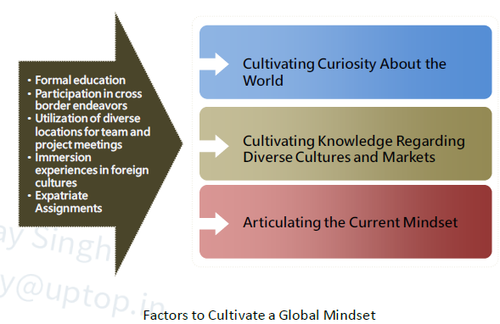
Cultivate a Global Mindset

Slide 54
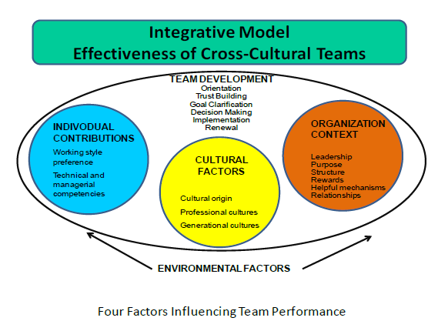
Team Performance

Slide 55
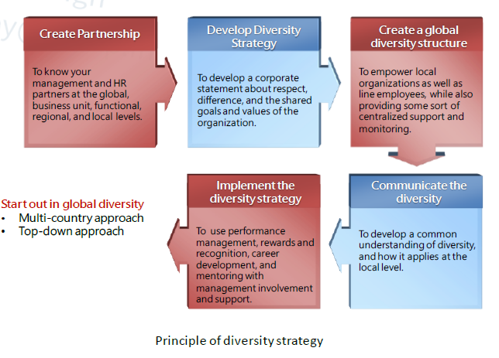
Global Diversity

Slide 56
Corporate Social Responsibility
The continuing commitment by business to behave ethically and contribute to economic development while improving the quality of life of the work force and their families as well as the local community and society at large.
CSR is a strategy that seeks to systematically integrate the economic, environmental and social impact of business into the management of business, with the vision to make the future better or at least sustain it at the present prevailing condition.

Slide 57
Questions

