Slide 1
XAMPP is an abbreviation for cross-platform, Apache, MySQL, PHP and Perl,
  it allows you to build WordPress site offline, on a local web server on your computer
This simple and lightweight solution works on Windows, Linux, and Mac – hence the “cross-platform” is used for XAMPP
Since WordPress isn’t a stand-alone application, XAMPP provides two essential components for its installation – Apache, which is used to create the local server, and MySQL which you can use as a database for your website

Slide 2
A domain is the name of a website, a URL is how to find a website, and a website is what people see and interact with when they get there
when you buy a domain, you have purchased the name for your site, but you still need to build the site

Slide 3
Why and how developers are using WordPress local server.
  It allows them to create a local copy of the site in which they can try out new plugin updates before implementing them on its live version
This way they can prevent and spot potential errors and issues that might occur
Let us learn how to locally host a website on Windows, Mac, or Linux.

Slide 4
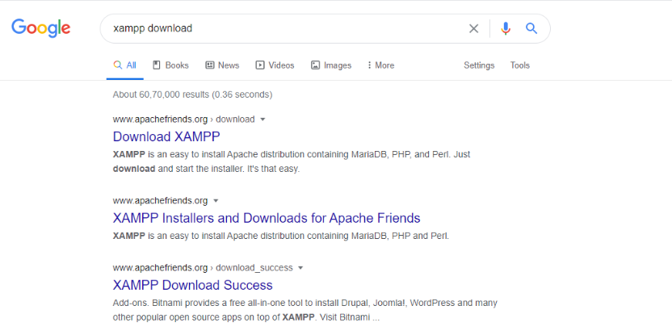

Slide 5
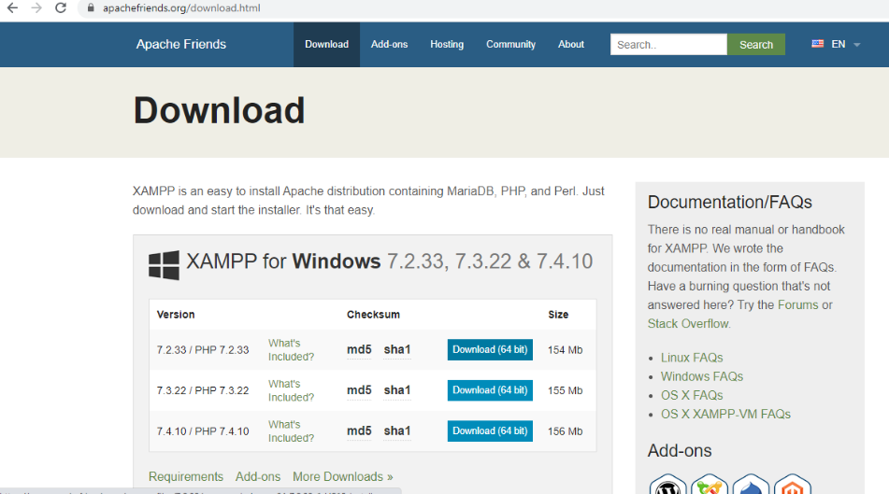

Slide 6
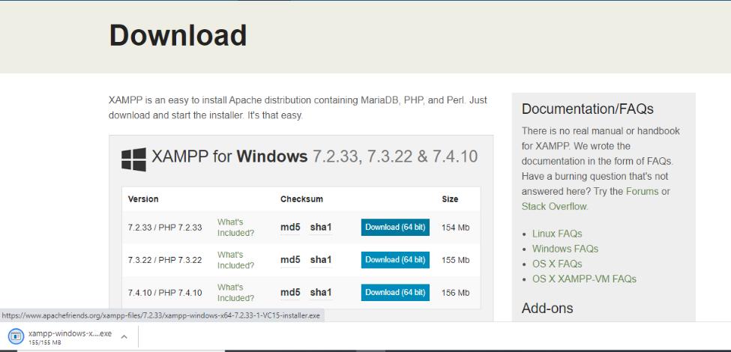

Slide 7
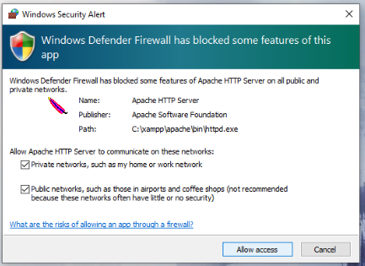
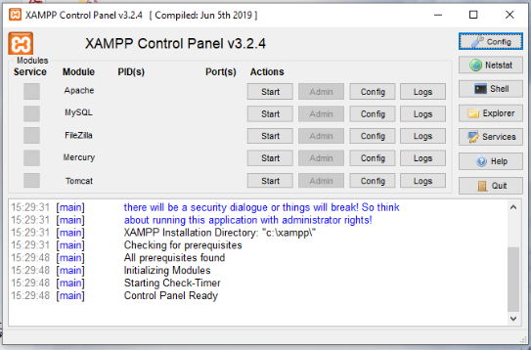

Slide 8
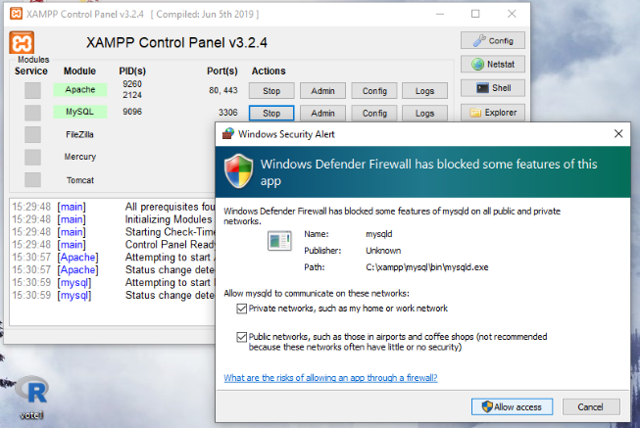
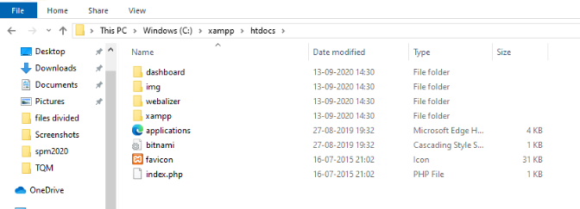

Slide 9
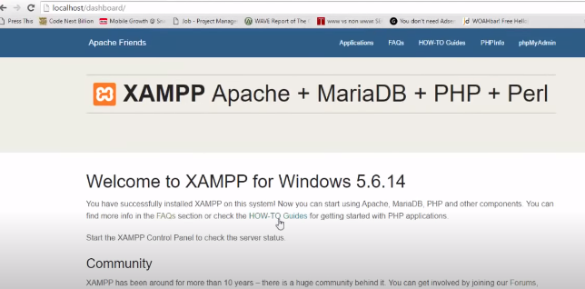

Slide 10
How to run your first php program with XAMPP server?
PHP ; XAMPP Server; Install location is C: \Xampp
After Installation
Go to Xampp folder in C: Drive
Goto htdocs
Create a new folder and rename it with your project name
Goto new folder and create a new file with filename.php extension
Open it with notepad++
Save the file using Ctrl+S
Goto control panel and type xampp
You will get XAMPP control panel
Click on it
Start Apache server
Goto browser
Type localhost
You will get the XAMPP server
Type localhost/Project
You will get the code link displayed and you can run your first PHP code on XAMPP server
This is how you run your first program in XAMPP

Slide 11
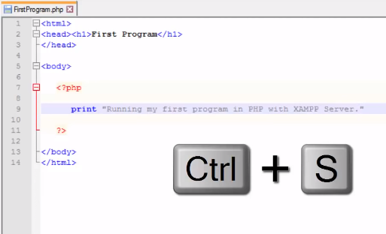

Slide 12
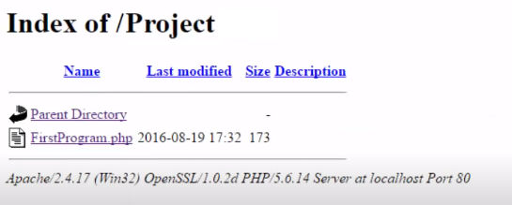
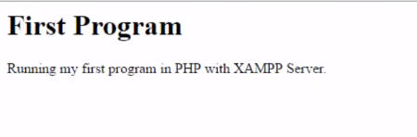

Slide 13
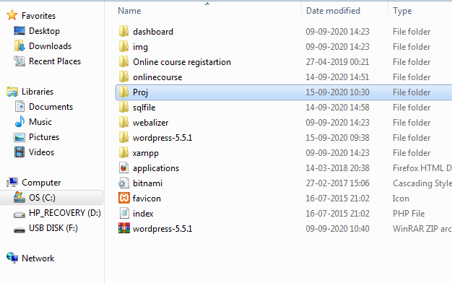
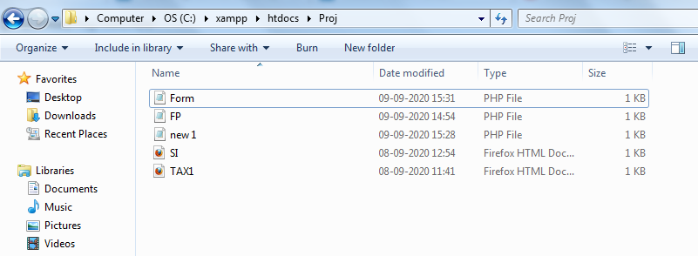

Slide 14
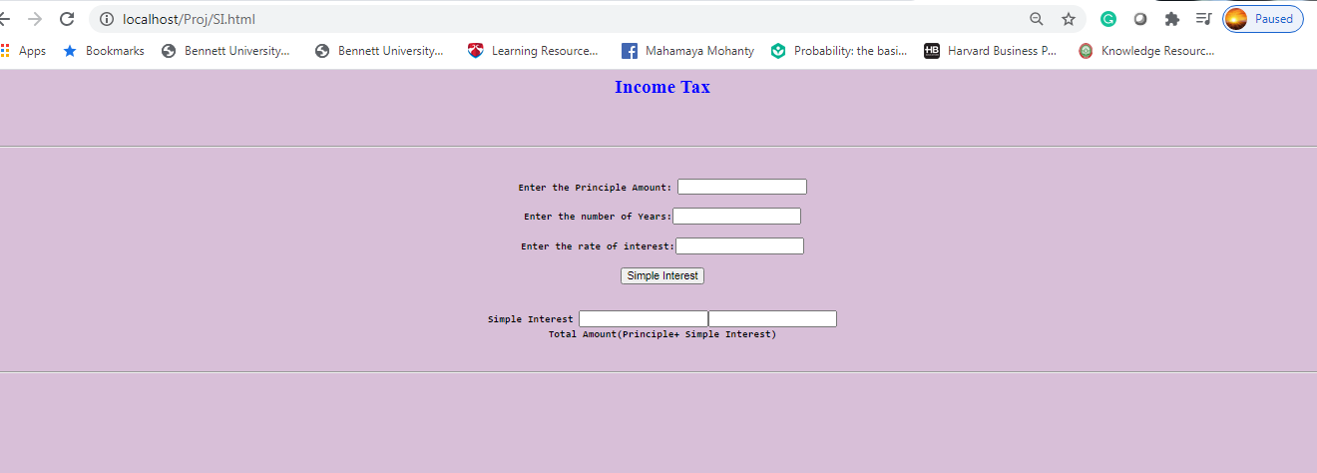

Slide 15
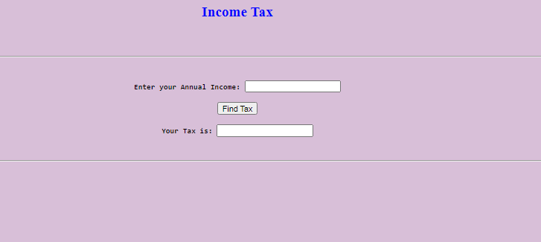

Slide 16


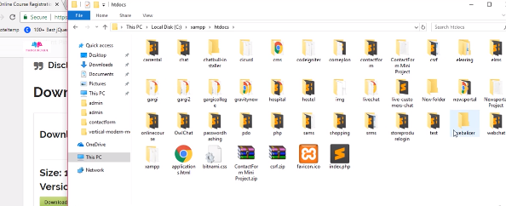

Slide 17
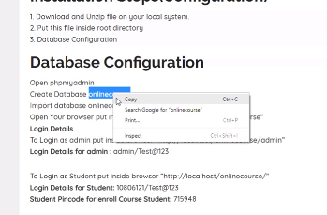
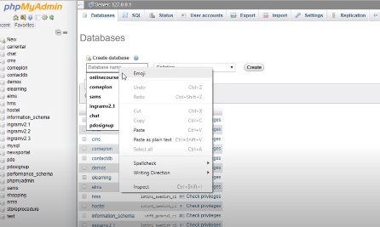

Slide 18
Create an online course database
Import the sql file given in the package

Slide 19
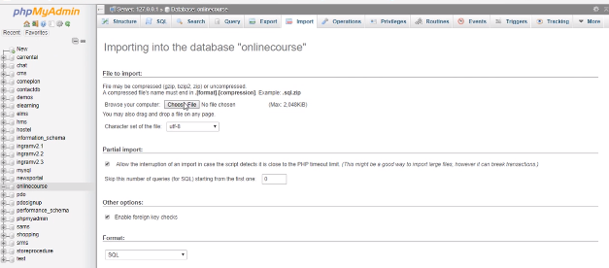

Slide 20
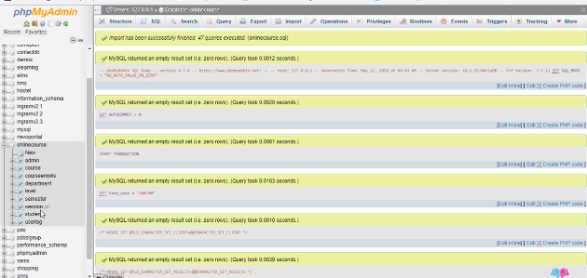

Slide 21
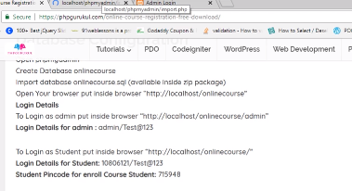
First we will work on Admin Panel
Secondly we will use User Panel

Slide 22
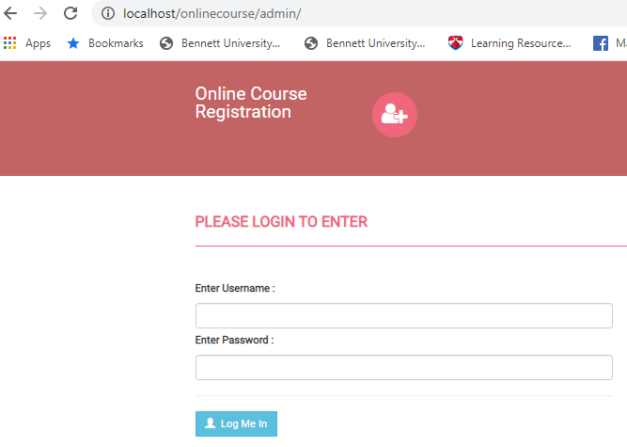

Slide 23
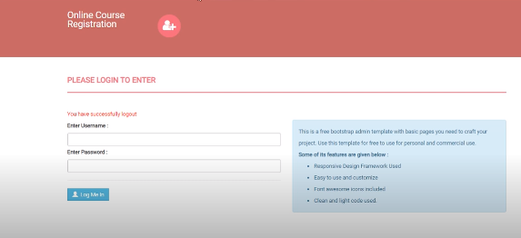
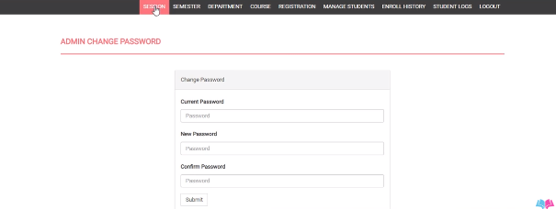

Slide 24
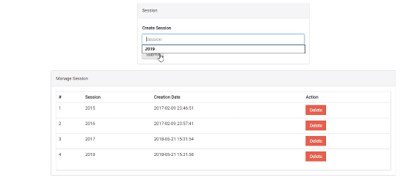
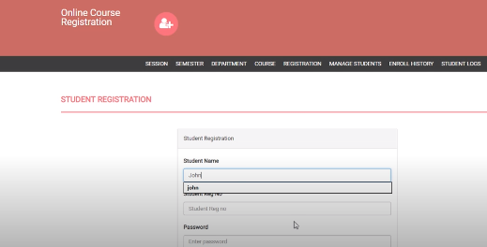

Slide 25
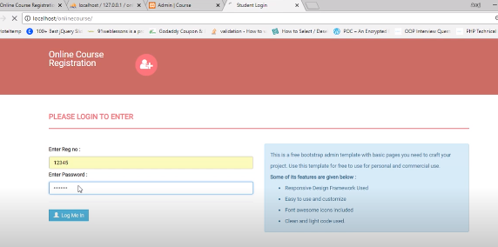

Slide 26
A WordPress localhost setup is much more secure as it offers you a personal and private playground, away from any potential threats.

Slide 27
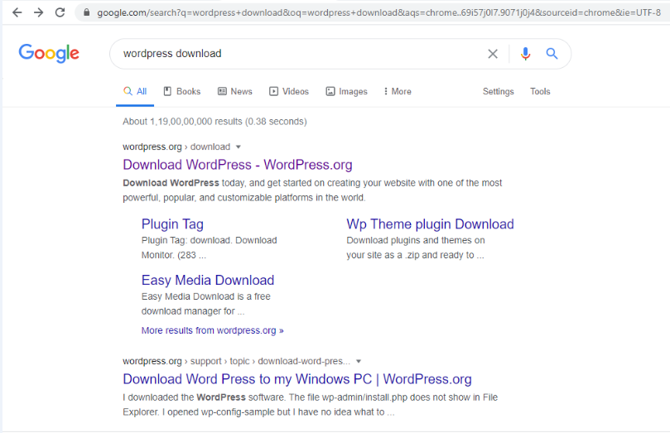

Slide 28
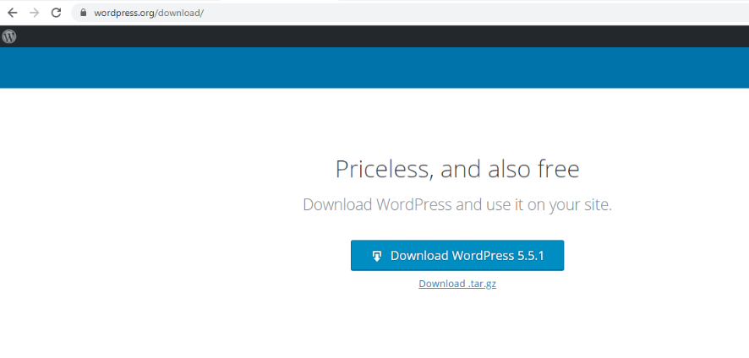

Slide 29
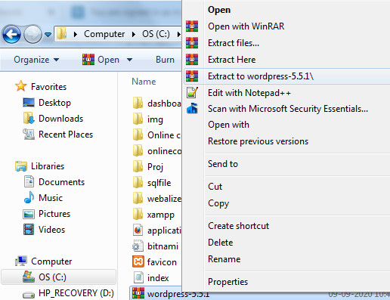

Slide 30
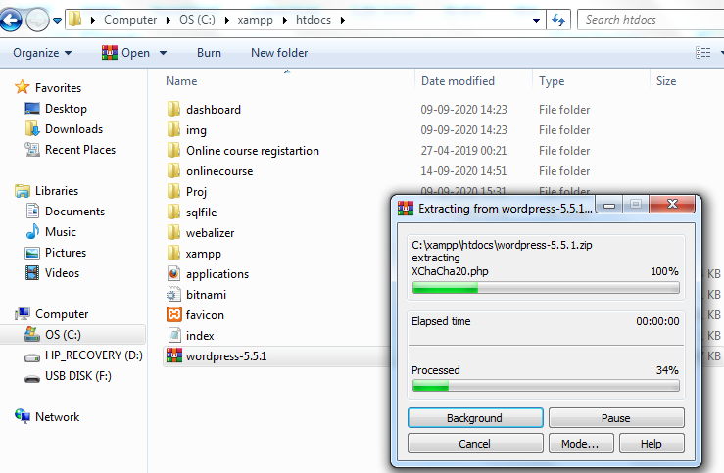
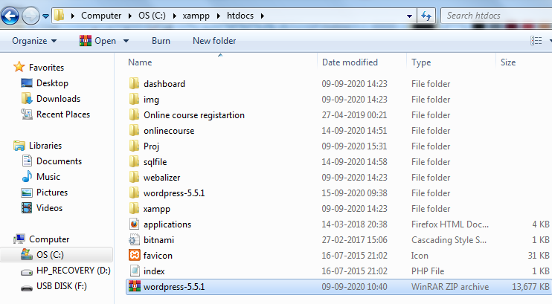

Slide 31
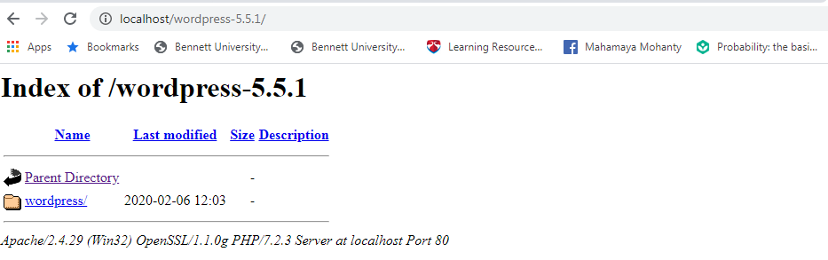

Slide 32
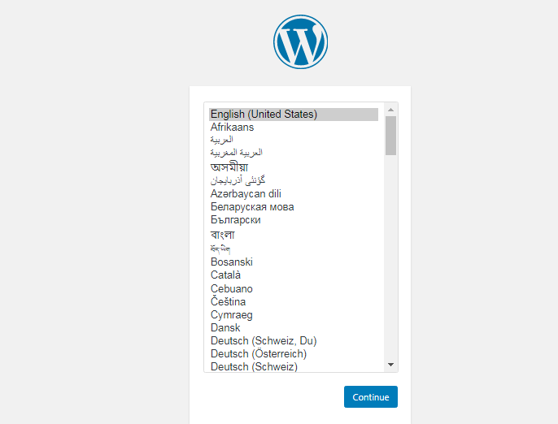

Slide 33
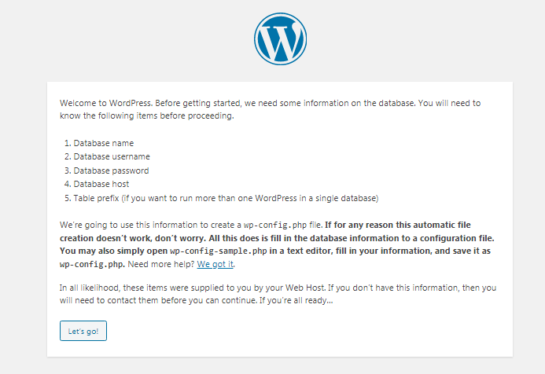

Slide 34
Create database
Goto localhost again
Click on phpMyAdmin
  New
    wpdp

Slide 35
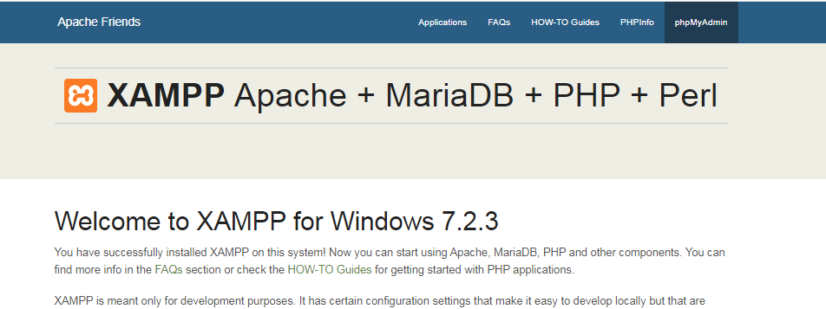

Slide 36
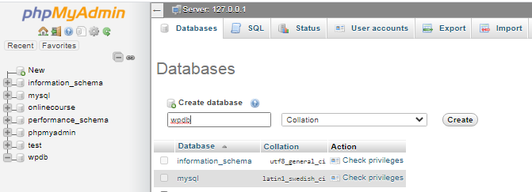
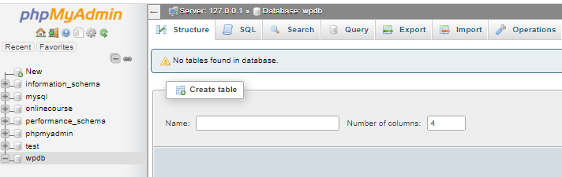

Slide 37
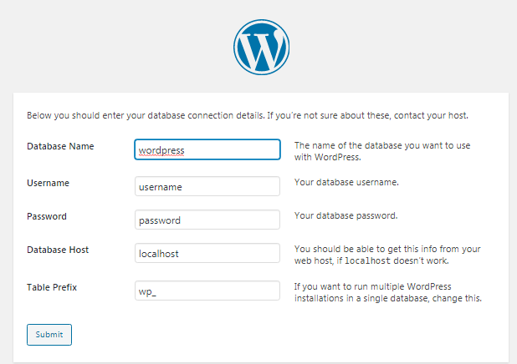
Now go back to localhost—wordpress setup configuration
Click on Let’s go

Slide 38
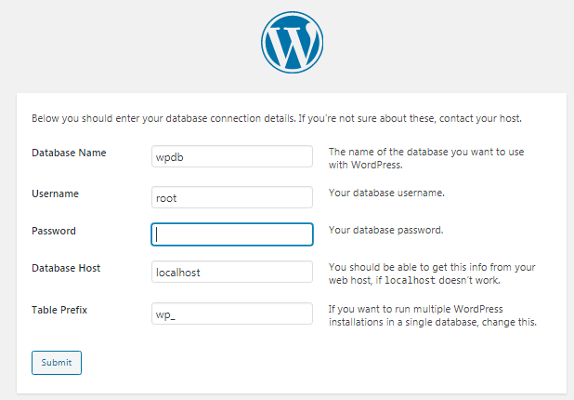

Slide 39
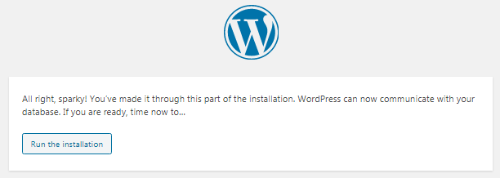

Slide 40

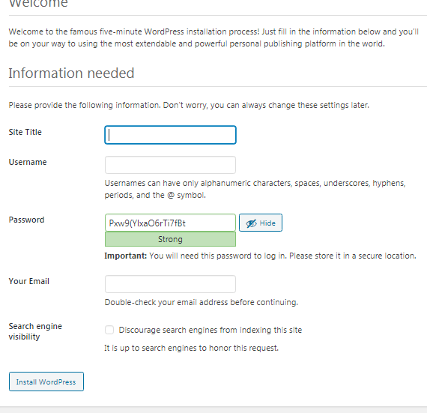

Slide 41
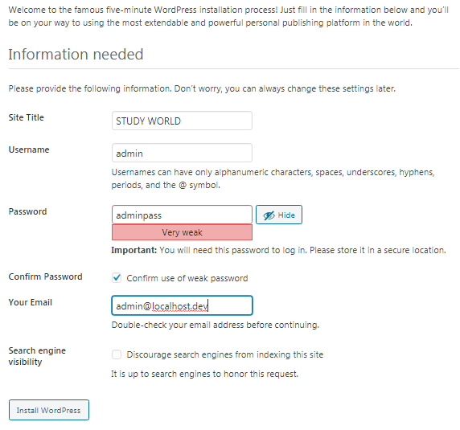

Slide 42
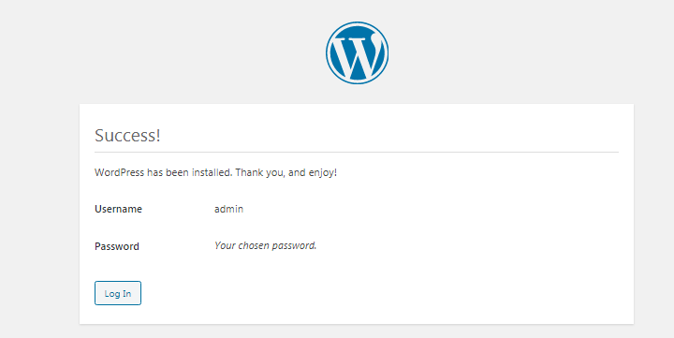

Slide 43
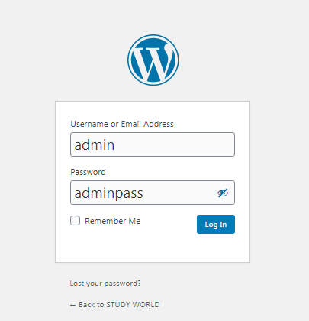

Slide 44
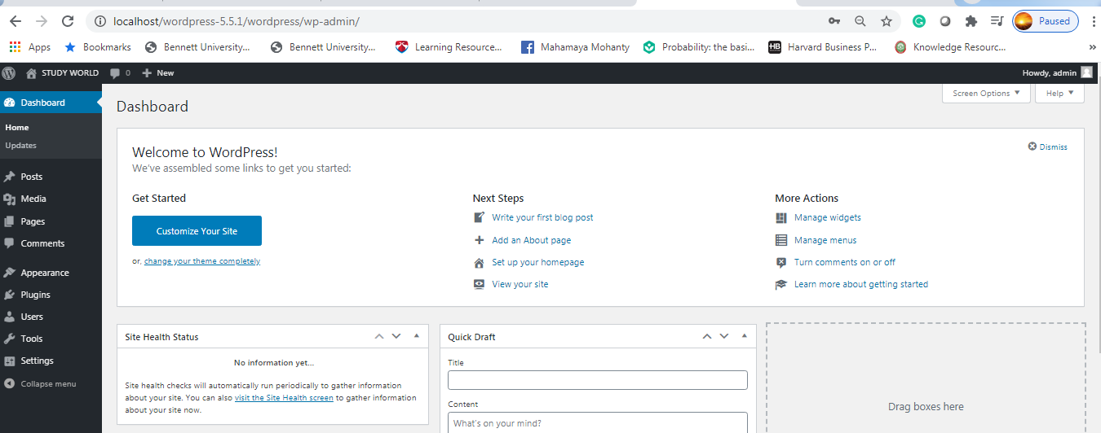

Slide 45
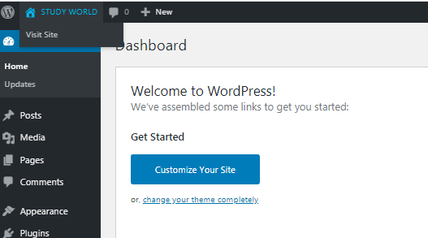

Slide 46
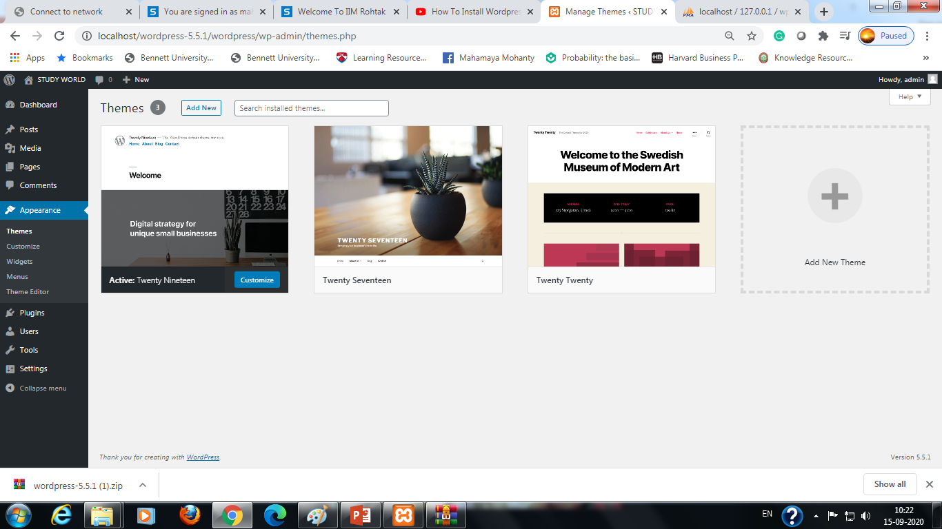

Slide 47
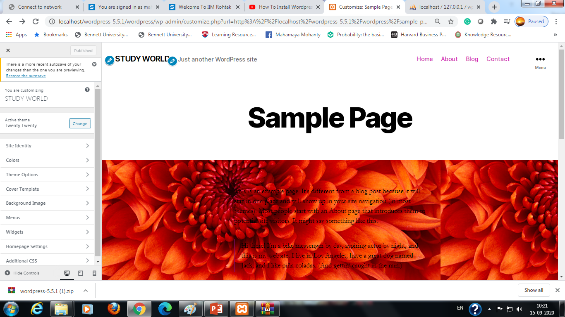

Slide 48
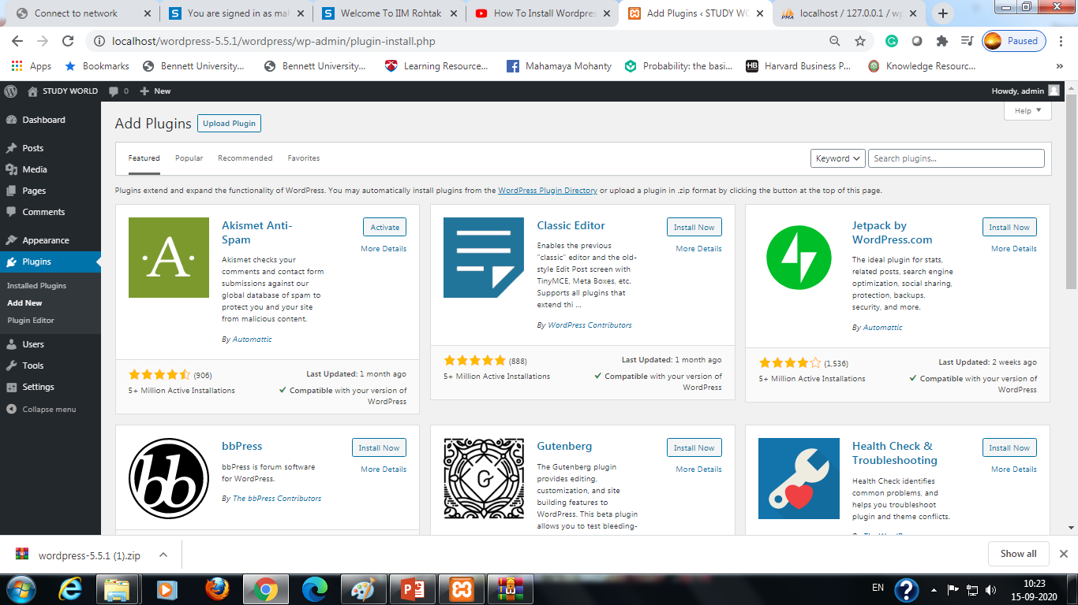

Slide 49


