Slide 1
Volatility in Finance and GARCH Models
Prof. M Shameem Jawed

Slide 2
A Quick Recap: ARMA models in Financial Markets context
We need to model the Returns, which arise due to the information absorption. Here, R_{t} = Expected Information + Unexp Information
  Expected information is the one that is being incorporated; Unexpected is the information shock, which is not captured in time t
Autoregressive Model AR(p)
  R_{t} depends only on its own past values R_{t-1}, R_{t-2} , R_{t-3} ,
  Today’s return depends on past returns.
R_{t} = μ + α₁ R_{t-1} + α₂ R_{t-2} + α₃ R_{t-3} + …..+α_{p} R_{t-p} + ε_{t}
Moving Average Model MA(q)
  R_{t} depends only on the past information shocks, which are being assimilated in current
period
  A common representation: R_{t} depends on q of its past values called as MA(q) model
  R_{t} = μ+ β₁ ε_{t-1} + β₂ ε_{t-2} - ….-+β_{q} ε_{t-q} + ε_{t}
  Todays return depends on the information absorption from the previous periods unexpected information
Autoregressive Moving Average Model - ARMA(p,q)
R_{t} = μ + α₁ R_{t-1} + α₂ R_{t-2} + …..+ α_{p} R_{t-p} + β₁ ε_{t-1} + β₂ ε_{t-2} - ….-+β_{q} ε_{t-q} + ε_{t}
P_{t} is non-stationary. P_{t} ~ ARIMA (1,1,1) and R_{t} ~ ARIMA(1,0,1)

Slide 3
Market Efficiency – Speed of convergence to Mkt Efficiency
Testing for Market Efficiency
  R_{t} = 𝛽₀+ 𝛽₁ R_{t-1} + 𝛽₂ R_{t-2} +…+ 𝛽_{𝑝} R_{t-p} +ε_{t}
  Significant coefficients of past lag values
    Yes – Market is inefficient as past returns are useful in predicting current returns
    No – Market is Efficient as past information (Returns) are not useful in predicting current returns
How fast the market becomes efficient ?
  Here the time interval of return calculation matters.
  Run the above regression at daily, hourly, 30-, 15- and 5-min frequency
  Check the significance of past lag values
    If insignificant (efficient market) at daily returns but significant (inefficient) at hourly
    Then market takes about an hour to become efficient or so.

Slide 4
Today’s Agenda
Introduction to the concept of Volatility in Finance.
ARCH & GARCH Models
Application of GARCH using R

Slide 5
Volatility …
simple concept ☺ but difficult task to measure
A series is said to be ‘volatile’
  Which moves a lot / swings wildly
  Measures variability / dispersion about a central tendency
Volatiltiy can’t be observed
  Measure of financial vulnerability : Standard Deviation
Crucial role of ‘volatility’ in varied applications of finance
  Portfolio selection; Option Pricing; Risk Management etc.
“less risk is preferred to more” …A good market should not be volatile?

Slide 6
Stylized Features of Volatility
Time Varying Volatility
  Volatility changes as time changes.
  Today's volatility may not be the same as that of yesterday or tomorrow
Volatility Clustering
  Volatility comes in cluster / group.
  High (low) volatility is followed by high (low) volatility.
  Positive autocorrelation in volatility

Slide 7
Stylized Features of Volatility
Asymmetric Volatility
  Impact of negative news is higher on volatility as compared to the same amount of positive news impact.
Co-movement
  Volatility of any asset comoves with volatility of another asset / market
High Risk – High Return
  If an asset carries high risk, then one would expect higher return
Fat Tails / Excess Kurtosis
  Extreme events are frequent as compared to normal distribution

Slide 8
Volatility proxies….?
Historical Volatility
  Standard Deviation or Variance
  Squared Returns
  Extreme Value (Range based) estimators
  Semi-variance (Downside Risk Measures)
Forward looking Volatility Proxies: Implied Volatility
  Implicit in the market price of an option
  Market’s forecast of volatility of the underlying asset over the life of
option
  Best guess of volatility, if the market is efficient and the pricing model is appropriate
  Problems with Implied volatility

Slide 9
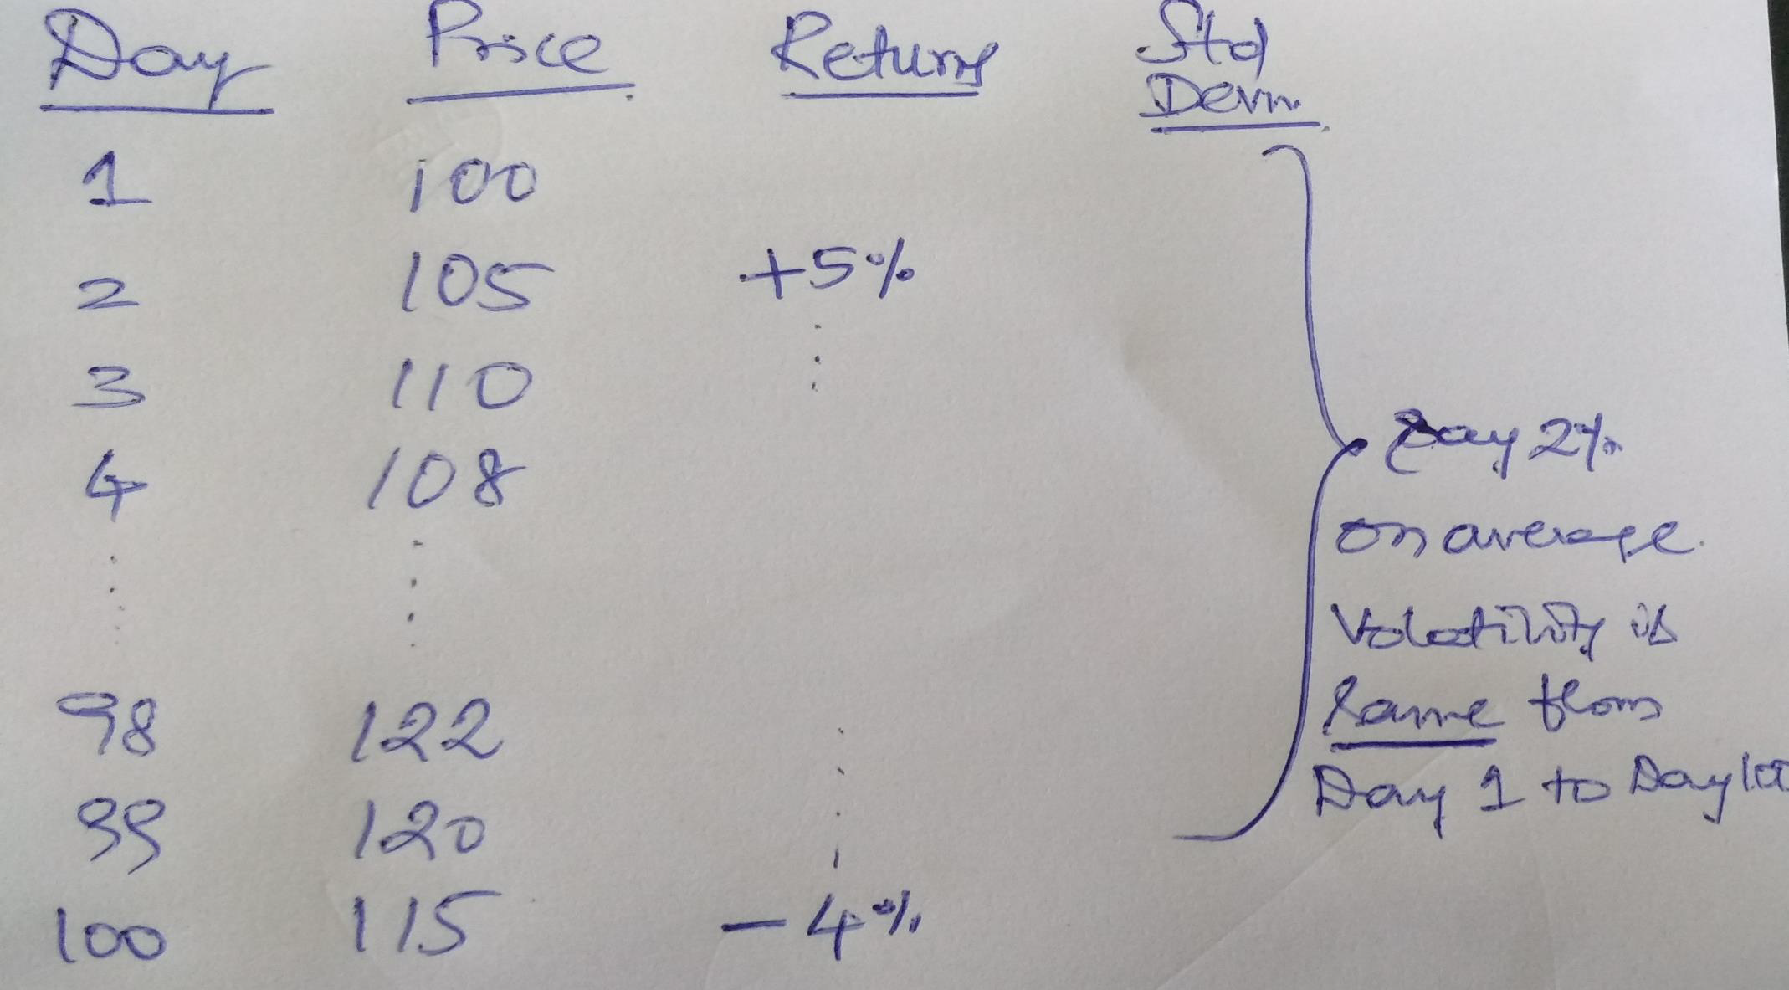
Variance or Standard Deviation remains constant over an interval of days.
Violates the TimeVarying Volatility feature.
So, Variance or StdDeviation, calculated as above, is not a right proxy.
Need to have a proxy, which changes as time interval changes.

Slide 10
Squared Returns
On average, how many points Nifty or Sensex will change on daily basis?
Sensex is around 82k….some days +/- 100 and other days +/-
500…over the last year
On average, Sensex will change by +/-80 points.
Implies a 0.1% change or 0.001
  Can assume of return value equivalent to 0 (tending to zero)
  Then, Var(Rt)=E(Rt-Mean(R) )²
  Assuming Mean(R)= zero,Var(Rt) is Squared Returns.
SqRt changes as day or return changes - A crude proxy of Volatility

Slide 11
ARE THESE DAYS THE SAME?
CAN WE USE THIS INFORMATION TO MEASURE VOLATILITY BETTER?

Slide 12
Extreme Value or Range based Volatility Estimators
Uses Open, High, Low and Close values of each day / period
Parkinson Volatility proxy looks at just High and Low values.
  (H-L)/Avg of (H, L)
GarmanKlass volatility proxy looks at the combination of O, H, L, C values.
2*ln(H/L​)*ln(C/Previous​C​)​​
= ----------------------------------
n-1
Even if the Cl. Price and Op. Price remains the same…will have
volatility proxy

Slide 13
Example of Downside Risk Measures / Semi-Variance:
To see how these alternative risk statistics compare probability distributions for two investment portfolios: Potential Prob. of Return for Return Portfolio #1 |  | to | the variance consider the following Prob. of Return for Portfolio #2
-15% 5% |  |  | 0%
-10 | 8 | 0
-5 | 12 | 25
0 | 16 | 35
5 | 18 | 10
10 | 16 | 7
15 | 12 | 9
20 | 8 | 5
25 | 5 | 3
30 | 0 | 3
35 | 0 | 3
Notice that the expected return for both of these portfolios is 5%:
E(R)₁ = (.05)(-0.15) + (.08)(-0.10) + ...+ (.05)(0.25) = 0.05, &
E(R)₂ = (.25)(-0.05) + (.35)(0.00) + ...+ (.03)(0.35) = 0.05

Slide 14
Example of Downside Risk Measures …
Clearly, however, these portfolios would be viewed differently by different investors. These nuances are best captured by measures of return dispersion (i.e., risk).
1. Variance
As seen earlier, this is the traditional measure of risk, calculated the sum of the weighted squared differences of the potential returns from the expected outcome of a probability distribution. For these two portfolios the calculations are:
(Var)₁ = (.05)[-0.15 - 0.05]² + (.08)[-0.10 - 0.05]² + ... + (.05)[0.25 - 0.05]² = 0.0108
and
(Var)₂ = (.25)[-0.05 - 0.05]² + (.35)[0.00 - 0.05]² + ... + (.03)[0.35 - 0.05]² = 0.0114
Taking the square roots of these values leaves:
SD₁ = 10.39%
and SD₂ = 10.65%

Slide 15
Example of Downside Risk Measures (cont.):
2. Semi-Variance
The semi-variance adjusts the variance by considering only those potential outcomes that fall below the expected returns. For our two portfolios we have:
(SemiVar)₁ = (.05)[-0.15 - 0.05]² + (.08)[-0.10 - 0.05]² + (.12)[-0.05 - 0.05]² +
(.16)[0.00 - 0.05]² = 0.0054
(SemiVar)₂ = (.25)[-0.05 - 0.05]² + (.35)[0.00 - 0.05]² = 0.0034
Also, the semi-standard deviations can be derived as the square roots of these values:
(SemiSD)₁ = 7.35% and (SemiSD)₂ = 5.81%
Notice here that although Portfolio #2 has a higher standard deviation than Portfolio #1, it's semi-standard deviation is smaller.

Slide 16
Regression Model
Y_{i} = α + β₁X_{1i} + β₂X_{2i} + U_{i}
Homoskedasticity:
Var(U_{i}) = σ ²
Heteroskedasticity:
Var(U_{i}) = σ_{i} ²
A larger variance when values of some Xi (or theYi’s themselves) are large (or small)

Slide 17
What's the problem with the afore-mentioned remedies?
For finance people….variance is a measure of risk….and which takes ‘central’ part in any procedure.
Changes in Risk are almost order of the day….so explicitly modeling how risk(volatility / variance) is changing is of utmost need.
Simplest problem :What is the estimate of “Volatility now” ?
  standard deviation over the last 5 years (old info??)
  standard deviation over the last 5 days (little info??)
  Alternative??
    Weighted average of these two…higher weights on recent past & non-zero small weights on distant past
    But how to determine the weights?
    Determine from historical data….statistical estimation problem….which is answered by ARCH
Autoregressive Conditional Heteroskedasticity
  Predictive (conditional)
  Uncertainty (heteroskedasticity)
  That fluctuates over time (autoregressive)

Slide 18
So ARCH looks like ?
Proposed by Engle to explain the variation in Inflation
Basic ARCH (1) model
  conditional variance of a shock at time t is a function of the squares of past shocks: . (h_{t} is the variance and ε is a “shock”, “news,” or “error”).
h = ω + α ε
2
t 1 t −1
Since the conditional variance needs to be non-negative, the conditions have to be met. If α₁ = 0, then the conditional variance is constant and is conditionally homoscedastic.
Can be generalized to ‘p’ lags…ARCH(p) model
Remember…there are two eqns in the regression model now.
  One for Mean level, Other for Variance level
  Both have to be estimated simultaneously….thats where complexity arises

Slide 19
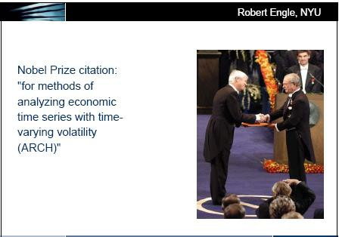

Slide 20
Then what is GARCH ?
Prof. Bollerslev…1986…GENERALIZED -ARCH
Today’s variance is a weighted average of the long-run average variance
h = ω + α ε + β h
2
t
1 t −1
1 t −1
Yesterday’s variance lptha₁+Beta₁<1
GARCH(1,1)--Parsimoniouforecast -- Persistence coefficient
The news (yday’s squared shock) -- Information absorption coefficient
Non-negativity constraints: w >0; Alpha₁>=0; Beta₁>=0
Stationarity constraints: As representation of ARCH(p)
GARCH(1,1) is empirically successful model

Slide 21
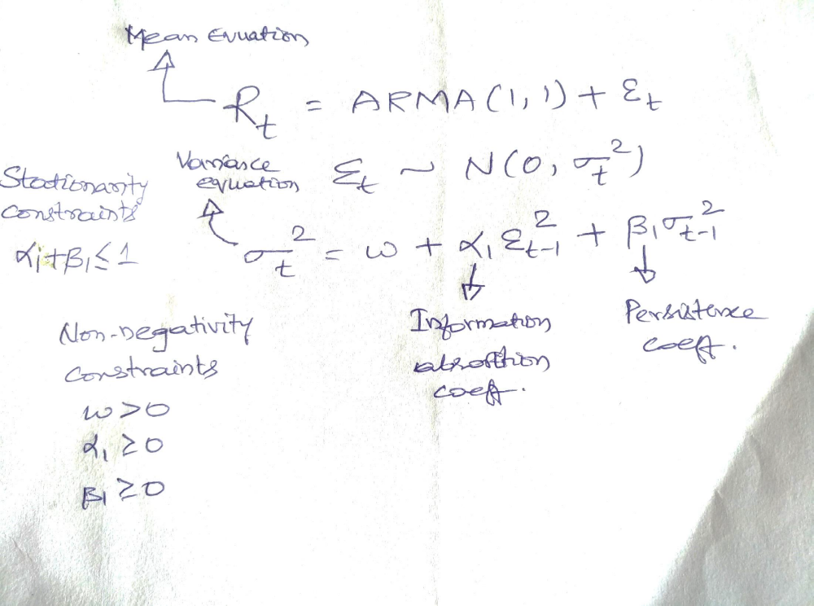
ARMA(1,1) – GARCH (1,1) model
Gives an output,Volatility estimate, one for every time period t. TimeVarying feature satisfied.
As Beta₁ is positive, high(Low) Volatility is followed by another high (low) volatility. Volatility clustering satisfied.

Slide 22
Now let’s head towards applications
Tests on market quality due to events such as
  regulatory interventions
  technological innovations, etc.
Please open your R-Studios

Slide 23
Derivatives Trading - Spot Market Quality
Destabilizing View :: Increase in spot volatility
Due to highly levered and speculative participants
Stabilizing View :: Reduces spot volatility Provides low cost state-contingent strategies
Transfers speculators from spot to futures market
Only price volatility greater than that justified by fundamental economic conditions is undesirable, by definition

Slide 24


Slide 25
Is the spot market better off after derivatives introduction?
Index futures introduced: 12th June 2000
Index options introduced: 04th June 2001
Take one-year before the introduction of index futures as PreSeries
  But beTake one-year data after the introduction of index futures as PostSeries
  fore the IndexOptions introduction, to avoid confounded events
Fit an appropriate ARMA-GARCH model for PreSeries
  Note the information absorption (α1) and persistence (β1) coefficients
Fit an appropriate ARMA-GARCH model for PostSeries
  Note the information absorption (α1) and persistence (β1) coefficients
If the spot market has become efficient after futures introduction, then:
  α1Post > α1Pre and β1Post < β1Pre
  EXPECTATIONS: Higher information absorption and lesser persistence coefficient after index futures introduction
  Otherwise, index futures are not welcome feature to Indian markets.

Slide 27
Steps in estimation of ARMA-GARCH model ?
Say, you would like to build a time series model to Nifty or any series ...lets list down the steps that you do sequentially
You have Nifty levels data → Plot the series (trend present?); Plot the correlogram (long memory?);Objective test for Stationarity (adf test).
  If the series is stationary, then go ahead to model. If not, then difference the series to make it stationary
If the series is stationary, then check its dependence with past
  Correlogram and note the lags at which autocorrelation is significant
  In general, <for financial daily returns>, look for the maximum ten lags.
Fit an ARMA model with appropriate lags
  Check and compare for AR, MA and ARMA models at the lag significant in correlogram
  ARMA-X models (in case you have some other explanatory variable)
  Preliminary selection based on the lowest AIC (lowest residual sum of squares)

Slide 28
Steps in estimation of ARMA-GARCH model ?
Validate the selected model with diagnostics (check the validity of assumptions on errors)
  Zero autocorrelation of residuals (Residual correlogram – insignificant correlations)
    If you see significant correlations then adjust the order of AR / MA / ARMA model
  Constant variance of residuals (Squared Residuals correlogram – insignificant correlations)
    If you see significant correlations then it’s a changing variance problem → time varying volatility →need to fit a GARCH model
Fit an ARMA-GARCH model
  check non-stationarity and non-negativity constraints
Validate the model with diagnostics (check the assumptions on errors)
  Residual plot, Residual correlogram, SqResidual correlogram
    All above need to have insignificant correlations then the model is appropriate and can be used. Otherwise need to modify model.
  Obtain / Use the model outcome, sigma_{t} as proxy for volatility
  Plot Sigma_{t}, Compare with realized volatility

Slide 29
GARCH Estimation in R using RUGARCH package
File→ Change Directory and then select the folder where data is stored
Nifty<- read.csv(“indexfutures.csv”) ret=diff(log(nifty$AdjClose))*100 library(tseries) Install.packages(“rugarch”) library(rugarch)
# indexfutures.csv file contains raw data of Nifty
# calculate log returns of NSE Nifty
# invoke ‘tseries’ package
# invoke ‘ruarch’ package
acf(ret,lag.max=10) # plot correlogram (acf n pacf) of ret series; see help: ?acf meqn2=arima(ret,order=c(0,0,1)) # fitting MA(1) model for ret series n name it as meqn2 res=residuals(meqn2) # extract residuals of meqn1 and standardize the residuals sres=(res-mean(res))/sd(res)
sresq=sres*sres acf(sres) acf(sresq)
# Examine correlogram of std residuals and std residual squares
# presence of significant spikes in residual squares correlogram # indicates time varying volatility feature n need to use GARCH
fit1=ugarchfit(spec=ugarchspec(variance.model=list(model="sGARCH",garchOrder=c(1,1)),mea n.model=list(armaOrder=c(1,0))),data=ret) # Fitting MA(1)-GARCH(1,1) model to ret
gres<-residuals(fit1,standardize=TRUE) # fits a AR(1)-GARCH(1,1) model for ret series;
acf(gsres) gsresq=gsres**2 acf(gsresq) acf(gsresq,lag.max=10) fit1
# Extract standardized residuals of fitted AR-GARCH model
# construct squared standardized residuals
# check correlogram of std residuals and its squares
#
# displays estimation results of fitted AR-GARCH model
volatility=sigma(fit1) # Extracts estimated GARCH volatility (std deviation)
plot(volatility, type="l") # plotting estimated garch volatility

Slide 30
How to read data directly from a compressed files like .gz
install.packages("readr")
library(readr)
trds=read_delim(”20090803.gz", delim="|”) #col.types=list(col.double(), col.character(), col.character(), col.character(), col.double(), col.double())
head(gz)
names(xx)=c("tid","sym","series","time","price","qty")
head(xx)

