Slide 1
Data Visualization using Power BI
12/04/2025

Slide 2
Learning Objective
Session 1
Introduction to Power BI Ecosystem
Best Practices in Visualization
Hands on Exposure to Power BI
Session 2
Introduction to PowerBI advanced features, DAX , R Integration , Realtime Advanced Financial Dashboards.

Slide 3
How to learn any tool ?

Slide 4
Who made it
Purpose & Use cases
Desktop / Web based / hybrid
GUI / Command line / Script / Hybrid
Input
Process
Output
Data types & Structures ( default , user defined)
Documentation / Help/ Forums
ChatGPT / Copilot

Slide 5
What is Power BI ?

Slide 6

Analytics and business intelligence (ABI) platforms enable less technical members of a CX team to “analyze, explore, share and manage data.”
The platform also allows users to uncover and visualize insights while providing a foundation for cross-function collaboration.

Slide 7
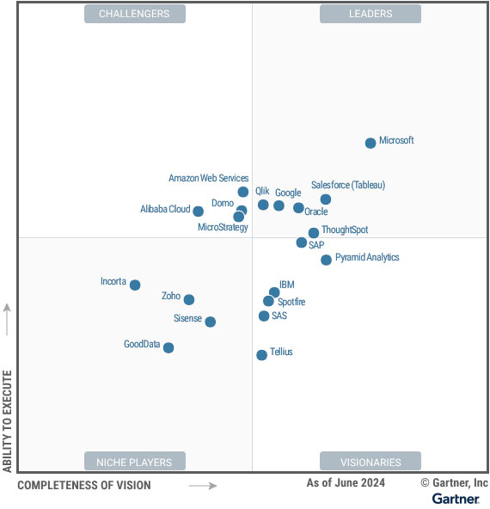

Slide 8
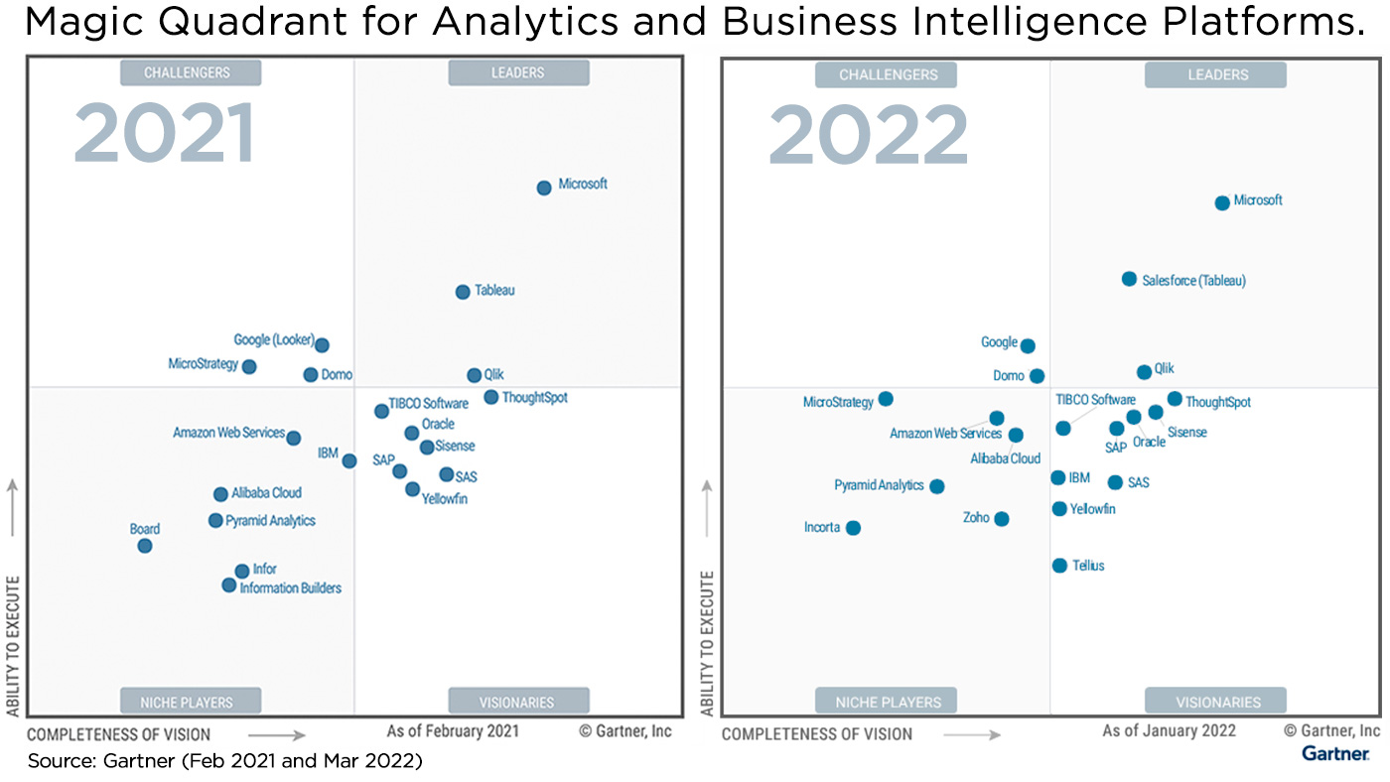

Slide 9
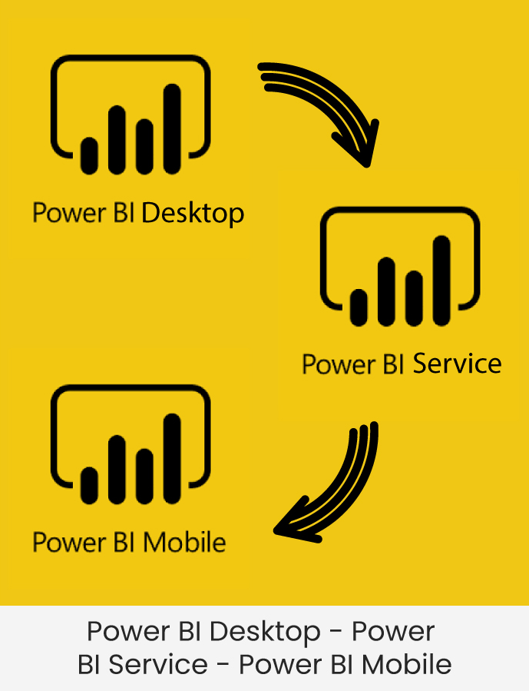
Power BI Ecosystem

Slide 10
Microsoft Fabric
is an end-to-end analytics platform introduced by Microsoft
unifies various data tools and services into a single, integrated ecosystem.
Next evolution of Azure Synapse, bringing together data engineering, data warehousing, data science, real-time analytics, and business intelligence (BI) — all under one roof.

Slide 11
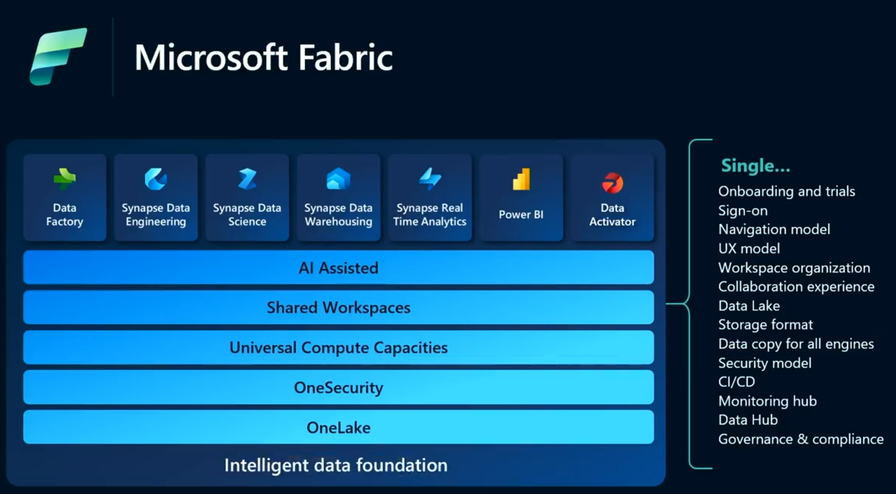

Slide 12
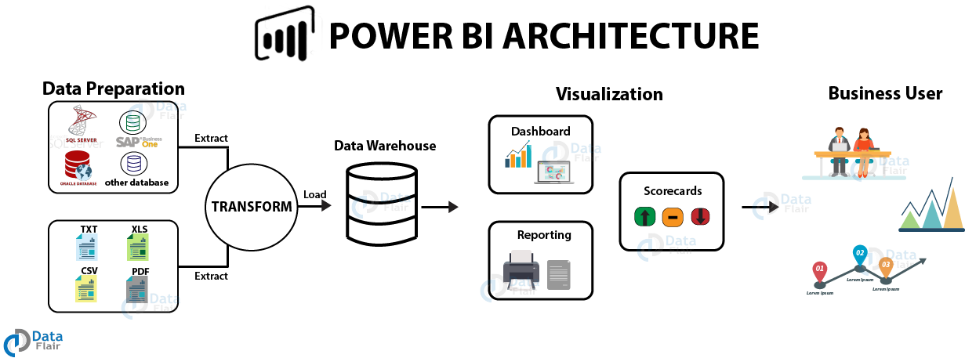
@data-flair

Slide 13
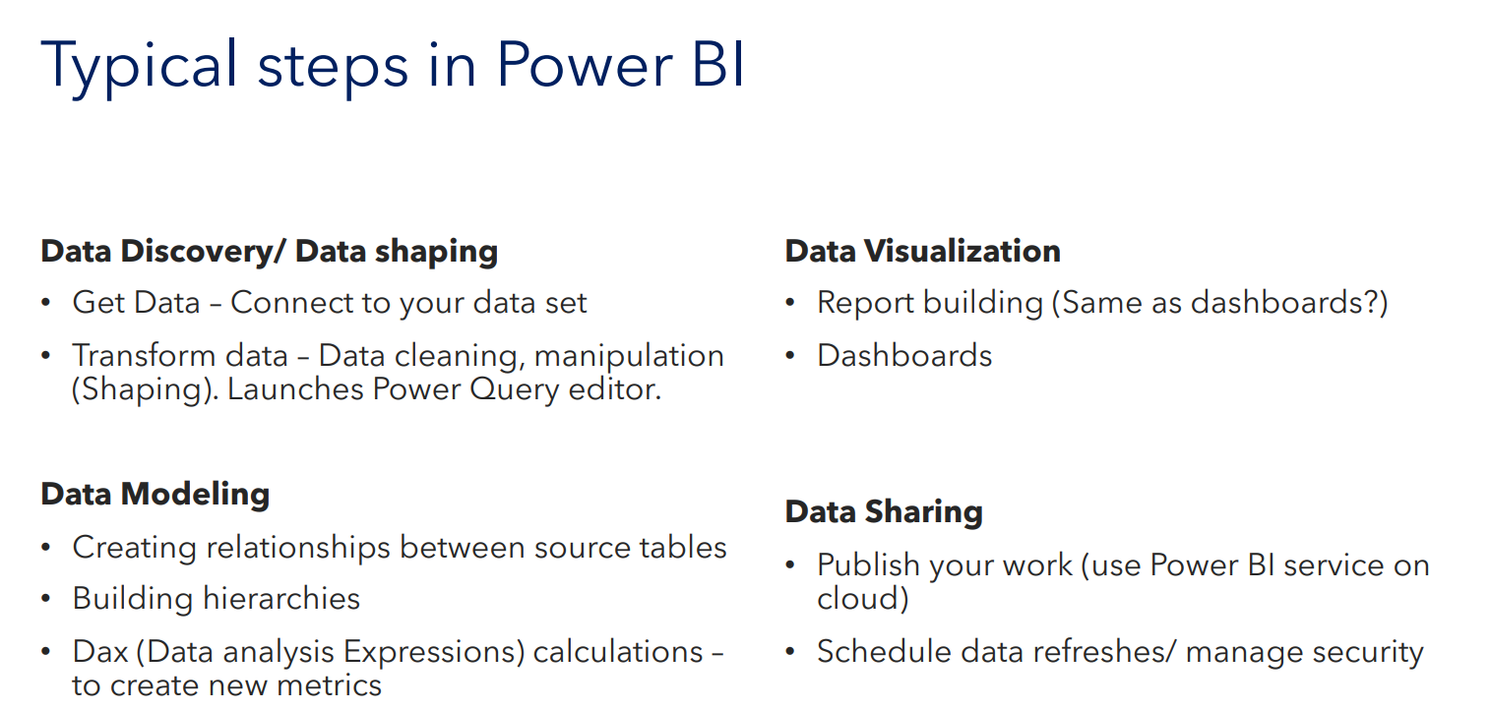

Slide 14
PowerBI Dashboard vs Reports

Slide 15
Microsoft defines a Power BI dashboard as “a single page, often called a canvas, that tells a story through visualizations. Because it’s limited to one page, a well-designed dashboard contains only the story’s highlights, and readers can view related reports for the details.”

Slide 16
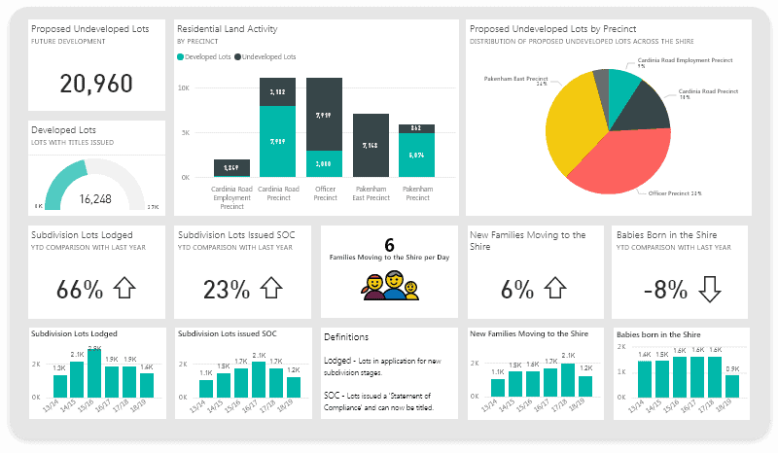

Slide 17
As per Microsoft - “A Power BI report is a multi-perspective view of a dataset, with visuals representing different findings and insights from that dataset. A report can have a single visual or pages full of visuals.”
While a dashboard may comprise visuals from several different reports, a report is a detailed breakdown of a single dataset.
A dashboard may present a teaser or one particular facet of a dataset, whereas a report provides the entire picture and, thus, a more robust view.

Slide 18
More on PowerBI bit later , but now let’s revisit some the best practices in visualization

Slide 19
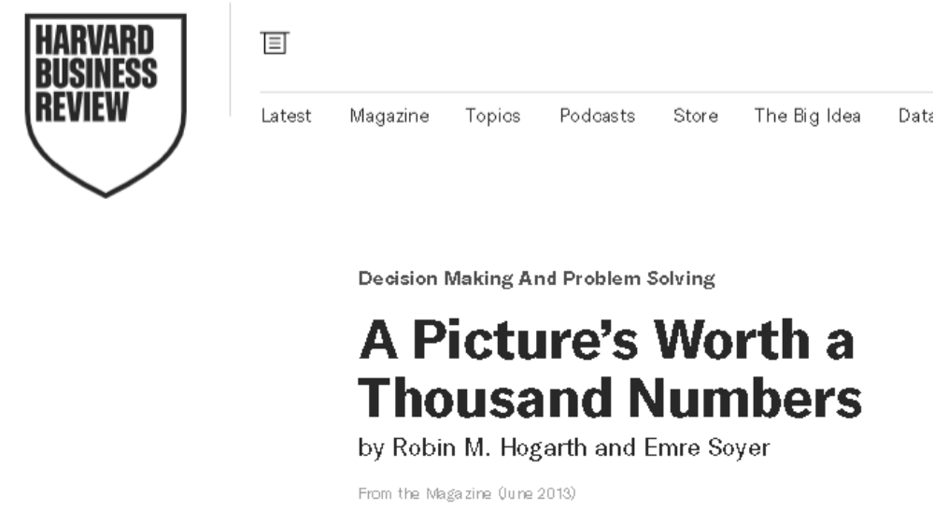
Visualization
https://hbr.org/2013/06/a-pictures-worth-a-thousand-numbers

Slide 20
Experiment: 257 economists were asked to assess regression outcomes.
Text-Based Data Group: Given statistical summaries (mean, standard deviation) and mostly answered incorrectly.
Visual Data Group: Given only a scatterplot; some felt they lacked data but performed much better.
Key Insight: Visualizations enhance understanding more effectively than raw statistics.

Slide 21
Visualizations can enhance decision-making but, unfortunately, can also be manipulated to mislead users by presenting false narratives.

Slide 22


Slide 25
Which is performing better - Brand X or Brand Y ?

Slide 26
Truncated Y-Axis
TYA.xlsx

Slide 28
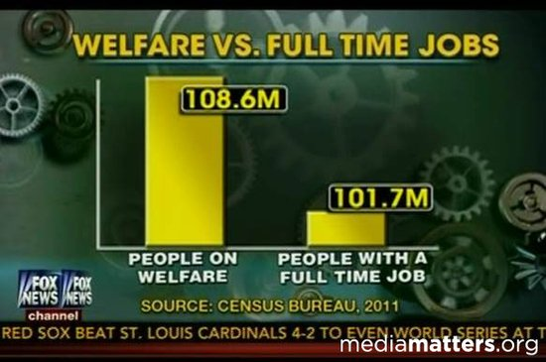

Slide 29
A CEO Success Story !

Slide 30
Is it really a success story ?

Slide 31
Let’s Find out
CMG.xlsx

Slide 33
cumulative graphs are often used to present things a lot more positive than they actually are . It is often misleading and wrong

Slide 34
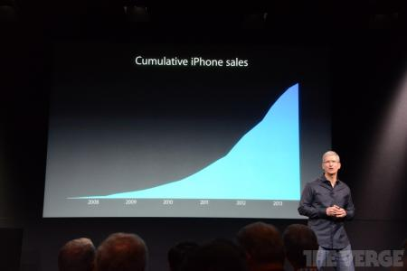
https://qz.com/122921/the-chart-tim-cook-doesnt-want-you-to-see/

Slide 35
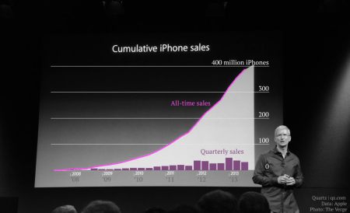
https://qz.com/122921/the-chart-tim-cook-doesnt-want-you-to-see/

Slide 36
Is Jammu the epicentre of Global Warming !!!

Slide 37
Using Incomplete Data to just shock the audience !

Slide 38
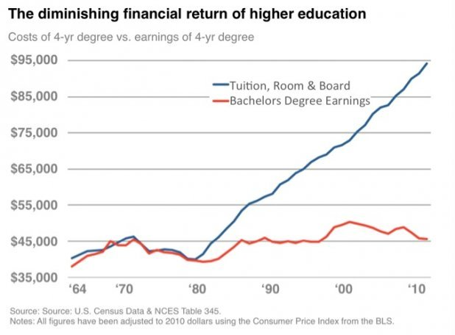
When one tries to interpret Data without full domain knowledge
https://www.businessinsider.com/these-two-charts-prove-a-college-education-just-isnt-worth-the-money-anymore-2012-6?IR=T

Slide 39
Last bit not least

Slide 40
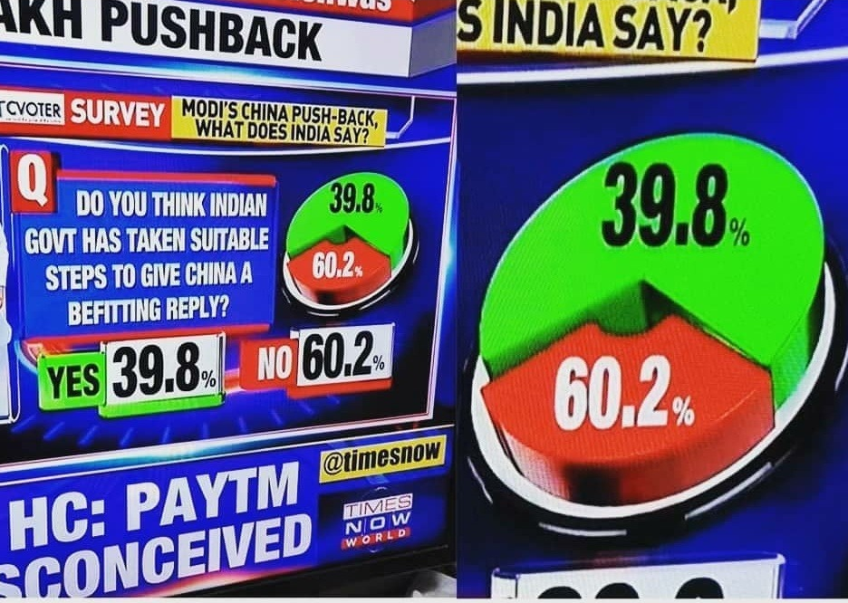

Slide 41
Visualization is not just about numbers.

Slide 42
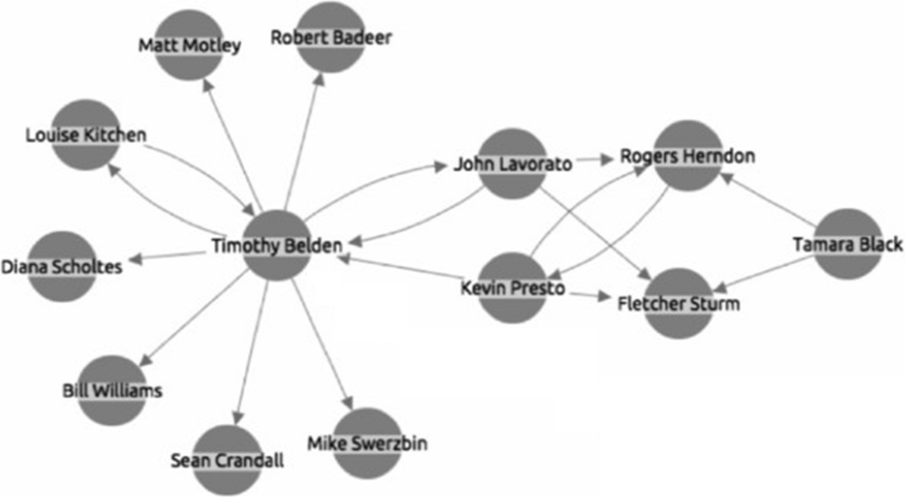

Slide 43
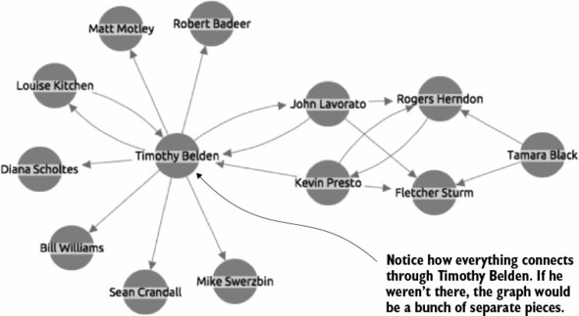

Slide 44
Best practices in Visualizations

Slide 45
The five possibilities data comparison in a chart

Slide 46
Part -to -whole
Description : compares individual values with the sum of those values.
Example : Comparing the sales generated by individual products with the total sales enjoyed by a firm.
Chart type : pie , doughnut , or area : if you want to make a part-to-whole data comparison, choose a pie chart ( if you’re working with a single data series or a doughnut chart or an area chart (if you’re working with more than one data series ).

Slide 47
Whole- to- whole : description : compares individual data values and sets of data values ( or what excel calls data series ) to each other . example : comparing sales revenues of different firms in your industry.
Chart type : bar , cylinder , cone, or pyramid if you want to make a whole – to – whole data comparison , you probably want to use a chart that uses horizontal data markers . bar charts use horizontal data markers ,

Slide 48
Geographic : description : looks at data values using a geographic map.
Example : examine sales by country using a map of the world .
Chart type : Surface , Map chart also available now

Slide 49
Correlation: description : looks at different data series in an attempt to explore correlation , or association , between the data series.
Example : comparing information about the numbers of school going age children with sales of toys.
Checking relation between high trading volumes and increased price swings (volatility) in a specific stock or across a portfolio.
Chart type : scatter or bubble

Slide 50
Time - series : description : shows how values change over time.
Example : a chart showing sales revenues over the last 5 years or profits over the last 12 months.
Chart type: Line or column : to make a time series data comparison , you want to use a chart type that has a horizontal category axis. By convention , western societies ( Europe , north America and south America ) use a horizontal axis moving from left to right to denote the passage of time . Because of this culturally programmed convention , you want to show series data comparisons by using a horizontal category axis. This means you probably want to use either a line chart or column chart. ( Do check PowerBI Regional settings )

Slide 51


Slide 52
PowerBI Views

Slide 53
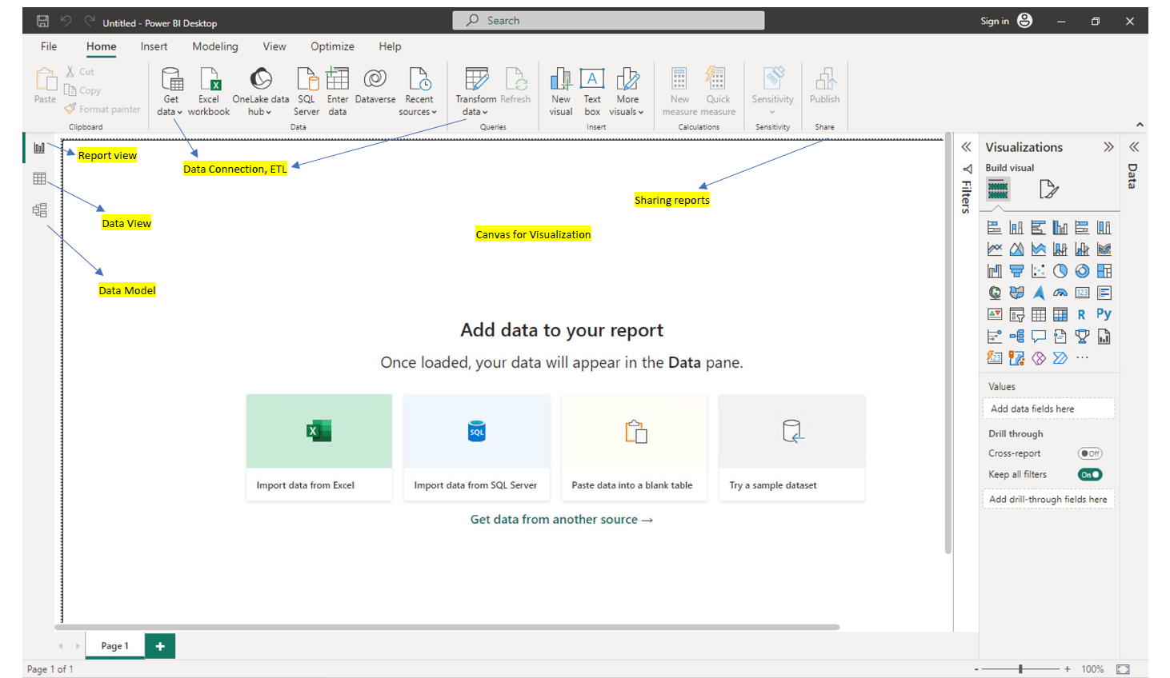

Slide 54
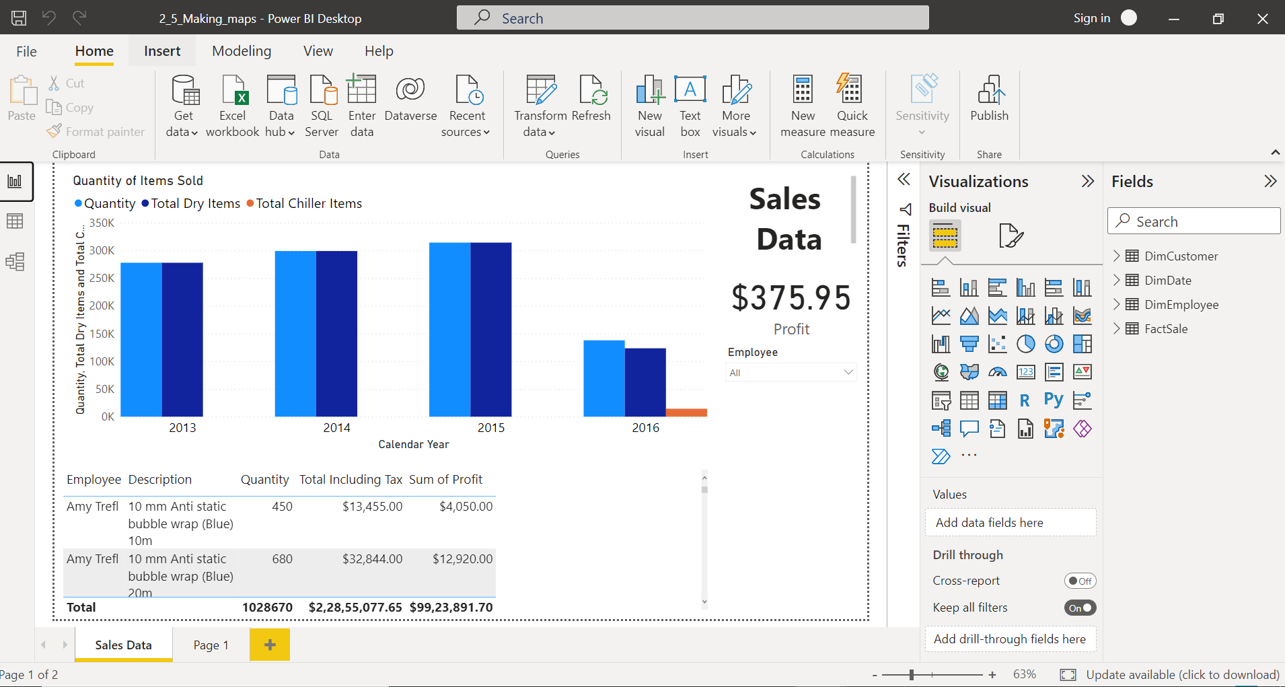
Report View

Slide 55
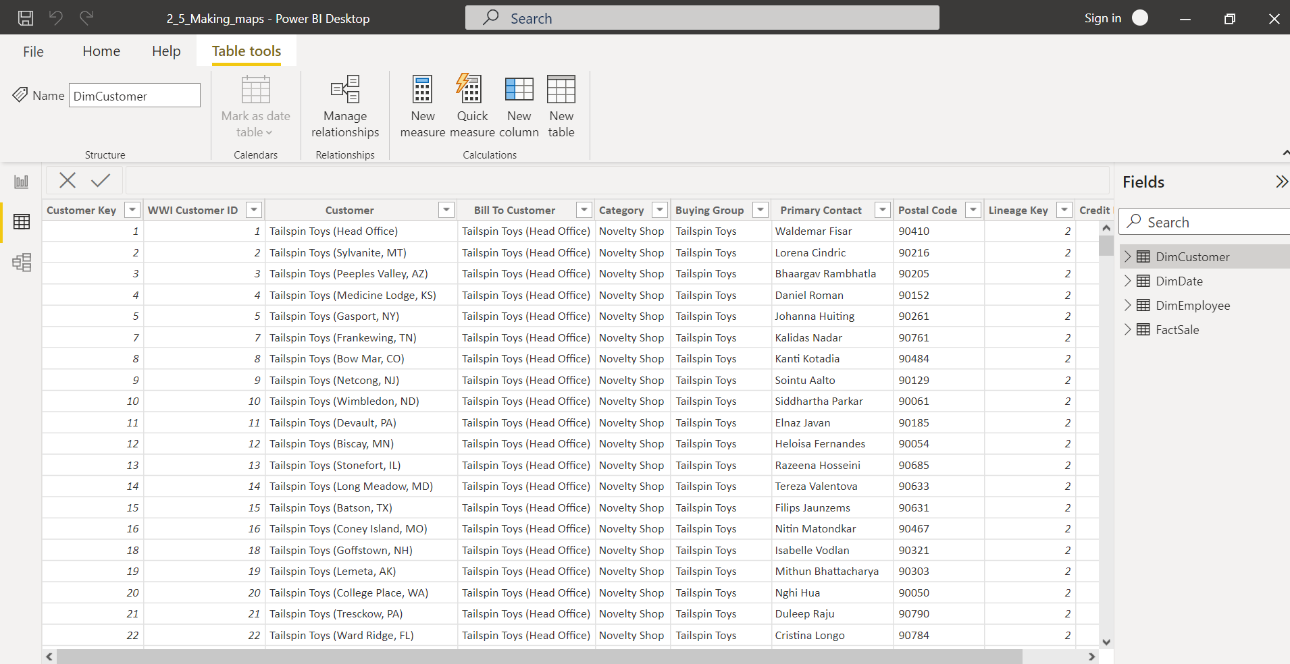
Data View

Slide 56
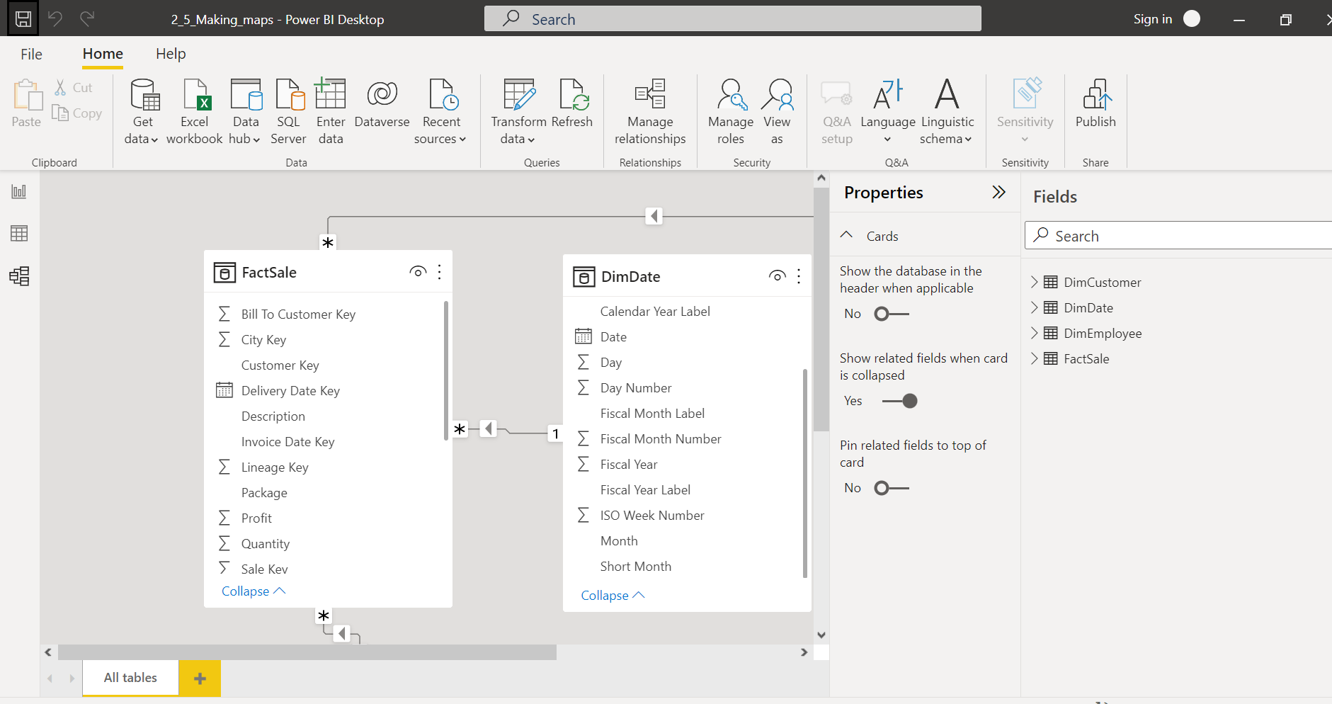
Modelling View

Slide 57
test_data_powerBI_1.xlsx

Slide 58
Slicers (visual filters) … Retail analysis

Slide 59
Do explore slicers interaction with elements same page, global

Slide 60
Class task 1
Create a report using test_dataset_powerBI_2.xlsx with multiple pages and try to showcase some interesting findings that are not easily seen in raw table

Slide 61
Guided class task
Create a financial dashboard using Financial Sample.xlsx
Total Units Sold = SUM(financials[Units Sold])
Calendar = CALENDAR(DATE(2013,01,01),Date(2014,12,31))

Slide 62
Take home task - 3
Create a comprehensive report using Dataset - Superstore (1).xlsx with multiple pages and try to showcase some interesting findings that are not easily seen in raw table .

Slide 63
DAX
Data Analysis Expressions - is a formula expression language and can be used in different BI and visualization tools

