Slide 1
Vehicle Routing Problem
Dr. Anurag Tiwari
IIM Rohtak

Slide 2
Introduction
The Vehicle Routing Problem (VRP) is a generic name given to a set of problems in which set of routes for a fleet of vehicles based at one or several depots are to be formed for servicing the customers dispersed geographically.

Slide 3
Introduction
Generally, distribution or collection of goods from customers to depot is called as VRP or Vehicle Scheduling Problem.
The distribution of goods concerns the service, in a given time period, to a set of customers by a fleet of vehicles, which are located in one or more depots.
These vehicles are operated by a set of crews (drivers), and perform their movements by using an appropriate network.

Slide 4
Introduction
A classical Vehicle routing problem having a single depot with certain number of correspondent vehicles with constant capacity, and a set of customers with known demands.
The Primary objective of classical VRP is to minimize total cost by minimizing total travelling distance travelled by vehicle.
The operational constraints can be a vehicle capacity, route length, time window, precedence relation between customers

Slide 5
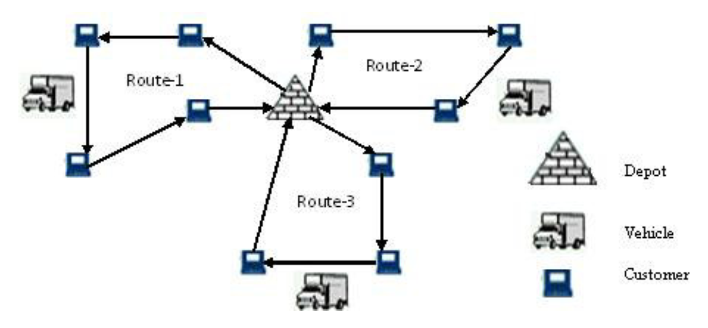
Introduction

Slide 6
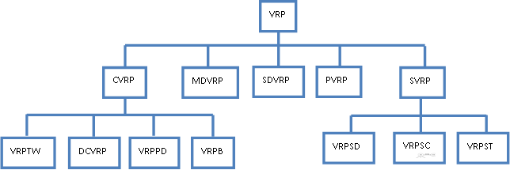
VARIANTS OF VRP
Usually, in real world VRPs, many side constraints will appear.

Slide 7
VARIANTS OF VRP
Capacitated VRP (CVRP)
VRP with Time Windows (VRPTW)
VRP with Backhauls (VRPB)
Distance-Constrained VRP (DCVRP)
Multi-Depot VRP (MDVRP)
VRP with Pick-Up and Delivering (VRPPD)
Split Delivery VRP (SDVRP)
Stochastic VRP (SVRP)
Periodic VRP (PVRP)

Slide 8
Capacitated VRP (CVRP)
CVRP is a Vehicle Routing Problem (VRP) in which a fixed fleet of delivery vehicles of uniform capacity must service known customer demands for a single commodity from a common depot at minimum transit cost.
That is, CVRP is like VRP with the additional constraint that every vehicle must have uniform capacity of a single commodity.

Slide 9
Capacitated VRP (CVRP)
Objective: The objective is to minimize the vehicle fleet and the sum of travel time, and the total demand of commodities for each route may not exceed the capacity of the vehicle which serves that route.
Feasibility: A solution is feasible if the total quantity assigned to each route does not exceed the capacity of the vehicle which services the route.

Slide 10
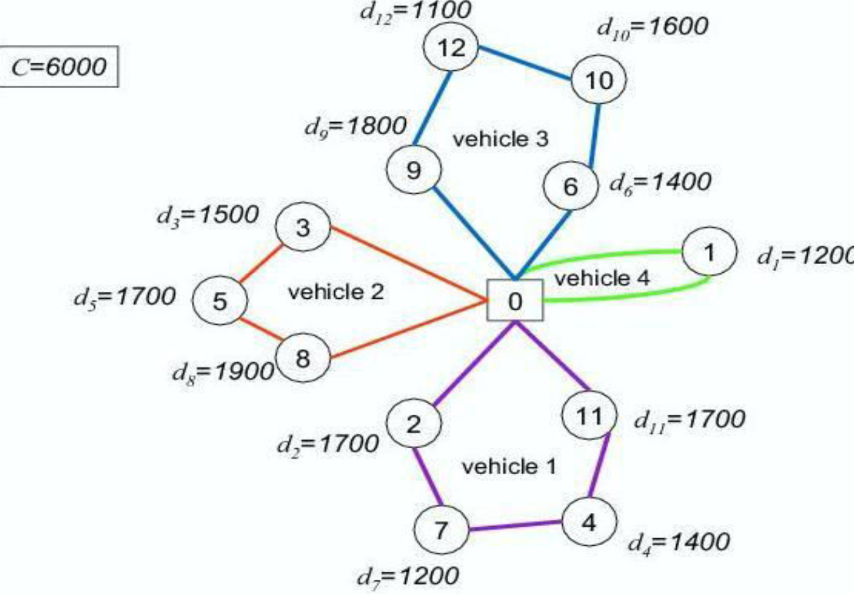
Capacitated VRP (CVRP)

Slide 11
VRP with Time Windows (VRPTW)
It can be reviewed as a combined vehicle routing and scheduling problem which often arises in many real-world applications.
It is to optimize the use of a fleet of vehicles that must make a number of stops to serve a set of customers
To specify which customers should be served by each vehicle and in what order to minimize the cost, subject to vehicle capacity and service time restrictions.
The problem involves assignment of vehicles to trips such that the assignment cost and the corresponding routing cost are minimal.

Slide 12
Vehicle Routing Problem with Pick-Up and Delivery (VRPPD)
One complication that arises in practice is that goods not only need to be brought from the depot to the customers, but also must be picked up at a number of customers and brought back to the depot.
The VRPPD is also called VRP with Backhauls.
The problem can be divided into two independent CVRPs
For the delivery (linehaul) customers
For the pickup (backhaul) customers

Slide 13
Distance-Constrained VRP (DCVRP)
A non-negative demand is associated with each customer and the sum of demands on any vehicle route may not exceed the vehicle capacity.
The length of each vehicle route consists of loading time at the depot, inter-customer travel times and service time at each customer.
The total length of any vehicle route may not exceed the specified vehicle range.

Slide 14
Multi-depot Vehicle Routing Problem
The multi-depot vehicle routing problem (MDVRP) arises as a generalization of the vehicle routing problem (VRP),
where vehicles depart from and return to one of multiple depot locations.
Therefore, besides the definition of the vehicles’ routes, it is also necessary to decide from which depot the customers are visited.
The MDVRP simultaneously defines the service areas of each depot and establishes the associated vehicle routes.

Slide 15
Multi depot vehicle routing Problem
Proposed a model for The multi-objective, multi-depot vehicle routing problem with simultaneous deliveries and pickups
V1
C1
V1
C2
C1
V1
C6
V3
C7
V3
C3
C2
V3
C4
V1
V1
V1
V1
C1
V3
V2
Depot
V3
C3
V1
Depot2
C9
Depot1
C5
C8
V3
V2
V3
V2
V2
V4
C11
V4
V2
C5
C6
C7
C4
V4
C10
C8
V2
(a)Classical Vehicle Routing Problem
(b)Multi-depot Vehicle Routing Problem

Slide 16
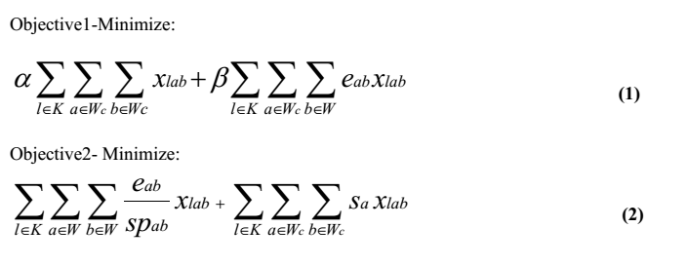
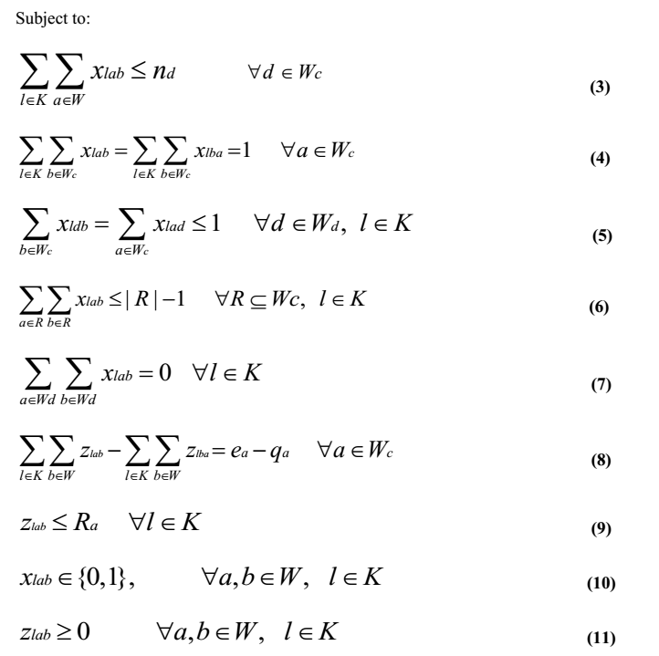
Multi depot vehicle routing Problem

Slide 17
Split Delivery Vehicle Routing Problem (SDVRP)
The Split Delivery Vehicle Routing Problem (SDVRP) is a relaxation of the Capacitated Vehicle Routing Problem (CVRP) where each customer can be visited more than once.

Slide 18
Stochastic VRP
Stochastic VRP (SVRP) are VRPs where one or several components of the problem are random.
Three different kinds of SVRP are the next examples:
Stochastic customers: Each customer ${v_{i}}$ is present with probability ${p_{i}}$ and absent with probability ${1-p_{i}}$.
Stochastic demands: The demand ${d_{i}}$ of each customer is a random variable.
Stochastic times: Service times ${\delta_{i}}$ and travel times ${t_{ij}}$ are random variables.

Slide 19
Periodic VRP (PVRP)
In the case of the Period Vehicle Routing Problem (PVRP), the classical VRP is generalized by extending the planning period to M days.
A vehicle may not return to the depot in the same day it departs.
Over the M-day period, each customer must be visited at least once.

Slide 20
APPLICATIONS OF VRP
There are several important problems that must be solved in real-time.
Dynamic fleet management
Vendor-managed distribution systems
Couriers
Rescue and repair service companies
Dial-a-ride systems
Emergency services
Taxi cab services
Refuse collection
Newspaper distribution

Slide 21
SOLUTION TECHNIQUES
Heuristic Algorithm for VRP
  Classical heuristics
  Metaheuristics

Slide 22
Metaheuristic methods
The six main types of metaheuristic methods that have been applied to the VRP
Deterministic Annealing (DA)
Simulated Annealing (SA)
Tabu Search (TS)
Genetic Algorithm (GA)
Ant Colony Optimization (ACO)
Neural Networks (NN).
In recent years apart from these metaheuristics, Particle Swarm Optimization (PSO), Bee Colony Optimization

Slide 23
A Novel Approach to solve Green Logistic Problem

Slide 24


Stage 1: Vehicle Routing Problem
P1-120
P3-520
P2-400
P1-250
P2-350
P1-80
P3-280
P2-100
P1-50
P3-80

Slide 25
Green Vehicle Routing Problem
The vehicle routing problem (VRP) is a combinatorial optimization ad integer programming problem seeking to service a number of customers with a fleet of vehicles
Green Vehicle Routing Problem Is the Variant of Vehicle Routing Problem
Each Customer(city) must be visited at least once.
Demand of customer should fulfill

Slide 26
Green Vehicle Routing Problem
The aim of this Study
Distance based approach to calculate the carbon dioxide emission
A block recombination approach is applied to solve the GVRP benchmark problem
Objective of The study
To minimize the total distance travelled by vehicle
Reduce the emitted carbon di-oxide

Slide 27
Problem Formulation
This problem has two objectives.
One is find the minimum distance and second objective is to find the minimum Carbon Dioxide Emission.
Total minimum cost is the equal to the total distance travelled by the entire vehicle.
The number of vehicle is not constraint.

Slide 28
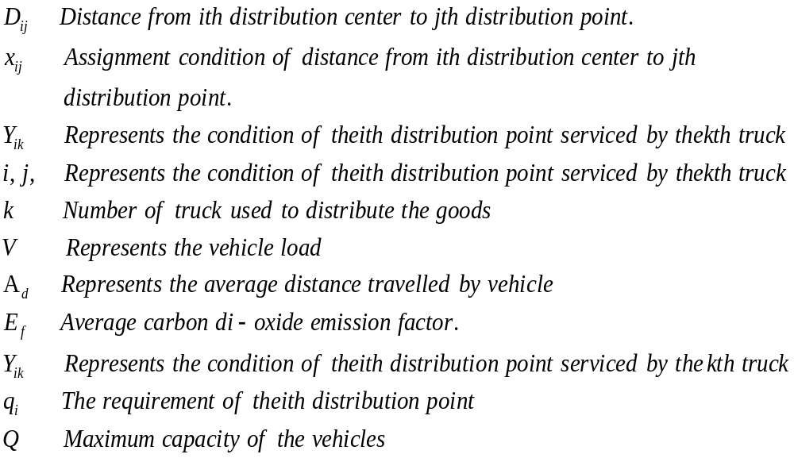
Variable and Parameter

Slide 29
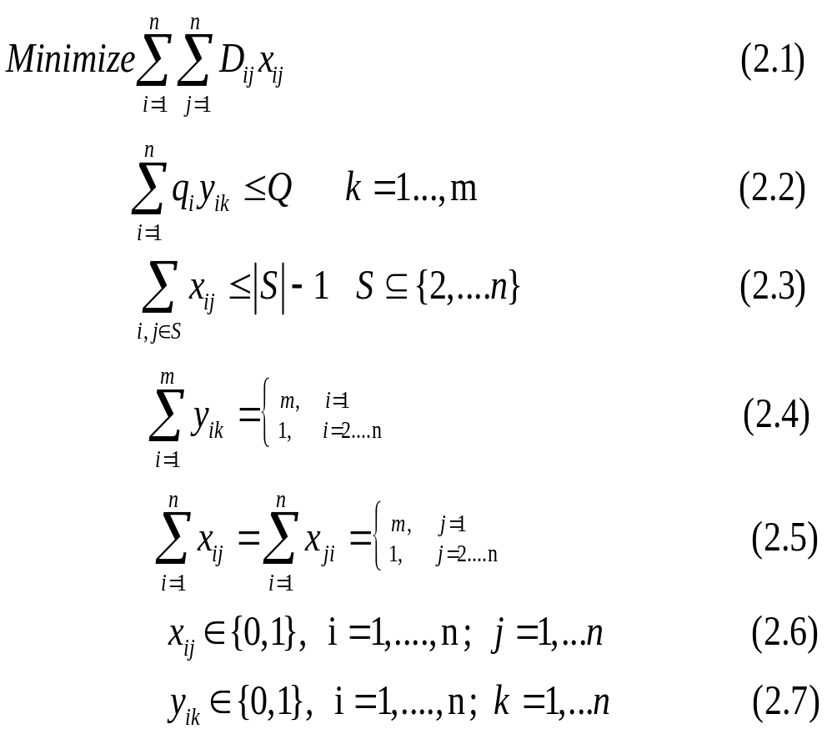
Formulation

Slide 30
Methodology
A block recombination approach used to calculate the minimum distance and minimum carbon di oxide emission.
To get the better block we used the angel and capacity based allocation method to generate the better artificial chromosome.
The number of blocks depends on the number of vehicle used in each data set.

Slide 31
Pseudo Code
1 Arrange the city in clock wise and anti-clock wise uses the polar angles.
2. Create initial population based on the weight.
3. For i=0 to every initial population
4. For j=0 to every cluster
5. Create the structured chromosome using nearest neighbor algorithm.
6. End for
7. End for
8.//Reverse order
Arrange the initial population in descending order.
9. Repeat the steps 3 to 7.
10 Combined the entire cluster to form the chromosome.
11. Create better chromosome using dependent matrix.
12. Use genetic algorithm for all cluster to find better chromosome.
13. Block recombination
15 Calculate the final fitness.
14. End

Slide 32
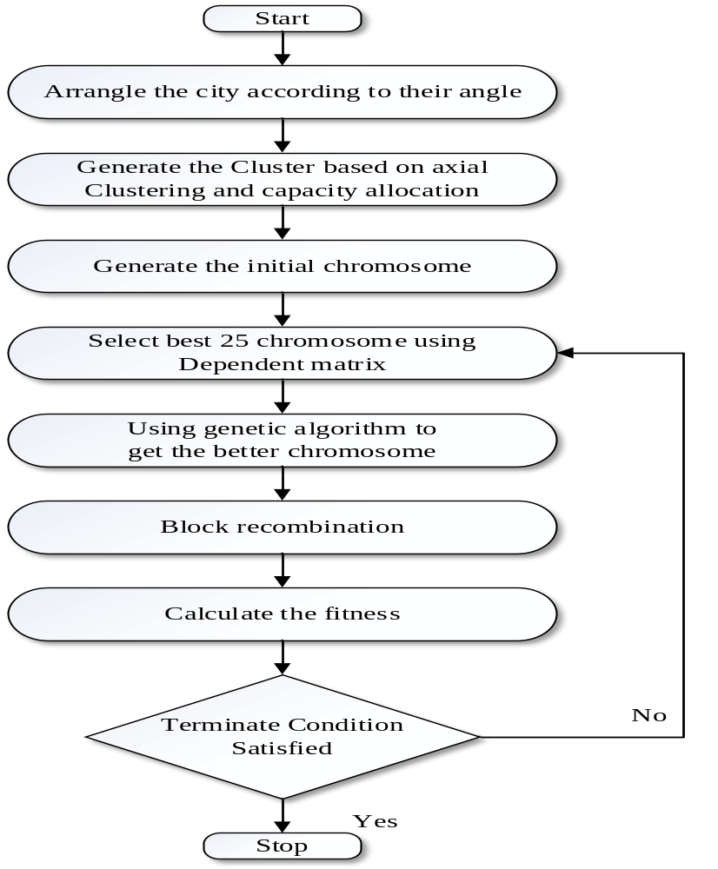
Flow Chart of Proposed Methodology

Slide 33
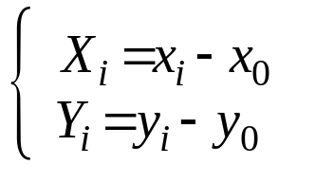
Arrangement of the city according to angel
To arrange the city according to angel, first we calculate the coordinate (X, Y) points for all the distribution point
The X,Y coordinate for all the distribution point relative to their depot area are calculated as follows：
Where the x and y is coordinates of the ith distribution point relative to the depot

Slide 34
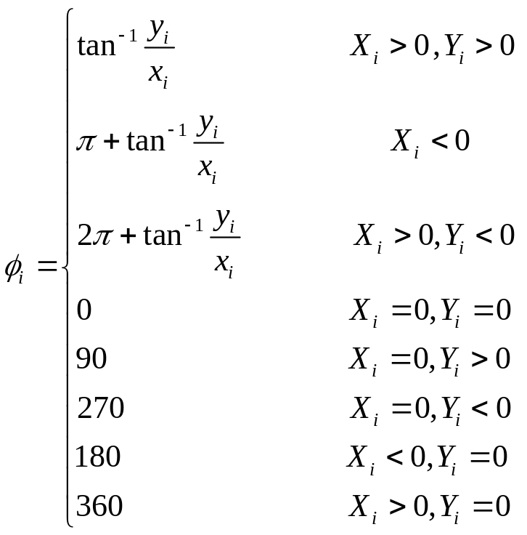


Generate the Cluster based on axial clustering and capacity allocation
Where represents, the polar angel of the ith distribution point.

Slide 35
Generate the Cluster based on axial clustering and capacity allocation
In this problem we consider load as an important factor.
generate the initial chromosome based on the capacity allocation
Each vehicle have a minimum and maximum capacity limit
Generate the new distribution point based on capacity allocation based on distribution points from polar angel.

Slide 36
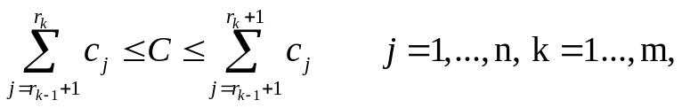


Generate the Cluster based on axial clustering and capacity allocation
The capacity allocation of the distribution points is as fallows
Where C represents the vehicle capacity constraint,
is the demand of the jth distribution points,
k is the number of vehicle
is the last distribution point after sorting according to polar angel.

Slide 37
Generate the Cluster based on axial clustering and capacity allocation
Representation of Distribution Point based on Polar angel
Distribution
Point
1 cluster using polar angel
Depot

Slide 38
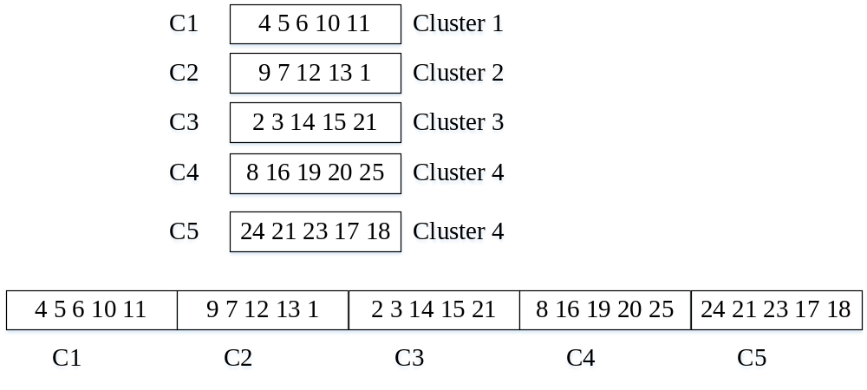
Generation of Initial Chromosome

Slide 39
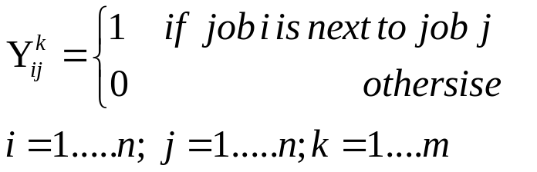

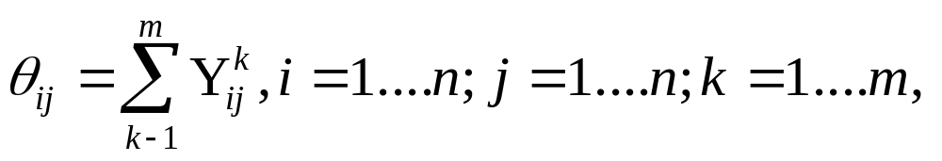
Generating better chromosomes using Dependent Matrix
Each element of dependent matrix and dependency probability matrix is defined in equation
The in following equation represents the number of times that city j is before city i.

Slide 40
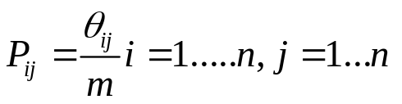
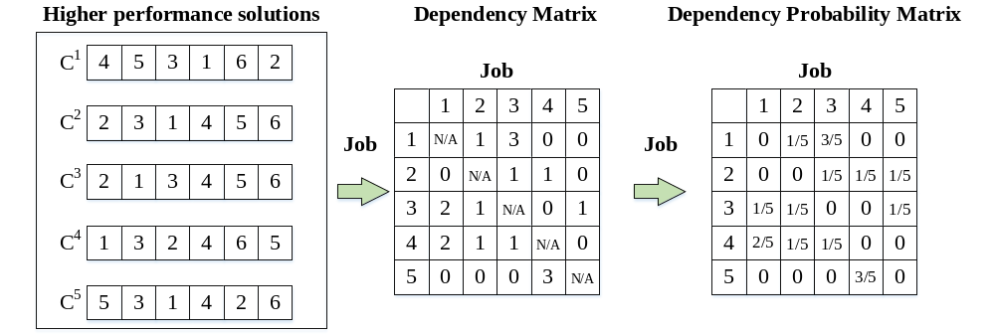
Generating better chromosomes using Dependent Matrix
Each element of dependency matrix is defined as follows
A systematic diagram of the dependency matrix to dependency matrix is as shown

Slide 41
Applying Genetic Algorithm for each Cluster
Using final Chromosome from depending matrix as an initial chromosome.
Roulette wheel selection is applied to select the better chromosome.
Using two point crossover and one point mutation
crossover probability 0.3 and 0.05 mutation probability

Slide 42
Generation of blocks and artificial chromosome
Selecting each cluster as a block
Generating 100 chromosomes and calculate the fitness value of the entire chromosome.
Selection of best 20 chromosomes for the block recombination techniques
Rank the entire cluster and calculated the fitness value of each cluster.
Select the entire cluster with higher fitness and combined it according to their rank

Slide 43
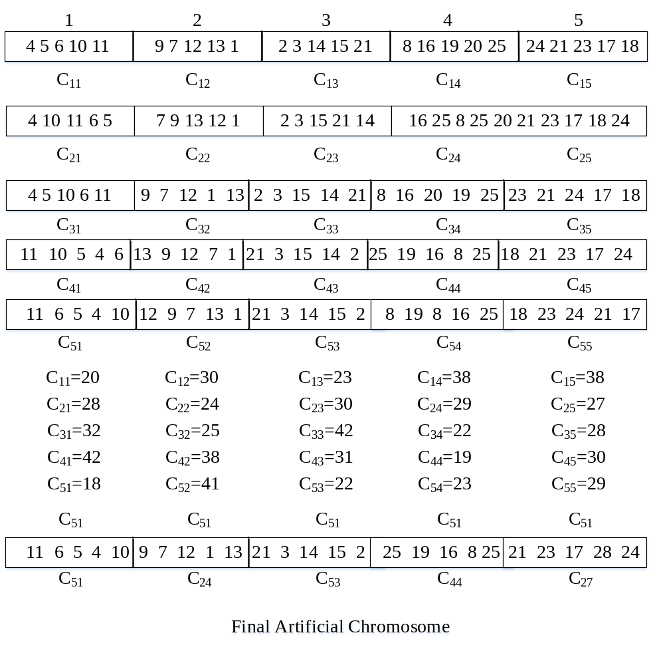
Generation of blocks and artificial chromosome

Slide 44
Computational Results
To test the problem we used the benchmark problem obtained from international VRP Websites (http://neo.lcc.uma.es/radi-aeb/WebVRP/).
Each instance is executed for at least ten runs.
The number of city is represented by n.
The population size is set to be 100 and number of generation is 100.
Compare our first objective with minimum distance with hybrid genetic algorithm.

Slide 45
Computational Results
Effect of weight on carbon di oxide emission (E-n33-k4 )
Distance | Weight | Co2 (gm)
11.1803398874989 23 | 3625 | 2495.451863
34.1803398874989 10 | 3325 | 4741.45
37.7858911629629 11 | 3225 | 787.9932313
39.200104725336 12 | 2275 | 234.5473193
47.2623624736346 8 | 2150 | 1749.509931
50.2623624736346 14 | 1700 | 590.55
58.8646877406772 9 | 1550 | 1853.370979
62.9877933662949 17 | 1250 | 849.9782247
80.0171797322213 7 | 1150 | 3721.77239
92.0587743110136 13 | 1000 | 2594.361552
95.6643255864776 16 | 850 | 776.8160223
101.988880906814 15 | 700 | 1362.625444
130.273152154276 18 | 150 | 5392.396313
139.7599851 | 0 | 661.7066004
Table 1. En-33 K-4 D, Effect of weight

Slide 46
Computational Results2
Distance | Weight | Co2 (gm)
15.8113883008419 19 | 3700 | 3529.101869
55.6360038043217 6 | 3300 | 8148.116332
63.6360038043217 1 | 3150 | 1760.8
71.2517769101856 24 | 2850 | 1605.404971
77.0827288050309 25 | 2350 | 1156.860856
82.4678936121654 29 | 1550 | 968.2526323
96.4678936121654 27 | 550 | 2343.6
119.813128672023 28 | 450 | 5210.656465
137.277377868596 26 | 300 | 3843.881248
184.1495444 | 0 | 3269.333619
Table 2. En-33 K-4 D, Effect of weight

Slide 47
Computational Results2
Distance | weight | Co2 (gm)
26.1725046566048 22 | 3925 | 5841.703039
56.1891666962121 2 | 3825 | 6699.718967
69.6055745612108 5 | 725 | 935.7944486
79.6554501823317 4 | 525 | 2243.132239
92.693854992737 3 | 425 | 2910.171954
115.953261691963 20 | 300 | 5191.499575
134.9269277 | 0 | 1323.413201
Table 3. En-33 K-4 D, Effect of weight
Distance | weight | Co2 (gm)
23.1948270094864 21 | 1500 | 2157.118912
46.38965402 | 0 | 1617.839184
Table 4. En-33 K-4 D, Effect of weight

Slide 48
Computational Results2
Comparison Results
Instance | Block Recombination Approach | Co2 (gm) | HGA solution | Best known | Vehicle capacity
E-n30-k3 | 568.56 | 91992.74617 | 568.56 | 568.563 | 4500
E-n33-k4 | 505 | 88568.92938 | 508.14 | 538.958 | 4500
E-n51-k5 | 845 | 256024.1771 | 845.24 | 838.721 | 8000
E-n51-k5 | 524.61 | 3930.832769 | 524.61 | 524.944 | 160
E-n76-k7 | 701.28 | 6816.146455 | 701.28 | 687.603 | 220
E-n76-k8 | 750.48 | 5958.608851 | 750.48 | 735 | 180
E-n76-k10 | 853.05 | 5390.838835 | 853.05 | 832 | 140
E-n76-k14 | 1057.7 | 4061.023914 | 1057.7 | 1032 | 100
E-n101-k8 | 847.5 | 7479.43902 | 847.5 | 817 | 200
E-n101-k14 | 1121.3 | 6001.300386 | 1121.3 | 1077 | 112
E-n484-k19 | 1755.37 | 80183.07 | ------ | 1137.176 | 1000
Table 5. Summary of the calculation of the benchmark

Slide 49
Computational Results3
Effect of truck load on carbon di oxide emission

Slide 50
Conclusions
Contribution
Proposed a new approach name block recombination to solve green vehicle routing problem
Consider truck load as a major factor for Carbon di oxide emission.
Proposed A new Block Recombination approach to solve Green Vehicle Routing Problem.
Proposed Model can be useful for real life problem.
Future Research
Future research should contain divers GSCM dimensions.
  Future research should collect data from a more diverse sample.
  Resource Efficient Transportation model.

Slide 51
Current Research Focus in Multi depot vehicle routing Problem
Proposed a model for The multi-objective, multi-depot vehicle routing problem with simultaneous deliveries and pickups
V1
C1
V1
C2
C1
V1
C6
V3
C7
V3
C3
C2
V3
C4
V1
V1
V1
V1
C1
V3
V2
Depot
V3
C3
V1
Depot2
C9
Depot1
C5
C8
V3
V2
V3
V2
V2
V4
C11
V4
V2
C5
C6
C7
C4
V4
C10
C8
V2
(a)Classical Vehicle Routing Problem
(b)Multi-depot Vehicle Routing Problem

Slide 52
Current Research Focus in Multi depot vehicle routing Problem

Slide 53
Case Study School Chaley Hum
Question 1: Identify and discuss issue and difficulties in the corporate world that are similar to those described in the case:

Slide 54
Route plan for a courier service
The distribution system for fast moving consumer goods
Optimizing a travel plan for marketing executives
Home delivery of consumer goods to customer (retail Industry)
A fast food home delivery system.

Slide 55
Question 2
Assuming that the institute hires/assigns only one person (or team) to deliver invitations to parents for its annual function, develop a model to identify the shortest possible delivery route.

Slide 56
Nodes/Distance | 1 | 2 | 3 | 4 | 5 | 6
1 | 0 | 7 | 8 | 3 | 4 | 6
2 | 7 | 0 | 2 | 7 | 6 | 1
3 | 8 | 2 | 0 | 5 | 3 | 5
4 | 3 | 7 | 5 | 0 | 7 | 2
5 | 4 | 6 | 3 | 7 | 0 | 5
6 | 6 | 1 | 5 | 2 | 5 | 0

