Slide 1
Valuing Bonds

Slide 2
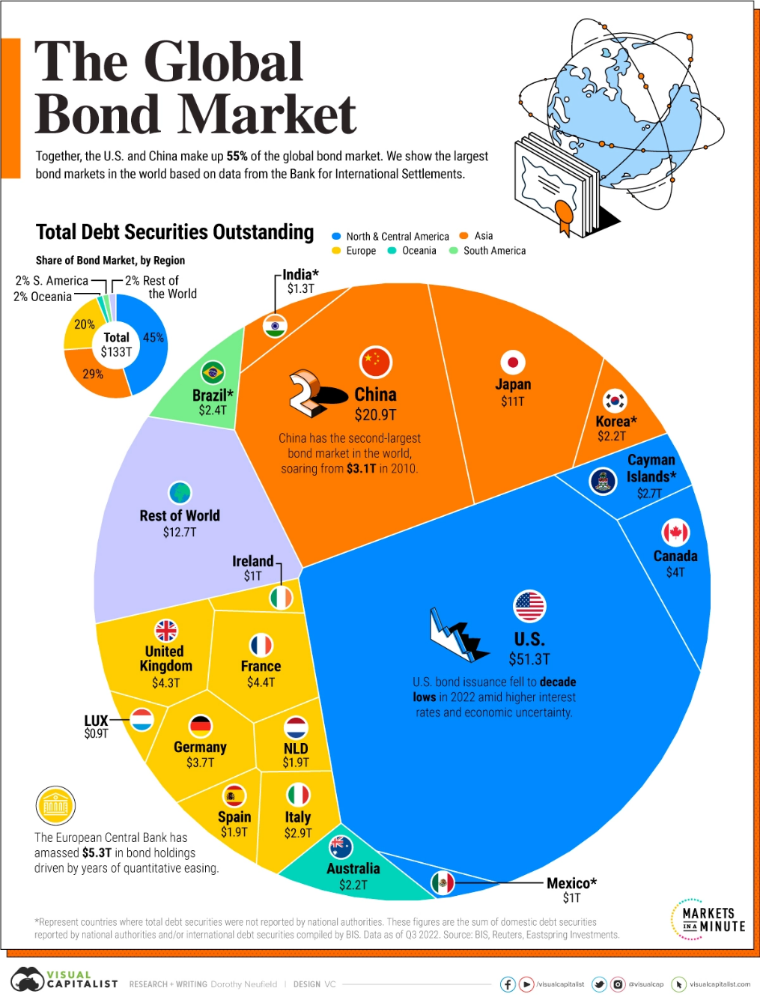
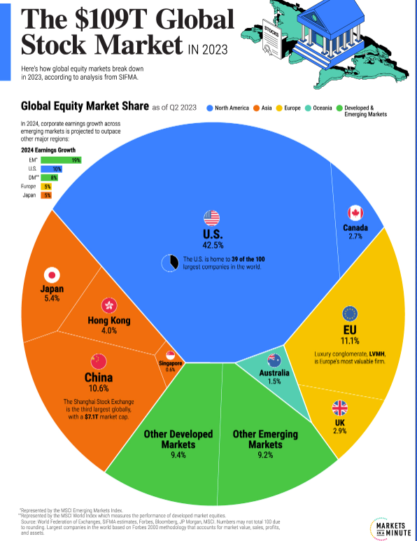

Slide 3
Bond Cash Flows, Prices, and Yields
Bond Terminology
  Face Value
  It is the principal value underlying the bond
    It is the amount payable by the borrower to the last holder at maturity
    It is the amount on which the periodic interest payments are calculated
Term to Maturity
  It is the time remaining in the life of the bond
    It represents the length of time for which interest has to be paid as promised
    It represents the length of time after which the face value will be repaid

Slide 4
Bond Cash Flows, Prices, and Yields
  Coupon
    The coupon payment is the periodic interest payment that has to be made by the borrower.
    The coupon rate when multiplied by the face value gives the dollar value of the coupon.
    Most bonds pays coupons on a semi-annual basis.
Consider a bond with a face value of $1000. The coupon rate is 8% per annum paid semi-annually. So the bond holder will receive
1000 x 0.08
2 = $40 every six months.

Slide 5
Bond Cash Flows, Prices, and Yields
Yield to Maturity (YTM)
  the rate of return for an investor if he buys the bond at the prevailing market price and holds it till maturity.
At any point in time the YTM may be
  Greater than
  Less than or
  Equal to the Coupon Rate
YTM is the IRR of a bond

Slide 6
Value of a Bond
A bond holder gets a stream of contractually promised payments.
The value of the bond is the value of this stream of cash flows.
However, you cannot simply add up cash flows arising at different points in time.
  Cash flows have to be discounted before being added.

Slide 7
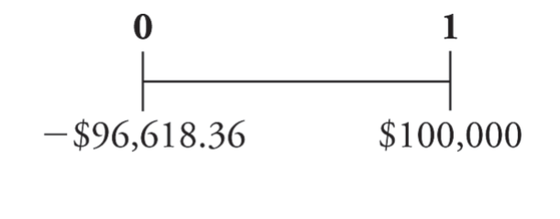
Zero-Coupon Bonds
does not make coupon payments
sells at a discount (a price lower than face value), so they are also called pure discount bonds
Treasury Bills are U.S. government zero-coupon bonds with a maturity of up to one year.
Eg: Suppose that a one-year, risk-free, zero-coupon bond with a $100,000 face value has an initial price of $96,618.36.
Although the bond pays no “interest,” your compensation is the difference between the initial price and the face value.

Slide 8
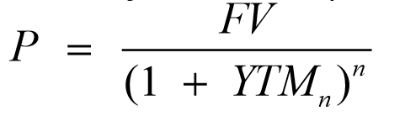
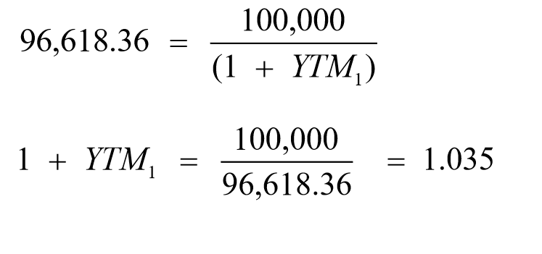
Zero-Coupon Bonds
Yield to Maturity – The discount rate that sets the present value of the promised bond payments equal to the current market price of the bond.
Price of a Zero-Coupon bond
YTM for the one year zero coupon bond is 3.5%

Slide 9
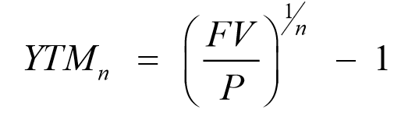
Zero-Coupon Bonds
Yield to Maturity of an n-Year Zero-Coupon Bond

Slide 10
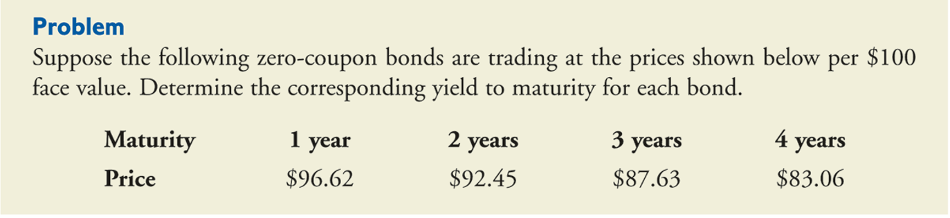
Yields for Different Maturities

Slide 11
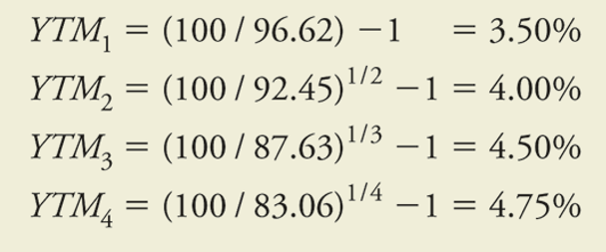
Yields for Different Maturities

Slide 12
Coupon Bonds
Coupon Bonds
  Pay face value at maturity
  Pay regular coupon interest payments
  Notes
  coupon security with original maturities of 1–10 years
  Bonds
  coupon security with original maturities over 10 years

Slide 13
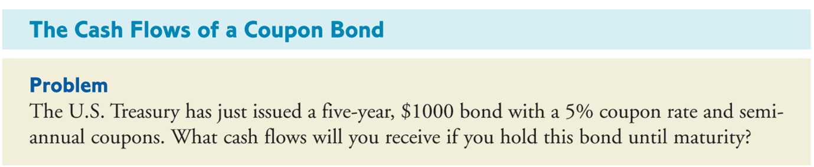
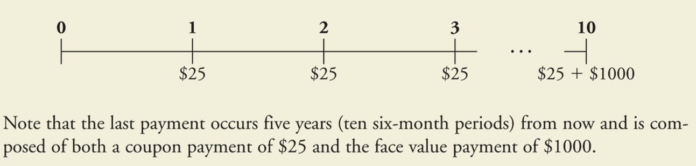
Example

Slide 14
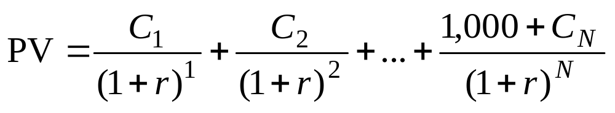
Using the Present Value Formula to Value Bonds

Slide 15
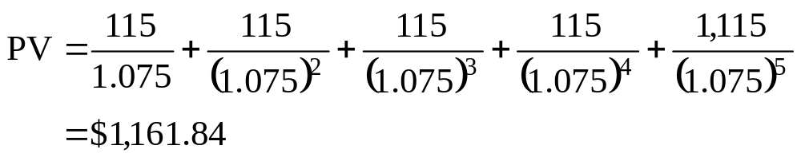
Using the Present Value Formula to Value Bonds
Example
  What is the value of the following bond? An IBM bond pays $115 every December for five years. In December 2028, it pays an additional $1,000 and retires the bond. The bond is rated AAA. YTM is 7.5%.

Slide 16
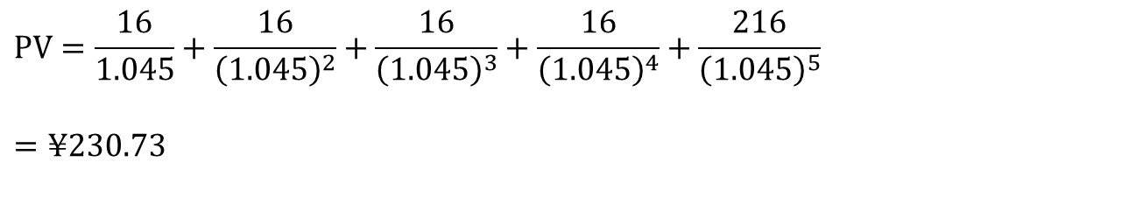
Using the Present Value Formula to Value Bonds
Another Example: Japan
  In Aug 2024 you purchase 200 yen of bonds in Japan which pay an 8% coupon every year. If the bond matures in 2029 and the YTM is 4.5%, what is the value of the bond?
$$\text{PV}=\frac{16}{1.045}+\frac{16}{{\left(1.045\right)}^{2}}+\frac{16}{{\left(1.045\right)}^{3}}+\frac{16}{{\left(1.045\right)}^{4}}+\frac{216}{{\left(1.045\right)}^{5}}$$
$$=¥230.73$$

Slide 17
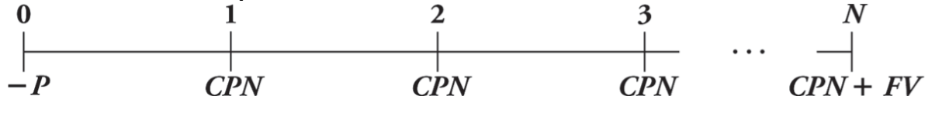
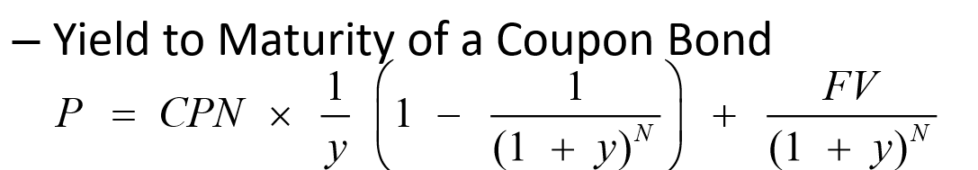
Coupon Bonds
Yield to Maturity – The YTM is the single discount rate that equates the present value of the bond’s remaining cash flows to its current price.

Slide 18
Example
Computing the yield to maturity of a coupon bond
Consider the five-year, $1000 bond with a 5% coupon rate and semi-annual coupons. If this bond is currently trading for a price of $957.35, what is the bond’s yield to maturity?

Slide 19
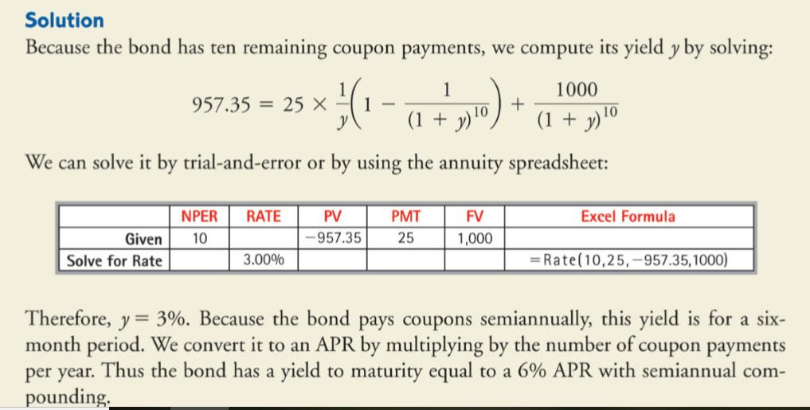

Slide 20
Example
Consider the five-year, $1000 bond with a 5% coupon rate and semi-annual coupons. If the YTM is 6.30% (expressed as an APR with semi-annual compounding). What price is the bond trading now?
Note that 6.30% APR is equivalent to a semi-annual rate of 3.15%.
P = 944.98

Slide 21
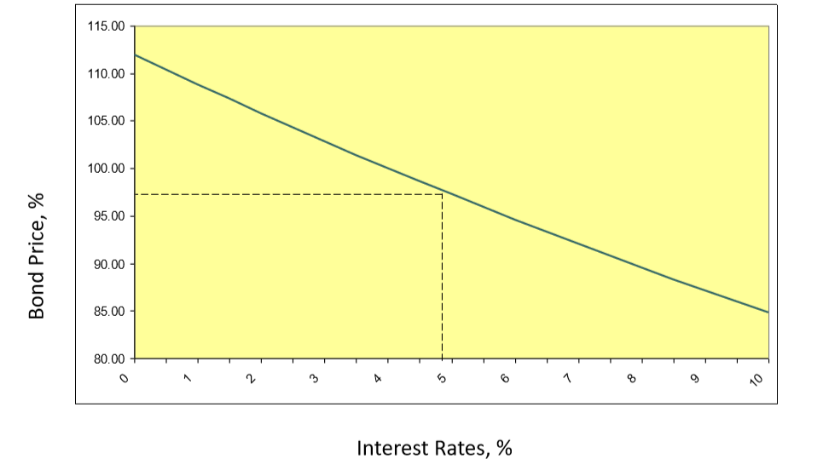
Bond Prices and Yields

Slide 22
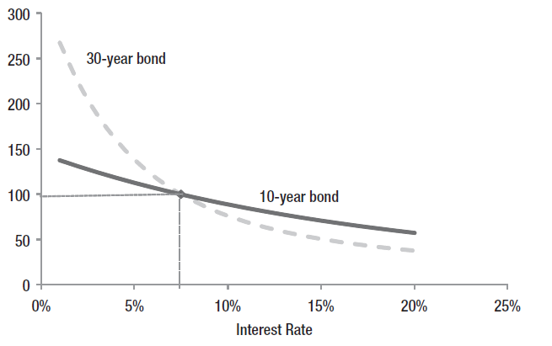
Maturity and Prices

Slide 23
10-Year Government Bond Yields
COUNTRY | YIELD
United States | 4.57%
Canada | 3.73%
Brazil | 11.64%
Mexico | 9.71%
United Kingdom | 4.28%
Australia | 4.41%
New Zealand | 4.81%
Japan | 0.89%
Singapore | 3.35%
India | 7.15%
Source: https://www.bloomberg.com/markets/rates-bonds

Slide 24
The Yield Curve
The yield curve displays the relationship between YTM and time to maturity
Information on expected future short-term rates can be implied from the yield curve

Slide 25
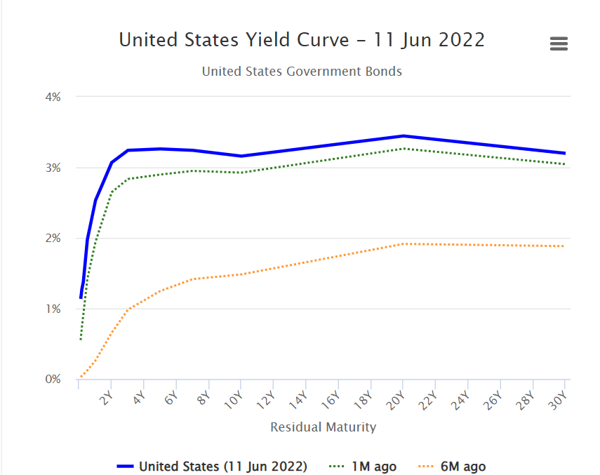
US YIELD CURVE
http://www.worldgovernmentbonds.com/country/united-states/

Slide 26
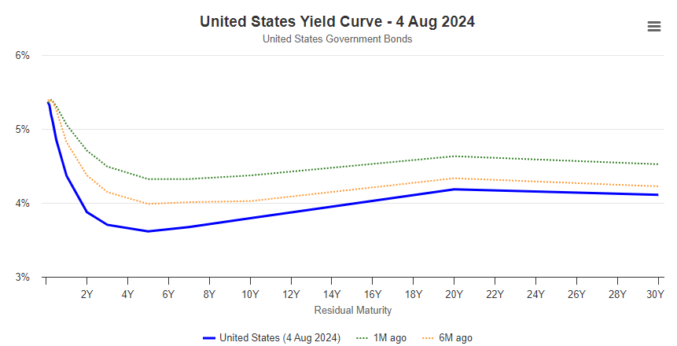
US YIELD CURVE
http://www.worldgovernmentbonds.com/country/united-states/

Slide 27
CRUCIAL QUOTE
"If you lock your money up for a longer period of time, you almost always get a higher interest rate," Duke University finance professor Campbell Harvey
However, things are backwards today - 10-year interest rates are far below short-term rates. This is known as an 'inverted yield curve.’
In the past 50 years, we have seen seven inverted interest rate curves. Each one was followed by a recession.
https://www.forbes.com/sites/anthonytellez/2023/03/08/what-to-know-about-the-yield-curve-and-why-it-may-predict-a-recession/?sh=1fba5ca2653c

Slide 28
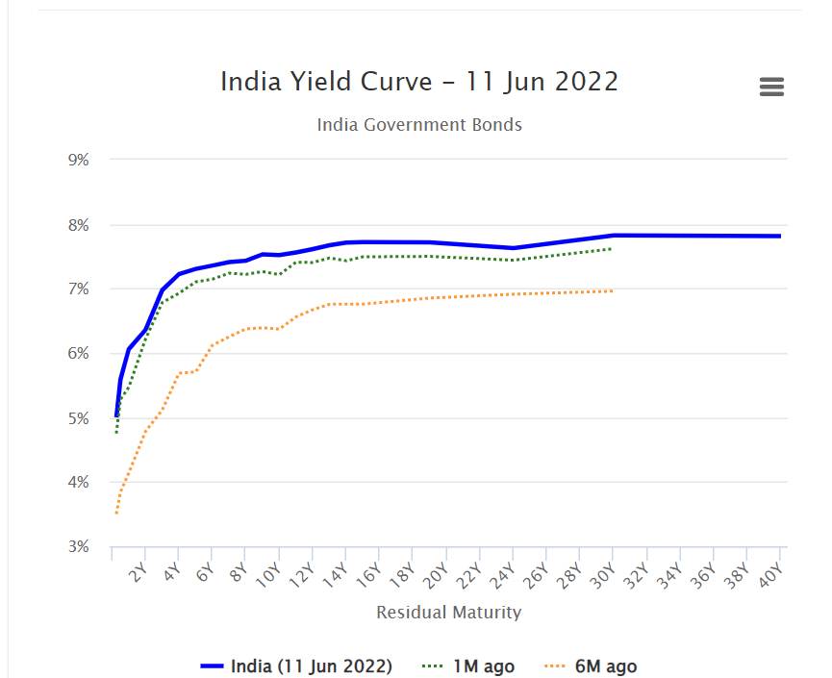
INDIA YIELD CURVE
http://www.worldgovernmentbonds.com/country/india/

Slide 29
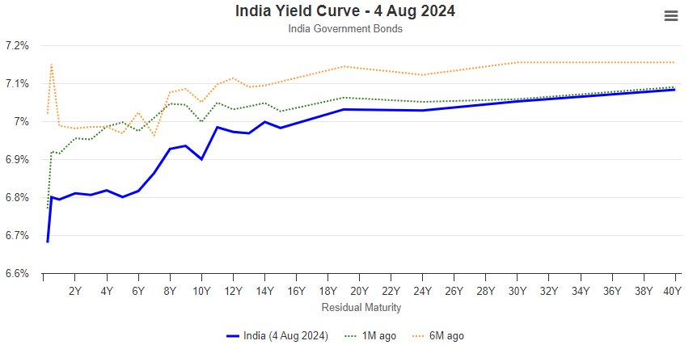
INDIA YIELD CURVE
http://www.worldgovernmentbonds.com/country/india/

Slide 30
Interpreting the Term Structure
The yield curve reflects expectations of future interest rates
The forecasts are clouded by liquidity premiums
An upward sloping curve could indicate:
  Rates are expected to rise
  and/or
  Investors require large liquidity premiums to hold long term bonds
The yield curve is a good predictor of the business cycle
  Long term rates tend to rise in anticipation of economic expansion
  Inverted yield curve may indicate that interest rates are expected to fall and signal a recession

Slide 31
The Risk of Default
Corporate Bonds and Default Risk
  Payments promised to bondholders represent best-case scenario
  Most bonds’ safety judged by bond ratings

Slide 32
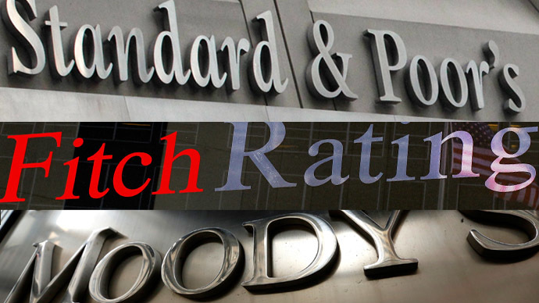
Bond Ratings
The highest-quality bonds are rated triple A.
Bonds rated triple B or above are investment grade.
Lower rated bonds are called high-yield, or junk, bonds.

