Slide 1
Valuation

Slide 2
Valuation
“Knows the price of everything, but the value of nothing” (Oscar Wilde).
Greater fool theory: there will always be a “greater fool” in the market who will be ready to pay a price based on higher valuation for an already overvalued security. Therefore, valuing assets are irrelevant.
The value is in the eye of beholder, possibly, bitcoin and gold.
However, most of financial investors do not buy financial assets based on emotional or aesthetic reasons. Therefore, the price paid for any asset should reflect the cashflows it is expected to generate.
Most of times, in the stock market, we follow the noise and we try to support the noise through our valuation.

Slide 3
Misconceptions about valuation
Myth 1: A valuation is an objective search for “true value.
  Truth: All valuations are biased. The only questions are how much and in which direction.
  Truth: The direction and magnitude of the bias in your valuation is directly related to who pays and how much you are paid?
Myth 2: A good valuation provides a precise estimate of value
  Truth: There are no precise valuation.
Myth 3: The more quantitative a model, the better the valuation
  Truth: If you use more variables to estimate the value, you must make more assumptions.

Slide 4
Valuing an asset is not same as pricing the asset
Drivers of value
Cashflows from existing assets
Growth in cashflows
Quality Growth
Drivers of price
Demand and supply
Market moods & momentum
Surface stones about fundamental
Accounting estimates
The GAP
Is there one?
If so, will it close?
If it will be close, what will cause it to close?
Intrinsic value
Value
Price
Price
Valuation estimates

Slide 5
Two approaches to valuation
Intrinsic valuation: The value of an asset is a function of its fundamentals – cash flows, growth and risk. In general, discounted cash flow models are used to estimate intrinsic value. Intrinsic valuation is designed to value assets that generate cashflows.
Relative valuation: The value of an asset is estimated based upon what investors are paying for similar assets. In general, this takes the form of value or price multiples and comparing firms within the same business.

Slide 6
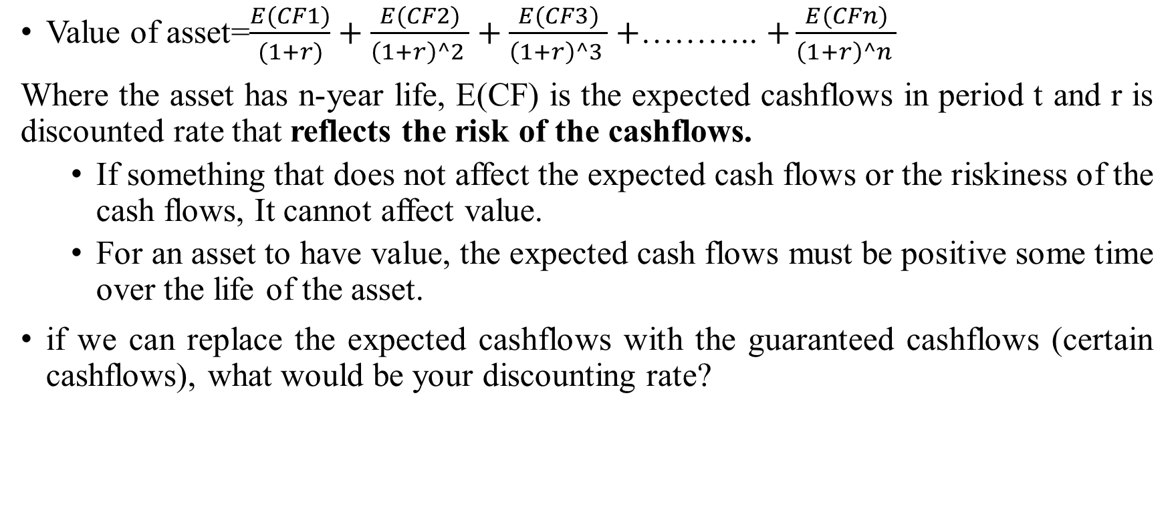
Discounted cash flow valuation
Value of asset=$\frac{E(CF1)}{(1+r)}+\frac{E(CF2)}{\left(1+r\right)^2 }+\frac{E(CF3)}{\left(1+r\right)^3 }+$……….. $+\frac{E(CFn)}{\left(1+r\right)^n }$
Where the asset has n-year life, E(CF) is the expected cashflows in period t and r is discounted rate that reflects the risk of the cashflows.
  If something that does not affect the expected cash flows or the riskiness of the cash flows, It cannot affect value.
  For an asset to have value, the expected cash flows must be positive some time over the life of the asset.
if we can replace the expected cashflows with the guaranteed cashflows (certain cashflows), what would be your discounting rate?

Slide 7
Don’t mistake accounting for finance
Accounting Balance sheet
Liabilities | Assets
Equity | Fixed assets (long-lived real assets)
Debt | Current Assets (Short-lived assets)
Other liabilities | Financial investment
Current assets | Intangible assets (Patents &trademarks)

Slide 8
The financial balance sheet
Liabilities | Assets
Equity (Residual Claim on cash flows, Perpetual lives) | Assets in place (Existing investments)
Debt (Fixed claim on cash flows, Fixed life) | Growth assets (Expected value that will be created by future investments)
Question : What are you buying when you are buying a firm?

Slide 9
Firm Valuation
Liabilities | Assets
Equity | Assets in place
Debt | Growth assets
Discount rate reflects the cost
of raising both debt and equity
financing, in proportion to their use.
Cash flows considered are cashflows from assets, after making reinvestments needed for future growth.
To get from firm value to equity value, all you need to do is subtract out the debt outstanding today. Not only you
should include all debt that you considered as debt in your cost of capital, but also other “overhanging liabilities”,
Including under funded pension/ health care obligations & potential liabilities from lawsuits

Slide 10
Equity Valuation
Liabilities | Assets
Equity | Assets in place
Debt | Growth assets
Discount rate reflects only the
cost of raising equity financing
Cash flows considered are cashflows from assets, after debt payments and after making reinvestments needed for future growth.

Slide 11
Discounted cashflow valuation: the steps
Estimate the discount rate or rates the use in the valuation.
  Discount rate can be either a cost of equity (if doing equity valuation) or cost of capital (if valuing the firm)
  Discount rate can be nominal terms or real terms, depending on whether the cashflows are nominal or real.
  Discount rate can vary across time, depending on the risk of the firm.
Estimate the current earnings and cashflows on assets, to either equity investors (FCFE) or to all claimholders (FCFF).
Estimate the future earnings and cashflows on the firm being valued, generally by estimating an expected growth rate in earnings.
Estimate when the firm will reach “stable growth” and what characteristics (risk & cashflow) it will have when it does.

Slide 12
Estimation of cash flow (basic)
Free Cash flow to Firm | Free Cash flow to Equity
Sales - COGS EBIT - Tax paid NOPAT -Reinvestments FCFF (Free cashflow to films) | Sales - COGS EBIT -Interest paid EBT -Tax PAT -Reinvestments (New debt-Old debt) FCFE
FFFE=FCFF-Interest*(1-tax)+(New debt-Old debt)

Slide 13
The story of a firm valuation
Firm A has total sales of $5000, which is expected to grow by 10% for the 3 years, and thereafter stable growth rate would be 5% forever. EBIT margin (before depreciation) is 40%. Depreciation is 10% of sales. Capital expenditures equal depreciation plus 10% of the growth in sales to keep the capital intensity constant. Tax rate is 30%. Working capital requirement is 5% of total sales.
If all investors (both debt and equity) expect to earn 10%, please value the firm? What would be the value of equity if total debt in the firm is $5000 @ 8%?

Slide 14
Converting story into numbers: Free cashflow to firm
 | Base year | 1 | 2 | 3
Sales | 5000 | 5500 | 6050 | 6655
Less COGS | 2000 | 2200 | 2420 | 2662
Less Depreciation | 500 | 550 | 605 | 665.5
EBIT | 2500 | 2750 | 3025 | 3327.5
Less Tax paid@ 30% | 750 | 825 | 907.5 | 998.25
NOPAT | 1750 | 1925 | 2117.5 | 2329.25
Add depreciation | 500 | 550 | 605 | 665.5
Less Capex |  | 570 | 627 | 689.7
NWC | 250 | 275 | 302.5 | 332.75
Less Change in NWC |  | 25 | 27.5 | 30.25
FCFF |  | 1880 | 2068 | 2274.8

Slide 15
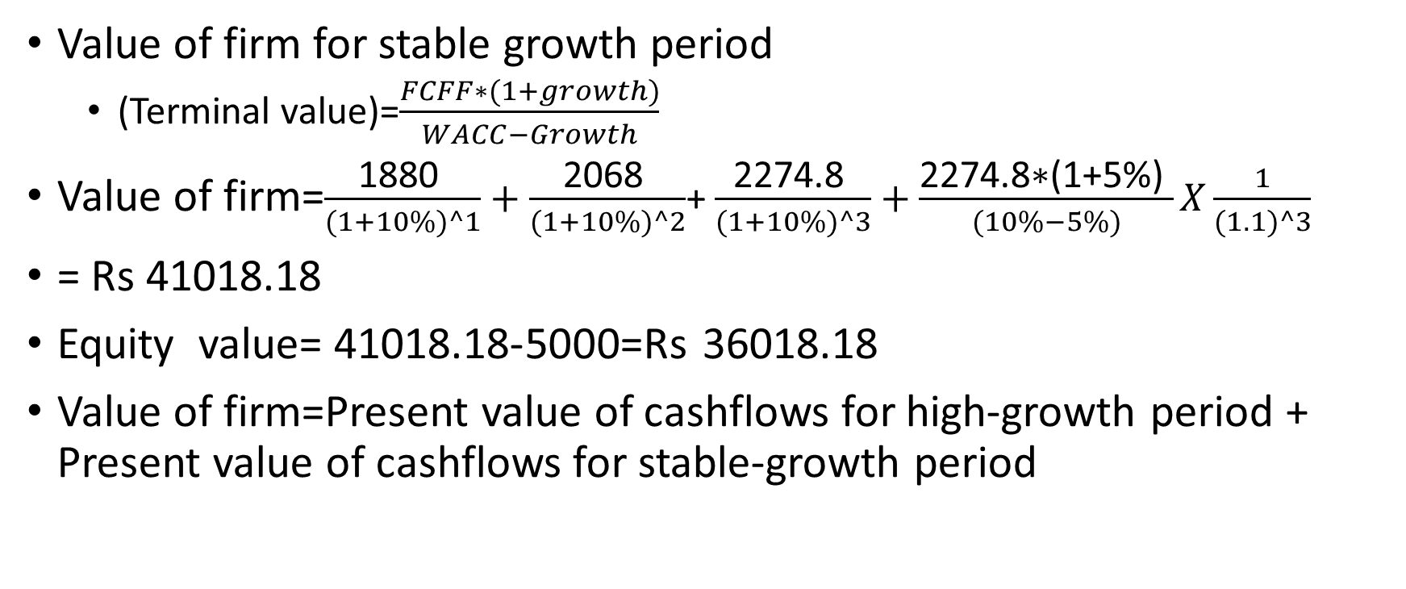
Story converting into numbers : Firm valuation
Value of firm for stable growth period
  (Terminal value)=$\frac{FCFF∗(1+growth)}{WACC−Growth}$
Value of firm=$\frac{\text{1880} }{(1+10\%)^1}+$ $\frac{\text{2068} }{(1+10\%)^2}$+ $\frac{\text{2274.8} }{(1+10\%)^3}+$ $\frac{\text{2274.8}\text{∗(1+5\%)} }{(10\%−5\%)}X\frac{1}{(1.1)^3}$
= Rs 41018.18
Equity value= 41018.18-5000=Rs 36018.18
Value of firm=Present value of cashflows for high-growth period + Present value of cashflows for stable-growth period

Slide 16
Principles of valuation
Companies create value by investing capital from investors to generate future cash flows at rate of return exceeding the cost of that capital. (Combination of growth and ROIC drives value).
Value is created for shareholders when companies generate higher cashflows, not by rearranging investors’ claims on those cash flows.
  When a firm substitutes debt for equity or issues debt to repurchase shares, it changes the ownership of claims to its cash flows. However, it doesn’t change the total available cashflows.
A company’s performance in the stock market is driven by changes in the stock market’s expectations, not just the company’s actual performance .
The value of a business depends on who is managing it and what strategy they pursue.

Slide 17
Road map
Step 1: Develop a story for the business you are valuing
In a story, you tell how you see the business evolving over time
Step 2: Test the narrative to see if it is possible, plausible, and probable.
There are lots of possible story, not all of them are plausible, and only a few of them are probable
Step 3:Convert the narrative into drivers of value.
Take the narrative apart and look at how you will translate it into valuation inputs, starting with potential market size and moving on to cash flows and risk. By the time you are done, each part of the narrative should have a place in your numbers, and each number should be backed
up with a portion of your story.
Step 4: Connect the drivers of value to a valuation.
Create an intrinsic valuation model that connects the inputs to an end-value in the business.
Step 5: Keep the feedback loop open.
Listen to people who know the business better than you do and use their suggestions to fine-tune your narrative and perhaps even alter it. Work out the effects on value of alternative narratives for the company.

Slide 18
Same ingredients, different approaches
Inputs | Dividend Discount Model | FCFE (Potential dividend) discount model | FCFF (firm) valuation model
Cash flow | Dividend | Potential dividends = FCFE = Cash flows after taxes, reinvestment needs and debt cash flows | FCFF = Cash flows before debt payments but after reinvestment needs and taxes.
Expected growth | In equity income and dividends | In equity income and FCFE | In operating income and FCFF
Discount rate | Cost of equity | Cost of equity | Cost of capital
Steady state | When dividends grow at constant rate forever | When FCFE grow at constant rate forever | When FCFF grow at constant rate forever

Slide 19
Cost of equity
Cost of equity=Risk-free rate+ Equity risk premium of matured market*Equity beta+ Country risk premium
TCS (cost of equity)=6.68% + 4.77%*0.54 + 1.47%=10.73%
HUL (cost of equity)=6.68% + 4.77%*0.40 + 1.47%=10.16%

Slide 20
Measuring Relative risk
Do you believe that the marginal investors who price risk is diversified?
Yes
No
Beta
Relative standard deviation
Std dev of Stock/Average Std dev across all stocks , rather than market risk
TCS (2017)=1.43/3.49=0.41

Slide 21
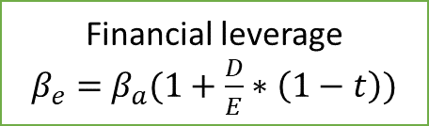
Determinates of beta
If total risk is born by only equity holders
Beta of equity (Levered Beta)
Beta of Business (Unlevered Beta
Financial leverage
$β_{e}=$ $β_{a}(1+\frac{D}{E}∗\left(1−t\right))$
Nature of product or service offered by firm:
High elasticity (discretionary) of demand of your product would have higher beta
Operating leverage (Fixed Costs as % of total costs)
Firms with high infrastructure needs and rigid costs structures should have higher betas than firms flexible cost structures
Smaller firms should have higher betas than larger firms.
Young firms should have higher betas than more mature firms
Cyclical firms should have higher beta than non-Cyclical firms .
Luxury Goods firms should have higher beta than basic goods
High priced goods/service firms should have higher betas than low prices goods/service.
Growth firms should have higher beta

Slide 22
Cost of debt (TCS)
Expected Rating =AAA
ICRA Rating =AAA
Default spread=0.27
Risk free rate=6.68%
Country risk premium=1.40%
Cost of debt (Pre-tax)=6.68% + 0.27% + 1.40%=8.35%

Slide 23
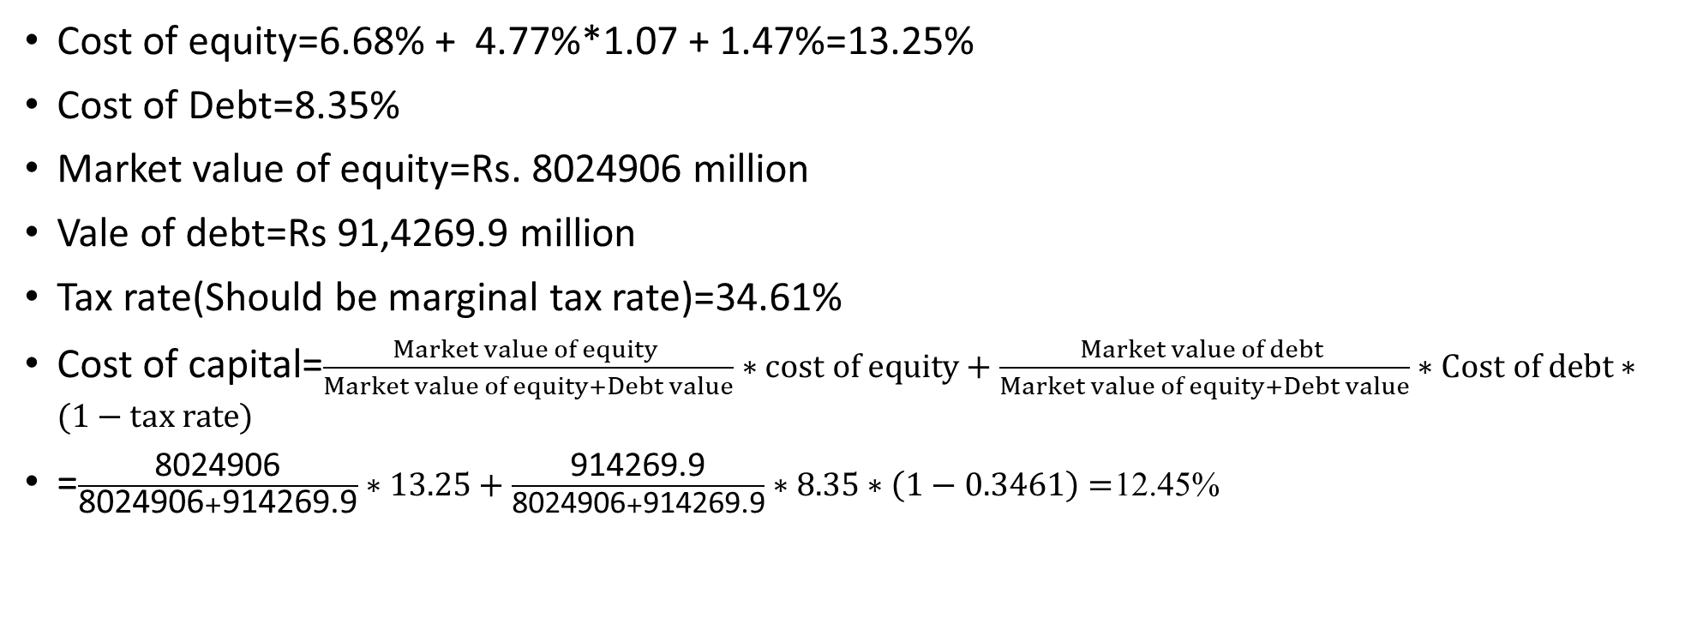
Cost of capital of RIL
Cost of equity=6.68% + 4.77%*1.07 + 1.47%=13.25%
Cost of Debt=8.35%
Market value of equity=Rs. 8024906 million
Vale of debt=Rs 91,4269.9 million
Tax rate(Should be marginal tax rate)=34.61%
Cost of capital=$\frac{Market value of equity }{Market value of equity+Debt value}∗cost of equity+\frac{Market value of debt }{Market value of equity+Debt value}∗Cost of debt∗(1−tax rate)$
=$\frac{\text{8024906}}{\text{8024906}+\text{914269.9}}∗13.25+\frac{\text{914269.9}}{\text{8024906}+\text{914269.9}}∗8.35∗\left(1−0.3461\right)=$12.45%

Slide 24
Estimating cashflow

Slide 25
Estimation of cash flow (basic)
Free Cash flow to Firm | Free Cash flow to Equity
Sales - COGS EBIT - Tax paid NOPAT -Reinvestments FCFF (Free cashflow to films) | Sales - COGS EBIT -Interest paid EBT -Tax PAT -Reinvestments (New debt-Old debt) FCFE
FFFE=FCFF-Interest*(1-tax)+(New debt-Old debt)

Slide 26
The basis ingredients for free cashflows
Estimate the current earnings of the firm
  If looking at cashflows to equity, look at earnings after interest expenses:- net income
  If looking at cashflow to firm, look at operating income after tax.
Consider how much the firm invested to create future growth
  If investment is not expensed, it will be categorized as capital expenditure. To the extent depreciation provides a cashflow, it will cover some of these expenditures.
  Increasing working capital needs are also investment for future growth.
If looking at cashflows to equity, consider the cashflows from net debt issues( debt issues-debt repaid).

Slide 27
Step1: From reported to actual earnings
Operating leases
Convert into debt
Adjust operating income
R&D Expenses
Convert into assets
Adjust operating income
Firm’s history
Comparable firms
Cleanse operating items of
Financial expenses
Capital expenses
Non-recurring expenses
Normalized earnings
Update numbers:
Trailing earnings
Unofficial numbers
Measuring earnings

Slide 28
Updating earnings
When valuing firm, we often depend on financial statements for inputs on earnings and assets. Annual reports are generally outdated. We can update the numbers:
  Trailing 12 months data, constructed from quarterly earnings reports
Updating makes sense for smaller and more volatile firms, as well as growth firms (such as LinkedIn)
TTM (for now)=Sales (in the last annual report) + Sales for first qtr(April to Jun 2019)- Sales for first qtr(April to Jun 2018)

Slide 29
Updating earnings (TTM)
(Financial data in millions, except per share amounts) | Dec 1998 | Nine Months Ended September 30, 1998 | Nine Months Ended September 30, 1999 | Last 12 months
REVENUE
U.S. domestic package | 20,650 | 15,129 | 16,239 | 21760
International package | 3,237 | 2,342 | 2,562 | 3457
Non-package | 901 | 653 | 805 | 1053
TOTAL REVENUES | 24,788 | 18,124 | 19,606 | 26270
Operating expenses: |  |  |  | 0
Compensation and benefits | 14,346 | 10,587 | 11,226 | 14985
Other | 7,352 | 5,315 | 5,522 | 7559
Restructuring charge | — | — | —
TOTAL OPERATING EXPENSES | 21,698 | 15,902 | 16,748 | 22544
OPERATING PROFIT (LOSS) |  |  |  | 0
U.S. domestic package | 2,899 | 2,098 | 2,522 | 3323
International package | 56 | 19 | 147 | 184
Non-package | 135 | 105 | 85 | 115
Corporate | — | — | 104
TOTAL OPERATING PROFIT | 3,090 | 2,222 | 2,858 | 3726

Slide 30
Capital expenditure, operating expenses, and financial expense
The distinction between operating and capital expenditures is critical for tax calculations.
  Since, we consume the benefits of operating expenditure in the year in which it is incurred, we can subtract it from pre-tax operating profit, thereby reducing tax-liability
  The benefits of capital expenditure spread over multiple years. Therefore, we subtract it from pre-operating income over multiple years as deprecation.
We don’t subtract financial expenses when we calculate operating income.

Slide 31
Correction earnings misclassification: Lease adjustment
Make sure that there are no financial expenses mixed in with operating expenses
  Financial expense: Any commitment that is tax deductible that you must meet no matter what is your operating result: Failure to meet its leads to loss of control of the business.
  Example: Operating leases: While accounting convention treats operating leases as operating expenses, they are actually financial expenses and need to be reclassified as such.
Make sure that there are no capital expenses mixed in with the operating expenses
  Capital expenses: Any expense that is expected to generate benefits over multiple periods.
  Big Bazar has opened new stores with the investment of Rs 10 crores, whereas flipkart has spent Rs. 10 crores in marketing and advertising.

Slide 32
Dealing with operating leases
Accounting standards view capital leases as the acquisition of a long-term property right and the incurrence of debt. Therefore, during the lease term, firms amortize the capitalized property right and divide the lease payment between interest expense and the repayment of debt.
For operating leases, firms don't recognize debt even though they are contractually obligated for lease payments and a failure to make a lease payment often triggers events of default, as if the obligation were debt.
In the eyes of lenders and rating agencies, incurring operating lease obligations reduces a firm's borrowing capacity.
In the absence of a lease financing option, the firm would likely borrow the money and buy the asset.

Slide 33
Dealing with operating lease expenses
Our analytic goal is to simulate a company’s financial statements assuming it had bought and depreciated the leased assets and financed the purchase with a like amount of debt.
Value of operating lease=Present value of operating lease commitment at the pre-tax cost of debt.

Slide 34
Dealing with operating lease expenses
Effect on Balance Sheet: The present value of lease payment would be shown as leased assets as an assets, and the same amount would be added into total debt of the firm.
Effect on Income Statement:
  Reported operating profit + lease payment – deprecation
  Reported operating profit + imputed interest amount on capitalized lease
Capitalizing operating lease should not have any effect on net profit. There can be timing effects on net income, with the net income in earlier years being lower and in later years being higher as a result of the recategorization.
Net Income= Reported net income + Operating Lease Expenses – (Imputed Interest Expense on Capitalized Lease + Depreciation on Capitalized Lease Asset).

Slide 35
Dealing with operating lease expenses
Effect on Free cash flow to firm: The net capital expenditures on operating leases is determined by the increase in the present value of the operating lease commitments over time: Net Cap Ext = (PVOL(t) – PVOL(t-1)). We will also not add back deprecation on leased assets, since it is actual cash outflows.
Effect on Free cash flow to equity: There is no effect on free cash flow to equity. This is because the increase in capital expenditures created by the change in the present value of operating lease expenses will be exactly offset by the increase in net debt created by this reclassification.

Slide 36
Bata ltd (2018)
The Company has entered into operating lease arrangements for fixed assets and premises. The future minimum lease rental obligation under non-cancellable operating leases payable not later than one year is Rs. 1,121.75 Crore, payable later than one year but not later than five-year Rs. 2,970.49 Crore and payable later than five years is RS. 1,359.72 Crore.

Slide 37
Bata ltd (2018)
Market Cap=Rs. 10627 Crore
Book debt=Rs. 1,077.59 Crore
Probability of default=0.05% (Rating AAA)
Pre-tax cost of debt=6.86 + 0.27 + 1.41=8.54%
PBDIT= Rs 573 Crore
Sales=Rs. 17,591.75 Crore
Total Assets=Rs. 6,937.53 Crore
ROA=573*(1-0.3461)/ 6,937.53 =5.4%
D/E= 1,077.59/ 10627=0.10

Slide 38
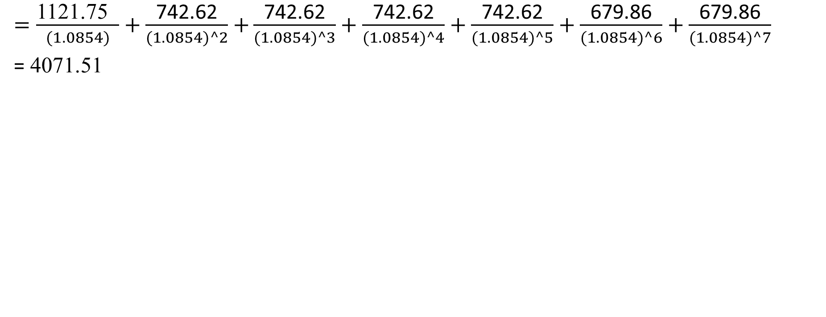
Bata ltd (2018): Value of operating leased assets
$=\frac{\text{1121.75 } }{(1.0854)}+\frac{\text{742.62}}{(1.0854)^2}$ $+\frac{\text{742.62}}{(1.0854)^3}+\frac{\text{742.62}}{(1.0854)^4}+\frac{\text{742.62}}{(1.0854)^5}+$ $\frac{\text{679.86}}{(1.0854)^6}+\frac{\text{679.86}}{(1.0854)^7}$
= 4071.51
Expected Per annum lease commitment
1-5 years | 742.62=(2,970.49/4)
Expected life for 6 and beyond | Around 2 years (=1,359.72/742.62)

Slide 39
EBIT to adjusted EBIT (Bata)
Approach 1:
  EBIT after lease rental= Rs 573 Crore
  Add Lease rental= 1,121.75
  Less Depreciation= (4071.51/7)=581.6
  Adjusted Profit= Rs. 1113.15
Approach 2:
EBIT after lease rental= | 573
Add Imputed interest on leased assets (4071.51*8.54%) | 348
Adjusted profit= | 921

Slide 40
Balance-sheet (without adjustment) | Balance-sheet (with adjustment)
Total assets= 6,937.53 | Total assets= 6,937.53 (total Assets) Leased assets(4071)=Rs. 11008.53
Total debt= 1,077.59 | Total debt= 1,077.59 + 4071=Rs 5148.59
Book Equity=2,554 | Book Equity=2554
Capital Employed=3631.59 | Capital Employed(5148.59+2554)=7702.59
Default rate=0.05% (Rating AAA) | Default rate=Rs. 2.16% (Rating=A or less than A)
Pre-tax Cost of debt=8.54% | Pre-tax cost of debt=6.68% + 2.16% + 1.40%=10.24%
D/E (MV)= 1,077.59/ 10627=0.10 | D/E (MV)= 5148/10627=0.49
ROIC=573*(1-0.3461)/ 3631.59 =10.3% | ROIC= 1113.15*(1-0.3461)/7702.59=9.4%
MV of equity=10627

Slide 41
Bata ltd (2018)
If we use regression beta of Bata, do we need to update our beta for changed leverage ratio because of capitalization of operating lease?
What if we use bottom up beta?
  Beta=1.05
  Cost of equity=6.68% + 1.05*4.77% + 1.41%=13.09%
  Cost of capital (without adjustment)=13.09%*(10627/ 11704.59 ) + 8.54%*(1-0.3461)*(1,077.59/ 11704.59)=12.4%
  Cost of capital (with adjustment)=13.09%*(10627/ 15877.01 ) + 10.25%*(1-0.3461)*(5250.01/ 15877.01)=10.98%

Slide 42
What is this?
On March 7, 2017, OPPO Mobiles India Pvt Ltd., has won the sponsorship rights for Team India(Cricket) through a tender process. The Team India sponsorship rights are for a period of five years and have been acquired at Rs. 1079.29 crore.

Slide 43
Net capital expenditures
Net capital expenditures=Capital expenditure-Depreciation
  Depreciation is a cash inflow that pays for some or a lot the capital expenditure.
In general, the net capex is a function of how fast a firm is growing or expecting to grow. High growth firms require more capex than low growth firm.
Assumption about net capital expenditures can thus never be made independently of assumption about growth in the future.
I prefer to use Net capex /sales ratio to estimate future capital expenditure.

Slide 44
Total Capex of TCS
 | 2010 | 2011 | 2012 | 2013 | 2014 | 2015 | 2016 | 2017 | 2018
Revenue | 300,289.2 | 373,245.1 | 488,938.3 | 629,894.8 | 818,093.6 | 946,484.1 | 1,086,460.0 | 1,179,660.0 | 1,231,040.0
Operating Income (Loss) | 80,550.9 | 104,438.1 | 135,385.5 | 171,214.0 | 238,034.3 | 254,217.3 | 287,890.0 | 303,210.0 | 305,020.0
EBIT*(1-t) | 52,672.2 | 68,292.1 | 88,528.6 | 111,956.8 | 155,650.6 | 166,232.7 | 188,251.3 | 198,269.0 | 199,452.6
Acq of Fixed Prod Assets | -10,447.9 | -18,266.1 | -20,070.7 | -26,378.4 | -30,745.7 | -28,861.7 | -19,870.0 | -19,890.0 | -18,620.0
Acq of Intangible Assets | 0.0 | 0.0 | 0.0 | 0.0 | -75.2 | -19.7 | -30.0 | -10.0 | 0.0
Cash for Acq of Subs | -128.7 | 0.0 | 0.0 | -1,626.2 | -4,524.1 | -2,636.5 | 0.0 | 0.0 | 0.0
M&A(Stock payment) |  |  |  |  | -508.94
Total capex | -10,576.6 | -18,266.1 | -20,070.7 | -28,004.6 | -35,853.9 | -31,517.9 | -19,900.0 | -19,900.0 | -18,620.0
Depreciation & Amortization | 6,608.9 | 7,352.6 | 9,179.4 | 10,799.2 | 13,242.3 | 18,698.8 | 18,880.0 | 19,870.0 | 20,140.0
Net Capex | -3,967.7 | -10,913.5 | -10,891.3 | -17,205.4 | -22,611.6 | -12,819.1 | -1,020.0 | -30.0 | 1,520.0
Net Capex/Revenue | 1.32% | 2.92% | 2.23% | 2.73% | -2.76% | -1.35% | -0.09% | 0.00% | 0.12%
Capex/EBIT*(1-t) | 7.53% | 15.98% | 12.30% | 15.37% | 14.53% | 7.71% | 0.54% | 0.02% | -0.76%
Avg Capex/Revenue | 1.48%
Avg Capex/EBIT*(1-t) | 8.14%

Slide 45
Global trade of capex (computer services)
Emerging markets firms:
  Capex/Sales=1.23%
  Net Cap Ex/ EBIT (1-t) =20.59%
Global
  Capex/Sales=1.93%
  Net Cap Ex/ EBIT (1-t)= 32.26%

Slide 46
Working capital investments
In accounting terms, working capital=current assets-current liabilities
A clearer definition of working capital from a cash flow perspective is the difference between non-cash current assets (inventory and accounting receivable) and non-debt current liabilities (account payable).
While some analysts consider operating cash into working capital, it should not be included as long as it earns fair returns.
For firms in some sectors, it is the investment in working capital that is the bigger part of reinvestment, such as retail store.
If your business is currency business, you may include (normal) cash in your working capital (retail businesses, Pan shop).

Slide 47
Working capital: General proposition
Working capital details: While some analysts break down working capital into details (inventory, deferred taxes, payable, etc.), it is pointless exercise unless you feel that you can bring some specific information that improves your forecast.
Working capital volatility: Changes in non-cash working capital from year to year tend to be volatile. Hence, building of the change in the most recent year is dangerous. It is a good idea to measure working capital as a percent of sales, while looking at industry average.
Negative working capital: Some firms have negative non-cash working capital. These firms use suppliers’ credit to finance their growth. However, some business model, e-commerce, allows a firm to run business even with negative working capital.

Slide 48
Classification of non-cash working capital (TCS)
Total Current Assets | Yes/No | Total Current Liabilities |  | Yes/No
Cash, Cash Equivalents & STI | No | Accounts Payable |  | Yes
Cash & Cash Equivalents | No | Accrued Taxes |  | No
ST Investments | No | Interest & Dividends Payable |  | No
Accounts & Notes Receiv | Yes | Other Payables & Accruals |  | Yes
Unbilled Revenues | Yes | ST Debt |  | No
Inventories | Yes | ST Borrowings |  | No
Other ST Assets |  | ST Capital Leases |  | No
Derivative & Hedging Assets | No | Other ST Liabilities
Taxes Receivable | No | Deferred Revenue |  | No
Misc ST Assets | No | Derivatives & Hedging |  | No
 |  | Deferred Tax Liabilities |  | No
 |  | Misc ST Liabilities |  | No

Slide 49
Noncash working capital: TCS
 | 2010 | 2011 | 2012 | 2013 | 2014 | 2015 | 2016 | 2017 | 2018
Current assets
Accounts & Notes Receiv | 58,554.1 | 81,949.7 | 115,203.5 | 140,955.8 | 182,304.0 | 204,399.1 | 240,730.0 | 226,170.0 | 249,430.0
Unbilled Revenues | 12,011.4 | 13,488.5 | 22,477.6 | 31,410.3 | 40,056.1 | 38,270.8 | 39,920.0 | 52,080.0 | 66,860.0
Inventories | 177.9 | 228.2 | 177.7 | 211.5 | 0.0 | 0.0 | 160.0 | 0.0 | 260.0
Current assets | 70,743.4 | 95,666.4 | 137,858.8 | 172,577.6 | 222,360.1 | 242,669.9 | 280,810.0 | 278,250.0 | 316,550.0
Current Liabilities
Accounts Payable | 29,777.3 | 25,723.3 | 32,507.8 | 42,697.1 | 0.0 | 0.0 | 0.0 | 49,050.0 | 50,940.0
Net working capital | 40,966.1 | 69,943.1 | 105,351.0 | 129,880.5 | 222,360.1 | 242,669.9 | 280,810.0 | 229,200.0 | 265,610.0
Revenue | 300,289.2 | 373,245.1 | 488,938.3 | 629,894.8 | 818,093.6 | 946,484.1 | 1,086,460 | 1,179,660 | 1,231,040
NWC/Revenue | 14% | 19% | 22% | 21% | 27% | 26% | 26% | 19% | 22%
Avg NWC | 21.58%

Slide 50
Global trend of NWC (computer services)
Emerging markets firms:
  Non-cash NWC/Sales=20.29%
Global
  Non-cash NWC/Sales==14.32%

Slide 51
Noncash working capital: Flipkart
Flipkart-working capital with cash
 | Mar 2018 | Mar 2017 | Mar 2016 | Mar 2015 | Mar 2014 | Mar 2013 | Mar 2012
Sundry Debtors | 1,235.59 | 892.81 | 224.64 | 358.71 | 109.19 | 47.39 | 15.51
Cash and Bank | 70.26 | 773.77 | 1,264.03 | 2,219.75 | 427.25 | 166.21 | 235.98
Current Assets | 1,235.59 | 1,666.58 | 1,488.67 | 2,578.46 | 536.44 | 213.60 | 251.49
Sundry Creditors | 2,870.57 | 2,287.66 | 1,472.49 | 1,607.59 | 590.17 | 102.95 | 35.8
Net working capital | -1,634.98 | -621.08 | 16.18 | 970.87 | -53.73 | 110.65 | 215.69
Net Sales | 21438.65 | 15264.42 | 12818.01 | 9032.18 | 2804.95 | 1180.07 | 204.82
WC % of net sales | -7.63% | -4.07% | 0.13% | 10.75% | -1.92% | 9.38% | 105.31%
Average | 15.99%
Flipkart-working capital without cash
 | Mar 2018 | Mar 2017 | Mar 2016 | Mar 2015 | Mar 2014 | Mar 2013 | Mar 2012
Sundry Debtors | 1,235.59 | 892.81 | 224.64 | 358.71 | 109.19 | 47.39 | 15.51
Current Assets | 1,235.59 | 892.81 | 224.64 | 358.71 | 109.19 | 47.39 | 15.51
Sundry Creditors | 2,870.57 | 2,287.66 | 1,472.49 | 1,607.59 | 590.17 | 102.95 | 35.8
Net working capital | -1,634.98 | -1,394.85 | -1,247.85 | -1,248.88 | -480.98 | -55.56 | -20.29
Net Sales | 21438.65 | 15264.42 | 12818.01 | 9032.18 | 2804.95 | 1180.07 | 204.82W
WC % of net sales | -7.63% | -9.14% | -9.74% | -13.83% | -17.15% | -4.71% | -9.91%
Average | -10.30%

Slide 52
Global trend
Retail (Online)
  Emerging market: -5.37%
  Global: -0.30%
  US: -1.18%
Retail (General)
  Emerging market: -1.51%
  Global: -0.45%
  US: 2.07%

Slide 53
The value of growth
When valuing a firm, most of analysts get caught up in view that higher growth means higher valuation.
Good, however, is a double-edged sword.
  The good side of the growth is that increases future revenues and therefore future cash flows.
  The bad side of the growth is that you have reinvest current cash flows for future earnings.
  The net effect of growth is whether the good outweighs the bad.

Slide 54
Ways of estimating Growth in Earnings
Look at the past
  The growth in revenues and operating profits can be a first point for expected growth estimation.
  When earnings are negative, then its past growth rate does not make sense.
  It is easy for a smaller firm to grow at greater rate compared to a larger firm.
Look at what other estimates: Analysts, and Managers
Look at fundamentals
  You have to buy the growth

Slide 55
Historical growth rates
Historical growth rates can be estimated in several different ways:
  Arithmetic versus Geometric averages
  Simple versus Regression models.
Historical growth rates can be sensitive to
  The period used in the estimation (starting and ending periods)
  The metric that the growth is estimated in
Historical growth rates can be estimated for firms with negative earnings.

Slide 56
TCS: Arithmetic versus Geometric growth rate
Year | PBDITA | % Change | PBT | %Change | Sales | %Change
2010 | 92546 |  | 86059.3 |  | 299311.2
2011 | 145801.8 | 58% | 134013.2 | 56% | 412823.7 | 38%
2012 | 165504.2 | 14% | 156640.6 | 17% | 506573.5 | 23%
2013 | 250097.1 | 51% | 230768.5 | 47% | 685404 | 35%
2014 | 256068.2 | 2% | 239812.3 | 4% | 780829.5 | 14%
2015 | 308980 | 21% | 293070 | 22% | 896210 | 15%
2016 | 318830 | 3% | 301850 | 3% | 973800 | 9%
2017 | 341310 | 7% | 320190 | 6% | 1035870 | 6%
2018 | 419660 | 23% | 394340 | 23% | 1312550 | 27%
Arithmetic average |  | 22% |  | 22% |  | 21%
Geometric average |  | 13% |  | 14% |  | 18%
Std dev |  | 21% |  | 20% |  | 12%

Slide 57
Sun pharma: Arithmetic verses Geomatics Growth
Year | Revenue | Growth Rate | Operating Income | Growth Rate | EPS | Growth Rate
2002 | 7392 |  | 1717 |  | 0.89
2003 | 9722 | 27.40% | 2570 | 40.37% | 1.33 | 39.92%
2004 | 11088 | 13.15% | 3743 | 37.58% | 1.88 | 35.06%
2005 | 11853 | 6.67% | 3840 | 2.56% | 2.14 | 12.52%
2006 | 16368 | 32.28% | 4300 | 11.32% | 3.09 | 36.96%
2007 | 21321 | 26.43% | 6483 | 41.06% | 4.17 | 30.06%
2008 | 33565 | 45.38% | 16374 | 92.65% | 7.47 | 58.16%
2009 | 42723 | 24.12% | 18322 | 11.24% | 8.78 | 16.17%
2010 | 38086 | -11.49% | 12198 | -40.68% | 6.52 | -29.67%
2011 | 57216 | 40.70% | 17632 | 36.84% | 8.77 | 29.58%
2012 | 80054 | 33.59% | 29898 | 52.81% | 12.83 | 38.04%
2013 | 112389 | 33.93% | 46393 | 43.93% | 14.40 | 11.57%
2014 | 160044 | 35.35% | 67841 | 38.00% | 15.17 | 5.19%
2015 | 272451 | 53.20% | 69124 | 1.87% | 18.90 | 22.00%
2016 | 275097 | 0.97% | 72042 | 4.13% | 18.90 | 0.00%
2017 | 299939 | 8.65% | 88583 | 20.67% | 29.00 | 42.81%
2018 | 260659 | -14.04% | 41083 | -76.83% | 9.00 | -117.01%
2019 | 297520 | 13.23% | 56395 | 31.68% | 17.93 | 68.95%
2020 | 335891 | 12.13% | 73075 | 25.91% | 23.56 | 27.30%
Arithmetic |  | 21.20% |  | 20.84% |  | 18.20%
Geomantic |  | 23.62% |  | 23.17% |  | 19.96%
Std dev |  | 18.79% |  | 36.75% |  | 40.44%

Slide 58
The effects of size on growth: Flipkart
Year | Net Sales | % Change
2012 | 204.82
2013 | 1180.07 | 476%
2014 | 2804.95 | 138%
2015 | 9032.18 | 222%
2016 | 12818.01 | 42%
2017 | 15264.42 | 19%
2018 | 21438.65 | 40%
Geometric average growth rate |  | 88%

Slide 59
Problem with historical growth rate: Flipkart
Year | Sales (in corers)
2019 | 40304.66
2020 | 75772.76
2021 | 142452.8
2022 | 267811.3
2023 | 503485.2
The sale of flipkart for 2023 is expected to be about 5% of Indian GDP

Slide 60
Fundamental growth
Growth has to be earned by a firm. You and I do not have the power to endow a firm growth.
In terms of basic fundamentals for a firm to grow its earnings, it has to
  Add to its asset or capital base and generate on that added capital.
    A firm reports after-tax operating income Rs 75 million on invested capital of Rs 1 billion. It plans to reinvest 50 million in new asset but will maintain existing assets and its current return on capital. What should be the growth rate?
  Manage its existing assets more efficiently generate higher margins and higher returns on existing assets.
      Firm thinks that it can improve its return on capital on existing assets from 7.5% to 10% next year by making them more efficient. What growth rate will you see in operating income next year?

Slide 61
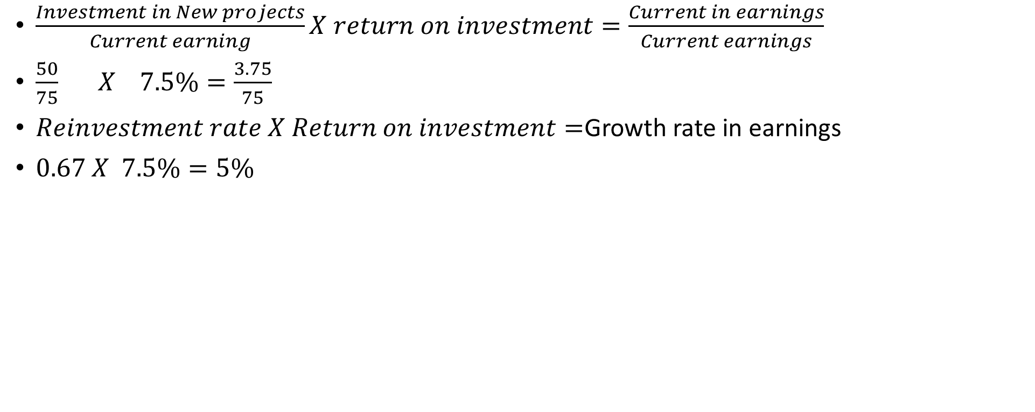
Growth Rate Derivations
$\frac{Investment in New projects}{Current earning}X return on investment=\frac{Current in earnings}{Current earnings}$
$\frac{50}{75} X 7.5\%=\frac{3.75}{75}$
$Reinvestment rate X Return on investment=$Growth rate in earnings
$0.67 X 7.5\%=5\%$

Slide 62
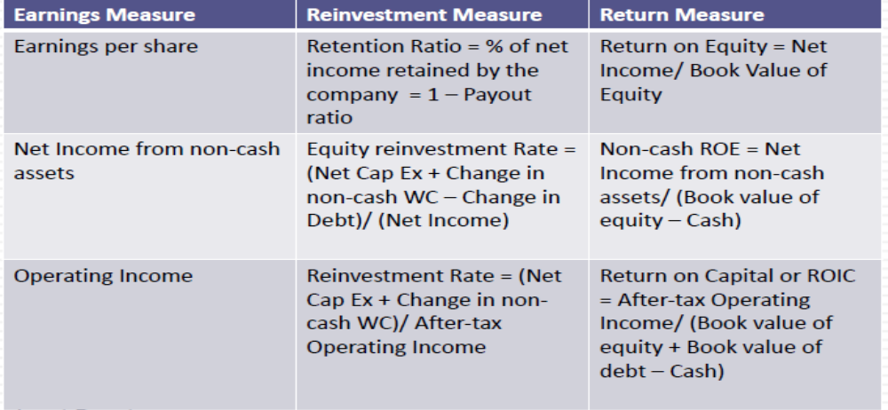
Estimating Fundamental Growth from new investments: Three variations

Slide 63
Estimating growth in Net income: Sun Pharma (2019)
Adjusted book value of Sun Pharma= Rs. 27855.39
Cash balance= 155.27
Non-cash book value of equity= 27855.39- 155.27= 27700.12
Non-cash net income= 9995.92 (does not have cash income)
ROE= 9995.92/ 27700.12=36.09%
Equity investment=(3763.8- 16.78)/ 9995.92=37.5%
  Net investment= 3763.8
  Net debt=16.78
Growth rate=37.5%*36.09%=13.53%

Slide 64
The value of growth
 | Firm 1 | Firm 2 | Firm 3
Reinvestment rate | 20% | 100% | 200%
ROIC | 50% | 10% | 5%
Expected growth rate | 10.0% | 10.0% | 10.0%
Assume that your cost of capital is 10%. As an investor, rank these firms in the order of
most value of growth to least value growth.

Slide 65
Stable growth rate
The stable growth rate cannot exceed the growth rate of the economy, but it can be set lower.
One simple proxy for the nominal growth rate of the economy is the risk-free rate
Risk-free rate=expected real interest rate + expected inflation.
Nominal GDP growth=Expected inflation + expected real growth.
Risk-free rate=nominal GDP growth rate
  In the long term, the real growth rate cannot lower the real interest rate, since growth in goods/service has to be enough to cover the promised rate.
  In long term, the real growth rate can be higher than the real interest rate, to compensate risk talking. However, as the economics mature, it reduces.

Slide 66
Don’t wait too long…
Assume that you are valuing a young, high growth firm with great potential, just after its IPO. How long would you set your high-growth period.
  < 5 years
  5 years
  10 years
  >10 years

Slide 67
High growth period
Recapping a key lesson about growth, it is not growth per se that create value but growth with excess returns.
For growth firms to continue to generate value creating growth should have sustainable competitive advantage, more competitive advantages longer high growth period (LinkedIn, Facebook, Flipkart).

Slide 68
Growth myth
 |  | ROIC
 |  | 6% | 8% | 10% | 12% | 14%
Growth rate | 0% | 1000 | 1000 | 1000 | 1000 | 1000
 | 0.50% | 965 | 987 | 1000 | 1009 | 1015
 | 1% | 926 | 972 | 1000 | 1019 | 1032
 | 1.50% | 882 | 956 | 1000 | 1029 | 1050
 | 2% | 833 | 938 | 1000 | 1042 | 1071
 | 2.50% | 778 | 917 | 1000 | 1056 | 1095
 | 3% | 714 | 893 | 1000 | 1071 | 1122
NOPAT (t+1)=Rs 100: cost of capital=10%

Slide 69
Valuation of TCS

Slide 70
TCS (NOPAT and Net investment)
 | 2010 | 2011 | 2012 | 2013 | 2014 | 2015 | 2016 | 2017 | 2018
Operating Income | 80551 | 104442 | 135386 | 171214 | 238036 | 226844 | 287890 | 303240 | 305020
Less tax (34.6%) | 27879 | 36147 | 46857 | 59257 | 82384 | 78511 | 99639 | 104951 | 105567
NOPAT | 52672 | 68294 | 88529 | 111957 | 155652 | 148333 | 188251 | 198289 | 199453
Net working capital | 40966 | 69943 | 105351 | 129881 | 222360 | 242670 | 280810 | 229200 | 265610
Change in NWC |  | -28977 | -35408 | -24530 | -92480 | -20310 | -38140 | 51610 | -36410
Capex | -3968 | -10914 | -10891 | -17205 | -22612 | -12819 | -1020 | -30 | 1520
Net Investment |  | -39891 | -46299 | -41735 | -115091 | -33129 | -39160 | 51580 | -34890

Slide 71
TCS (ROIC and Net Investment rate)
 | 2010 | 2011 | 2012 | 2013 | 2014 | 2015 | 2016 | 2017 | 2018
Fixed Assets | 42708 | 54045 | 62671 | 78871 | 102033 | 121425 | 116410 | 115980 | 114940
Total Intangible Assets | 34846 | 35438 | 38413 | 38363 | 25095 | 22621 | 18030 | 16440 | 17570
Total Assets | 77554 | 89483 | 101084 | 117234 | 127128 | 144045 | 134440 | 132420 | 132510
(CA-CL) | 40966 | 69943 | 105351 | 129881 | 222360 | 242670 | 280810 | 229200 | 265610
Invested Capital (TA+CA-CL) | 118520 | 159426 | 206435 | 247114 | 349488 | 386715 | 415250 | 361620 | 398120
NOPAT | 52672 | 68294 | 88529 | 111957 | 155652 | 148333 | 188251 | 198289 | 199453
ROIC | 44.44% | 42.84% | 42.88% | 45.31% | 44.54% | 38.36% | 45.33% | 54.83% | 50.10%
Net Investment |  | -39890.5 | -46299.2 | -41734.9 | -115091.2 | -33128.9 | -39160.1 | 51580 | -34890
Net Investment/NOPAT |  | 58.41% | 52.30% | 37.28% | 73.94% | 22.33% | 20.80% | -26.01% | 17.49%
Growth rate |  | 25.0% | 22.4% | 16.9% | 32.9% | 8.6% | 9.4% | -14.3% | 8.8%

Slide 72
TCS (ROIC and Net Investment rate)
Average ROIC | 45.40%
Average Reinvestment rate | 32.07%
Growth rate | 14.56%

Slide 73
TCS (FCFF for high growth period)
 | 2019 | 2020 | 2021 | 2022 | 2023
Operating Income (Loss) | 349431 | 400308 | 458593 | 525364 | 601857
Less tax | 120938 | 138547 | 158719 | 181828 | 208303
NOPAT | 228493 | 261761 | 299874 | 343536 | 393554
Less Net Investment | 73273 | 83942 | 96163 | 110165 | 126205
FCFF | 155220 | 177820 | 203711 | 233371 | 267350

Slide 74
TCS (Terminal Value)
Cost of capital =6.68% + 4.77%*0.54153 + 1.48%=10.74%
Stable growth growth=6.68%
FCFF(terminal value)=(267350*1.0668)=285208
Expected ROIC=25%
Terminal Value= 285208*(1-(0.0668/25%))/(10.74%-6.68%)=7103365
PV of Terminal value=7103365 /1.1074^5=4265221
PV high growth forecasted period cash flows=$750,878
Value of operation= ($750,8784265221)=$5,016,098

Slide 75
Other loosed value
Value of cash=425810*1.22=519488.2
Investments & receivables=360920 940=361860
Value of Minority/Non-Controlling Interest=6.09*4020=24481.8

Slide 76
Minority/Non-Controlling Interest (Comparable firms’ Pb ratio)
 | PB ratio
Oracle Fin Serv | 8.86
Infosys | 4.76
Persistent | 3.3
NIIT Tech | 5.31
L&T Infotech | 7.95
MphasiS | 5.72
Tech Mahindra | 3.24
TCS | 10.06
HCL Tech | 4.89
Cyient | 3.68
Mindtree | 5.47
Tata Elxsi | 11.77
Wipro | 3.21
Intellect Desig | 4.14
Hexaware Tech | 9.07
Average | 6.09
Value of minority Interest=6.09*4020=24481.8

Slide 77
TCS (Firm value)
Value of Operation | Rs.5,016,098
Add Cash &Short-term Inv (1.22) | Rs.519488.2
Add Other ST Assets | Rs.69880
Add LT Investments & Receivables | Rs.361860
Add Other LT Assets | Rs.131830
Firm value | Rs. 6,099,157

Slide 78
Firm value to per share
Firm Value | Rs. 6,099,157
Less
ST Debt | Rs.1930
Other ST Liabilities | Rs.68260
LT Debt | Rs.540
Other LT Liabilities | Rs.28840
Total debt liabilities | 99570
Total Equity value | Rs.5,999,587
Less Minority/Non-Controlling Interest | Rs. 24481.8
Value of Pure equity | Rs.5,975,105
Basic Weighted Avg Shares | Rs.3828.6
Value per share | Rs.1,560.66

Slide 79
Sensitivity analysis
 | Terminal Growth
$1,560.66 | 5% | 6% | 7% | 8% | 9% | 10%
20% | 1253 | 1358 | 1519 | 1798 | 2398 | 4617
21% | 1266 | 1377 | 1547 | 1841 | 2474 | 4816
22% | 1278 | 1394 | 1572 | 1880 | 2543 | 4996
23% | 1288 | 1409 | 1595 | 1916 | 2606 | 5161
24% | 1298 | 1423 | 1616 | 1948 | 2664 | 5312
25% | 1307 | 1436 | 1635 | 1978 | 2717 | 5451
26% | 1315 | 1448 | 1653 | 2006 | 2766 | 5579
27% | 1323 | 1459 | 1669 | 2032 | 2811 | 5698
28% | 1330 | 1470 | 1684 | 2056 | 2854 | 5809
29% | 1337 | 1479 | 1699 | 2078 | 2893 | 5911
30% | 1343 | 1488 | 1712 | 2099 | 2930 | 6007
ROIC

Slide 80
Closing DCF: Value=Story
Let’s assume that you are looking at the valuation of a firm, where the analyst has estimated a CAGR of 50% for the next ten years, an operating margin of 20% in year 10 (twice the industry average), a low reinvestments (given growth), and cost of capital of 10% in year 10 (below the market average). On each of the following dimension, what is your implicit story:
  Company size: Small or Large
  Total market: Stable or Growing
  Competitive advantages: Strong or Weak
  Capital Intensity of business: Low or high
  Nature of product/Service: Discretionary or Non-discretionary.

Slide 81
Story changes?
Every valuation has an implicit story in it. What might cause this story to change?
  Earning reports from the firm.
  Macroeconomic changes (interest rates, inflation etc.)
  Regulatory changes
  Earnings reports from other firms
  All of above
  None of the above. A good story should be timeless.

Slide 82
Life Cycle, stores, and numbers
Valuation is a combination of a story with numbers. As companies move through the life cycle from young start-up to declining firms, which of the following statements would you agree with about the mix of stories and numbers?
  The mix should not change as companies age.
  The number are more important for young firms and stories for older firms.
  The stories are more important for young firms and numbers for older firms.

Slide 83
Pricing (relative valuation) of assets

Slide 84
Why relative valuation?
I purchased a land near to IIM Raipur, paid Rs. 10,000,00 for 1000 sqrt ft land. Now, you want to buy 2000 sqrt ft land, how much would you pay?
It is easy to convey. It is easy to sell pricing than valuation.
If you are wrong with relative valuation, there are others to be wrong along with you but, in DCF, you are alone.
Most of times, portfolio managers’ performance is evaluated based on relative basis.

Slide 85
Information requirements
Mostly analysts claim that they do not prefer to use DCF valuation because it requires too many assumptions (about cashflows, growth, risk). They argue that it is far simpler to use a multiple (EV/EBITDA, PE ratio, etc.), obtained by looking at other firms in the sector, to estimate value. Are they right?

Slide 86
The essence of relative valuation
In DCF, the objective is to find the value of assets, given their cash flows, growth, and risk characteristics.
In relative valuation, the objective is to price assets based on how similar assets are currently priced in the market. Therefore, the relative valuation is much more likely to reflect the current mood of the market.
To do relative valuation then,
  Convert market values into standardized value, since the absolutes prices cannot be compared. This process of standardizing creates price multiples.
  Compare the standardized value or multiple for assets being analyzed to the standardized value for comparable asset, controlling for any differences between firms that might affect the multiple, to judge whether the asset in under or over valued.

Slide 87
Basic steps to using multiples
Market value of equity
Market value of Firm=Debt + equity
Market value of operating assets (EV)=Debt + Equity-Cash
$$Multiple=\frac{Numerator=What you are paying for the assets (Should be marekt based)}{Denominator=What you are getting in return}$$
Revenues
Accounting revenues
Drivers
  Customers
  Subscribers
  units
Earnings
To equity investors
  PAT
  EPS
To firm
  Operating income (EBIT)
Book value
BV of Equity
Firm
  BV of equity + BV of debt

Slide 88
Controlling variables
You are pricing a software firm, having PE ratio 12. However, the average PE ratio of software is 20. Based on this comparison, you would conclude that
  The stock is cheap
  The stock is expensive
  The stock is fairly priced.

Slide 89
The four Steps of Multiples
Define the multiple: in use, the same multiple can be defined in difference ways by different uses, hence, be consistent
Describe the multiple: Cross-sectional variation (descriptive analysis)
Analyze the multiple: it is critical that we understand the fundamentals that drive each multiple, and the nature of the relationship between the multiple and each variable.
Apply the multiple: Defining the comparable universe and controlling for differences is far more difficult in practice than it is in theory.

