Slide 1
Understanding Conflict
PG Certificate Program in General Management with Data Science & Analytics (PGCPGMDSA)
02/02/2025
Faculty: Prof. Anupama Sharma
anupama@iimv.ac.in
Indian Institute of Management (IIM) Visakhapatnam

Slide 2
Conflict Defined
A process that begins when one party perceives that another party has negatively affected, or is about to negatively affect, something that the first party cares about
  That point in an ongoing activity when an interaction “crosses over” to become an interparty conflict
Encompasses a wide range of conflicts that people experience in organizations
  Incompatibility of goals
  Differences over interpretations of facts
  Disagreements based on behavioral expectations
Notes:
Conflict primarily deals with perception. If nobody thinks there is conflict, then no conflict exists. Conflict can be experienced in an organization through many different avenues. It can be that the goals of the individuals are incompatible or there is a difference in opinion over the interpretation of facts. Many conflicts also arise through disagreements about how people should behave.

Slide 3

Transitions in Conflict Thought
Traditional View of Conflict
  The belief that all conflict is harmful and must be avoided
  Prevalent view in the 1930s-1940s
Conflict resulted from:
  Poor communication
  Lack of openness
  Failure to respond to employee needs
Notes:
The traditional view of conflict believes that conflict is bad and it should be avoided as much as possible. This view was more prevalent in the 1930’s and 40’s than it is today. This view held that conflict was the result of poor communication, lack of openness, or failure to respond to employee needs. All these things are negative and can be fixed so management thought that conflict could be fixed and should be fixed.

Slide 4

Continued.. Transitions in Conflict Thought
Human Relations View of Conflict
  The belief that conflict is a natural and inevitable outcome in any group
  Prevalent from the late 1940s through mid-1970s
Interactionist View of Conflict
  The belief that conflict is not only a positive force in a group but that it is absolutely necessary for a group to perform effectively
  Current view
Notes:
The views of conflict have shifted over the years and have developed into more acceptance of conflict as a natural and inevitable outcome of group dynamics. This idea was prevalent in the late 40’s – 70’s and was called the Human Relations view of conflict.
The current view on conflict is that it is not only a positive force in a group but it is actually necessary for a group to perform effectively. This is called the interactionist view of conflict and is widely accepted today.

Slide 5
Forms of Interactionist Conflict
Functional Conflict
Dysfunctional Conflict
Conflict that supports the goals of the group and improves its performance
Conflict that hinders group performance
Notes:
The interactionist view of conflict does recognize that even though functional conflict can support the group goals and improve their performance there is also dysfunctional conflict that hinders group performance. This type of conflict should be avoided, controlled, or minimized as much as possible.

Slide 6
Types of Interactionist Conflict
Task Conflict
  Conflicts over content and goals of the work
  Low-to-moderate levels of this type are FUNCTIONAL
Relationship Conflict
  Conflict based on interpersonal relationships
  Almost always DYSFUNCTIONAL
Process Conflict
  Conflict over how work gets done
  Low levels of this type are FUNCTIONAL
Notes:
There are many types of interactionist conflict including task, relationship, and process. Task conflict arises when there is conflict over the content and/or goals of the work. If this type of conflict exists at low to moderate levels, then this is a functional conflict that can help individuals seek clarification or new ideas on how to accomplish their goals.
Relationship conflict is based on problems between individuals and is almost always dysfunctional.
Process conflict occurs when there is disagreement on how the work gets done. Low levels of process conflict represent functional conflict.

Slide 7
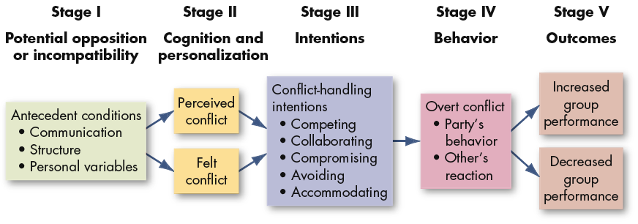
The Conflict Process
We will focus on each step in a moment…
E X H I B I T 14-1
Notes:
The conflict process is outlined above. In the following slides we will look at each step individually.

Slide 8
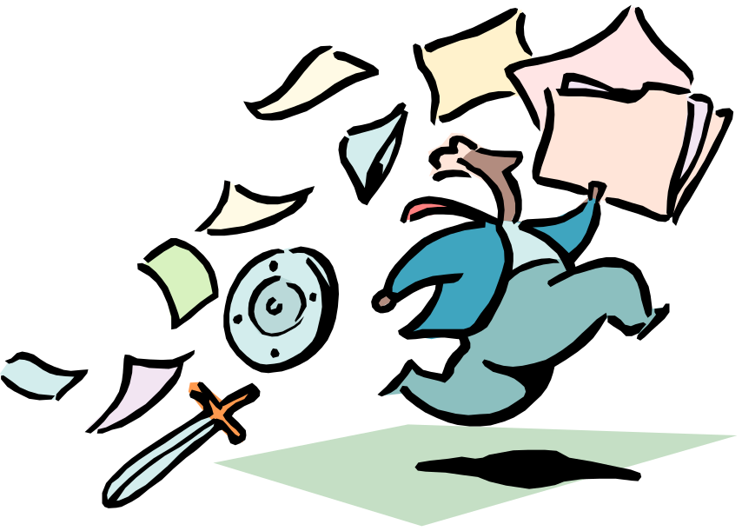
Conflict Resolution Techniques
  Problem solving
  Superordinate goals
  Expansion of resources
  Avoidance
  Smoothing
  Compromise
  Authoritative command
  Altering the human variable
  Altering the structural variables
  Communication
  Bringing in outsiders
  Restructuring the organization
  Appointing a devil’s advocate
Source: Based on S. P. Robbins, Managing Organizational Conflict: A Nontraditional Approach (Upper Saddle River, NJ: Prentice Hall, 1974), pp. 59–89
E X H I B I T 14-4
Notes:
There are a number of techniques available to help work through conflict. Some ideas include problem solving, increasing communication, and restructuring the organization. Each technique chosen needs to reflect the situation and the people involved in order to be an effective conflict resolution technique.

Slide 9
Practical Techniques
Acceptance and Awareness
  Of yourself
  Of others
Proactiveness
Curiosity through lot of questions
Bring/propose solution
Professional > Friends
Target problems rather people
Verbal vs Written
Three positive encounters for each negative
Apology

Slide 10
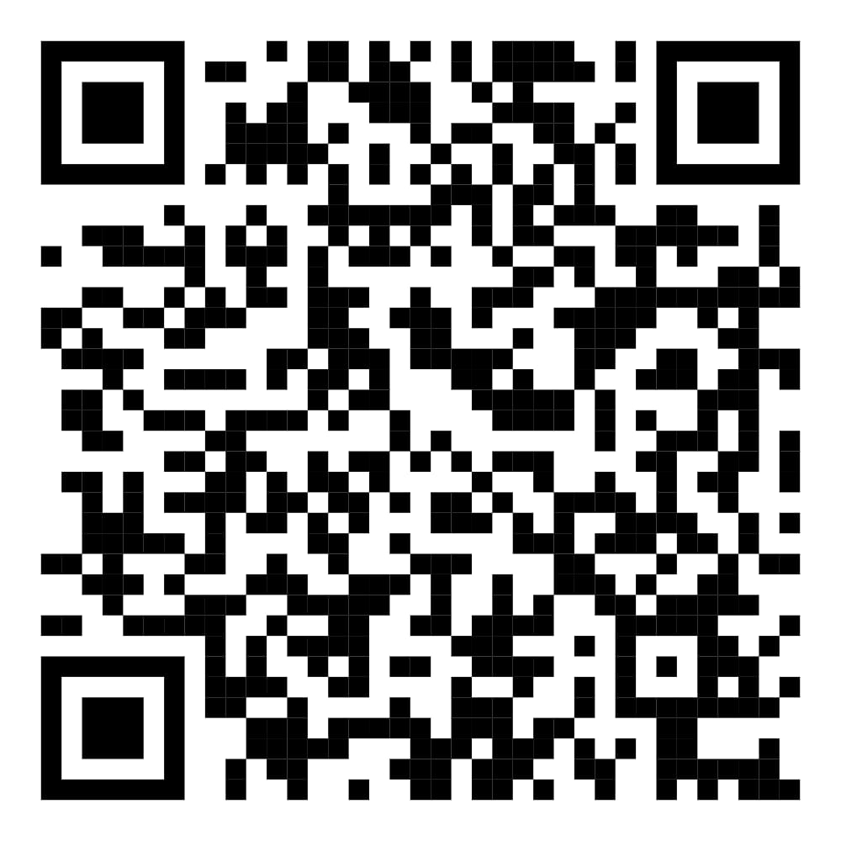
Participation in the research study
https://forms.gle/U91W6gdCDdp2uaKG6

Slide 11
Thank You

