Slide 1
Transportation in a
Supply Chain
Dr. Anurag Tiwari
IIM ROhtak

Slide 2
Learning Objectives
Understand the role of transportation in a supply chain
Evaluate the strengths and weaknesses of different modes of transportation
Discuss the role of infrastructure and policies in transportation
Identify the relative strengths and weaknesses of various transportation network design options
Identify trade-offs that shippers need to consider when designing a transportation network

Slide 3
The Role of Transportation in a Supply Chain
Movement of product from one location to another
Products rarely produced and consumed in the same location
Significant cost component
Shipper requires the movement of the product
Carrier moves or transports the product

Slide 4
Modes of Transportation and Their Performance Characteristics
Air
Package carriers
Truck
Rail
Water
Pipeline
Intermodal

Slide 5
Modes of Transportation and Their Performance Characteristics
Mode | Freight Value ($ billions) in 2002 | Freight Tons (billions) in 2002 | Freight Ton-Miles (millions) in 2002 | Value Added to GNP ($ billions) in 2009
Air (includes truck and air) | 563 | 6 | 13 | 61.9
Truck | 9,075 | 11,712 | 1,515 | 113.1
Rail | 392 | 1,979 | 1,372 | 30.8
Water | 673 | 1,668 | 485 | 14.3
Pipeline | 896 | 3,529 | 688 | 12.0
Multimodal | 1,121 | 229 | 233

Slide 6
Air
Cost components
  Fixed infrastructure and equipment
  Labor and fuel
  Variable depending on passenger/cargo
Key issues
  Location/number of hubs
  Fleet assignment
  Maintenance schedules
  Crew scheduling
  Prices and availability

Slide 7
Package Carriers
Small packages up to about 150 pounds
Expensive
Rapid and reliable delivery
Small and time-sensitive shipments
Provide other value-added services
Consolidation of shipments a key factor

Slide 8
Truck
Significant fraction of the goods moved
Truckload (TL)
  Low fixed cost
  Imbalance between flows
Less than truckload (LTL)
  Small lots
  Hub and spoke system
  May take longer than TL

Slide 9
Rail
Move commodities over large distances
High fixed costs in equipment and facilities
Scheduled to maximize utilization
Transportation time can be long
  Trains ‘built’ not scheduled

Slide 10
Water
Limited to certain geographic areas
Ocean, inland waterway system, coastal waters
Very large loads at very low cost
Slowest
Dominant in global trade
Containers

Slide 11
Pipeline
High fixed cost
Primarily for crude petroleum, refined petroleum products, natural gas
Best for large and stable flows
Pricing structure encourages use for predicable component of demand

Slide 12
Intermodal
Use of more than one mode of transportation to move a shipment
Grown considerably with increased use of containers
May be the only option for global trade
More convenient for shippers – one entity
Key issue – exchange of information to facilitate transfer between different modes

Slide 13
Transportation Infrastructure and Policies
Governments generally take full responsibility or played a significant role in building and managing infrastructure elements
Without a monopoly, deregulation and market forces help create an effective industry structure
Pricing should reflect the marginal impact on the cost to society

Slide 14
Key Point
Transportation infrastructures often require government ownership or regulation because of their inherently monopolistic nature.
In the absence of a monopoly, deregulation and market forces help create an effective industry structure.
When the infrastructure is publicly owned, it is important to price usage to reflect the marginal impact on the cost to society.
If this is not done, overuse and congestion result because the cost borne by a user is less than the user’s marginal impact on total cost.

Slide 15
Design Options for a
Transportation Network
When designing a transportation network
  Should transportation be direct or through an intermediate site?
  Should the intermediate site stock product or only serve as a cross-docking location?
  Should each delivery route supply a single destination or multiple destinations (milk run)?

Slide 16
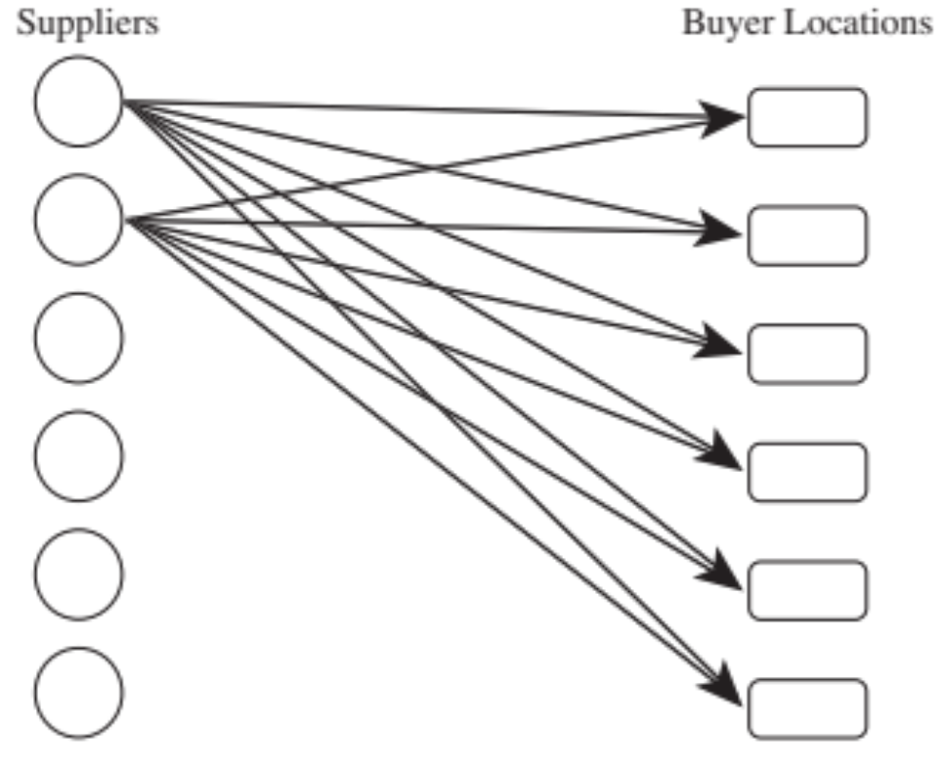
Direct Shipment Network to Single Destination

Slide 17
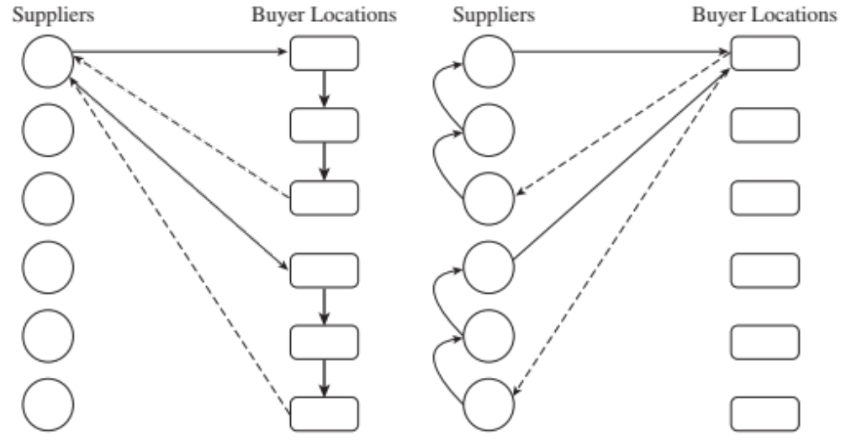
Direct Shipping with Milk Runs

Slide 18
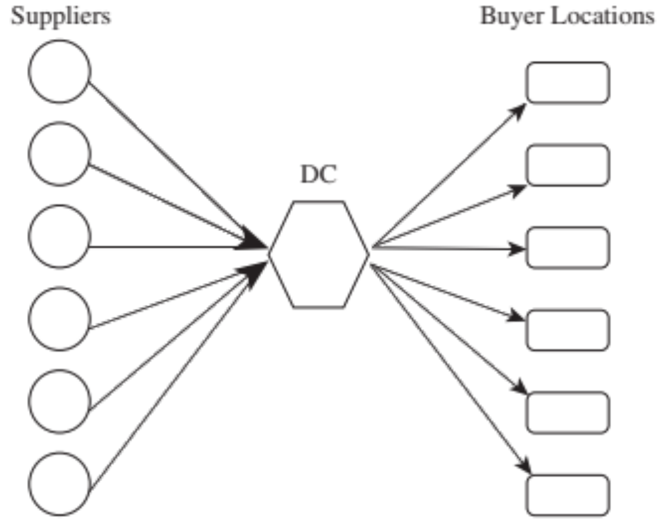
All Shipments via Intermediate Distribution Center with Storage

Slide 19
All Shipments via Intermediate Transit Point with Storage
Suppliers send their shipments to a central distribution center
Stored until needed by buyers
Shipped to each buyer location

Slide 20
All Shipments via Intermediate Transit Point with Cross-Docking
Suppliers send their shipments to an intermediate transit point
They are cross-docked and sent to buyer locations without storing them

Slide 21
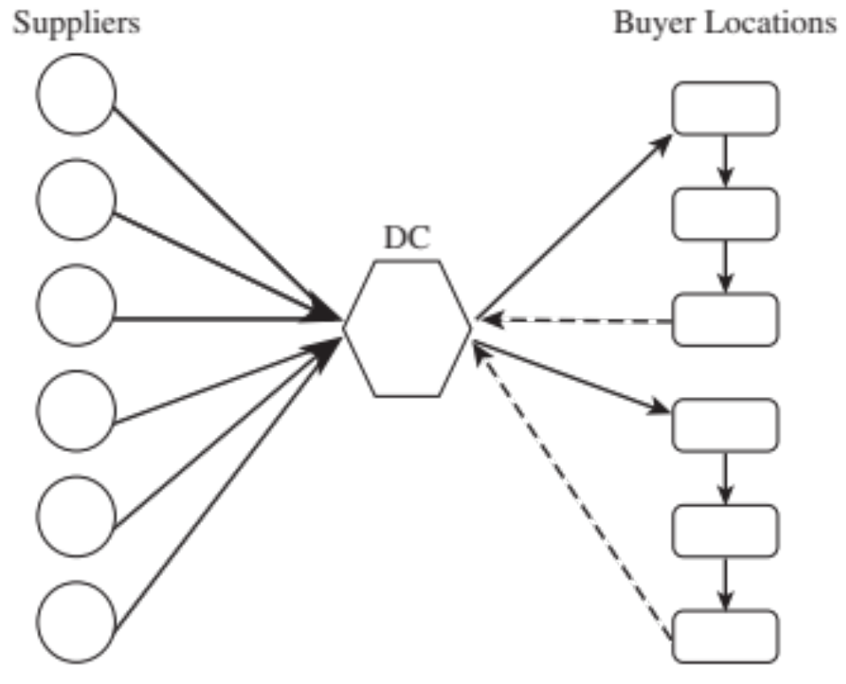
Shipping via DC Using Milk Runs

Slide 22
Tailored Network
Network Structure | Pros | Cons
Direct shipping | No intermediate warehouse Simple to coordinate | High inventories (due to large lot size)
Direct shipping with milk runs | Lower transportation costs for small lots Lower inventories | Increased coordination complexity
All shipments via central DC with inventory storage | Lower inbound transportation cost through consolidation | Increased inventory cost Increased handling at DC
All shipments via central DC with cross-dock | Low inventory requirement Lower transportation cost through consolidation | Increased coordination complexity
Shipping via DC using milk runs | Lower outbound transportation cost for small lots | Further increase in coordination complexity
Tailored network | Transportation choice best matches needs of individual product and store | Highest coordination complexity

Slide 23
Selecting a Transportation Network
Eight stores, four supply sources
Truck capacity = 40,000 units
Cost $1,000 per load, $100 per delivery
Holding cost = $0.20/year
The vice president of a supply chain is considering whether to use direct shipping from suppliers to retail stores or setting up mil runs from suppliers to retail stores.
What network do you recommend if annual sales for each retail stores are 960,000?
What network do you recommend if sales for each product at each store are 120,000 units?

Slide 24
Selecting a Transportation Network
Annual sales = 960,000/store Direct shipping
Batch size shipped from each
supplier to each store = 40,000 units
Number of shipments/yr from
each supplier to each store = 960,000/40,000 = 24
Annual trucking cost
for direct network = 24 x 1,100 x 4 x 8 = $844,800
Average inventory at each
store for each product = 40,000/2 = 20,000 units
Annual inventory cost
for direct network = 20,000 x 0.2 x 4 x 8 = $128,000
Total annual cost of
direct network = $844,800 + $128,000 = $972,800

Slide 25
Selecting a Transportation Network
Annual sales = 960,000/store Milk runs
Batch size shipped from each
supplier to each store = 40,000/2 = 20,000 units
Number of shipments/yr from
each supplier to each store = 960,000/20,000 = 48
Transportation cost per shipment
per store (two stores/truck) = 1,000/2 + 100 = $600
Annual trucking cost
for milk run = 48 x 600 x 4 x 8 = $921,600
Average inventory at each
store for each product = 20,000/2 = 10,000 units
Annual inventory cost
for mil run network = 10,000 x 0.2 x 4 x 8 = $64,000
Total annual cost of
mil run network = $921,600 + $64,000 = $985,600

Slide 26
Selecting a Transportation Network
Annual sales = 120,000/store Direct shipping
Batch size shipped from each
supplier to each store = 40,000 units
Number of shipments/yr from
each supplier to each store = 120,000/40,000 = 3
Annual trucking cost
for direct network = 3 x 1,100 x 4 x 8 = $105,600
Average inventory at each
store for each product = 40,000/2 = 20,000 units
Annual inventory cost
for direct network = 20,000 x 0.2 x 4 x 8 = $128,000
Total annual cost of
direct network = $105,600 + $128,000 = $233,600

Slide 27
Selecting a Transportation Network
Annual sales = 120,000/store Milk runs
Batch size shipped from each
supplier to each store = 40,000/4 = 10,000 units
Number of shipments/yr from
each supplier to each store = 120,000/10,000 = 12
Transportation cost per shipment
per store (four stores/truck) = 1,000/4 + 100 = $350
Annual trucking cost
for direct network = 12 x 350 x 4 x 8 = $134,400
Average inventory at each
store for each product = 10,000/2 = 5,000 units
Annual inventory cost
for direct network = 5,000 x 0.2 x 4 x 8 = $32,000
Total annual cost of
direct network = $134,400 + $32,000 = $166,400

Slide 28
Mumbai Dabbawalas
Lunchbox delivery system
Factors facilitating success
  Low uncertainty of demand
  Temporal aggregation of demand
  Use of transportation resources when they are underutilized

Slide 29
Trade-offs in Transportation Design
Transportation and inventory cost trade-off
  Choice of transportation mode
  Inventory aggregation
Transportation cost and responsiveness trade-off

Slide 30
Transportation and Inventory Cost Trade-off
The trade-off between transportation and inventory cost is significant when designing a supply chain network
Two fundamental supply chain decisions involving this trade-off are:
Choice of transportation mode
Inventory Aggregation

Slide 31
Choice of Transportation Mode
Selecting a transportation mode is both a planning and an operational decision in a supply chain.
Shipper must balance transportation and inventory cost.
The mode of transportation that results in the lowest transportation cost does not necessarily lower total cost of a supply chain.
Cheaper modes of transport typically have longer lead times and larger minimum shipment quantities, both of which result in higher levels of inventory in supply chain.

Slide 32
Choice of Transportation Mode
Mode | Cycle Inventory | Safety Inventory | In-Transit Cost | Transportation Cost | Transportation Time
Rail | 5 | 5 | 5 | 2 | 5
TL | 4 | 4 | 4 | 3 | 3
LTL | 3 | 3 | 3 | 4 | 4
Package | 1 | 1 | 1 | 6 | 1
Air | 2 | 2 | 2 | 5 | 2
Water | 6 | 6 | 6 | 1 | 6
Ranking of transportation Modes in Terms of supply chain performance
1=lowest, 6 highest

Slide 33
Trade-offs When Selecting Transportation Mode
Demand = 120,000 motors, Cost = $120/motor,
Weight = 10 lbs/motor, Lot size = 3,000,
Safety stock = 50% ddlt
One cwt=100 pounds batch size=2000
Carrier | Range of Quantity Shipped (cwt) | Shipping Cost ($/cwt)
AM Railroad | 200+ | 6.50
Northeast Trucking | 100+ | 7.50
Golden Freightways | 50–150 | 8.00
Golden Freightways | 150–250 | 6.00
Golden Freightways | 250+ | 4.00

Slide 34
Trade-offs When Selecting Transportation Mode
Gloden’s Pricing represents a marginal unit discount. Golden representative has proposed lowering the marginal rate for the quantity over 250 cwt in a shipment from $4/cwt to $ 3/cwt and suggested that EE increase its batch size to 4000 motors to take advantages of the lower transportation cost. What should the plant manager do?

Slide 35
Trade-offs When Selecting Transportation Mode
Cycle inventory = Q/2 = 2,000/2 = 1,000 motors
Safety inventory = L/2 days of demand
= (6/2)(120,000/365) = 986 motors
In-transit inventory = 120,000(5/365) = 1,644 motors
Total average inventory = 1,000 + 986 + 1,644
= 3,630 motors
Annual holding cost
using AM Rail = 3,630 x $30 = $108,900
Annual transportation
cost using AM Rail = 120,000 x 0.65 = $78,000
The total annual cost for
inventory and transportation
using AM Rail = $186,900

Slide 36
Trade-offs When Selecting Transportation Mode
Alternative | Lot Size (Motors) | Transpor- tation Cost | Cycle Inventory | Safety Inventory | In-Transit Inventory | Inventory Cost | Total Cost
AM Rail | 2,000 | $78,000 | 1,000 | 986 | 1,644 | $108,900 | $186,900
Northeast | 1,000 | $90,000 | 500 | 658 | 986 | $64,320 | $154,320
Golden | 500 | $96,000 | 250 | 658 | 986 | $56,820 | $152,820
Golden | 1,500 | $96,000 | 750 | 658 | 986 | $71,820 | $167,820
Golden | 2,500 | $86,400 | 1,250 | 658 | 986 | $86,820 | $173,220
Golden | 3,000 | $80,000 | 1,500 | 658 | 986 | $94,320 | $174,320
Golden (old proposal) | 4,000 | $72,000 | 2,000 | 658 | 986 | $109,320 | $181,320
Golden (new proposal) | 4,000 | $67,000 | 2,000 | 658 | 986 | $109,320 | $176,820

Slide 37
Key Point
When selecting a mode of transportation, managers must account for unit costs and cycle, safety, and in-transit inventory costs that result from using each mode.
Modes with high transportation costs can be justified if they result in significantly lower inventory costs.

Slide 38
Inventory Aggregation
Can significantly reduce safety inventories
Transportation costs generally increase
Use
  When inventory and facility costs form a large fraction of a supply chain’s total costs
  For products with a large value-to-weight ratio
  For products with high demand uncertainty

Slide 39
Tradeoffs When
Aggregating Inventory
HighVal – weekly demand μ_{H} = 2, σ_{H} = 5, weight = 0.1 lbs, cost = $200
LowVal – weekly demand μ_{L} = 20, σ_{L} = 5, weight = 0.04 lbs, cost = $30
CSL = 0.997, holding cost = 25%, L = 1 week, T = 4 weeks
UPS lead time = 1 week, $0.66 + 0.26x
FedEx lead time = overnight, $5.53 + 0.53x
Option A. Keep the current structure but replenish inventory once a week rather than once every four weeks
Option B. Eliminate inventories in the territories, aggregate all inventories in a finished-goods warehouse at Madison, and replenish the warehouse once a week

Slide 40
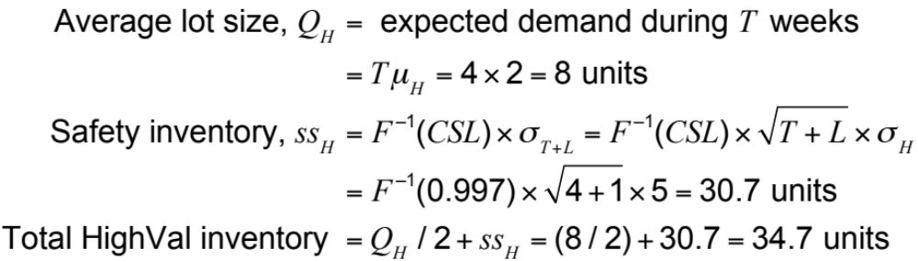
Tradeoffs When
Aggregating Inventory
HighMed inventory costs (current scenario, HighVal)
All 24 territories, HighVal inventory = 24 x 34.7 = 832.8 units

Slide 41
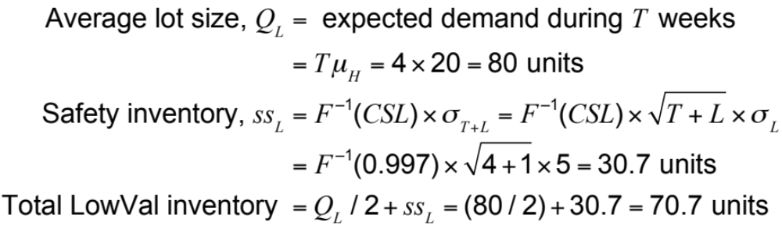
Tradeoffs When
Aggregating Inventory
HighMed inventory costs (current scenario, LowVal)
All 24 territories, LowVal inventory = 24 x 70.7 = 1696.8 units

Slide 42
Tradeoffs When
Aggregating Inventory
Annual inventory
holding cost
for HighMed = (average HighVal inventory x $200
+ average LowVal inventory x $30) x 0.25
= (832.8 x $200 + 169.8 x $30) x 0.25
= $54,366 ($54,395 without rounding)

Slide 43
Tradeoffs When
Aggregating Inventory
HighMed transportation cost (current scenario)
Average weight of each replenishment order
= 0.1Q_{H} + 0.04Q_{L} = 0.1 x 8 + 0.04 x 80 = 4 pounds
Shipping cost per replenishment order
= $0.66 + 0.26 x 4 = $1.70
Annual transportation cost = $1.70 x 13 x 24 = $530
HighMed total cost (current scenario)
Annual inventory and transportation cost at HighMed
= inventory cost + transportation cost
= $54,366 + $530 = $54,896

Slide 44
Tradeoffs When
Aggregating Inventory
 | Current Scenario | Option A | Option B
Number of stocking locations | 24 | 24 | 1
Reorder interval | 4 weeks | 1 week | 1 week
HighVal cycle inventory | 96 units | 24 units | 24 units
HighVal safety inventory | 737.3 units | 466.3 units | 95.2 units
HighVal inventory | 833.3 units | 490.3 units | 119.2 units
LowVal cycle inventory | 960 units | 240 units | 240 units
LowVal safety inventory | 737.3 units | 466.3 units | 95.2 units
LowVal inventory | 1,697.3 units | 706.3 units | 335.2 units
Annual inventory cost | $54,395 | $29,813 | $8,473
Shipment type | Replenishment | Replenishment | Customer order
Shipment size | 8 HighVal + 80 LowVal | 2 HighVal + 20 LowVal | 1 HighVal + 10 LowVal
Shipment weight | 4 lbs. | 1 lb. | 0.5 lb.
Annual transport cost | $530 | $1,148 | $14,464
Total annual cost | $54,926 | $30,961 | $22,938

Slide 45
Tradeoffs When
Aggregating Inventory
Average weight of
each customer order = 0.1 x 0.5 + 0.04 x 5 = 0.25 pounds
Shipping cost per
customer order = $5.53 + 0.53 x 0.25 = $5.66
Number of customer orders
per territory per week = 4
Total customer orders
per year = 4 x 24 x 52 = 4,992
Annual transportation cost = 4,992 x $5.66 = $28,255
Total annual cost = inventory cost
+ transportation cost
= $8,474 + $28,255 = $36,729

Slide 46
Tradeoffs When
Aggregating Inventory
 | Aggregate | Disaggregate
Transport cost | Low | High
Demand uncertainty | High | Low
Holding cost | High | Low
Customer order size | Large | Small

Slide 47
Key Point
Inventory aggregation decisions must account for inventory and transportation costs.
Inventory aggregation decreases supply chain costs if the product has a high value-to-weight ratio, high demand uncertainty, low transportation cost, and customer orders are large.
If a product has a low value-to-weight ratio, low demand uncertainty, large transportation cost, or small customer orders, inventory aggregation may increase supply chain costs.

Slide 48
Trade-off Between Transportation Cost and Customer Responsiveness
Closely linked to degree of responsiveness
  High responsiveness, high transportation costs
  Decreased responsiveness, lower transportation costs
Temporal aggregation – combining orders across time

Slide 49
Trade-off Between Transportation Cost and Responsiveness
Steel shipments LTL = $100 + 0.01x
 | Monday | Tuesday | Wednesday | Thursday | Friday | Saturday | Sunday
Week 1 | 19,970 | 17,470 | 11,316 | 26,192 | 20,263 | 8,381 | 25,377
Week 2 | 39,171 | 2,158 | 20,633 | 23,370 | 24,100 | 19,603 | 18,442

Slide 50
Trade-off Between Transportation Cost and Responsiveness
 |  | Two-Day Response |  | Three-Day Response |  | Four-Day Response
Day | Demand | Quantity Shipped | Cost ($) | Quantity Shipped | Cost ($) | Quantity Shipped | Cost ($)
1 | 19,970 | 19,970 | 299.70 | 0 |  | 0
2 | 17,470 | 17,470 | 274.70 | 37,440 | 474.40 | 0
3 | 11,316 | 11,316 | 213.16 | 0 |  | 48,756 | 586.56
4 | 26,192 | 26,192 | 361.92 | 37,508 | 475.08 | 0
5 | 20,263 | 20,263 | 302.63 | 0 |  | 0
6 | 8,381 | 8,381 | 183.81 | 28,644 | 386.44 | 54,836 | 648.36
7 | 25,377 | 25,377 | 353.77 | 0 |  | 0
8 | 39,171 | 39,171 | 491.71 | 64,548 | 745.48 | 0
9 | 2,158 | 2,158 | 121.58 | 0 |  | 66,706 | 767.06
10 | 20,633 | 20,633 | 306.33 | 22,791 | 327.91 | 0
11 | 23,370 | 23,370 | 333.70 | 0 |  | 0
12 | 24,100 | 24,100 | 341.00 | 47,70 | 574.70 | 68,103 | 781.03
13 | 19,603 | 19,603 | 296.03 | 0 |  | 0
14 | 18,442 | 18,442 | 284.42 | 38,045 | 480.45 | 38,045 | 480.45
 |  |  | $4,164.46 |  | $3,464.46 |  | $3,264.46

Slide 51
Key Point
Temporal aggregation of demand results in a reduction of transportation costs because it entails larger shipments and reduces the variation in shipment sizes from one shipment to the next.
It does, however, hurt customer response time.
The marginal benefit of temporal aggregation declines as the time window over which aggregation takes place increases.

Slide 52
Tailored Transportation
The use of different transportation networks and modes based on customer and product characteristics
Factors affecting tailoring
  Customer density and distance
  Customer size
    Transportation cost based on total route distance
    Delivery cost based on number of deliveries
  Product demand and value

Slide 53
Tailored Transportation
 | Short Distance | Medium Distance | Long Distance
High density | Private fleet with milk runs | Cross-dock with milk runs | Cross-dock with milk runs
Medium density | Third-party milk runs | LTL carrier | LTL or package carrier
Low density | Third-party milk runs or LTL carrier | LTL or package carrier | Package carrier

Slide 54
Tailored Transportation
Product Type | High Value | Low Value
High demand | Disaggregate cycle inventory. Aggregate safety inventory. Inexpensive mode of transportation for replenishing cycle inventory and fast mode when using safety inventory. | Disaggregate all inventories and use inexpensive mode of transportation for replenishment.
Low demand | Aggregate all inventories. If needed, use fast mode of transportation for filling customer orders. | Aggregate only safety inventory. Use inexpensive mode of transportation for replenishing cycle inventory.

Slide 55
Key Point
Tailoring transportation based on customer density and distance, customer size, or product demand and value allows a supply chain to achieve appropriate responsiveness and low cost.

Slide 56
Role of IT in Transportation
The complexity of transportation decisions demands use of IT systems
IT software can assist in:
  Identification of optimal routes by minimizing costs subject to delivery constraints
  Optimal fleet utilization
  GPS applications

Slide 57
Making Transportation
Decisions in Practice
Align transportation strategy with competitive strategy
Consider both in-house and outsourced transportation
Use technology to improve transportation performance
Design flexibility into the transportation network

Slide 58
Multi-facility location problem
Locating distribution centers for nation-wide distribution of products is one typical example belonging to this category
Decisions variables in a multiple location – multiple candidate problem
  Identifying k out of n candidates for locating facilities
  Which of the demand points will be served by each of these locations and to what extent
The problem is one of managing network flows of satisfying a set demand points using a combination of supply points

Slide 59
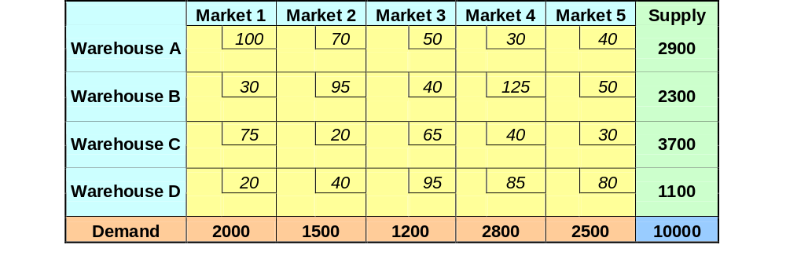
Multiple facilities location problem
Problem

Slide 60
Multiple facilities location problem
10
10
10
20
1100
10 20 10 10 10

Slide 61
Multiple facilities location problem
 | Market 1 | Market 2 | Market 3 | Market 4 | Market 5 | Supply
Warehouse A | 100 | 70 | 50 | 30 | 40 | 2900
Warehouse B | 30 | 95 | 40 | 125 | 50 | 2300
Warehouse C | 75 | 20 | 65 | 40 | 30 | 3700
Warehouse D | 20 | 40 | 95 | 85 | 80 | 0
Demand | 900 | 1500 | 1200 | 2800 | 2500
10
10
10
0
1100
45 50 10 10 10

Slide 62
Multiple facilities location problem
 | Market 1 | Market 2 | Market 3 | Market 4 | Market 5 | Supply
Warehouse A | 100 | 70 | 50 | 30 | 40 | 2900
Warehouse B | 30 | 95 | 40 | 125 | 50 | 2300
Warehouse C | 75 | 20 | 65 | 40 | 30 | 2200
Warehouse D | 20 | 40 | 95 | 85 | 80 | 0
Demand | 900 | 0 | 1200 | 2800 | 2500
10
10
10
0
1500
1100
45 50 10 10 10

Slide 63
Multiple facilities location problem
 | Market 1 | Market 2 | Market 3 | Market 4 | Market 5 | Supply
Warehouse A | 100 | 70 | 50 | 30 | 40 | 2900
Warehouse B | 30 | 95 | 40 | 125 | 50 | 2300
Warehouse C | 75 | 20 | 65 | 40 | 30 | 2200
Warehouse D | 20 | 40 | 95 | 85 | 80 | 0
Demand | 900 | 0 | 1200 | 2800 | 2500
10
10
10
0
1500
1100
45 0 10 10 10

Slide 64
Multiple facilities location problem
 | Market 1 | Market 2 | Market 3 | Market 4 | Market 5 | Supply
Warehouse A | 100 | 70 | 50 | 30 | 40 | 2900
Warehouse B | 30 | 95 | 40 | 125 | 50 | 1400
Warehouse C | 75 | 20 | 65 | 40 | 30 | 2200
Warehouse D | 20 | 40 | 95 | 85 | 80 | 0
Demand | 900 | 0 | 1200 | 2800 | 2500
10
10
10
0
900
1500
1100
0 0 10 10 10

Slide 65
Multiple facilities location problem
 | Market 1 | Market 2 | Market 3 | Market 4 | Market 5 | Supply
Warehouse A | 100 | 70 | 50 | 30 | 40 | 2900
Warehouse B | 30 | 95 | 40 | 125 | 50 | 200
Warehouse C | 75 | 20 | 65 | 40 | 30 | 2200
Warehouse D | 20 | 40 | 95 | 85 | 80 | 0
Demand | 0 | 0 | 0 | 2800 | 2500
10
75
10
0
900
1200
1500
1100
0 0 0 10 10

Slide 66
Multiple facilities location problem
 | Market 1 | Market 2 | Market 3 | Market 4 | Market 5 | Supply
Warehouse A | 100 | 70 | 50 | 30 | 40 | 2900
Warehouse B | 30 | 95 | 40 | 125 | 50 | 200
Warehouse C | 75 | 20 | 65 | 40 | 30 | 2200
Warehouse D | 20 | 40 | 95 | 85 | 80 | 0
Demand | 0 | 0 | 0 | 2800 | 2500
10
10
10
0
900
1200
1500
1100
0 0 10 10 10

Slide 67
Multiple facilities location problem
 | Market 1 | Market 2 | Market 3 | Market 4 | Market 5 | Supply
Warehouse A | 100 | 70 | 50 | 30 | 40 | 2900
Warehouse B | 30 | 95 | 40 | 125 | 50 | 0
Warehouse C | 75 | 20 | 65 | 40 | 30 | 2200
Warehouse D | 20 | 40 | 95 | 85 | 80 | 0
Demand | 0 | 0 | 0 | 2800 | 2300
10
0
10
0
900
1200
200
1500
1100
0 0 0 10 10

Slide 68
Multiple facilities location problem
 | Market 1 | Market 2 | Market 3 | Market 4 | Market 5 | Supply
Warehouse A | 100 | 70 | 50 | 30 | 40 | 2900
Warehouse B | 30 | 95 | 40 | 125 | 50 | 0
Warehouse C | 75 | 20 | 65 | 40 | 30 | 0
Warehouse D | 20 | 40 | 95 | 85 | 80 | 0
Demand | 0 | 0 | 0 | 2800 | 100
10
0
10
0
900
1200
200
1500
2200
1100
0 0 0 10 10

Slide 69
Multiple facilities location problem
 | Market 1 | Market 2 | Market 3 | Market 4 | Market 5 | Supply
Warehouse A | 100 | 70 | 50 | 30 | 40 | 0
Warehouse B | 30 | 95 | 40 | 125 | 50 | 0
Warehouse C | 75 | 20 | 65 | 40 | 30 | 0
Warehouse D | 20 | 40 | 95 | 85 | 80 | 0
Demand | 0 | 0 | 0 | 0 | 0
10
0
0
0
2800
100
900
1200
200
1500
2200
1100
0 0 0 10 10

Slide 70
Multiple facilities location problem
 | Market 1 | Market 2 | Market 3 | Market 4 | Market 5 | Supply
Warehouse A | 100 | 70 | 50 | 30 | 40 | 0
Warehouse B | 30 | 95 | 40 | 125 | 50 | 0
Warehouse C | 75 | 20 | 65 | 40 | 30 | 0
Warehouse D | 20 | 40 | 95 | 85 | 80 | 0
Demand | 0 | 0 | 0 | 0 | 0
10
0
0
0
2800
100
900
1200
200
1500
2200
1100
0 0 0 10 10

Slide 71
Shipping From | Received at | Quantity | Unit Cost | Cost of transportation
Warehouse A | Market 4 | 2800 | 30 | 84000
Warehouse A | Market 5 | 100 | 40 | 4000
Warehouse B | Market 1 | 900 | 30 | 27000
Warehouse B | Market 3 | 1200 | 40 | 48000
Warehouse B | Market 5 | 200 | 50 | 10000
Warehouse C | Market 2 | 1500 | 20 | 30000
Warehouse C | Market 5 | 2200 | 30 | 66000
Warehouse D | Market 1 | 1100 | 20 | 22000
Total cost of Transportation |  |  |  | 291,000

