Slide 1
TOTAL REWARDS - II
GPHR

Slide 2
Compensation Philosophy
Each employer needs a policy which outlines their desired market position.
What percentile of the market is your target?
Which comparators are appropriate?
Is the target the same for all grades?
A well-articulated compensation policy provides valuable guidance for the development of a pay structure. In large organizations, there is often a corporate policy which forms the basis for local policies.

Slide 3
Steps to develop a salary structure
Establish your compensation philosophy
Gather market data
Identify benchmark jobs
Measure your market position
Calculate the compa-ratio
Check your budget
Start allocating
Final adjustments
Management approval
Communicate

Slide 4
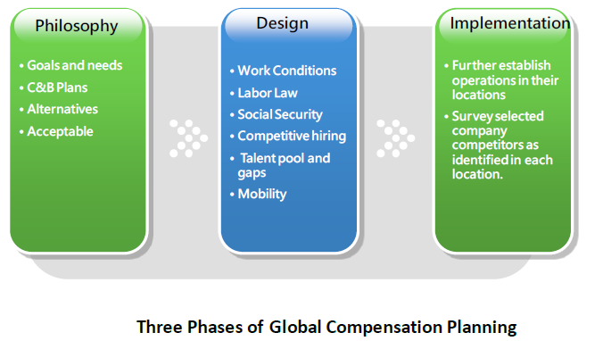
Global Compensation Planning

Slide 5
Phase One: Philosophy
Understanding strategic global/regional/local goals and needs.
Addressing global compensation and benefits plans.
Considering program alternatives
Determining how to implement programs that are culturally acceptable yet competitive blending global strategies with local practices

Slide 6
Phase Two: Design
Determining
  Employment and working conditions.
  Labor laws and contracts of employment.
  Statutory and social security benefits.
  Competitive hiring practices.
  Existing talent pool and gaps.
  Mobility of local workforce

Slide 7
Phase Three: implementation
Further establish operations in their locations based on information gathered in the design phase-recruiting, hiring, compensating, incenting, paying, and administering company local national employees.
Survey selected company competitors as identified in each location. Then, based on survey data, form recommendations of best practices and complete a “total" compensation/benefits study of these positions in each country.

Slide 8
Global Compensation Approaches
Headquarters (HQ) scale : Worldwide salary levels are established at HQ with differentials for each affiliate subsidiary according to the local cost of living. This option is usually reserved for managers and executives.
Salary scale based on location : Wages or salary levels are based on location-the local scale and norms. This option is primarily for the broader base of employees and usually excludes executives and globally mobile employees.

Slide 9
Global Job Grading
Global job grading approach recognizes this organizational reality by aligning job levels with both the internal value companies place on individual contributor positions relative to managerial positions, as well as the value the market places on each type of job. The system combines individual contributors and managers into global grades where market pay suggests equivalence. Below is an example of how different job families are graded and grouped into two tracks—one for management and one for individual contributor.

Slide 10

Global Job Grading

Slide 11
Remuneration Surveys
Remuneration surveys collect information on prevailing market compensation and benefit practices, including base pay, variable compensation (e.g., short- and long-term incentive plans), and time off. Remuneration surveys allow organizations to recognize and relate their remuneration structures to global and local trends.

Slide 12
Purposes of Remuneration Surveys
Adjust the pay level in response to changing rates paid by competitors.
Set the mix of pay forms relative to that paid by competitors.
Establish or price a pay structure.
Analyze pay-related problems.
Estimate the labor costs of product/service market competitors

Slide 13
Global Pay Structure
Policy Line : The pay level that a company sets its pay at compared to the market pay line, typically the midpoint of the pay structure is set to judge the going market rate. In building pay structure scientifically, the line is a statistically computed least-squares-regression line.
Pay grades are used to group jobs that have approximately the same relative internal or external worth; in other words, all jobs within a particular grade are paid the same rate or within the same pay range. Grades enhance an organization's ability to move people among jobs with no change in pay.

Slide 14
Global Pay Structure
Pay range typically means high to low or minimum to maximum pay for a certain job grade. The range midpoints, minimums, and maximums reflect career paths, promotions, and other management systems and philosophy within the organization. The differential must be large enough to induce employees to seek and/or accept the promotion or to undertake the necessary training required.

Slide 15
Global Pay Structure
Compa-ratios (CP) is a salary expressed as a percentage of or indexed to the salary range midpoint/market rate (salary/midpoint or market rate = CP). The CP may be used as an indicator of how an individual is doing against plan.

Slide 16
Global Pay Structure
Broad banding, called fat grades, means collapsing pay grades and ranges into just a few wide levels or a band, which includes one minimum and one maximum range, while midpoint often not used. The purposes of using broad banding as follow:
• Provide flexibility to define job responsibilities more broadly.
• Foster cross-functional growth and development.
• Ease mergers and acquisitions

Slide 17

Global Pay Structure

Slide 18
Questions

