Slide 1
TOTAL REWARDS - II
GPHR

Slide 2
Differential Pay
Approaches of Expat Compensation
Totalization Agreement and Tax Treaty
International Retirement Plans
Components of International Compensation
Tax Reimbursement
Purchasing Power Parity

Slide 3
Global Compensation Approaches
Headquarters (HQ) scale : Worldwide salary levels are established at HQ with differentials for each affiliate subsidiary according to the local cost of living. This option is usually reserved for managers and executives.
Salary scale based on location : Wages or salary levels are based on location-the local scale and norms. This option is primarily for the broader base of employees and usually excludes executives and globally mobile employees.

Slide 4
Compensation Approaches
Entitlement-oriented approach. Some organizations promote a caring, protective feeling and want employees to feel as if they are a part of the family. These organizations feel that employees are entitled to benefits such as health care, employee assistance or disability insurance as a condition of employment.
Performance-oriented approach. The compensation programs of other organizations are more performance-driven, putting more emphasis on the performance and contributions of individual employees

Slide 5
Goals of the Total Rewards System
Attracts people who can help the organization meet its mission and vision
Retains valuable employees
Motivates and rewards desired performance
Spends compensation money wisely

Slide 6
Equity
Equity means fair pay treatment for employees. Equity helps to attract, motivate and retain competent employees, making it an important concern
Internal equity refers to the pay relationship among different jobs/skills/competencies within a single organization. To achieve internal consistency, the employee must believe that all jobs are paid what they are worth. For the pay rates to be internally consistent, an organization first must determine the overall importance or worth of each job.
External Equity : A firm achieves external competitiveness when employees perceive that their pay is fair in relation to what their counterparts in other organizations earn. To become externally competitive, organizations must first learn what other employers are paying and then make a decision regarding just how competitive they want to be

Slide 7

Pay Strategies
Organizations will compete for employees with other organizations in the same labor market. Three factors that define labor markets are :

Slide 8

Pay Strategies
Based on what is known about those markets and the competition, organizations usually decide on a pay strategy that matches, leads or lags the competition

Slide 9
Pay Strategies
The correct strategy depends on two things:
How the employees add value to the organization‘s success
The degree to which the organization can afford to pay for a particular strategy
An organization will probably use a combination of these strategies. For example, for critical jobs, the organization may decide to lead the competition; in other areas, it may use a match strategy

Slide 10
Compensation and Benefits Strategy
Business success depends heavily on developing a total rewards strategy that enables the organization to compete cost- effectively for talent.
Elements in a total rewards system that vary from year to year:
Employment costs and conditions
Supply and demand for talent
Laws that affect business and employment
Employees‘ perceived value of rewards

Slide 11
Job Evaluation
Job evaluation is the process of analyzing and assessing the various jobs systematically to ascertain their relative worth in an organization. Job is evaluated on the basis of their content and is placed in the order of their importance

Slide 12
Objectives of Job Evaluation
Job Analysis
Job Description
Job Specification
Job Evaluation Program
Wage Survey
Employee Classification

Slide 13
Job Evaluation
Job-Content-Based (Internal) Job Evaluation
In job-content-based job evaluation, the worth and pay opportunities of different jobs are based on an appraisal of their responsibilities and requirements and their relationship to other jobs within the organization.
Market-Based (External) Job Evaluation
Market-based job evaluation is sometimes referred to as market pricing because this method bases the worth and pay opportunities of different jobs on their market value or the going rate in the marketplace.

Slide 14
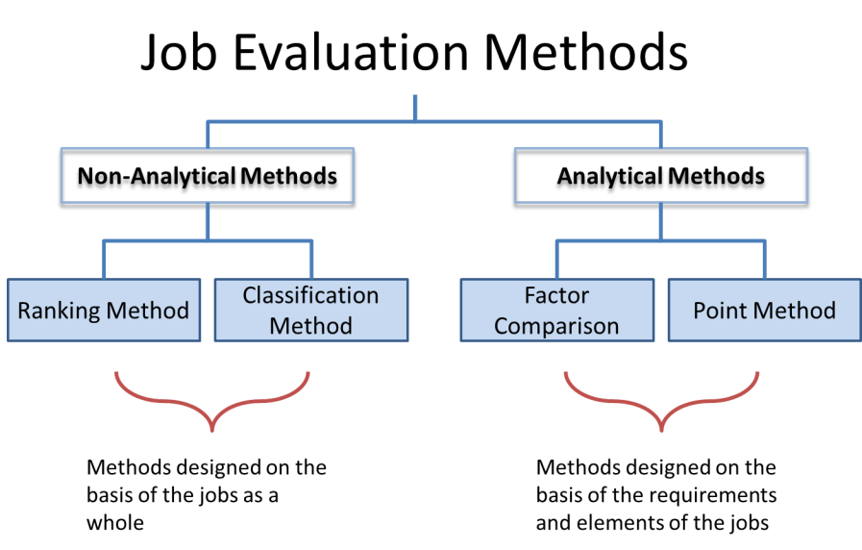

Slide 15
Factor Comparison Method
This method is based on the assumption that all jobs contain certain common factors to determine the worth of jobs. These factors may differ in the degree to which they are present in different jobs
PROCESS:
Select the set of Benchmark Jobs
Rank the Benchmark jobs on the basis of each compensable factor.
For each Benchmark job, allocate market pay across the compensable factor
Determine the pay for each job by adding up the pay from each compensable factor.

Slide 16
Point Factor Approach
The point factor method is a commonly used quantitative technique. This approach breaks down jobs into compensable factors identified during a job analysis. Points are assigned to the factors, and a pay structure is established for the position.
Using a system for internal equity, such as the point factor system, forces an organization to quantify total points for each unique job, determining its true value to the company. This process often provides value beyond compensation, including benefits for recruitment, promotions and job design.

Slide 17
Factors | ₁st Degree | ₂nd Degree | ₃rd Degree | ₄th Degree | 5th Degree
SKILL
Education | 15 | 30 | 45 | 60 | 75
Experience | 20 | 40 | 60 | 80 | 100
Initiative and Ingenuity | 15 | 30 | 45 | 60 | 75
EFFORT
Physical demand | 10 | 20 | 30 | 40 | 50
Mental or visual demand | 5 | 10 | 15 | 20 | 25
RESPONSIBILITY
Equipment or process | 5 | 10 | 15 | 20 | 25
Material or product | 5 | 10 | 15 | 20 | 25
Safety of others | 5 | 10 | 15 | 20 | 25
Work of other job conditions | 5 | 10 | 15 | 20 | 25
JOB CONDITIONS
Working conditions | 10 | 20 | 30 | 40 | 50
Unavoidable hazards | 5 | 10 | 15 | 20 | 25

Slide 18
Global Job Grading
Global job grading approach recognizes this organizational reality by aligning job levels with both the internal value companies place on individual contributor positions relative to managerial positions, as well as the value the market places on each type of job. The system combines individual contributors and managers into global grades where market pay suggests equivalence. Below is an example of how different job families are graded and grouped into two tracks—one for management and one for individual contributor.

Slide 19

Global Job Grading

Slide 20
Question
This is a type of job evaluation system where each position has common compensable items that are graded and scored and then divided into levels or degrees which are assigned points. Each job is then rated on all the scorable items and the total point total is tabulated to determine the job's relative internal worth.
Point factor approach
Factor comparison method
Classification method
Ranking

Slide 21
Answer
Option A

Slide 22
Remuneration Surveys
Remuneration surveys collect information on prevailing market compensation and benefit practices, including base pay, variable compensation (e.g., short- and long-term incentive plans), and time off. Remuneration surveys allow organizations to recognize and relate their remuneration structures to global and local trends.

Slide 23
Purposes of Remuneration Surveys
Adjust the pay level in response to changing rates paid by competitors.
Set the mix of pay forms relative to that paid by competitors.
Establish or price a pay structure.
Analyze pay-related problems.
Estimate the labor costs of product/service market competitors

Slide 24
Question
With 200 expatriates, (150 from Switzerland, 30 from Australia, and 20 from India) the decision by this Swiss company to employ a HQ-based pay system for all is:
Less expensive
Don't know
More expensive
Same cost

Slide 25
Answer
Option C

Slide 26
Differential Pay
Approaches of Expat Compensation
Totalization Agreement and Tax Treaty
International Retirement Plans
Components of International Compensation
Tax Reimbursement
Purchasing Power Parity

Slide 27
Pay Range
Pay range typically means high to low or minimum to maximum pay for a certain job grade. The range midpoints, minimums, and maximums reflect career paths, promotions, and other management systems and philosophy within the organization. The differential must be large enough to induce employees to seek and/or accept the promotion or to undertake the necessary training required.

Slide 28
Compa-ratios (CP)
Compa-ratios (CP) is a salary expressed as a percentage of or indexed to the salary range midpoint/market rate (salary/midpoint or market rate = CP). The CP may be used as an indicator of how an individual is doing against plan.

Slide 29
Broadbanding
Broad banding, called fat grades, means collapsing pay grades and ranges into just a few wide levels or a band, which includes one minimum and one maximum range, while midpoint often not used. The purposes of using broad banding as follow:
• Provide flexibility to define job responsibilities more broadly.
• Foster cross-functional growth and development.
• Ease mergers and acquisitions

Slide 30

Global Pay Structure

Slide 31
Wage Compression
Pay compression, also referred to as salary or wage compression, occurs when the pay of one or more employees is very close to the pay of more-experienced employees in the same job, or even those in higher-level jobs, including managerial positions. Often, it is the result of a market rate for a given job surpassing the increases historically awarded to long-term employees.

Slide 32
Benefits
Organization must be aware that specific countries require benefits that may not be offered in the home country. For example, in France employers are required by law to provide every employee with 25 days of vacation. Although an American working for an American company in France is not legally entitled to such a vacation, the organization may want to follow this practice to avoid morale problems with expatriates.
Other countries may have retirement, disability, and termination policies that are different from the expatriate’s home country

Slide 33
Equalization Benefits
Equalization benefits are benefits intended to keep expatriates in the same/equal financial condition they were in before accepting an overseas assignment and to reduce any negative aspects of living in a foreign country.
Often, expatriates require additional benefits to equalize the standard of living they enjoyed in their home country. This adjustment of benefits is referred to as equalization.

Slide 34
Equalisation Benefits
• Housing allowance
• Educational allowance for children
• Foreign Service premium
• Assignment completion bonus
• Emergency leave
• Home leave
• Language training
• Domestic staff
• Club membership
• Spousal employment
• Cultural training for family
• Company vehicles

Slide 35
Question
Which is the BEST term to describe the situation where expatriate pay levels are the same or only marginally higher than home-office pay?
Wage compression
External pay comparisons
Pay disparity
Red circle pay

Slide 36
Answer
Option A

Slide 37
Differential Pay
Approaches of Expat Compensation
Totalization Agreement and Tax Treaty
International Retirement Plans
Components of International Compensation
Tax Reimbursement
Purchasing Power Parity

Slide 38
Differential Pay
Differentials are adjustments to base pay made to address factors that create pay inequities. A “differential” is pay an employer provides to employees for working in less desirable countries, assignments, or for performing particularly unpleasant or arduous work.
Hardship Allowances
Danger Pay
Foreign Service Premium
Mobility Premium
Relocation or Transfer allowance

Slide 39

Hardship Allowances
Hardship allowances are designed to compensate expatriates assigned to areas that are challenging in which to live due to culture, climate, language, or remoteness.

Slide 40
Danger Allowance
Danger pay allowances are often given to expatriates who live and work in a foreign location that is plagued by civil revolution, civil war, or terrorism—conditions that threaten physical harm or imminent danger to expatriates’ health or well-being.

Slide 41
Foreign Service Premium
The Foreign Service premium is generally paid only to employees who are on an overseas assignment of at least 1 year or more in duration or who receive a full expatriate compensation package.
These extra moneys are provided to the assignee to offset many out-of-pocket expenses that come with an international assignment.

Slide 42
Mobility Premiums
The mobility premium is a payment given upon transfer to another foreign post or repatriation to the home country to indemnify the assignee for both the actual cost and the challenges associated with a relocation.
It is sometimes given to phase out a Foreign Service premium

Slide 43
Relocation or Transfer Allowance
The relocation or transfer allowance is a lump sum payment designed to cover the incidental expenses that inevitably arise during a transfer to a different work location, and which may not be itemized.
Payment is generally made at the time of the transfer to, from, or between foreign posts.

Slide 44
Question
An expatriate will MOST probably be assigned a car and driver when posted to this country.
Canada
Chechnya
Sweden
England

Slide 45
Answer
Option C

Slide 46
Questions

