Slide 1
TOTAL REWARDS - I
GPHR

Slide 2
Introduction
An organization’s goals are accomplished through people.
The major challenge of any organization is to attract, retain, motivate, and align the types and numbers of people it needs to achieve its goals.
This is accomplished through a value exchange—a situation in which the company and the employee give value to the other in exchange for value received to achieve their respective self-interests.
This notion can be summarized by the phrase, “Value given for value received.”

Slide 3

Value Exchange - Employee

Slide 4

Value Exchange - Employer

Slide 5

Evolution of Rewards

Slide 6
Total Rewards
Total Reward relates to all aspects of the employment offering, including the remuneration package (base pay, variable pay and benefits) as well as the intangible aspects of the psychological contract such as career development, employment security and working environment.
Total rewards include everything the employee perceives to be of value resulting from the employment relationship ~ WorldatWork

Slide 7

Total Rewards

Slide 8
Fixed Pay
Fixed pay, also known as base pay, is nondiscretionary compensation that does not vary according to performance or results achieved. It’s usually determined by the organization’s philosophy and pay structure.
Base Pay: Fixed or base pay is the compensation paid to an employee for performing specific job. The definition of base pay can vary by country. Base pay levels need to take into account variations in equivalent monthly salaries vary by country. The bottom line to fixed pay practices need to be based on a competitive strategy for each country. Types of Base pay include

Slide 9
Types of Base Pay
Salary: paid on a weekly, biweekly or monthly basis rather than by the hour, generally to higher level positions.
Nonexempt / hourly rates: paid by the hour for a job being performed. An individual’s annual pay is dependent on the number of hours worked during the course of the year.
Piece rate: payment is based on an individual ’s rates production. A payment is received for each piece or unit work produced.

Slide 10
Variable Pay
Incentive or Variable pay, also known as pay at risk, is compensation that is contingent on discretion, performance or results achieved. Much of the innovation in compensation is occurring in the variable pay element.
These schemes are adopted by many corporations in order to improve the employee morale and increase the motivation to work for the employees.

Slide 11
Types of Variable Pay
Bonuses or Incentives are delivered through plans that predetermine a performance and reward schedule.
Commission is a sum of money that is paid to an employee upon completion of a task, usually selling a certain amount of goods or services.
Profit- Sharing is a form of variable pay provided to all employees based on the profits of the company.
Performance-Sharing Plans : A variable pay plan bases rewards on the performance of a combination of quantitative and/or qualitative measures

Slide 12
Benefits
Programs an employer uses to supplement the cash compensation that employees receive. These health, income protection, savings and retirement programs provide security for employees and their families
Housing Allowance
Transportation Allowance
Meal Allowance
Phone Allowance
Training Allowance

Slide 13
Flexible benefits
Flexible benefits are the approach to benefits in an increasing number of American organizations. In essence, employees are typically given choices, up to a certain dollar limit, among a series of options for their benefits, including such things as pension contributions, health insurance options, dental insurance, life insurance,

Slide 14
External Influences on Total Rewards
Economic Factors : Total rewards is the near universal form of exchange worldwide between an employee’s talent, effort and skills and the employer’s ability to attract and retain the needed skills to accomplish its mission. Thus, total rewards becomes the crucial intersection between the supply and demand for labor

Slide 15
External Influences on Total Rewards
Cultural norms : Cultural norms and social mores are another critical component related to external influences. Rewards that are valued and appreciated in one culture may be less valuable (even offensive) in another. HR professionals must have a firm grasp of the customs and drivers of the diverse makeup and expectations of the workforce to effectively tailor programs for maximum efficacy.

Slide 16
External Influences on Total Rewards
Regulatory : Laws affect the design and implementation of pay, benefits and work rules. Organization-wide programs should be assessed to ensure they can be legally applied at the local level. This may require adaptation or even alternative programs to ensure compliance . Also, legal and regulatory violations can result in sanctions, damaging publicity and potential restrictions that may negatively affect an organization’s ability to conduct business

Slide 17
Internal Influences on Total Rewards
A business strategy may place its emphasis in one of the following key areas:
Operational excellence: a combination of price, quality, dependability and ease of purchase that competitors cannot match. The corporate culture typically strives to minimize waste and reward efficiency.
Product/service leadership: innovation, product development and market exploitation. The corporate culture encourages imagination and a mindset driven by the prospect of creating the future.
Customer intimacy: creates results for carefully selected customers. The corporate culture encourages deep and lasting relationships with customers.

Slide 18
Internal Influences on Total Rewards
Organizational Culture : Every business has a unique organizational culture that is shaped not only by the external influences in the world, but also by senior leadership, geography, employee demographics and even the business strategy itself.

Slide 19
Internal Influences on Total Rewards
HR Strategy : Business strategy and organizational culture are driven by external influences, these are the components that drive the design and execution of the all —inclusive approach an organization takes related to every facet of its human capital, or the HR strategy. In turn, the HR strategy drives the development and administration of total rewards strategy.

Slide 20
Total Rewards Communication
Awareness and understanding of total rewards by employees present an opportunity to enhance the employee experience. It’s a chance to:
Relate compensation and rewards to the company’s operating model.
Show how associates advance the company’s principles and values.
Clearly communicate how employees help the organization achieve and sustain dominance

Slide 21
Global Compensation Form
From a global perspective, there are substantial differences in the ways people get paid. Consider, for example, that the pay packages offered by the same multinational operating in both Shanghai and Bratislava are very different. In Shanghai, the package may emphasize housing allowances and bonuses intended to retain scarce critical skills, while in Bratislava the package will place greater emphasis on productivity - based gainsharing and base

Slide 22
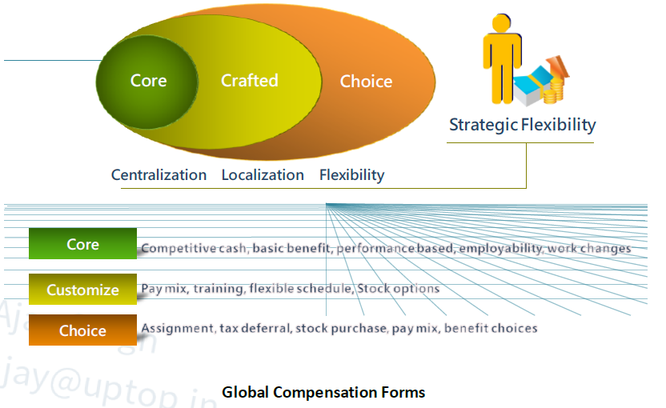
Global Compensation Form

Slide 23
Core
The core section of the model includes compensation and reward forms that signal the corporate global mind-set (e.g., creating a performance/customer service culture or a culture of ownership, insuring a basic level of services and benefits). Specific practices may vary according to market and local conditions but must be consistent with the core policies.

Slide 24
Crafted
The crafted set of compensation elements assumes that business unit or regional leaders have discretion to choose among a menu of total compensation forms that may be important to gain and sustain advantage in the markets in which they operate. For example, some form of housing assistance (loans, allowances, dormitories) may make sense in Shanghai, whereas in London or Tokyo, transportation assistance may make more sense. A single company with operating units in San Jose and Kuala Lumpur may find that specific elements (e.g., risk sharing, bonuses, language training, and flexible schedules) may be more important in California than in Kuala Lumpur.

Slide 25
Choice
Finally, the alternatives in the choice set offer flexibility for employees to select among various forms of total compensation. Analogous to flexible benefits, the choice set shifts the focus of customizing compensation from managers to employees. Examples here might include opportunities to take educational leaves to become eligible for regional or global assignments.

Slide 26
Strategic Flexibility
Strategic flexibility means that companies achieve advantage by customizing multiple compensation and reward systems. This is already the state of practice in companies operating in multiple markets or employing contingent and core workforces. The art is to avoid the chaos created when multiple systems go off in multiple directions. This results in numerous compensation systems, one for each country in which the company operates. To overcome the chaos, the company must ensure that the multiple deals signal the organization's global mindset and support its strategic priorities.

Slide 27
Factors affecting Global Compensation
Culture : In some areas of the world, job and income security needs command paramount interest over pay-at-risk, so in the pay mix the base salary dominates the variable portion. For example, while China has a very aggressive sales compensation environment, in India there is more interest in base salary and their CTC (cost-to company) package than variable pay-at-risk compensation.

Slide 28
Factors affecting Global Compensation
Economic : Many differences subsist from country to country, in terms of the Influence of politics and power, Distribution of wealth across country’s citizenry and Unpredictability of events (i.e., sometimes rapid changes in rates of inflation, currency)

Slide 29
Compensation Philosophy
Each employer needs a policy which outlines their desired market position.
What percentile of the market is your target?
Which comparators are appropriate?
Is the target the same for all grades?
A well-articulated compensation policy provides valuable guidance for the development of a pay structure. In large organizations, there is often a corporate policy which forms the basis for local policies.

Slide 30
Steps to develop a salary structure
Establish your compensation philosophy
Gather market data
Identify benchmark jobs
Measure your market position
Calculate the compa-ratio
Check your budget
Start allocating
Final adjustments
Management approval
Communicate

Slide 31
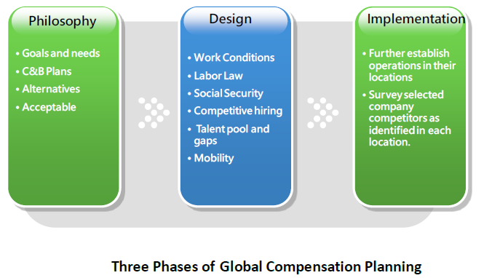
Global Compensation Planning

Slide 32
Phase One: Philosophy
Understanding strategic global/regional/local goals and needs.
Addressing global compensation and benefits plans.
Considering program alternatives
Determining how to implement programs that are culturally acceptable yet competitive blending global strategies with local practices

Slide 33
Phase Two: Design
Determining
  Employment and working conditions.
  Labor laws and contracts of employment.
  Statutory and social security benefits.
  Competitive hiring practices.
  Existing talent pool and gaps.
  Mobility of local workforce

Slide 34
Phase Three: implementation
Further establish operations in their locations based on information gathered in the design phase-recruiting, hiring, compensating, incenting, paying, and administering company local national employees.
Survey selected company competitors as identified in each location. Then, based on survey data, form recommendations of best practices and complete a “total" compensation/benefits study of these positions in each country.

Slide 35
Global Compensation Approaches
Headquarters (HQ) scale : Worldwide salary levels are established at HQ with differentials for each affiliate subsidiary according to the local cost of living. This option is usually reserved for managers and executives.
Salary scale based on location : Wages or salary levels are based on location-the local scale and norms. This option is primarily for the broader base of employees and usually excludes executives and globally mobile employees.

Slide 36
Global Job Grading
Global job grading approach recognizes this organizational reality by aligning job levels with both the internal value companies place on individual contributor positions relative to managerial positions, as well as the value the market places on each type of job. The system combines individual contributors and managers into global grades where market pay suggests equivalence. Below is an example of how different job families are graded and grouped into two tracks—one for management and one for individual contributor.

Slide 37

Global Job Grading

Slide 38
Remuneration Surveys
Remuneration surveys collect information on prevailing market compensation and benefit practices, including base pay, variable compensation (e.g., short- and long-term incentive plans), and time off. Remuneration surveys allow organizations to recognize and relate their remuneration structures to global and local trends.

Slide 39
Purposes of Remuneration Surveys
Adjust the pay level in response to changing rates paid by competitors.
Set the mix of pay forms relative to that paid by competitors.
Establish or price a pay structure.
Analyze pay-related problems.
Estimate the labor costs of product/service market competitors

Slide 40
Global Pay Structure
Policy Line : The pay level that a company sets its pay at compared to the market pay line, typically the midpoint of the pay structure is set to judge the going market rate. In building pay structure scientifically, the line is a statistically computed least-squares-regression line.
Pay grades are used to group jobs that have approximately the same relative internal or external worth; in other words, all jobs within a particular grade are paid the same rate or within the same pay range. Grades enhance an organization's ability to move people among jobs with no change in pay.

Slide 41
Global Pay Structure
Pay range typically means high to low or minimum to maximum pay for a certain job grade. The range midpoints, minimums, and maximums reflect career paths, promotions, and other management systems and philosophy within the organization. The differential must be large enough to induce employees to seek and/or accept the promotion or to undertake the necessary training required.

Slide 42
Global Pay Structure
Compa-ratios (CP) is a salary expressed as a percentage of or indexed to the salary range midpoint/market rate (salary/midpoint or market rate = CP). The CP may be used as an indicator of how an individual is doing against plan.

Slide 43
Global Pay Structure
Broad banding, called fat grades, means collapsing pay grades and ranges into just a few wide levels or a band, which includes one minimum and one maximum range, while midpoint often not used. The purposes of using broad banding as follow:
• Provide flexibility to define job responsibilities more broadly.
• Foster cross-functional growth and development.
• Ease mergers and acquisitions

Slide 44

Global Pay Structure

Slide 45
Questions

