Slide 1
Total Rewards - I
GPHR

Slide 2
Introduction
An organization’s goals are accomplished through people.
The major challenge of any organization is to attract, retain, motivate, and align the types and numbers of people it needs to achieve its goals.
This is accomplished through a value exchange—a situation in which the company and the employee give value to the other in exchange for value received to achieve their respective self-interests.
This notion can be summarized by the phrase, “Value given for value received.”

Slide 3

Value Exchange - Employee

Slide 4

Value Exchange - Employer

Slide 5

Evolution of Rewards

Slide 6
Total Rewards
Total Reward relates to all aspects of the employment offering, including the remuneration package (base pay, variable pay and benefits) as well as the intangible aspects of the psychological contract such as career development, employment security and working environment.
Total rewards include everything the employee perceives to be of value resulting from the employment relationship ~ WorldatWork

Slide 7

Total Rewards

Slide 8
Fixed Pay
Fixed pay, also known as base pay, is nondiscretionary compensation that does not vary according to performance or results achieved. It’s usually determined by the organization’s philosophy and pay structure.
Base Pay: Fixed or base pay is the compensation paid to an employee for performing specific job. The definition of base pay can vary by country. Base pay levels need to take into account variations in equivalent monthly salaries vary by country. The bottom line to fixed pay practices need to be based on a competitive strategy for each country. Types of Base pay include

Slide 9
Types of Base Pay
Salary: paid on a weekly, biweekly or monthly basis rather than by the hour, generally to higher level positions.
Nonexempt / hourly rates: paid by the hour for a job being performed. An individual’s annual pay is dependent on the number of hours worked during the course of the year.
Piece rate: payment is based on an individual ’s rates production. A payment is received for each piece or unit work produced.

Slide 10
Variable Pay
Incentive or Variable pay, also known as pay at risk, is compensation that is contingent on discretion, performance or results achieved. Much of the innovation in compensation is occurring in the variable pay element.
These schemes are adopted by many corporations in order to improve the employee morale and increase the motivation to work for the employees.

Slide 11
Types of Variable Pay
Bonuses or Incentives are delivered through plans that predetermine a performance and reward schedule.
Commission is a sum of money that is paid to an employee upon completion of a task, usually selling a certain amount of goods or services.
Profit- Sharing is a form of variable pay provided to all employees based on the profits of the company.
Performance-Sharing Plans : A variable pay plan bases rewards on the performance of a combination of quantitative and/or qualitative measures

Slide 12
Benefits
Programs an employer uses to supplement the cash compensation that employees receive. These health, income protection, savings and retirement programs provide security for employees and their families
Housing Allowance
Transportation Allowance
Meal Allowance
Phone Allowance
Training Allowance

Slide 13
Flexible benefits
Flexible benefits are the approach to benefits in an increasing number of American organizations. In essence, employees are typically given choices, up to a certain dollar limit, among a series of options for their benefits, including such things as pension contributions, health insurance options, dental insurance, life insurance,

Slide 14
External Influences on Total Rewards
Economic Factors : Total rewards is the near universal form of exchange worldwide between an employee’s talent, effort and skills and the employer’s ability to attract and retain the needed skills to accomplish its mission. Thus, total rewards becomes the crucial intersection between the supply and demand for labor

Slide 15
External Influences on Total Rewards
Cultural norms : Cultural norms and social mores are another critical component related to external influences. Rewards that are valued and appreciated in one culture may be less valuable (even offensive) in another. HR professionals must have a firm grasp of the customs and drivers of the diverse makeup and expectations of the workforce to effectively tailor programs for maximum efficacy.

Slide 16
External Influences on Total Rewards
Regulatory : Laws affect the design and implementation of pay, benefits and work rules. Organization-wide programs should be assessed to ensure they can be legally applied at the local level. This may require adaptation or even alternative programs to ensure compliance . Also, legal and regulatory violations can result in sanctions, damaging publicity and potential restrictions that may negatively affect an organization’s ability to conduct business

Slide 17
Internal Influences on Total Rewards
A business strategy may place its emphasis in one of the following key areas:
Operational excellence: a combination of price, quality, dependability and ease of purchase that competitors cannot match. The corporate culture typically strives to minimize waste and reward efficiency.
Product/service leadership: innovation, product development and market exploitation. The corporate culture encourages imagination and a mindset driven by the prospect of creating the future.
Customer intimacy: creates results for carefully selected customers. The corporate culture encourages deep and lasting relationships with customers.

Slide 18
Internal Influences on Total Rewards
Organizational Culture : Every business has a unique organizational culture that is shaped not only by the external influences in the world, but also by senior leadership, geography, employee demographics and even the business strategy itself.

Slide 19
Internal Influences on Total Rewards
HR Strategy : Business strategy and organizational culture are driven by external influences, these are the components that drive the design and execution of the all —inclusive approach an organization takes related to every facet of its human capital, or the HR strategy. In turn, the HR strategy drives the development and administration of total rewards strategy.

Slide 20
Total Rewards Communication
Awareness and understanding of total rewards by employees present an opportunity to enhance the employee experience. It’s a chance to:
Relate compensation and rewards to the company’s operating model.
Show how associates advance the company’s principles and values.
Clearly communicate how employees help the organization achieve and sustain dominance

Slide 21
Global Compensation Form
From a global perspective, there are substantial differences in the ways people get paid. Consider, for example, that the pay packages offered by the same multinational operating in both Shanghai and Bratislava are very different. In Shanghai, the package may emphasize housing allowances and bonuses intended to retain scarce critical skills, while in Bratislava the package will place greater emphasis on productivity - based gainsharing and base

Slide 22
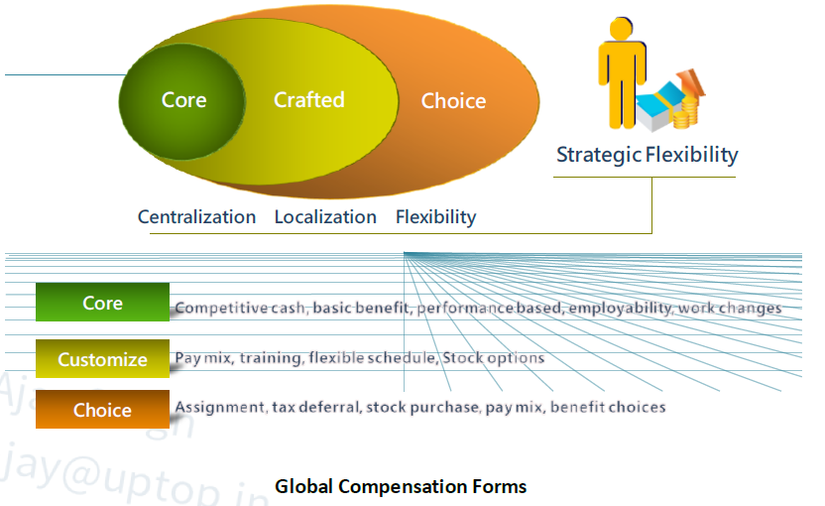
Global Compensation Form

Slide 23
Core
The core section of the model includes compensation and reward forms that signal the corporate global mind-set (e.g., creating a performance/customer service culture or a culture of ownership, insuring a basic level of services and benefits). Specific practices may vary according to market and local conditions but must be consistent with the core policies.

Slide 24
Crafted
The crafted set of compensation elements assumes that business unit or regional leaders have discretion to choose among a menu of total compensation forms that may be important to gain and sustain advantage in the markets in which they operate. For example, some form of housing assistance (loans, allowances, dormitories) may make sense in Shanghai, whereas in London or Tokyo, transportation assistance may make more sense. A single company with operating units in San Jose and Kuala Lumpur may find that specific elements (e.g., risk sharing, bonuses, language training, and flexible schedules) may be more important in California than in Kuala Lumpur.

Slide 25
Choice
Finally, the alternatives in the choice set offer flexibility for employees to select among various forms of total compensation. Analogous to flexible benefits, the choice set shifts the focus of customizing compensation from managers to employees. Examples here might include opportunities to take educational leaves to become eligible for regional or global assignments.

Slide 26
Strategic Flexibility
Strategic flexibility means that companies achieve advantage by customizing multiple compensation and reward systems. This is already the state of practice in companies operating in multiple markets or employing contingent and core workforces. The art is to avoid the chaos created when multiple systems go off in multiple directions. This results in numerous compensation systems, one for each country in which the company operates. To overcome the chaos, the company must ensure that the multiple deals signal the organization's global mindset and support its strategic priorities.

Slide 27
Factors affecting Global Compensation
Culture : In some areas of the world, job and income security needs command paramount interest over pay-at-risk, so in the pay mix the base salary dominates the variable portion. For example, while China has a very aggressive sales compensation environment, in India there is more interest in base salary and their CTC (cost-to company) package than variable pay-at-risk compensation.

Slide 28
Factors affecting Global Compensation
Economic : Many differences subsist from country to country, in terms of the Influence of politics and power, Distribution of wealth across country’s citizenry and Unpredictability of events (i.e., sometimes rapid changes in rates of inflation, currency)

Slide 29
Questions

