Slide 1
Topic Modelling
helps in identifying the abstract topics present in a collection of documents.
It is used to discover the hidden thematic structure in large volumes of text data.
The key idea is to find word patterns that can represent topics, and subsequently, the documents can be classified into these topics.

Slide 2
Applications of LDA:
Organize and manage a large number of different types of content.
Use cases ?

Slide 3
· Document Classification:
Application: Automatically categorize a collection of news articles into topics like politics, sports, technology, etc.
Example: A news organization uses Topic Modeling to sort daily articles into different sections for easier management and retrieval.
· Content Recommendation:
Application: Recommend content to users based on the topics of articles or papers they have previously read.
Example: A research database like Google Scholar suggests relevant academic papers to a user based on the topics inferred from their reading history.
·
.

Slide 4
Social Media Analysis:
Application: Analyze social media posts to identify trending topics or public sentiment.
Example: A company uses Topic Modeling to analyze tweets about their brand, identifying common themes like customer service, product features, and complaints.
· Customer Feedback Analysis:
Application: Understand customer concerns and preferences by analyzing reviews and feedback.
Example: An e-commerce company uses Topic Modeling on customer reviews to identify frequently mentioned issues, such as delivery times, product quality, or pricing.
· Market Research:
Application: Analyze survey responses or focus group discussions to identify consumer preferences and trends.
Example: A market research firm uses Topic Modeling on survey data to uncover hidden topics related to consumer behavior, such as brand loyalty or product satisfaction.

Slide 5
· Legal Document Summarization:
Application: Summarize large volumes of legal documents by extracting key topics.
Example: A law firm uses Topic Modeling to quickly identify the main legal arguments and relevant cases in a large set of legal briefs.
· Healthcare Data Analysis:
Application: Analyze medical records or research papers to discover emerging health trends.
Example: Researchers use Topic Modeling to analyze a corpus of medical papers to track the development of topics like COVID-19 variants, vaccine efficacy, and treatment methods.

Slide 6
· E-learning Content Organization:
Application: Organize educational content into thematic modules for personalized learning experiences.
Example: An online learning platform uses Topic Modeling to automatically group courses into topics like data science, machine learning, and natural language processing

Slide 7
Unsupervised
LDA - Latent Dirichlet Allocation

Slide 8
Input
Set of Documents
Document-topic density factor (‘α’) – Higher means more themes/topic per document
Topic-word density factor (‘β’) – Higher means more terms per theme/topic
The number of topics to be considered (K).

Slide 9
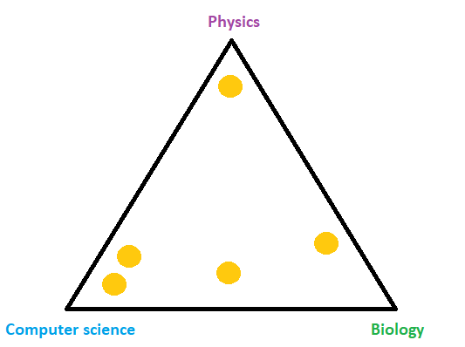
@Enes Zvornicanin

Slide 10
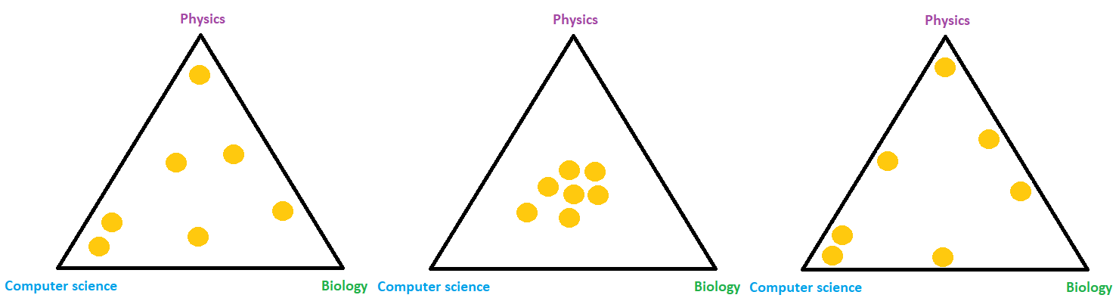
@Enes Zvornicanin

Slide 11
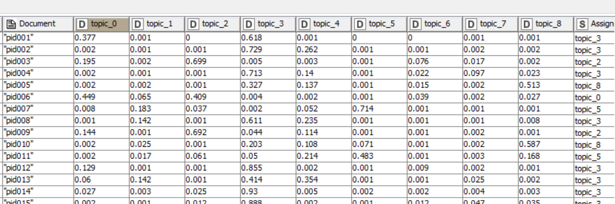

Slide 12
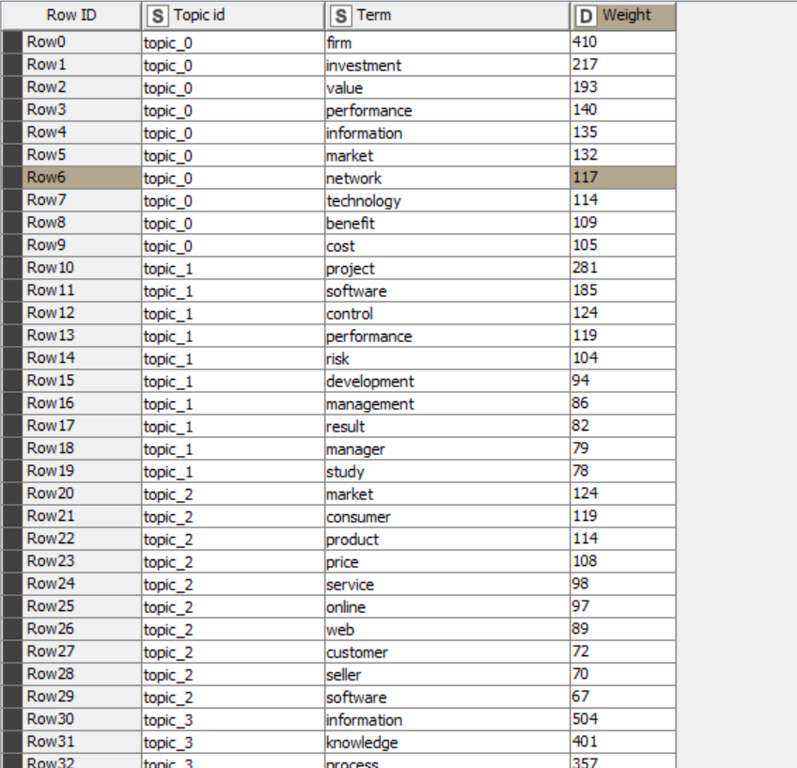

Slide 13
Hands on
IS Literature Mining with Topic Detection (LDA)
https://kni.me/w/OgrcuCEJMcJE1R43
Topic Detection movie reviews
https://kni.me/w/y1RewSCIeoyC001g
Topic Detection
https://kni.me/w/U6_7s11qz6-9GgFx

