Slide 1
BERT & GPT3
Bidirectional Encoder Representations from Transformers, Google
https://kni.me/w/3VGz0gdnmIy-DfT4
https://hub.knime.com/redfield/extensions/se.redfield.bert.feature/latest
Generative Pre-trained Transformer 3, OpenAI Inc.
https://kni.me/w/eMgEfCXE4QOhqvLR

Slide 2
Topic Modelling
Unsupervised
Extract topics(themes) from corpus
LDA - Latent Dirichlet Allocation

Slide 3
Input
Set of Documents
Document-topic density factor (‘α’) – Higher means more themes/topic per document
Topic-word density factor (‘β’) – Higher means more terms per theme/topic
The number of topics to be considered (K).

Slide 4
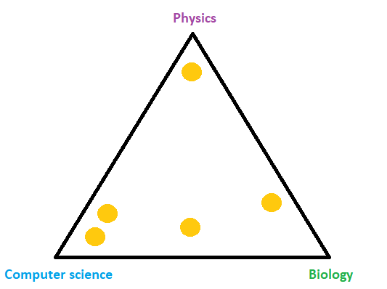
@Enes Zvornicanin

Slide 5
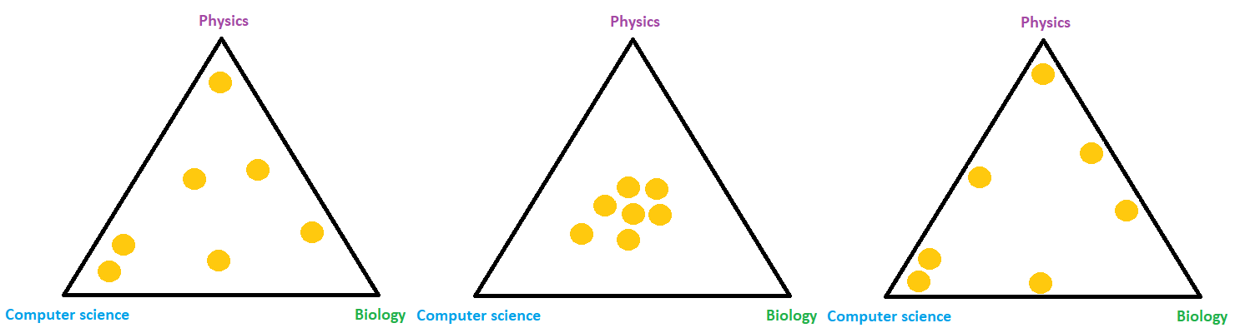
@Enes Zvornicanin

Slide 6
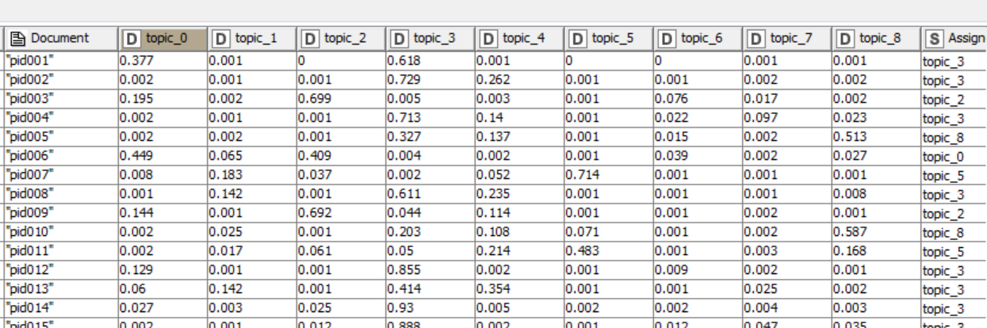

Slide 7
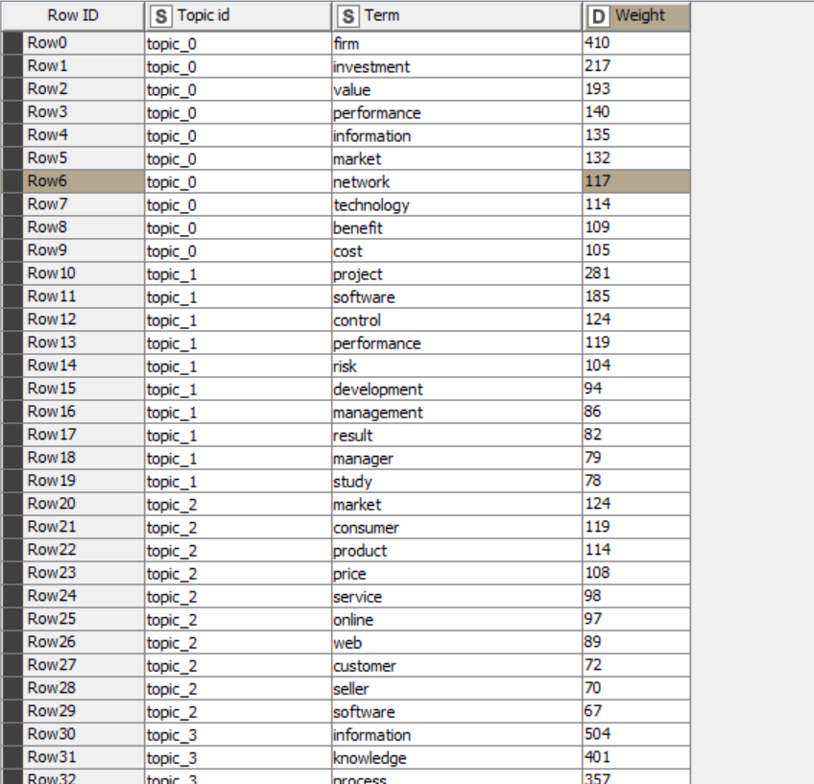

Slide 8
Applications of LDA:
Organize and manage a large number of different types of content.
Use cases ?

Slide 9
Hands on
IS Literature Mining with Topic Detection (LDA)
https://kni.me/w/OgrcuCEJMcJE1R43
Topic Detection movie reviews
https://kni.me/w/y1RewSCIeoyC001g
Topic Detection
https://kni.me/w/U6_7s11qz6-9GgFx

