Slide 1

Project Management – Time Cost Trade-off Using Solver
Akanksha Saxena
INDIAN INSTITUTE OF MANAGEMENT ROHTAK

Slide 2

Project Management
Let’s hear from you!

Slide 3
Agenda for today’s sessions
Discussion on some theoretical aspects
Constructing a project network
Perform forward and backward passes
Determine project completion time
Calculate slack values
State the critical path
Time cost trade-off in projects – crashing
Time cost trade-off in projects – Using solver

Slide 4
Resources
Every project needs resources
Resources can be in any forms from human, labour, material, etc.
Resources have costs
Management of resources is important for any activity to be performed
We do not want to over allocate a resource for a task as it will lead to conflict and increase in project cost

Slide 5
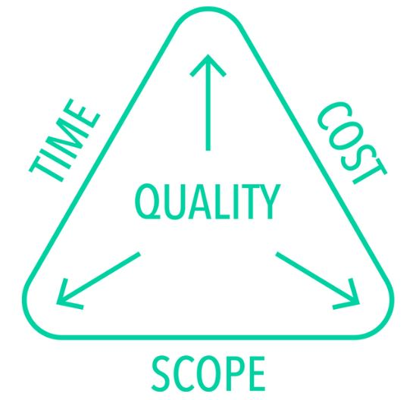
The Iron Triangle of Project Management

Slide 6
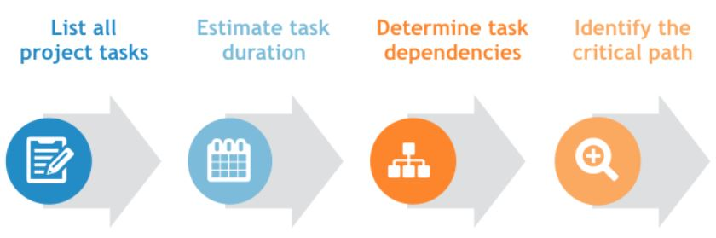
What should you do first?

Slide 7
Critical Path Method
Critical Path : The longest path (in time) from Start to Finish; it indicates the minimum time necessary to complete the entire project.
By using CPM, you will be able to answer questions such as:
When will the entire project be completed?
What are the critical activities or tasks in the project, that is, the ones that will delay the entire project if they are late?
Which are the noncritical activities, that is, the ones that can run late without delaying the whole project’s completion time?
At any particular date, is the project on schedule, behind schedule, or ahead of the schedule?
On any given date, is the money spent equal to, less than, or greater than the budgeted amount?

Slide 8
Example
Activity | Immediate Predecessors | Expected Time
A | -- | 2
B | A | 8
C | A | 6
D | B,C | 3

Slide 9
Activity | Immediate Predecessors | Expected Time
A | -- | 2
B | A | 8
C | A | 6
D | B,C | 3

Slide 10
Example
Activity | Immediate Predecessors | Expected Time
A | -- | 7
B | -- | 9
C | A | 12
D | A,B | 8
E | D | 9
F | C,E | 6
G | E | 5

Slide 12
Fast-tracking and crashing
Fast-tracking
The process of shortening a project by doing tasks at the same time (in parallel) is called fast- tracking
Fast tracking is the most common method used for shortening a project because it appears to be less expensive than the only alternative
Crashing
Crashing requires applying additional resources to critical path tasks to shorten individual tasks.

Slide 13
Crashing
Crashing
  Reducing project time by including additional resources
Crash time
  An amount of time an activity is reduced
Crash cost
  Cost of reducing activity time
Goal
  Reduce project duration at minimum cost

Slide 14
Project Crashing: Time-Cost Trade-Off Overview
Project duration can be reduced by assigning more resources to project activities.
However, doing this increases project cost.
Decision is based on analysis of trade-off between time and cost.
Project crashing is a method for shortening project duration by reducing one or more critical activities to a time less than normal activity time.

Slide 15
General relationship of Time and Cost
Project has direct and indirect costs
Direct costs are attributed to a specific project. Example – raw materials, equipment, labor costs etc.
Indirect costs cannot be attributed to a specific project. Example – management, general administration, rental and utility costs. Indirect activities benefit more than one project
Crashing costs are highest when the project is shortened.
Indirect costs increase as the project duration increases.
The optimal project time is at the minimum point on the total cost curve.

Slide 16
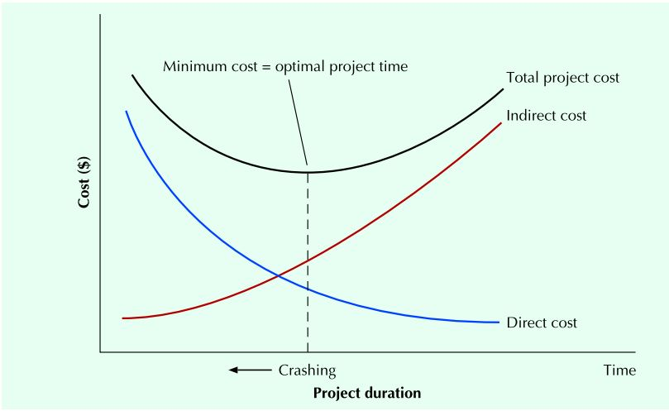
Time cost trade-off

Slide 17
Crashing example
Additional project overhead cost/day = $600/day
Activity | Predecessors | Normal Duration | Crash Duration | Normal Cost of Activity ($) | Additional Cost/Day to Crash ($)
A | -- | 2 | 2 | 1200 | 0
B | A | 5 | 4 | 1800 | 600
C | B | 6 | 4 | 1700 | 400
D | B | 7 | 5 | 1500 | 700
E | C,D | 4 | 3 | 1900 | 500

Slide 18
Additional project overhead cost/day = $600/day
Activity | Predecessors | Normal Duration | Crash Duration | Normal Cost of Activity ($) | Additional Cost/Day to Crash ($)
A | -- | 2 | 2 | 1200 | 0
B | A | 5 | 4 | 1800 | 600
C | B | 6 | 4 | 1700 | 400
D | B | 7 | 5 | 1500 | 700
E | C,D | 4 | 3 | 1900 | 500

Slide 19
Activity | Predecessors | Normal Duration | Crash Duration | Normal Cost of Activity ($) | Additional Cost/Day to Crash ($)
A | -- | 2 | 2 | 1200 | 0
B | A | 5 | 4 | 1800 | 600
C | B | 6 | 4 | 1700 | 400
D | B | 7 | 5 | 1500 | 700
E | C,D | 4 | 3 | 1900 | 500

Slide 20
Case : Project Management Analysis in the Internet Forecasting Industry
The company ABC Ltd. designed and distributed a variety of management software products through the Internet and retail outlets like Best Buy. The company was considering the development of an Internet-based forecasting system. This system was designed specifically for the new start-up and small business owner.
Baldwin, Director of Operations, after consulting with the technical staff and reviewing historical efforts, had developed the task descriptions, time estimates and immediate predecessor (IP) relations.
ABC Ltd.’s management team had established a 35-week completion time for this effort. A preliminary assessment indicated that some of the project tasks would need to be shortened to meet the management deadline of 35 weeks. Accordingly, the project manager had prepared a set of task-crashing estimates.
He needed to estimate the completion time and budget for the project. Furthermore, he knew that he would need to determine the probability that the project could be completed within the deadline of 35 weeks.

Slide 21
Project Management Analysis in the Internet Forecasting Industry
He knew that the board would want to know the minimum expected time in which the project could be completed. In addition, he wanted to assess the additional costs for reducing the project time to the required 35 weeks, and which specific tasks could be crashed to achieve this milestone.

Slide 22
Exhibit 1 : Project description and time estimates (weeks)
Task | Description | Most optimistic | Most likely | Most pessimistic | IP
A | Requirements | 2 | 3 | 4 | -
B | Market assessment | 4 | 7 | 10 | A
C | Design | 5 | 6 | 9 | A
D | Development | 6 | 7 | 16 | C
E | Testing | 7 | 9 | 10 | D
F | Revising | 4 | 5 | 6 | B,E
G | Documentation | 3 | 6 | 10 | D
H | Quality assurance | 2 | 4 | 7 | C,E
I | Pricing | 2 | 2 | 2 | B
J | Production | 3 | 4 | 14 | F,G,H,I
K | Distribution | 2 | 3 | 4 | J
Exhibit 2 : Project crash data
Task | Normal costs ($) | Crash time (weeks) | Crash costs ($)
A | 10,000 | 3 | 10,000
B | 20,000 | 6 | 25,000
C | 15,000 | 5 | 30,000
D | 45,000 | 6 | 65,000
E | 10,000 | 8 | 20,000
F | 15,000 | 4 | 18,000
G | 20,000 | 4 | 30,000
H | 10,000 | 3 | 15,000
I | 5,000 | 2 | 5,000
J | 40,000 | 5 | 50,000
K | 15,000 | 2 | 25,000

Slide 23
Project Management Analysis in the Internet Forecasting Industry
What is the estimated completion time for this project? What is the estimated project budget?
What is the probability that the project can be completed in 35 weeks?
What is the minimum expected time in which this project can be completed?
What is the additional cost for reducing the project time to the required 35 weeks?
Which specific tasks do you recommend crashing in order to achieve this milestone?

Slide 24
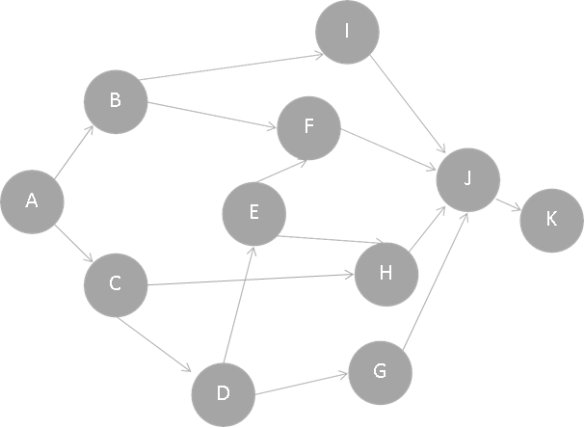
AON Diagram
Task | Description | Most optimistic | Most likely | Most pessimistic | IP
A | Requirements | 2 | 3 | 4 | -
B | Market assessment | 4 | 7 | 10 | A
C | Design | 5 | 6 | 9 | A
D | Development | 6 | 7 | 16 | C
E | Testing | 7 | 9 | 10 | D
F | Revising | 4 | 5 | 6 | B,E
G | Documentation | 3 | 6 | 10 | D
H | Quality assurance | 2 | 4 | 7 | C,E
I | Pricing | 2 | 2 | 2 | B
J | Production | 3 | 4 | 14 | F,G,H,I
K | Distribution | 2 | 3 | 4 | J

Slide 25
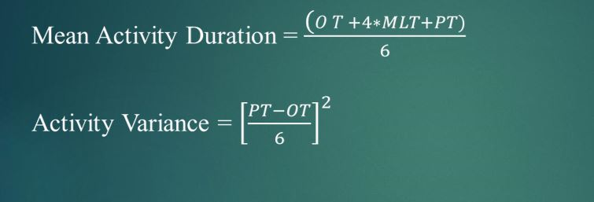

Slide 26
Keller Carpet
Keller Carpet and Trim installs carpet in commercial offices. Peter Kelle has been very concerned with the amount of time it took to complete several recent jobs. Some of his workers are very unreliable. A list of activities and their optimistic completion time, the most likely completion time, pessimistic completion time (all in days), and crash cost for a new project are given in the following table.

Slide 27
Keller Carpet
ACTIVITY | IMMEDIATE PREDECESSORS
A | —
B | —
C | —
D | C
E | B, D
F | A, E
G | A, E
H | F
I | G
J | C
K | H, I

Slide 28
Keller Carpet
Keller Carpet
ACTIVITY | Optimistic | Most Likely | Pessimistic | Crash cost/day
A | 3 | 6 | 8 | 300
B | 2 | 4 | 4 | 200
C | 1 | 2 | 3 | 1800
D | 6 | 7 | 8 | 2500
E | 2 | 4 | 6 | 1900
F | 6 | 10 | 14 | 2300
G | 1 | 2 | 4 | 500
H | 3 | 6 | 9 | 800
I | 10 | 11 | 12 | 1500
J | 14 | 16 | 20 | 600
K | 2 | 8 | 10 | 1400

Slide 29
Compute expected duration of all the activities in the project.
Draw the network of the project and identify alternative paths in the network.
For. each path, compute the expected duration and hence identify the critical path and the near critical path for the problem
What is the probability of completion of the project by 34 days?

Slide 30
Keller Carpet
ACTIVITY | Duration | Variance
A | 5.83 | 0.69
B | 3.67 | 0.11
C | 2.00 | 0.11
D | 7.00 | 0.11
E | 4.00 | 0.44
F | 10.00 | 1.78
G | 2.17 | 0.25
H | 6.00 | 1.00
I | 11.00 | 0.11
J | 16.33 | 1.00
K | 7.33 | 1.78
END | 0 | 0

Slide 31
Keller Carpet
Activity | Predecessor
A | —
B | —
C | —
D | C
E | B, D
F | A, E
G | A, E
H | F
I | G
J | C
K | H, I
I
G
A
K
B
E
F
H
Start
END
C
D
J

Slide 32
Keller Carpet
Activity | Duration
A | 5.83
B | 3.67
C | 2.00
D | 7.00
E | 4.00
F | 10.00
G | 2.17
H | 6.00
I | 11.00
J | 16.33
K | 7.33
I
G
A
K
B
E
F
H
Start
END
C
D
J

Slide 33
Keller Carpet
Kellar Carpet
ACTIVITY | Duration | ES | EF | LS | LF | Slack
A | 5.83 | 0 | 5.83 | 7.17 | 13.00 | 7.17
B | 3.67 | 0 | 3.67 | 5.33 | 9.00 | 5.33
C | 2.00 | 0 | 2.00 | 0.00 | 2.00 | 0.00
D | 7.00 | 2.00 | 9.00 | 2.00 | 9.00 | 0.00
E | 4.00 | 9.00 | 13.00 | 9.00 | 13.00 | 0.00
F | 10.00 | 13.00 | 23.00 | 13.00 | 23.00 | 0.00
G | 2.17 | 13.00 | 15.17 | 15.83 | 18.00 | 2.83
H | 6.00 | 23.00 | 29.00 | 23.00 | 29.00 | 0.00
I | 11.00 | 15.17 | 26.17 | 18.00 | 29.00 | 2.83
J | 16.33 | 2.00 | 18.33 | 20.00 | 36.33 | 18.00
K | 7.33 | 29.00 | 36.33 | 29.00 | 36.33 | 0.00
END | 0 | 36.33 | 36.33 | 36.33 | 36.33 | 0.00

Slide 34
Critical and Near Critical Path
Paths | Length
C-D-E-F-H-K-END | 36.33
C-J-END | 18.33
B-E-F-H-K-END | 31.00
B-E-G-I-K-END | 28.17
A-F-H-K-END | 29.17
A-G-I-K-END | 26.33
C-D-E-G-I-K-END | 33.50

Slide 35
Keller Carpet 2
Keller Carpet
Activity | Predecessor | Successor | Normal Time | Crash Time | Normal Cost | Crash Cost
A | - | G, F | 5.8 | 3 | 1750 | 2600
B | - | E | 3.7 | 2 | 733 | 1067
C | - | D, J | 2.0 | 1 | 3600 | 5400
D | C | E | 7.0 | 6 | 17500 | 20000
E | B, D | F, G | 4.0 | 2 | 7600 | 11400
F | A, E | H | 10.0 | 6 | 23000 | 32200
G | A, E | I | 2.2 | 1 | 1083 | 1667
H | F | K | 6.0 | 3 | 4800 | 7200
I | G | K | 11.0 | 10 | 16500 | 18000
J | C | End | 16.3 | 14 | 9800 | 11200
K | H, I | END | 7.3 | 2 | 10267 | 17733

Slide 36
Resource classifying in MS-Project
Resource Type – Identifies the kind of activity that is planned or tracked using this resource; options are as follows:
☐ Work – Resource assignments have estimated (and actual) work (typically hours of effort) at a specified cost per time period. Units refer to the proportion of time that the resource is assigned to this task.
☐ Material – Resource assignments have estimated (and actual) units of consumption at a specified cost per unit (e.g. cubic yards of concrete at $200 per cu yard). Units refer to the number of specified items for the task. There is no work (effort) associated with material resources although under some conditions, the units amount is copied into the work field.
☐ Cost – Resource assignments have estimated (and actual) cost amounts for this resource (e.g. consulting fees). There are no units or work associated with cost resources.
☐ Generic – This is a Yes/No flag that can be associated with any resource type. A resource flagged as Generic behaves just as the basic resource as far as estimating and scheduling is concerned. However, generic resources are essentially placeholders and so are incapable of carrying out actual work, being consumed as materials, or being charged as costs. Before undertaking an actual task, any assigned generic resources should be replaced with equivalent named resources.
☐ Local – This is a Yes/No flag set automatically depending on the source of the resource information. If the resource is derived from the enterprise resource pool, it is an enterprise resource. If it was entered by the project manager in a project, it is a local resource.

Slide 37
Budget – This is a Yes/No flag associated with any resource type. A resource flagged as Budget can be assigned only at the project summary level. The purpose of this type of resource is to provide a way of recording a high-level (budget) estimate for the project. The same basic resource types can be applied to budget resources, and you may use a combination of budget resources on a single project to model the various aspects of the project budget. For example, you may have different cost budget resources for capital versus expense and different ones for different general ledger accounts. You may also have different work budget resources for hours of effort by different categories of worker.
Budget resource information is normally applied by using a resource custom field that allows the budget resource information and the “real” resource information to be grouped together in a report. This allows the budget, baseline, actual to date and estimate to completion figures to be seen in the same report.

Slide 38
Budget
Cost budgeting involves associating the overall cost estimates with individual work items to establish a cost baseline for measuring project performance. The cost estimates developed, the WBS, and the project schedule are used to carry out cost budgeting.
This process will result in a cost baseline , a time-phased forecast that will be used to measure and monitor cost performance on the project.
The cost baseline is developed by summing estimated costs by period

Slide 39
Budget work
Budget work - The Budget Work fields are used to enter or review budget work for budget work and material resources.
Budget resources are assigned only to the project summary task.
You can use the Budget Work fields to compare the current budgeted work with the planned work for the project.
How calculated - When you assign a work or material resource that is a budget resource to a project summary task, and then enter a work amount for the resource in either the Task Usage or Resource Usage view, Project rolls up the total amount to the project summary task.

Slide 40
Budget work
Example –
Having built your project based on an estimate of 5,000 hours for three full-time equivalent work resources, you create "Staffing" as a work resource and identify it as a budget resource.
You assign the "Staffing" resource to the project summary task, and then enter the work amount of 5,000 hours in the Task Usage view.
As work continues, you enter actual progress information in the project plan. You can compare any variances between your planned work and actual work to analyze whether you're on track or need to make any adjustments.

Slide 41
Budget cost
The Budget Cost fields are used to enter or review budget costs for budget cost resources.
Budget resources are assigned only to the project summary task. You can use the Budget Cost fields to compare the current budgeted costs with the planned or actual costs for the project.
How calculated - When you assign a cost resource that is a budget resource to a project summary task, and then enter a budget amount for the cost resource in either the Task Usage or Resource Usage view, Microsoft Project rolls up the total amount to the project summary task.
This information can then be used to review the overall budget cost information for the project.

Slide 42
Budget cost
Example –
With a budget of $15,000 for travel for a three-month project, you have identified "Travel" as a cost resource and a budget resource.
You've assigned this cost resource to the project summary task, and entered the budget amount for travel in the Task Usage view. As work on the project continues, you enter actual progress information in the project plan.
You compare any variances between your planned costs and actual costs to ensure that you're on track and to make any necessary adjustments.

Slide 43
Baseline plan
Taking the time to develop a well-thought-out plan is critical to the successful accomplishment of any project.
Many projects have overrun their budgets, missed their completion dates, or only partially met their requirements because there was no viable baseline plan before the project was started

Slide 44
Baseline plan
The project baseline represents your expectations for the project. When you track actual project progress, you can use the baseline to compare your original plan for the project with the actual results—which tasks started earlier or later than planned, exceeded their original budget, took longer than planned, and so on.
You may be able to use this information to prevent problems on future projects and make better time and budget estimates. After you finish building your plan, but before you begin to execute it, you are ready to set a baseline.
One the baseline plan is established, it must be implemented. This involves performing the work according to the plan and controlling the work do that the project scope is achieved within the budget and schedule, to the customer’s satisfaction

Slide 45
Baseline budget cost
The Baseline Budget Cost fields display the originally planned budget for budget cost resources. Budget resources are assigned only to the project summary task. The Baseline Budget Cost fields show the total costs budgeted for the project.
You can use the Baseline Budget Cost fields to compare the baseline budgeted costs with the current budgeted costs and planned costs for the project.
How calculated - When you assign a cost resource that is a budget resource to a project summary task, and then enter a cost for the resource in either the Task Usage or Resource Usage view, Microsoft Office Project rolls up the total amount to the project summary task. The Baseline Budget Cost field contains $0.00 until you set a baseline for the project. When you then save a project baseline, this value is saved in the Baseline Budget Cost task field.

Slide 46
Baseline budget cost
Example - Work started on your project two months ago, when you first saved the project baseline.
Now you want to compare the Baseline Budget Cost field with the current Budget Cost field.
In the Task Sheet, you show the project summary task, and then add both the Baseline Budget Cost and Budget Cost fields to analyze your budget cost variances and determine whether you're on track or need to make any adjustments.

Slide 47
Baseline budget work
The Baseline Budget Work fields display the originally planned budget work amounts for budget work and material resources. Budget resources are assigned only to the project summary task. The Baseline Budget Work fields show the total budgeted work for the project.
You can use the Baseline Budget Work fields to compare the baseline budgeted work with the current budgeted work and planned work for the project.
How calculated –
When you assign a cost resource that is a budget resource to a project summary task, and then enter a cost for the resource in either the Task Usage or Resource Usage view, Microsoft Office Project rolls up the total amount to the project summary task. The Baseline Budget Cost field contains $0.00 until you set a baseline for the project. When you then save a project baseline, this value is saved in the Baseline Budget Cost task field.

Slide 48
Baseline budget work
Example –
Work started on your project two months ago, when you first saved the project baseline. Now you want to compare the Baseline Budget Cost field with the current Budget Cost field. In the Task Sheet, you show the project summary task, and then add both the Baseline Budget Cost and Budget Cost fields to analyze your budget cost variances and determine whether you're on track or need to make any adjustments.

Slide 49
Time-phase of baseline budget work and baseline budget cost
The time-phased versions of these fields show these same costs distributed over time.
The time-phased versions of these fields show these same person-hours distributed over time.

Slide 50
Contingency Budget
Contingency budget, in the context of project management, is an amount of money that is included to cover potential events that are not specifically accounted for in a cost estimate.
Multiple ways you can set up contingency reserve –
  By setting contingency cost as a set percentage of total cost
  By creating a separate column set against percentage cost of any activity that might need a contingency reserve
  By adding a fixed cost in project summary task and adding a note

Slide 51
Project Budget – Danshui Plant
In August 2010, Wentao Chen, manager of Danshui Plant No. 2 in southern China, was anxious. The plant was in the third month of a 12-month contract to assemble the Apple iPhone 4. The contract called for Danshui to assemble 2.4 million iPhones in the period between June 1, 2010, and May 31, 2011, but now in the third month of the contract, production was only 180,000 units per month. Chen called Jianye Ma, the plant controller, to request a summary of monthly operations for August as soon after the end of the month as possible.
Danshui was a contract manufacturer that assembled electronic products for companies wishing to save labor costs by locating in southern China where semiskilled labor was available for less than one dollar an hour.
Manufacturers like Danshui assembled parts in large plants using assembly line techniques according to specifications of the international companies that contracted with them for assembly and final testing.
The largest contract manufacturer in China was Foxconn, a division of the Hon Hai Group of Taiwan, with more than 800,000 workers in China alone and contracts to supply Apple, Dell, and Hewlett Packard among others.

Slide 52
In expectation of high demand for the iPhone 4, Apple had contracted with Danshui to assemble iPhones in Plant No. 2, which had been assembling computer hard drives on a contract that was fulfilled at the end of May 2010.
Although the assembly of hard drives was different than assembly of iPhones, Danshui was confident that its workers would adapt to the new assembly tasks and that it could hire and train the additional workers as needed.
Chen’s job was to get Plant No. 2 up to speed to fulfill the Apple contract and earn a profit for Danshui’s parent company, located in Hong Kong, China.
Danshui Plant No. 2 was a profit center that was credited for each iPhone produced and shipped, and charged for parts, labor, overhead, and shipping. Because the contract was for a year, an annual budget was established soon after the iPhone contract was signed.
This budget was divided by 12 to establish equal monthly budgets to which actual revenues and expenses could be compared. All budgeting and monthly reporting was done in U.S. dollars.
As the plant manager, Wentao Chen was responsible for control of all costs in his plant. Materials, labor, and overhead were his responsibility. This was done to provide incentive to control all costs whether caused by use waste, damage, theft, or inefficiencies.

Slide 53
Apple iPhone 4
The iPhone 4 contained more than 100 components manufactured in plants located in Europe, Asia, and the United States.
For examples, Samsung supplied flash memories and application processors, and Infineon (a German chip maker) supplied chips that send and receive phone calls and data.
A gyroscope, new to the iPhone 4, came from STMicroelectronics, based in Geneva, and a touch-screen module came from Taiwan. Contract manufacturers assembled these parts in assembly line plants that required each worker to focus on one or more tasks in a short period of time as each phone moved along an assembly line toward completion.
Estimates of the material cost of each iPhone were around $180, assembly labor around 7% of total cost, and Apple’s profit margins about 60% of the selling price to customers.
The assembly process at Danshui Plant No. 2 was almost entirely based on handwork by workers. There were about 140 steps in the assembly process for an iPhone 4, and each phone was handled by 325 individuals during the five days required for assembly.
Apple released the iPhone 4 on June 24, 2010 and more than 1.7 million units were sold in the first three days it was available. It was the most successful product launch in Apple history. Apple fanatics around the world waited in long lines to get their hands on the new phone.

Slide 54
The August Report
September 1, 2010
Revenue was below budget, material usage seems good, and labor costs were above budget.
In terms of plant profit, budget was $100,000, but they actually had a loss of $672,000.
The main reason - unable to produce 200,000 iPhone 4 units in any of the three months
Major obstacle –
Unable to find people to hire, even though they raised factory wages by almost 30% since July – (But competitors raised by 35%)
Trouble with Samsung Flash memory installation – To be handled very carefully – can get damaged by heat
1000 flash memories damaged and had to replaced
However, Samsung being aware of this, started providing them shield to prevent damage and hence increased the price $2 – (Apple raised Danshui’s revenue by equal amount, so should be neutral)

Slide 55
Company Context
Danshui Plant No. 2 has a contract with Apple to assemble the iPhone 4
Danshui has completed 3 months of the 12-months contract, only 9 months remain.
To date, production (180,000 iphones/month) is less than target (200,000 iphones/month(
  The major problem is that Danshui can’t find enough labor to increase the volume to 200,000 units per month. The increased wages 30%, but they are still short of labor
  Danshui also had a problem with Samsung flash memory. The problem was solved, but it resulted in an increased cost of the flash memory. Apple has agreed to an increased price to offset the increased cost.
Danshui budgeted $100,000 net income per month. This equates to $1,200,000 net income for full year context. The loss this month ($672,000) was approximately one half of their expected total income for the year

Slide 56
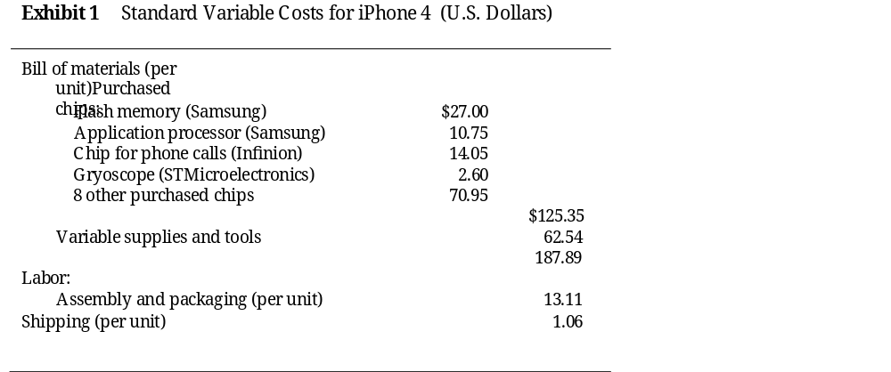
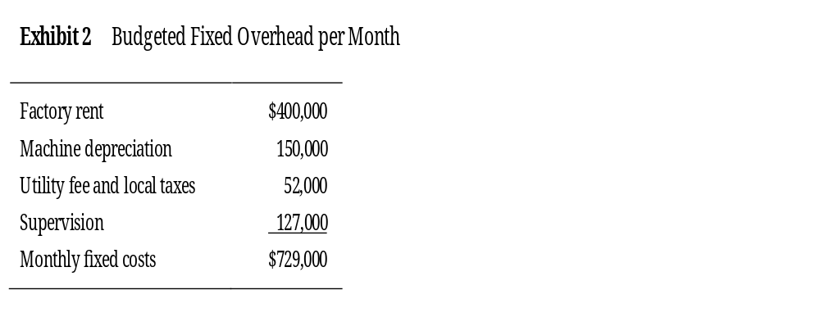

Slide 57
