Slide 1
FATS
Time Series Analysis
Prof. M Shameem Jawed

Slide 2
Time Series Data?
What is a time series?
  Anything observed sequentially (by time?)
  Returns, volatility, interest rates, exchange rates, bond yields, …
  Trade and Order book
How is it different?
The observations are not independent.
There is correlation from observation to observation / time to
time.
Discrete time series may arise in two ways:
By sampling a continuous time series
By accumulating a variable over a period of time
Characteristics of time series
  Time periods are of equal length
  No missing values

Slide 3
What we mean by Auto(Serial) Correlation?
Autocorrelation is a systematic pattern in the errors that can be either attracting (positive) or repelling (negative) autocorrelation.
  Time series data : Autocorrelation : Cov(u_{t}, u_{t-1})≠ 0
  Cross section data : Serial Correlation : Cov(u_{i}, u_{j})≠ 0
Correlogram
  Plot of Autocorrelation against its lag

Slide 4
How about our day-to-day Economic Series look like ?
2.5
.7
2.25
2
Share Prices
.65
Exchange Rate
1.75
.6
1.5
.55
1.25
.5
1
.75
.45
.5
.4
.25
.35
0
50
100
150
200
250
300
350
400
450
0
50
100
150
200
250
9.3
Mean is changing -- As time changes, mean is
changing
9.2
Income
9.1
9
Normal (and t, F etc) distributions have constant mean
8.9
8.8
So any analysis with changing means → can’t
assess thro’ hypothesis testing.
8.7
1960
1965
1970
1975

Slide 5
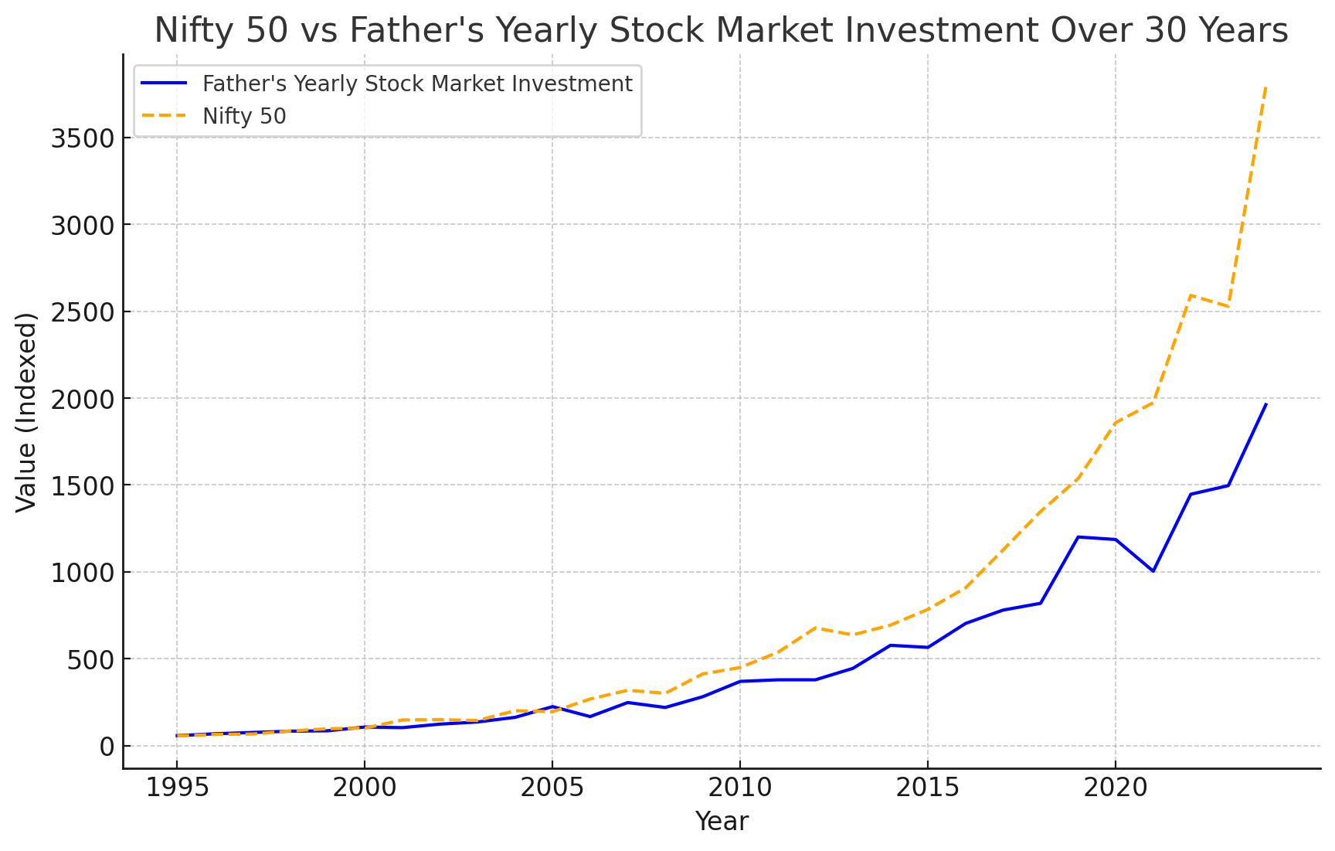
Ref. to the plot …

Slide 6
As observed both series are on increasing trend over time. Income of any individual 30 years back is very minimum and the same individuals income increases over time – so will be their investments in markets.
Same is the case for NIFTY.
If you see the mean values of these variables, calculated in a block of every 4 years or any sub- period, is increasing.
A regression to check the influence of Income on Nifty will give highly significant results
  These results are spurious or wrong. This is Spurious regression
  As both the variables are increasing over time (due to different reasons) and appear to be strongly correlated though there is no actual relation.

Slide 7
Spurious Regression -- Why Stationarity of time series ?
Spurious regressions. If two variables are trending over time, a regression of one on the other could have a high R² even if the two are totally unrelated. Such regressions are called as Spurious or Non-sense regressions.
To avoid spurious regressions, one should make the series– Stationary.
Stationary time series is one – which has constant mean, constant variance and constant autocorrelation.
  Mean, Variance and autocorrelation don’t depend on time t
  If these are changing then we call the series as NON-STATIONARY.
If the variables in the regression model are not stationary, then it can be proved that the standard assumptions for asymptotic analysis will not be valid. In other words, the usual “t-ratios” will not follow a t-distribution, so we cannot validly undertake hypothesis tests about the regression parameters.

Slide 8
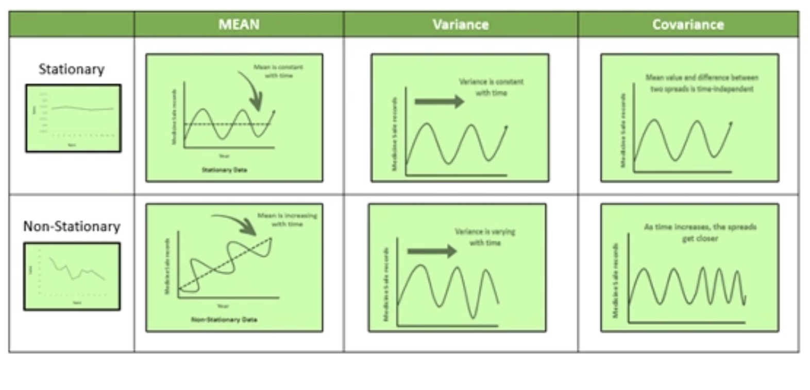
Stationary Time Series: Meaning

Slide 9
X_{t} is stationary if E(X_{t}),_{σ} ², and the population
STATIONARY PROCESSES
covariance of X_{t} and X_{t+s} ^{X}ar^{t} e independent of t
X_{t} = β₂ X_{t −1} + ε _{t} − 1 < β₂ < 1
^{X}t −1 ^{= β}2 ^{X}t −2 ^{+ ε} t −1
= β ^{t} X + β ^{t −1}ε + ... + β ε + ε
2 0 2 1 2 t −1 t
E( X_{t} ) = β₂ X₀ + β₂ E(ε₁ ) + ... + E(ε _{t} ) = β₂ X₀ → 0
t t −1 t
The expected value of each innovation is 0. Hence the expected value of X
is β X , which
t
t
tends to 0 as t increases. Thus E(X_{t}) is ultimately independent of t.
2 0

Slide 10
Augmented Dickey-Fuller Test data: Nifty Dickey-Fuller = -1.68889,
Lag order = 21,
p-value = 0.41
alternative hypothesis: stationary
ΔX_{t} = (β₂ + β₃ − 1)X_{t −1} − β₃ΔX_{t −1} + β₁ + β₄t + ε _{t}

Slide 11
150
100
50
0
-50
-100
-150
-200
TESTING FOR NONSTATIONARITY
D(LGHOUS)
100
200 300
400
500
DNIF
Augmented Dickey-Fuller Test data: DNifty Dickey-Fuller = -17.67113,
Lag order = 5, p-value = 0.01
alternative hypothesis: stationary Warning message:
In adf.test(aprce$cp) : p-value smaller than
value
printed p-

Slide 12
Different Time-Series Processes
Autoregressive Model AR(p)
  Y_{t} depends only on its own past values Y_{t-1}, Y_{t-2} ,Y_{t-3} ,
  A common representation:Y_{t} depends on p of its past values called as AR(p) model
  Y_{t} = μ + α₁Y_{t-1} + α₂Y_{t-2} + α₃Y_{t-3} + …..+α_{p}Y_{t-p} + ε_{t}
  Example: This year’s income depends on past incomes
Moving Average Model MA(q)
  Y_{t} depends only on the random error terms which follow a white noise process
  A common representation:Y_{t} depends on q of its past values called as MA(q) model
  Y_{t} = μ+ β₁ ε_{t-1} + β₂ ε_{t-2} - ….-+β_{q} ε_{t-q} + ε_{t}
  Example: Number of patients discharged on a day depends on how many patients get admitted and stay for one day, two days ot three days.

Slide 13
Different Time-Series Processes
Autoregressive Moving Average Model - ARMA(p,q)
  The time-series may be represented as a mix of both AR and MA model referred as ARMA (p,q)
  General form of such a time-series model, which depends on p of its own past values and q past values of random disturbances
Y_{t} = μ + α₁Y_{t-1} + α₂Y_{t-2} + …..+ α_{p}Y_{t-p} + β₁ ε_{t-1} + β₂ ε_{t-2} - ….-+β_{q} ε_{t-q} + ε_{t}
Here,Y_{t} is a stationary series.
In case Non-stationary and need to be differenced once to make it stationary (d=1) then the model is AutoRegressive Integrated Moving Average model, ARIMA (p,d,q)

Slide 14
ARMA models in Financial Markets context
We need to model the Returns, which arise due to the information absorption. Here, R_{t} = Expected Information + Unexp Information
  Expected information is the one that is being incorporated; Unexpected is the information shock, which is not captured in time t
Autoregressive Model AR(p)
  R_{t} depends only on its own past values R_{t-1}, R_{t-2} , R_{t-3} ,
  Today’s return depends on past returns.
R_{t} = μ + α₁ R_{t-1} + α₂ R_{t-2} + α₃ R_{t-3} + …..+α_{p} R_{t-p} + ε_{t}
Moving Average Model MA(q)
  R_{t} depends only on the past information shocks, which are being assimilated in current
period
  A common representation: R_{t} depends on q of its past values called as MA(q) model
  R_{t} = μ+ β₁ ε_{t-1} + β₂ ε_{t-2} - ….-+β_{q} ε_{t-q} + ε_{t}
  Todays return depends on the information absorption from the previous periods unexpected information
Autoregressive Moving Average Model ARMA(p,q)
R_{t} = μ + α₁ R_{t-1} + α₂ R_{t-2} + …..+ α_{p} R_{t-p} + β₁ ε_{t-1} + β₂ ε_{t-2} - ….-+β_{q} ε_{t-q} + ε_{t}
P_{t} is non-stationary. P_{t} ~ ARIMA (1,1,1) and R_{t} ~ ARIMA(1,0,1)

Slide 15
Market Efficiency – Speed of convergence to Mkt Efficiency
Testing for Market Efficiency
  R_{t} = 𝛽₀+ 𝛽₁ R_{t-1} + 𝛽₂ R_{t-2} +…+ 𝛽_{𝑝} R_{t-p} +ε_{t}
  Significant coefficients of past lag values
    Yes – Market is inefficient as past returns are useful in predicting current returns
    No – Market is Efficient as past information (Returns) are not useful in predicting current returns
How fast the market becomes efficient ?
  Here the time interval of return calculation matters.
  Run the above regression at daily, hourly, 30-, 15- and 5-min frequency
  Check the significance of past lag values
    If insignificant (efficient market) at daily returns but significant (inefficient) at hourly
    Then market takes about an hour to become efficient or so.

Slide 16
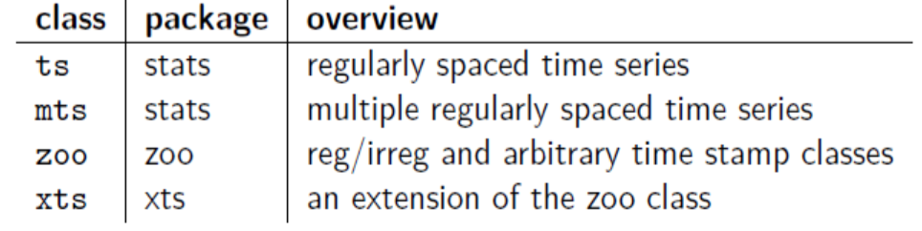
Time Series data
Time Series:
  It is a sequence of ordered data points measured in specific point in time.
Time Series Objects:
  In R, t-series object is a complex data structure that includes a data matrix associated with a vector of associated time stamps.

Slide 17
Components of an “xts” object
An xts object is composed of 3 components:
Index: A Data Class or Time-Date class used for the time-stamp of observations
Matrix: the Time Series observation (univariate or multivariate) can be numeric, character, logical, etc., but must be homogenous.
Attribute: hidden and user defined
1. Class of index
2. Format of index
3. Time zone

Slide 18
Date class
A date object is stored internally as the number of days form 1970-01-01
as.Date(date, format)
Convert this into date class
  My_date = “4/14/2018”
Format: %m/%d/%Y
  %Y – Year as YYYY
  %y – year as YY (last two digits only)
  %m – month as a decimal number (01-12)
  %d – day of the month as decimal number (01-31)

Slide 19
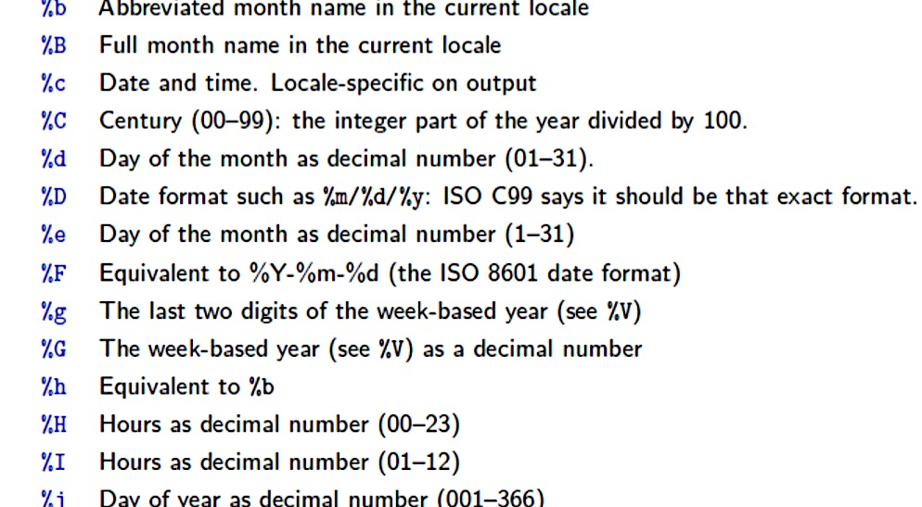
Comprehensive
List of
Date/Time settings

Slide 20
Let’s Play a little with the t-series data…
Load the nifty_ret data
Check the str()
Create a date vector using the Date column of the nifty data
Drop the Date column of the Nifty data
Use xts() to convert the nifty data-subset (without dates) and the date vector to create a xts object of nifty data
Check the str()
Look at the 1st 10 entries of the data
What is the last entry?
Store all the entries of 2002 in variable tmp_2002
Select entries from January 1 2002, till March 22, 2002
Select all the entries of the last week’s data and store in lastweek
Extract all entries of the last week except the first 2 entries
Extract the first 3 days of the 17th week of nifty returns (xts) data
Extract the last 2 days of the third last week of nifty returns (xts) data

