Slide 1

The nature of organizing and Reengineering
Dr. Sushil Kumar
Assistant Professor
Entrepreneurship & Strategic Management IIM Visakhapatnam

Slide 2
Formal and Informal Organization
Formal Organization means the intentional structure of roles in a formally organized enterprise.
Informal Organization is a network of interpersonal relationships that arise when people associate with each other.

Slide 3

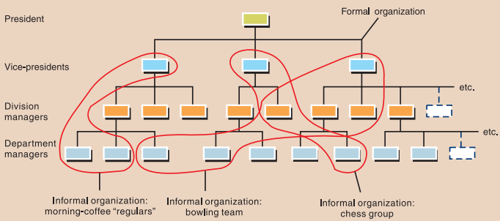
Formal and informal organizations

Slide 4

Organizational Division: The Department
Department is a distinct area, division, or branch of an organization over which a manager has authority for the performance of specified activities.

Slide 5
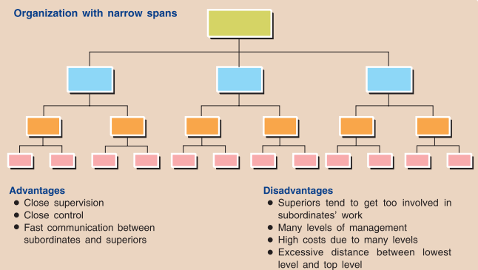
Organizational Levels and the Span of
Management

Slide 6
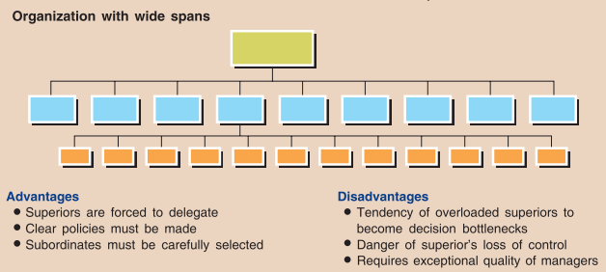

Slide 7
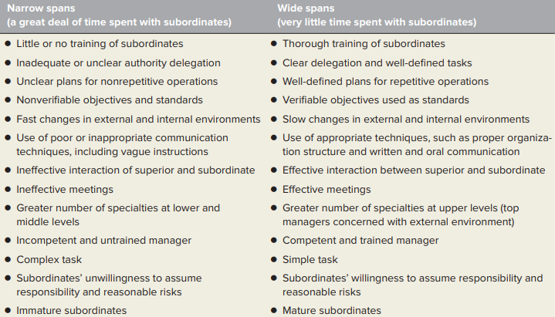
Factors influencing the span of management

Slide 8

An Organizational Environment for
Entrepreneuring and Intrapreneuring
The Intrapreneur and the Entrepreneur
  Intrapreneur is a person who focuses on innovation and creativity and who transforms an idea into a profitable venture while operating within an established organizational environment.
  Entrepreneur is a person who creates an organization to take advantage of market opportunities.
  Creating an Environment for Entrepreneurship
  Innovation and Entrepreneurship

Slide 9
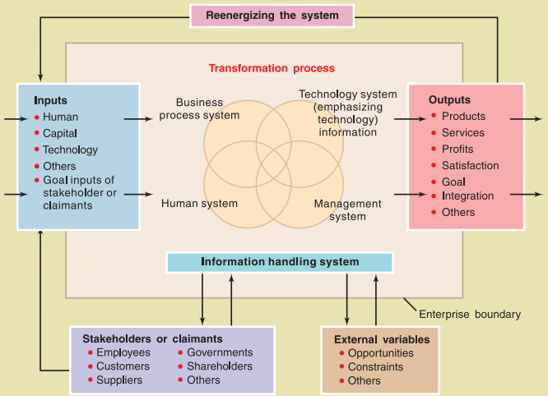
Reengineering the Organization : Management by processes

Slide 10
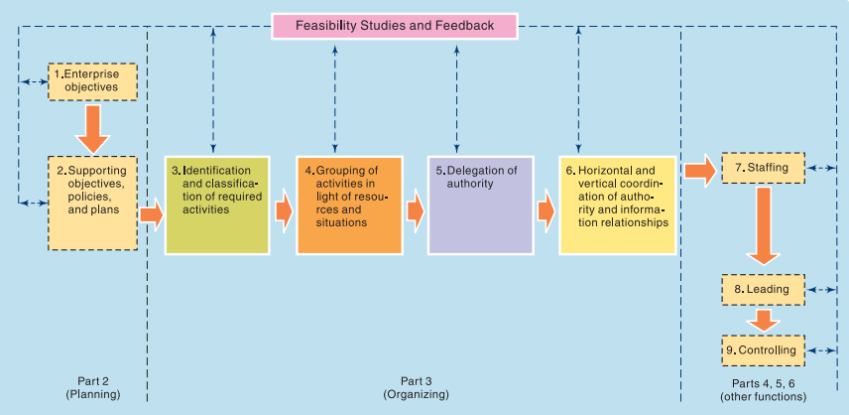
The Structure and Process of Organizing
The Logic of Organizing
Some Misconceptions

Slide 11
Basic Questions for Effective Organizing
What determines the span of management and hence the levels of organization?
What determines the basic framework of departmentation, and what are the strengths and weaknesses of the basic forms?
What kinds of authority relationships exist in organizations?
How should authority be dispersed throughout the organization structure, and what determines the extent of this dispersion?
How should the manager make organization theory work in practice?

