Slide 1
The Sources of Finance

Slide 2
Introduction
Corporation and financial manager.
The goal of financial management.
Corporate financial decisions.
Financial system and financial markets.
  Money and capital markets.
Types of financial instruments.
Financial instruments by issuer.
Yields on debt securities.
Yield curve.
Key interest rates.
Bonds and stocks.
Global Financial Markets
Global financial market instruments
  ADR
  GDR
  Masala Bonds
  Other financial Instruments

Slide 3
Function of Financial Manager
1a.Raising funds
2.Investments
Operations (plant, equipment, projects)
Financial Markets (investors)
Financial Manager
1b.Obligations (stocks, debt securities)
3.Cash from operational activities
4.Reinvesting
5.Dividends or interest payments
Finance function – managing the cash flow

Slide 4
Financial decisions
Financing decision – where is money going to come from
Investment decision – how much to invest and in what assets
Operations
Financial markets
Financial Manager
Investments
Financing

Slide 5
Financial decisions
Capital structure and cost of capital
Operations
Financial markets
Financial Manager
Investments
Financing

Slide 6
The goal of financial management
Maximizing shareholder’s wealth
Maximizing stock prices

Slide 7
Objectives for financial manager
Maximizing earnings and earnings growth
Maximizing return on investments and return on equity

Slide 8
Financial markets
The main goal of financial markets:
Take savings from those who do not wish to consume (savings surplus units) and to channel them to those who wish to invest more than they have presently (saving deficit units)

Slide 9
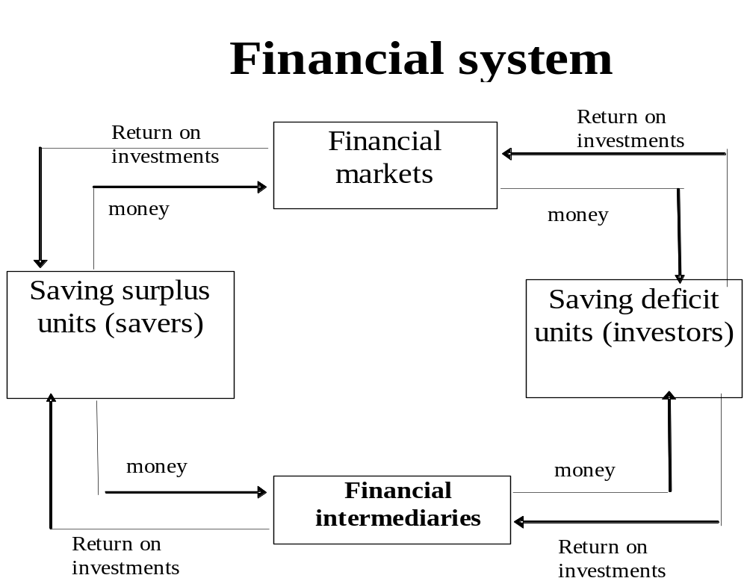
Financial markets and financial system

Slide 10
Financial markets
Financial markets
Primary markets
Secondary markets
Money market
Capital market
Organized exchanges
Over-the-counter

Slide 11
Primary and secondary markets
Primary market – primary issues of securities are sold, allows governments, banks, corporations to raise money by directly selling financial instruments to the public.
Secondary market – allows investors to trade financial instruments between themselves. Secondary transactions take place.

Slide 12
Money and capital markets
Money markets – short-term assets (maturity less than 1 year) are traded:
  Certificates of deposits (CDs)
  Commercial papers (CPs)
  Treasury bills
Capital markets – long-term assets (maturity longer than 1 year) are traded:
  Stocks
  Corporate bonds
  Long-term government bonds

Slide 13
Organized exchanges and over-the-counter
Organized exchange – most of stocks, bonds and derivatives are traded. Has a trading floor where floor traders execute transactions in the secondary market for their clients.
Stocks not listed on the organized exchanges are traded in the over-the-counter (OTC) market. Facilitates secondary market transactions. Unlike the organized exchanges, the OTC market doesn’t have a trading floor. The buy and sell orders are completed through a telecommunications network.

Slide 14
Financing decisions
Financing
decisions
Internal corporate
financing
External sources
of funds
Retained earnings
Direct financing
(financial markets
Instruments)
Indirect financing
(financial
Intermediaries)
Stocks
Loans
Debt instruments
(bonds, CPs etc.)

Slide 15
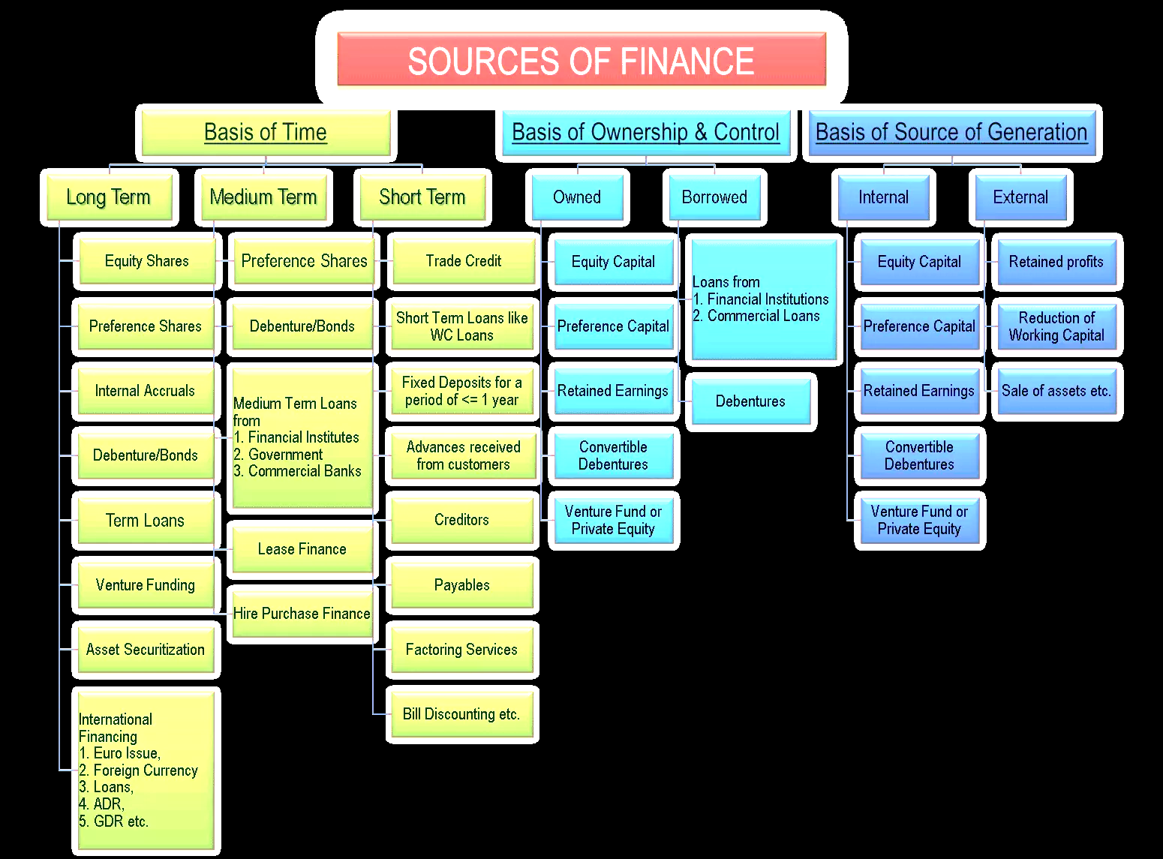

Slide 16
Types of financial instruments
Type of issuer
Government, government
agencies
States (regions,
provinces), municipalities
Corporations
Financial
institutions
Others

Slide 17
Types of financial instruments
Maturity
Short-term instruments
Long-term instruments

Slide 18
Types of financial instruments
Type of yield
Dividend bearing
(stocks)
Discount debt
Instruments
(treasury bills)
Interest income instruments (bonds)

Slide 19
Types of financial instruments
By level of risk
Risk-free instruments (treasury bills)
Low-risky securities (treasury notes and bonds),
investment grade corporate bonds,
blue-chip stocks)
High-risky securities (junk bonds,
stocks), derivatives

Slide 20
Pricing of Financial Instrument
Prices of financial instruments are determined in equilibrium by demand and supply forces
They reflect market expectations regarding the future as inferred from currently available information

Slide 21
Financial instruments issued by government: goals
To finance any shortfall between expenditures and taxes (deficit)
To refinance maturing debt
To finance investment projects, social programs etc.

Slide 22
Financial instruments issued by government
Treasury bills (T-bills)
T-Bills are the largest component of the money market
Maturities: 4 weeks, 13 weeks, 26 weeks
Sold at a discount from face value
Considered as a risk-free investment
No chance of default
Very little interest rate risk
Are actively traded
Interest is subject to federal tax (but exempted from state and local taxes)

Slide 23
Financial instruments issued by government
Treasury coupon issues:
  Treasury notes (T-notes): maturity of 1-10 years
  Treasury bonds (T-bonds): maturity of 10-30 years
Considered free of default risk
Subject to interest rate risk
Interest is subject to tax (but exempted from state and local taxes)

Slide 24
Financial instruments issued by government
Treasury inflation-protected securities (TIPs):
  Treasury inflation-indexed securities
  Offer a fixed (real) coupon rate plus linkage to the consumer price index (inflation)
  Interest is subject to tax (but exempted from state and local taxes)
  TIPs are available in 5,10,30-year maturities in some countries and with different maturities in several other countries.

Slide 25
Financial instruments issued by federal agencies
Federal agencies (such as Ginnie Mae) and government-sponsored enterprises (such as Federal Home Loan Bank and Federal Farm Credit Bank) issue bonds to finance projects consistent with their mission
Most popular bonds: Fannie Mae (FNMA) and Freddie Mac (FHLMC)
  No explicit government guarantee, not risk free
  Securitize some loans, and hold others on balance sheet
  Provide liquidity by pooling many specific loans, thereby creating diversification and a more active secondary market

Slide 26
Yields on debt securities
Are affected by the following characteristics:
  Credit (default) risk
  Liquidity
  Tax status
  Term to maturity

Slide 27
Credit (default) risk
Investors must consider the creditworthiness of the security issuer, as most securities are subject to the risk of default
Securities with higher degree of risk would have to offer higher yields
Is especially relevant for longer-term securities

Slide 28
Liquidity
Liquid securities could be easily converted to cash without a loss in value
Securities with less liquidity will have to offer a higher yield
Securities with a short-term maturity or an active secondary market have greater liquidity

Slide 29
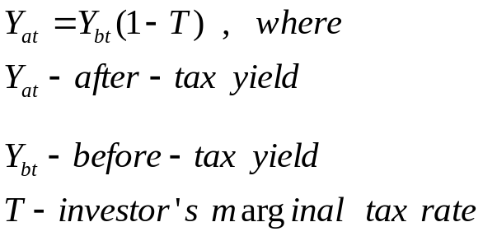
Tax status
Investors are concerned with after-tax income earned on securities
Taxable securities will have to offer a higher before-tax yield to investors than tax-exempt securities
Investors in high tax brackets benefit most from tax-exempt securities

Slide 30
Yield Curve
Yield curve describes YTM (yield to maturity) for different maturities of debt instruments. It reflects risk and expectations regarding future interest rates.
Also called “term structure of interest rates”
Bond price reaction to interest rate changes:
  As interest rates increase bond prices decrease
  As interest rates decrease bond prices increase

Slide 31
Yield curve
Yield curve could be inverted:
  short-term interest rates are higher than long-term interest rates.
  Long-term rates should raise because of expectations of higher interest rates reflecting inflation and risk.
Inverted yield curve could be a signal of recession.
http://www.bloomberg.com/markets/rates/index.html
  stockcharts.com/charts/yieldcurve.html

Slide 32
Financial instruments issued by commercial banks
Banks raise funds by accepting deposits and selling securities. These funds are used to fund various loans.
Certificates of Deposits (CDs):
  Large fixed-maturity deposits.
  No Minimum deposit or maximum limits
  Liquid secondary market
  Upon maturity, the holder of the certificate receives the funds from the issuing bank.
What could be the difference between yields of T-bills and CDs?

Slide 33
Bank rates
Prime rate
Federal funds rate
Discount rate/Repo Rate

Slide 34
Prime rate
The Prime Interest Rate is the interest rate charged by banks to their most creditworthy customers (usually the most prominent and stable business customers).
The rate is almost always the same among major banks. Adjustments to the prime lending rate are made by banks at the same time; although, the prime rate does not adjust on any regular basis.

Slide 35
Financial instruments issued by corporations: goals
To finance operations
To invest in new projects
To expand their business
To repay debt or repurchase shares

Slide 36
Financial instruments issued by corporations: CPs
Commercial paper – short-term debt with maturity
  Issued by larger, known corporations
  Issued at discount/premium – zero coupon bonds etc.
  Higher rates than comparable Treasury bills because of smaller default risk and less liquidity than government securities

Slide 37
Financial instruments issued by corporations: bonds
Corporate bond – long-term debt security, promising a bondholder interest payments on a regular basis and payback of a par (face) value at maturity.
  Maturities
  Short-term: 1-5 years
  Intermediate-term: 5-10 years
  Long-term: 10-20 years
  Exceptions: Ford and Disney – 100 years
  Interest is quoted as a percentage from face value

Slide 38
Financial instruments issued by corporations: bonds ratings
Moody’s | S&P | Meaning | Expected return
Investment grade
Aaa | AAA | Best quality | Lowest
Aa | AA | High quality | Lower
A | A | Favorable | Middle
Baa | BBB | Medium-grad | Middle/Upper

Slide 39
Financial instruments issued by corporations: bonds ratings
Moody’s | S&P | Meaning | Expected return
Speculative grade
Ba | BB | Speculative element | High
B | B | Not desirable.Small long-term assurance of payments | Higher

Slide 40
Financial instruments issued by corporations: bonds ratings
Moody’s | S&P | Meaning | Expected return
Speculative grade
Caa | CCC | Poor standing, Default or danger of default | Very high
Ca | CC | Highly speculative standing
C | C | Very speculative. Very poor prospects of ever attaining investment standing
 | D | In default

Slide 41
Financial instruments issued by corporations: bonds ratings
Junk bonds – bonds with below investment grade rating
High yield (high risk) bonds

Slide 42
Corporate bonds
Debentures-unsecured debt. Backed only by the general assets of the issuing corporation
Secured debt (mortgage debt) – secured by specific assets
Subordinated debt – in default, holders get payments only after other debtholders get their full payment
Senior debt – in default holders get payment before other debtholders get.

Slide 43
Corporate bonds
Zero Coupon Bonds
  Bonds that pay face value at maturity and no payment until then
  Sell today at a discount from face value
  Taxed based on accrued interest
  No reinvestment risk or reinvestment cost

Slide 44
Financial instruments issued by corporations: common stocks
The common stockholders are the owners of the corporation’s equity
Do not have a specified maturity date and the firm is not obliged to pay dividends to shareholders
Returns come from dividends and capital gains

Slide 45
Financial instruments issued by corporations: common stocks
Common stockholders are called the residual claimants of the firm
Stockholders have only limited liabilities

Slide 46
Financial instruments issued by corporations: preferred stocks
Hybrid securities: has characteristics of debt and equity
Have face value, predetermined periodical (dividend) payments with priority over common stockholders
If dividend payment is not paid, preferred stockholders may get voting rights

Slide 47
Summary of companies: stocks, financials, ownership etc.
http://finance.yahoo.com
Bloomberg
Thompson Reuters
NSE & BSE in India
Moneycontrol.com

Slide 48
Derivative securities
Securities whose value is derived from the value of some underlying asset
Most important derivatives are options and futures
Stock options. Is not a tool of fundraising, it is a method of compensation

Slide 49
International Financial Markets
Eurocurrency is a domestic currency of one country on deposit in a second country – time deposit of money in an international bank located in a country different from the country that issued the currency.
The Eurocurrency market includes:
  Eurosterling (British pounds deposited outside the UK)
  Euroeuros (euros on deposit outside the euro zone)
  Euroyen (Japanese yen deposited outside Japan)
  Eurodollars (US dollars deposited outside USA)

Slide 50
International Financial Markets
The basic borrowing interest rate for Eurodollar loans has long been tied to the
  London Interbank Offered Rate (LIBOR) – the average of Interbank offered rates for Eurocurrency deposits in London market

Slide 51
https://topforeignstocks.com/foreign-adrs-list/the-full-list-of-indian-adrs/

