Slide 1
The Link Between Operations and Finance
Milan Kumar
IIM Visakhapatnam
Cachon, G., & Terwiesch, C. (2023). The Link Between Operations and Finance (Ch 6, Pg 241-257). In Matching supply with demand. McGraw Hill.

Slide 2
Economic Value Creation
Every for-profit firm aims to create Economic Value.
What is Economic Value?
Economic value is created whenever the Return on Invested Capital (ROIC) in a corporation exceeds the cost of capital.
Formally,
Economic value created = Invested capital x (ROIC-WACC)
Where WACC is weighted average cost of capital.

Slide 3
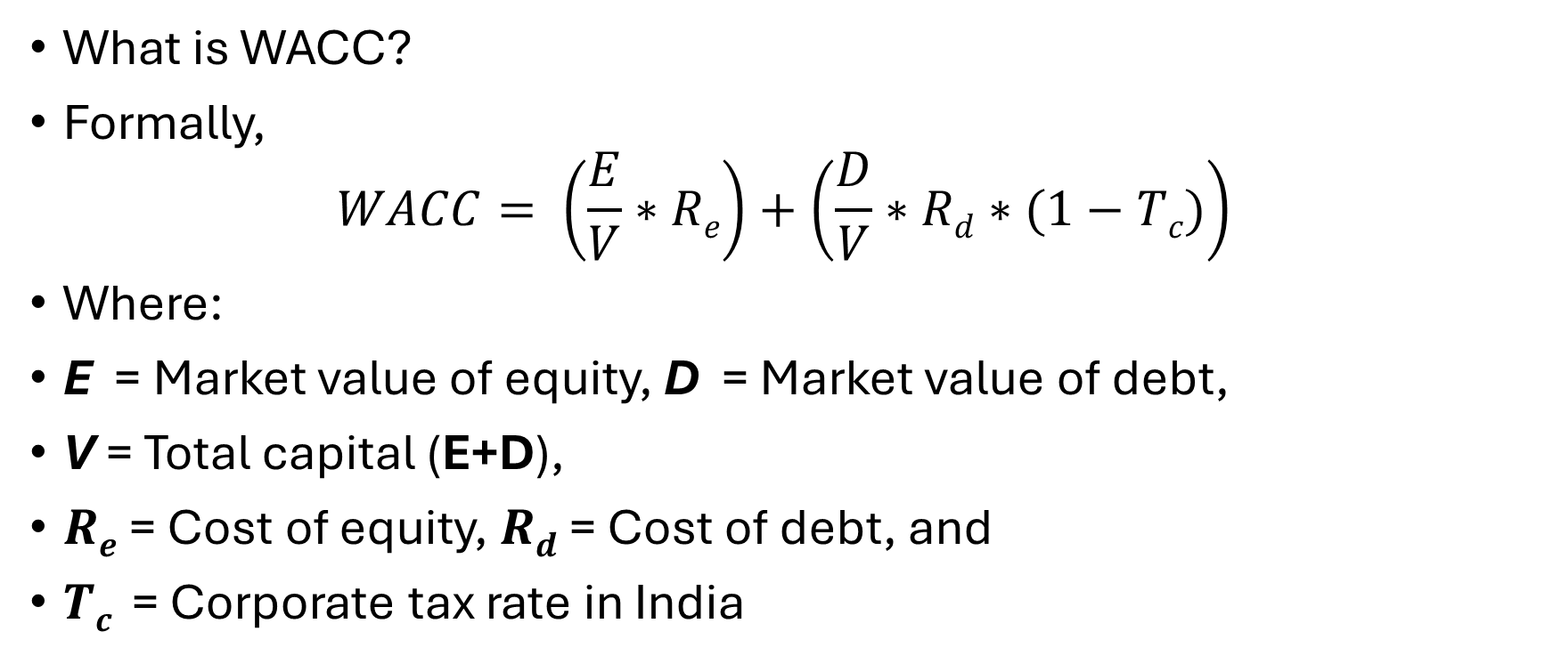
Weighted Average Cost of Capital (WACC)
What is WACC?
Formally,
$$WACC= \left(\frac{E}{V}∗Re\right)+\left(\frac{D}{V}∗Rd∗(1−Tc)\right)$$
Where:
E = Market value of equity, D = Market value of debt,
V = Total capital (E+D),
$Re$ = Cost of equity, $Rd$​ = Cost of debt, and
$Tc$​ = Corporate tax rate in India

Slide 4
WACC contd..
Let’s understand WACC using an example.
Company XYZ Pvt Ltd.
  Equity (E): ₹50 lakh
  Debt (D): ₹30 lakh
  Cost of Equity (Re​): 12%
  Cost of Debt (Rd​): 9%
  Corporate Tax Rate (Tc​): 25%

Slide 5
WACC contd..
Step 1: Total Capital (V)
  V=E+D=₹50 lakh+₹30 lakh=₹80 lakh
Step 2: Weights of Equity and Debt
  Weight of Equity (E/V​): ₹50/₹80=0.625
  Weight of Debt (D/V​): ₹30/₹80=0.375
Step 3: After-Tax Cost of Debt
  After-tax Rd=9%×(1−0.25)=9%×0.75=6.75%
Step 4: Calculate WACC
  WACC=(0.625×12%)+(0.375×6.75%) =7.5%+2.531%=10.03%
Thus, XYZ Pvt Ltd.'s WACC is approximately 10.03%.

Slide 6
Let’s return to Economic Value and ROIC
As the example around WACC has demonstrated WACC is primarily governed by market forces.
Thus, to improve Economic Value, firms should improve their ROIC.
But how??
let us create an ROIC tree.
But what is an ROIC tree??
Let me introduce data for a business and then explain ROIC tree using it.

Slide 7
Overview of Paul Downs Cabinetmakers
Paul Downs started making furniture in 19 86, in a small shop in Manayunk, P A.
Now, the business is operating in a 33,000–square–foot facility in Bridgeport, P A.
The company focuses on high–end residential furniture.
One of their high–end dining tables could cost about $3,000. A customer pays 50% down and gets the furniture 3 months later.

Slide 8
Production at Paul Downs Cabinetmakers
Machines and other wood–processing equipment is valued at $450,000, with an annual depreciation of $80,000.
Show rooms and factory: $150k for rent.
Indirect costs: marketing ($100k, $180k management, $60k finish).
Inventory: $50,000 W I P and $20,000 raw material.
Suppliers need to be paid 1 month before receiving the wood.
End Product.
  Average price is $3,000 per unit.
  Requires 30 kg of wood (wood costs about $10 per kg) before scrap.
  25% scrap.

Slide 9
Workers at Paul Downs Cabinetmakers
Work force:
  12 cabinet makers each working about (220 days @ 8 hours/day).
  $20 per hour.
A worker needs about 40 hours per unit of furniture (work cell) as labour content.
  Spend about 15% of the time on setups (build fixtures/program machines).
  Labor utilization is around 90% (idle time resulting from waiting).

Slide 10
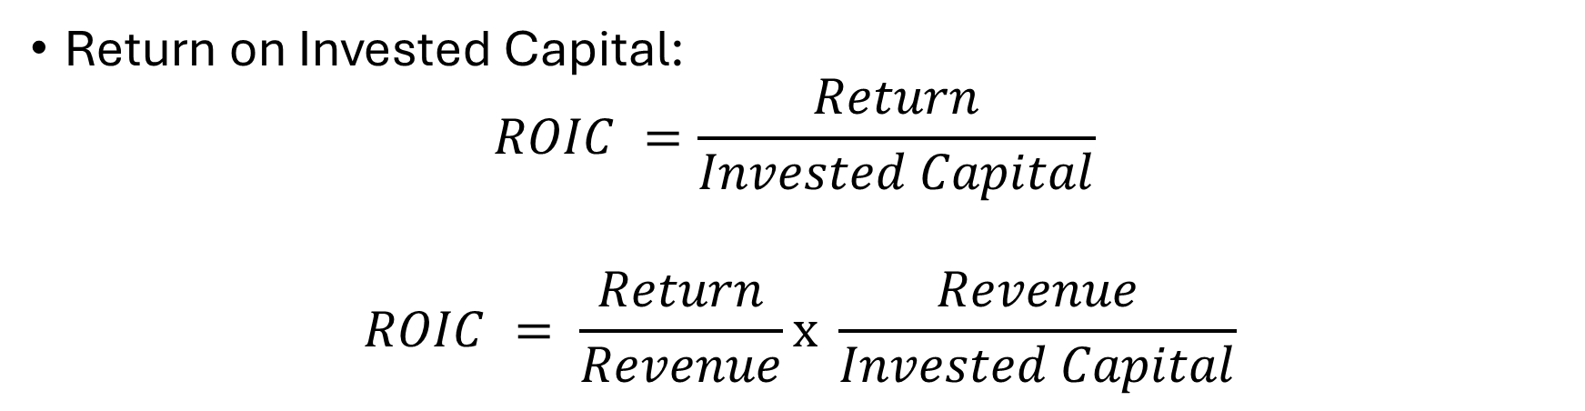
Building an ROIC Tree [1]
Return on Invested Capital:
$$ROIC =\frac{Return}{Invested Capital}$$
$$ROIC = \frac{Return}{Revenue}\text{x} \frac{Revenue}{Invested Capital}$$
Margin
Capital Turns
This decomposition of ROIC into Margin and Capital Turn is also referred to as DuPont Model.

Slide 11
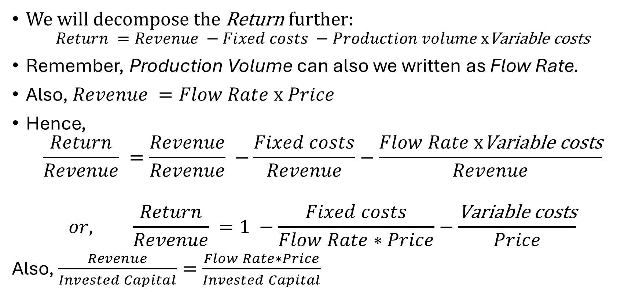
Building an ROIC Tree [2]
We will decompose the Return further:
$$Return =Revenue −Fixed costs −Production volume \text{x}\text{Variable} \text{costs}$$
Remember, Production Volume can also we written as Flow Rate.
Also, $Revenue =Flow Rate \text{x} Price$
Hence,
$$\frac{Return}{Revenue} =\frac{Revenue}{Revenue} −\frac{Fixed costs}{Revenue}−\frac{Flow Rate \text{x}\text{Variable} \text{costs}}{Revenue}$$
$$or, \frac{Return}{Revenue} =1 −\frac{Fixed costs}{Flow Rate∗Price}−\frac{\text{V}\text{ariable} \text{costs}}{Price}$$
Also, $\frac{Revenue}{Invested Capital}=\frac{Flow Rate∗Price}{Invested Capital}$

Slide 12
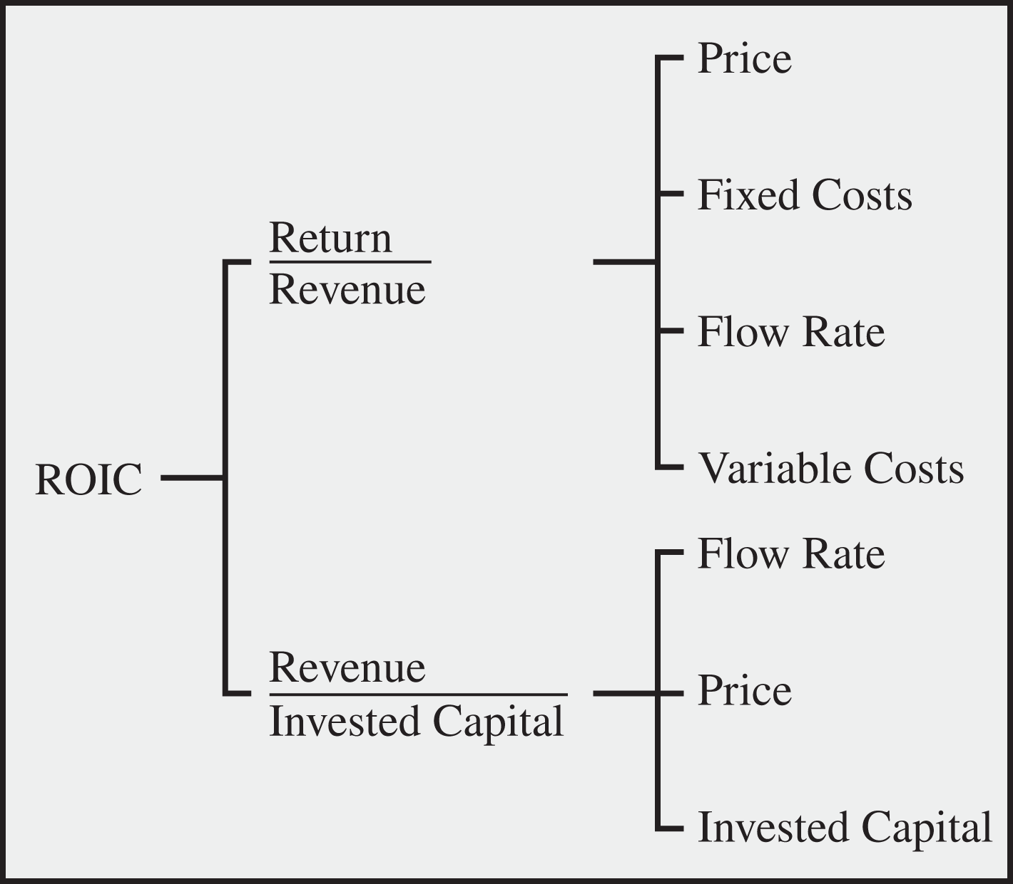
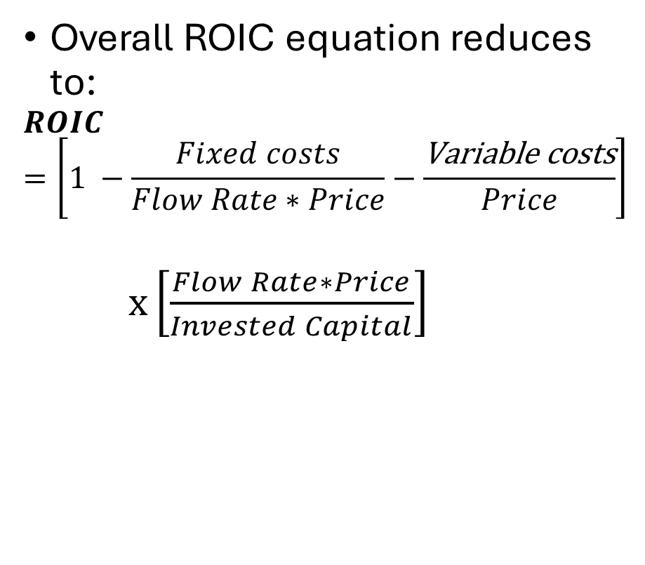
Building an ROIC Tree [3]
Overall ROIC equation reduces to:
$$ROIC=\left[1 −\frac{Fixed costs}{Flow Rate∗Price}−\frac{\text{Variable} \text{costs}}{Price}\right]$$
$\text{x}\left[\frac{Flow Rate∗Price}{Invested Capital}\right]$

Slide 13
Variable Cost
What are the components of variable cost?
We assume that the labor cost is independent of the flow rate. We can also incorporate labor costs when labor is paid per unit of production.
Variable cost = Price of wood x Wood per table
= Price of wood x (Wood in Final Table + Cutting loss)
Remember that for each piece of table, 25% scrap is generated.

Slide 14
Flow Rate and Process Capacity
Flow rate = Min{Demand, Process capacity}
There is sufficient demand at the moment.
Hence, process capacity is the bottleneck.
Process capacity is dependent on:
  The number of worker hours which is Number of workers (n) x work hours/worker/year
  Time spent on each piece of furniture. Which is dependent on Wait Time on Machine + Set up Time on Machine + Actual Production Hour

Slide 15
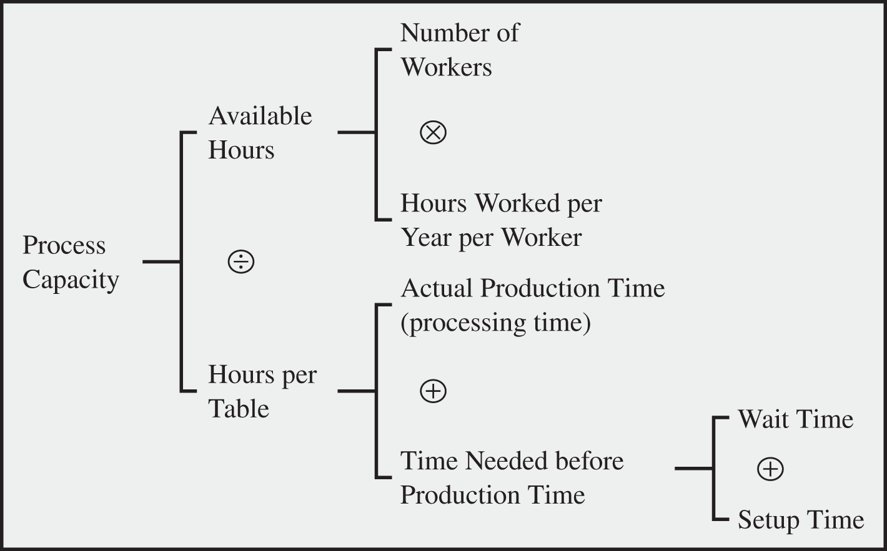
Flow Rate and Process Capacity contd..

Slide 16
What is Fixed Cost?
Fixed costs constitute marketing, labour expenses for overhead (inspection, purchase, administration, etc.), rent, and depreciation.
For our example, we have assumed the number of works to be fixed and not dependent on the flow rate. Hence, cost of the workforce is also considered as a fixed cost.
  As explained earlier, if the workers are also paid an incentive based on per unit of production, then that will be added as a part of the variable cost.

Slide 17
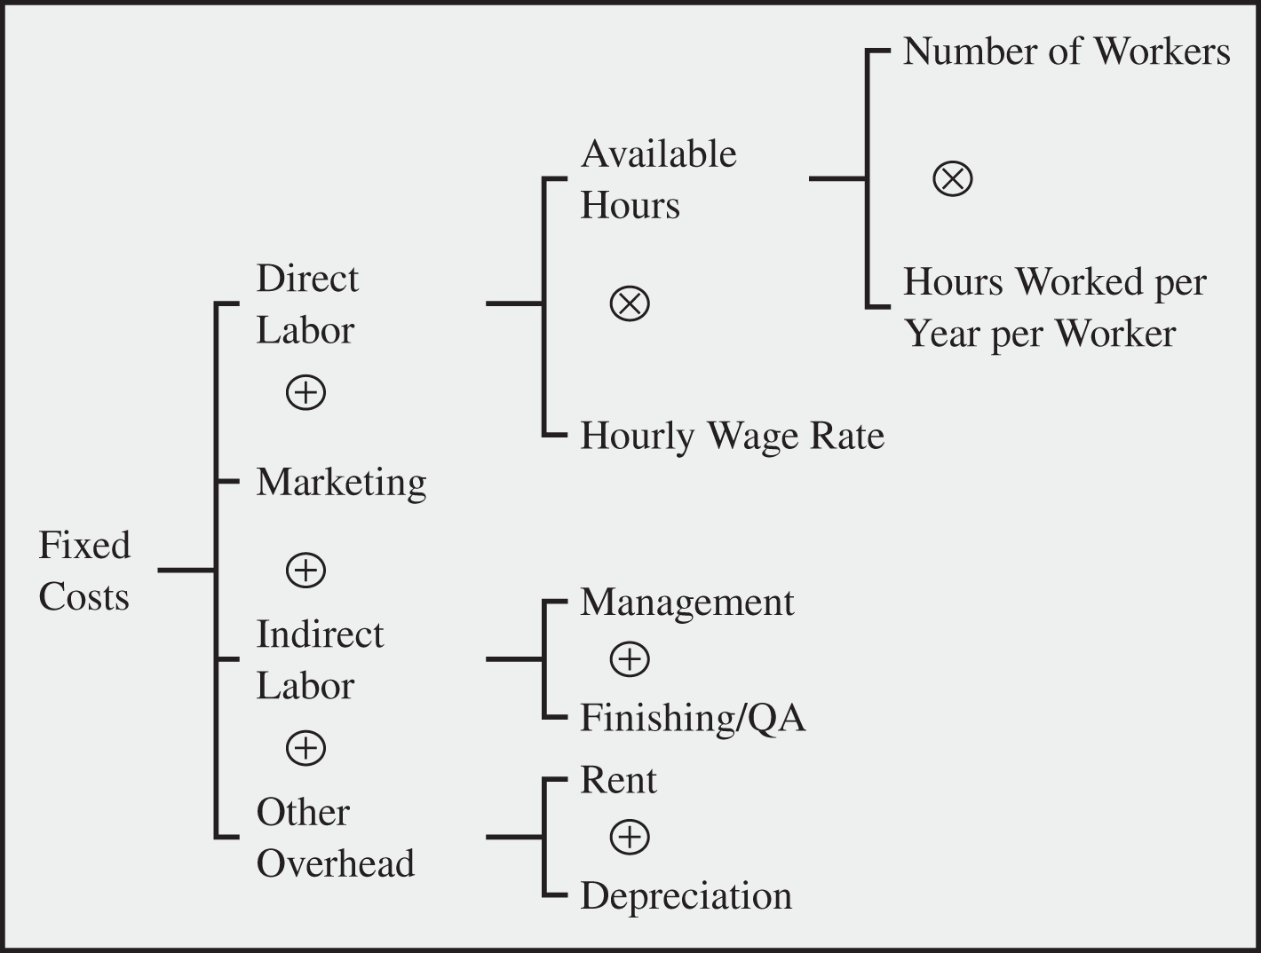
Fixed Cost

Slide 18
Investigate the Invested Capital
Let us delve into Invested Capital
There are two broad heads of invested capital:
  Plant, Property and Equipment (PP&E)
  Working Capital
PP&E is also called as fixed asset owned by the firm.
let us take a detour and spend some time on Working Capital (WC)
  WC management has become very important after 2008 Financial crisis.

Slide 19
Working Capital
Working capital consists of three important components:
  1. Funds paid in advance to suppliers or amounts owed to suppliers (Accounts Payable): This includes any prepayments made to suppliers or outstanding payments due for goods or services received.
  2. Money invested in work-in-process inventory: Capital tied up in the production process where raw materials are being transformed into finished products but are not yet complete.
  3. Amounts to be received from buyers for anticipated or already delivered items (Accounts Receivable): This encompasses payments expected from customers for products or services that are scheduled for delivery or have already been delivered but not yet paid for.

Slide 20
Working Capital [2]
An important metric to understand working capital requirements is the Cash Conversion Cycle (CCC).
CCC roughly measures the average amount of time from when cash enters the process as cost to when it returns as collected revenue
CCC = DIO + DSO − DPO
Where
  DIO is Days Inventory Outstanding
  DSO is Days Sales Outstanding
  DPO is Days Payable Outstanding

Slide 21
Working Capital [3]
Days Inventory Outstanding (DIO)
  Measures: Average number of days a company holds inventory before selling it.
  Formula: DIO=(Average Inventory/Cost of Goods Sold)×365
Days Sales Outstanding (DSO)
  Measures: Average number of days to collect payment after a sale.
  Formula: DSO=(Average Accounts Receivable/Revenue)×365
Days Payable Outstanding (DPO)
  Measures: Average number of days a company takes to pay its suppliers.
  Formula: DPO=(Average Accounts Payable/Cost of Goods Sold)×365

Slide 22
Working Capital [4]
Let’s understand the concept using an example:
Company XYZ Pvt Ltd. which works in Consumer Goods Manufacturing has the following financial data:
  Cost of Goods Sold (COGS): ₹25,00,000
  Revenue (Sales): ₹40,00,000
  Average Inventory: ₹5,00,000
  Average Accounts Receivable: ₹4,00,000
  Average Accounts Payable: ₹3,00,000

Slide 23
Working Capital [5]
DIO=(₹5,00,000/₹25,00,000​)×365=0.2×365=73 days
  XYZ Pvt Ltd. holds its inventory for an average of 73 days before selling.
DSO=(₹4,00,000/₹40,00,000​)×365=0.1×365=36.5 days
  Interpretation: It takes an average of 36.5 days to collect payment from customers.
DPO=(₹3,00,000 /₹25,00,000​)×365=0.12×365=43.8 days
  The company takes an average of 43.8 days to pay its suppliers
CCC=73 days+36.5 days−43.8 days=65.7 days
XYZ Pvt Ltd.'s cash is tied up in the operating cycle for approximately 66 days.

Slide 24
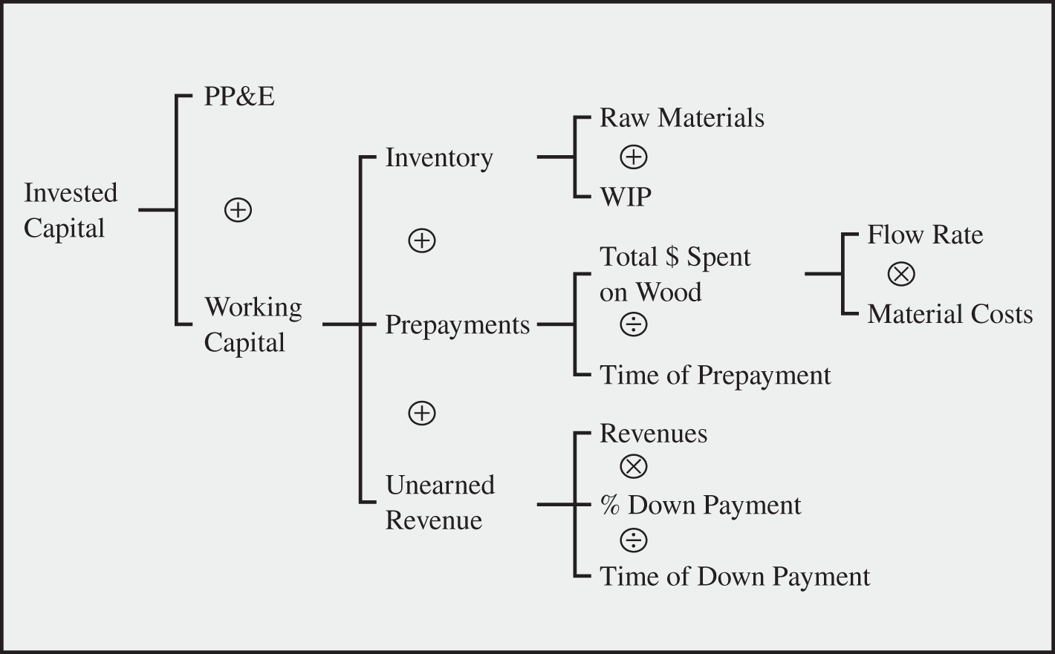
Invested Capital

Slide 25
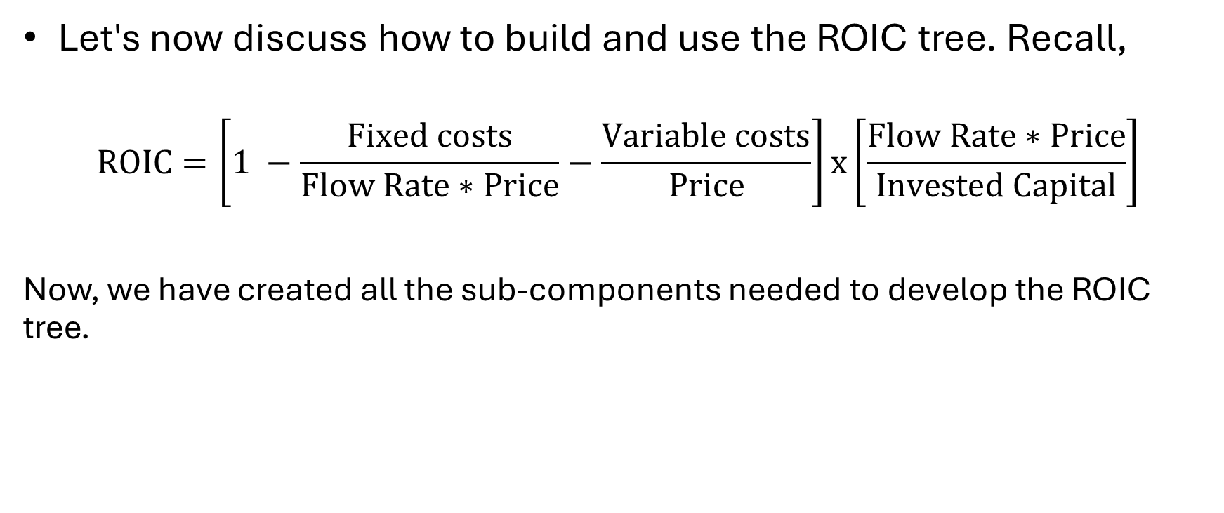
Complete ROIC tree
Let's now discuss how to build and use the ROIC tree. Recall,
$$ROIC=\left[1 −\frac{Fixed costs}{Flow Rate∗Price}−\frac{\text{Variable} \text{costs}}{Price}\right]\text{x}\left[\frac{Flow Rate∗Price}{Invested Capital}\right]$$
Now, we have created all the sub-components needed to develop the ROIC tree.

Slide 26
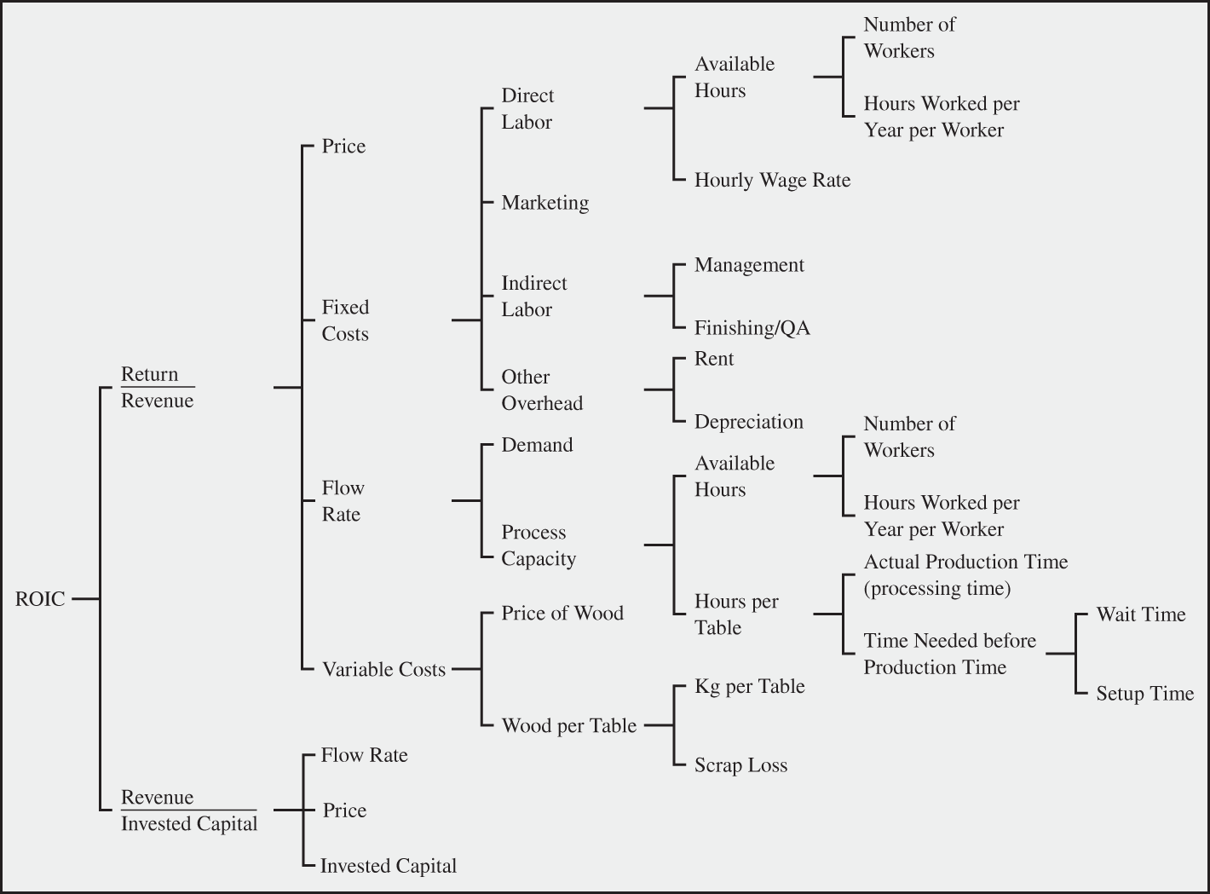
ROIC Tree

Slide 27
Impact of Operational Improvements on ROIC
We have now built the ROIC tree. The ROIC value for the given data is 12.27%.
Let us do an exercise. I provide a table below with suggested changes in operational values, you provide the change that it will result in ROIC.
Scenario | Base Case | $1/hr Lower Wages | 5 Percent Shorter Setups | $10k per Year Lower Rent | 2 hr/Table Lower Labor Content | 5 Percent Lower Scrap Rate
ROIC [%] | 12.3

Slide 28
Updated ROIC on Improved Operational Performance
Scenario | Base Case | $1/hr Lower Wages | 5 Percent Shorter Setups | $10k per Year Lower Rent | 2 hr/Table Lower Labor Content | 5 Percent Lower Scrap Rate
ROIC [%] | 12.3 | 17.7 | 31.1 | 14.8 | 27 | 13.8
Base case ROIC: The baseline ROIC is 12.3%, representing the current efficiency without any improvements.
$1/hr lower wages: Reducing wages by $1 per hour increases ROIC to 17.7%, indicating a significant positive impact from lowering labor costs.
5% shorter setups: A 5% reduction in setup times results in a substantial ROIC boost to 31.1%, suggesting that efficiency in setup processes dramatically enhances capital utilization.
Other improvements: Lower rent ($10k/year) raises ROIC to 14.8%, reducing labor content by 2 hours per table increases ROIC to 27.0%, and reducing the scrap rate by 5% improves ROIC to 13.8%

