Slide 1

@Graeme Stuart

Slide 2
Theoretical Foundations
Hands On Implementations & Model Building
Commercial Solutions

Slide 3


Slide 4
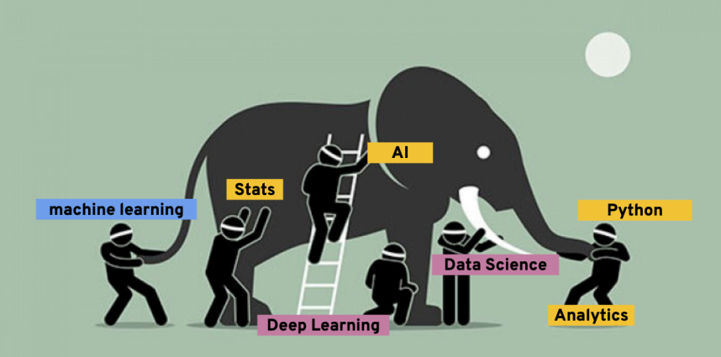

Slide 5
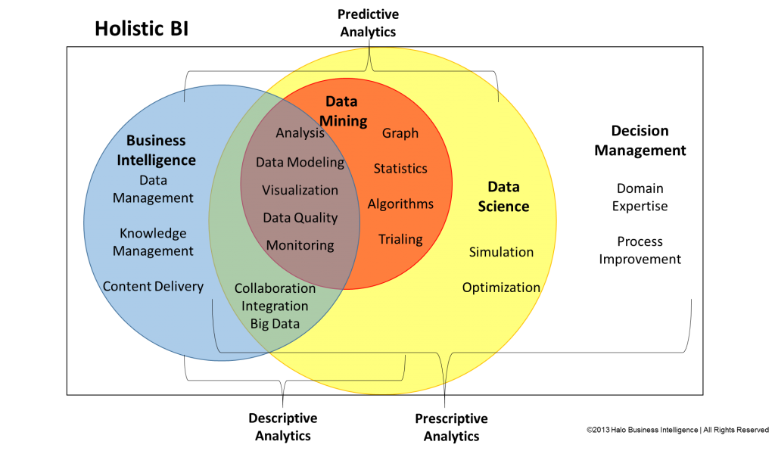
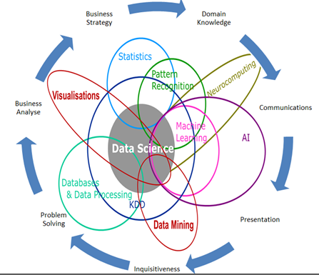
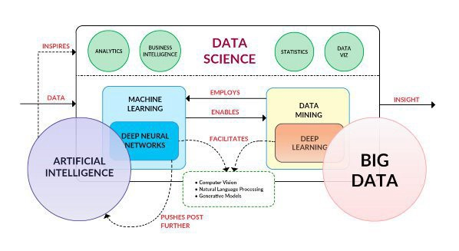
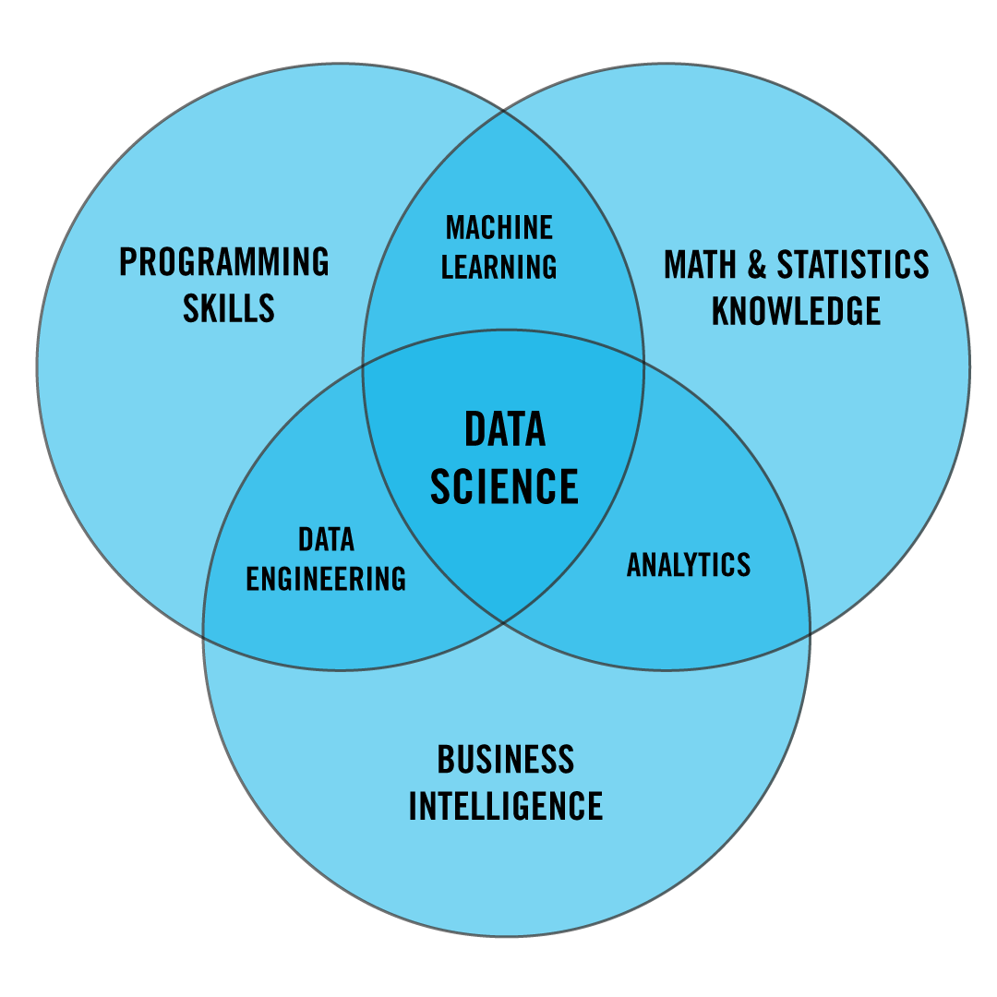
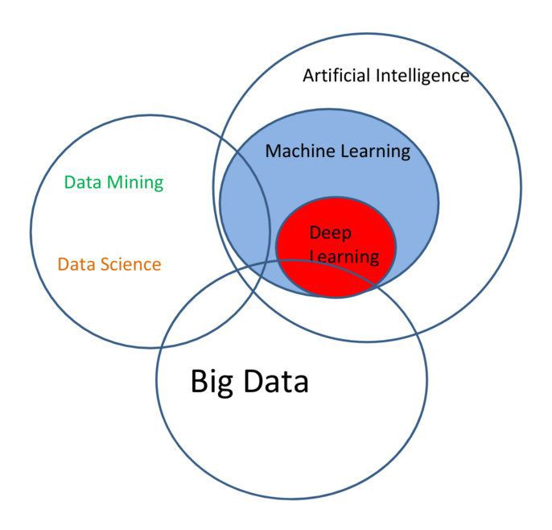
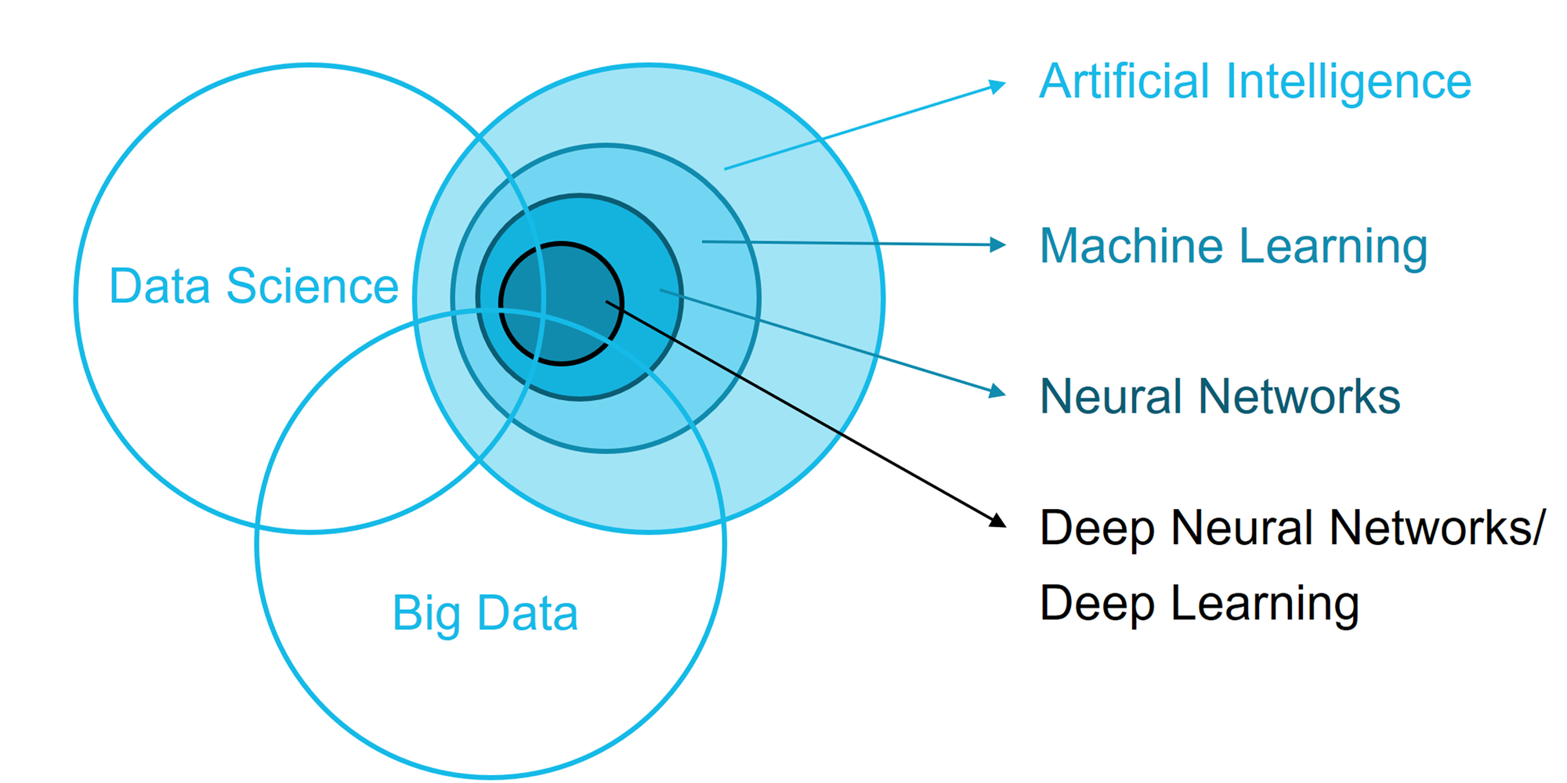
Battle of Venn Diagrams

Slide 6
Make your own Venn diagram

Slide 7
“There is no machine intelligence without (knowledge) representation.”
~ Adrian Bowles

Slide 8


Slide 9
Grammar(syntax) and semantics are utterly unrelated to each other

Slide 10
Syntax vs Semantics
Syntax is the grammatical structure of the text, whereas semantics is the meaning being conveyed.
“Semantic analysis is the process of understanding the meaning and interpretation of words, signs and sentence structure. This lets computers partly understand natural language the way humans do.”
Partially , because it is extremely complex, and a problem yet not fully solved !
Sentence might be grammatical correct but still convey no meaning

Slide 11



Slide 13
Text mining – Traditional data mining to mine patterns in text content. Roots in Information Retrieval domain.
NLP is a field in machine learning with the ability of a computer to understand, analyze, manipulate, and potentially generate human language.

Slide 14
Summarization
Sentiment Analysis, emotion detection
Personality detection
Gender detection
Sarcasm detection
Machine Translation
Evaluation
Writing Assistant
Autoresponder
Chatbots & Virtual Assistants
Content Generation (GAN)
…

Slide 15
Document
Collection of text.
Indian Institute of Management Visakhapatnam (IIMV) belongs to the prestigious IIM family of business schools. It is a new generation IIM, set up by the Government of India in September 2015. The Indian Institutes of Management Act 2017 declares IIMs as Institutions of National Importance, empowered to attain standards of global excellence in management, management research and allied areas of knowledge. IIM Visakhapatnam is located in its temporary, but state-of-the-art facility in the salubrious Andhra University campus in the ‘City of Destiny’, Visakhapatnam. The Institute has begun the process for building a permanent, full-fledged, word-class campus on approx. 230 acres of land in the (relative) vicinity of the upcoming green-field international airport, about 25 kilometers from the present (temporary/transit) campus.

Slide 16
Tokens
represent words.
For example: “India", “democracy", “happiness“ , “the”

Slide 17
Term
may represent single words or multiword units,
such as “civil war” , ”golden handshake” , “United States of America”

Slide 18
Corpus
is a collection of documents (database) usually of specific domain.
Deepmind Question Answering Corpus. Question answering about news articles from the Daily Mail.
TIPSTER Text Summarization Evaluation Conference Corpus. A collection of nearly 200 documents and their summaries.
Personae: a Corpus for Author and Personality Prediction from Text
Hotel Corpora
Corpora" is the plural form of "corpus",

Slide 19

Tokenization
Process to divide unstructured data into tokens such as words, phrase, keywords etc.

Slide 20
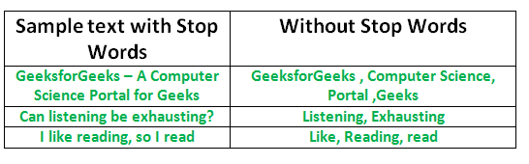
Stop words
Basically a set of commonly used words which you want to exclude while analyzing text as do not contain important significance in further analysis
Examples of stop words - 'a', 'an', 'the', 'to', ‘of’ , ‘be’

Slide 21

Stemming
Stemming is a text preprocessing task for transforming related or similar variants of a word (such as walking) to its base form (to walk), as they share the same meaning.
CHOPPING.
For example, "interesting", "interest" and "interested" are all stemmed to "interest“.

Slide 22

Lemmatization
Lemmatization, unlike Stemming, reduces the words properly ensuring that the root word belongs to the language.

Slide 23

Bag-of-words model -
Simplified representation of texts for further processing
Each document is a bag of words ignoring grammar and even word order, but frequency is preserved

Slide 24


Document Term Matrix
a matrix consisting of documents in a row and terms in columns
Data, result ,statistics, analysis

Slide 26


Slide 27
TF-IDF
TF-IDF is a statistical measure that evaluates how relevant a word is to a document in a collection of documents.
TF-IDF = TF * IDF

Slide 28
Term Frequency -
Term Frequency measures how frequently a word (term) occurs in a document.
TF(t) = (Number of times term t appears) / (Total number of terms).

Slide 29
Inverse Document Frequency(IDF)
IDF(t) = log_e(Total number of documents / Number of documents with term t in it).
how common or rare a word is in the entire document set
diminishes the weight of terms that occur very frequently in the document set and increases the weight of terms that occur rarely.
IDF(t) = log(Total number of documents / Number of documents with term t in it).
IDF(india) = log( 50 / 20)

Slide 30
Consider a document containing 100 words wherein the word cat appears 3 times.
we have 10 million documents and the word cat appears in one thousand of these.

Slide 31
The term frequency (i.e., tf) for cat is then (3 / 100) = 0.03.
the inverse document frequency (i.e., idf) is calculated as log(10,000,000 / 1,000) = 4.
the Tf-idf weight is the product of these quantities: 0.03 * 4 = 0.12

Slide 32
Uses of TF-IDF
Building Stopwords
Terms having tf-idf value zero or close to zero can be used in stop-words list. These are all words that appear in all of the documents, so the idf term is zero.
Important Words
Sort TF-IDF values in descending order. The term which appear at top after sorting is the most important word.

Slide 33
N-grams -
They are basically a set of co-occurring words within a given window.
N-gram of size 1 - unigram
N-gram of size 2 - bigram
N-gram of size 3 - trigram
can store more context

Slide 34
For Example, for the sentence "The cow jumps over the moon".
If N=2 (known as bigrams), then the n-grams would be:
the cow, cow jumps, jumps over, over the, the moon
In this case, we have 5 bigrams.

Slide 35
If N=3 (trigram), the n-grams would be:
the cow jumps, cow jumps over, jumps over the, over the moon

Slide 36
POS tagging
Parts of Speech
POS refers to categorizing the words in a sentence into specific syntactic or grammatical functions.
In English, the main parts of speech are nouns, pronouns, adjectives, verbs, adverbs, prepositions, determiners, and conjunctions

Slide 37
Tripod of Sentiment Analysis
Cognitive Science
Sentiment Analysis
Machine Learning
Machine Learning
Natural Language Processing
Natural Language Processing

Slide 38
Sentiment Analysis
Sentiment Analysis:The study of extracted information to identify reactions, attitudes, context and emotions.
Identify the orientation of opinion in a piece of text
Sentiment -> belief, view, opinion, conviction
What do people feel about a certain topic?
Explicit versus Implicit sentiment
Sentiment polarity
  Positive vs Negative
  Neutral?

Slide 39
Sentiment → belief, view, opinion, conviction
Sentiment analysis → opinion mining, subjectivity analysis, and appraisal extraction
The goal is to answer the question:
“What do people feel about a certain topic?”
Explicit versus Implicit sentiment
Sentiment polarity
  Positive versus Negative
  … versus Neutral?

Slide 40
Knowing sentiment is a very natural ability of a human being.
Can a machine be trained to do it?
SA aims at getting sentiment-related knowledge especially from the huge amount of information on the internet
Can be generally used to understand opinion in a set of documents

Slide 41
Challenge !
Example: The actors are good,
the music is brilliant and appealing.
Yet, the movie fails to strike a chord.

Slide 42



Slide 43
Sentiment analysis contd….
Sentiment analysis can be done via lexicons or new models can be trained using ML techniques
lexicon in simpler terms is a vocabulary , with rated words ,
selection of words with the two polarities that can be used as a metric in sentiment analysis.
many different types of lexicons that can be used depending on the context of the data you are working with
syuzhet package (nrc lexicon)

Slide 44

It is based on word polarities, it takes into account positive or negative words and neutral words are dismissed.

Slide 45


Slide 46


Slide 47
Hands on using R

