Slide 1

HR Analytics
Talent Retention Metrics
Talent Analytics Maturity Model

Slide 2
Learning Objective
Improve Talent Retention using Analytics
Understand the talent analytics maturity model
Evaluate our organizational context and way forward

Slide 3
What is Talent?
Is Everybody a Talent?

Slide 4

All the great strategies in the world will have little effect on a company unless the right people are chosen to execute those strategies.
GE Chairman Jack Welch

Slide 5

What is Talent
Employees who drive a major part of the company's business performance and generate above-average value for customers and shareholders.
They possess highly developed skills and deep knowledge. They don’t just “do their jobs,” but go above and beyond to contribute to the organization’s success

Slide 6


Examples
At British Petroleum they may include the geologists and petroleum engineers who find and extract oil
At Boeing, it may be the machinists who perform precision operations to develop parts for airplanes using Six Sigma standards
At Wal-Mart it may be the inventory managers who ensure that the right goods are in the right store at the right time

Slide 7

Critical Roles
Identifying critical jobs in the organization
Ensuring current and backup incumbents are top performers

Slide 8
What are the causes of Talent Departure ?
Why is there a need to diagnose causes of talent departure?

Slide 9
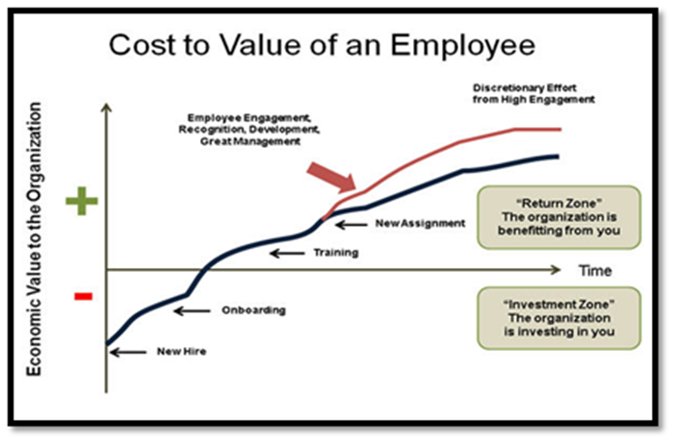
Source: http://www.thestaffingstream.com/2015/04/17/7-most-effective-employee-retention-strategies/
Notes:
But so is losing a Star !!!

Slide 10
Retention
Turnover | Employee Engagement | Cost of Turnover
1. Involuntary termination rate | 1. Employee commitment Index | 1. Average termination value
2. New hire turnover | 2. Employee engagement index | 2. Average voluntary termination value
3. Retention rate | 3. Employee retention index | 3. Turnover cost rate < 1 Year
4. Termination breakdown by PMS | 4. Offer fit index
5. Voluntary termination rate

Slide 11
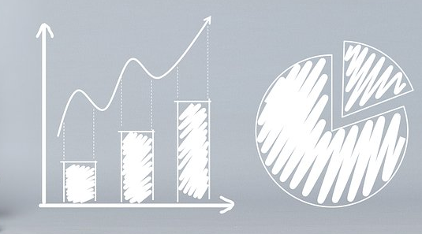
Need to diagnose causes of talent departure
Solutions appear to be obvious
Everyone has an opinion about the cause
Analysis takes too much time and consumes too many resources
Analysis appears confusing

Slide 12


Developing more measures will may not solve the fundamental issues. The real need is for decisions about talent and organizational investments to become for systematic, consistent and shared between HR and non-HR professionals.

Slide 13
Hitting the Wall in HR Measurement
Strategic Intent
Organizational Change
Validity & Rigor
Causation
Leading Indicators
Dashboards
Value
Scorecards & Drilldowns
Data Portals
Benchmarks
Ad hoc measures
Time

Slide 14

Typically HR seeks measurements not to improve decisions but to increase the respect for (and potentially the investment in) the HR function and its services and activities. Talent management is often a search for validation of the HR function more than a quest for better talent and organizational decisions.
If the measurements show that the HR is doing well, no one cares. If the measurements show there is a problem, even when the problem is not caused by the HR function, it is still assigned to HR to fix. If turnover is high, it becomes an HR issue. In contrast, when a division is behind budget, the accounting department is rarely responsible for fixing the problem. Rather the finance department is tasked with providing the insights, measures and frameworks that highlight the issue and provide the mental model for the business leader to craft an appropriate response.

Slide 15
The LAMP Framework
The Right Logic: Rational Talent Strategy
(Competitive advantage, critical talent)
The Right Analytics: Valid questions & Results
(Information, design, statistics)
The Right Measures: Sufficient data
(Timely, Reliable, Available)
The Right Process: Effective knowledge Management
(Values, Culture, Influence)

Slide 16
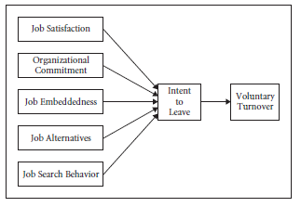
Employee Job Factors and Retention
Source: Managing Talent Retention, an ROI based approach by Jack Philips & Lisa Edwards

Slide 17
What are the challenges that you face in your organizations with respect to Talent Retention?
What is the approach that you have followed to increase retention?

Slide 18
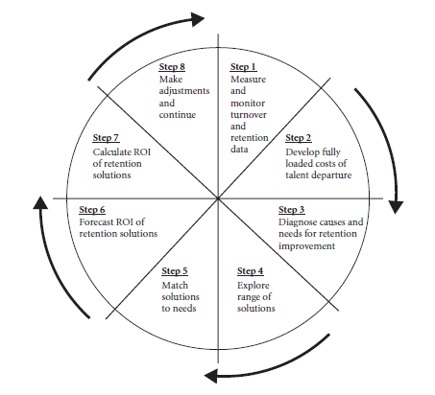
Talent Retention Metrics
Provides rigorous, analytical, and strategic approach to Talent Retention

Slide 19
Measure and monitor turnover data
Appropriate definition of turnover: Voluntary, Avoidable
Turnover rates by various demographics
Report by critical job groups
Report turnover with costs
Compare data with benchmarking targets
Develop trigger points for action

Slide 20

Develop Fully Loaded Costs of Talent Departure

Slide 21
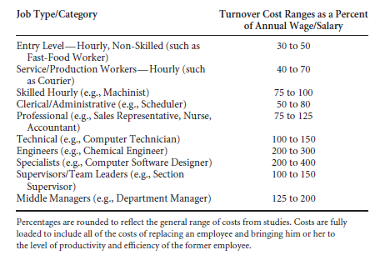
Turnover Cost as a function of Job type
Source: Managing Talent Retention, an ROI based approach by Jack Philips & Lisa Edwards

Slide 22
Diagnose Causes and Needs for Retention Improvement
Diagnostic tools
Demographic analysis
Focus groups
Probing interviews
Job satisfaction surveys
Organizational commitment surveys
Exit interviews
Exit surveys
Nominal group technique
Brainstorming
Cause-and-effect diagram

Slide 23
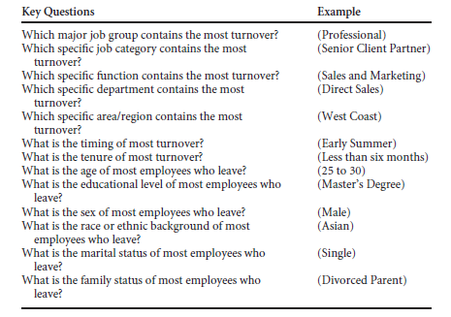
Developing a turnover database: Patterns

Slide 24
Explore a Range of Solutions
Recruit Talent
Establish an Appropriate Work Environment
Create Equitable Pay and Performance Processes
Build Motivation and Commitment

Slide 25
Match Solutions to Needs
Avoid
Avoid mismatches
Discourage
Discourage multiple solutions
Select
Select a solution for a maximum return
Verify
Verify match early - Accumulating data from appropriate individuals
Check
Check the progress of each solution

Slide 26
Forecast ROI of the Retention Solutions
Expert estimation of what a solution should contribute
Difficult, challenging and risky
Allows the team to establish priorities and focus on solutions with greatest ROI
Accumulate as much data as possible to build credibility around the process
Show what percentage of the turnover would actually be eliminated
Offer a range of possible ROI values, given certain assumptions

Slide 27
Calculate ROI of Retention Solutions
Reaction to and satisfaction with the solution
Skill and knowledge acquisition
Application and implementation of progress
Business impact improvement
Return on investment, expressed as a financial ROI formula
Intangible measures, not converted to monetary values.

Slide 28
Make Adjustments and Continue
Collect extensive data to inform adjustments and changes in strategies
Examine barriers to success
Identify the processes that enable or support a turnover-reduction solution
Provide a framework for adjusting and/or repositioning the solution so that it can be revised, discontinued, or amplified.

Slide 29
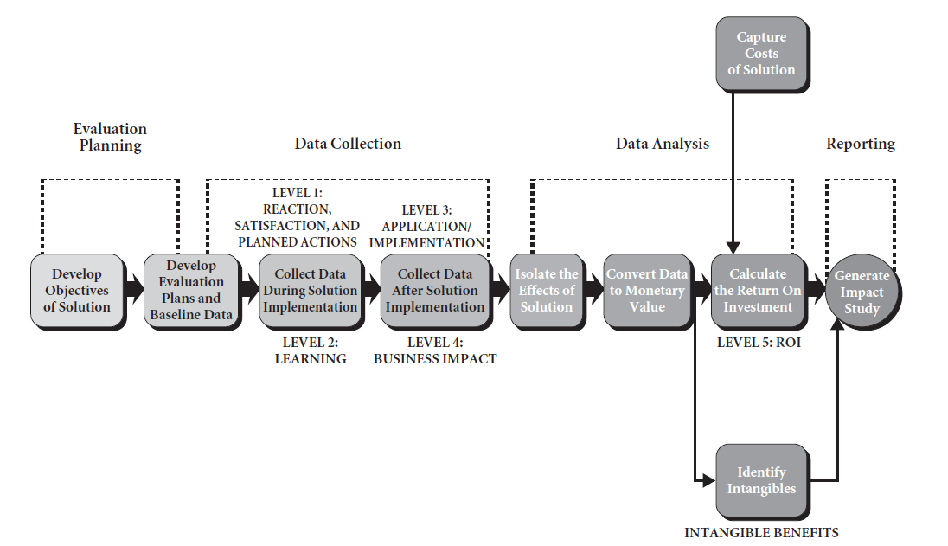
Talent Analytics Methodology

Slide 30
Talent Analytics Maturity Model

Slide 31

Talent Analytics Maturity: Challenges
HR has not delivered strategic value because it does not have a strategic management model. It continues to buy packaged products and apply them as patches to an obsolescent form.
Talent Analytics Maturity is the capability to frame the logic that is used to gather, organize, and interpret data, and subsequently also knowledge, for the purpose of assessing the probability of upcoming events.

Slide 32
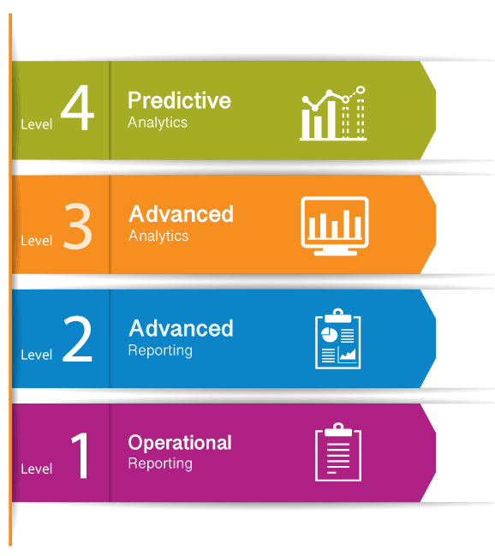
Talent Analytics Maturity Model
Source: https://www.analyticsinhr.com/blog/test-hr-analytics-maturity-level/

Slide 33
Level 1: Operational Reporting
HR mostly sticks to operational reporting.
56% of all organizations are at HR analytics maturity level 1.
Report traditional metrics
  Headcount
  Attrition
  labor cost
  training cost
Reports generated with the use of a Human Resources Information System (HRIS)

Slide 34
Level 2: Advanced reporting
Capable of operational and advanced reporting of HR metrics
30% of organizations are at level 2
HR reports proactively
Provides multiple perspectives
Advanced to influence strategic decision-making
Reports are descriptive and focused on efficiency
Deliver HR metrics in organized dashboards

Slide 35
Level 3: Advanced Analytics
Transitioning from reporting to analytics
10% of organizations are in level 3
Statistically analyzing HR data to develop relevant models for better decision-making
Combines different forms of data - demographics, performance and hiring data along with financial and operational data from different systems
Add tangible value to the organization by proactively identifying issues and recommending actionable solutions

Slide 36
Level 4: Predictive Analytics
Answers the question: “Where will / could we be?”
4% of organizations are in level 4
Engage in scenario planning by forecasting what is likely to happen in the future
Mitigate risks and thus engage in strategic workforce planning
Use dedicated data scientist and advanced tools
How the workforce will develop, where leadership succession will be jeopardized, and which position the organization will need to fill in the near future?

Slide 37
Where are you with respect to Talent Analytics Maturity?

Slide 38
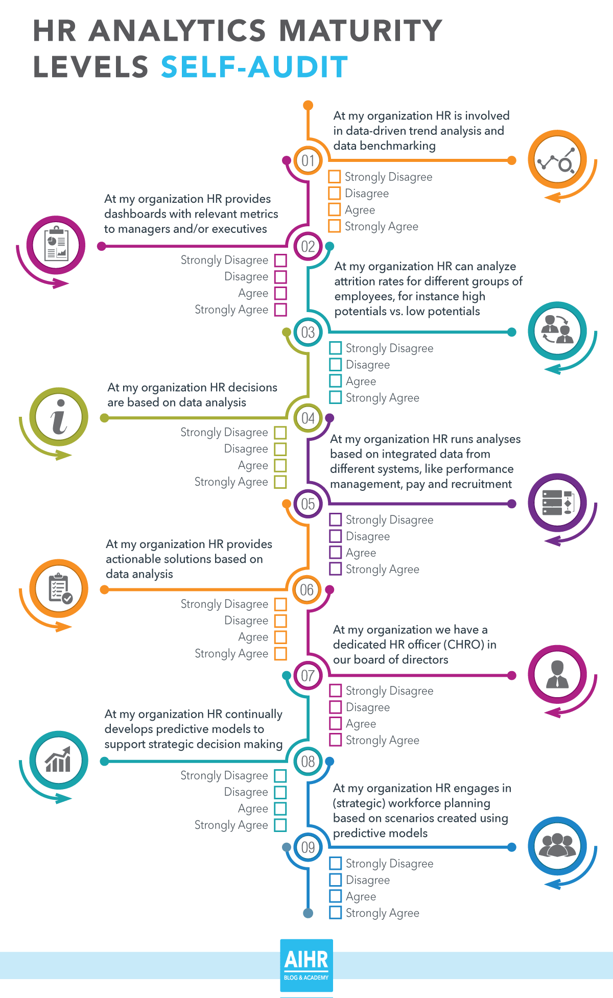

Slide 39
Score your organization
Add your points
Strongly disagree: 0 points
Disagree: 1 point
Agree: 2 points
Strongly agree: 3 points
Calculate your level
0-5 points: Level 1
6-11 points: Level 2
12-18 points: level 3
19+ points: level 4

Slide 40
Retain
Lack of company loyalty
The desire to have challenging and useful work
The need for autonomy, flexibility, and independence
The need to have rewards based on performance
The need to be recognized for participation, accomplishments, and contributions
The need to learn new skills
Career growth in all directions
The need for a caring, supportive environment
Need for work/life balance

Slide 41

Thank you

