Slide 1
TALENT DEVELOPMENT AND MANAGEMENT VI
SPHRi

Slide 2
Employee Relations
Employee relations refers to an organization’s efforts to create and maintain a positive relationship with its employees. By maintaining positive, constructive employee relations, organizations hope to keep employees loyal and more engaged in their work.
When it comes to employee relations, an HR department has two primary functions.
First, HR helps prevent and resolve problems or disputes between employees and management.
Second, they assist in creating and enforcing policies that are fair and consistent for everyone in the workplace

Slide 3

Employee-Organisation Relationship

Slide 4
Nature of Employee Relations
Quasi-sport Contracts :
The employment relationship represents a pure economic exchange focused on a short-term and relatively well-defined set of duties s (e.g., brokerage firms’ contracts with stockbrokers).
Use of temporary, part-time employees or contractors to keep from paying benefits. This type of exchange is usually found in relationships with contractors in unskilled, skilled, and even professional jobs.
Firms use the quasi-spot contract approach to gain flexibility in the employment and deployment of people resources.
2. Under Investment :
Underinvestment occurs when a firm offers a narrow set of inducements but in return expects a broad set of contributions from employees. This ER is imbalanced to the advantage of employers because they get more (from employees) out of less (from themselves).

Slide 5
Nature of Employee Relations
3. Over-Investment :
Organizations couple high or broad inducements with low or narrow expected contributions. This exchange favors employees, who receive more than they give and is practiced by government bureaucracies and quasi-monopolistic corporations
4. Mutual Investment :
The firm focuses on developing a long-term and open-ended relationship with the employees. Under this approach, employees are expected to contribute broadly to their organization instead of focusing only on performing their own jobs.

Slide 6
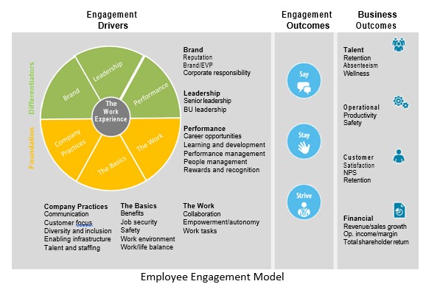
Employee Engagement Model

Slide 7
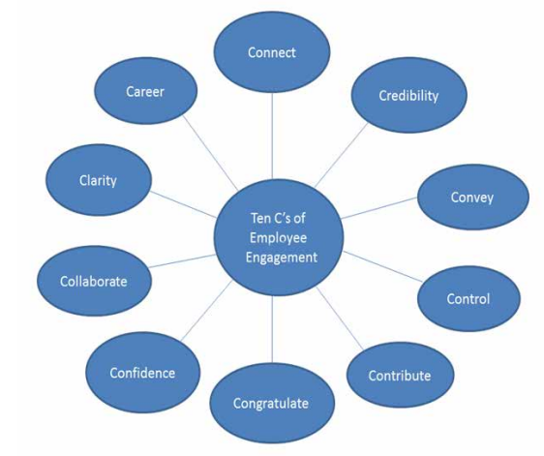
10 C’s of Employee Engagement

Slide 8
10 C’s of Employee Engagement
1. Connect: The managers should value the employees. Employee engagement is positively related with the behaviour of managers with the employees. Therefore employers should properly connect with their employees
2. Career: The manager should provide the opportunity for growth and development of the employees. Proper training and induction programme are very important for the career advancement of the employees.
3. Clarity: The managers must communicate the goals and objectives of the
organization. The success of the organization is largely depends upon clarity of goals and objectives among the employees.
4. Convey: The managers should discuss the expectation which they want from the employees and provide feedback on the performance of the employees. Effective leaders work daily to improve the performance of the employees.

Slide 9
10 C’s of Employee Engagement
5. Congratulate: The employees are getting feedback in the area where they are lacking behind and at the same they should also be rewarded and recognized on their excellent performance.
6. Contribute: The employees feel happy and motivated if their works contributes in achieving the organizational goals in a meaningful way. Therefore the managers must discuss the role of the employees in achieving goals and objectives of the organization. Effective leaders help employees to see and feel that how they are contributing to the organization success and future.
7. Control: Control is very important function of management. It is process to check whether organization is running in desired direction or towards its goals and objective. The leaders should have the quality to control the organization.

Slide 10
10 C’s of Employee Engagement
8. Collaborate: When employees work in group and have trust and cooperation of their group members, they perform best. Good leaders are team builders, they create an environment that fosters trust and collaboration
9. Credibility: Leaders should struggle to maintain organizational image and show high ethical standards. People want to be proud of their jobs, performance and organization.
10. Confidence: Good leaders help to create confidence in the organization by developing high ethical and standards performance.

Slide 11
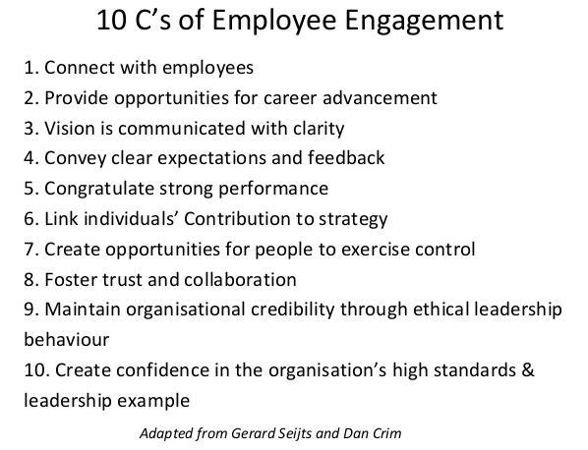
The ten C’s of employee engagement

Slide 12

Employee Communication

Slide 13

Types of Formal Communication

Slide 14
Formal Communication types
Upward or Bottom-up: The communication in which the flow of information goes from sub-ordinate to superior authority.
Downward or Top-down: The communication in which the flow of information goes from superior to sub-ordinate.
Horizontal or Lateral: The communication between two employees of different departments working at the same level.
Crosswise or Diagonal: The communication between the employees of two different departments working at different levels.

Slide 15
Types of Informal Communication
Single Strand Chain: The communication in which one person tell something to another, who again tells something to some other person and the process goes on.
Cluster Chain: The communication in which one person tells something to some of its most trusted people and then they tells them to their trustworthy friends and the communication continues.
Probability Chain: The communication happens when a person randomly chooses some persons to pass on the information which is of little interest but not important.
Gossip Chain: The communication starts when a person tells something to a group of people and then they pass on the information to some more people and in this way the information is passed on to everyone.

Slide 16

Types of Informal Communication

Slide 17
Differences Between Formal and Informal communication
Formal communication is also known by the name of official communication. Informal Communication is also known by the name of grapevine.
In formal communication the information must follow a chain of command. Conversely, the informal communication can move freely in any direction.
In formal communication full secrecy is maintained, but in the case of informal communication maintenance of secrecy is a very tough task.
Formal communication is generally written, whereas Informal communication is oral.
Formal communication is time consuming as opposed to Informal communication, which is rapid and quick
Formal communication is more reliable than Informal communication.
Formal communication is designed by the organization. Informal communication starts itself due to the urge of ‘human to talk’.
In formal communication the documentary evidences are always available. On the other hand, in the case of informal communication the documentary evidences are not available.
Response
Feedback

Slide 18

Differences Between Formal and Informal communication

Slide 19

Communication Process

Slide 20
Communication Process
Source/Sender – the person or organization that has information to share
Receiver – person(s) with whom the sender is sharing thoughts
Message – the information the source hopes to convey
Channel – method by which the communication travels from source to receiver
Encoding – putting thoughts, ideas, or information into symbolic form
Decoding – transforming the senders message back into thought
Response – receiver’s reactions after seeing, hearing, or reading the message
Feedback – part of the receiver’s response that is communicated back to the sender
Noise – unplanned distortion or interference

Slide 21

Employee Survey

Slide 22
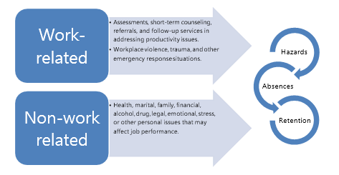
Employee Assistance Program (EAP)

Slide 23

Employee Disciplinary Procedure

Slide 24
Talent Management
Talent management as activities and processes that involve the systematic identification of key positions which differentially contribute to the organization’s sustainable competitive advantage, the development of a talent pool of high potential and high performing incumbents to fill these roles, and the development of a differentiated human resource architecture to facilitate filling these positions with competent incumbents and to ensure their continued commitment to the organization.

Slide 25
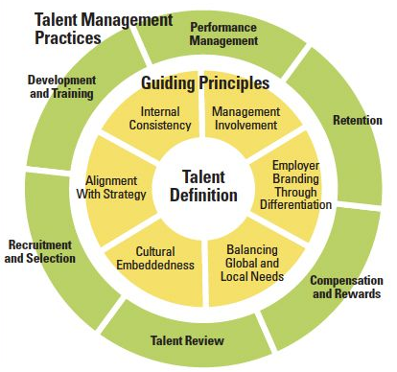
Talent Management

Slide 26
Six Principles of Effective Global Talent Management
Alignment With Strategy
Internal Consistency
Cultural Embeddedness
Management Involvement
Balance of Global and Local Needs
Employer Branding Through Differentiation

Slide 27
Replacement Planning vs. Succession Planning vs. Talent Management
Replacement planning is the process of identifying short-term and long-term emergency backups to fill critical positions or to take the place of critical people. Short-term replacement planning focuses on finding backups while a critical person is out for a short time, such as on vacation or out sick
Succession Planning - Talent pools are thus defined as all people who are considered promotable to the next level up on the organization chart regardless of department. When need is great – such as may occur when all members of a group (like senior executives) are at or near retirement age – then a special focus may be placed on accelerating the development of the talent pool.
Talent management moves beyond succession planning. Although a term that has been variously defined, talent management is often defined as a process of “attracting the best people, developing the best people, and retaining the best people”. It is that threefold, integrated focus that distinguishes talent management from succession planning.

Slide 28
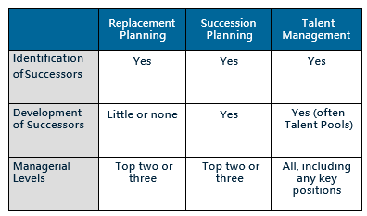
Replacement Planning vs. Succession Planning vs. Talent Management
In sum, Replacement Planning is a process of identifying short-term or long-term backups so that organizations have people who can assume responsibility for critical positions during emergencies. Individuals identified as ‘replacements’ are not promised promotions; rather, they are prepared to the point where they can assume a critical position long enough for the organization’ leaders to do a proper internal and external search for a permanent replacement. It should not be confused with Succession Planning, which focuses on developing a pool of people to consider for promotion, or Talent Management, which focuses on attracting, developing, deploying and retaining the best people. Using a case study approach, this article describes how one organization used replacement planning as a means to raise and consider important issues as a starting point for the eventual implementation of succession planning.

Slide 29
Questions

