Slide 1
TALENT DEVELOPMENT & MANAGEMENT - V
PHRi

Slide 2
Difference - Training and Development
Employee Development Techniques
Stages in Career Development
Career Management Systems
Career Planning Points
Career Transitions

Slide 3
Employee Development
Development refers to learning activities and experiences that help employees grow and prepare for the future.
Development often involves voluntary learning that is not tied directly to the employee’s current job.
Training, on the other hand, is related to the current job and is typically required.
Development prepares employees for other positions and increases their ability to move into jobs that may not yet exist.
Development is especially important for senior managers and employees with leadership potential.

Slide 4
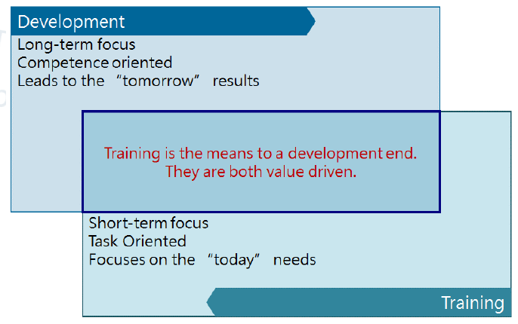
Differences Between Employee Training and Development

Slide 5
Differences Between Employee Training and Development
Development is accomplished through systematic training, learning experiences, work assignments, and assessment efforts.
Training is the acquisition of knowledge, skills and competencies as a result of teaching.
Development teaches how to become more productive and effective at work and at the company.
Training provides the skill and development maximizes it.

Slide 6
Question # 1
Replacement planning is based on an organization's ability to :
a) find candidates with development potential.
b) identify the best available candidate for a job
c) plan specific goals and assignments for individuals.
d) test candidates' potential early in their careers.

Slide 7
Answer # 1
Option B
The key phrase "for a job" identifies the correct answer. Replacement planning focuses on finding a person who could move into a key job in the organization. Planning specific goals and assignments for individuals, finding candidates with developmental potential, and testing candidates early in their careers are all hallmarks of succession planning.

Slide 8
Difference - Training and Development
Employee Development Techniques
Stages in Career Development
Career Management Systems
Career Planning Points
Career Transitions

Slide 9
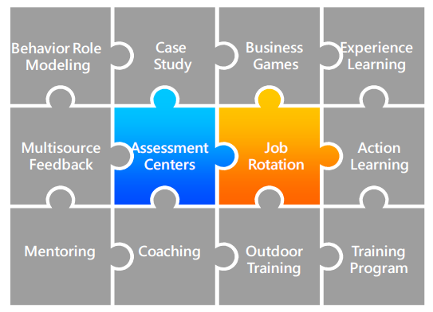
Employee Development Techniques

Slide 10
1. Behavior Role Modeling
The method uses a combination of demonstration (or videotape) and role playing to enhance interpersonal skills. Small group so of trainees observe someone demonstrate how to handle a particular type of interpersonal problem, then they practice the behavior in a role play and get nonthreatening feedback.

Slide 11
2. Case Study
Cases are descriptions of events in an organization and used in a variety of ways in courses to develop management skills, such as practice analytical and decision making skills. The benefits of using case study are to increase understanding about situations managers encounter and effective managerial behavior.

Slide 12
3. Business Games and Simulations
Simulations require trainees to analyze complex problems and make decisions. After decisions are made, trainees usually receive feedback about what happened as a result of their decision. Business games can be used also to assess training needs, the success of prior training, or the validity of a manager’s mental model for a particular decision situation.

Slide 13
4. Learning from Experience
Much of the management skill essential for effective leadership is learned from experience rather than from formal learning programs. Appropriate values and behaviors can be learned from competent superiors who provide positive role models to emulate.
Growth and learning are greater when job experiences are diverse as well as challenging. It is beneficial for managers to have early experience with a wide variety of problems that require different leadership behavior and skills.

Slide 14
5. Multi Source Feedback
This approach is called by various names, including 360-degree feedback and multirater feedback. This approach can be used for variety of purposes, but the primary use is to assess the strengths and developmental needs for individual managers
360-degree feedback is the process of appraising performance by collecting evaluations from all the way around the employee, i.e., from subordinates, peers, customers, the manager, and his/herself.

Slide 15
6. Assessment Center (AC)
The assessment center (AC) refers to a process involving multiple raters or assessors on multiple exercises or activities.The entire process is usually conducted off-site. Outcomes include identifying managerial potential in terms of personality characteristics, administrative skills, and interpersonal skills; and identifying employees with team skills. Exercises may include:
Leaderless group discussion
Role plays
Personality, interest and ability tests

Slide 16
7. Special Assignment
Special assignments include managing a new project or start-up operation, serving as the department representative on a cross-functional team, chairing a special task force to plan a major change or deal with serious operational problem, developing and conducting a training program for the organizational unit, and assuming responsibility for some administrative activities previously handled by the boss.
Research show that diverse, challenging assignments early in one’s career facilitated career advancement.

Slide 17
8. Job Rotation
Managers who are assigned to work in a variety of different functional subunits of the organization for periods of time can learn about the unique problems and processes in different subunits and the interdependencies among different parts of the organization. Also, it provides managers the opportunity to develop a large network of contact.

Slide 18
9. Action Learning
The emphasis is on developing cognitive and interpersonal skills rather than technical knowledge. The managers meet periodically with a skilled facilitator to discuss, analyze, and learn from their experiences.

Slide 19
10. Mentoring
Mentoring is a relationship in which a more experienced manager helps a less experienced protégé; the mentor is usually at a higher managerial level and is not the protégé’s immediate supervisor. Mentors can facilitate adjustment, learning, and stress reduction during difficult job transitions, while mentors may also benefit from the experience, because it is likely to increase their job satisfaction and help them develop their own leadership skills

Slide 20
11. Executive Coaching
Having a coach provides the unusual opportunity to discuss issues and try out ideas with someone who can understand them and provide helpful, objective feedback and suggestions, while maintaining strict confidentiality. Executive coaching is especially useful in conjunction with techniques that provide information about developmental needs but do not directly improve skills. The person who provides the coaching may be external or internal consultant.

Slide 21
12. Outdoor Challenge Program
The methods, often called outdoor training, involve physical activities performed by a group of people in an outdoor setting. An experienced facilitator conducts the activities, provides coaching and encouragement, and helps participants understand the link between their experiences in an activity and organization life. The perceptions of teamwork and individual problem solving increased for participants, especially when intact groups were used.

Slide 22
13. Personal Growth Programs
These programs usually involve strong emotional experiences and are more likely than most training programs to have a lasting effect on participants, which are designed to improve self-awareness and overcome inner barriers to psychological growth and development of leadership competencies. The net effect of personal growth programs that encourage people to find a better balance between their work and personal life may be to reduce commitment to the organization.

Slide 23
14. Succession Planning
It is a dynamic, ongoing process of systematically identifying, assessing, and developing leadership talent pool to contribute to the achievement of future strategic goals.
Succession planning is a strategy that targets long-range needs and focuses on the cultivation of talent to satisfy those needs, such as changes in strategy, market environment and retirement. Succession planning is proactive and attempts to ensure the continuity of leadership by cultivating talent from within the organization through planned development activities

Slide 24
Employee Development Techniques
Off-site training - It is often selected for multiday programs; a hotel or conference center could be used. The novelty of a new environment can help make participants more alert and involved.
Tuition reimbursement programs -These are sometimes offered by organizations to support employees' education and development. Most companies require that the program attended by the employee directly pertain to their job responsibilities.

Slide 25
Question # 2
In which training method are videotapes frequently used to illustrate how managers function in various situations?
a) Behaviour modelling.
b) Business games.
c) Lecture discussions.
d) Mentoring.

Slide 26
Answer # 2
Option A
In behaviour modelling trainees observe a supervisor role-play in a common work situation. Because situations presented are typical of those encountered, trainees are able to relate it to their own jobs.

Slide 27
Question # 3
What is a frequent criticism of using assessment centers in organizations?.
a) Problems with establishing validity.
b) Potential is high for adverse impact.
c) Cost of developing and administering.
d) Problems with the self-fulfilling prophecy.

Slide 28
Answer # 3
Option C
ACs are costly to develop and administer. Much time and cost is put into creating the exercise, training, assessor, and administering the AC

Slide 29
Difference - Training and Development
Employee Development Techniques
Stages in Career Development
Career Management Systems
Career Planning Points
Career Transitions

Slide 30
Career Development
Careers have been described as a sequence of positions held within an occupation. A career has also been described in the context of mobility within an organization. Finally, a career has been described a characteristic of the employee whose career consists of different jobs, positions, and experiences. As a result, career could be considered as the pattern of work-life experiences.
Protean Career refers a career that is frequently changing based on both changes in the person’s interests, abilities, and values and changes in the work environment. Compared to the traditional career, employees take major responsibility for managing their careers.
Plateaued careers are situations in which the employee, due to anyone of many different factors, is unable to advance further within the organization or, possibly, within the selected industry. An individual's career may reach a plateau for a wide variety of reasons.

Slide 31
Career Development
Career development is the process by which employees progress through a series of stages, each characterized by a different set of developmental tasks, activities, and relationships. Career development consists of two processes-career planning and career management.
Career planning are actions and activities that individuals perform to give direction to their work life.
Career Management is the process through which employees become aware of their own interests, values, strengths, and weaknesses; obtain information about job opportunities within the company; identify career goal; establish action plans to achieve career goals
Career Path is the line of job progression along which an employee typically moves during his or her tenure with a company.

Slide 32
Career Development
Career without boundaries views a manager as having many possible trajectories for a career, and many are across organizational boundaries.
Portfolio career are built around a collection of skills and interests and are self-managed. Portfolio careers are usually built around a collection of skills and interests, though the only consistent theme is one of career self-management. With a portfolio career you no longer have one job, one employer, but multiple jobs and employers within one or more professions.
Authentic career refers to people achieve a high level of personal insight and use this to follow a “true-to-self” career. The Authentic Career is about finding and living the authentic self. It brings us back to the things we might have once been told by a well-meaning friend or a self-help lecture. It makes real and fleshes out exactly what we need to do to work through core issues of our identity and find our "true bliss" in the workplace.

Slide 33

Stages in Career Development

Slide 34
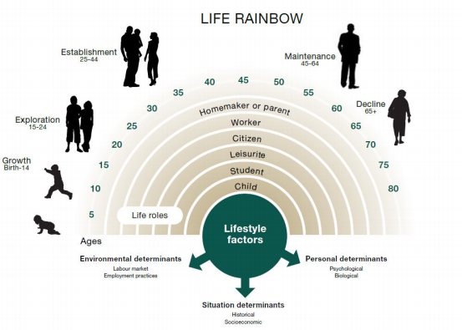
Donald Super’s Self Concept

Slide 35
Super’s - Career Development Theory
The career development process is unique to every person.
Factors like gender, ethnicity, ability, personality, socioeconomic status, family, geography, and opportunity all, to varying degrees, play a part in the development of one’s career path.
At the foundation of Super’s theory lie life stages, vocational tasks, and self concept.

Slide 36
1. Exploration Stage
In this stage, individual attempt to identify the type of work that interests them. They consider their interests, values, and work preferences, and they seek information about jobs, careers, and occupations form co-worker, friends, and family members. Therefore they can begin pursuing the needed education or training. From the company’s perspective, orientation activities are necessary to help new employees get as comfortable as possible with their new jobs and co-workers.

Slide 37
2. Establishment Stage
In this stage, individuals find their place in the company, make an independent contribution, achieve more responsibility and financial success, and establish a desirable life-style. Employee need to become more actively involved in career planning activities, while the company needs to develop policies that help balance work and non-work roles.

Slide 38
3. Maintenance Stage
In this stage, the individual is concerned with keeping skills up to date and being perceived by others as someone who is still contributing to the company. A major issue for company is how to keep employees in the maintenance stage from plateauing and ensure that employees’ skills do not become obsolete.

Slide 39
4. Disengagement Stage
In this stage, individuals prepare for a change in the balance between work and nonwork activities, while maintain self-esteem. Some may be forced to leave due to downsizing or merger; others may leave because of their interest, values, or abilities, and then back to the exploration stage. For the company’s perspective, the major career management activities in this stage are retirement planning and outplacement.

Slide 40

Super’s Career Development Stages

Slide 41
Question # 4
Which is describing a situation in which Firm occupational goals are set and an individual conducts more explicit career?.
a) Exploration stage
b) Establishment stage
c) Maintenance stage
d) Disengagement stage

Slide 42
Answer # 4
Option C
In maintenance stage, the individual is concerned with keeping skills up to date and being perceived by others as someone who is still contributing to the company. A major issue for company is how to keep employees in the maintenance stage from plateauing and ensure that employees’ skills do not become obsolete.

Slide 43
Difference - Training and Development
Employee Development Techniques
Stages in Career Development
Career Management Systems
Career Planning Points
Career Transitions

Slide 44
Career Management System
Individuals are actively involved in career management activities, but the emphasis is on the organization providing development programs and opportunities that align with its interests, such as staffing and succession planning.
Career management focuses on the organization and concerns itself with identifying future staffing needs, matching organizational needs with individual abilities, and designing appropriate career development programs and paths.

Slide 45

Career Management Process

Slide 46
Career Management Process
Self-assessment refers to the use of information by employees to determine their career interests, values, aptitudes, and behavioral tendencies.
Reality Check refers to the information employees receive about how the company evaluates

Slide 47
3. Goal Setting
Goal setting refers to the process of employees developing short- and long-term career objectives. These goals usually relate to desired positions, level of skill application, work setting, or skill acquisition. These goals are usually discussed with the manager and written into an individual development plan (IDP).

Slide 48
Individual Development Plan
An individual development plan (IDP) is a tool to assist employees in career and personal development. Its primary purpose is to help employees reach short and long-term career goals, as well as improve current job performance. An IDP is not a performance evaluation tool or a one-time activity. It should be looked at like a partnership between the employee and the supervisor. It involves preparation and continuous feedback. Many agencies require IDPs for for new and current employees. It is encouraged throughout many organizations.

Slide 49
4. Action Planning
Action planning involves employees determining how they will achieve their shortand long-term career goals. Action plans may involve enrolling the training courses and seminars, conducting informational interview, or applying for job openings with the company.

Slide 50
Difference - Training and Development
Employee Development Techniques
Stages in Career Development
Career Management Systems
Career Planning Points
Career Transitions

Slide 51
Career Planning Points
Career planning focuses on the individual, who assesses personal abilities and interests, evaluates career paths, and plans personal career goals. Choosing a career determines how much money you'll make, how much you'll work each week, where you'll live, when you can retire.
The career planning process has four components: (1) Self Assessment, (2) Career Exploration, (3) Career Identification, and (4) Action Plan.

Slide 52
3. Career Identification
Career planning process is when selected just one occupation, among the many you've considered. During this step -
Identify the occupation that is most interested
Make few alternatives to fall back on if the first choice doesn't pan out.
Identify all the requirements (e.g. education, costs, etc.) for entering your chosen career field.

Slide 53
4. Create an Action Plan
The action plan is a road map that takes you from choosing a career to finding your first job all the way to achieving your long-term career goals.
Identify your short-term and long- term goals,
Identify education and training requirements
Develop a job search strategy
Identify potential employers
Create a resume, compose cover letters
Prepare for job interviews.

Slide 54
Question # 5
Which of the following best describes career planning?
a) A deliberate process through which someone becomes aware of personal skills, interests, knowledge, and motivations and establishes action plans to attain specific career goals.
b) The lifelong series of activities that contribute to a person's career exploration, establishment, success, and fulfillment
c) A process of helping employees to better understand and develop their career skills and interests and to use these skills and interests most effectively.
d) The process of advising, counseling, and guiding subordinates as they maneuver through their long-term career plans.

Slide 55
Answer # 5
Option A
The actions and activities that individuals perform to give direction to their work life (goals) are called career planning.

Slide 56
Difference - Training and Development
Employee Development Techniques
Stages in Career Development
Career Management Systems
Career Planning Points
Career Transitions

Slide 57
Job Loss
Job loss as a career transition has been most associated with downsizing, mergers, and acquisitions. Losing a job is a stressful event in one’s career, frequently causing depression, anxiety, and nervousness. The financial implications and the effects on family can be extreme as well. Yet the potential for job loss continues to increase for many individuals, and effectively addressing their concerns should be considered in career transition decision making.

Slide 58
Retirement Issues
Career development for people toward the ends of their careers may be managed in a number of ways. Phased-in retirement, consulting arrangements, and callback of some retirees as needed all act as means for gradual disengagement between the organization and the individual.
Early retirement often occurs as a result of downsizings and organizational restructurings.

Slide 59
Questions

