Slide 1
TALENT DEVELOPMENT & MANAGEMENT - IV
PHRi

Slide 2
Training Program Development
Training Implementation
Kirkpatrick Training Evaluation Model
Training Transfer
Trends for Employee Training
Outsourced Training
Learning Management System
Training Need Analysis

Slide 3
Learning Management System (LMS)
Learning Management System (sometimes also called "Course Management System", "Pedagogical Platform", "E-Learning Platform") is a software system that delivers courseware plus e-tutoring over the Internet.
A learning management system (LMS) allows you to create, distribute and track training anywhere, on any device.

Slide 4
Choice of LMS
As with most software, there’s no “one size fits all, best” LMS
Is it easy to use?
Does it offer reporting?
How many learners can you invite?
Can you create individual learning tracks?
What course and media formats does the LMS support?

Slide 5
Training Program Development
Training Implementation
Kirkpatrick Training Evaluation Model
Training Transfer
Trends for Employee Training
Outsourced Training
Learning Management System
Training Need Analysis

Slide 6
Training Need Analysis
Training needs are identified on the basis of organisational analysis, job analysis and individual analysis.
Course content are to be planned on the basis of training needs.
Training needs are those aspects necessary to perform the job in an organisation in which employee is lacking attitude/aptitude, knowledge, skill.

Slide 7

Training Needs Assessment

Slide 8
Assessment Process
Gather data to identify needs.
Determine needs that can be met by training interventions.
Propose solutions.(Training is not a solution for employee relations problems such as poor morale, lack of motivation, or lack of ability to learn.)
Calculate potential cost of training interventions.
Choose and implement the training.

Slide 9
Types of Assessments
Organizational Assessment - Identifies the knowledge, skills, and abilities employees will need in the future.
Task Assessment - Compares job requirements with employee knowledge and skills to identify are as needing improvement through job analysis.
Individual Assessment - Focuses on individual employees and how they perform their jobs, usually determined through performance appraisal or review.

Slide 10
Question # 1
Once the data of training needs analysis has been gathered, the next step is to:.
Report the needs that training can and cannot meet.
Develop the objectives for the training program.
Propose a series of solutions for customer service problems.
Decide whether to develop or buy the training program.

Slide 11
Answer # 1
Option A

Slide 12
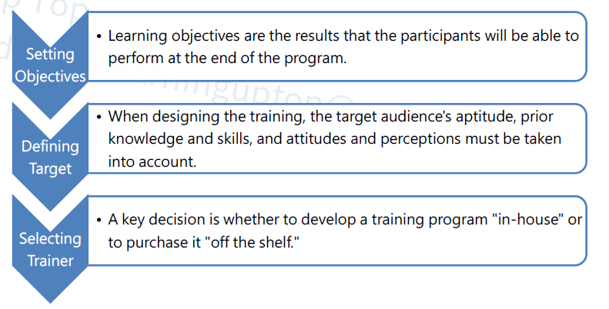
Training Design

Slide 13
Training Program Development
Training Implementation
Kirkpatrick Training Evaluation Model
Training Transfer
Trends for Employee Training
Outsourced Training
Learning Management System
Training Need Analysis

Slide 14

Training Program Development

Slide 15
Question # 2
One well-recognized advantage of on-the-job training is:.
a) Supervisors' expertise in conducting job-specific instruction.
b) The incorporation of unplanned activities in the learning situation.
c) The ability to fit the learning to the trainee.
d) The ability to expand the learning to a more developmental focus.

Slide 16
Answer # 2
Option C

Slide 17
Types of Training Program
Vestibule Training - It is a method in which trainees learn on the actual or simulated equipment they will use on the job, but are trained off the job. It can be considered a combination of onand off-the-job training.
Virtual training - A trainer in a central location teaches groups of employees at remote locations via television hookups.
Electronic Performance Support Systems (EPSS) - The systems are sets of computerized tools and displays that effectively automate and integrate training, documentation, and phone support, thus enabling individuals to provide support that’s faster, cheaper, and more effective than the traditional methods.

Slide 18
Types of Training
Blended Learning - It is a planned approach to learning that includes a combination of methods such as classroom, e-learning, self-paced study, and performance support such as job aids or coaching.
Cross training occurs when people are trained to do more than one job—theirs and someone else’s. For the employer, the advantages of cross training are flexibility and development.

Slide 19
Orientation and On-boarding
Orientation and on boarding refers to the process of new employee assimilation, which often lasts up to six months or a year. The programs smooth the adjustment phase by introducing new employees to others, lessening feelings of isolation, and providing a better understanding of the organization, expectations, and future opportunities for personal growth and development.

Slide 20
E-Learning
E-learning is the delivery of formal and informal training and educational materials, processes, and programs via the use of electronic media. E-learning includes Web based learning, computer-based training (CBT), and virtual classrooms.
E-learning can be synchronous or asynchronous:
Synchronous learning is when participants interact together in real time.
Asynchronous learning is when participants access information at different times and in different places.

Slide 21
Question # 3
A major concern with e-Learning is that:.
a) Retention of learned material is affected by the speed with which the learner progresses through the course.
b) Trainees will discontinue other learning experiences critical to job performance.
c) It is more costly than other training methodologies.
d) It provides too much flexibility because of self-pacing.

Slide 22
Answer # 3
Option A

Slide 23
Question # 4
The HRCI is adding five new stamping machines, which are identical in design and operation to 20 stamping machines currently operated by 20 machine operators and 20 assistant machine operators. The operators for the new equipment will be selected from the pool of current assistant machine operators. Which of the following is the most cost effective instructional method for training the new operators?.
a) Classroom-based lecture
b) E-learning from the vendor
c) Structured on-the-job training
d) Simulation-based training

Slide 24
Answer # 4
Option C

Slide 25
Training Program Development
Training Implementation
Kirkpatrick Training Evaluation Model
Training Transfer
Trends for Employee Training
Outsourced Training
Learning Management System
Training Need Analysis

Slide 26
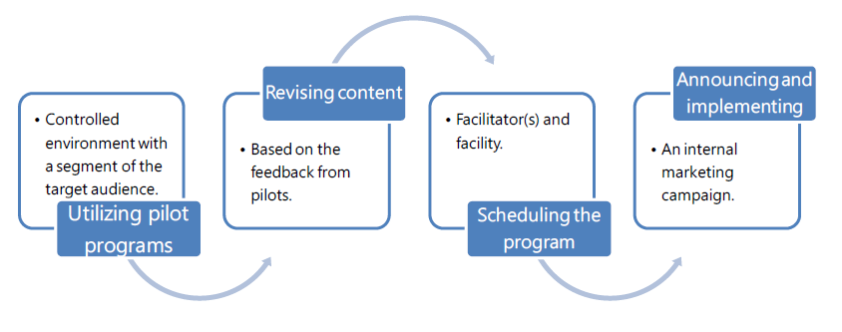
Training Implementation

Slide 27
Training Implementation
Utilizing pilot programs - A pilot program involves offering the program initially in a controlled environment with a segment of the target audience, and evaluating the sequencing of content.
Revising content - Based on the feedback provided by the pilot audience, now is the time to make adjustments to the program prior to final delivery.

Slide 28
Training Implementation
Scheduling the program involves paying attention to the target audience, the intended learning outcomes, the deadlines for completion, whether regular work hours or evenings and weekends are required, participation at a distance, etc. Selecting qualified facilitator(s) and selecting a facility are also important factors to consider.
Announcing and implementing the program - An effective way to increase interest in an upcoming training program is to launch an internal marketing campaign. Giving participants a preview of the topics and agenda creates interest

Slide 29
Training Program Development
Training Implementation
Kirkpatrick Training Evaluation Model
Training Transfer
Trends for Employee Training
Outsourced Training
Learning Management System
Training Need Analysis

Slide 30
Kirkpatrick's 4 Levels of Training Evaluation
The Kirkpatrick Model of Evaluation, first developed by Donald Kirkpatrick in 1959, is the most popular model for evaluating the effectiveness of a training program. The model includes four levels of evaluation, and as such, is sometimes referred to as 'Kirkpatrick's levels" or the "four levels.“
The four levels are:
Reaction.
Learning.
Behavior.
Results.

Slide 31

Training Evaluation Model

Slide 32

Kirkpatrick's 4 Levels of Training Evaluation

Slide 33
Kirkpatrick's 4 Levels of Training Evaluation
Level 1: Reaction :Reaction data captures the participants' reaction to the training experience. Specifically, it refers to how satisfying, engaging, and relevant they find the experience.
Level 2: Learning : This data tells us whether or not the people who take the training have learned anything. Specifically, it helps you answer the question: "Did the training program help participants learn the desired knowledge, skills, or attitudes?".

Slide 34
Kirkpatrick's 4 Levels of Training Evaluation
Level 3 Behaviour : data tells us whether or not people are behaving differently on the job as a consequence of the training program. Since the purpose of corporate training is to improve performance and produce measurable results for a business, this is the first level where we are seeing whether or not our training efforts are successful.
Level 4 Performance :data is the most valuable data covered by the Kirkpatrick model; it measures how the training program contributes to the success of the organization as a whole. This refers to the organizational results themselves, such as sales, customer satisfaction ratings, and even return on investment (ROI)

Slide 35
Training Program Development
Training Implementation
Kirkpatrick Training Evaluation Model
Training Transfer
Trends for Employee Training
Outsourced Training
Learning Management System
Training Need Analysis

Slide 36
Training Transfer
Training transfer is performing certain activities before, during, and after training sessions that enable employees to more effectively and quickly apply the skills learned in training on the job. Training transfer is the goal when employees are involved in any internal or external training activity, session, seminar, or on-the-job training.

Slide 37
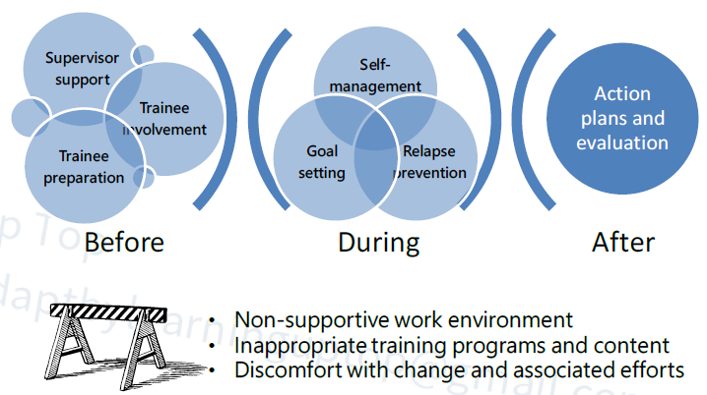
Training Transfer

Slide 38
Barriers of Training Transfer
Interference from immediate (work) environment
Non-supportive organizational culture
Impractical training programs
Irrelevant training content
Discomfort with change and associated efforts
Separation from inspiration or support of the facilitator
Poorly defined/delivered training
Pressure from peers to resist changes
Newly learned behaviors are not valued or modeled by participant's manager(s)

Slide 39
Training Program Development
Training Implementation
Kirkpatrick Training Evaluation Model
Training Transfer
Trends for Employee Training
Outsourced Training
Learning Management System
Training Need Analysis

Slide 40
MOOCs (Massive Online Open Courses)
Massive Open Online Course, or MOOC, refers to a free online course available to a mass audience. MOOCs are a recent development in distance education. Courses are generally education-based programs stemming from colleges and universities, although they do not provide degrees or credits to students.

Slide 41
Gamification
Gamification is the process of applying gaming designs and concepts to learning or training scenarios in order to make them more engaging and entertaining for the learner.
In game-based learning events, learners compete directly against one or more individuals or participate individually in an interactive experience that rewards learning performance in some way.

Slide 42
Questions

