Slide 1
TALENT DEVELOPMENT AND MANAGEMENT III
SPHRi

Slide 2
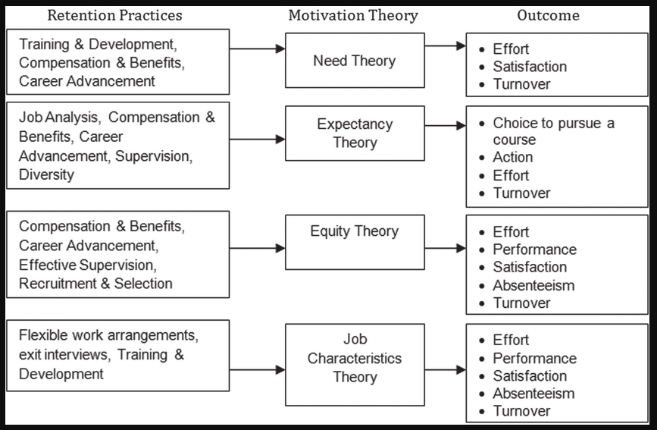
Usage of Theories

Slide 3
Major Theories of Motivation
I. Need Approaches :
  - Maslow’s Hierarchy of Needs
  - Alderfer’s ERG Theory
  - Herzberg’s Two Factor Theory
  - McClelland Learned Needs Theory
II. Cognitive Approaches :
  - Expectancy Theory
  - Equity Theory
  - Goal Setting Theory

Slide 4
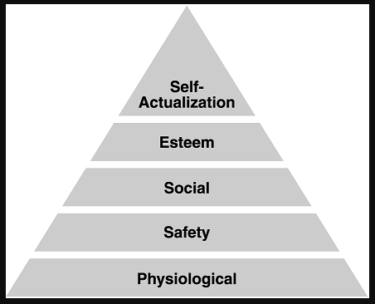
Maslow’s Hierarchy of Needs

Slide 5
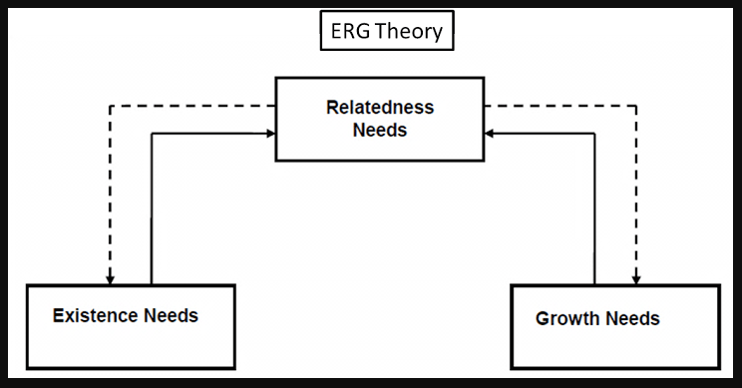
Alderfer’s ERG Theory

Slide 6
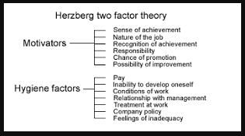
Herzberg’s Two Factor Theory

Slide 7
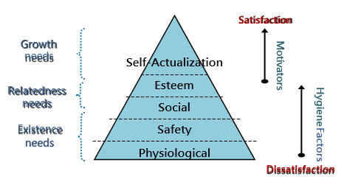
Motivational Theories

Slide 8
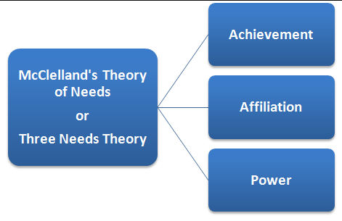
McClelland's Need Theory

Slide 9
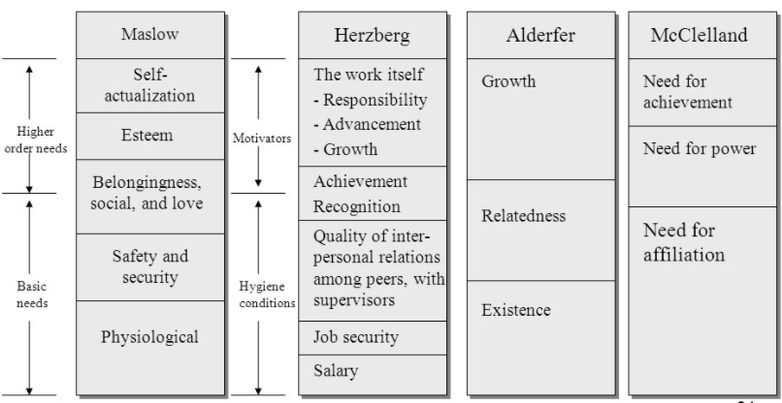
Comparison of Motivation Models

Slide 10
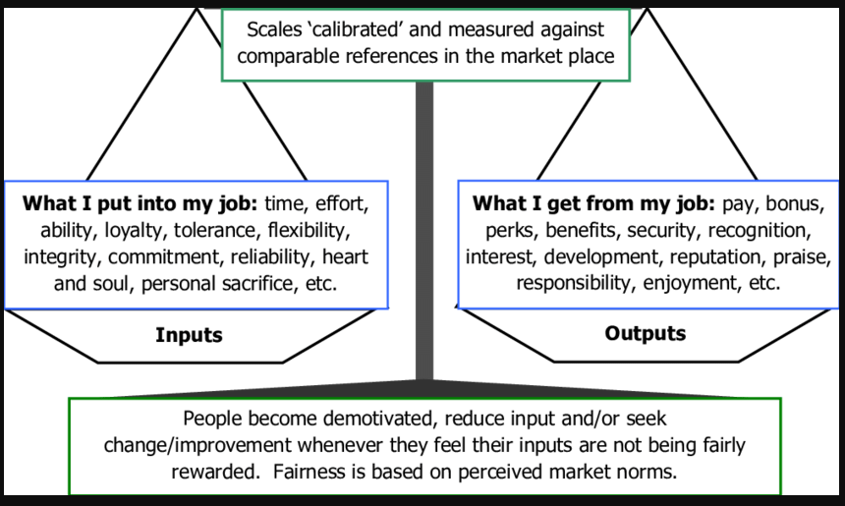
Adams’ Equity Theory

Slide 11
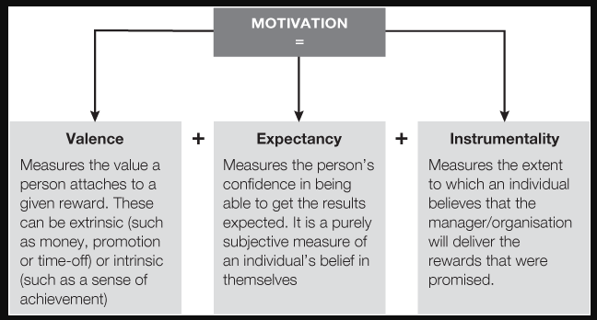
Vroom's Expectancy Theory

Slide 12
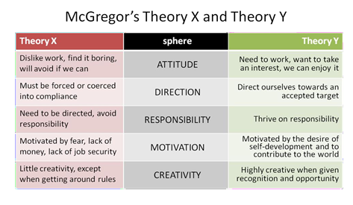
McGregor's X and Y Theory

Slide 13
Poll Question # 1
Which of the following HR practices involves both the people and the processes equally?
A. Organizational behaviour theories
B. Theories of motivation
C. Human relations theories
D. Organizational development theories

Slide 14
Answer to Poll Question # 1
Option - D.
Theories related to organizational development are equally focused on both people and processes. These theories describe different types of interventions aimed to develop people, processes, or sometimes both.

Slide 15
Feedback, Counseling, and Coaching
Feedback provides information to people on their performance, which helps them to understand how well they have been doing and how effective their behavior has been. Cultural differences can affect the degree of need for feedback, inhibit employees from seeking necessary feedback, and determine the most effective form of feedback.
Counseling uses a set of skills and techniques to help people to take responsibility for and to manage their own decision-making whether it work related or personal. A counseling session is a meeting between the supervisor and the employee which may focus on a specific incident, a particular aspect of an employee's performance which the supervisor has identified as needing improvement, or the employee's overall performance or conduct. The counseling process is initiated and executed at the department level by the supervisor and is not discipline. It is a face-to-face communication between the supervisor and the employee, conducted in private, and is intended to have a constructive goal of providing feedback to the employee to correct the problem.
Coaching can be used to help people develop their competencies during normal day-to-day activities. Coaching often provides positive feedback about employee contributions. At the same time, regular coaching brings performance issues to an
employee's attention when they are minor, and assists the employee to correct them

Slide 16
Performance Appraisal
Performance Appraisal is the systematic evaluation of the performance of employees and to understand the abilities of a person for further growth and development. Performance appraisal is generally done in systematic ways which are as follows:
The supervisors measure the pay of employees and compare it with targets and plans.
The supervisor analyses the factors behind work performances of employees.
The employers are in position to guide the employees for a better performance

Slide 17
Objectives of Performance Appraisal
Improvement
Coaching and Guidance
Feedback and Communication
Compensation
Staffing Decision and Professional Development
Termination and Legal Documentation

Slide 18
Process of Performance Appraisals
A performance appraisal is a formal interaction between an employee and her manager. This is when the performance of the employee is assessed and discussed in thorough detail, with the manager communicating the weaknesses and strengths observed in the employee and also identifying opportunities for the employee to develop professionally. Here is the process involved in performance appraisal
Conducting Job analysis.
Establishing Performance Standards
Communicating the standards
Measuring the actual Performance
Comparing the Actual with the Desired Performance
Discussing Results
Decision Making

Slide 19

Acceptability of Performance Appraisals

Slide 20
Performance Development
Performance development is a broad term that includes performance management and employee development. It describes both managing/assessing the work that needs to be done and providing opportunities for professional growth and development.
Performance development is the ongoing process between supervisor and employee of communicating and clarifying position responsibilities, priorities and performance expectations to guarantee mutual understanding and to enhance effectiveness in achieving the campus and departmental mission and goals. Conducting employee performance reviews demands a lot of time and effort, but when done correctly, they can bring numerous benefits to both the employee and the business, including:

Slide 21

Performance Development Process

Slide 22
Performance Improvement Plans and Individual Development Plans
A performance improvement plan is a document that lists where an employee is falling short and what he can do to improve. For instance, the performance action plan may detail skills or training the employee lacks. Alternatively, it could specify how the employee needs to change his behavior. In either case, the PIP will clearly state the steps the employee needs to take to make the necessary improvements.
An individual development plan (IDP) is a tool to assist employees in career and personal development. Its primary purpose is to help employees reach short and long-term career goals, as well as improve current job performance. An IDP is not a performance evaluation tool or a one-time activity. It should be looked at like a partnership between the employee and the supervisor. It involves preparation and continuous feedback

Slide 23
Managing Performance in Cross Culture Context
The general terms "high context" and "low context" (popularized by Edward Hall) are used to describe broad-brush cultural differences between societies.
High context refers to societies or groups where people have close connections over a long period of time. Many aspects of cultural behavior are not made explicit because most members know what to do and what to think from years of interaction with each other. Your family is probably an example of a high context environment.
Low context refers to societies where people tend to have many connections but of shorter duration or for some specific reason. In these societies, cultural behavior and beliefs may need to be spelled out explicitly so that those coming into the cultural environment know how to behave

Slide 24
Questions

