Slide 1
TALENT DEVELOPMENT & MANAGEMENT - III
SPHRi

Slide 2
Adult Learning Theory
According to the adult learning theory, adults are different than children in their process and approach to learning in the following ways:
Adults have the need to know why they’re learning something.(Readiness to learn)
Adults have a need to be self-directed. (Self Concept)
Adults bring more work-related experience into the learning situation.(Experience)
Adults enter into a learning experience with a problem-centered approach to learning. (Orientation to learn)
Adults are motivated to learn by both extrinsic and intrinsic motivators. (Motivation to learn)

Slide 3
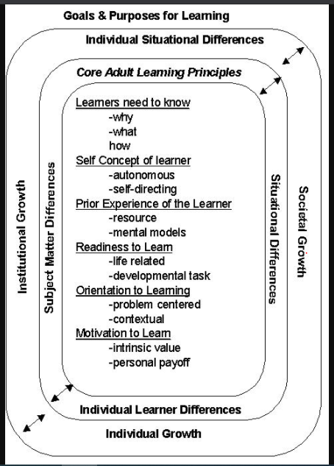
Adult Learning

Slide 4

Andragogy vs Pedagogy

Slide 5
Learning Curve
Learning curves graphically depict individual rates of learning over time, with learning proficiency indicated vertically and elapsed time indicated horizontally.
Decreasing returns occur when the amount of learning or skill level increases rapidly at first and then the rate of improvement slow. The beginning of the curve is slow while the basics are being learned; then performance takes off as skills and knowledge are acquired.
Increasing returns pattern is most common when a person is learning something completely new.
S-shaped curve is a combination of increasing and decreasing returns. There is a presupposition that the individual is learning a difficult task that also requires specific insight.
Plateau curve refers the learning is fast at first, but it then flattens out and there is no apparent progress.

Slide 6

Learning Curve

Slide 7
Poll Question # 1
Sherrie is a customer service rep for your manufacturing organization. She is participating in training for the new customer database software being rolled out company-wide. Sherrie was struggling with the training material until the third day, when she applied the training content from previous sessions with success. This is an example of which of the following learning curves?
Negatively accelerating
Positively accelerating
Plateau
S-shaped

Slide 8
Answer to Poll Question # 1
Option - B.
A positively accelerating learning curve occurs when learning is slow at first but then
accelerates as the training continues. This is usually the result of the participant grasping
and applying information from previous training sessions to influence learning.

Slide 9
Learning Styles
Visual learners remember best what they see pictures, diagrams, flow charts, time lines, films, and demonstrations.
Auditory learners, called verbal learners; it’s a learning style in which a person learns through listening. An auditory learner depends on hearing and speaking as a main way of learning.
Kinesthetic learners, also known as tactile learners, learn best through a hands-on approach. They prefer to actively explore the physical world around them.

Slide 10
Learning Level
Knowledge simply means that the learner can recall specific facts.
Comprehension allows the learner to translate or interpret information.
Application is the ability to use learned information in a new situation.
Analysis means understanding information to the level of being able to break it down and explain how it fits together.
Synthesis is the level at which the learner would be able to respond to new situations and determine trouble-shooting techniques and solutions.
Evaluation is the highest level of learning because it allows one to make judgments.

Slide 11

Bloom’s Taxonomy Six Levels

Slide 12
Training Plan
Training is the process through which knowledge and skills are developed, information is provided, and attributes are nurtured, in order to help individuals who work in organizations to become more effective and efficient in their work.
Education is 'mind preparation' and is carried out remote from the actual work area.
Development is education, job experiences, relationships, and assessments of personality and abilities that help trainees prepare for the future

Slide 13

Difference between Training, Education and Development

Slide 14

ADDIE MODEL

Slide 15

The Five Phases of ADDIE

Slide 16
Poll Question # 2
At which stage of the ADDIE model would decisions about course content be made?
Needs assessment
B. Design
C. Develop
D. Implement

Slide 17
Answer to Poll Question # 2
Option - B.
The design stage of the ADDIE model is where a framework for training will be built, based on the needs assessment completed in stage 1. Decisions about course content, delivery methods, and logistics will be made in this stage of the ADDIE model.

Slide 18
Learning Management System
A Learning Management System (sometimes also called "Course Management System", "Pedagogical Platform", "E-Learning Platform") is a software system that delivers courseware plus e-tutoring over the Internet. A learning management system (LMS) allows you to create, distribute and track training anywhere, on any device. Nowadays, powerful software for managing complex databases has been combined with digital frameworks for managing curriculum, training materials, and evaluation tools. The LMS allows anyone to create, track, manage and distribute learning materials of any kind.
LMS products and software allow any organization to develop electronic coursework, deliver it with unprecedented reach and flexibility, and manage its continued use over time. Many business and organizations use LMS to deliver online training, as well as to track completion of courses, reports, and records.

Slide 19
Training Need Assessment
A training needs assessment (TNA) is a tool used to identify the goals of training. TNA can be used on a macro level to view the company from 50,000 feet during the strategic planning process. For example, if the company is introducing a new product or installing new software, the training need is fairly obvious. On a smaller scale, the training needs are generally viewed from three perspectives:
Compliance: So many labor laws, so little time. Training is often the second step to demonstrating compliance with various labor laws, bowing only to establishing a policy. Areas where training is required by law include harassment prevention and safety.
Technical: How to perform the work is another reason for training. Although most companies seek to hire individuals with at least some level of skill or experience, all jobs usually require a learning curve that must be nurtured through training efforts.
Retention: Many employers simply attempt to hire employees with the necessary skills required for the job. When this is impossible (or impractical), they may find that training current workers with the specificskills needed for new jobs is more effective. Training costs may prove to be much lower than recruitment costs. Also, employees may be less likely to leave an organization that is willing to offer more job security through training.

Slide 20

Training Needs Assessment

Slide 21
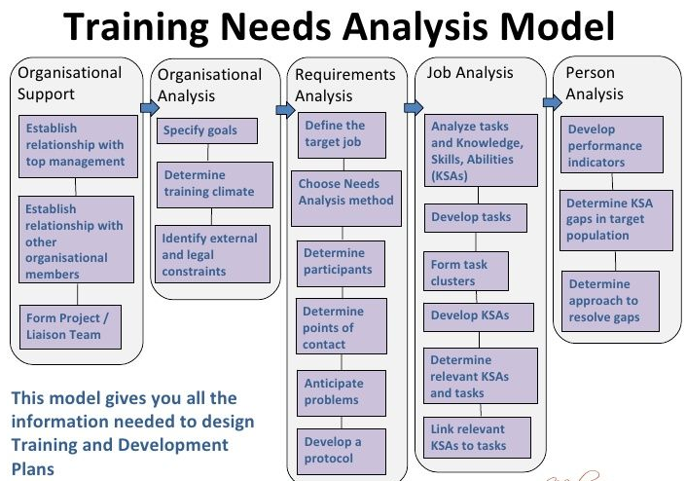
Training Need Assessment

Slide 22
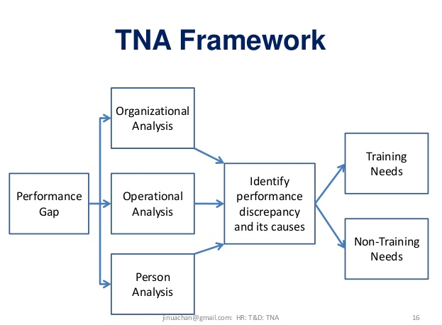
TNA Framework

Slide 23
Training Design
Setting Objectives -Learning objectives are the results that the participants will be able to perform at the end of the program.
Defining Target -When designing the training, the target audience's aptitude, prior knowledge and skills, and attitudes and perceptions must be taken into account.
Selecting Trainer - A key decision is whether to develop a training program "in-house" or to purchase it "off the shelf."

Slide 24

Training Program Development

Slide 25

Kirkpatrick's 4 Levels of Training Evaluation

Slide 26
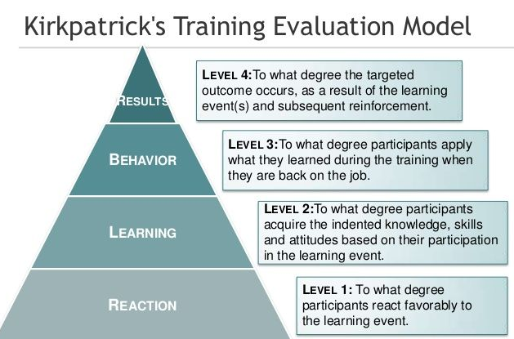
Kirkpatrick Table

Slide 27
Questions

