Slide 1
TALENT DEVELOPMENT AND MANAGEMENT II
SPHRi

Slide 2
Performance Management System
Performance Planning
Performance Monitoring
Performance Appraisal
Performance Development
Performance in Cross Culture Context
Employee Disciplinary Procedure

Slide 3
Performance Management
Performance management is a system for managing organizational business performance, managing employee job performance, and integrating the management of business and job performance.
Performance management aims specifically to improve achievement of strategic objectives, daily effectiveness, and the core competencies within the organization.

Slide 4
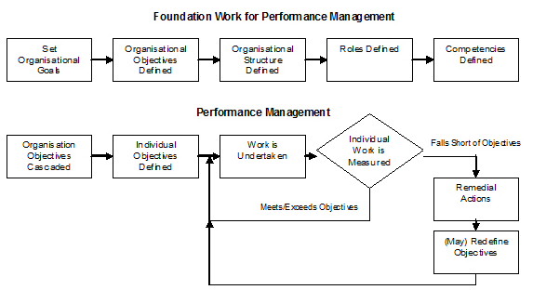
Foundation for Performance Management

Slide 5
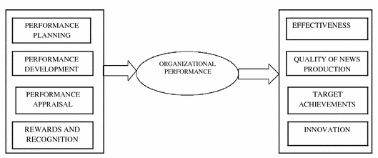
Organisational Performance Process

Slide 6
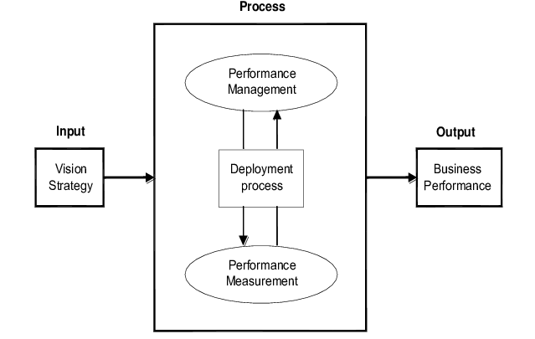
Performance Management Process

Slide 7

Strategic Business Performance Management

Slide 8
Business Performance Management
Strategic Planning
Communicating and linking
Budgeting
Performance Measurement

Slide 9
Strategic Planning
Translating the vision helps managers build a consensus around the organization’s vision and strategy.
Lofty statements about becoming “best in class,” “the number one supplier,” or an “empowered organization” don’t translate easily into operational terms that provide useful guides to action at the local level.
For people to act on the words in vision and strategy statements, those statements must be expressed as an integrated set of objectives and measures, agreed upon by all senior executives, that describe the long-term drivers of success

Slide 10
Communicate and Linking
Communicating and linking lets managers communicate their strategy up and down the organization and link it to departmental and individual objectives.
Traditionally, departments are evaluated by their financial performance, and individual incentives are tied to short-term financial goals.
The scorecard gives managers a way of ensuring that all levels of the organization understand the long-term strategy and that both departmental and individual objectives are aligned with it

Slide 11
Budgeting
Budgeting is the process by which a company or individuals evaluate their earnings and expenses and project their cash flow for the future.
Budgeting enables companies to integrate their business and financial plans.
Goal setting is a key element to making a budget.
Managers use the ambitious goals set for performance measures as the basis for allocating resources and setting priorities, they can undertake and coordinate only those initiatives that move them toward their long-term strategic objectives.
Cascading the strategic objectives and translate the corporate-wide objectives down to first business units, support units or departments and then teams or individuals

Slide 12
Performance Measurement
Performance measurement, also called performance metric, refers to numerical information that quantifies input, output, and performance dimensions of processes, products, services, and the overall organization outcomes.
Performance measurement can provide feedback and learning that gives companies the capacity for what we call strategic learning.

Slide 13
Managing Job Performance
Job performance is defined as the set of behaviours that are relevant to the goals of the organization or the organizational unit in which a person work.
Job performance is what the organization hires one to do, and do well.
Job performance is not the consequence or result of action, it is the action itself. However, if the action does not produce a result that is useful to shareholder, the action does not count. The criterion domain of job performance:

Slide 14
Task Performance
Task performance refers the proficiency with which job incumbents perform activities that are formally recognized as part of their job or activities that contribute to the organization’s technical core. It often belongs to “can do behavior”. The components of task performance are:
Declarative Knowledge: fact, principles, goals, self-knowledge.
Procedural Knowledge and Skill: cognitive skill, psychomotor skill, physical skill, Self-management skill, interpersonal skill.
Motivation: choice to perform, level of effort, persistence of effort.

Slide 15
Contextual Performance
Organisational Citizenship - a perspective that employee have whereby they extend their behaviors beyond the normal duties of their position
The components of task performance are:
Interpersonal citizenship behaviors: helping & cooperating with others.
Organizational citizenship behaviors: endorsing, supporting & defending organizational objectives; following organizational rules & procedures.
Job/Task citizenship behaviors: Persisting with enthusiasm & extra effort as to complete own task activities successfully

Slide 16
Job Performance Management Process
Job Performance management, often called “Performance Management” in an individual level, is the process of identifying, executing, evaluating, and developing the performance of the human resources in an organization.
The performance management process from two perspectives:
a). the upstream component encompasses planning, objective setting, and measurement, which lends itself to standardization of performance management practices
b).The downstream component includes the performance appraisal itself. This component often reflects localization of performance management practices.

Slide 17
Effective Performance Management process
Performance planning is a discussion for developing a common understands of the objectives or performance standard that need to be achieved.
Performance monitoring is a day-to-day management behavior to assure the objectives could be accomplished.
Performance appraisal is the process that measures the degree to which employee accomplishes work requirements.
Performance development is an ongoing cyclical process aims to develop, maintain and improve your skills, knowledge and job performance through performance planning, monitoring, and appraisal.

Slide 18
Integrating the Management of Business and Job Performance
The communication and integration between the three levels of organisational performance can be limited. Most of the times, strategic performance management efforts are lead by the executive team, operational performance management by group managers and individual performance management by the HR department.
This can be attributed to various constraints, both general to the performance management itself and specific to organisations. Management does not see performance management as an integrated discipline used at various organisational levels, but as a subcomponent of strategic, operational and HR management. An integrated approach, linking all levels of performance management becomes a necessity for both research and practice to facilitate the understanding and usage of performance management systems

Slide 19

Integrated Performance Management

Slide 20
Strategic Level
At strategic level, performance management deals with the achievement of the overall organizational objectives.
Practitioners refer to it as corporate, business, organizational or enterprise performance management, this being the highest and most complete level of usage of performance management principles in organizations.
Strategic management is a key driver of performance management at this level, as the key processes related to performance management systems are strategy formulation and implementation.

Slide 21
Operational Level
Performance management at operational level is linked to operational management, as its focus is on the achievement of operational objectives. Although aligned with corporate strategy, the focus here is more functional / tactical.
The evolution of operational performance management is linked to the evolution of accounting and management in history. This is due to the fact that operational performance was evaluated in terms of efficiency and effectiveness. And the easiest way to do this is by using financial indicators, provided by the accounting function in organizations.
Over time, as internal and external operating environments became more complex, organizations started to look at nonfinancial indicators of performance. This made the connection with operations management and other aspects of the general management discipline

Slide 22
Individual Level
The traditional level at which performance management is used in organizations is the individual level, looking at the performance of individuals in an organizational context.
At individual level, performance management is represented by an integrated and planned system for continuously improving the performance of all employees.
It involves defining work goals and standards, reviewing performance against these standards, actively managing all levels of performance, and maximizing learning and development

Slide 23
Performance Management System
Performance Planning
Performance Monitoring
Performance Appraisal
Performance Development
Performance in Cross Culture Context
Employee Disciplinary Procedure

Slide 24
Performance Planning
Performance planning is a formal structured process for identifying and communicating the organizational and individual goals expected of the employee. The performance plan consists of performance expected of an employee and an Individual Development Plan.
Performance plans are decided collaboratively between the supervisor and employee working together. They together determine the performance expectations and development objectives to be accomplished during the review period. They discuss goals, objectives and expectations for the review period. The process helps to improve the communication and discuss the career development plan of the employee

Slide 25

Performance Planning

Slide 26
Factors for Performance Standard
Some cultures value performance of the group over the individual as follow.
In some cases, an open and honest exchange of issues can occur. In other cultural contexts, a more formal, reserved relationship is the norm.
The appropriateness of forms and the meaning of rating scales vary significantly from culture to culture and location to location.
In some cultures, only positive feedback is provided so employees can save face.
The act of ranking employees within a group can be difficult in collective cultures.
Compensation practices vary widely across borders, cultures, and legal systems. The perceived value of the rewards can also vary from culture to culture.
This practice may not be accepted in collective cultures and those with high ascribed value dimensions.
Appraisals can be highly culturally specific. Even the meaning of the term "performance" can vary among individual and collective cultures. Also, the process of gaining input from colleagues can be easy and expected in some cultures but very guarded in others.

Slide 27

Management by objectives (MBO)
MBO can be defined as a process whereby the employees and the superiors come together to identify common goals, the employees set their goals to be achieved, the standards to be taken as the criteria for measurement of their performance and contribution and deciding the course of action to be followed.

Slide 28

Goal Setting
Employee goals can be clarified through performance and development planning, with attention to the level of performance needed and the specific desired results. Goal setting is most effective when it is combined with feedback, so progress can be monitored. Direct feedback and coaching is an often underutilized approach that enhances communication and bottom-line results. SMART goals include five elements in each objective

Slide 29

Performance Planning

Slide 30
Performance Management System
Performance Planning
Performance Monitoring
Performance Appraisal
Performance Development
Performance in Cross Culture Context
Employee Disciplinary Procedure

Slide 31
Performance Monitoring
The Periodic tracking (for example, daily, weekly, monthly, quarterly, annually) of any activity’s progress by systematically gathering and analyzing data and information is called Monitoring. The target audience/beneficiaries must be defined along with what you are doing, and whether your activities are being implemented as planned or not.
Monitoring of a program or intervention involves the collection of routine data that measures progress toward achieving program objectives. It is used to track changes in program outputs and performance over time. It provides regular feedback and early indications of progress (or lack of progress). Its purpose is to permit the management and stakeholders to make informed decisions regarding the effectiveness of programs and the efficient use of resources

Slide 32

Performance Monitoring

Slide 33
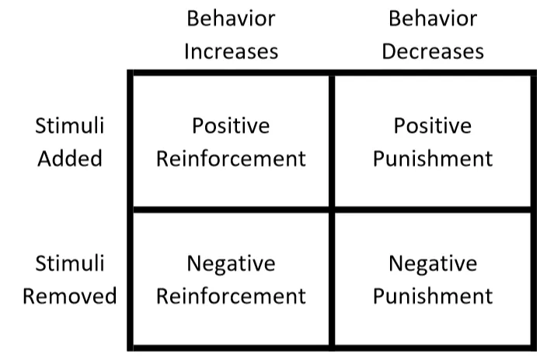
Reinforcement

Slide 34
Positive Reinforcement
This reinforcement implies giving a positive response when an individual shows positive and required behaviour. For example, immediately praising an employee for coming early for job.
This will increase probability of outstanding behavior occurring again.
Reward is a positive reinforce, but not necessarily. If and only if the employees’ behaviour improves, reward can said to be a positive reinforce. Positive reinforcement stimulates occurrence of a behaviour.
It must be noted that more spontaneous is the giving of reward, the greater reinforcement value it has.

Slide 35
Negative Reinforcement
This reinforcement strengthens a behavior because a negative condition is stopped or avoided as a consequence of the behavior. This implies rewarding an employee by removing negative / undesirable consequences. Both positive and negative reinforcement can be used for increasing desirable or required behavior.

Slide 36
Punishment
Punishment weakens a behaviour because a negative condition is introduced or experienced as a consequence of the behaviour.
It implies removing positive consequences so as to lower the probability of repeating undesirable behaviour in future. In other words, punishment means applying undesirable consequence for showing undesirable behaviour.
For instance, suspending an employee for breaking the organizational rules. Punishment can be equalized by positive reinforcement from alternative source.

Slide 37
Extinction
Extinction removes something in order to decrease a behaviour. It implies absence of reinforcements.
In other words, extinction implies lowering the probability of undesired behaviour by removing reward for that kind of behaviour.
For instance - if an employee no longer receives praise and admiration for his good work, he may feel that his behaviour is generating no fruitful consequence. Extinction may unintentionally lower desirable behaviour.

Slide 38
Performance Management System
Performance Planning
Performance Monitoring
Performance Appraisal
Performance Development
Performance in Cross Culture Context
Employee Disciplinary Procedure

Slide 39
Performance Appraisal
Performance Appraisal is the systematic evaluation of the performance of employees and to understand the abilities of a person for further growth and development. Performance appraisal is generally done in systematic ways which are as follows:
The supervisors measure the pay of employees and compare it with targets and plans.
The supervisor analyses the factors behind work performances of employees.
The employers are in position to guide the employees for a better performance

Slide 40

Process of Performance Appraisal

Slide 41
Objectives of Performance Appraisal
Improvement
Coaching and Guidance
Feedback and Communication
Compensation
Staffing Decision and Professional Development
Termination and Legal Documentation

Slide 42
Process of Performance Appraisals
A performance appraisal is a formal interaction between an employee and her manager. This is when the performance of the employee is assessed and discussed in thorough detail, with the manager communicating the weaknesses and strengths observed in the employee and also identifying opportunities for the employee to develop professionally. Here is the process involved in performance appraisal
Conducting Job analysis.
Establishing Performance Standards
Communicating the standards
Measuring the actual Performance
Comparing the Actual with the Desired Performance
Discussing Results
Decision Making

Slide 43

Acceptability of Performance Appraisals

Slide 44
Distributive Justice / Fairness
Distributive Justice, concept originated from Adam’s Equity Theory, which claims that individuals formulate fairness perceptions by comparing their perceived work outcomes (rewards) to their perceived work inputs (contribution) in relation to the perceived input to outcome ratio of a coworker.
The fairness of outcomes in the appraisal context means fairness of the performance ratings given by the supervisors.

Slide 45
Procedural Justice / Fairness
Procedural Justice / Fairness means the fairness of the procedures adopted to decide the outcomes. Process of assigning well trained raters, mutually establishing performance criteria and having appeals process adds to employee perception of procedural justice.
A justice model for performance appraisal, rooted in the due process of law and possessing three basic factors: adequate notice, a fair hearing and judgment based on evidence.

Slide 46
Interactional Justice / Fairness
Interactional Justice / Fairness refers to the quality of appraisal interview, appraisal system and performance interaction between the rater and the rate.
Individuals are highly influenced by the emotional intelligence of their supervisors and other representatives within the organization.

Slide 47
Informational Justice / Fairness
Informational Justice / Fairness is concerned with fairness perception based on clarification of performance expectation and standards.
The focus of informational justice is on clarification of events which determine outcome, just like the procedural justice, but perceptions are socially determined. Information can take the form of honest, sincere and logical explanations of allocation process.
In the context of appraisals it involves setting performance objectives feedback and explanations during performance interviews.

Slide 48

Methods of Performance Appraisal

Slide 49

Difference between Performance Appraisal and Performance Management

Slide 50
Poll Question # 1
Which of the following HR practices involves both the people and the processes equally?
A. Organizational behaviour theories
B. Theories of motivation
C. Human relations theories
D. Organizational development theories

Slide 51
Answer to Poll Question # 1
Option - D.
Theories related to organizational development are equally focused on both people and processes. These theories describe different types of interventions aimed to develop people, processes, or sometimes both.

Slide 52
Performance Management System
Performance Planning
Performance Monitoring
Performance Appraisal
Performance Development
Performance in Cross Culture Context
Employee Disciplinary Procedure

Slide 53
Performance Development
Performance development is the ongoing process between supervisor and employee of communicating and clarifying position responsibilities, priorities and performance expectations to guarantee mutual understanding and to enhance effectiveness in achieving the campus and departmental mission and goals. Conducting employee performance reviews demands a lot of time and effort, but when done correctly, they can bring numerous benefits to both the employee and the business, including:

Slide 54

Performance Development Process

Slide 55
Performance Improvement Plans and Individual Development Plans
A performance improvement plan is a document that lists where an employee is falling short and what he can do to improve. For instance, the performance action plan may detail skills or training the employee lacks. Alternatively, it could specify how the employee needs to change his behaviour. In either case, the PIP will clearly state the steps the employee needs to take to make the necessary improvements.
An individual development plan (IDP) is a tool to assist employees in career and personal development. Its primary purpose is to help employees reach short and long-term career goals, as well as improve current job performance. An IDP is not a performance evaluation tool or a one-time activity. It should be looked at like a partnership between the employee and the supervisor. It involves preparation and continuous feedback

Slide 56
Performance Management System
Performance Planning
Performance Monitoring
Performance Appraisal
Performance Development
Performance in Cross Culture Context
Employee Disciplinary Procedure

Slide 57
Managing Performance in Cross Culture Context
Communication is key in the workplace and when you are in charge of a cross cultural team that can present your with many unique challenges in terms of the language, dealing with accents and the different meanings of words in different countries. When you are striving to provide a clear message of the work that needs to be done, you may find that projects you though were on track have veered off course due to a misunderstanding or due to differences in communication.

Slide 58
Performance Management System
Performance Planning
Performance Monitoring
Performance Appraisal
Performance Development
Performance in Cross Culture Context
Employee Disciplinary Procedure

Slide 59
Employee Disciplinary Procedure
A disciplinary procedure is sometimes the best way for an employer to tell their employees when something is wrong. It allows them to explain clearly what improvement is needed and should give the employees an opportunity to put their side of the situation. Employer can put their disciplinary procedure in writing, and make it easily available to you (for example, by giving details in the employee handbook). It should include the rules, what performance and behavior might lead to disciplinary action, and what action the employer might take.

Slide 60

Employee Disciplinary Procedure

Slide 61
Stage 1 : Verbal Warning
Generally an employee should receive a verbal warning for a first transgression. Even though the employer is “only” giving a verbal warning, it is still part of a formal disciplinary process and the principles of natural justice, fair procedures, and equity/fairness would apply at all times.
This would involve a meeting with the employee at which the employee could bring a colleague or other representative. There is no right to bring a legal representative, unless the employer agrees.
At the meeting the employee should be advised of what the problem is and invited to respond and explain his actions. There should be no rush to judgement by the employer as the meeting is investigatory.

Slide 62
Stage 1 : Verbal Warning
Following the meeting a confirmatory letter should be given to the employee. This letter confirms that the employee has been given a verbal/oral warning. It should also contain the improvements required of the employee in respect of the behavior which led to the warning and the timeframe within which the improvement must be made.
This letter should also state that failure to improve will lead to the 2nd stage of the disciplinary procedure and ultimately dismissal.
It should also state the time period for which it will remain on the employee’s file, after which it will be removed. Three months would be a reasonable period for this 1st verbal warning to stay on file, but it could remain for 6 months.

Slide 63
Stage 2 : Written Warning
The written warning will then be issued and last for another 3 months. This warning should also clearly set out the nature of the problem, suggest solutions such as retraining, and advise of the possible sanctions (including dismissal) if no improvement is observed within the 3 months.
The employer should again afford all reasonable assistance to the employee to help him improve conduct and/or performance. However the empo9yer must be mindful of his duty of care to other employees also.

Slide 64
Stage 2 : Written Warning
If the required improvement is not forthcoming within the 3 month period after the 1st written warning then a 2nd written warning may be issued. This is entirely a matter for the employer and it is common for many employers to only issue a 1st and final written warning.
This warning is done in a similar fashion to the other 2 warnings referred to above but you would consider giving a 6 month monitoring period to allow improvement.

Slide 65
Stage 3 : Final Warning
If the required improvement is not happening then a final written warning would be issued with a 12 month monitoring period. The letter confirming this warning will advise that if there is no improvement or if the bad behavior/performance is repeated then dismissal will occur.
This warning letter will be the final one prior to dismissal so it is important that it is well drafted as it will be scrutinized closely by the employee and probably his legal advisor. This letter should only refer to the matters which have been the subject of the disciplinary procedure to date, no other matters which have never been put to the employee.

Slide 66
Stage 4 : Dismissal or action short of dismissal
If there is no improvement after the final written warning then dismissal is the likely outcome. A meeting should be called and the employee and his representative invited.
The employer should remind the employee of the behavior/conduct that has led to this point, the repeated transgressions/failure to improve performance sufficiently, and that the dismissal is in accordance with the disciplinary procedure.
The employee should be given the opportunity to appeal within 14 days. He should also be given a letter confirming the dismissal and the right to appeal, the time period for appeal, and who to appeal to.

Slide 67
Questions

