Slide 1
TALENT DEVELOPMENT AND MANAGEMENT II
SPHRi

Slide 2
Performance Management
Performance management is a system for managing organizational business performance, managing employee job performance, and integrating the management of business and job performance. Performance management aims specifically to improve achievement of strategic objectives, daily effectiveness, and the core competencies within the organization.

Slide 3
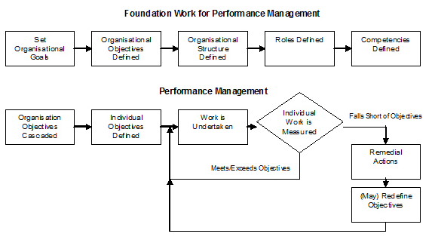
Foundation for Performance Management

Slide 4
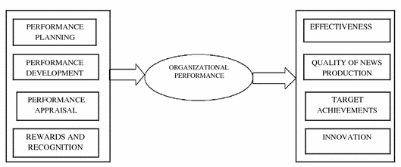
Organisational Performance Process

Slide 5
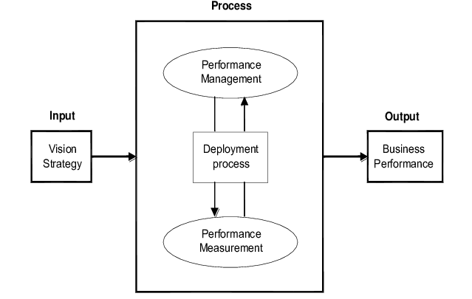
Performance Management Process

Slide 6

Strategic Business Performance Management

Slide 7
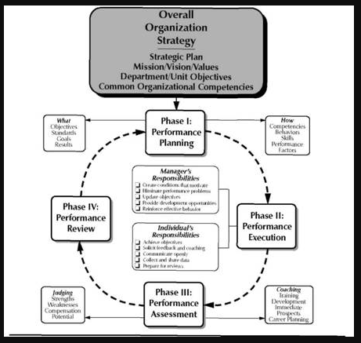
Overall Strategy

Slide 8
Business Performance Management
Strategic Planning
Communicating and linking
Budgeting
Performance Measurement

Slide 9
Strategic Planning
Performance Management begins with strategic planning. Translating the vision helps managers build a consensus around the organization’s vision and strategy. Despite the best intentions of those at the top, lofty statements about becoming “best in class,” “the number one supplier,” or an “empowered organization” don’t translate easily into operational terms that provide useful guides to action at the local level. For people to act on the words in vision and strategy statements, those statements must be
expressed as an integrated set of objectives and measures, agreed upon by all senior executives, that describe the long-term drivers of success

Slide 10
Communicate and Linking
Communicating and linking lets managers communicate their strategy up and down the organization and link it to departmental and individual objectives. Traditionally, departments are evaluated by their financial performance, and individual incentives are tied to short-term financial goals. The scorecard gives managers a way of ensuring that all levels of the organization understand the long-term strategy and that both departmental and individual objectives are aligned with it

Slide 11
Budgeting
Budgeting is the process by which a company or individuals evaluate their earnings and expenses and project their cash flow for the future. Budgeting enables companies to integrate their business and financial plans. Goal setting is a key element to making a budget. Almost all organizations today are implementing a variety of change programs, each with its own champions, gurus, and consultants, and each competing for senior executives’ time, energy, and resources. Managers find it difficult to integrate those diverse initiatives to achieve their strategic goals—a situation that leads to frequent disappointments with the programs’ results. But when managers use the ambitious goals set for performance measures as the basis for allocating resources and setting priorities, they can undertake and coordinate only those initiatives that move them toward their long-term strategic objectives. After that, cascading the strategic objectives and translate the corporate-wide objectives down to first business units, support units or departments and then teams or individuals

Slide 12
Performance Measurement
Performance measurement, also called performance metric, refers to numerical information that quantifies input, output, and performance dimensions of processes, products, services, and the overall organization outcomes. Performance measurement can provide feedback and learning that gives companies the capacity for what we call strategic learning. Existing feedback and review processes focus on whether the company, its departments, or its individual employees have met their budgeted financial goals. If the balanced scorecard (BSC) is implemented at the center of its management systems, a company can monitor short-term results from the three additional perspectives—customers, internal business processes, and learning and growth—and evaluate strategy in the light of recent performance. The scorecard thus enables companies to modify strategies to reflect real-time learning

Slide 13
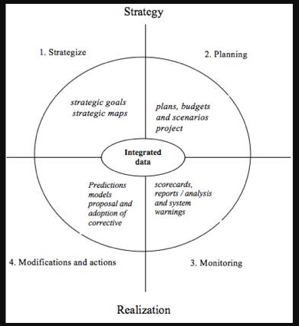
Strategic Business Performance Management

Slide 14
Managing Job Performance
Job performance is defined as the set of behaviors that are relevant to the goals of the organization or the organizational unit in which a person work. Job performance is what the organization hires one to do, and do well. Job performance is not the consequence or result of action, it is the action itself. However, if the action does not produce a result that is useful to shareholder, the action does not count. The criterion domain of job performance:

Slide 15
Task Performance
Task performance refers the proficiency with which job incumbents perform activities that are formally recognized as part of their job or activities that contribute to the organization’s technical core. It often belongs to “can do behavior”. The components of task performance are:
Declarative Knowledge: fact, principles, goals, self-knowledge.
Procedural Knowledge and Skill: cognitive skill, psychomotor skill, physical skill, Self-management skill, interpersonal skill.
Motivation: choice to perform, level of effort, persistence of effort.

Slide 16
Contextual Performance
Organisational Citizenship - a perspective that employee have whereby they extend their behaviors beyond the normal duties of their position
The components of task performance are:
Interpersonal citizenship behaviors: helping & cooperating with others.
Organizational citizenship behaviors: endorsing, supporting & defending organizational objectives; following organizational rules & procedures.
Job/Task citizenship behaviors: Persisting with enthusiasm & extra effort as to complete own task activities successfully

Slide 17
Job Performance Management Process
Job Performance management, often called “Performance Management” in an individual level, is the process of identifying, executing, evaluating, and developing the performance of the human resources in an organization.
The performance management process from two perspectives:
a). the upstream component encompasses planning, objective setting, and measurement, which lends itself to standardization of performance management practices
b).The downstream component includes the performance appraisal itself. This component often reflects localization of performance management practices.

Slide 18
Effective Performance Management process
Performance planning is a discussion for developing a common understands of the objectives or performance standard that need to be achieved.
Performance monitoring is a day-to-day management behavior to assure the objectives could be accomplished.
Performance appraisal is the process that measures the degree to which employee accomplishes work requirements.
Performance development is an ongoing cyclical process aims to develop, maintain and improve your skills, knowledge and job performance through performance planning, monitoring, and appraisal.

Slide 19

Performance Planning

Slide 20
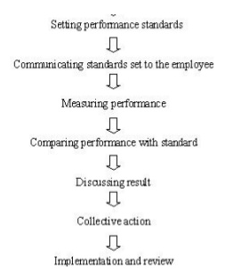
Performance Appraisal Process

Slide 21
Integrating the Management of Business and Job Performance
The communication and integration between the three levels of organisational performance can be limited. Most of the times, strategic performance management efforts are lead by the executive team, operational performance management by group managers and individual performance management by the HR department.
This can be attributed to various constraints, both general to the performance management itself and specific to organisations. Management does not see performance management as an integrated discipline used at various organisational levels, but as a subcomponent of strategic, operational and HR management. An integrated approach, linking all levels of performance management becomes a necessity for both research and practice to facilitate the understanding and usage of performance management systems

Slide 22

Integrated Performance Management

Slide 23
Strategic Level
At strategic level, performance management deals with the achievement of the overall organizational objectives. Practitioners refer to it as corporate, business, organizational or enterprise performance management, this being the highest and most complete level of usage of performance management principles in organizations. Strategic management is a key driver of performance management at this level, as the key processes related to performance management systems are strategy formulation and implementation.

Slide 24
Operational Level
Performance management at operational level is linked to operational management, as its focus is on the achievement of operational objectives. Although aligned with corporate strategy, the focus here is more functional / tactical.
The evolution of operational performance management is linked to the evolution of accounting and management in history. This is due to the fact that operational performance was evaluated in terms of efficiency and effectiveness. And the easiest way to do this is by using financial indicators, provided by the accounting function in organizations.
Over time, as internal and external operating environments became more complex, organizations started to look at nonfinancial indicators of performance. This made the connection with operations management and other aspects of the general management discipline

Slide 25
Individual Level
The traditional level at which performance management is used in organizations is the individual level, looking at the performance of individuals in an organizational context. At individual level, performance management is represented by an integrated and planned system for continuously improving the performance of all employees. It involves defining work goals and standards, reviewing performance against these standards, actively managing all levels of performance, and maximizing learning and development

Slide 26
1. Performance Planning
Performance planning is a formal structured process for identifying and communicating the organizational and individual goals expected of the employee. The performance plan consists of performance expected of an employee and an Individual Development Plan.
Performance plans are decided collaboratively between the supervisor and employee working together. They together determine the performance expectations and development objectives to be accomplished during the review period. They discuss goals, objectives and expectations for the review period. The process helps to improve the communication and discuss the career development plan of the employee

Slide 27
Factors for Performance Standard
Some cultures value performance of the group over the individual as follow.
In some cases, an open and honest exchange of issues can occur. In other cultural contexts, a more formal, reserved relationship is the norm.
The appropriateness of forms and the meaning of rating scales vary significantly from culture to culture and location to location.
In some cultures, only positive feedback is provided so employees can save face.
The act of ranking employees within a group can be difficult in collective cultures.
Compensation practices vary widely across borders, cultures, and legal systems. The perceived value of the rewards can also vary from culture to culture.
This practice may not be accepted in collective cultures and those with high ascribed value dimensions.
Appraisals can be highly culturally specific. Even the meaning of the term "performance" can vary among individual and collective cultures. Also, the process of gaining input from colleagues can be easy and expected in some cultures but very guarded in others.

Slide 28

Management by objectives (MBO)
MBO can be defined as a process whereby the employees and the superiors come together to identify common goals, the employees set their goals to be achieved, the standards to be taken as the criteria for measurement of their performance and contribution and deciding the course of action to be followed.

Slide 29

Goal Setting
Employee goals can be clarified through performance and development planning, with attention to the level of performance needed and the specific desired results. Goal setting is most effective when it is combined with feedback, so progress can be monitored. Direct feedback and coaching is an often underutilized approach that enhances communication and bottom-line results. SMART goals include five elements in each objective

Slide 30

Performance Planning

Slide 31
2. Performance Monitoring
The Periodic tracking (for example, daily, weekly, monthly, quarterly, annually) of any activity’s progress by systematically gathering and analyzing data and information is called Monitoring. The target audience/beneficiaries must be defined along with what you are doing, and whether your activities are being implemented as planned or not.
Monitoring of a program or intervention involves the collection of routine data that measures progress toward achieving program objectives. It is used to track changes in program outputs and performance over time. It provides regular feedback and early indications of progress (or lack of progress). Its purpose is to permit the management and stakeholders to make informed decisions regarding the effectiveness of programs and the efficient use of resources

Slide 32
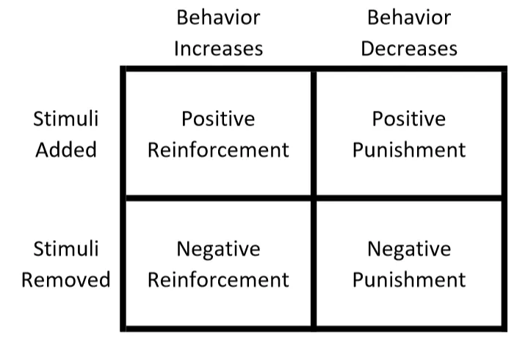
Reinforcement

Slide 33
Performance Appraisal
Performance Appraisal is the systematic evaluation of the performance of employees and to understand the abilities of a person for further growth and development. Performance appraisal is generally done in systematic ways which are as follows:
The supervisors measure the pay of employees and compare it with targets and plans.
The supervisor analyses the factors behind work performances of employees.
The employers are in position to guide the employees for a better performance

Slide 34

Process of Performance Appraisal

Slide 35

Methods of Performance Appraisal

Slide 36

Difference between Performance Appraisal and Performance Management

Slide 37
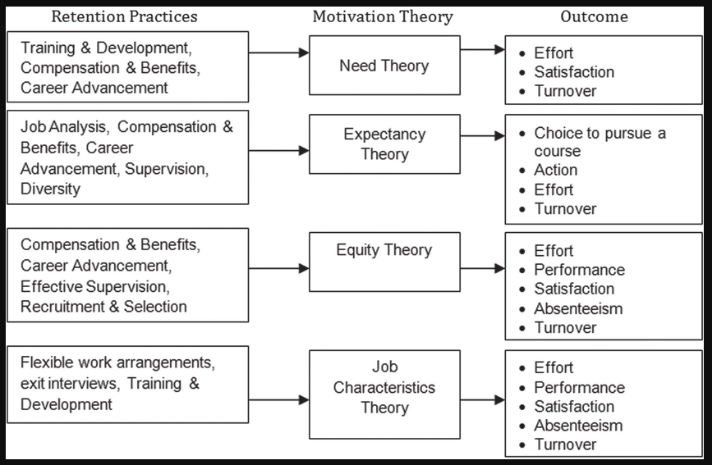
Usage of Theories

Slide 38
Major Theories of Motivation
I. Need Approaches :
  - Maslow’s Hierarchy of Needs
  - Alderfer’s ERG Theory
  - Herzberg’s Two Factor Theory
  - McClelland Learned Needs Theory
II. Cognitive Approaches :
  - Expectancy Theory
  - Equity Theory
  - Goal Setting Theory

Slide 39
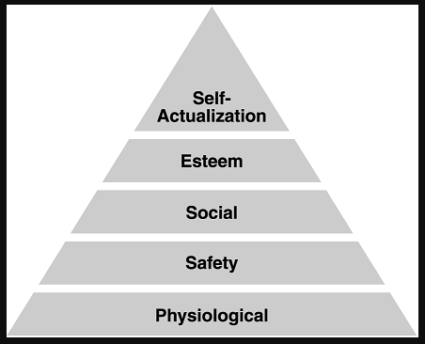
Maslow’s Hierarchy of Needs

Slide 40
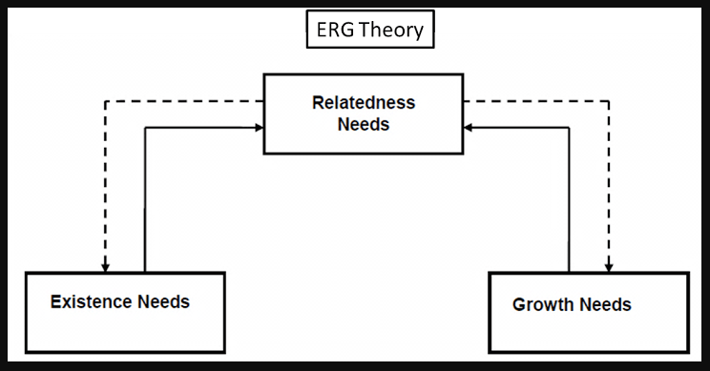
Alderfer’s ERG Theory

Slide 41
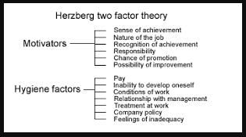
Herzberg’s Two Factor Theory

Slide 42
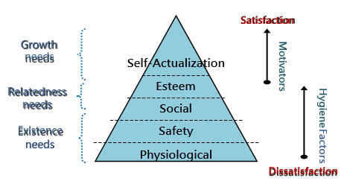
Motivational Theories

Slide 43
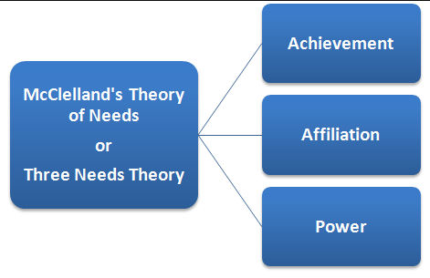
McClelland's Need Theory

Slide 44
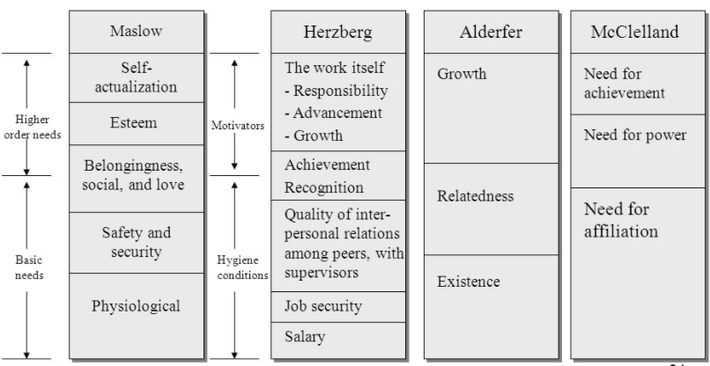
Comparison of Motivation Models

Slide 45
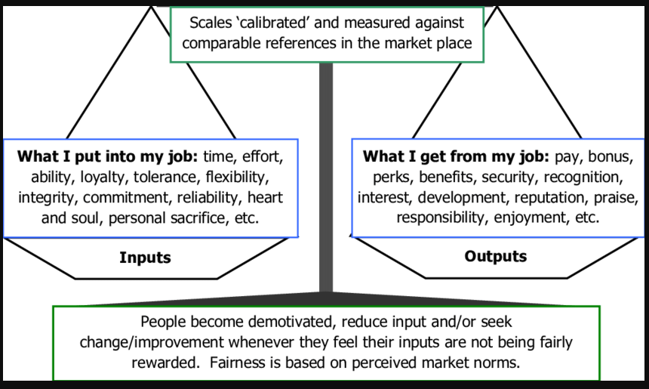
Adams’ Equity Theory

Slide 46
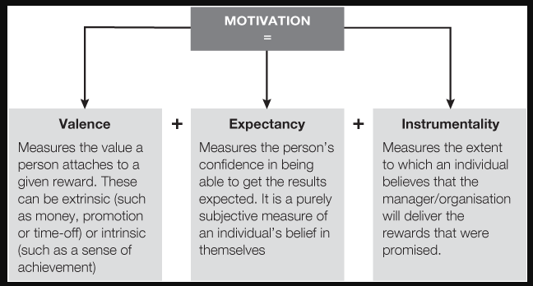
Vroom's Expectancy Theory

Slide 47
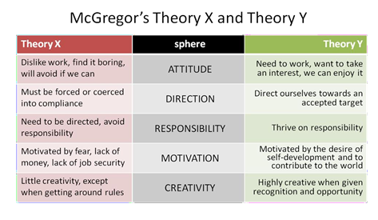
McGregor's X and Y Theory

Slide 48
Poll Question # 1
Which of the following HR practices involves both the people and the processes equally?
A. Organizational behaviour theories
B. Theories of motivation
C. Human relations theories
D. Organizational development theories

Slide 49
Answer to Poll Question # 1
Option - D.
Theories related to organizational development are equally focused on both people and processes. These theories describe different types of interventions aimed to develop people, processes, or sometimes both.

Slide 50
Feedback, Counselling, and Coaching
Feedback provides information to people on their performance, which helps them to understand how well they have been doing and how effective their behaviour has been. Cultural differences can affect the degree of need for feedback, inhibit employees from seeking necessary feedback, and determine the most effective form of feedback.
Counselling uses a set of skills and techniques to help people to take responsibility for and to manage their own decision-making whether it work related or personal. A counselling session is a meeting between the supervisor and the employee which may focus on a specific incident, a particular aspect of an employee's performance which the supervisor has identified as needing improvement, or the employee's overall performance or conduct. The counselling process is initiated and executed at the department level by the supervisor and is not discipline. It is a face-to-face communication between the supervisor and the employee, conducted in private, and is intended to have a constructive goal of providing feedback to the employee to correct the problem.
Coaching can be used to help people develop their competencies during normal day-to-day activities. Coaching often provides positive feedback about employee contributions. At the same time, regular coaching brings performance issues to an
employee's attention when they are minor, and assists the employee to correct them

Slide 51
Performance Appraisal
Performance Appraisal is the systematic evaluation of the performance of employees and to understand the abilities of a person for further growth and development. Performance appraisal is generally done in systematic ways which are as follows:
The supervisors measure the pay of employees and compare it with targets and plans.
The supervisor analyses the factors behind work performances of employees.
The employers are in position to guide the employees for a better performance

Slide 52
Objectives of Performance Appraisal
Improvement
Coaching and Guidance
Feedback and Communication
Compensation
Staffing Decision and Professional Development
Termination and Legal Documentation

Slide 53
Process of Performance Appraisals
A performance appraisal is a formal interaction between an employee and her manager. This is when the performance of the employee is assessed and discussed in thorough detail, with the manager communicating the weaknesses and strengths observed in the employee and also identifying opportunities for the employee to develop professionally. Here is the process involved in performance appraisal
Conducting Job analysis.
Establishing Performance Standards
Communicating the standards
Measuring the actual Performance
Comparing the Actual with the Desired Performance
Discussing Results
Decision Making

Slide 54

Acceptability of Performance Appraisals

Slide 55
Performance Development
Performance development is a broad term that includes performance management and employee development. It describes both managing/assessing the work that needs to be done and providing opportunities for professional growth and development.
Performance development is the ongoing process between supervisor and employee of communicating and clarifying position responsibilities, priorities and performance expectations to guarantee mutual understanding and to enhance effectiveness in achieving the campus and departmental mission and goals. Conducting employee performance reviews demands a lot of time and effort, but when done correctly, they can bring numerous benefits to both the employee and the business, including:

Slide 56

Performance Development Process

Slide 57
Performance Improvement Plans and Individual Development Plans
A performance improvement plan is a document that lists where an employee is falling short and what he can do to improve. For instance, the performance action plan may detail skills or training the employee lacks. Alternatively, it could specify how the employee needs to change his behaviour. In either case, the PIP will clearly state the steps the employee needs to take to make the necessary improvements.
An individual development plan (IDP) is a tool to assist employees in career and personal development. Its primary purpose is to help employees reach short and long-term career goals, as well as improve current job performance. An IDP is not a performance evaluation tool or a one-time activity. It should be looked at like a partnership between the employee and the supervisor. It involves preparation and continuous feedback

Slide 58
Managing Performance in Cross Culture Context
The general terms "high context" and "low context" (popularized by Edward Hall) are used to describe broad-brush cultural differences between societies.
High context refers to societies or groups where people have close connections over a long period of time. Many aspects of cultural behaviour are not made explicit because most members know what to do and what to think from years of interaction with each other. Your family is probably an example of a high context environment.
Low context refers to societies where people tend to have many connections but of shorter duration or for some specific reason. In these societies, cultural behaviour and beliefs may need to be spelled out explicitly so that those coming into the cultural environment know how to behave

Slide 59
Questions

