Slide 1
TALENT DEVELOPMENT AND MANAGEMENT - I
SPHRi

Slide 2
Human Resource Development
Organisational Development
Organisational Change
Learning Organisation
Knowledge Management

Slide 3
HRD - Definition
Human Resource Development (HRD) is a process of developing and unleashing expertise for the purpose of improving individual, team, work process, and organizational system performance through organizational development (OD) and personnel training and development for the purpose of improving performance. OD primarily focuses at the organizational level and connects with individuals, while Training & Development primarily focuses on individuals and connects with the organization.
Individual and organizational learning
Individual and organizational performance

Slide 4
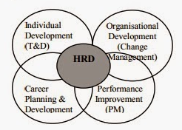
Human Resource Development

Slide 5
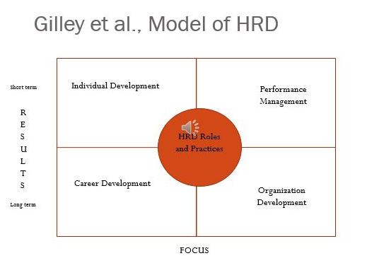
Model of HRD

Slide 6
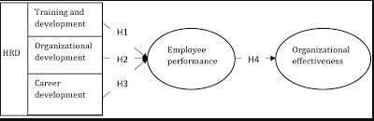
HRD Process

Slide 7
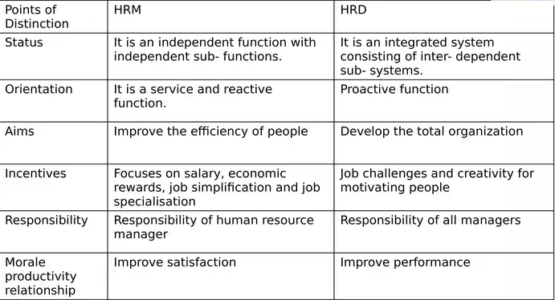
Difference HRM vs HRD

Slide 8
Human Resource Development
Organisational Development
Organisational Change
Learning Organisation
Knowledge Management

Slide 9
Organisational Development (OD)
Organisational Development concerns system planned change, targets humans and processes of organisations and intends to build the capacity to adapt and renew organisations

Slide 10
Features of Organisational Development
Organisation Development is an effort that is :
Planned
Organisation-wide
Managed from the top
Increase organisation effectiveness and health
Through planned interventions in the organisation’s “processes” using behavioural science knowledge

Slide 11

Process of OD
Entering and Contracting
Diagnosing Organizations, Groups, and Jobs
Collecting, Analysing, and Feeding Back Diagnostic Information
Designing Interventions
Leading and Managing Change

Slide 12

Organisational Development Process

Slide 13
Human Resource Development
Organisational Development
Organisational Change
Learning Organisation
Knowledge Management

Slide 14

Effective Change Management

Slide 15

Kurt Lewin Change Process Theory
Unfreezing stage: Getting people to accept that the change will occur. Ending things that resist change is vital at this stage
Moving stage: Getting people to accept the new, desired state
Refreezing stage: When the new ideal becomes a regular part of the organization

Slide 16

Organisational Development Process

Slide 17

Kurt Lewin Change Process

Slide 18

John Kotter’s, Eight Step Leading Change Model

Slide 19

Comparison of Change models

Slide 20
Human Resource Development
Organisational Development
Organisational Change
Learning Organisation
Knowledge Management

Slide 21
Learning Organisation
A learning organization is a place where employees excel at creating, acquiring, and transferring knowledge. There are three building blocks :
Supportive learning environment
Concrete learning processes and practices
Leadership behavior that reinforces learning.
Such learning organizations would be able to adapt to the unpredictable more quickly than their competitors could

Slide 22
Key features in Learning Organization
Employees share learning with each other and use a job as a basis for applying and creating knowledge.
Systems are developed for creating, capturing, and sharing knowledge
Employees are encouraged to think in new ways, see relationships and feedback loops, and test assumptions.
Learning is rewarded, promoted, and supported by managers and company objectives.
Employees are free to take risks, innovate, explore new ideas, try new processes, and develop new products and services.
System and environment focus on ensuring the development and well-being of every employee.

Slide 23

The Five Disciplines

Slide 24
Five Disciplines
System thinking is a conceptual framework that makes patterns clearer and helps one see how things interrelate and how to change them.
Mental models are our deeply ingrained assumptions that influence how we understand the world and how we take action.
Personal mastery is the high level of proficiency in a subject or skill area.
Team learning is aligning and developing the capacity of a team to create the results its member’s desire.
Shared vision is a look into the future that fosters genuine commitment and is shared by all who need to possess it.

Slide 25

Event vs Systems Thinking

Slide 26

Mental Models

Slide 27

Fifth Discipline – Learning Organisation

Slide 28

Organizational Learning vs. Learning Organization

Slide 29
Human Resource Development
Organisational Development
Organisational Change
Learning Organisation
Knowledge Management

Slide 30
Knowledge Management
Knowledge Management (KM) is a discipline that promotes an integrated approach to identifying, capturing, evaluating, retrieving, and sharing all of an enterprise's information assets. These assets may include databases, documents, policies, procedures, and previously un-captured expertise and experience of individual works

Slide 31

Knowledge Management Cycle

Slide 32
SECI Concepts
Socialization is the process where tacit knowledge it transmitted between people..
Externalization process allows tacit knowledge to be morphed into explicit knowledge. Through interaction between an individual and other groups in the organization, the individual’s tacit knowledge is expressed through whatever terms are possible, such as metaphors and stories.
Combination -Knowledge throughout the organization is collected and compiled into a more effective form of explicit knowledge, allowing the more refined forms to be distributed throughout the organization. An example would be a team in a tech firm whose job is to publish reports of successful products made throughout the company.
Internalization is the collective tacit knowledge of the organization is morphed from its explicit knowledge through internalization

Slide 33

SECI Model of Knowledge Management

Slide 34

Knowledge Management Model

Slide 35

Knowledge Assets

Slide 36
HR Roles in Organizational Development
HR should become a partner with senior and line managers in strategy execution, helping to move planning from the conference room to the marketplace.
It should become an expert in the way work is organized and executed, delivering administrative efficiency to ensure that costs are reduced while quality is maintained.
It should become a champion for employees, vigorously representing their concerns to senior management and at the same time working to increase employee contribution; that is, employees’ commitment to the organization and their ability to deliver results.
HR should become an agent of continuous transformation; shaping processes and a culture that together improve an organization’s capacity for change

Slide 37
Questions

