Slide 1
HCL Technologies: Leveraging Technology for Talent Acquisition Transformation
HCL: Technology that touches life

Slide 2
Q. Challenges before Mr. Rao?
Hiring in volume
Given the revenue growth target for 2018

Slide 3
What can Mr. Rao do?
Use technology
That makes “Hiring Easy”
By giving
  World class experience
  Enhancing efficiency
  Impact stakeholders

Slide 4
Initiative of Mr. Rao
Identifying the correct recruitment productivity metrics
Metrics should measure
  Progress of recruitment
  Without compromising quality of hire
  Cost effective
  Positive Experience

Slide 5
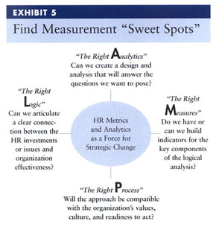
LAMP Model of Talent Analytics

Slide 6
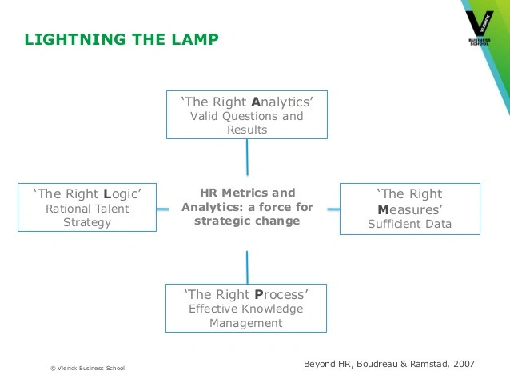

Slide 7
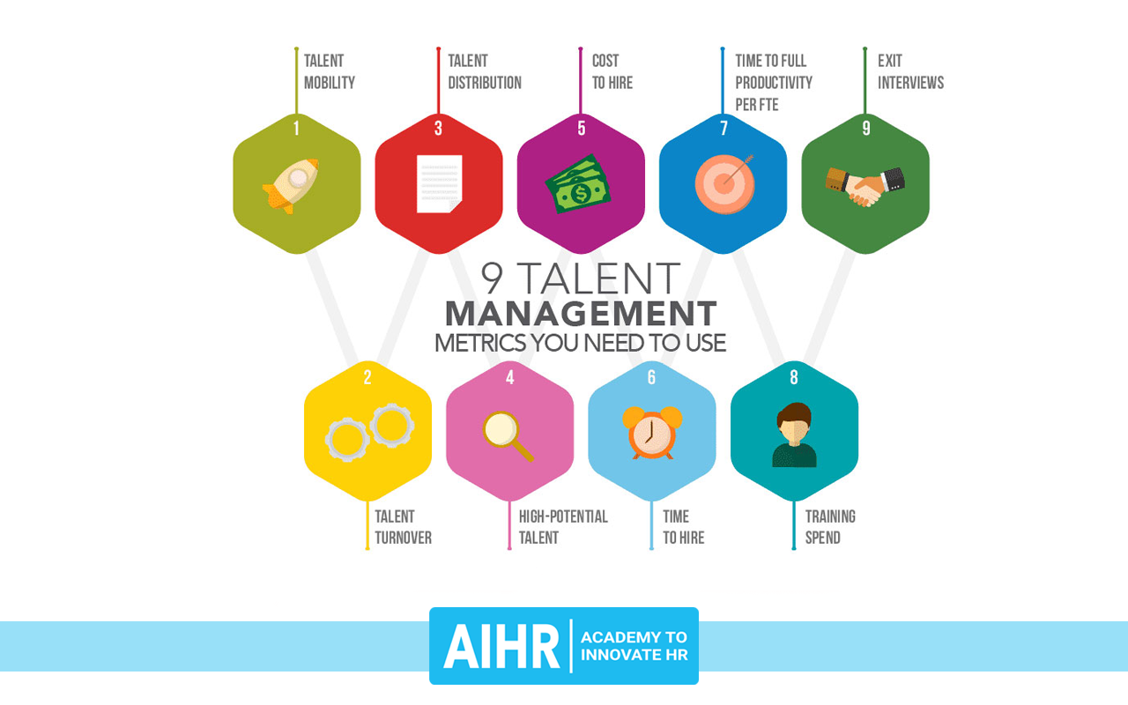
Talent Metrics

Slide 8
HCL Technology
Model 1-2-3 Strategy
Model 1
  Strengthen leadership
  Increase market share of core area businesses

Slide 9
HCL Technology
Model 1-2-3 Strategy
Model 2
  Sustain the market share
  New related offerings

Slide 10
HCL Technology
Model 1-2-3 Strategy
Model 3
  Look forward
  Follow the trend
  Future investment

Slide 11
What is the hiring Target for HCL?

Slide 12
What is TA – CoE?

Slide 13
Process of Talent Acquisition in HCL
What were lacuna of old HR recruitment system (2012)?

Slide 14
Process of Talent Acquisition in HCL
New Recruitment system (2013-17)
ATS
iTAP (reduced duplicacy)
Lead time – 56 days

Slide 15
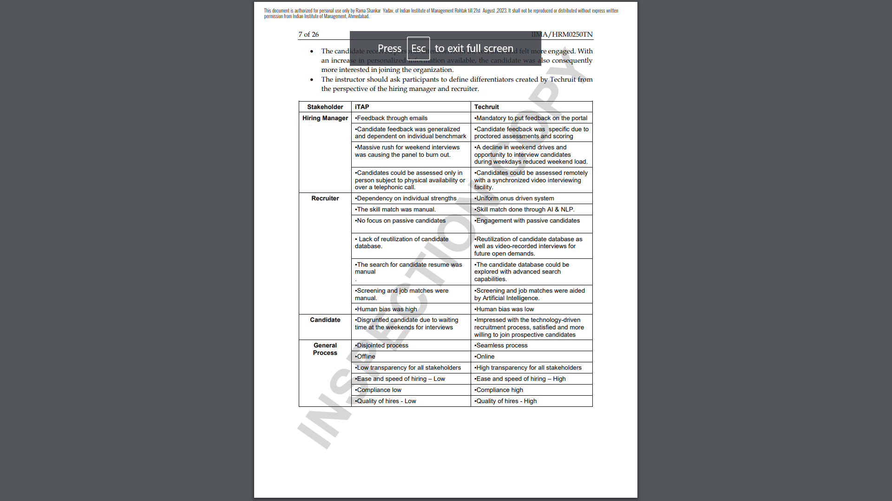
Target of 50 K Recruitment:
Emergence of Techruit

Slide 16
References
Boudreau and Ramstad (2007)

