Slide 1
TALENT ACQUISITION- II
PHRi

Slide 2
Recruiting
Recruiting Metrics
Validity and Reliability
Selection Process
Screening
Job Interview
Reference Check

Slide 3
Recruitment
Recruitment is the process of attracting, screening and hiring qualified people for a job. The goal is to attract a pool of qualified candidates, some of whom will later be given job offers.
Recruitment consists of two crucial factors. One factor is attracting the appropriate quantity of applicants. The other factor is attracting quality applicants.
The starting place for determining who is qualified should be a carefully prepared job analysis, job description and job specification. These three documents are needed to establish selection criteria, evaluate applicants and screen out those who do not meet the minimum qualifications needed for the job.

Slide 4
Recruiting Process
The recruiting process starts with getting approvals for opening a job requisition.
The job requisition is a request to hire a person for an open position. Job requisitions usually include the following information for candidates:
Job description
Job level
Job location
The requisitions also include information required for HR professionals, such as cost estimates and headcount information. Headcount refers to the number of employees an organization has on its payroll.
Requisition forms are required for :
Authorizing the recruitment of full-time, part-time, temporary and contract employees
Authorizing filling a position that has been vacated by the transfer or termination of a current employee
Authorizing creating a new position that is not currently filled by an employee

Slide 5
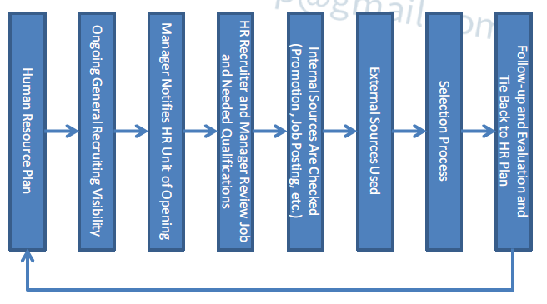
Recruiting Process

Slide 6
Recruiting Process
Recruiting efforts aim to translate HR plans into action. The following decisions about recruiting must be made:
How many people does an organization need?
Where will the organization get these people?
What special skills and experience are really necessary?
How will the organization spread its message of openings?
How effective are the recruiting efforts?

Slide 7
Recruiting
Recruiting Metrics
Validity and Reliability
Selection Process
Screening
Job Interview
Reference Check

Slide 8
Recruiting Strategies I
Build a Candidate Pipeline
Building a candidate pipeline means developing a pool of applicants that will be available when a job opening needs to be filled. A candidate pipeline has crucial value to an organization. However, organizations must first know what they are looking for ?
Consider the following strategies for starting and maintaining effective candidate pipelines:
Let potential candidates know that your organization may be interested in hiring them if an appropriate job position becomes available.
Let management know when exceptional talent is available.
Consider creating a new position for a very strong candidate who may not match your organization’s current job openings.
Keep your pipeline to a manageable size

Slide 9
Recruiting Strategies II
Consider Flexible Staffing Options
Also referred to as alternative staffing, flexible staffing uses alternative recruiting sources and workers who are not regular employees.
Flexible staffing can be based on either schedule flexibility or location flexibility. Schedule flexibility includes situations such as compressed workweeks and part- time options. Location flexibility includes working remotely from a location other than the main office or worksite.
Reasons to consider flexible staffing options for your organization include the following situations:
A shortage of available workers for open positions
Seasonal workload demands
Organizational upturns and downturns that make permanent headcounts impractical
Special projects that demand specific skills
Flexible staffing offers organizations the following benefits:
Improved job commitment over a one-year period
Decreased health problems or complications that impact the employee’s work

Slide 10
Recruiting Strategies III
Internal Recruitment Sources :
Organizations can fill open positions through internal promotions and transfers. This internal recruitment allows the organization to capitalize on its investment in recruiting, selecting and developing its current employees.
Effective methods of recruiting internally include the following:
Job postings
Skills assessment tools
Employee databases
Employee referrals

Slide 11

Advantages and Disadvantages of Recruiting Internally

Slide 12
Job Postings
A job posting is an internal system that allows employees to respond to a job opening for a specific position. A posting should provide a brief description of the job, including significant job duties and minimum qualifications, education and experience. Job postings can be communicated through bulletin board notices, newsletters, memos, electronic bulletins or the company Intranet.
In some cases, jobs are not advertised externally until employees have an opportunity to respond to the posting. In other cases, jobs may be simultaneously advertised externally to speed up the hiring process.
Job postings have several advantages:
Allows all qualified employees to compete for positions
Alerts candidates to advancement opportunities in the department or the organization
Allows the organization to reduce the costs of recruiting
Accommodates seniority by establishing qualifications and other position requirements

Slide 13
Skills Assessment Tools
The human resource information system (HRIS) is technology that supports human resources functions. HRIS can be used as a source for internal recruitment.
HRIS skill banks and skill tracking systems can generate computerized employee profiles and skill inventories. These inventories provide a list of candidates who have the needed knowledge, skills and abilities. Having a complete record of each employee’s qualifications provides the following benefits:
Allows organizations to scan records quickly and to locate qualified candidates
Increases the likelihood of a good match between the job and the employee

Slide 14

Employee Referrals
An employee referral program is a recruiting strategy that rewards current employees for referring qualified candidates for open positions

Slide 15
Internal Movement
Internal movement refers to the movement of employees from one job to another within the organization.
We will look in more detail at the following forms of internal movement:
Promotions
Demotions
Relocations
Transfers
International assignments

Slide 16
Promotions
In most organizations, a promotion is an advancement of an employee's rank, usually with greater responsibility and more money. Some reasons for promotion include the following:
Assuming new and different duties of a different position at a higher level
Assuming a position that involves increased responsibilities and the acquisition of additional knowledge, skills or abilities in the same line of work
HR, together with line management, should develop a natural progression of jobs whenever possible. This progression provides employees with a career path for future growth that can also be used as a basis for promotion from within. However, HR management should not create jobs simply to provide a path of upward mobility. Artificial career paths can lead to unrealistic expectations and unnecessary organizational structure and costs.

Slide 17
Demotions
A demotion is moving an employee back or laterally to a position that is better suited to his or her talents. Demotions can occur for several different reasons:
Staff reductions, consolidations or reorganizations
An attempt to move an underqualified employee to a more suitable position
An employee’s request (For example, an employee may not want to continue as a supervisor or may request a part-time schedule.)

Slide 18
Relocations
Relocation means moving an employee to another location for work. This relocation can be within the country or to another country.
The organization should consider several factors related to relocations:
The cost to the organization
The employee’s willingness to accept the relocation
The impact on the employee’s family (including employment opportunities for the spouse)
The need for an orientation program to adjust employees and their families to the new location

Slide 19
Transfers
Often employees transfer to other divisions within an organization. Transfers are usually considered a lateral move with no salary adjustment. Transfers can be initiated by either the employee or management and may involve a move to a different geographic location, function or organizational line.
Reasons for transfers include the following:
The employee desires change but does not want to leave the organization.
The organization finds a better match between the employee’s abilities and the organization’s staffing needs.
The transfer helps the organization balance staffing and reduces the need for terminations.

Slide 20
International Assignments
An international assignee is a person who moves to a new country to work on an international assignment
Reasons for organizations to make an international assignment include the following:
Filling an open position
Transferring technology or knowledge
Developing an employee’s career
Analyzing the market for the organization’s products or services

Slide 21

Recruiting Strategies IV
External Recruitment Sources
During the external recruitment process, HR or the lead recruiter plays the liaison role between the hiring manager and the external recruitment source. As a liaison, the recruiter is the main contact point in the recruitment process and facilitates the communication between the organization and the external recruitment source.

Slide 22

External Recruiting Sources

Slide 23
Poll Question # 1
What form is best used to authorize creating a new position that is not currently filled by an employee?
Requisition form
Requisition Replacement form
Add to Headcount form
Recruitment form

Slide 24
Answer to Poll Question # 1
A. Requisition form

Slide 25
Poll Question # 2
Which of the following statements about effective recruiting is NOT true?
What works for one organization will usually apply to another organization.
Job specifications should reflect the collective input of managers, supervisors, incumbents and others.
Recruiters should show genuine interest in job candidates and treat them like valued prospective employees.
Organizations should recruit continuously rather recruiting only to fill specific existing openings.

Slide 26
Answer to Poll Question # 2
A. What works for one organization will usually apply to another organization.

Slide 27
Poll Question # 3
What is meant by building a candidate pipeline?
Using alternative recruiting sources and workers who are not regular employees
Developing a pool of applicants that will be available when a job opening needs to be filled
Establishing a specific plan of action for meeting your recruitment objectives
Encouraging the best potential candidates to apply

Slide 28
Answer to Poll Question # 3
B. Developing a pool of applicants that will be available when a job opening needs to be filled

Slide 29
Poll Question # 4
Which of the following is an advantage of internal recruiting?
Brings new ideas into the organization
Provides cross-industry insights
May reduce training costs
Can improve employee morale

Slide 30
Answer to Question # 4
D. Can improve employee morale

Slide 31
Time to Fill
Time to fill (also known as days to fill) is the average number of days required to hire a person for an open job position or vacancy. The vacancy rate measures the percentage of positions being actively recruited for at the end of the reporting period. If openings are not filled quickly with qualified candidates, the work and productivity of the organization are likely to suffer.

Slide 32
Cost per Hire
Cost per hire is one of the most commonly used HR metrics, this can tell you just how much it really costs your company when you hire a new worker. Add up the total cost of your recruitment operation, and divide this figure by the number of individuals you successfully recruit to find out how much you are spending for each individual you obtain through recruitment. The total cost of bringing on board a new staff member, including recruitment, purchase of equipment, onboarding, administrative costs and benefits.

Slide 33
Yield ratios
One means for evaluating recruiting efforts is yield ratios, which compare the number of applicants at one stage of the recruiting process with the number at another stage. The result is a tool for approximating the necessary size of the initial applicant pool.The ratios can determine which recruitment source or method or type of recruiter produces the greatest yield and identify areas that may need improvement. The source yield is calculated as (Number of hires from a source / Number of candidates generated from a source).

Slide 34
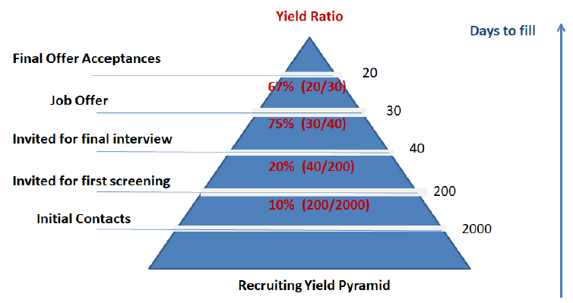
Yield ratios

Slide 35
Selection Rate
Another useful calculation is the selection rate, which is the percentage hired from a given group of candidates. It equals the number hired divided by the number of applicants; for example, a rate of 30% indicates that 3 out of 10 applicants were hired.

Slide 36
Acceptance Rate
The acceptance rate is the percent of applicants hired divided by the total number of applicants offered jobs. It is common for HR staff members to track the reasons candidates turn down job offers. That analysis helps explain the rejection rate in order to learn how competitive the employer is compared with other employers and what factors are causing candidates to choose employment elsewhere

Slide 37
Success Base Rate
A longer-term measure of recruiting effectiveness is the success rate of applicants. The success base rate can be determined by comparing the number of past applicants who have become successful employees against the number of applicants they competed against for their jobs, using historical data within the organization.

Slide 38
Applicant Tracking System (ATS)
An applicant tracking system (ATS), also called a candidate management system, is a software application designed to help an enterprise recruit employees more efficiently. An ATS can be used to post job openings on a corporate Web site or job board, screen resumes, and generate interview requests to potential candidates by e-mail. Other features may include individual applicant tracking, requisition tracking, automated resume ranking, customized input forms, pre-screening questions and response tracking, and multilingual capabilities.

Slide 39
Realistic Job Previews
The cost of hiring and training an employee is substantial. Therefore, providing a realistic job preview (RJP) is in the best interest of the candidate and the organization.
A realistic job preview informs candidates about all aspects of the job and the work environment. For some candidates, the RJP can occur earlier in the selection process, during the interview.
The RJP has three purposes:
Gives candidates as much information as possible, so they can make an informed decision about their suitability for the job
Gives organizations an opportunity to portray the job objectively— including both favorable and unfavorable factors
Increases the possibility of a good match between the candidate and the organization

Slide 40
Types of Realistic Job Previews
Organizations can create realistic job previews in a variety of ways, including the following:
Tours of the workplace. A walk-through of the workplace provides a candidate with an accurate impression of the work environment. Candidates can determine their comfort level with the physical format (for example, cubicles or traditional offices, break areas and cafeterias) and with noise levels.
Job simulations. Candidates may experience a simulation of the job in order to determine their suitability. For example, an applicant for a clean- room manufacturing position can wear the clean-room attire that is required several hours a week.
Video presentation. A candidate may view a video presentation before starting to work for an organization. The video can portray the history of the company, the organizational culture, and a discussion of benefits and the path of a typical day.

Slide 41
Recruiting
Recruiting Metrics
Validity and Reliability
Selection Process
Screening
Job Interview
Reference Check

Slide 42
Selection
Selecting is the process of choosing from a group of applicants that individual deemed to be best qualified for a particular job opening. An organization’s success in its recruiting activities significantly affects the efficiency and effectiveness of selection. An adequate pool of applicants provides organization greater latitude in choosing employees; an inadequate pool reduces latitude and may result in the employment of marginally qualified candidates.

Slide 43

Selection Process

Slide 44
Selection Process
Initial Screening
Secondary Screening
Candidacy
Verification
Final Decision

Slide 45

Selection Process

Slide 46
Recruiting
Recruiting Metrics
Validity and Reliability
Selection Process
Screening
Job Interview
Reference Check

Slide 47
Reliability and Validity of Selection Tools and Methods
Hiring the wrong person for the job is a costly mistake. Selection errors can impact the organization’s human capital management plan, employee morale, management time, training budgets, productivity and profitability. Just as reliability and validity were critical parts of the pre-screening process, you must also establish the reliability and validity of the selection tools and methods.

Slide 48
Reliability and Validity of Selection Tools and Methods
Establishing Reliability
Reliability is the ability of an instrument to measure consistently. For example, if an applicant takes a motor skills test twice, the scores should be similar (allowing for the effect of practice). If the scores differ significantly, the test may not be reliable.
Perfect reliability is difficult to achieve. The following types of errors can lead to inconsistent results:
Failure to measure some aspect of an important attribute
Irrelevant questions in an interview or on a test
Different time limits for candidates in an interview or on a test
Establishing Validity
Validity is the ability of an instrument to measure what it is intended to measure. For example, a typing performance test is probably a valid prerequisite for applicants who will be expected to do typing (such as for a position in an administrative processing center).

Slide 49
Recruiting
Recruiting Metrics
Validity and Reliability
Selection Process
Screening
Job Interview
Reference Check

Slide 50

Selection Tools

Slide 51
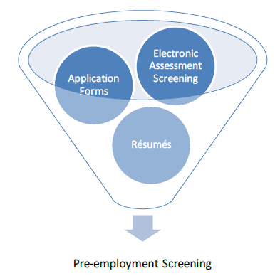
Pre-employment Screening

Slide 52
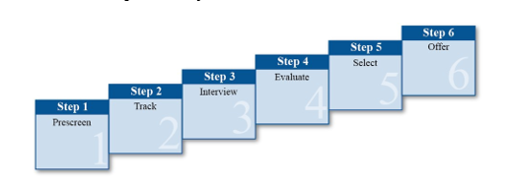
Selection
After HR and line managers have identified and recruited qualified candidates for an open position, they need to gather the information needed to make a selection decision.
Selection is the process of hiring the most suitable candidate for a job.

Slide 53
Step 1: Pre-Screen
The first step of the selection process is to pre-screen the pool of candidates. Pre- screening means examining or interviewing applicants before further selection takes place.
CVs and Application Forms
Pre-screening begins with analyzing the candidate’s curriculum vitae (CV) and/or application form. Efficient pre-screening by HR has the following important uses:
Identifies who fits the minimum selection criteria
Provides a source of questions for the interviewer and for reference checks
Ensures that line management spends time interviewing only qualified candidates

Slide 54
Application Forms
A good application form is one that is complete, easy to read and easy to review
Basic personal data (name, address and phone number)
Education, training and special skills
Work history, with dates of employment
References and authorization to check them
Authorization to verify all information
Statement regarding truthfulness of information
Candidate signature
Many HR professionals believe candidates should submit an application form in addition to a resume, for the following reasons:
The resume provides information the candidate wants you to know; the application provides information you want to know.
The application form may indicate if the candidate has exaggerated accomplishments on the resume.
The candidate’s signature on the application form serves as legal verification that the information is correct and truthful.

Slide 55
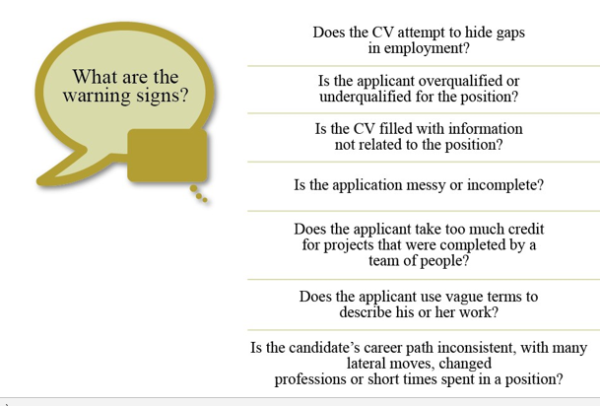
Warning Signs in a CV

Slide 56
Pre-Employment Tests
Pre-employment testing is a useful screening tool for many organizations. An appropriate pre-employment test has the following features:
Is job relevant
Is valid (that is, measures what it claims to measure)
Is reliable (that is, measures consistently)
Helps the organization make more effective employment decisions about candidates
Aptitude Tests :
Aptitude tests assess the candidate’s ability to learn a new skill. For example, a candidate for a factory assembly job may be asked to take a manual skill test.
Cognitive Ability Tests :
Cognitive ability tests assess skills the candidate has already learned. One kind of cognitive ability test is the performance test (also known as the work sample test). There are several kinds of cognitive ability tests. Typing tests are one simple example. Another example is asking an editor to edit a brief section of the organization’s policy manual.

Slide 57
Pre-Employment Tests
Personality Tests
Personality tests assess the candidate’s social interaction skills and patterns of behavior. These tests report what can be described as traits, temperaments or dispositions. Some tests focus on characterizing an individual as being within the normal ranges of adult functioning. Others focus on identification of abnormal behavior.
Psychomotor Tests
Psychomotor tests require a candidate to demonstrate a minimum degree of strength, physical dexterity and coordination in a specialized skill area. This test is appropriate only if the job’s essential functions require such abilities.

Slide 58
Other Pre-Screening Tools
Phone calls and work reference checks are two other tools that HR professionals can use to pre-screen candidates.
Pre-Screening Phone Calls
A phone call with the candidate can be a time-effective form of pre-screening. In a few minutes, interviewers can accomplish the following:
Verify the candidate’s background, experience and availability.
Describe the job in greater detail and answer questions.
If both the interviewer and candidate are still interested, ask the candidate to come to the organization for a pre-screening interview.

Slide 59
Other Pre-Screening Tools
Work Reference Checks
Former employers, clients and colleagues can provide in-depth information about the candidate’s work. The most informative references will be from former or current supervisors, who will know the candidate’s work and will have observed the candidate performing a similar job.
Reference checking has several important purposes:
To achieve better hiring fits
To confirm the honesty and accuracy of the resume
To protect the substantial investment that an organization makes when hiring
Qualifications and Eligibility
Some organizations request verification of the candidate’s academic qualification. For example, candidates may be asked to provide verification that they attended the educational institution listed on the resume or application form.

Slide 60
Step 2: Track
The second step of the selection process is to track the pre-screened applicants.
An applicant tracking system (ATS) is a software system that helps an organization recruit employees. Many applicant tracking systems support the following tasks:
Storing and processing resumes
Making the job requisition process more efficient
Providing reporting metrics that allow organizations to apply their recruiting budget more effectively
Another option for tracking applicants is outsourcing the task to an external agency. In this case, recruiting professionals act as a liaison between external agency recruiters and internal hiring managers or other internal stakeholders involved in the recruiting process. The recruiting professional has the following additional responsibilities:
Serve as a point of contact within the organization to communicate job requirements and recruiting processes to the agency
Ensure that the applications received from the agency are tracked to the organization’s job database and are consistent with the external candidate application process

Slide 61
Recruiting
Recruiting Metrics
Validity and Reliability
Selection Process
Screening
Job Interview
Reference Check

Slide 62

Step 3: Interview
The third step of the selection process is to interview the qualified candidates.
Types of Interviews
Interviews determine how well the candidate meets the needs of the organization. Organizations tend to use interviews for qualifying candidates more than any other procedure in the selection process.
Interviews can range from short pre-screening interviews (20 minutes or less) to long in-depth interviews (one hour or more).

Slide 63
Behavioral Interview
There are many styles of in-depth interviews. Three are the behavioral interview, the competency-based interview and the structured interview.
Description | Comments
The interviewer focuses on how the applicant previously handled situations (real experiences, not hypothetical ones). The interviewer asks very direct questions to determine if the individual possesses the skills necessary for the job. | Provides insight into how the candidate handled past job- related situations Allows the interviewer to probe more than with traditional interview questions
The premise of the behavioral interview is that past performance is the best predictor of future performance.

Slide 64

Behavioral Interview
An interviewer may ask a candidate for a management position to describe a situation in which the candidate coached a difficult employee. The candidate gives an example that illustrates past performance, while the interviewer looks for the following three key pieces of information:
A description of the situation or task
The action taken
The result or outcome

Slide 65
Competency-Based Interview
Competencies are the skills, behaviors and knowledge that are needed to succeed in a specific job.
Description | Comments
The interviewer asks questions that are based on real situations related to the competencies for the position. The interviewer asks the candidate to provide an example of a time he or she demonstrated the competency. | Provides insight into the candidate’s proficiency in a particular competency Gathers information that is predictive of what the candidate’s behavior and performance is likely to be in the position

Slide 66

Examples of Questions for Competency-Based Interviews

Slide 67
Structured Interview
Description | Comments
The interviewer asks every candidate the same questions. Follow-up questions may be different. The interviewer stays in control of the interview. | Ensures that similar information is gathered from all candidates Gives each candidate the same opportunity to create a good impression Works best when the interviewer wants to ensure that the same questions are asked of all candidates
Different types of questions can be used in the structured interview. The key is that the interviewer asks every candidate the same group of questions.

Slide 68
Step 4: Evaluate
The fourth step of the selection process is to evaluate the candidates.
Interview Feedback
Giving feedback to candidates after an interview is an important part of the selection process. Guidelines for providing effective feedback to candidates include the following:
Be honest in your assessment and give the applicant meaningful feedback for future employment.
Provide feedback that is clear and concise allowing the applicant to understand their strengths and weaknesses in comparison to the job requirements.
Give balanced feedback and discuss the person’s strengths first and then weaknesses against the job requirements.
Relate feedback to the job requirements not feelings, impression, or views of the applicant’s personality.
Consider the language used when providing feedback, especially in relation to interview performance.
Give factual examples in support to the feedback being provided.

Slide 69
Recruiting
Recruiting Metrics
Validity and Reliability
Selection Process
Screening
Job Interview
Reference Check

Slide 70
Background Investigations
Background investigation is the process of authenticating the information supplied to a potential employer by a job applicant in his or her resume, application and interviews. Organizations that conduct thorough background investigations usually make better hiring decisions and may avoid negligent hiring claims. Negligent hiring involves hiring a candidate who the employer knew (or should have known based on a reasonable investigation of the candidate’s background) posed a risk to others in the workplace.
HR professionals often conduct the background investigations. These investigations should be the same for candidates applying for the same job. Make sure a clear connection exists between the background investigations and the requirements of the job.

Slide 71
Common Background Investigations
Internet Search :
An Internet search on the candidate's name, especially using an Internet search engine such as Google.com, helps the organization confirm candidates’ claims about their jobs, performance, awards and other information. Sites such as LinkedIn may also serve to check the candidate’s consistency in claims about job history and achievements
Criminal Background Check
Organizations conduct criminal background checks for the following reasons:
To determine if the candidate has a history of criminal convictions that may disqualify her or him from consideration
To increase the quality of applicant hiring
To reduce the possibility of theft and embezzlement
Credit History Checks
Credit history checks should be conducted only on the following candidates:
Candidates for positions of financial responsibility (such as accounting and finance professionals)
Candidate for positions that involve handling significant amounts of currency or other valuables
If your credit reports are acquired from external vendors, the organization must comply with any applicable credit check laws.

Slide 72
Step 5: Select
The fifth step in the selection process is selecting a candidate to fill the open position.
Selection of the most qualified candidate will be based on the interviews, evaluations, and tests conducted in Steps 3 and 4 of the selection process.
A tie breaker is a method used to select a preferred candidate when two or more candidates are considered equally qualified. The job requirements will help you determine what particular categories are the most important. The winning candidate should be the one who scores higher in the most consequential categories.
In some cases the decision must be based on a personality fit. The wrong fit leads to an unhappy employee, manager and team. The right fit can energize the environment and lead to a happy employee, manager and team. Often the head of the department or the organization must make the final decision about the right fit.

Slide 73
Step 6: Offer
The last step of the selection process is offering the position to the most qualified candidate.
Contingent Job Offer
Organizations may make a job offer that is contingent on the candidate passing certain tests or meeting certain requirements. This is known as a contingent job offer. The tests or requirements can include the following:
Medical examination
Physical fitness test
Psychological test
Employment Offer
An employment offer should quickly follow the selection of the most qualified candidate. Mishandling this part of the process can result in losing the candidate to another organization or can give the employment relationship a negative start even if the candidate accepts the position.
An employment offer is formally communicated through an offer letter. Employment offers must be worded carefully.

Slide 74
Employment Contracts
An employment contract is an agreement between the organization and an employee that explains the employment relationship.
A written contract helps clarify employment terms. The specific terms will vary based on the organization, the job and applicable local laws. The following list provides examples of items commonly covered in an employment contract:
Terms and conditions of employment
General duties and job expectations of the employee
Confidentiality and nondisclosure terms
Compensation and benefits
Terms for resignation or termination
Relocation
Severance provisions
Appropriate signatures and date

Slide 75
Difference between an offer and a contract
In general, an offer is not legally binding and can be retracted at any time. A contract confers specific legal obligations on both the organization and the new employee. In some counties, the contract can be very difficult to break without significant costs. Involve legal counsel in developing any offer letter or contract for the organization.

Slide 76
Poll Question # 1
Which one of the following statements related to resumes and applications is true?
Resumes highlight the candidate’s strengths.
Many HR professionals believe candidates should submit only a resume and that an application form is not needed.
The application provides information the candidate wants you to know; the resume provides information you want to know.
The presence of any warning signs means that a candidate should immediately be rejected.

Slide 77
Answer to Poll Question # 1
a. Resumes highlight the candidate’s strengths.

Slide 78
Poll Question # 2
Which pre-employment test assesses skills the candidate has already learned?
Aptitude test
Cognitive ability test
Personality test
Psychomotor test

Slide 79
Answer to Poll Question # 2
B. Cognitive ability test

Slide 80
Poll Question # 3
Which of the following is a question used in a behavioral interview?
Describe a time when you used your fact-finding skills to solve a problem.
Do you possess good management skills?
Have you ever dealt with stress in your current position
Describe your current job responsibilities.

Slide 81
Answer to Poll Question # 3
C. Have you ever dealt with stress in your current position?

Slide 82
Poll Question # 4
In which type of interview is each candidate asked the same group of questions?
Behavioral interview
Competency-based interview
Structured interview
Unstructured interview

Slide 83
Answer to Poll Question # 4
C. Structured interview

Slide 84
Poll Question # 5
Which of the following is NOT a feature of an effective RJP (realistic job preview)?
Dispels unrealistic expectations
Accurately represents organizational realities
Helps increase job satisfaction
Increases the likelihood that the candidate will not accept the job offer

Slide 85
Answer to Poll Question # 5
D. Increases the likelihood that the candidate will not accept the job offer

Slide 86
Poll Question # 6
What term is used for an agreement between the organization and an employee that explains the employment relationship?
Contingent job offer
Offer letter
Employment contract
Offer negotiation

Slide 87
Answer to Poll Question # 6
C. Employment contract

Slide 88
Questions

