Slide 1
TALENT ACQUISITION- I
PHRi

Slide 2
Class Information
Welcome to the 2nd batch of PHRi
Your class timings is 3:30pm to 5:30pm
Break 10 mins
1st Half : 3:30pm-4:30pm
4:30-4:45pm : Break
2nd Half : 4:45-5:30pm
ALL Sundays and alternate Saturdays

Slide 3
Key Points
Students who regularly participate in class are constantly involved with the material and are more likely to remember a greater portion of the information.
Attendance builds consistency.
Actively take notes.
Have your own whatsapp group

Slide 4
Job Analysis
Methods of Job Analysis
Human Resource Planning
Job Design
Staffing Plan
Contingent Staffing
Diversity and Inclusion
Employment Contract

Slide 5
Job Analysis
The success of any organization depends on each employee’s performance on the job. To make the recruitment and selection process effective, both employees and employers must have a clear concept of what a given job is and a clear language to communicate about the job.
A job analysis is a study of the major tasks and responsibilities of jobs in an organization. Job analysis is the foundation of many HR functions and activities. Effective HR practices depend on a thorough understanding of how jobs are performed

Slide 6
Job Analysis
Human resource management in organizations virtually always requires an in-depth understanding of the work that people do in that organization. The process by which this understanding is developed is a job analysis.
Systematic collection of data on the observable job behaviors of employees and what is accomplished by these behaviors and what technologies are required to do so
A job description is the documentation of the results of that analysis.

Slide 7
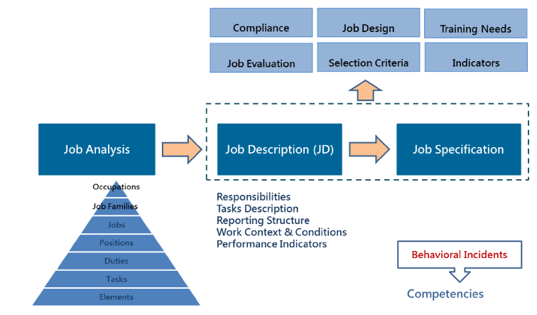
Job Analysis

Slide 8
Application of Job Analysis
Recruitment
Candidate Selection
Employee Training and Development
Performance Management
Organizational Management and Planning
Litigation Protection

Slide 9
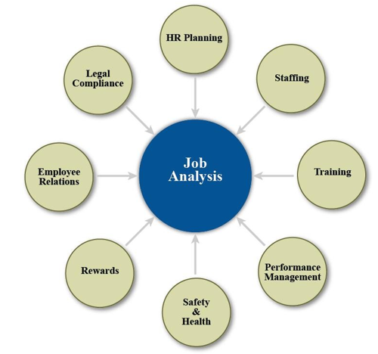
Roles of Job Analysis in HR

Slide 10
1. Job Analysis in Recruitment
The first external application of job analysis is in recruitment, when the job description becomes the basis for recruiting applicants. In beginning to fill a vacant job, the recruiter needs to know the job responsibilities as well as the skills and other characteristics required of candidates.

Slide 11
2. Job Analysis in Selection
Job analysis is used in developing behavioral interviewing protocols for candidate screening. The job description that is the end-product of the job analysis should provide a clear picture of the work and activities and the requirements.
job analysis is used as the criteria for validity studies of any preemployment selection procedure, especially psychological tests

Slide 12
3. Job Analysis in T & D
Job analysis used for the new hire should lead to an analysis of the competencies of the existing staff, and a training and development program should be instituted to produce the necessary competencies.

Slide 13
4. Job Analysis in Performance Management
Job analyses should highlight the various work activities involved in performing a job and the relative importance of each activity. A rational performance appraisal system would evaluate the quality of the work performed by the individual being appraised according to the various importance ratings.

Slide 14
5. Job Analysis in Organisational Management and Planning
Job analysis help draft current job descriptions, create a uniform set of job titles, and recommend a compensation system based on the job content involved and a regional salary survey.

Slide 15
6. Job Analysis in Litigation
It is a basis for selection decisions
Job analysis using only well-validated selection procedures based on those job analyses will deter frivolous filings.
Record documenting what was done and why it was done.

Slide 16
Question # 1
Before establishing a recruitment program at a new branch office, HR interviews employees and managers to determine the duties and qualifications of each position to be filled. This is known as a(n).
a) job analysis.
b) workforce analysis.
c) availability analysis.
d) applicant flow analysis.

Slide 17
Answer # 1
Option A
Job analysis is a systematic study of jobs to determine what activities and responsibilities they include, their relative importance and relationship with other jobs, the personal qualifications necessary for performance of the jobs, and the conditions under which the work is performed. A job analysis enables an organization to recruit people with the appropriate knowledge, skills, and abilities.

Slide 18
Importance of Job Analysis
A job analysis measures the job, not the person doing the job.
A job analysis helps to determine the following information:
The importance of each task and responsibility
How the job relates to other jobs in the organization
The performance qualifications for the job
The conditions under which the work is performed
The general purpose of the job analysis is to understand the requirements of a job and to develop a pay structure. All jobs must be interrelated to accomplish the organization’s vision, mission, goals and objectives. Job analysis is the first step toward that end.

Slide 19
Job Analysis Data
Essential and nonessential tasks, duties and responsibilities
Knowledge, skills, and abilities
Mental and physical attributes required for the job
Level of responsibility in the job (supervision received and given)
Work environment (including equipment used, hazards and general physical conditions that may affect the work)

Slide 20
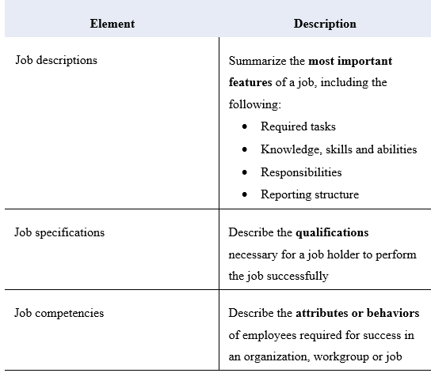
Outcomes of the Job Analysis

Slide 21
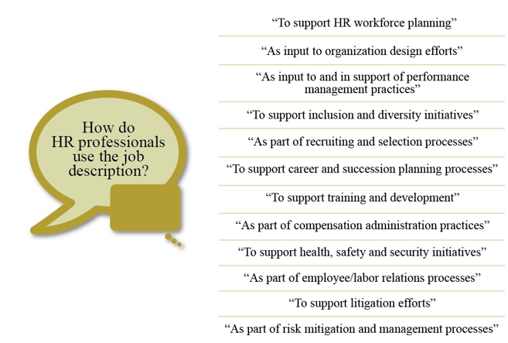
Job Description
A job description is a written document describing an employee’s work activities.

Slide 22
Job Specifications
A job specification is a written description of the minimum qualifications required to perform a specific job. A job specification should reflect what is necessary for satisfactory performance, not what the ideal candidate should have.
Job specifications can be generated during the preparation of the job description. These specifications are often included as part of the job description document.
Examples of job specifications include the following:
Experience
Education
Training
Licenses and certification (if required)
Mental abilities and physical skills
Level of organizational responsibility

Slide 23
Job Competencies
Job competencies are the observable and measurable skills, behaviors and knowledge that are needed to succeed in a specific job. Some organizations use the term ―competencies interchangeably with the knowledge, skills and abilities needed to perform a job successfully. However, competencies are more than basic KSAs. An employee usually develops competency at a job over a period of time. Therefore, job competencies represent the accumulation of multiple abilities and traits and knowledge required for success.
A competency-based job analysis describes a job in terms of competencies instead of job duties. The focus is on what the employee or team must be competent to do in order to perform the job.

Slide 24
Poll Question # 1
What term is used to describe a study of the major tasks and responsibilities of jobs in an organization?
Job analysis
Job description
Job specification
Job competency

Slide 25
Answer to Poll Question # 1
A. Job analysis

Slide 26
Poll Question # 2
Which of the following information is NOT collected during a job analysis?
Job context
Job content
Internal strengths and weaknesses
Performance criteria

Slide 27
Answer to Poll Question # 2
C. Internal strengths and weaknesses

Slide 28
Poll Question # 3
When you collect data for a job analysis, which of the following can be considered a primary source?
Job applicants
Employees who are currently performing the job
Employees throughout the organization
Employees who perform similar jobs at other organizations

Slide 29
Answer to Poll Question # 3
B. Employees who are currently performing the job

Slide 30
Poll Question # 4
Which method of collecting primary source data provides a realistic view of the daily tasks and activities performed in a job?
Interviews
Observation
Questionnaire
Work log

Slide 31
Answer to Question # 4
B. Observation

Slide 32
Elements of Job Analysis
A description of the work activity (WA) or tasks involved in doing the job;
The knowledge, skills, and abilities (KSA) or competencies necessary to perform the job;
Data on the range of job performance; and
The characteristics of the workplace.

Slide 33
Work Activity (WA)
the action performed in observable terms;
the outcomes or results of that action;
the tools or other equipment used;
the amount of discretion allowed the worker in that action.
Importance of the action to the success of performing the job
the frequency with which that action is performed.

Slide 34
Knowledge, Skills, and Ability (KSA)
Knowledge is defined as an organized body of information, usually of a factual or procedural nature, that, when applied, makes the successful performance of a job action possible.
Skill is defined as the proficiency in the manual, verbal, or mental manipulation of people, ideas, or things.
Ability is defined as the present capacity to execute a job action, to perform a job function by applying an underlying knowledge base and the necessary skills simultaneously.

Slide 35
Job Specification
Job specification is a statement of employee characteristics and qualifications required for satisfactory performance of defined duties and tasks comprising a specific job or function. Job specification is derived from job analysis. In other word, Job specification as a statement of minimum qualification that person must possess to perform a given job successfully.
Usually, the information of a job specification includes Experience, Education and KSAOs

Slide 36
Question # 2
A job requires a master's degree in HR, three years of HR generalist experience and the ability to use statistical computer software. These are
a) Position outcomes.
b) Essential job functions.
c) Performance standards.
d) Job specifications.

Slide 37
Answer # 2
Option D
A job specification is the KSAOs that an individual needs to perform a job satisfactorily.

Slide 38
Job Analysis
Methods of Job Analysis
Human Resource Planning
Job Design
Staffing Plan
Contingent Staffing
Diversity and Inclusion
Employment Contract

Slide 39
Methods of Job Analysis
Job description describes:
the important tasks that need to be performed to successfully hold this job;
the requirements necessary to perform these tasks;
the levels of job performance that can be expected at various levels of experience and expertise;
those characteristics of the work setting that impact work performance

Slide 40
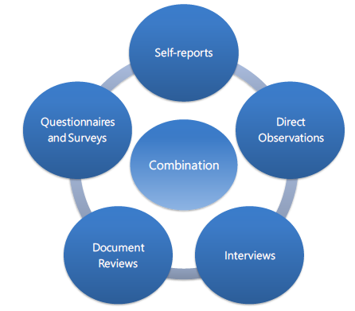
Methods of Job Analysis

Slide 41
Document Reviews
Most organizations contain a variety of documents that are useful in conducting job analysis :
Analysis of output
Performance appraisals,
Reports by both internal auditors
External consultants about workplace issues
Prior job descriptions
Customer complaint records
Time and Attendance records

Slide 42
Questionnaires and Surveys
Custom-Designed Questionnaires –the HR professional responsible for the job analysis must develop the questionnaire using information typically obtained individually from the job incumbent, his or her supervisor, other SMEs, and whatever other data sets are available to the responsible professional
Commercially available questionnaire are developed by job-analysis experts and is commercially available.

Slide 43
Question # 3
Which is a job-analysis method that allows for a quick response rate and gathering of data on a large number of jobs?
a) Observation.
b) Interview.
c) Questionnaire.
d) Functional.

Slide 44
Answer # 3
Option C
Questionnaires, as a means of gathering job-analysis data, provide the most efficient use of resources when data must be collected on many jobs, while allowing many participants at once. Observation and interviews requires a bit of time. Functional job analysis used by the US federal government, is highly structured and requires extensive resources.

Slide 45
Problems in using Job Descriptions
Changes in the nature of work over time
the low accuracy of the data obtained
the general stability of job performance

Slide 46
Job Analysis
Methods of Job Analysis
Human Resource Planning
Job Design
Staffing Plan
Contingent Staffing
Diversity and Inclusion
Employment Contract

Slide 47
Job Design
Job design is the process of Work arrangement (or rearrangement) aimed at reducing or overcoming job dissatisfaction and employee alienation arising from repetitive and mechanistic tasks.
Through job design, organizations try to raise productivity levels by offering non-monetary rewards such as greater satisfaction from a sense of personal achievement in meeting the increased challenge and responsibility of one's work

Slide 48
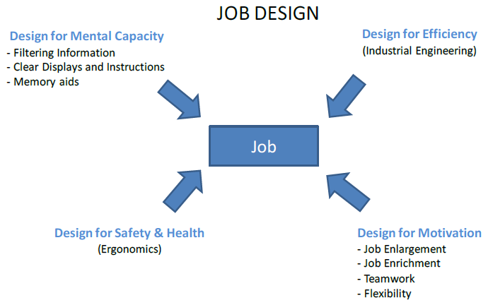
Job Design

Slide 49
Job Rotation
Job rotation refers to moving employees from job to job to add variety and reduce boredom by allowing them to perform a variety of tasks. As traditionally used, job rotation is low in both impact and complexity because it typically moves employees from one routine job to another.

Slide 50
Job Engineering
A cornerstone of job engineering is specialization of labor with the goal of achieving greater efficiency. High levels of specialization are intended to
(1) allow employees to learn a task rapidly
(2) permit short work cycles so that performance can be almost automatic and involve little or no mental effort,
(3) make hiring easier because low skilled people can be easily trained and paid relatively low wages, and
(4) reduce the need for supervision, owing to simplified jobs and standardization

Slide 51
Job Enlargement
Job enlargement is expansion of the number of different tasks performed by an employee in a single job.
Job enlargement attempts to add somewhat similar tasks to the job so that it will have more variety and be more interesting.
Job enlargement is also viewed as an extension of job engineering.

Slide 52
Job Sharing
Job sharing is a type of flexible work arrangement in which two people work part-time schedules to complete the work one person would do in a single full-time job.
Job sharing can be appealing for workers who are looking to reduce their hours to provide care for someone at home, or who are simply looking for a lighter workload without quitting altogether.
Job sharing can also decrease benefits costs for employers, depending on their benefits policies

Slide 53
Job Enrichment
Job enrichment refers to the empowerment of employees to assume more responsibility and accountability for planning, organizing, performing, controlling, and evaluating their own work.
Five job characteristics hold the key to job enrichment efforts
Skill variety—the extent to which a job requires a variety of employee competencies to carry out the work.

Slide 54
Job Enrichment
Task identity—the extent to which a job requires an employee to complete a whole and identifiable piece of work.
Task significance—the extent to which an employee perceives the job as having a substantial impact on the lives of other people, whether those people are within or outside the organization.

Slide 55
Job Enrichment
Autonomy—the extent to which the job provides empowerment and discretion to an employee in scheduling tasks and in determining procedures to be used in carrying out those tasks.
Job feedback—the extent to which carrying out job-related tasks provides direct and clear information about the effectiveness of an employee’s performance.

Slide 56
Question # 4
Which of the following is the BEST example of an essential job function for a senior shipping specialist in an operations department?
a) Supervise shipping staff to ensure that procedures are followed.
b) Oversee the use of the company van when needed.
c) Accompany HR personnel at local recruiting fairs.
d) Encourage shipping staff to participate in company-sponsored retirement planning.

Slide 57
Answer # 4
Option A
Job analysis is a crucial step in validating all major personnel activities in accordance with Equal Employment Opportunity Commission (EEOC). In evaluating the validity of essential job functions, the EEOC notes that case by case determinations are made. While percentages of time may be helpful as a starting point for HR to assess whether a function is essential, it is ordinarily recommended that the percentages not be included in the job description itself

Slide 58
Job Analysis
Methods of Job Analysis
Human Resource Planning
Job Design
Staffing Plan
Contingent Staffing
Diversity and Inclusion
Employment Contract

Slide 59
Human Resource Planning
Workforce planning (also called Human Resource Planning, HRP) has traditionally been used by organizations to ensure that the right person is in the right job at the right time
Human Resource Planning focuses on analyzing an organization’s HR needs as the organization’s conditions change, and then supplying strategies to help respond proactively to those changes over time.

Slide 60
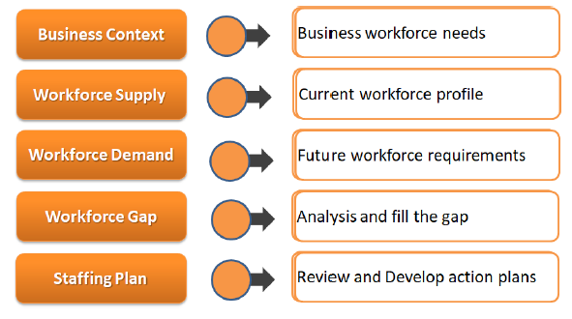
Workforce planning

Slide 61
Workforce Planning
Workforce planning is the process of identifying and analysing the organization’s need for human capital to allow for the achievement of the organization’s goals. This process includes the following actions:
Forecasting the future composition of the workforce
Identifying any gaps between the current and future staff
Deciding how to close those gaps
Determining how to meet the staffing needs

Slide 62
Workforce Planning
Quantity Of Talent
Demand
Gap
12 X
Supply
10 X
Time

Slide 63
Workforce Planning
How to fill the Gap
Hire
Develop
Outsource
Design
Organisation must have
Capability to do the work
Capacity – enough people
Cost – within a budget
Construct – internal vs external

Slide 64

Talent Strategy

Slide 65
Benefits of Workforce Planning
Organizations should conduct a regular and detailed workforce planning assessment. The goal is to create the best staffed and trained workforce that can respond to the needs of the organization.
Effective workforce planning offers the following benefits to an organization:
Easily accessing employee data to locate talent anywhere in the organization
Finding the best use for each employee
Recruiting passive job candidates

Slide 66
Equating Workforce Demand to Supply
Demand Equals Supply - The company can simply continue doing what it is doing; nothing else is required, at least in the short run.
Demand Is Less Than Supply - Large organizations down-size, restructure, right-size, and streamline to cut costs, increase efficiency, improve productivity, and remain competitive. Methods used are restricted hiring, reduced working hours, job sharing, early retirement, retraining, and layoffs.

Slide 67
Equating Workforce Demand to Supply
Demand Is Greater Than Supply - Creative recruiting (seeking different sourcing), compensation incentive (premium pay, four-day workweeks, flexible working hours, telecommuting, parttime, employment, and child care centers), training programs (special training programs to prepare previously unemployable individuals for positions with a firm), and different selection standards (lowering of employment standards and coupled with training programs).

Slide 68
Job Analysis
Methods of Job Analysis
Human Resource Planning
Job Design
Staffing Plan
Contingent Staffing
Diversity and Inclusion
Employment Contract

Slide 69
Demand Forecast
Demand forecasting is the process of estimating the future quantity and quality of people required. The basis of the forecast must be the annual budget and long-term corporate plan, translated into activity levels for each function and department.

Slide 70
Supply Forecast
Supply forecasting means to make an estimation of supply of human resources taking into consideration the analysis of current human resources inventory and future availability
Gap Analysis - Subtract the projected supply from the projected demand. A negative result indicates the need for a new strategy.

Slide 71
Strategy Identification
Demand-side strategies reduce the number of positions that need to be filled. They include:
Retention: Reduce turnover through retention incentives and employee engagement strategies.
Reorganization: Reduce the number of management positions by expanding supervisory span of control.
Work Process Redesign: Reduce staffing needs by streamlining workflows and methods.
Employee Performance Management: Reduce staffing needs by improving individual productivity.

Slide 72
Supply-side strategies
Supply-side strategies help fill the remaining staffing gap once demand-side strategies have reduced the number of positions that must be filled. They include:
Recruitment: Expand applicant pools through enhanced marketing (e.g., broadening the target recruitment area, increasing advertising venues, and improved branding strategy).
Modified Qualifications: Expand applicant pools by considering a broader range of experience and education.

Slide 73
Supply-side strategies
Workforce Development: Grow future applicant pools by supporting schools and apprenticeship programs.
Training and Development: Keep current staff up-to-date in their knowledge and skills through on-the-job and other training and development programs.
Succession Planning: Grow new internal applicant pools through training and development programs.

Slide 74
Job Analysis
Methods of Job Analysis
Human Resource Planning
Job Design
Staffing Plan
Contingent Staffing
Diversity and Inclusion
Employment Contract

Slide 75
Contingent Staffing
Contingent staffing also referred to as alternative staffing, also called flexible staffing, it uses alternative recruiting sources and workers who are not regular employees. Many staffing approaches are possible other than conventional full-time arrangements where the organization directly hires, supervises, and provides compensation and benefits to regular employees.

Slide 76

Contingent Staffing

Slide 77
Professional employer organization (PEO)
A professional employer organization (PEO) is an organization that enters into a joint-employment relationship with an employer by leasing employees to the employer, thereby allowing the PEO to share and manage many employee-related responsibilities and liabilities. This allows employers to outsource their human resource functions, such as employee benefits, compensation and payroll administration, workers' compensation, and employment taxes.

Slide 78
Job Analysis
Methods of Job Analysis
Human Resource Planning
Job Design
Staffing Plan
Contingent Staffing
Diversity and Inclusion
Employment Contract

Slide 79
Diversity and Inclusion
Diversity means all the ways we differ. Some of these differences we are born with and cannot change. Anything that makes us unique is part of this definition of diversity.
Inclusion involves bringing together and harnessing these diverse forces and resources, in a way that is beneficial. Inclusion puts the concept and practice of diversity into action by creating an environment of involvement, respect, and connection.

Slide 80
Inventory of Action
Incorporate diversity principles across business functions and units.
Create opportunities for cross-generational work teams and interactions.
Appointing a Chief Diversity Officer
Setting up diverse candidate slates,
Implementing flexible working policies

Slide 81
Job Analysis
Methods of Job Analysis
Human Resource Planning
Job Design
Staffing Plan
Contingent Staffing
Diversity and Inclusion
Employment Contract

Slide 82
Employment Contract
An employment contract can be verbal, written or both to be valid. The agreement can be either explicit or implied. With an implied contract there may be no formal agreement in writing that an employee signs, but an employer’s promises can be binding all the same. An explicit employment contract details the employee’s job duties, compensation and number of work hours in writing. Implicit contracts imply expectations on the part of both employers and employees

Slide 83
Implied Agreement
Implied employment contracts come about when an employer discusses details relating to job duties, compensation, benefits and termination of employment with an interviewee or current employee.
Employers must always make it clear verbally and in writing that the employer/employee relationship is at will, which means that either the employer or employee can terminate employment at any time.

Slide 84
Written Agreement
The employer state that benefits that could change at any point, although the employee will be advised of a change before it occurs.
To protect against misunderstandings, an employer often will ask employees to sign a document agreeing to at-will employment rather than sign an employment contract.

Slide 85
Job offer
A job offer letter is an informal employment contract used in private sector employment. The job offer letter usually spells out just the basics of compensation and benefits, paid time off, job title, and reporting relationships.

Slide 86
Employment Contract Elements
Define the Position
Length of Agreement
Performance
Compensation
Benefits
Termination
Other Elements

Slide 87
Questions

