Slide 1
Functionalities, Managing Data Source & Creating Dynamic Visualization
By Nilesh Ohol

Slide 2
A glance at the previous session:
Visually describing the behaviour of the data is called Data Visualization.
Tableau allows for instantaneous insight by transforming data into interactive visualizations called dashboards.
To predict what is likely to happen by looking at the trends is called Forecasting.
Lines, Scatter plots are used to plot data points.
Dashboard is a combination of multiple sheets and textual information.

Slide 3

Contents
Joins and its types.
Grouping and Blending.
Dashboards.
Story.

Slide 4
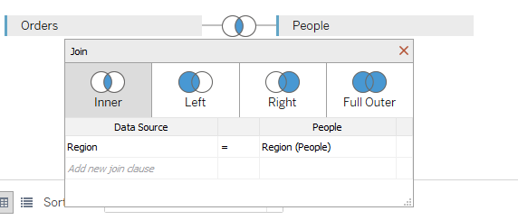
Joins
It is often necessary to combine data from multiple places—different tables or even data sources—to perform a desired analysis. Depending on the structure of the data and the needs of the analysis, there are several ways to combine the tables.

Slide 5
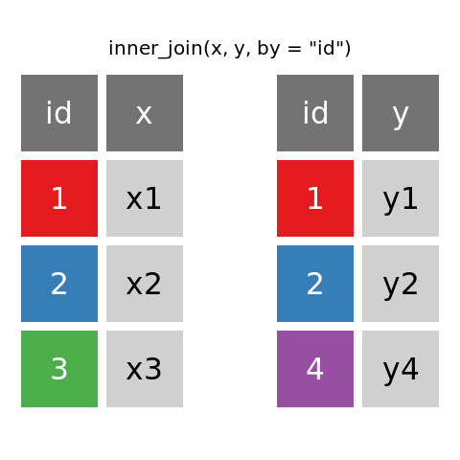
Inner Joins
Image Source:
warin.ca

Slide 6
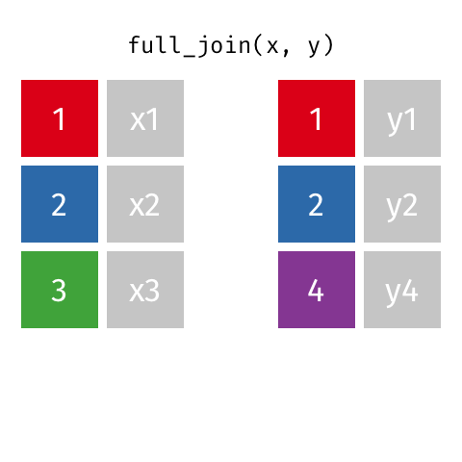
Outer Joins
Image Source:
tidyexpalin

Slide 7
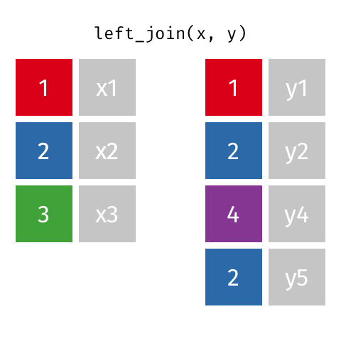
Left Joins
Image Source:
tidyexpalin

Slide 8
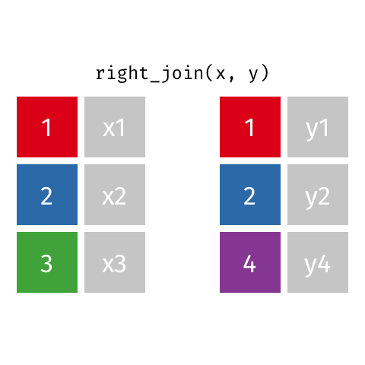
Right Joins
Image Source:
Self Service BI Blogs

Slide 9

Let’s dive in into the implementation,

Slide 10
Groups:
You can create a group to combine related members in a field.
For example,
if you are working with a view that shows average test scores by major, you might want to group certain majors together to create major categories. English and History might be combined into a group called Liberal Arts Majors, while Biology and Physics might be grouped as Science Majors

Slide 11
Let’s dive in into the implementation,

Slide 12
Data Blend:
Data blending is a method for combining data from multiple sources. Data blending brings in additional information from a secondary data source and displays it with data from the primary data source directly in the view.

Slide 13
Let’s dive in into the implementation,

Slide 14
Dashboards:
A dashboard is a collection of several views, letting you compare a variety of data simultaneously. For example, if you have a set of views that you review every day, you can create a dashboard that displays all the views at once, rather than navigate to separate worksheets.

Slide 15
Let’s dive in into the implementation,

Slide 16
Story:
In Tableau, a story is a sequence of visualizations that work together to convey information. You can create stories to tell a data narrative, provide context, demonstrate how decisions relate to outcomes, or to simply make a compelling case.

Slide 17
Let’s dive in into the implementation,

Slide 18
Quiz
What is a Calculated Field?
Where do we use Clustering and Bar Graphs?
What are different types of joins?
Difference between groups and blending.
What is a Dashboard?
What is Story?

Slide 19

nilesh.ohol
Thank You!
Nilesh Ohol

