Slide 1
Overview and Functionalities of Tableau
By Nilesh Ohol

Slide 2

Contents
What so we mean by Data visualization? Why is it so important?.
What is Tableau?
Features of Tableau
  Calculation Field.
  Parameters.
  Filters.
Forecasting, Lines, Clustering and Dashboards.

Slide 3
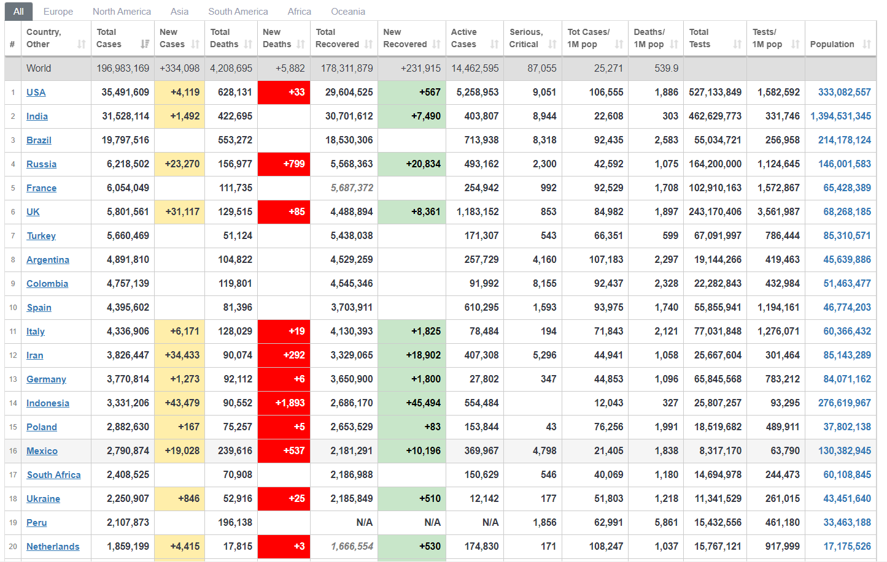
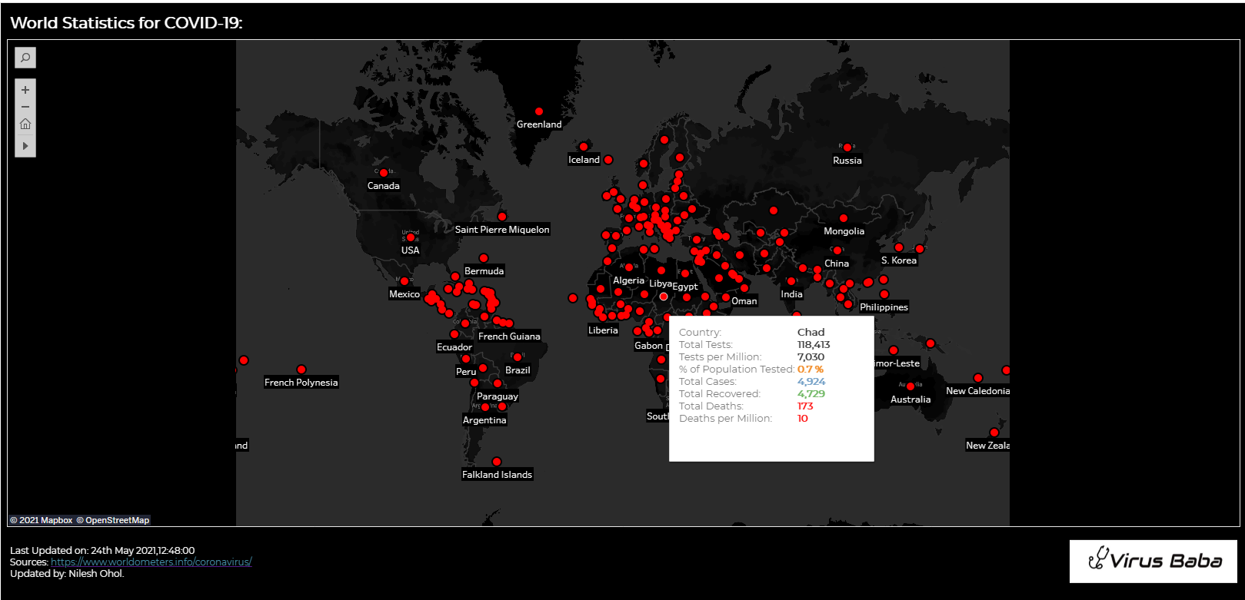
What so we mean by Data visualization? Why is it so important?.
Visually describing the behaviour of the data.
Image Source: Worldometer.com

Slide 4

What is Tableau?
Tableau is ground-breaking data visualization software created by Tableau Software.
Tableau connects easily to nearly any data source
Tableau allows for instantaneous insight by transforming data into interactive visualizations called dashboards.

Slide 5
Let’s Download and Install
.
.
Download Link: https://public.tableau.com/en-us/s/download
And
Create an Account on Tableau Public

Slide 6
Features of Tableau:
  Calculation Field:
  Calculated fields allow you to create new data from data that already exists in your data source.
  Parameters:
  A parameter will allow you to provide a value to pass into Tableau.
  Filters:
  Tableau provides the ability to filter individual views or even
  entire data sources on dimensions, measures, or sets.

Slide 7
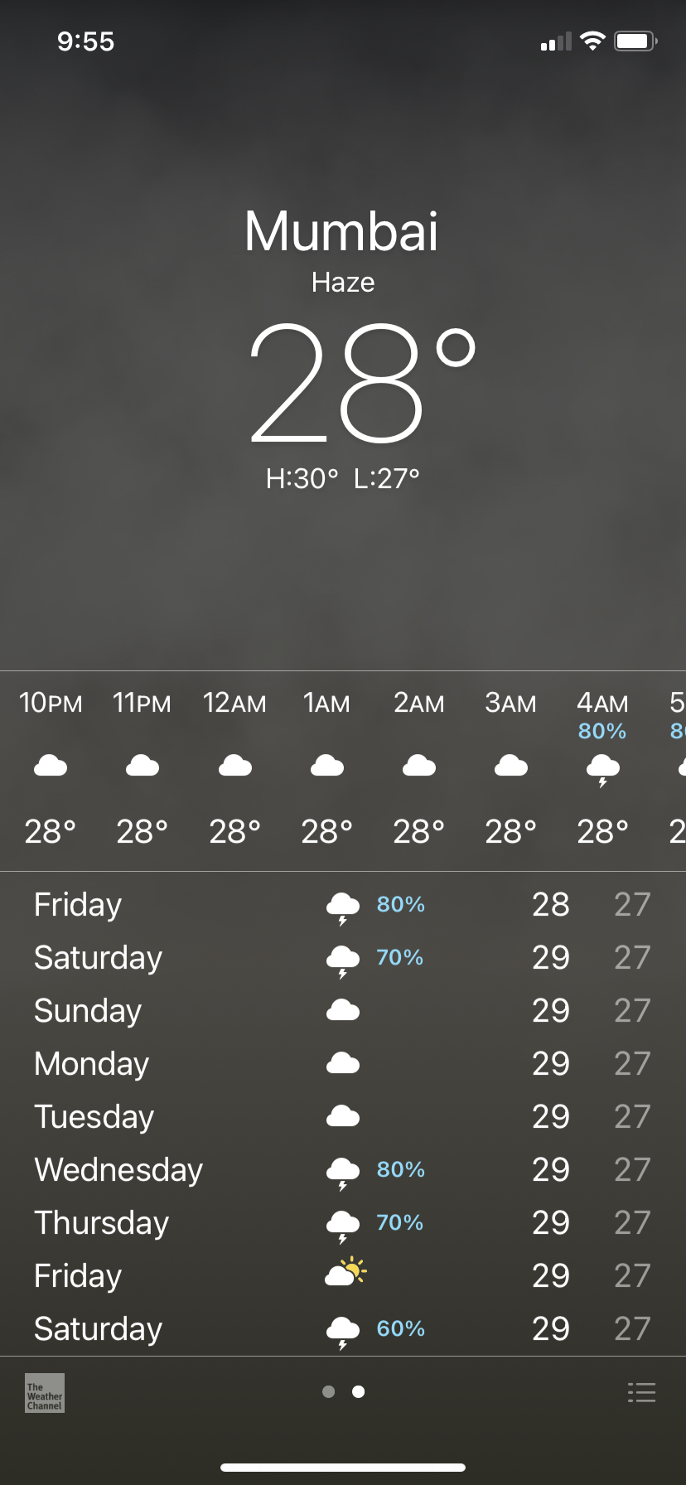
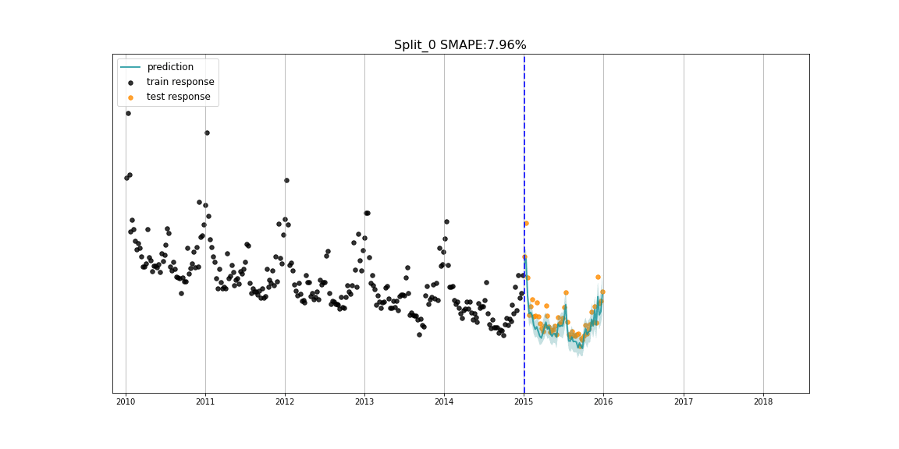
Forecasting
To predict what is likely to happen by looking at the trends
Image Source:
Uber Engineering Blog

Slide 8
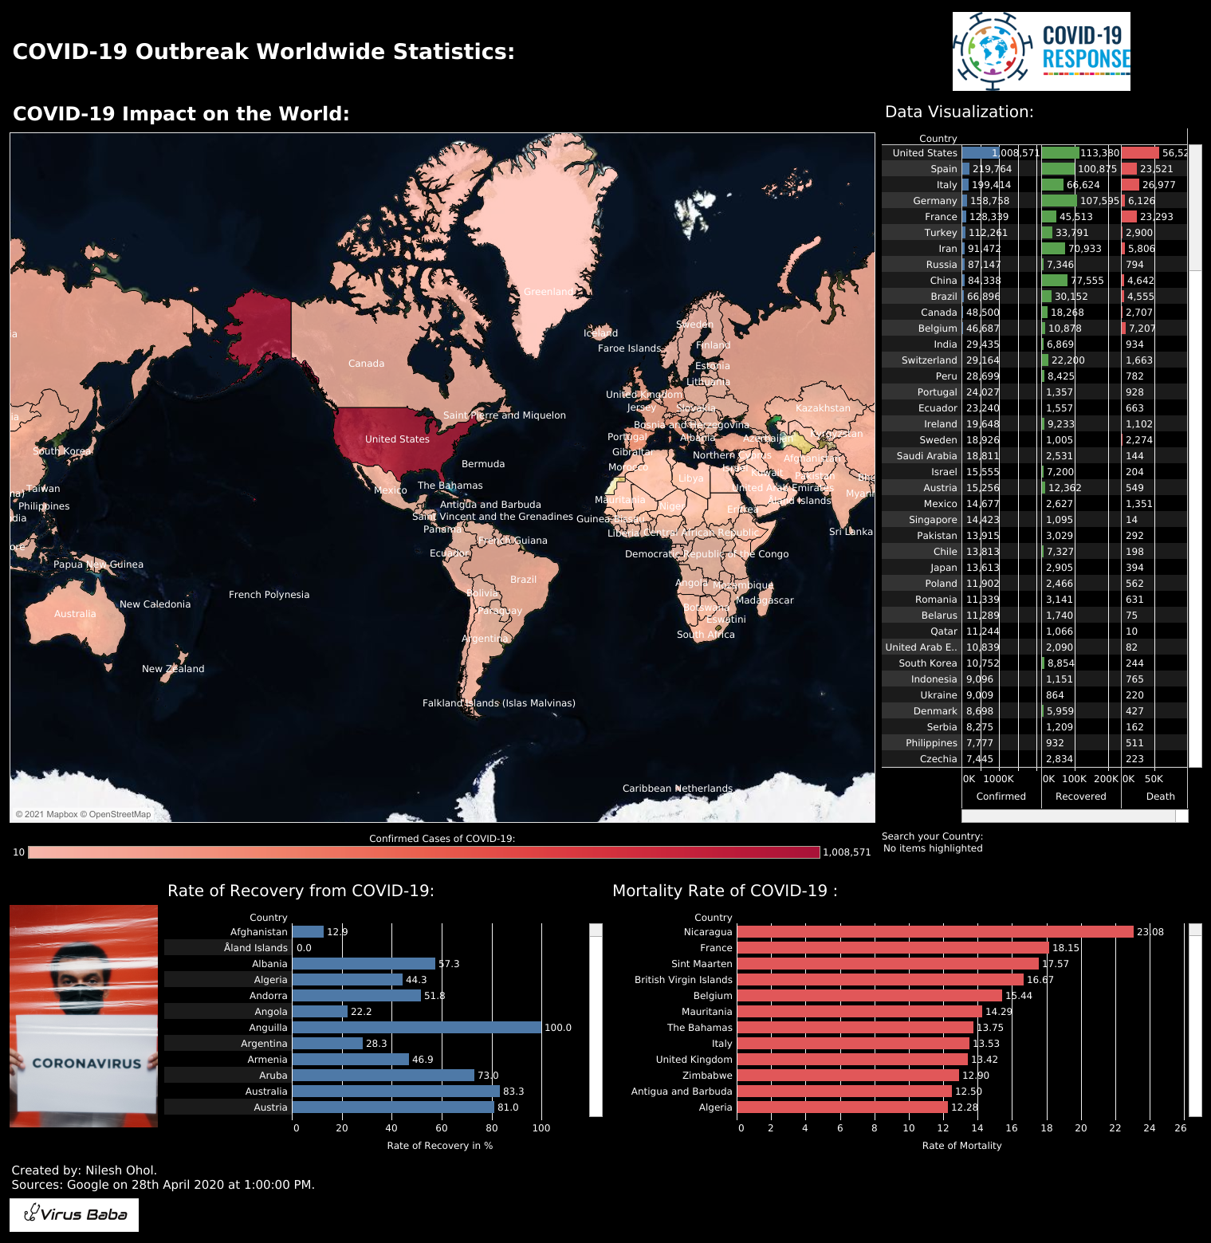
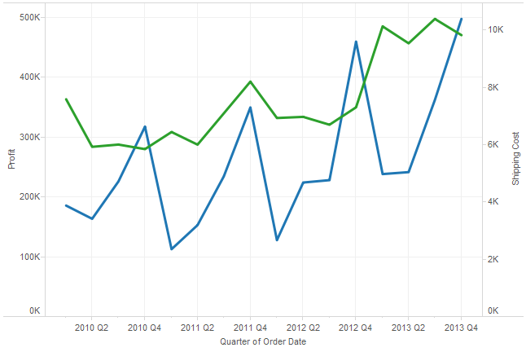
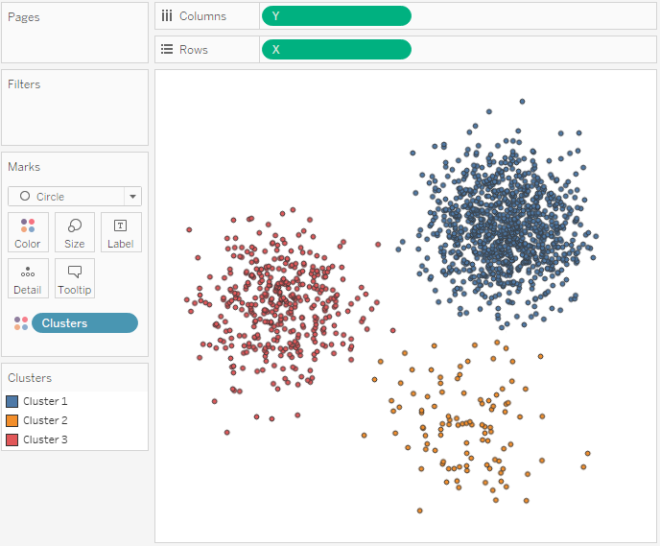
Line, Clusters and Dashboard

Slide 9
Thank You!

