Slide 1
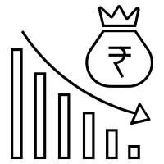
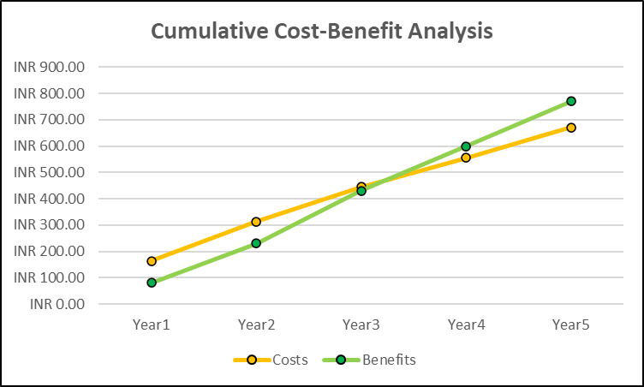
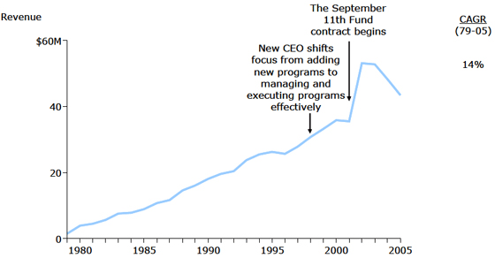
Pricing Analytics and Revenue Management (RM) in Supply Chain
Trilok Prakash Nanda
LinkedIn: https://www.linkedin.com/in/triloknanda/
Email: triloknanda@outlook.com
This Photo by Unknown Author is licensed under CC BY

Slide 2
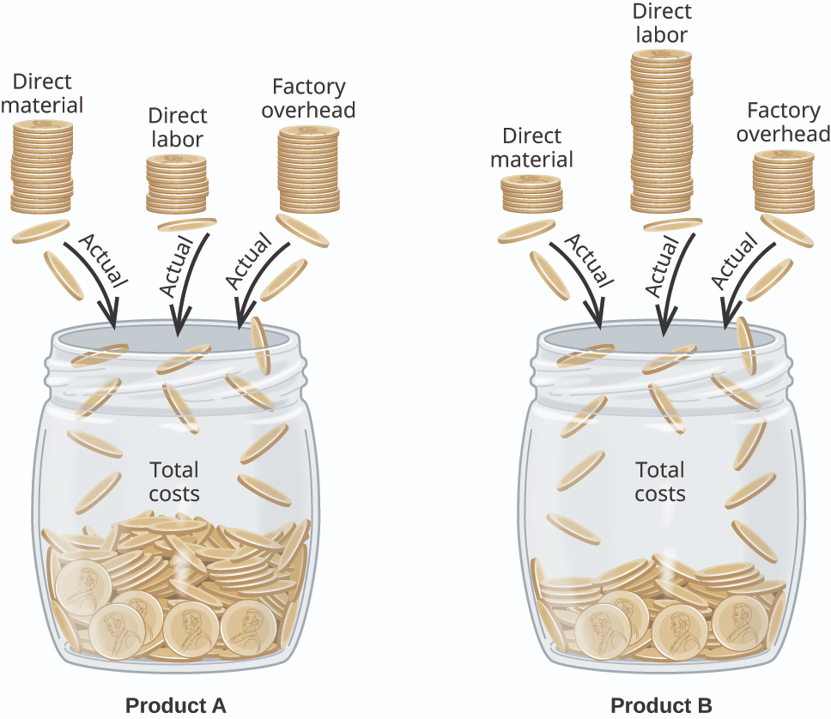
Product Pricing
Overview & Importance of Pricing Analytics and Revenue Management
Product Pricing
  Types of Costs
  Product Pricing Strategies (with Use Case Examples)
    Perceived vs Actual Price
    Variable Pricing
    Algorithmic Pricing
    Yield Management
    Cognitive Bias
    Storytelling
    Price Skimming
    Every Day Low Pricing (EDLP)
    Pricing related Metrics
  Exercise

Slide 3
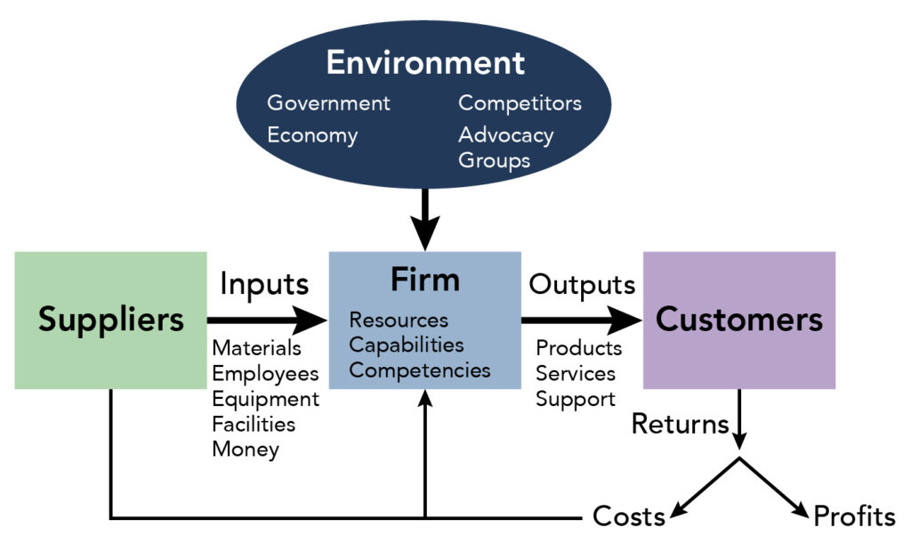
Revenue Management
Revenue Management
  Key Components
    Customer Segmentation (STP Model)
    Product Pricing
    Demand Forecast
    Product Market Fit
    Revenue Lifecycle Management
  Case Study (Airlines Industry, Jewellery Industry)
This Photo by Unknown Author is licensed under CC BY

Slide 4
Overview & Importance of Pricing Analytics and RM
Pricing Analysis is the process by which a firm decides how much to charge customers for its goods and services.
All pricing decisions should be made with the objective of increasing firm profits.
This requires an understanding of the cost structure of performing a supply chain activity and the value this activity brings to the supply chain.
The primary aim of Revenue Management is to sell the right product to the right customer at the right time for the right price.
Revenue Management can be defined as the application of differential pricing on the basis of:
Customer segment,
Time of use and
Product or capacity availability to increment supply chain surplus
Revenue Management comprises Marketing, Finance, and Operation functions to maximize the net profit earned.

Slide 5
Product Pricing Analytics
Identify potential Customers:
  Who is your target Audience ?
  What is your Problem Statement? How is your Product a Solution to the Problem?
What is your Unique Selling Point?
  What is the Actual Value of the Product vs Perceived Value?
Identify Costs:
  What are the the costs involved with bringing your product to market ?
    Cost of Goods Sold (COGS) . It is neither an Asset nor a Liability. It is an Expense.
    [Materials, Labour, Packaging, Promotional Materials, Shipping, Taxes, Goods Recovery]
    Sunk costs like Manufacturing Plant, Warehouse, Manpower, Admin, Transport
    Fixed costs like Rent, Raw Materials
    Short-term costs like loan repayments
    Time to Market [Production time, Effort required]
    How much money do you need to support your Business?

Slide 6
Types of Product Costs
Type | Description
Direct & Variable | Costs directly traceable to Product. Total cost changes in proportion to change in total output. E.g. Direct material costs like sheet metal in preparation of automobile parts
Direct & Fixed | Costs directly traceable to Product. Total cost does not change in proportion to change in total output. E.g. Salary of Shop-floor manager in Manufacturing plant.
Indirect & Variable | Costs not directly traceable related to Product. Total cost changes in proportion to change in total output. E.g. Cost of Power consumption at Manufacturing plant
Indirect & Fixed | Costs not directly traceable related to Product. Total cost does not change in proportion to change in total output. E.g. Annual License Fee
All Direct Cost + All Indirect Costs = Total Costs
All Variable costs + All Fixed Costs = Total Costs

Slide 7
Direct Cost, Variable Cost, Fixed Cost, Indirect Cost
Costs | Fixed Costs | Variable Costs | Total
Direct Costs | Rent of Production factory Security charges of Production department Plant Utilities - Fixed charges Crew salaries Salaries of Bus drivers for a Tour operator company | Direct material Direct Labor Direct Supervision Electricity consumption charges of manufacturing unit Food served on a plane Fuel used by a Taxi company Construction workers daily wages Hourly teaching rate of visiting faculty | Fixed Direct costs + Variable Direct Costs = Total Direct Costs
Indirect Costs | Direct material Rent of Admin office Salaries of finance staff Staff medical insurance cost Utilities fixed charges of administration Annual license fee | Indirect material Indirect labor and supervision Sales commission Additional packaging cost Utilities variable charges of administration Income tax | Fixed Indirect costs + Variable Indirect Costs = Total Indirect Costs
Total | Total Fixed Costs | Total Variable Costs | Total Costs

Slide 8
Cost-Based Pricing Strategy
Pricing Technique | Formula/ Description | Remarks
Cost-plus Pricing | Total Cost per Unit = Fixed Cost + Variable Cost Selling Price = Total Cost per Unit + Profit | SP = INR 10 + 10% of INR 10 = INR 11 [Profit = 10%]
Markup Pricing | Markup Price = Total Cost per Unit (1-desired Markup) | MP = 10 = 11 [Markup = 9.09%] (1-0.0909)
Incremental Cost Pricing (Marginal Cost Pricing) | Selling Price = Variable Cost + Profit Margin | Good for Large Firms, Intense Market Competitions, Large product portfolio
Break-even Pricing | BEP => No Profit and No Loss Selling Price = Fixed Cost + Variable Cost per Unit | Economies of scale. Good for new entrant and reducing competition. E.g.: Reliance Jio
Demand based Pricing
Demand based Pricing | How much can a Customer afford to pay for product? | Good for short-term only
Skimming based Pricing | Product Price goes from High to Low | Good for short-term gains of a unique product. E.g.: Nokia Mobile phones
Penetration based Pricing | Product Price goes from Low to High | Increase market penetration for new entrants with common products

Slide 9
Cost-Volume-Profit (CVP) Analysis
Break-Even Point (BEP) | Margin of Safety (MoS)
BEP = Amount of Sales that covers entire Fixed and Variable costs. Sales < BEP => Losses, Sales > BEP => Profit after considering all the costs. | The Margin of Safety is the margin between the actual/budgeted sales and the breakeven point. It denotes the level of safety that the company enjoys before incurring losses (i.e., falling below the break-even level).
Measure of Sustenance. | Measure of Risk.
The lower the break-even quantity, the better it is for the companies. | The higher the margin of safety, the better it is for the company.
Indicates how any change in Selling Price would impact the Profitability and BEP | Provides freedom to the company’s management to alter the selling price of their product to gain market share from its competitors.
One of the indicators that help decide whether to manufacture a new product yourself or outsource. | Higher MoS allows the company to spend more on advertising or other activities to help improve sales in the long run.
Appropriate to analyse a single product at a time; Fails in the case of a multi-product scenario. Many times it isn’t easy to classify a cost as fixed or variable. | If MoS is too high, it can lead to higher risk-taking and inappropriate use of excess funds.

Slide 10
Break-Even Chart
What volume of sales/activity can achieve a break-even point for a business?
How to construct a break-even chart:
First, plot sales on the X-axis. You can also plot production in units on the same axis.
On the Y-axis, plot Costs and Revenue.
After that, plot a Fixed Cost line running parallel on the X-axis.
The variable cost line should originate from the point on the Y-axis.
Lastly, draw the Sales line, which should start from the zero point. It should finish at the point of the maximum scale.
Angle of incidence:
Angle of Incidence is the angle created when Total Sales line and Total Costs line intersect.
This angle suggests that the rate at which the company is making profits.
The higher the angle, the more the profit and vice versa. A large angle of incidence means the company is making profits at a higher rate. Similarly, a small angle suggests the profit is being earned at a lower rate.
This angle originates from the BEP. It represents the whole area between the two lines. The larger the area, the bigger the profit that a company is making, and the more cushion the company has in times of distress.

Slide 11
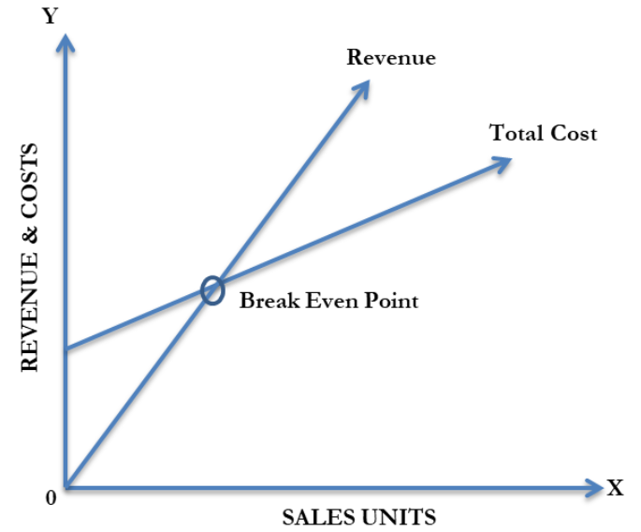
Break-Even Chart
Notes:
Give Excel file example

Slide 12
Notes:
Give Excel file example

Slide 13
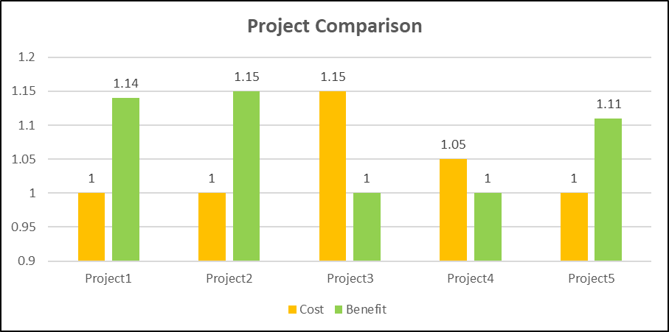
Notes:
Give Excel file example

Slide 14
Margin of Safety
Terms | Formula
Contribution | Total Sales – Total Variable Cost
Contribution per Unit | (Total Sales – Total Variable Cost) Number of units sold
PV/Contribution Ratio | Contribution*100 Total Sales
BEP Units | Fixed Cost Contribution per Unit
BEP Sales | Fixed cost Contribution Ratio
Margin of Safety | Total Sales – BEP Sales
Margin of Safety Ratio | (Total Sales – BEP Sales) * 100 Total Sales
A change in per unit Selling Price or Variable Cost will cause a change in Contribution and will eventually cause a change in Profit/Volume(PV) Ratio, BEP, and Margin of Safety.

Slide 15
Target Profit Pricing Strategy
Contribution Margin Method: Computing sales volume and sales revenues by achieving the target profits.
Total Sales Volume (Units) = (Target Profits + Total Fixed Costs )/ Contribution Margin Per Unit
Total Sales Revenue = Total Sales Volume * Selling Price Per Unit
Total Profit = Total Sales Volume * Contribution Margin Per Unit
Contribution Margin Per Unit = Selling Price Per Unit – Variable Cost Per Unit
Equation (or Contribution Margin) Method: Computing sales figures by satisfying target profits.
Selling Price Per Unit * Total Sales Volume = Variable Cost Per Unit * Total Sales Volume + Total Fixed Costs + Target Profits
Total Sales Revenue = Total Sales Volume * Selling Price Per Unit

Slide 16
Target Profit Pricing Exercise
Details are as follows:-
Selling Price Per Unit: INR 100
Variable Cost Per Unit: INR 25
Total Fixed Cost: INR 2000
Target Profits: INR 6000
Compute Sales Revenue and Volume by Contribution Margin Method and Equation Method.
Notes:
Contribution method: Sales Revenue = 10,000, Sales Volume = 100
Equation Method: Sales Revenue = 10,000, Sales Volume = 100

Slide 17
Pricing Techniques and Methods
Competitor Based Pricing
Pricing Technique | Formula/ Description | Remarks
Parity Pricing | Product Price matches or close to Competitor’s Product Price
Discount Pricing | Product Price is less than Competitor’s Product Price
Premium Pricing | Product Price is higher than Competitor’s Product Price | Cognitive Bias. Psychological pricing.
Tender Pricing | Price matches Tender price | Government or Public Sector Tenders

Slide 18
Pricing Techniques and Methods
Others
Pricing Technique | Formula/ Description | Remarks
Value Based Pricing | Value > Price > Cost | Good overall strategy
 | Price > Value > Cost | Bad in long term
 | Price > Cost > Value | Bad in short and long terms
 | Price = Value > Cost | Good overall strategy
Affordability based Pricing | Each customer segment can afford the product
Prestige based Pricing | High markup E.g.: Luxury goods, vehicles, Brands | Potentially bad in long term
Cycle based Pricing | Relevant to rarity of product in market at particular times or seasons. Related to Yield management. | E.g.: Sand, Drinking Water, Food products, Warm clothes, Hotel bookings, etc.

Slide 19
Cost Vs. Value-based Pricing
Cost-Based Pricing
Product
Cost
Price
Value
Customers
Value-Based Pricing
1. Estimation of Customer Perceived Value
2. Decide Price Range based on Customer Feedback
3. Check how much Customer actually values Product
4. Decide Price for differentiated features of Product

Slide 20
Cost Vs. Value-based Pricing
Cost-based Pricing | Value-based Pricing
Price is determined mainly based on the cost incurred for production and other tangible overheads | Price decided is irrelevant to the cost incurred
Tangible parameters. Cost incurred is real. | Intangible parameters such as customer’s perception
Less expensive Selling Price | Priced at premium depending on Product’s value
Does not have a price range for same product | Bigger range of prices for products
Less profit margin | High profit margin
Housing industry follows the Hedonic Pricing Model (Sherwin Rosen- “Hedonic Prices and Implicit Markets.”, 1974)
Notes:
https://www.nber.org/system/files/working_papers/w17611/w17611.pdf
Hedonic Prices and Implicit Markets: Product Differentiation in Pure Competition Author(s): Sherwin Rosen Source: The Journal of Political Economy, Vol. 82, No. 1 (Jan. - Feb., 1974), pp. 34-55 Published by: The University of Chicago Press

Slide 21
Value-based Pricing
The product should be focused on a particular segment and not deviate from the main and only element. Customer perceived value is estimated in this step.
The price of the nearest competitor’s products in the same segment is taken to decide the range of fixed costs. Then, based on feedback from customers, the price range of the product is determined.
See the product’s value from a customer’s perspective and point out differentiated features in the product to be priced. Check how much the customer values the output.
Decide a price for this differentiated product feature and price the product collectively by adding a competitor’s price and extra feature price.

Slide 22
Value-based Pricing
Good Value Pricing | Value-Added Pricing
Product is priced as per the quality of the product and service provided to the customers concerning the product. | Product/service is priced as per the value-added products
Pricing depends mainly on the quality and service associated with the product. | Customer’s perception of value of particular feature of Product decides Price of Product.

Slide 23
Product Pricing Strategies (continued)
    Perceived vs Actual Value
    Variable Pricing
    Yield Management
    Algorithmic Pricing
    Fixed Pricing Range
    Bundle Pricing
    Every Day Low Pricing (EDLP)
    Storytelling
    Cognitive Bias
    Product Market Fit
    Price Skimming
    Pricing related Metrics

Slide 24
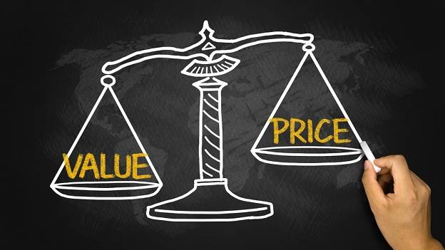
Value Comparison
Greek philosophers such as Xenophon (427-355 BC) and Aristotle (384-322 BC) dwelt upon what determines the value of a good.
Adam Smith (1723-1790), often regarded as the founding father of Economics, examined the same question in the context of the Water-Diamond Paradox in which the value of a good is determined by its relative scarcity.
This Photo by Unknown Author is licensed under CC BY-SA-NC

Slide 25
Perceived Value Vs Actual Value - Exercise
A Company launches a new product P1.
Out of 100 target customers,
10 customers signed up on the spot;
20 customers thought that P1 “sounds cool”;
20 customers signed up in response to Company website or email;
3 months later, 30 customers are using P1 more frequently;
35 customers who signed up told their family or friends about P1;
Recently there was a service outage. 30 customers complained.
Does product P1 have higher Perceived value or Actual value?

Slide 26
Perceived Value Vs Actual Value
Value Type | Value Identifier | Minimum %
Perceived Value | When you describe your service or product to your target audience, what percent are ready to buy / sign up on the spot? | 25%
 | When you describe your service or product to your target audience, how do they describe it? Is it “interesting”, “sounds cool”, or “OMG I need this now!” | High/Low
 | Put up a sign-up page on your website or email people and ask them to buy or sign-up. What % sign up for it? | High/Low
Actual Value | Of the people who are currently using your product and are not friends or family members, what percent would definitely tell friends about it? (Example: Net Promoter Score) | 30%
 | Of people using your product, what % of them are using it more frequently now than previously 3 months ago? | High/Low
 | If your service has ever stopped working, what % of your users complained? | High/Low

Slide 27
Value Comparison
Brand/Commodity | Perceived Value | Actual Value (Cost/Benefit) | Sales Margin | Sales Volume
Luxury Motorcycle | High | Medium | High | Low
Economy Motorcycle | Low/ Medium | High | Low | High
Luxury Watch | High | Medium/Low | High | Low
Economy Watch | Medium | High | Medium/Low | High
Diamonds | High | Medium/Low | High | Low
Gold | Medium | High | Medium/Low | High
Silver | Low | High | Low | High
Drinking Water | Low | High | High | High
Potatoes | Low | High | Low | High
Avocado | High | Medium | High | Low
Notes:
Prestige/Premium/

Slide 28
Variable Pricing
This is Data driven Product Pricing. It is the basis of Revenue Management, Dynamic Pricing, and Yield Management. For Example:
1. Price Discrimination: (Target both Price Sensitive and Price Insensitive Customers)
A mobile phone company sells same phone at two different prices. Phone model in unpopular colour is sold at lower price. Price Sensitive Customer will buy phone at lower cost irrespective of colour. Price Insensitive Customer will buy phone of preferred colour irrespective of Price.
2. Inventory Levels:
Clear Inventory Level: Product is Outdated. Product Price is lowered to accelerate Sales and to clear Inventory.
    Extend Inventory Level: Product is selling fast and company will soon go out of stock. Related to Rarity of Product. E.g.: Luxury Goods, Commodities.
3. Competition:
Reduce Product Price to compete against Market Competitor who threatens your Market Position.
4. Dynamic Pricing:
This variable pricing occurs in real-time based on algorithms and inventory levels. E.g. Taxi fare is sporadically costlier at certain times of day and on certain days based on demand.

Slide 29
Variable Pricing
5. Peak Pricing:
Toll is costlier to use Infrastructure with fixed capacity (e.g. Roads) during peak hours.
6. Sustainability Pricing:
Vehicle registration and Licence fees are higher for those that produce more pollution (bigger IC Engines).
7. Price Forecasting:
Set prices based on Demand & Supply Forecast. Cinema Hall Movie tickets are cheaper on Monday morning and more expensive on weekends and public holidays.
8. Yield Management
Fixed amount of resources available for sale.
Resources sold are perishable (there is a time limit to selling the resources, after which they have no value).
Market segmentation
Product is sold prior to use.
Fluctuating demand.
Strictly limited possibilities of capacity adjustment - Available capacities cannot be increased or reduced without major difficulties.
E.g. : Hotel, Airlines, Car Rental, Railways, Insurance, Telecom, Online Media (Ads, Viewers)

Slide 30
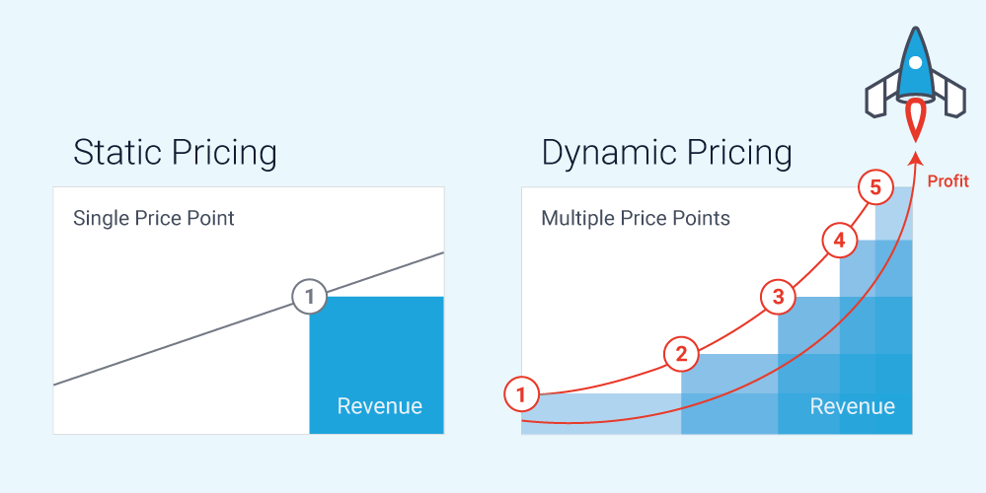
Static Vs Dynamic Pricing
This Photo by Unknown Author is licensed under CC BY-SA

Slide 31
Dynamic Pricing
Pricing Type | Improvements using AI
Segmented Pricing Set different prices for the same product based on customer data (e.g., age, job, location, purchasing channel, willingness to pay) | Customer behavior: Data about search queries, purchase habits, preferred items and categories of products/services, customers’ comments and reviews of certain products, etc. Leverage natural language processing for sentiment analysis to understand the general market behavior towards certain products, services, or specific features. Target customers with coupons, promotions, and ads in a data-driven manner.
Time-based Pricing Price of a product/service according to a specific time of the month, year, or season. | Historical data: Predict which products will be in demand soon and set prices accordingly. This is especially useful for time-based and peak pricing.
Peak Pricing Determine the price according to high demand times. Leverage data about competitors, inventory &/or availability

Slide 32
Dynamic Pricing
Pricing Type | Improvements using AI
Penetration Pricing | Market trends: Data about market trends can be collected via web scrapers from news websites, customer reviews, competitor blogs, and annual reports and surveys. Input to recommendations system AI models which can generate suggestions about products to be set out to the market and estimate prices accordingly.
Competitive Pricing
Bulk Pricing Offering a lower price or a discount to customers who wish to buy a product in bulk numbers.

Slide 33
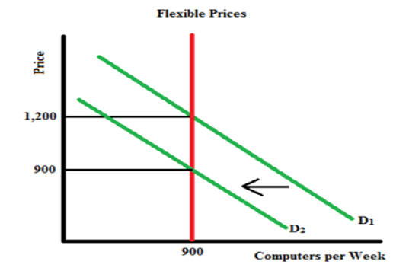
Dynamic Pricing Example
A Firm produces 900 computers/week at a price of $1,200 per computer. The prices are flexible.
Negative Demand Shock => Decrease in Demand. The Demand Curve shifts leftwards.
The graph is as follows:
From the graph it is seen that the Firm can continue to produce 900 computers/week but at a lower price.
This Photo by Unknown Author is licensed under CC BY-SA-NC

Slide 34
Algorithmic Pricing
Algorithmic pricing is the use of algorithms and computer programs to set prices.
Dynamic pricing algorithms leverage historical data about:
  Product prices
  Production costs
  Market trends
  Customers’ purchase behavior
Modern algorithms may also include real-time data about competitors’ prices and stocks collected from online websites using web scrapers or RPA bots.
Supply and Demand, Seasonal, Holiday, Weekend, Time of Day
Algorithm must:
Maximize the profit
Minimize customer churn
Attract competitors’ customers
Improve customers’ experience and maintain loyalty
Price Optimisation Using Decision Tree (Regression Tree) – Machine Learning
https://www.datasciencecentral.com/price-optimisation-using-decision-tree-regression-tree/
Notes:
https://research.aimultiple.com/ - Cem Dilmegani

Slide 35
Dynamic Pricing Algorithms
Bayesian Model | User picks a prior value indicating the initial belief about the possible price. Then, whenever a new data point is entered into the algorithm, the initial belief shifts either higher or lower. Most Bayesian models use historical pricing data as the most important feature to decide on the final price.
Reinforcement learning model (RL) | Goal-directed machine learning model which aims to achieve the highest rewards by learning from environment data. An RL dynamic pricing model explores data about customers’ demand, taking into account seasonality, competitors’ prices, and the uncertainty of the market, with high revenue being the final goal.
Decision tree model | Tree-like model of decisions and their possible consequences, including the possibility of a certain outcome, resource costs, and utility. Helps businesses understand which parameters have the most effect on the prices, and which of these price ranges predicts the highest revenues, and using this information, the algorithm predicts the best price range for each product.
Data Science Central
https://www.datasciencecentral.com/profiles/blogs/reinforcement-learning-for-dynamic-pricing

Slide 36
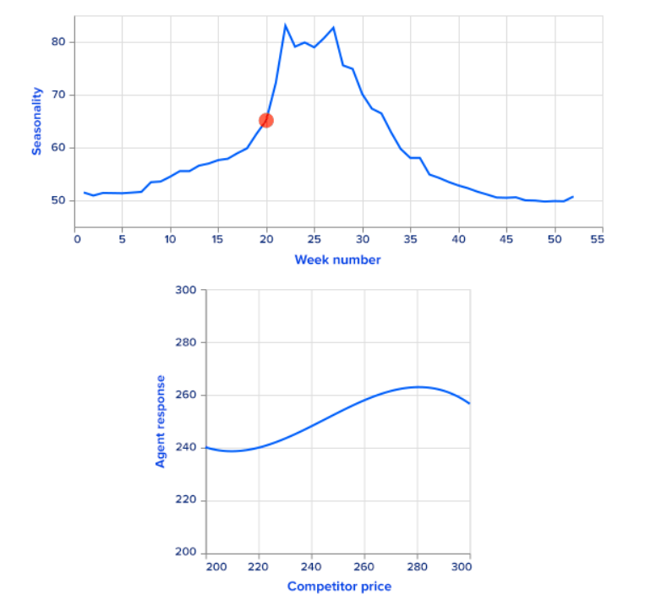
Dynamic Pricing Algorithms
RL Model
Notes:
Data Science Central
https://www.datasciencecentral.com/profiles/blogs/reinforcement-learning-for-dynamic-pricing

Slide 37
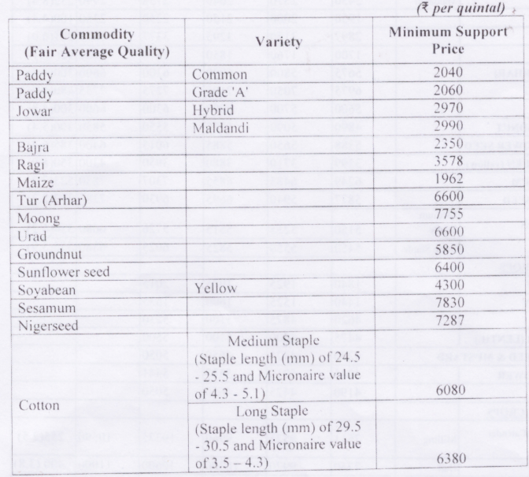
Fixed Pricing Range – Agriculture (India)
Minimum Support Price | Crop cannot be sold lower than this price (recommended by Commission for Agricultural Costs and Prices (CACP))
Ceiling Price | The Government usually determines the maximum price of agricultural products so as to protect the general public from exorbitant rise in prices.
Buffer Stock (Equilibrium pricing) | The agricultural price policy has made provision for buffer stock of food grains for its distribution among the consumers through public distribution system.
As of now, CACP recommends MSPs of 23 commodities:
7 cereals (paddy, wheat, maize, sorghum, pearl millet, barley and ragi),
5 pulses (gram, tur, moong, urad, lentil),
7 oilseeds (groundnut, rapeseed-mustard, soyabean, seasmum, sunflower, safflower, nigerseed)
4 commercial crops (copra, sugarcane, cotton and raw jute).
Notes:
https://www.india.gov.in/minimum-support-price-msp-agricultural-crops
https://agricoop.nic.in/sites/default/files/pssguidelines.pdf
https://en.wikipedia.org/wiki/Commission_for_Agricultural_Costs_and_Prices
https://www.economicsdiscussion.net/agricultural-economics/agricultural-price-policy-in-india/21416

Slide 38
Bundle Pricing
Price bundling is when multiple products or services are grouped together in a single package and sold for a lower price than if the customer were to buy each item individually.
Typically, the bundled products include at least one high ticket item and other complementary products.
Pure Bundling | Leader Bundling | A leader product, or primary product, alongside other non-leader products of lesser value or popularity within the same bundle.
 | Joint Bundling | Offer two items together as a bundle.
 | Mixed-leader Bundling | Same as Leader bundling but also allows the consumer to purchase the leader item individually.
Mixed Bundling | Custom bundling | Either purchase a bundle or purchase the items individually. Offer bundle for a lesser price than the total of all the items when sold individually. Some customers receive a discount on certain items, while others pay full price if they decide not to purchase all of the items.
E.g.: Restaurants, Telecom, Internet and Cable TV companies, Retail Stores

Slide 39
Everyday Low Pricing (EDLP)
EDLP is a pricing strategy in which a company charges a consistently low price over a long-time horizon. (E.g. Walmart)
Minimizes marketing costs, staff efforts, and helps with demand forecasting.
High-Low pricing (or Skimming) is more profitable than EDLP

Slide 40
Storytelling
Peak-End Rule:
People judge overall experiences by the peak (most intense part) and the end.
For example:
Industry | Use Case / Example | Outcome | Benefits
Hospitality | Restaurant owner habitually surprises Customers by giving them small portion of a new dish (Product) for free. | By surprising customers with a positive experience, business generates repeat customers and orders. | Risk Mitigated. If new dish is not well received in prototype stage, it is discontinued with no loss to business.
 | Theme parks provide free entertainment, discounted food & drink and easy access to clean toilets to customers waiting in line. | Customers get multiple peak experiences, the highest being the attractions themselves. | Improved Yield, Repeat Customers, free personalised Word-of-Mouth Recommendations, Promotions
Telecom | Telco provides subscriber free calling between a few local numbers | Subscribers use regular call channels more frequently than texting, VOIP earlier. | Improved Yield of local calls and increased sales of additional Services such as International Dialler Cards .

Slide 41
Cognitive Bias
Decoy Effect:
Put a bad choice in a Price List in order to direct Consumer Behaviour. For example:
Buy 2 for INR 8
Buy 4 for INR 20
Buy 6 for INR 24
Ambiguity Effect:
Customer will avoid Products that have ambiguity or uncertainty or unknown possibilities.
E.g.: Online Purchase. Choose between 3 pairs of headphones.
Option 1 is least expensive but no brand value.
Option 2 is medium priced but no brand value and no warranty.
Option 3 is most expensive but has brand value.

Slide 42

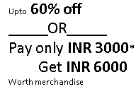
Psychological Pricing
Charm Pricing | Instead of INR 100, price is INR 99.99 (left-digit bias) | Benefits non-luxury products to give customers the impression that they’re getting a deal. Luxury/Recreational goods benefit from rounded prices- INR 400 vs, INR 399.
Odd-Even Pricing | "Odd pricing” - Price ending in 1,3,5,7,9 (e.g., INR 8.77, INR 84.95) “Even pricing” – INR 0.50, 8.50, 85.00. | Odd Pricing tends to be more popular because it indicates a deal in a customer’s mind, making them more likely to buy. Odd Pricing works best for businesses that are aiming to be perceived as discounted retailers. Luxury brands tend to use even pricing to create the perception of a premium product.
Artificial time constraints | Create a sense of urgency with limited-time offers such as flash sales or one-day-only sales. | If you create artificial time constraints too often, you may dilute their effect, reducing the quality of your product or brand or inadvertently motivating customers to buy from you only during these sales.
Innumeracy | Take advantage of the fact that most customers don’t actively do the math on Sale Prices. | Brand 1: Buy one can of soup for INR 40, get another free Brand 2: Get 50% off the total cost if you buy two cans of soup for INR 40 Purchase the first item and receive X% off on the next purchase Purchase one and receive a discount coupon value of INR 40 Buy one and get two items for free
Price appearance | The price is physically shorter and has fewer syllables for customers to read. | Use smaller fonts for your prices, especially for the numbers after the decimal points, remove currency signs and adding zeroes at the end of whole numbers. Larger and longer prices appear to be more expensive for than smaller and shorter prices, even if they represent the same number. Use larger fonts to emphasize discounts or large savings.
This Photo by Unknown Author is licensed under CC BY-SA-NC

Slide 43
Price Discrimination
Willingness to Pay (WTP) is a function of customer’s preferences as well as their (mis)perceptions.
Sellers are interested in customer’s WTP for their goods and services.

Slide 44
Pricing related Metrics
Cost Price
Selling Price
Markup
Gross Profit/ Margin = Revenue - COGS
Operating Margin = (Revenue – Cost)/Revenue
Sales Revenue
Cost of Goods Sold (COGS)
Gross Revenue/Income = Number of Goods sold * Price per Unit [OR Number of Customers * Price of Service]
Total or Specific General Expenses (SG&A)
Depreciation Expense
Interest Expense
Tax Expense

Slide 45
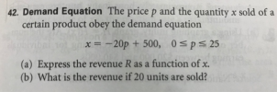
Exercise
This Photo by Unknown Author is licensed under CC BY-SA-NC
Notes:
p=24; R =p*x = 480;

Slide 46

Break
This Photo by Unknown Author is licensed under CC BY

Slide 47
Why do we need Revenue Management?
RM plays a major role in supply chain and contributes to the profitability of supply chain when one or more of the following conditions exist:
The product value differs in different market segments.
The product is highly perishable or product tends to be defective.
Demand has seasonal and other peaks.
The product is sold both in bulk and the spot market.

Slide 48
Revenue Management
Revenue Management
  Key Components
    Customer Segmentation (STP Model)
    Product Pricing
    Demand Forecast
    Product Market Fit
    Revenue Lifecycle Management
  Case Study (Airlines Industry, Jewellery Industry)
This Photo by Unknown Author is licensed under CC BY

Slide 49
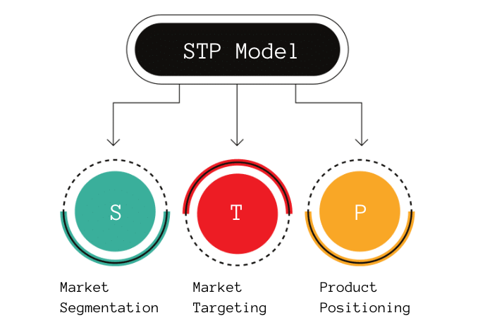
Segmentation, Targeting, and Positioning (STP) Model
Notes:
Product Mindset Newsletter

Slide 50
Segmentation, Targeting, and Positioning (STP) Model
STEP Formula: Segmentation + Targeting Equals Positioning
Segmentation | Description
Geographic | Customer location, including the region, state, or country they live in.
Demographic | Customer age, gender, education level, occupation, and income.
Behavioural | What products do Customers buy, how often, and which items do they view when they shop.
Psychographic | Customer’s personal characteristics like their interests, opinions, and activities.
Value | Group Customer’s as per religious, cultural, and political beliefs.
Targeting:
Analyse the categories of Customers, focus on specific groups for a marketing campaign.
Consider each segment’s size, growth potential, profitability, and overall accessibility.
Select a group of customers that you hope to persuade into joining a loyalty program or otherwise interacting with a business.

Slide 51
Segmentation, Targeting, and Positioning (STP) Model
Positioning: Use customer data to develop a unique, personalized marketing strategy.
Symbolic positioning: Consider enhancing the sense of belonging and self-image of your customers.
Functional positioning: With this method, you center your advertisement around the most important problem that an audience has and provide them with a solution.
Experiential positioning: This approach allows you to focus on the relationship a company has with its customers.
Experiment with different combinations of these factors or use all three in the same marketing campaign. This can help increase the number of customers who engage with your advertisements.
Notes:
Product Mindset Newsletter

Slide 52
STP Marketing Strategy
Key Tasks:
Understand your Product’s Market Present Value,
Align your Product Prices, and then
Strategically Distribute on the right channels to the right customers.
Key Issues in Multiple Customer Segmentation:
How to- Distinguish between each segment and design their pricing to make one segment pay more than the other?
How to- Control the demand so that the lower price segment does not use the complete asset that is available ?

Slide 53
STP Marketing Strategy (7 steps)
1. Define the Market: Define your TAM, SAM, and SOM.
2. Create audience segments: Segment your market using STP Model variables.
3. Construct segment profiles: Define Customer Personas or detailed descriptions of the people in each segment. Needs, behaviors, demographics, brand preferences, shopping traits, marital status, any other characteristics.
4. Evaluate commercial attractiveness of each segment: Cross-reference your findings with available market data and consumer research to assess which of your constructed segments can bring in the biggest return on your investment. Consider factors like segment size, growth rates, price sensitivity, and brand loyalty.
5. Select the target audiences: Perform a cluster analysis - use mathematical models to identify groups of customers that are more similar to one another than those in other groups. Ideal audience segment is one that is both large and still growing, and you can reach with your marketing efforts. Do not sell hiking gear that you are phasing out to an audience in a location with no free shipping.

Slide 54
TAM, SAM, SOM
TAM
Total Addressable Market – How big is the market?
Serviceable Available Market – How big is the market you could reach now?
Serviceable Obtainable Market – How much of the market can you reach with your current Resources?
Early Investors – How many customers are you most likely to get up front?
SAM
SOM
EI
Identify Early Investors:
They have a problem;
They know that they have a problem;
They are actively searching for a solution;
The problem is painful enough that they created a homegrown solution;
There is money or a budget to solve the problem.
Notes:
https://productmindset.substack.com/p/tam-sam-som

Slide 55
STP Marketing Strategy (7 steps)
6. Develop a positioning strategy: Category-based positioning – Determine how are your products or services better than the existing solutions on the market. Consumer-based positioning – Aligning your product/service offering with the target audience’s behavioral parameters. Competitor-based positioning – Prove you are better than competitor X. Benefit-based positioning – Prove the benefits that customers will get from purchasing your product or service. Price-based positioning – Distinguishing based on the value for money people get when purchasing your product/service. Attribute-based positioning – Unique selling proposition that makes your product or service stands out from the rest. Prestige-based positioning – Prove that your products supply a particular boost in status to those who purchase. Product Positioning Map – The product positioning map is a technique where the business uses a visual display to show their products against competitors. This allows for an easy way of navigating and understanding which products are being represented in comparison with others, ultimately helping them make decisions about what should be prioritized or modified based on company needs.

Slide 56
STP Marketing Strategy (7 steps)
7. Choose a Marketing Mix: The 4 P’s: Product considers factors like variety, quality, design, branding, features, packaging, services, availability, and convenience. Price considers factors like pricing strategy, list price, penetration price, premium, discounting, payment methods, credit terms, and payment period. Are your target audience segments price sensitive? Place considers factors like channels, coverage, location, inventory, logistics, and trade channels. Promotion considers factors like digital marketing, public relations, social media, sponsorship, influencer marketing, content marketing, product placement, sales promotion, and marketing communications. How will you communicate your value proposition to your target audience segments?
If we knew what we're doing, it wouldn’t be called research. - Albert Einstein

Slide 57
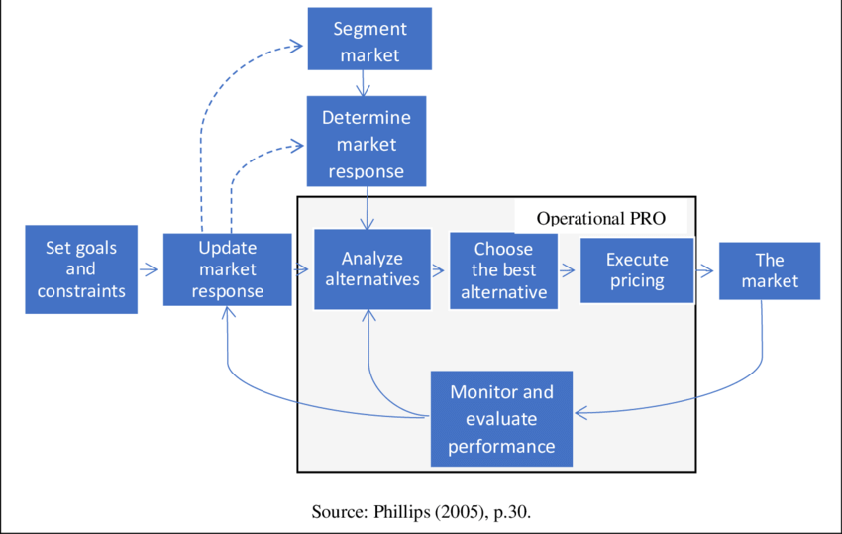
Pricing and Revenue Optimisation (PRO) Process

Slide 58
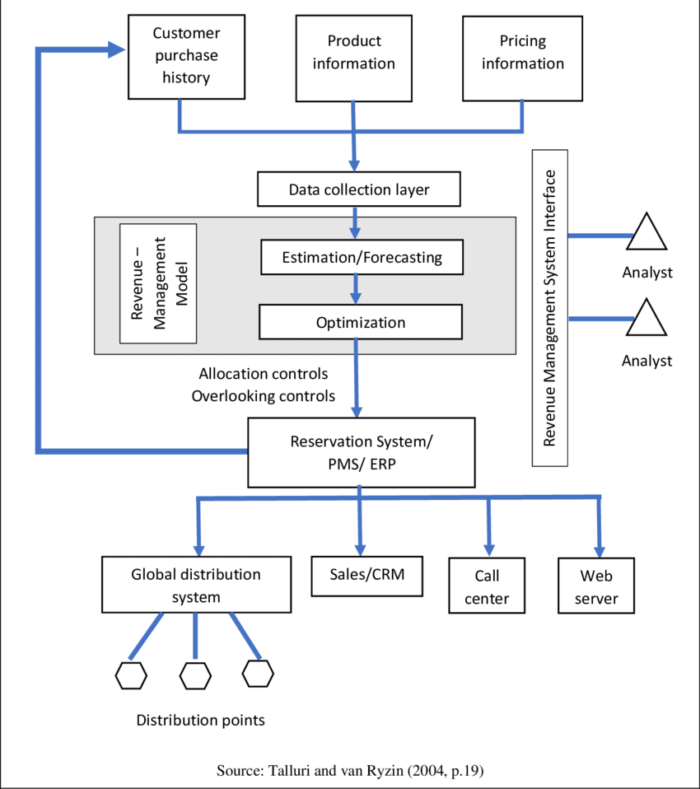
Pricing in Revenue Management Process Flow

Slide 59
RM Case Study - Jewellery (Initial failure)
Title | Description
Competition | 3,50,000+ family owned independent jewellers across India (Unorganised). Inventory owned by Vendors. Design ordered by Jewellers. Craftsman (Karigars) controlled by Vendors. Low cost Competitors have long standing relationships with Customers. Quick turnaround time.
Initial Segmentation & Target Group | Young, affluent people.
Initial Positioning | Jewellery that tells time. (Jewellery watches, only 18 carat Gold) High snob value. Western in style & design. Limited design options. Showrooms were boutiques in 5-star hotels. Ordered service could not be delivered at short notice.
Result | Launched in 1995, but heavy losses thereafter. First profit recorded only in 1999.

Slide 60
RM Case Study - Jewellery (Turnaround story)
Title | Description
Segmentation | People who love jewellery.
Target Group | Urban middle and upper class customers.
Positioning | Mainstream, Indian household brand name. Provide Modern as well as Traditional designs. Localised - Replace Western designs with ethnic ones for each region of India. Transmigration of designs (e.g. stock Bengali designs in Delhi, Mumbai designs in Kerala, Kerala designs in Tamil Nadu) to appeal to much broader and diverse customer base. Increased product portfolio – Studded designs, 18,22,24 carat purities. Retail boutiques across India for easy access to products. Retail outlets empowered to choose from the 3,500+ designs which they thought would sell best in their stores. Trend analysis and feedback from stores. In-house manufacturing. (In future, 3D printing as well)
Result | Increased profits and revenue. (FY22 revenue INR 23,268 crores, 88% of Titan’s total revenue) Increased market penetration. (435 stores in 220 cities by 2023)

Slide 61
RM Case Study - Jewellery (Turnaround story)
Pricing Strategy:
Control gold price variations by aligning with International Market rates and standardising gold price across all Company showrooms.
Establish customer trust in product quality. Add value proposition by replacing Touchstone testing method and introducing Karatmeters in all showrooms to give accurate reading of ornament Gold purity within 3 minutes.
Provide a product price for every class of consumer. (Entry level Rs. 600 for a pendant.)
100% return guarantee.
Exchange other jewellery after deductions based on purity.
Seasonal and localised promotions based on Indian festivals.
Corporate Gold Gift Scheme.
Gold coin ATM’s
Golden Harvest Jewellery Purchase Plan (Flexible monthly amount, Flexible monthly payment date, entitlement to Loyalty program “Encircle” for additional benefits)

Slide 62
RM Case Study (Yield Management)
Yield Management:
Maximise revenue with the help of effective management of 3 essential instruments:
Market Segmentation
Price Differentiation
Capacity Management (Availability of 3M – Man, Machine, Material (Employees, Aircraft, Fuel))
Yield Management is the process of integrated Price and Capacity Management with the objective of splitting a total capacity given into partial capacities and to assign them to different price ranges in order to achieve a revenue optimization and profit maximization within the entire route structure of an airline.
Airlines Industry:
Total seats on an airplane: 200
How to maximise revenue?
Notes:
Wang & Bowie

Slide 63
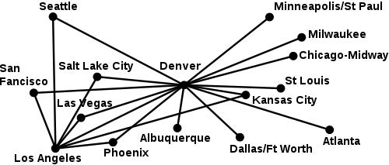
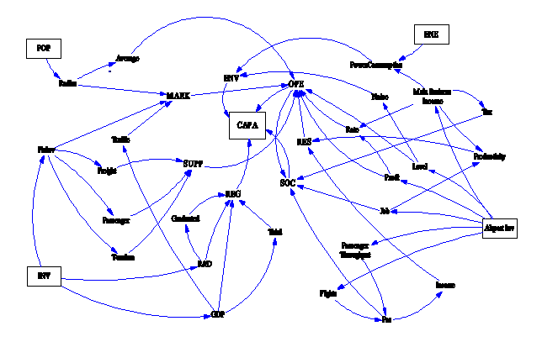
Yield Management
Airlines generally follow one of two business strategies: hub-and-spoke or point-to-point .
In a point-to-point model, airlines have specialised in carrying passengers from a specific origin directly to a specific destination.
In contrast, with a hub-and-spoke system, airlines use feeder flights to bring passengers to a specific hub, and then provide connecting service to an array of possible destinations, with a specific path called an origin–destination (OD) pair.
Most large, legacy carriers follow the hub-and-spoke model, while many low-cost carriers have adopted a point-to-point strategy.
To maximise revenue, it is important to make inventory decisions that match the business strategy.
US-Airline Route Structure after deregulation in 1978
This Photo by Unknown Author is licensed under CC BY-SA
This Photo by Unknown Author is licensed under CC BY-NC
Notes:
Airline network revenue management: Considerations for implementation - Marcial Lapp and Larry Weatherford US Airways Inc, Tempe; and University of Wyoming, Laramie

Slide 64
Correlation between Marketing and YM
Marketing
Yield Management
Product
Price
Capacity Management
Communication
Overbookings
Distribution
Price/Qty Management
Notes:
Airline Yield Management - Frau Prof. Schusteritsch, Julius Neubauer, 5BT , Kärntner Tourismusschulen Warmbad Villach May 2009

Slide 65
Yield Management – Airline Industry
Customer Segment | Demand | Ticket Booking | Target Price | Strategy | Fences/Barriers
Leisure | Leisure | In advance | Leisure/Discounted/Economy | Phase out discounted seats as flying date gets closer | Low baggage allowance, limited service on board, no free cancellation/rebooking, No late check-ins
Business | Business | Just in time | Full/Business | Phase in full price seats as flying date gets closer | Free cancellation/rebooking, Premium services on board, Access to airport lounges, Late check-ins
Notes:
Airline Yield Management - Frau Prof. Schusteritsch, Julius Neubauer, 5BT , Kärntner Tourismusschulen Warmbad Villach May 2009

Slide 66
Yield Management – Airline Industry
Basic Idea of Yield Management
(book in advance)
Sell at Discount
Discount fare: INR 2500
Flight from A to B
Sell at Full fare
Full fare: INR 3500
Do Not Sell at Discount
(risk of not selling at all)
Do not Sell
Zero fare: INR 0
Notes:
Airline Yield Management - Frau Prof. Schusteritsch, Julius Neubauer, 5BT , Kärntner Tourismusschulen Warmbad Villach May 2009

Slide 67
Yield Management – Hotel Industry
Customer Segment | Demand | Ticket Booking | Target Price | Strategy | Fences/Barriers
Leisure | Leisure | In advance | Leisure/Discounted/Economy | Phase out discounted rooms as booking date gets closer | Floor/Level, View from Room, Meals not included, pay extra for WiFi, Parking, Facilities, Housekeeping, etc.
Business | Business | Just in time | Full/Business | Phase in full price rooms as booking date gets closer | Free cancellation/rebooking, Premium services, Floor/Level, View from Room, Free WiFi, Parking, Hotel Lounges, Free meals, Facilities, Late check-in/check-outs
The hotel might also require Guests to stay on a Saturday night to get the discounted room on Monday.
Business travelers prefer to stay at home on weekends.
Leisure customers (price sensitive) are more likely to book this weekend stay.
Therefore, the hotel sells as many rooms as possible to business customers at a higher price while ensuring that it maintains a high level of room utilization.

Slide 68
Airlines Industry - Ticket Price Differentiation
By compartment | First/Business/Economy
By time of booking | Early bird discount, last minute offers
By season | Strong or poor demand
By region | By airports of departure/arrival (special airport surcharges) (also called Origin and Destination, O&D)
By destination | National/Continental/Intercontinental
By quantity | By the number of participating persons (volume discount)
By sales channel | Online-only fares, direct booking cheaper than booking via Agency

Slide 69
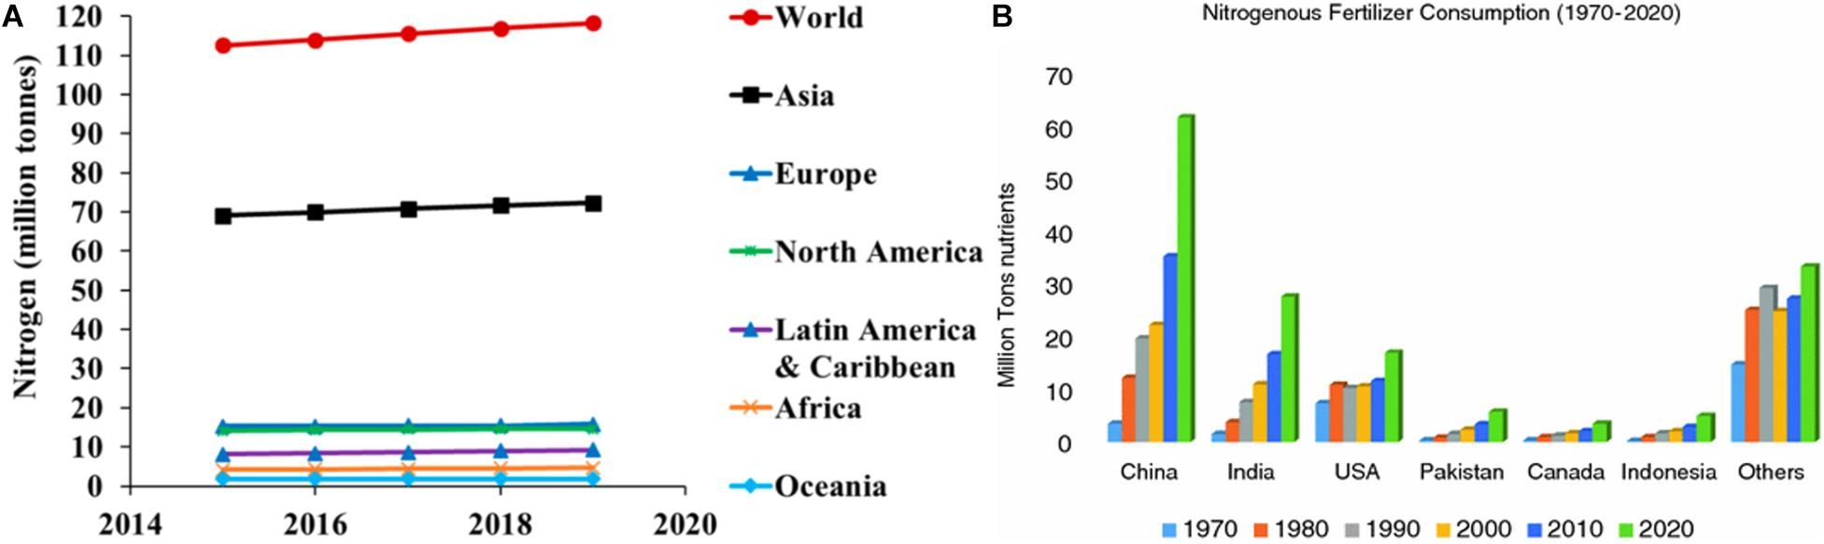
Demand Forecast
This Photo by Unknown Author is licensed under CC BY
Demand forecasting - Analyse historical sales data, current market research, and consumer trends to accurately predict demand.
Overcome demand forecasting challenges by employing a holistic solution that tracks everything you need, including:
  Accurately monitoring of every SKU and stock level in real-time
  High availability of historical sales forecasting data with statistical modeling to manage seasonal variations and time series forecasting
  Sophisticated forecasting tools for calculating accurate supplier lead times by tracking each supplier and vendor for more accurate reorder point planning
  A single source of truth for accurate data modeling
  The ability to see accurate pricing and lead times for suppliers to meet demand and maintain margins.
  Forecasting and projection tools to quickly adapt to new supply chain disruptions, pricing anomalies, or unexpected consumer demand
  Artificial intelligence and machine learning to continually improve your demand forecasting, pricing, and supply chain management

Slide 70
Simple Linear Demand Function
1) Write down the basic linear function,
Y = mX + b (Basic Linear function)
X = mY + b
Demand function (Q_{D}) = slope(m)*Price(P) + X-Axis Intercept/Quantity intercept (b)
Q_{D} = mP + b
2) Find two ordered pairs of Price(P) and Quantity(Q),
For Example: When unit price is INR 3.00 (P₁), Customers order 1000 units (Q₁) of Product.
When unit price is INR 4.00 (P₂), Customers order only 800 unit (Q₂) of Product.
3) Calculate the slope of the demand function, m = (Q₂-Q₁)/(P₂-P₁) = -200 (downward slope, as expected)
4) Calculate X-intercept of Demand Function.
1000 = (-200*3) + b
b = 1600
800 = (-200*4) + 1600
In the case of the supply and demand diagram note that the X and Y axis are flipped.
Independent variable (Price) is on the Y-axis, whereas the dependent variable (Quantity) is on the X-axis.
(it works!)

Slide 71
Linear Demand Curve for Product

Slide 72
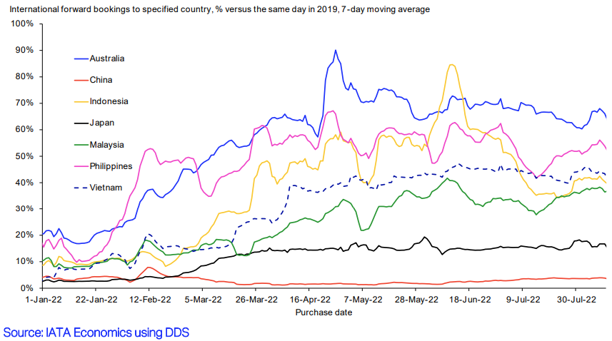
Easing restrictions met with high demand in Asia Pacific
Notes:
https://www.iata.org/en/iata-repository/publications/economic-reports/easing-restrictions-met-with-high-demand-in-asia-pacific/

Slide 73
Airlines Industry - Data Acquisition and Forecasting
Yield Management Data Pool / databases contain information about the following parameters:
Current bookings
Course of cancellations
No-show-behavior
Load factors
Development of costs and revenue
Competitive behavior
Seasonal influences
E.g.: Computer-assisted reservation systems like Galileo or Amadeus.

Slide 74
Airlines Industry - Data Acquisition and Forecasting
Generate Forecast models including these factors:
Input for Allocation | Future level of Demand
 | Expected course of Bookings
Input for Overbooking Control | No-show prospects
 | Go-show prospects
 | Cancellation rates

Slide 75
Different Outcomes in Asia Pacific
Within APAC, widely different outcomes can be seen as some major markets remain closed.
When the Australian government decided to reopen the country to tourists, international bookings for travel to the country jumped from 57% of pre-pandemic levels to 90%.
Similarly in Indonesia, bookings have reached 84% of 2019 levels thanks to the lifting of travel restrictions from January this year.
Travelers for business and tourism purposes have been allowed to enter the Philippines without a visa since February, allowing that country’s international bookings to rise quickly to around 50% of pre-pandemic levels.
On the other hand, China and Japan remain almost fully closed to international visitors and traffic, a situation that contrasts greatly with the recent developments in the region.
Notes:
https://www.iata.org/en/iata-repository/publications/economic-reports/easing-restrictions-met-with-high-demand-in-asia-pacific/

Slide 76
Cost of Flying (Düsseldorf to Palma de Mallorca)
Passenger dependent costs | per passenger | per flight
1. Taxes and Public Fees
Air traffic tax (LuftVStG from 9.12.2010) | €7.50 | €1,215
Passenger Security Control DUS | €5.60 | €907
Passenger Security Control PMI | €3.36 | €544
Security fee DUS | €0.88 | €143
Security fee PMI | €0.59 | €96
Sales tax (only applies to domestic German flights) | - | -
Total taxes and fees | €17.93 | €2,905
2. Airport charges (infrastructure)
Passenger Charges, DUS | €14.55 | €2,357
PRM fee (levy for special services for the disabled), DUS | €0.48 | €77
CUTE fee (check-in infrastructure), DUS | €0.26 | €42
Total airport charges DUS | €15.29 | €2,477
Passenger Charges, PMI | €6.30 | € 1,021
PRM fee (special services for the disabled), PMI | €0.59 | €96
Total airport charges PMI | €6.89 | €1,116
Notes:
https://www.airliners.de/was-kosten-flug-aviation-management/41685

Slide 77
Cost of Flying (Düsseldorf to Palma de Mallorca)
Passenger dependent costs | per passenger | per flight
4. Passenger services at DUS and PMI airport
Estimated proportionate total services | €1 | €162
5. Additional fuel consumption per passenger (80 kg)
(3.7% of the additional weight, €430/ ton of kerosene) | € 5.09 | €825
Total variable costs per passenger | € 46.20 | € 7485

Slide 78
Cost of Flying (Düsseldorf to Palma de Mallorca)
Flight dependent costs | per passenger | per flight
1. Airport Taxes
DUS take-off and landing fee | €2.12 | €343
DUS positioning fee (passenger boarding bridge) | €0.25 | €41
DUS noise surcharge (06:00 - 21:59) | €0.56 | €91
DUS NOX fee (estimate) | €0.31 | €50
DUS DFS (Airport Control Services) | €1.06 | €171
DUS total | € 4.30 | €697
PMI take-off and landing fee | €3.08 | €499
PMI position fee | €0.47 | €77
PMI noise surcharge, NOX fee | - | -
PMI ENAIRE (airport control services) | €0.15 | €25
Total PMI | €3.70 | €600

Slide 79
Cost of Flying (Düsseldorf to Palma de Mallorca)
Flight dependent costs | per passenger | per flight
2. Ground handling
DUS ground handling (DUS ground handling price list) | € 9.54 | €1545
PMI ground handling (max. according to AENA price list) | €7.48 | €1212
Total ground handling | € 17.02 | € 2757
3. Air traffic control route | €11.78 | € 2070
4. Fuel depends on the flight (430 € / ton of kerosene) | € 25.31 | € 4100
5. Crew Travel Expenses | - | -
6. Variable technology costs | € 14.40 | € 2333
Total flight-related costs | €77.51 | €12,557
Total passenger and flight dependent costs | € 123.71 | € 20,042

Slide 80
Revenue Lifecycle Management (RLM)
RLM is a framework for growing and retaining revenue from existing customers
  Profits roll out over the full revenue lifecycle and are largely determined by ongoing and long-term relationships with customers, typified by trust and a deep understanding of customer needs.
  Lack of focus on RLM process has negative impact on profitability, market capitalization and shareholder value
  It’s easier to generate additional revenue from existing customers than from new ones.
Revenue Lifecycle Management maturity drives market leadership and corporate performance.
Evolving customer expectations and technologies are driving business changes.
Increasingly demanding customers will require increased engagement to succeed
Drive customer value, loyalty and retention.
Balance investments across technology, analytics and process.
Notes:
https://images.forbes.com/forbesinsights/StudyPDFs/ServiceSource-MasteringRevenueLifecycleManagement-REPORT.pdf

Slide 81
Formalise the RLM
Provide value to Customer daily
  A profound understanding of customer interests, goals and needs can’t be attained in a piecemeal fashion. A true partnership that drives success for both parties requires ongoing, frequent updates and check-ins.
Follow the money – long term
  One-off sale mindset is no longer valid. Consider every product sale a Subscription, and that the customer has higher expectations of the service they receive on their assets.
Focus on the Customer’s Metrics
Partner with customers on business outcomes to drive revenue
  Align Product/Services delivered to the Customer’s KPI to build long-term close business relations.
Stay up-to-date of Suppliers’ and Customers’ KPIs along the entire revenue lifecycle
  KPIs are a moving target, and companies may need to evolve the design of their KPIs to reflect new information that may be embedded in Customer data. E.g. Predictive Analytics across multiple customer lifecycle processes.
Make a commitment to investing in RLM a priority.
Consider partnering with companies who have expertise in and a comprehensive approach to RLM.
Notes:
https://images.forbes.com/forbesinsights/StudyPDFs/ServiceSource-MasteringRevenueLifecycleManagement-REPORT.pdf

Slide 82
Revenue Lifecycle Management (RLM)
Key Components:
Credit Management:
Development a credit policy, Onboarding new customers, and Manage the trade credit risk exposure of the company.
Tools used include analyzing credit reports, financial statements, employing automated credit scoring,
credit application processing, checking customer references, collaboration with internal departments
(e.g., Sales), as well as automated workflow to control customer monitoring and credit operations.
Dispute and Deduction Management
Develop a system to prioritize, route and track these issues throughout the company for resolution, and to highlight root causes since systemic deduction issues will not be cured otherwise.
After investigation, a significant percentage of customer deductions will be found to be erroneous, and
must be collected to avoid losing profits.
Notes:
https://images.forbes.com/forbesinsights/StudyPDFs/ServiceSource-MasteringRevenueLifecycleManagement-REPORT.pdf

Slide 83
Revenue Lifecycle Management (RLM)
Key Components:
Cash Application and Accounts Receivable Management
Automated to handle cash application, EDI, ACH and credit card payments seamlessly.
A modern cash application system will be virtually manpower-free and automatically match payments and invoices, credits against deductions, etc., as well as initiating new transactions (for example, debit memos) from the cash application process.
Collections Management
Advanced systems to drive and track the process, educate and manage staff, and monitor results of Receivables Collection.
Example:
Two similar $200 million (Sales) companies, one with a Days Sales Outstanding (DSO) of 38 days and the other with 52 days.
Hence, One company unnecessarily has $8 million less cash than the other and more money tied up in working capital.
Notes:
https://images.forbes.com/forbesinsights/StudyPDFs/ServiceSource-MasteringRevenueLifecycleManagement-REPORT.pdf

Slide 84
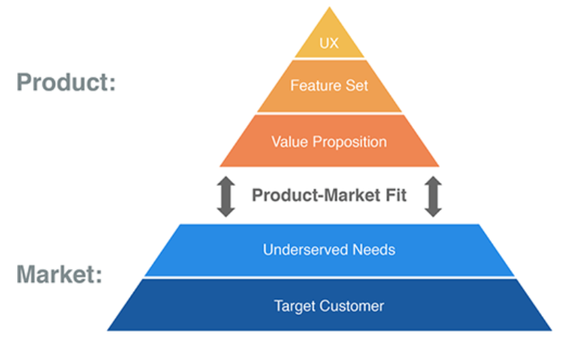
Product-Market Fit
Everyone engaged with the product is accountable for ensuring Product-Market fit.
Understand the Current Needs of Your Customer and Also Foresee Their Future Needs.
Keep Your Focus on the Value Proposition
Build Your Credibility
Measure Total Addressable Market (TAM) [Total potential customers/Avg. revenue per user]
Send out Surveys and respond to Customer feedback (Enhancements, Changes, Q&A, etc.)

Slide 85
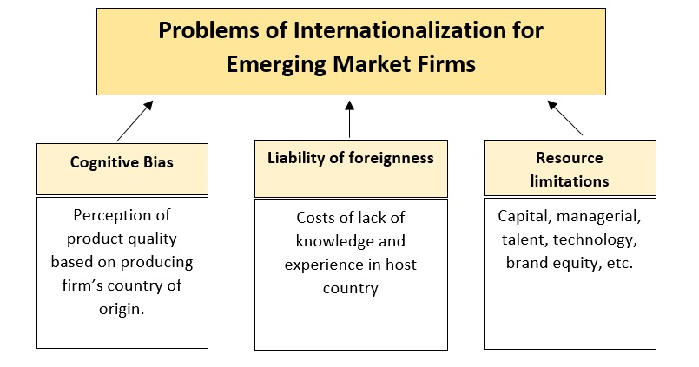
Emerging Market Firm (EMF)
Problems of Internationalization for Emerging Market Firms (EMFs) - Paul & Mas, 2017

Slide 86
References
Title | Link
The Landscape of Pricing and Algorithmic Pricing (2020), Casey Lee | ISEAS-Yusof Ishak Institute https://www.researchgate.net/publication/343575442_The_Landscape_of_Pricing_and_Algorithmic_Pricing
Supply Chain Management: Strategy, Planning, and Operation (2014), Sunil Chopra, Peter Meindl | Pearson (6th edition)
Algorithmic Price Discrimination, Oren Bar-Gill | https://lawreview.uchicago.edu/publication/algorithmic-price-discrimination-when-demand-function-both-preferences-and#footnote38_44tg78n
AI Use Cases & Applications in 2022, Cem Dilmegani | https://research.aimultiple.com/
Data Science Central | https://www.datasciencecentral.com/profiles/blogs/reinforcement-learning-for-dynamic-pricing
Product Mindset Newsletter | https://productmindset.substack.com/
Airline network revenue management: Considerations for implementation | Marcial Lapp and Larry Weatherford US Airways Inc, Tempe; and University of Wyoming, Laramie
Airline Yield Management | Frau Prof. Schusteritsch, Julius Neubauer, 5BT , Kärntner Tourismusschulen Warmbad Villach May 2009
Problems of Internationalization for Emerging Market Firms (EMFs) | Paul & Mas, 2017

Slide 87
References
Title | Link
International Air Transport Association (IATA) | https://www.iata.org/
Forbes Insights – Mastering Revenue Lifecycle Management | https://images.forbes.com/forbesinsights/StudyPDFs/ServiceSource-MasteringRevenueLifecycleManagement-REPORT.pdf
Product-Market Fit | https://www.productplan.com
Revenue Lifecycle Management | https://www.leibsolutions.com/views-blog/
How much does a flight actually cost?, Aviation professor Christoph Brützel | https://www.airliners.de/passagierabhaengige-kosten-pro-passagier-airline-flug-aviation-management/41481
Psychological Pricing | https://www.wallstreetmojo.com/psychological-pricing/
Commission for Agricultural Costs and Prices | https://www.india.gov.in/minimum-support-price-msp-agricultural-crops https://agricoop.nic.in/sites/default/files/pssguidelines.pdf https://en.wikipedia.org/wiki/Commission_for_Agricultural_Costs_and_Prices https://www.economicsdiscussion.net/agricultural-economics/agricultural-price-policy-in-india/21416

