Slide 1

Sustainability is the key to our survival on this planet and will also determine success on all levels.

Slide 2
Introduction
Purpose. The developments in the business commitment to sustainability over two decades and identifies the drivers that progressively changed fashion brands’ perspective on Sustainable Supply Chain Management.
Methodology .The research methodology is in the lines of Donald Schon reflective practice. Reflection-on-action is based on one of the authors practice in consultancy to fashion companies and in dialog with NGOs. The professional experience has been reconsidered through the analysis of the literature on sustainability initiatives and review of case histories.

Slide 3
Contents
2
3
1
Sustainability and Fashion
Impacts of Fashion and textile Industry.
What is Sustainability?
Achieving Sustainability
Tools in Sustainability
Progress in two decades
Brands towards Sustainability.
Conclusion

Slide 4
Sustainability and Fashion
Impacts of Fashion and textile Industry
1

Slide 5
Social
Sustainability
Labor
Forced and child labor
Working conditions
Health Risks
Models health /Anorexia
Eating disorders among young people
Consumer Safety
Hazardous chemicals on the apparel products.
Chemicals polluting water/soil.
Wages
“The search for profits is likely to create the temptation to exploit people associated with the industry e.g. workers and models” (Nordic Fashion Association, 2012).

Slide 6
Environmental sustainability
Environmental issues have not received as much as social responsibility issues in fashion SCM (Jørgensen & Pruzan-Jørgensen, 2003).
Clothing is estimated to account up to 6% of total Global Warming Potential of household consumption in Europe (EC, 2006; Nijdam and Wilting, 2003).
World Bank estimates that up to 20% of industrial water pollution comes from textile dyeing and finishing treatments (Kant, 2012, WWF-Accenture, 2013).
WWF (2014) reports that 95% of water consumption in textile is caused in fiber production and processing.
An example of energy impact cut in retailing is Marks&Spencer (M&S) that launched the Plan A program on 2007 to become the world’s most sustainable retailer by 2015; reducing the amount of energy we use in our stores by 25% per square foot of floor space.

Slide 7
Corporate economic sustainability
Two approaches relevant to the fashion industry
The first sees sustainability as linked to externalities (van den Bergh, 2010) and focuses on how businesses can or should be accounted for the “unpaid costs” for the use or the degradation of natural and social resources. According to this approach, sustainable practices impact on corporate financial bottom line tends to be negative as they mainly increase costs.
The second can increase the value for stakeholders (Sisodia et al.; 2014) and focuses mainly on innovation and value generation. In this approach the impact on the financial bottom line tend to be positive as sustainability practices can increase value and market shares
The analysis of sustainability practices impact on companies financial bottom line is still an open field of research and will not be addressed in the paper.

Slide 8
2
Achieving Sustainability
Tools in Sustainability
Progress in two decades
Brands towards Sustainability.

Slide 9

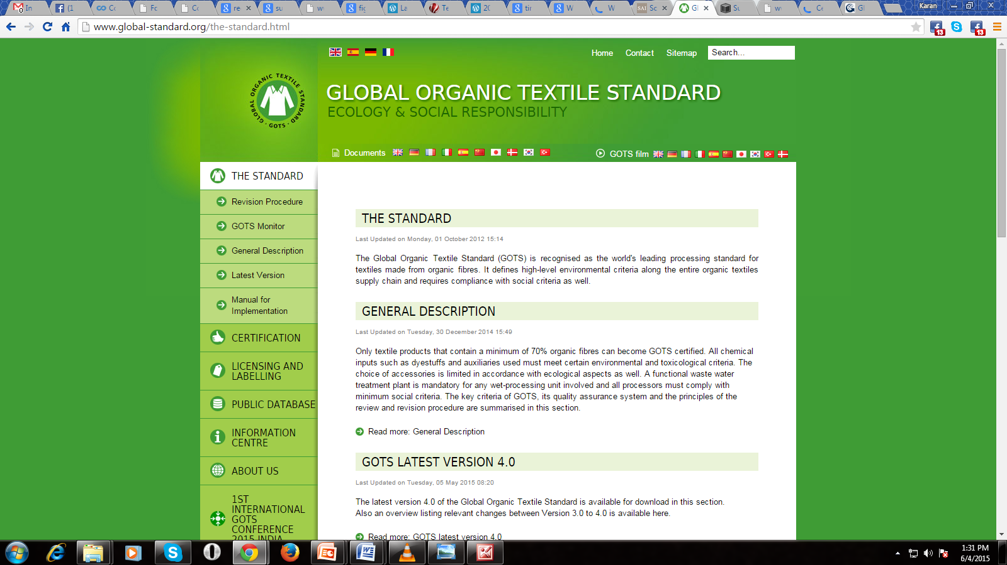
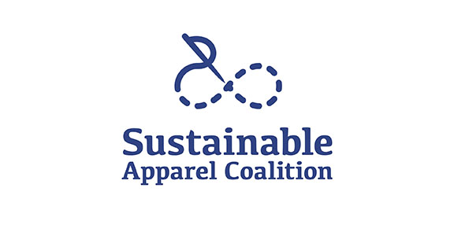
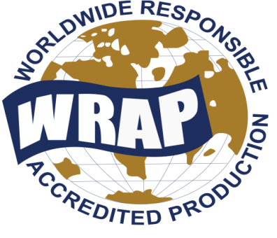
Achieving Sustainability -How far have we reached?
Tools in Sustainability
A. Documenting Sustainability
SA8000®
Higg Index 1.0

Slide 10
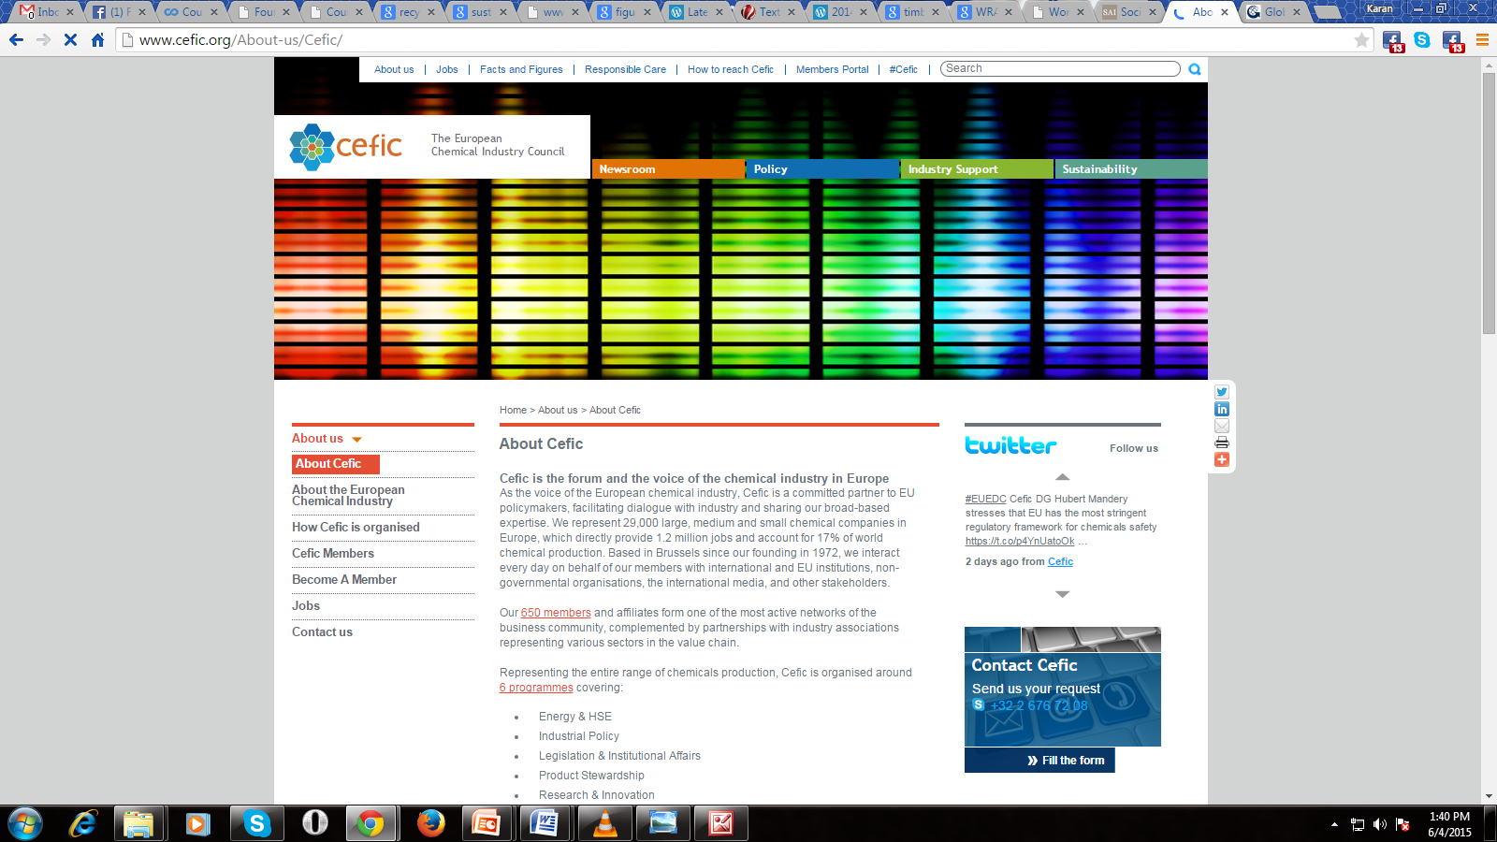
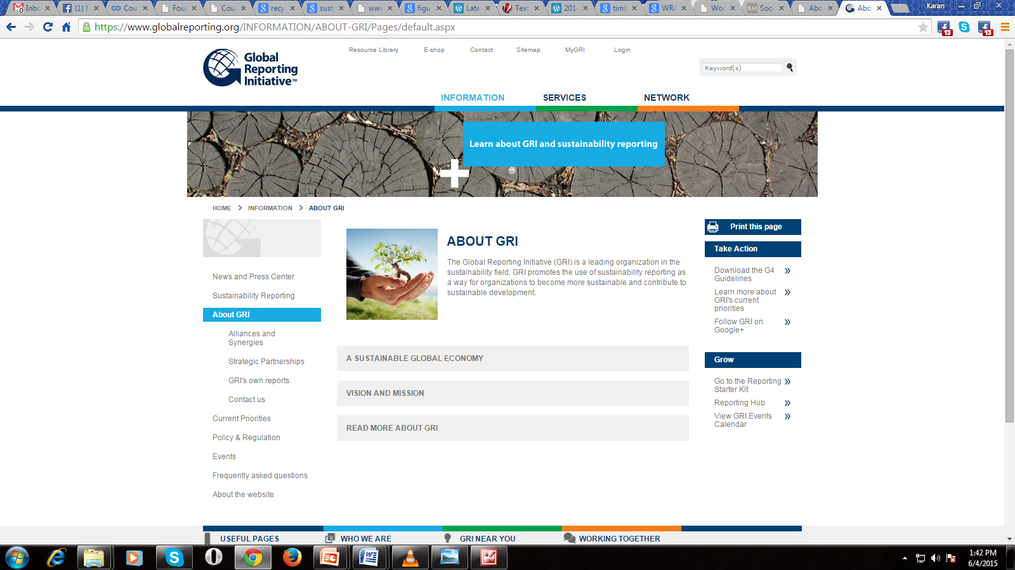
B. Environmental & Social Responsibility
Cefic is a committed partner to EU policymakers, facilitating dialogue with industry and sharing our broad-based expertise. We represent 29,000 large, medium and small chemical companies in Europe, which directly provide 1.2 million jobs and account for 17% of world chemical production.
The Global Reporting Initiative (GRI) is a leading organization in the sustainability field. GRI promotes the use of sustainability reporting as a way for organizations to become more sustainable and contribute to sustainable development.​

Slide 11
Progress in two decades
Sisco`s five lessons (BSR.org)
Go beyond monitoring.
Adopt a comprehensive approach
Look beyond first tier of suppliers
Integrate sustainability to core business practices
Bring transparency to the supply chain.

Slide 12
Go beyond monitoring
Compliance monitoring illuminated social & environmental issues.
Jucker (2012) calls “the maze of labels and certifications” that has made facts behind the certification schemes.
For small enterprises this can be an unbearable price to entry into a sustainable supply chain.
A survey on 41 Italian textile companies by Sustainability-lab (forthcoming), highlights that the proliferation of individual codes and commitments enforced in the contractual supply agreements by fashion brands is a major problem for textile supplier that are forced to meet the demands of many individual codes of conduct.

Slide 13
Duplicative and burdensome audits, generate “bribery and phony records, and a pass/fail mentality that drove problems underground” especially in low-cost-weak-legal-framework countries. Sisco (2012)
This questions the effectiveness of third-party audit bodies to combat bribery in their relationships with suppliers.

Slide 14
Adopt a Comprehensive Approach to Social, Environmental, And Ethical Practices .
Sustainability is a complex and multifaceted field; focusing on a single or a few issues can generate adverse effects .
Victoria’s Secret(2011), in this case certification was focused on organic growing and fair pay of growers only, missing to address children work issue.
The HIGG index tool -1.0 version on June 2012; 2.0 on December 2013. It is measurement and grading tool and while doesn’t provide a “certificate” in terms of pass/fail can help to spot weak points in supply chains sustainability.
The sustainability puzzle calls for the integration in SSCM of a management for stakeholder approach (Freeman et al., 2007; Guenza, 2012) as a tool for adapting to the rapidly evolving sustainability requirement

Slide 15
Look beyond first tier of suppliers
In case of violation of ethical or environmental standards consumers will hold the brand responsible” (Nordic Fashion Association, 2012)
In practice, this means that poor social and environmental management is now a concern both up and down the supply chain (Sisco, 2012), well beyond just the first tier of suppliers.
This concept splits in two different domains both relevant to the fashion industry: i) issues relevant to the subcontracting practices and indirect sourcing
ii) issues relevant to upstream stages of the supply chain that in the fashion case is very long from raw materials to spinning, weaving and finishing.

Slide 16
In the DETOX framework a fashion company “is committed to zero discharges of all hazardous chemicals from the whole lifecycle and all production procedures that are associated with the making and using of all products the company produces and / or sells” (excerpt from the standard DETOX commitment form).
The immediate requirement of a brand committing :an investigation into the issues relevant to the targeted chemicals along the supply chain. Second step is the publication of a Manufacturing Restricted Substances List (M-RSL)
The opinion : most of advantages in term of brand reputation are captured by the brand while most of the detoxing costs are born by suppliers. But DETOX framework to allow suppliers to capture advantages from the commitment in term of competitive advantages against not committed suppliers.

Slide 17
Integrate sustainability to core business.
Internal alignment across all departments and functions is the main route. It currently remains more a goal to be reached that a widespread practice, a sort of “Holy Grail” (Sisco, 2012).
In 2010 Nike started to fully integrate CSR into functions and departments, thus ending CSR as separate department. (Ricchetti and Guenza, 2012).
Since 2011 Puma publishes an environmental profit and loss statement that fully integrates in the financial statements and measures the impacts along all the supply chain.

Slide 18
Bring transparency to the supply chain
^{Transparency as} defined by Egels-Zandén et al. (2014) as an umbrella definition that comprises corporate disclosure of: 1) the names of the suppliers for traceability, 2) information about the sustainability condition at these suppliers and 3) the buying/purchasing practices of the brand.
Innovation flows quickly : a new fiber treatment or finishing creates a temporary competitive advantage for both the innovator and customer; lifecycle of an innovation being limited.
Traceability is a well known concept in business management/SCM, allowing products to be traced back to the whole supply chain ultimately to the raw material used (supply chain traceability).
The debate about supplier/customer link transparency brings ,Right to Know (RtK) principle a founding pillar of DETOX Commitment (Principle 10 “Rio Declaration on Environment and Development” 1992) .

Slide 19
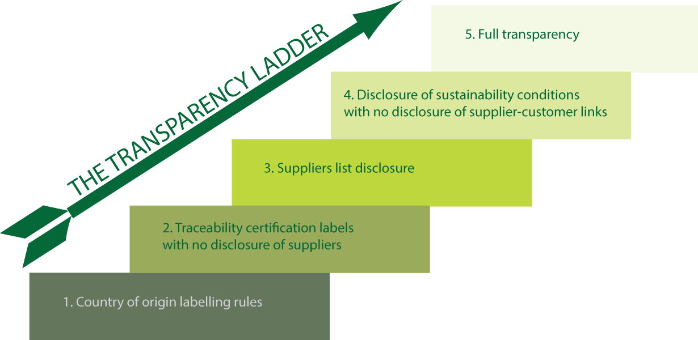
The different levels of transparency can be ranked in a 5 steps ladder

Slide 20
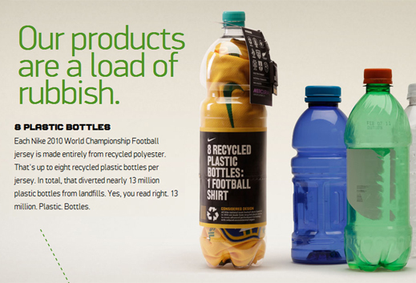
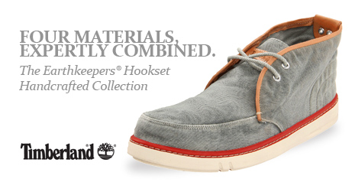
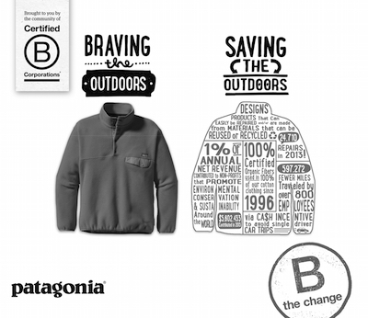
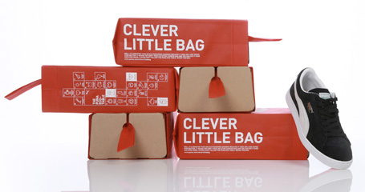
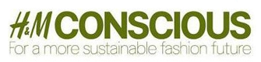
Brands towards Sustainability.

Slide 21
3
Conclusions & Further on

Slide 22
SSCM originated in the ‘90s and went through a trial and error process that led to substantial changes; The change developed in the two decades along five main drivers that called fashion brands.
The focus has shifted from sustainability of internal processes and products the brand sells to sustainability of all the process, inside the company and in the whole supply chain that creates the product. CSR managers’ job is now more outside than inside the company.
Transparency is progressively emerging as a key factor in opposition to the use of black box certification labels. Disclosure can be in conflict with incentive to innovation in a sector where trade secret is perceived as the best way to protect innovation or can increase the risk of name and shame campaigns.

Slide 23
Further research in assessment of the environmental and social sustainability practices impact on the financial bottom line remains an open area of research in the fashion business were the positive impact –especially relevant to the intangible value of brands, reputation and consumer loyalty - can be remarkable.
Fashion is a highly segmented business, where “a size does not fits all”, and is open to the implementation of different business models from luxury to mass retail, to niche targets. Fashion can on one hand draw from the experiences of supply chain giants such as Wall mart, IKEA, Tim Horton’s, Xerox on the other hand can suggest new solutions and perspectives.

Slide 24

Thank you

