Slide 1
Support Vector Machine

Slide 2
Supervised

Slide 3
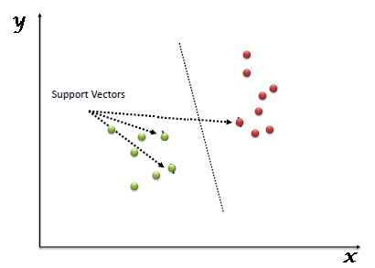

Slide 4
Hyperplane: A decision boundary that separates different classes in the feature space. In n-dimensional space, it is an (n-1)-dimensional subspace.
Support Vectors: The data points that are closest to the hyperplane and influence its position. These points are critical for defining the margin of the classifier.
Margin: The distance between the hyperplane and the nearest support vectors from either class. SVM aims to maximize this margin.

Slide 5
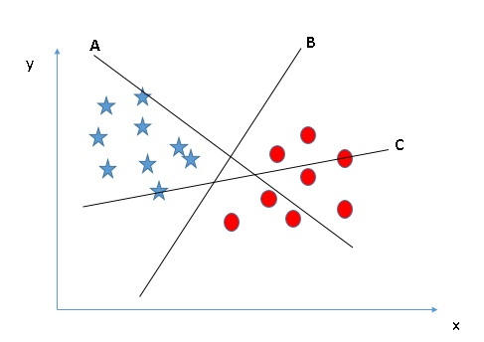

Slide 6
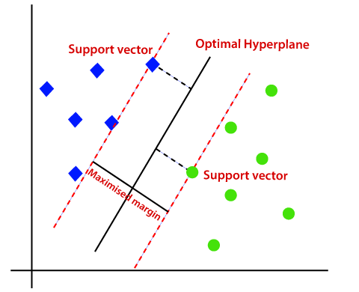

Slide 7
Problems with linear SVM
=-1
=+1
What if the decision function is not a linear?

Slide 8
Kernel: A function that transforms the input data into a higher-dimensional space to make it easier to find a hyperplane that separates the classes. Common kernels include linear, polynomial, radial basis function (RBF), and sigmoid.

Slide 9
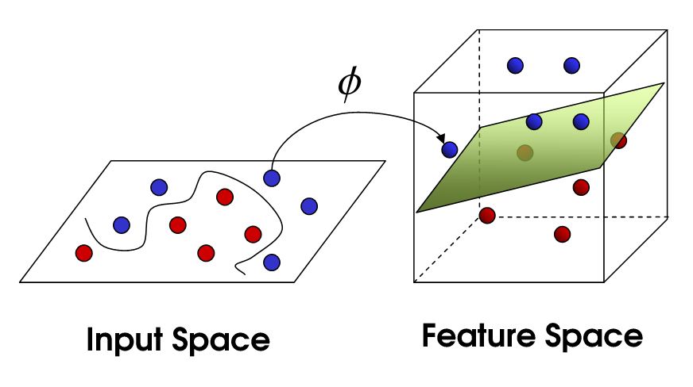


Slide 10
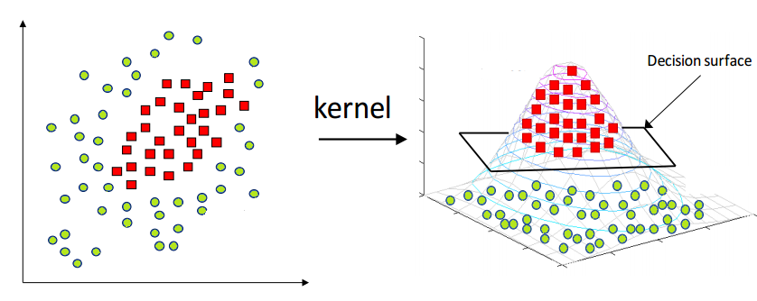

Slide 11
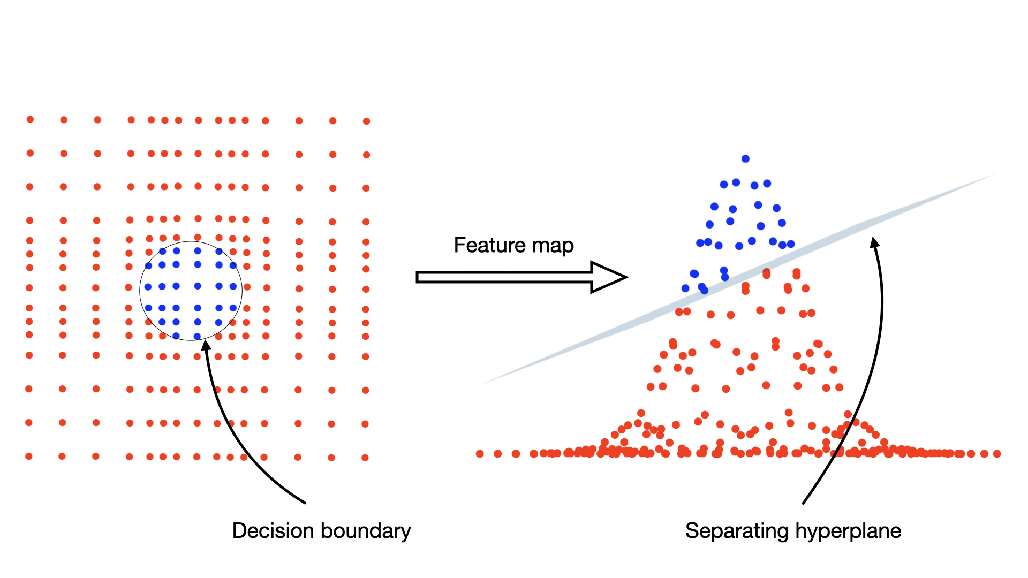

Slide 12
Hands on in R

Slide 13
Knime
https://hub.knime.com/knime/spaces/Educators%20Alliance/Guide%20to%20Intelligent%20Data%20Science/Example%20Workflows/Chapter9/03_SVM~DTfbNITUngKQVF8v/current-state

Slide 14
If we map the input vectors into a very high-dimensional feature space, surely the task of finding the maximum-margin separator becomes computationally intractable?
  The mathematics is all linear, which is good, but the vectors have a huge number of components.
  So taking the scalar product of two vectors is very expensive.
The way to keep things tractable is to use – The Kernel Trick

Slide 15
How is it done ?
All of the computations that we need to do to find the maximum-margin separator can be expressed in terms of scalar products between pairs of datapoints (in the high-dimensional feature space).
These scalar products are the only part of the computation that depends on the dimensionality of the high-dimensional space.
  So if we had a fast way to do the scalar products we would not have to pay a price for solving the learning problem in the high-D space.
The kernel trick is just a magic way of doing scalar products a whole lot faster than is usually possible.
  It relies on choosing a way of mapping to the high-dimensional feature space that allows fast scalar products.

Slide 16
Original Space: In the original input space, data points 𝑥 and 𝑦 might not be linearly separable.
Feature Space: Using a mapping function 𝜙(𝑥) the data points are transformed into a higher-dimensional feature space where they might become linearly separable. However, computing ϕ(x) explicitly can be complex and computationally intensive.
Kernel Function: A kernel function 𝐾(𝑥,𝑦) computes the dot product 𝜙(𝑥).ϕ(y) in the higher-dimensional space without needing to compute 𝜙(𝑥) and 𝜙(𝑦) directly. This allows SVM to work efficiently in the transformed feature space.

