Slide 1
Support Vector Machine

Slide 2
Supervised

Slide 3
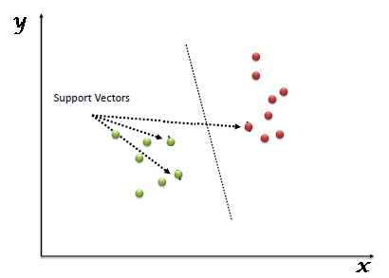

Slide 4
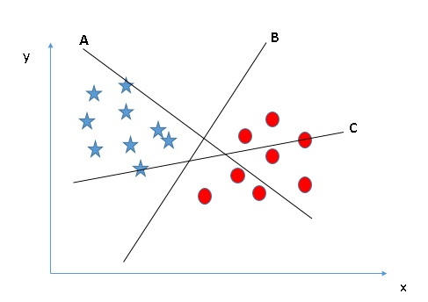

Slide 5
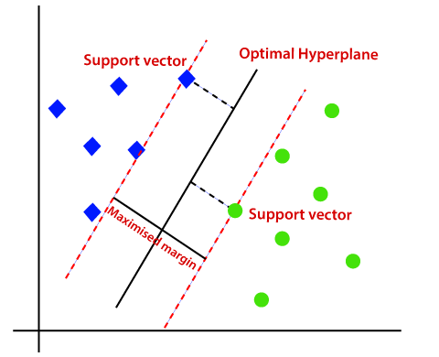

Slide 6
Problems with linear SVM
=-1
=+1
What if the decision function is not a linear?

Slide 7
If we map the input vectors into a very high-dimensional feature space, surely the task of finding the maximum-margin separator becomes computationally intractable?
  The mathematics is all linear, which is good, but the vectors have a huge number of components.
  So taking the scalar product of two vectors is very expensive.
The way to keep things tractable is to use – The Kernel Trick

Slide 8
How is it done ?
All of the computations that we need to do to find the maximum-margin separator can be expressed in terms of scalar products between pairs of datapoints (in the high-dimensional feature space).
These scalar products are the only part of the computation that depends on the dimensionality of the high-dimensional space.
  So if we had a fast way to do the scalar products we would not have to pay a price for solving the learning problem in the high-D space.
The kernel trick is just a magic way of doing scalar products a whole lot faster than is usually possible.
  It relies on choosing a way of mapping to the high-dimensional feature space that allows fast scalar products.

Slide 9
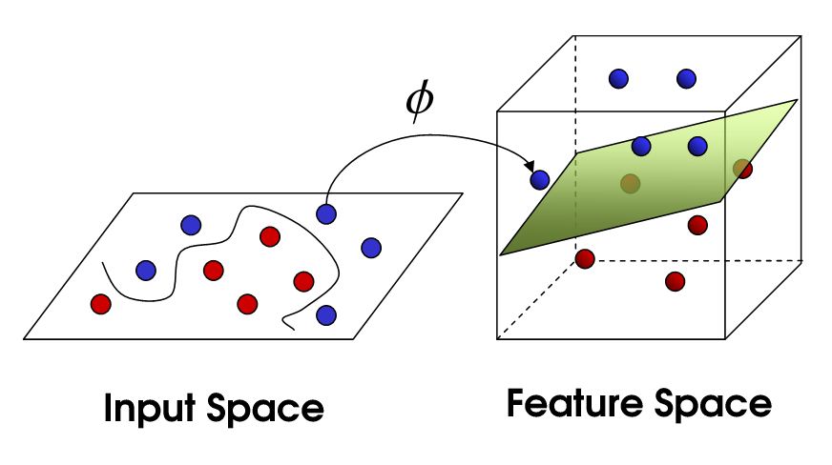


Slide 10
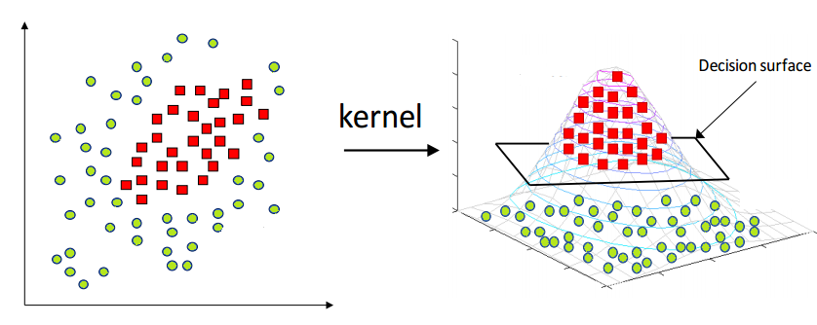

Slide 11
