Slide 1
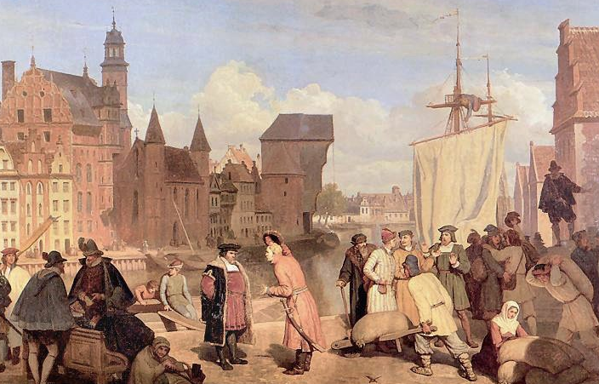
Seventh Edition
Principles of
Microeconomics
N. Gregory Mankiw
Wojciech Gerson (1831-1901)
The Market Forces of Supply and Demand
CHAPTER
4
Notes:
This is perhaps the most important chapter in the textbook. It’s worth mentioning to your students that investing extra time to master this chapter will make it easier for them to learn much of the subsequent material in the book.
This is also one of the longest chapters in the textbook, and this PowerPoint file is one of the most graph-intensive. Many students taking economics for the first time have difficulty grasping the graphs, which are critically important in this and all subsequent chapters in the book. So an extra degree of hand-holding might be appropriate.
Accordingly, this PowerPoint has carefully detailed animations that build many of the graphs with great care. For example, we show a demand or supply schedule next to the axes, and highlight each coordinate pair in the table as the corresponding point appears on the graph.
Please be assured that the presentation of graphs is more streamlined in subsequent chapters. In this early chapter, though, we do not want to leave any students behind.
If your students are already very comfortable with scatter-type graphs, consider simplifying or turning off the animation on these slides in order to get through them faster.

Slide 2
In this chapter, look for the answers to these questions
What factors affect buyers’ demand for goods?
What factors affect sellers’ supply of goods?
How do supply and demand determine the price of a good and the quantity sold?
How do changes in the factors that affect demand or supply affect the market price and quantity of a good?
How do markets allocate resources?
© 2015 Cengage Learning. All Rights Reserved. May not be copied, scanned, or duplicated, in whole or in part, except for use as permitted in a license distributed with a certain product or service or otherwise on a password-protected website for classroom use.

Slide 3
Some News Articles
https://www.reuters.com/business/energy/oil-edges-up-supply-worries-g7-pledge-enforce-russian-price-caps-2023-05-22/
https://www.thehindu.com/news/national/tomato-prices-expected-to-fall-after-higher-supplies-from-maharashtra-mp-says-centre/article67108629.ece
https://www.vice.com/en/article/pkp338/crocodile-meat-thailand

Slide 4
Markets and Competition
0
A market is a group of buyers and sellers of a particular product.
A competitive market is one with many buyers and sellers, each has a negligible effect on price.
In a perfectly competitive market:
  All goods exactly the same
  Buyers & sellers so numerous that no one can affect market price—each is a “price taker”
In this chapter, we assume markets are perfectly competitive.
Notes:
3
In the real world, there are relatively few perfectly competitive markets. Most goods come in lots of different varieties—including ice cream, the example in the textbook. And there are many markets in which the number of firms is small enough that some of them have the ability to affect the market price.
For now, though, we look at supply and demand in perfectly competitive markets, for two reasons: First, it’s easier to learn. Understanding perfectly competitive markets makes it a lot easier to learn the more realistic but complicated analysis of imperfectly competitive markets. Second, despite the lack of realism, the perfectly competitive model can teach us a lot about how the world works, as we will see many times in the chapters that follow.

Slide 5
Demand
0
The quantity demanded of any good is the amount of the good that buyers are willing and able to purchase.
Law of demand: the claim that the quantity demanded of a good falls when the price of the good rises, other things equal
Notes:
4
Demand comes from the behavior of buyers.

Slide 6
The Demand Schedule
0
Price of lattes | Quantity of lattes demanded
$0.00 | 16
1.00 | 14
2.00 | 12
3.00 | 10
4.00 | 8
5.00 | 6
6.00 | 4
Demand schedule:
a table that shows the relationship between the price of a good and the quantity demanded
Example:
Helen’s demand for lattes.
Notice that Helen’s preferences obey the
law of demand.
Notes:
5

Slide 7
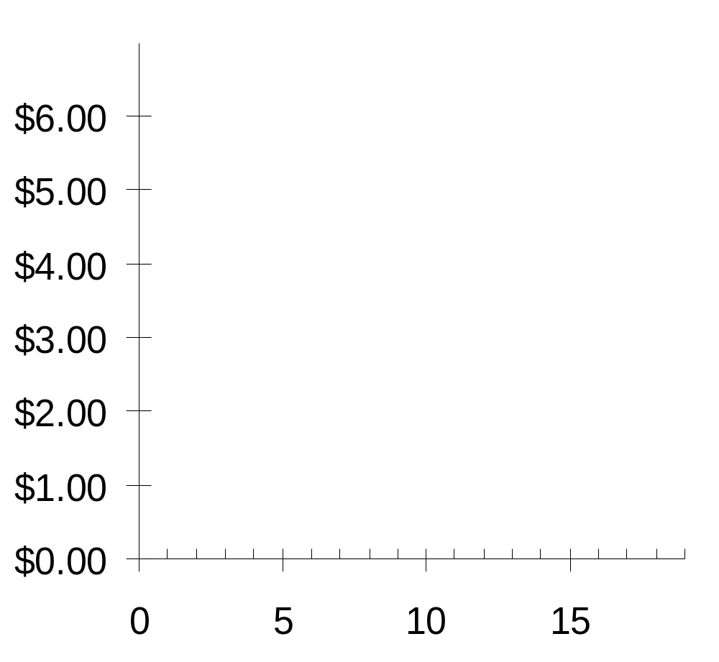
Helen’s Demand Schedule & Curve
0
Price of Lattes
Price of lattes | Quantity of lattes demanded
$0.00 | 16
1.00 | 14
2.00 | 12
3.00 | 10
4.00 | 8
5.00 | 6
6.00 | 4
Quantity of Lattes
Notes:
6

Slide 8
Market Demand versus Individual Demand
0
The quantity demanded in the market is the sum of the quantities demanded by all buyers at each price.
Suppose Helen and Ken are the only two buyers in the Latte market. (Q^{d} = quantity demanded)
Price
Helen’s Q^{d}
Ken’s Q^{d}
Market Q^{d}
$0.00
16
+
8
=
24
1.00
14
+
7
=
21
2.00
12
+
6
=
18
3.00
10
+
5
=
15
4.00
8
+
4
=
12
5.00
6
+
3
=
9
6.00
4
+
2
=
6
Notes:
7
This example violates the “many buyers” condition of perfect competition. Yet, we are merely trying to show here that, at each price, the quantity demanded in the market is the sum of the quantity demanded by each buyer in the market. This holds whether there are two buyers or two million buyers. But it would be harder to fit data for two million buyers on this slide, so we settle for two.

Slide 9
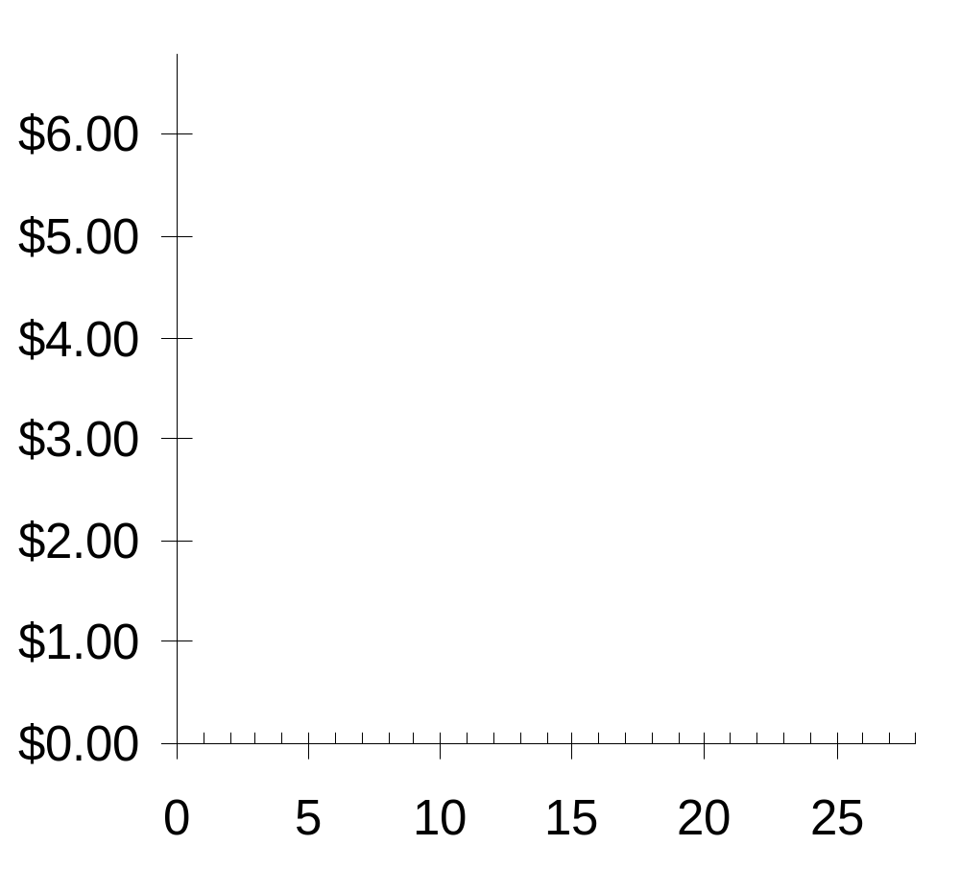
The Market Demand Curve for Lattes
0
P | Q^{d} (Market)
$0.00 | 24
1.00 | 21
2.00 | 18
3.00 | 15
4.00 | 12
5.00 | 9
6.00 | 6
P
Q
Notes:
8

Slide 10
Demand Curve Shifters
0
The demand curve shows how price affects quantity demanded, other things being equal.
These “other things” are non-price determinants of demand (i.e., things that determine buyers’ demand for a good, other than the good’s price).
Changes in them shift the D curve…
Notes:
9

Slide 11
Demand Curve Shifters: # of Buyers
0
Increase in # of buyers
increases quantity demanded at each price, shifts D curve to the right.
Notes:
10
Income is the first demand shifter discussed in this chapter of the textbook. I chose to start with a different one (number of buyers), for the following reason:
In discussing the impact of changes in income on the demand curve, the textbook also introduces the concept of normal goods and inferior goods. Students may find it easier to learn about curve shifts if the presentation focuses solely on a curve shift (at least initially) without simultaneously introducing other concepts.
If you wish to present the demand shifters in the same order as they appear in the book, simply reorder the slides in this presentation.

Slide 12
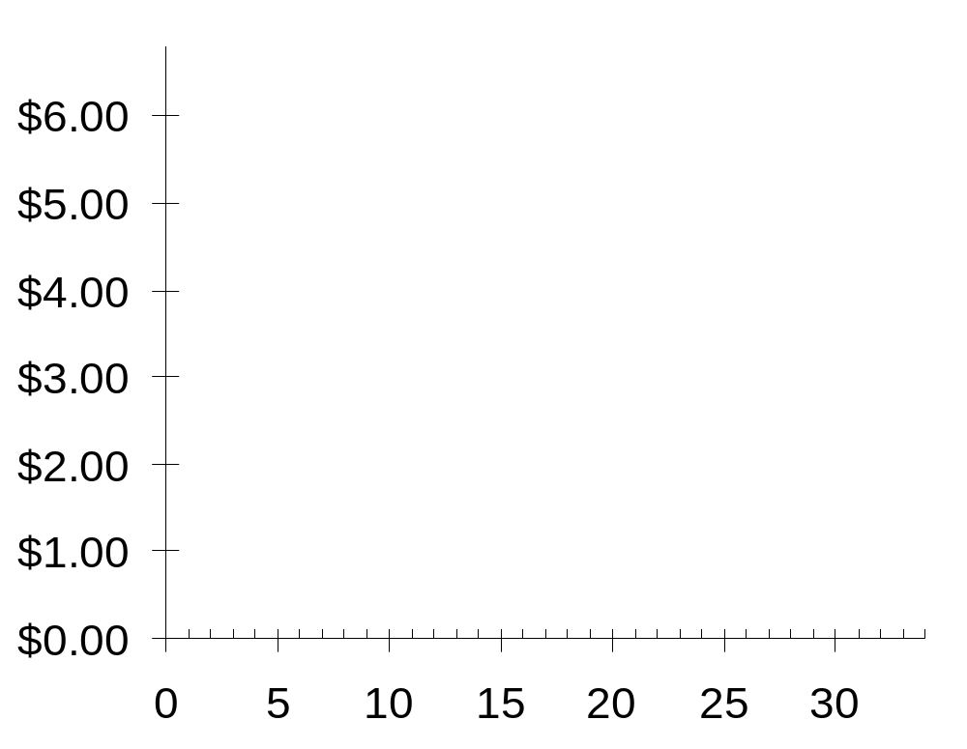
Demand Curve Shifters: # of Buyers
0
P
Suppose the number of buyers increases.
Then, at each P,
Q^{d} will increase
(by 5 in this example).
Q
Notes:
11
Beginning economics students often have trouble understanding the difference between a movement along the curve and a shift in the curve. Here, the animation has been carefully designed to help students see that a shift in the curve results from an increase in quantity at each price.
(A more realistic scenario would involve a non-parallel shift, where the horizontal distance of the shift would be greater for lower prices than higher ones. However, to remain consistent with the textbook, and to keep things simple, this slide shows a parallel shift.)

Slide 13
Demand Curve Shifters: Income
0
Demand for a normal good is positively related to income.
  Increase in income causes
  increase in quantity demanded at each price, shifts D curve to the right.
(Demand for an inferior good is negatively related to income. An increase in income shifts D curves for inferior goods to the left.)
Notes:
12

Slide 14
Demand Curve Shifters: Prices of Related Goods
0
Two goods are substitutes if
an increase in the price of one
causes an increase in demand for the other.
Example: pizza and hamburgers.
An increase in the price of pizza
increases demand for hamburgers,
shifting hamburger demand curve to the right.
Other examples: Coke and Pepsi,
laptops and desktop computers,
CDs and music downloads
Notes:
13
If you are willing to spend a couple extra minutes on substitutes and complements, and have a blackboard or whiteboard to draw on, here’s an idea:
Before (or instead of) showing this slide, draw the demand curve for hamburgers. Pick a price, say $5, and draw a horizontal line at that price, extending from the vertical axis through the D curve and continuing to the right. Suppose Q = 1000 when P = $5. Label this on the horizontal axis.
Now ask your students: If pizza becomes more expensive, but price of hamburgers does not change, what would happen to the quantity of hamburgers demanded? Would it remain at 1000, would it increase, or would it decrease? Explain.
Some and perhaps most students will see right away that people will want more hamburgers when the price of pizza rises. After establishing this, note that the increase in the price of pizza caused an increase in the quantity demanded of hamburgers. Then state the term “substitutes” and give the definition.
Before giving the other examples (listed in the 3rd bullet of this slide), do a similar exercise to develop the concept of complements. Finally, give the examples of substitutes and complements from the 3rd bullet point of this and the following slides, but mix up the order and ask students to identify whether each example is complements or substitutes.

Slide 15
Demand Curve Shifters: Prices of Related Goods
0
Two goods are complements if
an increase in the price of one
causes a fall in demand for the other.
Example: computers and software.
If price of computers rises,
people buy fewer computers,
and therefore less software.
Software demand curve shifts left.
Other examples: college tuition and textbooks,
bagels and cream cheese, eggs and bacon
Notes:
14

Slide 16
Demand Curve Shifters: Tastes
0
Anything that causes a shift in tastes toward a good will increase demand for that good
and shift its D curve to the right.
Example:
The Atkins diet became popular in the ’90s,
caused an increase in demand for eggs,
shifted the egg demand curve to the right.
Notes:
15

Slide 17
Demand Curve Shifters: Expectations
0
Expectations affect consumers’ buying decisions.
Examples:
  If people expect their incomes to rise,
  their demand for meals at expensive restaurants may increase now.
  If the economy sours and people worry about their future job security, demand for new autos may fall now.
Notes:
16

Slide 18
Summary: Variables That Influence Buyers
0
Variable A change in this variable…
Price …causes a movement
along the D curve
# of buyers …shifts the D curve
Income …shifts the D curve
Price of
related goods …shifts the D curve
Tastes …shifts the D curve
Expectations …shifts the D curve
Notes:
17
Students should notice that the only determinant of quantity demanded that causes a movement along the curve is price. Also notice: price is one of the variables measured along the axes of the graph.
Here’s a handy rule of thumb students can use to remember whether the curve shifts: If the variable causing demand to change is measured on one of the axes, you move along the curve. If the variable that’s causing demand to change does not appear on either axis, then the curve shifts.
This rule of thumb works with all curves in economics that involve an X-Y relationship, including the supply curve, the marginal cost curve, the IS and LM curves (not covered in this book), and many others, though it does not apply to curves drawn on time series graphs.

Slide 19

ACTIVE LEARNING ₁
Demand curve
Draw a demand curve for music downloads. What happens to it in each of
the following scenarios? Why?
A. The price of iPods falls
B. The price of music downloads falls
C. The price of CDs falls
©Enyezdi/Shutterstock.com
© 2015 Cengage Learning. All Rights Reserved. May not be copied, scanned, or duplicated, in whole or in part, except for use as permitted in a license distributed with a certain product or service or otherwise on a password-protected website for classroom use.
Notes:
In each case, there are only three possible answers:
- The curve shifts to the right
- The curve shifts to the left
- The curve does not shift (though there may be a movement along the curve)

Slide 20
ACTIVE LEARNING ₁
A. Price of iPods falls
Music downloads and iPods are complements.
A fall in price of iPods shifts the demand curve for music downloads
to the right.
Price of music down-loads
P₁
D₁
D₂
Q₁
Q₂
Quantity of
music downloads
© 2015 Cengage Learning. All Rights Reserved. May not be copied, scanned, or duplicated, in whole or in part, except for use as permitted in a license distributed with a certain product or service or otherwise on a password-protected website for classroom use.
Notes:
Point out to your students that there are no numbers or units on either axis, and we are using “P₁” and “Q₁” to represent the initial price and quantity, rather than specific numerical values. Tell them that this is common, because in much economic analysis, the goal is only to see the direction of changes, not specific amounts. (Besides, if we put numbers on this graph, they’d just have been made up, so why bother?)
Also point out the following:
The price of music downloads is the same, but the quantity demanded is now higher. In fact, this is the nature of a shift in a curve: at any given price, the quantity is different than before.

Slide 21
ACTIVE LEARNING ₁
B. Price of music downloads falls
Price of music down-loads
The D curve
does not shift.
Move down along curve to a point with lower P, higher Q.
P₁
P₂
D₁
Q₁
Q₂
Quantity of
music downloads
© 2015 Cengage Learning. All Rights Reserved. May not be copied, scanned, or duplicated, in whole or in part, except for use as permitted in a license distributed with a certain product or service or otherwise on a password-protected website for classroom use.

Slide 22
ACTIVE LEARNING ₁
C. Price of CDs falls
Price of music down-loads
CDs and
music downloads are substitutes.
A fall in price of CDs shifts demand for music downloads
to the left.
P₁
D₂
D₁
Q₂
Q₁
Quantity of
music downloads
© 2015 Cengage Learning. All Rights Reserved. May not be copied, scanned, or duplicated, in whole or in part, except for use as permitted in a license distributed with a certain product or service or otherwise on a password-protected website for classroom use.

Slide 23
Exercise - 1
https://mru.org/teacher-resources/active-learning/change-demand-vs-change-quantity-demanded-interactive-practice
Video: https://mru.org/courses/principles-economics-microeconomics/demand-curve-shifts-definition

Slide 24
Supply
0
The quantity supplied of any good is the amount that sellers are willing and able to sell.
Law of supply: the claim that the quantity supplied of a good rises when the price of the good rises, other things equal
Notes:
23
Supply comes from the behavior of sellers.

Slide 25
The Supply Schedule
0
Supply schedule:
A table that shows the relationship between the price of a good and the quantity supplied.
Example:
Starbucks’ supply of lattes.
Price of lattes | Quantity of lattes supplied
$0.00 | 0
1.00 | 3
2.00 | 6
3.00 | 9
4.00 | 12
5.00 | 15
6.00 | 18
Notice that Starbucks’ supply schedule obeys the
law of supply.
Notes:
24

Slide 26
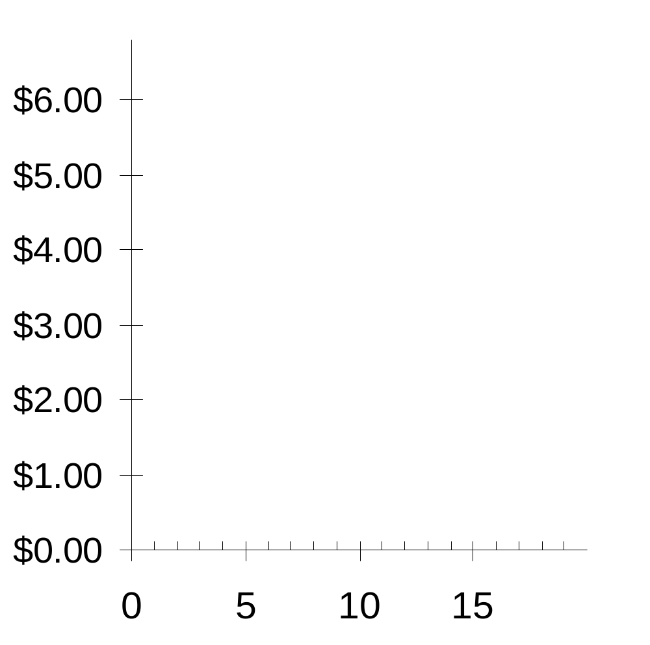
Starbucks’ Supply Schedule & Curve
0
Price of lattes | Quantity of lattes supplied
$0.00 | 0
1.00 | 3
2.00 | 6
3.00 | 9
4.00 | 12
5.00 | 15
6.00 | 18
P
Q
Notes:
25

Slide 27
Market Supply versus Individual Supply
0
The quantity supplied in the market is the sum of
the quantities supplied by all sellers at each price.
Suppose Starbucks and Peet’s are the only two sellers in this market. (Q^{s} = quantity supplied)
Price
Starbucks
Peet’s
Market Q^{s}
$0.00
0
+
0
=
0
1.00
3
+
2
=
5
2.00
6
+
4
=
10
3.00
9
+
6
=
15
4.00
12
+
8
=
20
5.00
15
+
10
=
25
6.00
18
+
12
=
30
Notes:
26
Again, the assumption of only two sellers is a clear violation of perfect competition. However, it’s much easier for students to learn how the market supply curve relates to individual supplies in the two-seller case.

Slide 28
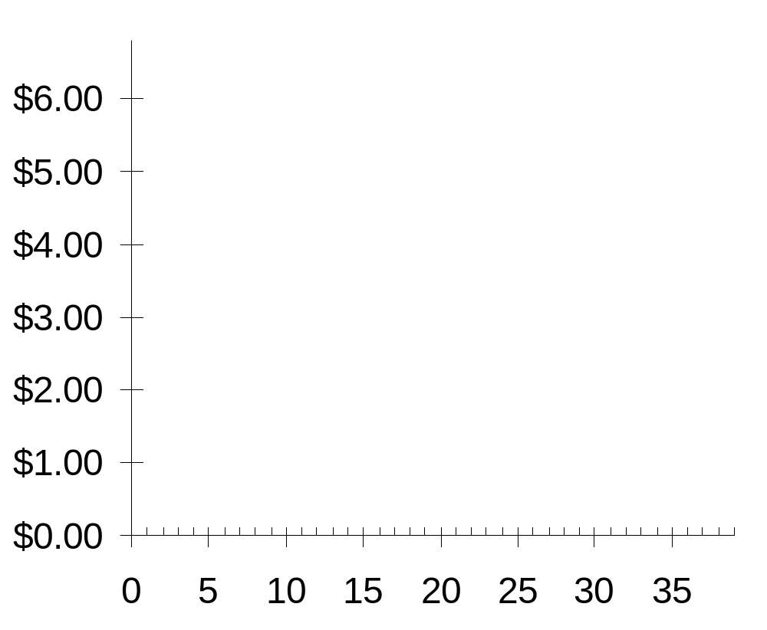
The Market Supply Curve
0
P | Q^{S} (Market)
$0.00 | 0
1.00 | 5
2.00 | 10
3.00 | 15
4.00 | 20
5.00 | 25
6.00 | 30
P
Q
Notes:
27

Slide 29
Supply Curve Shifters
0
The supply curve shows how price affects quantity supplied, other things being equal.
These “other things” are non-price determinants of supply.
Changes in them shift the S curve…
Notes:
28
“Non-price determinants of supply” simply means the things—other than the price of a good—that determine sellers’ supply of the good.

Slide 30
Supply Curve Shifters: Input Prices
0
Examples of input prices:
wages, prices of raw materials.
A fall in input prices makes production
more profitable at each output price,
so firms supply a larger quantity at each price,
and the S curve shifts to the right.
Notes:
29
In the second bullet point, “output price” just means the price of the good that firms are producing and selling. I have used “output price” here to distinguish it from “input prices.”

Slide 31
Supply Curve Shifters: Input Prices
0
P
Suppose the price of milk falls.
At each price, the quantity of
lattes supplied
will increase
(by 5 in this example).
Q
Notes:
30
Again, the animation here is carefully designed to help make clear that a shift in the supply curve means that there is a change in the quantity supplied at each possible price. If it seems tedious, you can turn it off.
In any case, be assured that, by the end of this chapter, the animation of curve shifts will be streamlined and simplified.

Slide 32
Supply Curve Shifters: Technology
0
Technology determines how much inputs are required to produce a unit of output.
A cost-saving technological improvement has
the same effect as a fall in input prices,
shifts S curve to the right.
Notes:
31

Slide 33
Supply Curve Shifters: # of Sellers
0
An increase in the number of sellers increases the quantity supplied at each price,
shifts S curve to the right.
Notes:
32

Slide 34
Supply Curve Shifters: Expectations
0
Example:
  Events in the Middle East lead to expectations of higher oil prices.
  In response, owners of Texas oilfields reduce supply now, save some inventory to sell later at the higher price.
  S curve shifts left.
In general, sellers may adjust supply* when their expectations of future prices change.
(*If good not perishable)
Notes:
33

Slide 35
Summary: Variables that Influence Sellers
0
Variable A change in this variable…
Price …causes a movement
along the S curve
Input Prices …shifts the S curve
Technology …shifts the S curve
# of Sellers …shifts the S curve
Expectations …shifts the S curve
Notes:
34

Slide 36

ACTIVE LEARNING ₂
Supply curve
Draw a supply curve for tax
return preparation software.
What happens to it in each
of the following scenarios?
  A. Retailers cut the price of
  the software.
  B. A technological advance
  allows the software to be
  produced at lower cost.
  C. Professional tax return preparers raise the price of the services they provide.
© v777999/Shutterstock.com
© 2015 Cengage Learning. All Rights Reserved. May not be copied, scanned, or duplicated, in whole or in part, except for use as permitted in a license distributed with a certain product or service or otherwise on a password-protected website for classroom use.
Notes:
“Tax return preparation software” means programs like TurboTax by Quicken and TaxCut by H&R Block.

Slide 37
ACTIVE LEARNING ₂
A. Fall in price of tax return software
Price of tax return software
S curve does
not shift.
Move down
along the curve
to a lower P
and lower Q.
S₁
P₁
P₂
Q₂
Q₁
Quantity of tax return software
© 2015 Cengage Learning. All Rights Reserved. May not be copied, scanned, or duplicated, in whole or in part, except for use as permitted in a license distributed with a certain product or service or otherwise on a password-protected website for classroom use.

Slide 38
ACTIVE LEARNING ₂
B. Fall in cost of producing software
Price of tax return software
S curve shifts to the right:
at each price,
Q increases.
S₁
S₂
P₁
Q₁
Q₂
Quantity of tax return software
© 2015 Cengage Learning. All Rights Reserved. May not be copied, scanned, or duplicated, in whole or in part, except for use as permitted in a license distributed with a certain product or service or otherwise on a password-protected website for classroom use.

Slide 39
ACTIVE LEARNING ₂
C. Professional preparers raise their price
Price of tax return software
S₁
This shifts the demand curve for tax preparation software, not the supply curve.
Quantity of tax return software
© 2015 Cengage Learning. All Rights Reserved. May not be copied, scanned, or duplicated, in whole or in part, except for use as permitted in a license distributed with a certain product or service or otherwise on a password-protected website for classroom use.

Slide 40
Exercise - 2
https://mru.org/teacher-resources/active-learning/change-supply-vs-change-quantity-supplied-interactive-practice
Video: https://mru.org/courses/principles-economics-microeconomics/supply-curve-definition-example

Slide 41
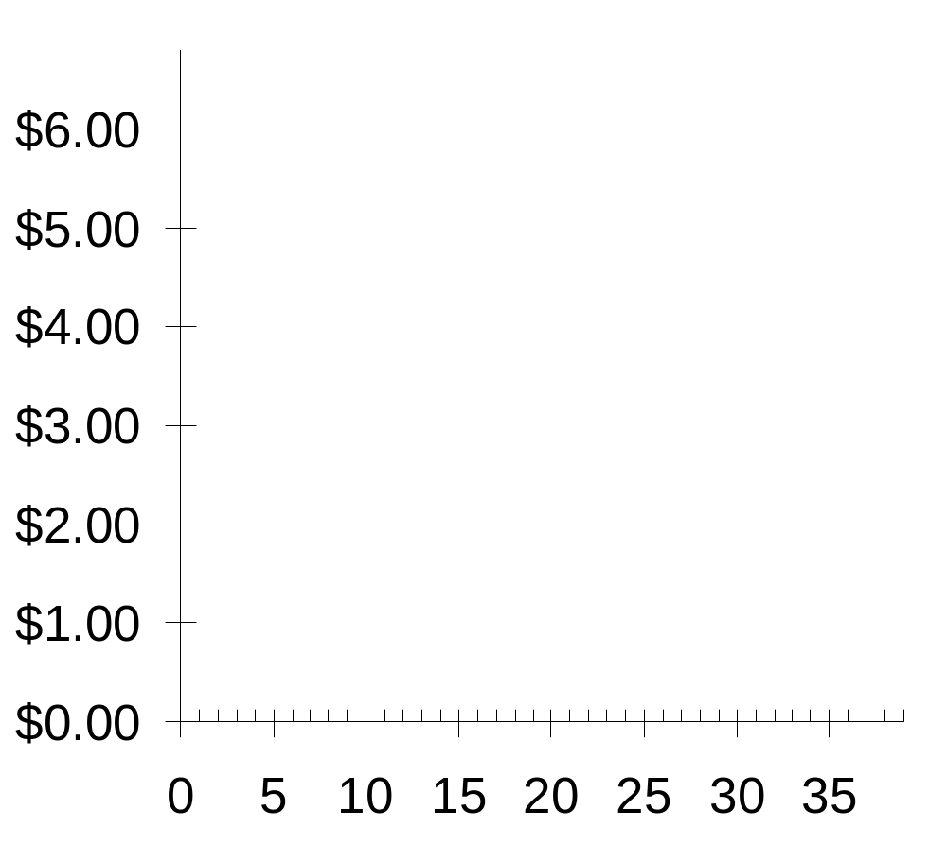
Supply and Demand Together
0
P
Equilibrium:
P has reached
the level where
quantity supplied equals
quantity demanded
D
S
Q
Notes:
40
We now return to the latte example to illustrate the concepts of equilibrium: shortage and surplus.

Slide 42
Equilibrium price:
0
the price that equates quantity supplied with quantity demanded
P
D
S
P | Q^{D} | Q^{S}
$0 | 24 | 0
1 | 21 | 5
2 | 18 | 10
3 | 15 | 15
4 | 12 | 20
5 | 9 | 25
6 | 6 | 30
Q
Notes:
41

Slide 43
Equilibrium quantity:
0
the quantity supplied and demanded at the equilibrium price
P
D
S
P | Q^{D} | Q^{S}
$0 | 24 | 0
1 | 21 | 5
2 | 18 | 10
3 | 15 | 15
4 | 12 | 20
5 | 9 | 25
6 | 6 | 30
Q
Notes:
42

Slide 44
Surplus (a.k.a. excess supply):
0
when quantity supplied is greater than quantity demanded
P
Example:
If P = $5,
D
Surplus
S
then
Q^{D} = 9 lattes
and
Q^{S} = 25 lattes
resulting in a
surplus of 16 lattes
Q
Notes:
43

Slide 45
Surplus (a.k.a. excess supply):
0
when quantity supplied is greater than quantity demanded
P
Facing a surplus,
sellers try to increase sales by cutting price.
D
Surplus
S
This causes
Q^{D} to rise
and Q^{S} to fall…
…which reduces the surplus.
Q
Notes:
44

Slide 46
Surplus (a.k.a. excess supply):
0
when quantity supplied is greater than quantity demanded
P
Facing a surplus,
sellers try to increase sales by cutting price.
D
Surplus
S
This causes
Q^{D} to rise and Q^{S} to fall.
Prices continue to fall until market reaches equilibrium.
Q
Notes:
45

Slide 47
Shortage (a.k.a. excess demand):
0
when quantity demanded is greater than quantity supplied
P
D
S
Example:
If P = $1,
then
Q^{D} = 21 lattes
and
Q^{S} = 5 lattes
resulting in a
shortage of 16 lattes
Shortage
Q
Notes:
46

Slide 48

Shortage (a.k.a. excess demand):
0
when quantity demanded is greater than quantity supplied
P
Facing a shortage,
sellers raise the price,
D
S
causing Q^{D} to fall
and Q^{S} to rise,
…which reduces the shortage.
Shortage
Q
Notes:
47

Slide 49
Shortage (a.k.a. excess demand):
0
when quantity demanded is greater than quantity supplied
P
Facing a shortage,
sellers raise the price,
D
S
causing Q^{D} to fall
and Q^{S} to rise.
Prices continue to rise until market reaches equilibrium.
Shortage
Q
Notes:
48

Slide 50
Exercise - 3
https://mru.org/teacher-resources/active-learning/shifts-both-supply-and-demand-curves-interactive-practice

Slide 51
Three Steps to Analyzing Changes in Eq’m
To determine the effects of any event,
  1. Decide whether the event shifts S curve,
  D curve, or both.
  2. Decide in which direction curve shifts.
  3. Use supply—demand diagram to see
  how the shift changes eq’m P and Q.
Notes:
50
Step 1 requires knowing all of the things that can shift D and S—the non-price determinants of demand and of supply.

Slide 52
EXAMPLE: The Market for Hybrid Cars
P
price of electric cars
S₁
P₁
D₁
Q
Q₁
quantity of
electric cars
Notes:
51

Slide 53
EXAMPLE 1: A Shift in Demand
EVENT TO BE
ANALYZED:
Increase in price of gas.
P
S₁
STEP 1:
D curve shifts
because price of gas affects demand for hybrids.
S curve does not shift, because price of gas does not affect cost of producing hybrids.
P₂
STEP 2:
D shifts right
because high gas price makes hybrids more attractive relative to other cars.
P₁
STEP 3:
The shift causes an increase in price
and quantity of electric cars.
D₁
D₂
Q
Q₁
Q₂
Notes:
52

Slide 54
EXAMPLE 1: A Shift in Demand
Notice:
When P rises, producers supply
a larger quantity
of electrics, even though the S curve has not shifted.
P
S₁
P₂
P₁
Always be careful to distinguish b/w a shift in a curve and a movement along the curve.
D₁
D₂
Q
Q₁
Q₂
Notes:
53

Slide 55
Terms for Shift vs. Movement Along Curve
Change in supply: a shift in the S curve
occurs when a non-price determinant of supply changes (like technology or costs)
Change in the quantity supplied:
a movement along a fixed S curve
occurs when P changes
Change in demand: a shift in the D curve
occurs when a non-price determinant of demand changes (like income or # of buyers)
Change in the quantity demanded:
a movement along a fixed D curve
occurs when P changes
Notes:
54
“Supply” refers to the position of the supply curve, while “quantity supplied” refers to the specific amount that producers are willing and able to sell.
Similarly, “demand” refers to the position of the demand curve, while “quantity demanded” refers to the specific amount that consumers are willing and able to buy.
If you’d like to be a rebel, delete this slide and all references to the jargon it contains, and just use the terms “movement along a curve” and “shift in a curve.” Note, however, that this is not the official recommendation of Cengage Learning or Dr. Mankiw.
If you’d like to cover this slide but make it move more quickly, delete the text next to each second-level bullet (starting with “occurs when”) and give the information to your students verbally or rely on them to read it in the textbook.

Slide 56
EXAMPLE 2: A Shift in Supply
EVENT: New technology reduces cost of producing electric cars.
P
S₁
S₂
STEP 1:
S curve shifts
because event affects cost of production.
D curve does not shift, because production technology is not one of the factors that affect demand.
STEP 2:
S shifts right
because event reduces cost,
makes production more profitable at any given price.
P₁
P₂
STEP 3:
The shift causes price to fall
and quantity to rise.
D₁
Q
Q₁
Q₂
Notes:
55

Slide 57
EXAMPLE 3: A Shift in Both Supply and Demand
EVENTS:
Price of gas rises AND
new technology reduces production costs
P
S₁
S₂
STEP 1:
Both curves shift.
P₂
P₁
STEP 2:
Both shift to the right.
STEP 3:
Q rises, but effect
on P is ambiguous:
If demand increases more than supply, P rises.
D₁
D₂
Q
Q₁
Q₂
Notes:
56

Slide 58
EXAMPLE 3: A Shift in Both Supply and Demand
EVENTS:
price of gas rises AND
new technology reduces production costs
P
S₁
S₂
STEP 3, cont.
P₁
But if supply increases more than demand,
P falls.
P₂
D₁
D₂
Q
Q₁
Q₂
Notes:
57

Slide 59
ACTIVE LEARNING ₃
Shifts in supply and demand
Use the three-step method to analyze the effects of each event on the equilibrium price and quantity of music downloads.
  Event A: A fall in the price of CDs
  Event B: Sellers of music downloads negotiate a reduction in the royalties they must pay for each song they sell.
  Event C: Events A and B both occur.
© 2015 Cengage Learning. All Rights Reserved. May not be copied, scanned, or duplicated, in whole or in part, except for use as permitted in a license distributed with a certain product or service or otherwise on a password-protected website for classroom use.
Notes:
Important note about Event B:
The royalties that sellers must pay the artists are part of sellers’ “costs of production.” Typically, this royalty is a fixed amount each time one of the artist’s songs is downloaded. Event B, therefore, describes a reduction in sellers’ “costs of production.”

Slide 60
ACTIVE LEARNING ₃
A. Fall in price of CDs
The market for music downloads
STEPS
P
1. D curve shifts
S₁
2. D shifts left
P₁
3. P and Q both fall.
P₂
D₂
D₁
Q
Q₂
Q₁
© 2015 Cengage Learning. All Rights Reserved. May not be copied, scanned, or duplicated, in whole or in part, except for use as permitted in a license distributed with a certain product or service or otherwise on a password-protected website for classroom use.
Notes:
This is an extension of Active Learning exercise 1C, where we saw that a fall in the price of compact discs would cause a fall in demand for music downloads, because the two goods are substitutes.

Slide 61
ACTIVE LEARNING ₃
B. Fall in cost of royalties
STEPS
The market for music downloads
P
1. S curve shifts
S₁
S₂
(Royalties are part of sellers’ costs)
2. S shifts right
P₁
3. P falls,
Q rises.
P₂
D₁
Q
Q₁
Q₂
© 2015 Cengage Learning. All Rights Reserved. May not be copied, scanned, or duplicated, in whole or in part, except for use as permitted in a license distributed with a certain product or service or otherwise on a password-protected website for classroom use.
Notes:
NOTE: Don’t worry that the text on this slide looks garbled in “Normal view” (i.e., edit mode). It works fine in “Slide Show” (i.e., presentation mode).
Event B: Sellers of music downloads negotiate a reduction in the royalties they must pay for each song they sell. This event causes a fall in “costs of production” for sellers of music downloads. Hence, the S curve shifts to the right.

Slide 62
ACTIVE LEARNING ₃
C. Fall in price of CDs and fall in cost of royalties
STEPS
1. Both curves shift (see parts A & B).
2. D shifts left, S shifts right.
3. P falls.
Effect on Q is ambiguous:
the fall in demand reduces Q,
the increase in supply increases Q.
© 2015 Cengage Learning. All Rights Reserved. May not be copied, scanned, or duplicated, in whole or in part, except for use as permitted in a license distributed with a certain product or service or otherwise on a password-protected website for classroom use.
Notes:
It’s not necessary to draw a graph here. The answers to steps 1 and 2 should be clear from parts A and B. The answer to step 3 is a combination of the results from A and B.

Slide 63
CONCLUSION:
How Prices Allocate Resources
One of the Ten Principles from Chapter 1:
Markets are usually a good way
to organize economic activity.
In market economies, prices adjust to balance supply and demand. These equilibrium prices are the signals that guide economic decisions and thereby allocate scarce resources.
Notes:
62
In the textbook, the conclusion of this chapter offers some very nice elaboration on the second bullet point.

Slide 64
Summary
A competitive market has many buyers and sellers, each of whom has little or no influence
on the market price.
Economists use the supply and demand model to analyze competitive markets.
The downward-sloping demand curve reflects the law of demand, which states that the quantity buyers demand of a good depends negatively on the good’s price.
© 2015 Cengage Learning. All Rights Reserved. May not be copied, scanned, or duplicated, in whole or in part, except for use as permitted in a license distributed with a certain product or service or otherwise on a password-protected website for classroom use.

Slide 65
Summary
Besides price, demand depends on buyers’ incomes, tastes, expectations, the prices of substitutes and complements, and number of buyers.
If one of these factors changes, the D curve shifts.
The upward-sloping supply curve reflects the Law of Supply, which states that the quantity sellers supply depends positively on the good’s price.
Other determinants of supply include input prices, technology, expectations, and the # of sellers. Changes in these factors shift the S curve.
© 2015 Cengage Learning. All Rights Reserved. May not be copied, scanned, or duplicated, in whole or in part, except for use as permitted in a license distributed with a certain product or service or otherwise on a password-protected website for classroom use.

Slide 66
Summary
The intersection of S and D curves determines the market equilibrium. At the equilibrium price, quantity supplied equals quantity demanded.
If the market price is above equilibrium,
a surplus results, which causes the price to fall.
If the market price is below equilibrium,
a shortage results, causing the price to rise.
© 2015 Cengage Learning. All Rights Reserved. May not be copied, scanned, or duplicated, in whole or in part, except for use as permitted in a license distributed with a certain product or service or otherwise on a password-protected website for classroom use.

Slide 67
Summary
We can use the supply-demand diagram to analyze the effects of any event on a market:
First, determine whether the event shifts one or both curves. Second, determine the direction of the shifts. Third, compare the new equilibrium to the initial one.
In market economies, prices are the signals that guide economic decisions and allocate scarce resources.
© 2015 Cengage Learning. All Rights Reserved. May not be copied, scanned, or duplicated, in whole or in part, except for use as permitted in a license distributed with a certain product or service or otherwise on a password-protected website for classroom use.

