Slide 1
A short message
MAHABHARATA

Slide 2
Strategy Management
Facilitator: Dr. Pooja Patnaik

Slide 3
Strategic Analysis
Strategic analysis refers to the process of conducting research on a company and its operating environment to formulate a strategy.
The process involves several common factors:
  Identifying and evaluating data relevant to the company’s strategy
  Defining the internal and external environments to be analyzed
  Using several analytic methods such as Porter’s five forces analysis, SWOT analysis, and value chain analysis

Slide 4
Strategy
Strategy is an action that managers take to attain one or more of the organization’s goals.
Strategy gives answer to two fundamental questions- (HBR, 2014)
  Where should we compete
  How should we compete
The purpose of strategy is
                → Competitive Advantage

Slide 5
There are two requirements:
  1. understanding of the business landscape: the forces that shape competition, dynamics among players, and drivers of industry evolution. This informs where the firm chooses to engage with its competition.
  2. the choice of a position on this landscape. The firm’s positioning shapes the choice of a business model and the underlying set of activities that sustains it.
Strategy consists of choices.
It is the integrated set of choices that positions the business in its industry so as to generate superior financial returns over the long run.

Slide 6
To develop a business strategy, a company needs a very well-defined understanding of what it is and what it represents. Strategists need to look at the following:
Vision – What it wants to achieve in the future (5-10 years)
Mission Statement – What business a company is in and how it rallies people
Values – The fundamental beliefs of an organization reflecting its commitments and ethics

Slide 7
Stages in Strategy Management
Formulation
Implementation
Evaluation

Slide 8
Strategy Formulation
Strategy formulation is the process of establishing goals and determining the proper plan of action to achieve those goals.
An organization uses strategy formulation to plan for success and make improvements to workplace strategies as needed.
Strategy formulation is essential for achieving and measuring the attainability of goals.
After creating strategies, an organization typically educates its employees so they know the organization's purpose, workplace objectives and goals.

Slide 9
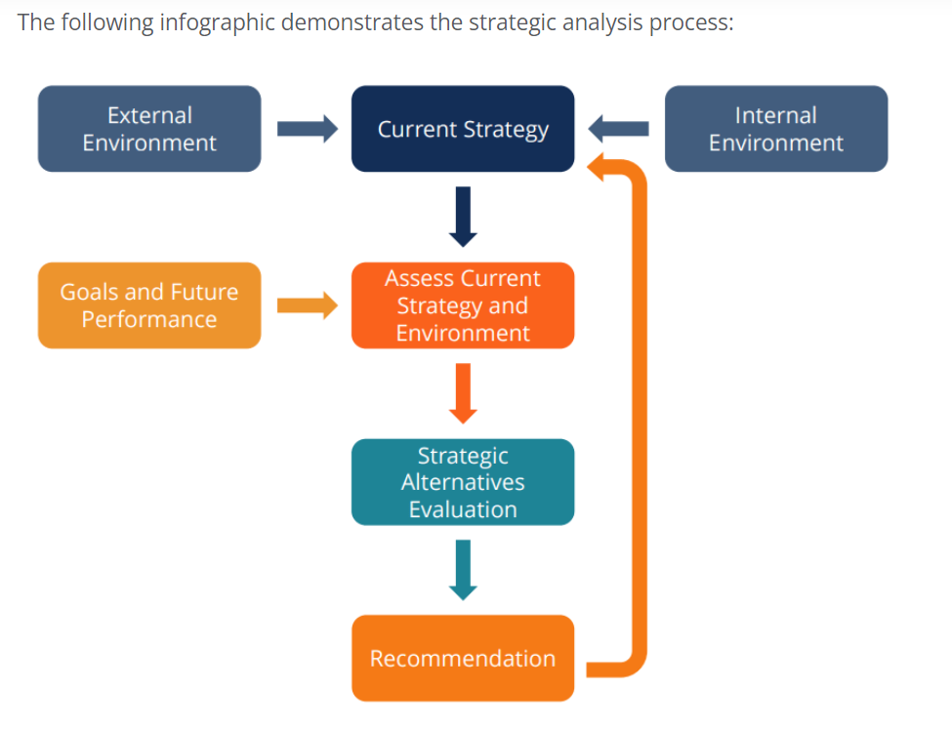

Slide 10
How Good are you?
PESTEL ANALYSIS

Slide 11
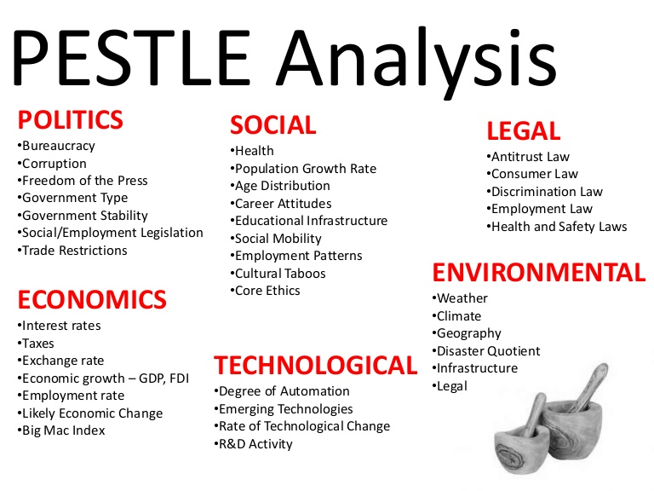

Slide 12
Zomato’s race to capture the Foodtech Market

Slide 13
What is the case all about?
Identify the dilemma in the case.
List the factors that have resulted in growth of FoodTech Industry in India

Slide 14
Synopsis in a snapshot!
2018 : Zomato geared up to chart new heights amidst the changing dynamics of the industry on one hand and a co-founder exiting the company on the other hand.
Zomato started in 2008 as a restaurant discovery platform offering users the ability to access restaurant menus and post online reviews.
It provided a range of value-added services for both its restaurant partners and end customers. Its vertical integration enabled it to grow its revenues across its three lines of business, namely, dining out, delivery and sustainability.
Zomato was an early internet startup that expanded rapidly in the international markets.
In the past ten years, the company both scaled and rolled back its operations with unique lessons learned in each market that paved its path for success both locally and globally.
The domestic market was being dominated by a few large players sharing the market.
Reports by market intelligence firms showed that Swiggy, the closest competitor was starting to dominate Zomato in India.
Deepinder, CEO, Zomato’s dilemma for adding value and increasing revenues by weighing options of whether the company should strengthen its presence in the domestic market, or, venture into foreign markets or serve both local and foreign markets.

Slide 15
Let’s do it together
Conduct a SWOT Analysis of Zomato
Critically discuss about the strategies adopted by Zomato to survive and sustain
Critically analyze the Value Chain Analysis of Zomato.

Slide 16
Value Chain
The value chain is concentrating on the activities starting with raw materials till the conversion into final goods or services.
Two categories:
  Primary Activities (operations, distribution, sales)
  Support Activities (R&D, Human Resources)

Slide 17
Value Chain Analysis
A firm determines the costs associated with organizational activities from purchasing raw materials to manufacturing product(s) to marketing those products
Aims to identify where low-cost advantages or disadvantages exist anywhere along the value chain from raw material to customer service activities

Slide 18
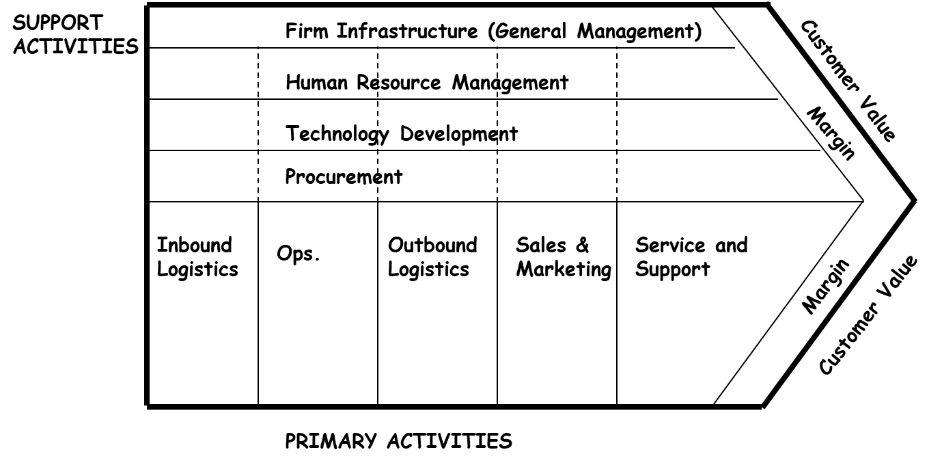
Value Chain Model
Can you do a Value Chain Analysis for Zomato?

Slide 19
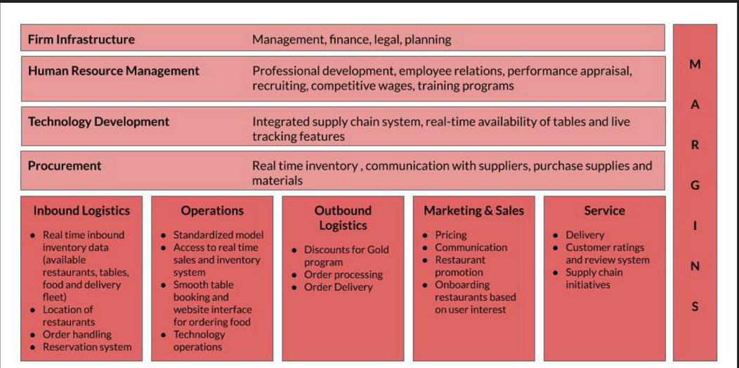
Value Chain Model- Zomato

Slide 20
Benefit of Doing Value Chain Analysis
The sources of the competitive advantage of a firm can be seen from its discrete activities and how they interact with one one another.
The value chain is a tool for systematically examining the activities of a firm and how they interact with one another and affect each other’s cost and performance.
A firm gains a competitive advantage by performing these activities better or at lower cost than competitors.
Helps you to stay out of the “No Profit Zone”
Presents opportunities for integration
Aligns spending with value processes

Slide 21
To move on
Elaborate on the value proposition of Zomato using Delivery, Dining and Sustainability model.
Critically introspect the Delivery, Dining, and Sustainability model and its impact on revenues and customer acquisition?
What is the message from the “marketing strategy” adopted by the company?

Slide 22
Value Proposition
Value proposition is a business or a marketing strategy wherein a company promises its customers to deliver value in exchange for the product or service they buy.
It is a statement that briefly explains and convinces a potential customer to buy the product from your company rather than some competitor.

Slide 23
What are the key insights drawn from Exhibit 4 related to the various parameters? Can you identify areas where Zomato can improve? Prescribe ways how it can be done?
Similarly, what are the insights drawn from Exhibit 5. Provide scope for improvement for Zomato.
Why is Zomato expanding inorganically? – Why is this move necessary? – Evaluate the pros and cons.

Slide 24
Discuss how Zomato’s business model evolved over the years?
Zomato initially started as a search and discovery platform for restaurants where users can find restaurants nearby across a range of filters like geography, price, cuisines, restaurant timings (breakfast, lunch, dinner, etc.) among other options.
It enabled users to access menus from the restaurants and encouraged users to actively engage with the platform through its reviews and rating option which helped it build upon user-generated content.
The company’s primary source of revenue was selling ad spaces to its restaurant partners through sponsored listings.
In 2015, Zomato ventured into the food delivery business as a reactive move to the existing players in the foodtech space.
In this business model, the company charged 10%–15% of the price from its restaurant partners for online ordering with additional commissions for delivery by Zomato.

Slide 25
It has slowly moved from outsourcing delivery to internalizing logistics as it now contributes to a major share of its revenue.
Zomato had also launched subscription programs for its loyal customers to add another stable revenue stream to the organization. The membership services had slowly decreased the customer acquisition cost for the company and also ensured customer retention on the platform.
As a proactive approach to complete the farm to fork model, Zomato entered the business of helping its restaurant partners procure the latest fresh and clean food ingredients through its initiative Hyperpure which was adding a fresh channel of revenue to the organization.
Zomato also generated revenues through its events ticketing and printed food guides in evolutionary stages.
The timeline of Zomato’s growth has been presented for quick reference of the facilitators (see Exhibit 4).

Slide 26
Evaluate Zomato’s business model and discuss the value proposition using the Business Model Canvas (BMC)
https://miro.com/templates/business-model-canvas/
https://www.strategyzer.com/canvas/business-model-canvas?url=canvas/bmc
https://canvanizer.com/new/business-model-canvas#

Slide 27
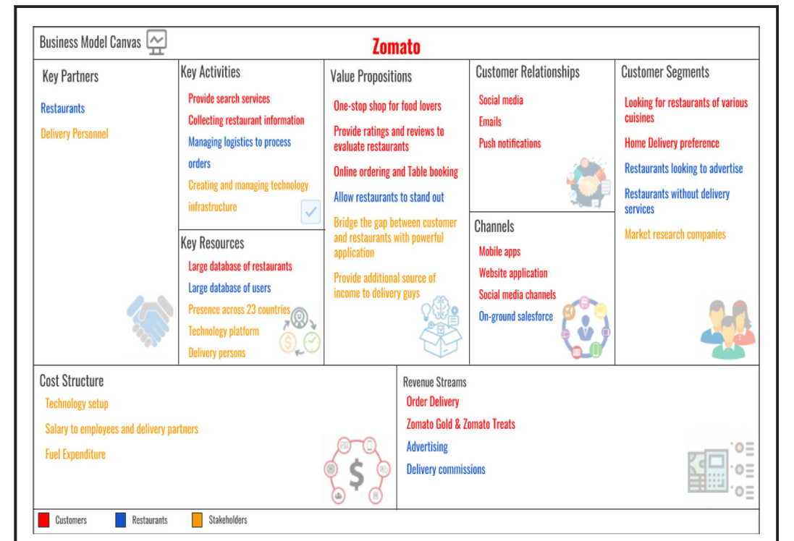

Slide 28
What was Zomato’s strategy for maintaining its stronghold in India? Do they need to be revisited?
Factors such as technological innovation, consumer demand, supplier relationships, regulations and competition influence the competitiveness of a firm in a market.
India’s foodtech industry was pioneered by Zomato which initially offered its services downstream of the agri-food value chain. Although Zomato responded late to the new challenges in the foodtech industry by commencing its food delivery arm in 2015, it was soon able to catch up with its rivals, given its existing supplier and customer network

Slide 29
India was a major market for Zomato since it launched its restaurant discovery operations since 2008. The company gradually moved to a delivery model in May 2015 and the market was expected to reach US$2.5–3.5bn by 2021.
Zomato also witnessed several logistics start-ups entering the mobile food delivery space, Swiggy, in particular, leading this race with investments totalling $1.5bn until 2018, giving severe competition to Zomato.
Given its early beginner advantage, Zomato was able to explore different initiatives across products and services that were experimented on both locally and globally, and the company retained the successful ones, which helped them build a loyal base of customers in India (Exhibit 6)

Slide 30
Their existing network helped them to quickly scale their food delivery wing in a short span, especially in 2008.
The growth in smartphone and internet penetration in recent years, aided internet firms like Zomato to truly uncap the revenue potential of tier 1, tier 2 and other markets that were previously exited from or were unexplored, thus giving them a first-mover advantage.
The foodtech industry in India witnessed a massive shift when Swiggy entered the market in 2014 with its focus on logistics and soon started capturing a major share in the food delivery business (Exhibit 5)

Slide 31
How do firms create and capture value abroad? What strategies should be adopted by Zomato to capture value abroad?
Firms need concrete global strategies to succeed in global markets. They capitalise on similarities or/and differences across markets.
Strategies adopted by firms when creating value abroad includes three types of strategies:
  deployment strategy,
  development strategy
  deepening strategies

Slide 32
Deployment strategies
Firms employing deployment strategies target a homogenous segment of customers globally.
The core products and services offered and the way it is delivered are the same across markets.
The firm focuses on similarities rather than differences across markets.
It adapts its products and operations to a small extent for the sake of maximising the local demand.
Firms emphasize replication and standardization over adaptation and customisation.
Concentration enables firms to tap the comparative advantages such as low wages, natural resources and economies of scale of a given country.
However, such strategies may escalate inflation costs and be affected due to the uncertainties that impact supply chains
Link:
https://www.industryweek.com/leadership/strategic-planning-execution/article/21962381/strategic-deployment-how-to-think-like-toyota

Slide 33
Development strategies
Firms employing development strategies leverage on differences in the locations owing to the unique endowments of different locations.
Endowments could be geographic such as natural ports or institutions such as the availability of research centres.
Firms employing development strategies diversify globally and capture value by identifying, acquiring, and integrating new and potential capabilities across markets.
Sometimes, the firm launches better products to increase the customer’s willingness to pay or reduce costs by improving production and procurement processes.
For an organisation to develop a successful development strategy, the new market should be different enough to provide the firm with a unique capability but not so different that the capability cannot be replicated elsewhere.

Slide 34
Deepening strategies
Firms adopting deepening strategies capitalise on the differences and similarities across markets. The firm grows its competitive advantage without changing its primary business model but by reducing the costs and increasing consumer willingness to pay.
Cost reduction through economies of scale and scope is specific to an organisation and hence competitors may not be able to replicate.
Another set of deepening strategies is to increase customer willingness to pay by adapting to local demand, leveraging the firm’s presence, or enforcing market power.

Slide 35
What Zomato adopted?
Zomato aggregated demand across its overseas markets which is similar to a domestic business growth strategy (Alcacer, 2015).
To achieve a similar willingness to pay across markets, Zomato targeted similar segments of customers across countries, focusing on similarities rather than dissimilarities across markets.
Zomato adapted its products and operations to a small degree in foreign markets to maximize the local demand, however keeping its core service offerings remained the same.
Service replication in other countries also required the company to adhere to the local legislation. The company aimed at replicating the Indian business model for its products in other countries. It was standardizing processes, products and cultures across countries.

Slide 36
Discuss Zomato’s target market selection process. Why do you think Zomato has chosen acquisition as a mode of entry in the foreign markets?
The process of the global strategy selection comprises seven dimensions (Alcacer, 2015):
  1. the goal the organisation wants to pursue;
  2. the product the organisation wants to offer across countries;
  3. the extent of concentration of the value chain in a country;
  4. similarities/differences across locations for capturing and creating value;
  5. the firm’s existing capabilities or those it wishes to develop;
  6. processes of the firm for successful expansion overseas; and
  7. ownership or mode of entry into another market

Slide 37
Companies employ strategic discipline in selecting the markets they serve, the timing of entry into these markets and evaluating the relative advantages of direct/indirect presence in various markets.
International expansion depends on customer demand.
Sometimes companies may leverage on the first mover by moving into the market first and securing long-term competitive advantage.
Key factors in selecting global markets include:
  market size and growth rate;
  institutional contexts of the country;
  competitive environment of the region; and Cultural, Administrative, Geographic and Economic (CAGE) distance of the market from other markets that the company currently serves (Cornelis, 2010).
Institutional context analysis of a country refers to the analysis of (a) political and social systems, (b) openness, (c) product markets, (d) labour markets and (e) capital markets (Tarun & Krishna, 2010; Cornelis, 2010).

Slide 38
Entry Modes
  Firms may choose to export, license their products, acquire other firms or start subsidiaries. Companies move from exporting to a higher investment strategy such as acquisitions and joint ventures.
  Firms consider the following incentives when considering joint ventures – (a) facilitating market entry, (b) risk and reward sharing (c) technology sharing (d) conforming to government regulations.
  Firms may consider an acquisition in other countries when they need a high degree of control in the operations and gain a better understanding of the consumers and competitors. Acquisitions need a huge commitment of resources and commitment (De Kluyver, 2010).

Slide 39
Should the company penetrate deeper into the Indian markets or expand into foreign markets? Discuss the way forward for Zomato.
Option 1: Penetrate deeper into the Indian market by generating revenues from its existing lines of businesses
Option 2: Continue its international expansion by testing markets with selected products/services and deepening its presence.
Option 3: Explore new but related lines of business for expansion in the future. How would the strategies of the firm evolve as the competition increases in the local market

Slide 40
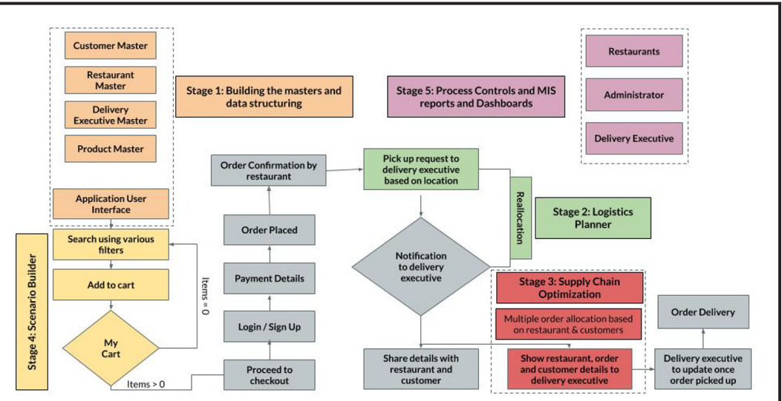
Zomato’s Business Processes

Slide 41
What else to explore?

Slide 42
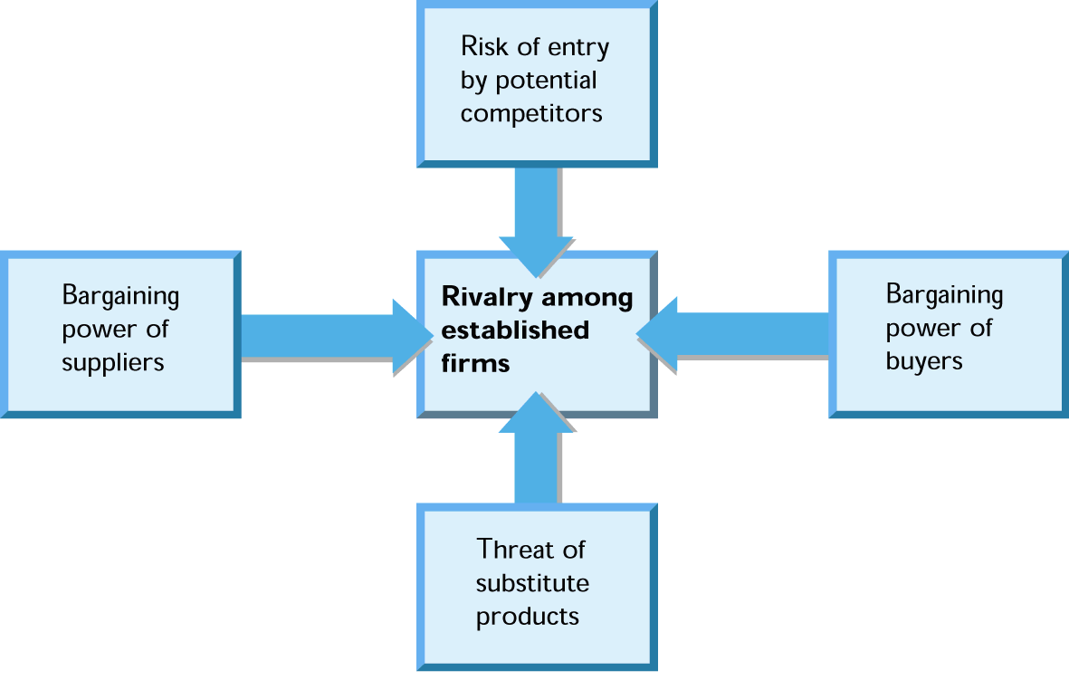
Porter’s five force analysis

Slide 43
Potential Competitors
New entrants into an industry threaten incumbent companies.
Barriers to entry:
  Brand loyalty
  Absolute cost advantages
  Economies of scale
  Switching costs
  Government regulation
Entry barriers reduce the threat
of new and additional competition.

Slide 44
Rivalry Among Established Companies
The intensity of competitive rivalry in an industry arises from:
  Industry’s competitive structure.
  Demand (growth or decline) conditions in industry.
  Height of industry exit barriers.

Slide 45
The Bargaining Power of Buyers
Buyers are most powerful when:
  There are many small sellers and few large buyers.
  Buyers purchase in large quantities.
  A single buyer is a large customer to a firm.
  Buyers can switch suppliers at low cost.
  Buyers purchase from multiple sellers at once.
  Buyers can easily vertically integrate to compete with suppliers.

Slide 46
The Bargaining Power of Suppliers
Suppliers have bargaining power when:
  Their products have few substitutes and are important to buyers.
  The buyer’s industry is not an important customer to the supplier.
  Differentiation makes it costly for buyers to switch suppliers.
  Suppliers can vertically integrate forward to compete with buyers and buyers can’t integrate backward to supply their own needs.

Slide 47
Substitute products
The competitive threat of substitute products increases as they come closer to serving similar customer needs.

Slide 48
A Sixth Force: Complementors
Complementors:
  Companies whose products are sold in tandem with another company’s products.
  Increased supply of a complementary product collaterally increases demand for the primary product.
Example:
  Faster CPU chips fuel sales of personal computers.

Slide 49
Exploring different levels of Strategy
Corporate office
SBU
A
SBU
B
Finance
Marketing
Operations
Personnel
SBU
C
} Corporate Strategy
} Business Level Strategy
} Functional Level Strategy

Slide 50
Levels of Strategy
Corporate strategy —this strategy seeks to determine what businesses a company should be in or wants to be in. Corporate strategy determines the direction that the organization is going and the roles that each business unit in the organization will plan in pursuing that direction.
Business strategy —this strategy seeks to determine how an organization should compete in each of its businesses.
Functional strategy —this strategy seeks to determine how to support the business strategy

Slide 51
Corporate Strategies
Corporate strategy is basically concerned with the choice of business, products and markets
It tries to answer key questions like what business the firm should be in terms of range of products it supplies ?
What should be the optimal geographic spread of activities for the firm?
What range of vertically linked activities should the firm encompass?
How the corporate office should manage its group of business?

Slide 52
Business Level Strategies
Business-level strategies are intended to create differences between the firm’s position relative to those of its rivals.
To position itself, the firm must decide whether it intends to perform activities differently or to perform different activities as compared to its rivals.

Slide 53
Cost Leadership: Ex Walmart
Differentiation: Ex: Starbucks
Focused Differentiation Strategy: Rolex, Rolls Royce
Focused cost leadership: IKEA
Cost Uniqueness
Broad Target
Cost leadership
Differentiation
Competitive
Scope
Integrated Cost Leadership/ Differentiation
Focused Cost
leadership
Focused
Differentiation
Narrow Target

Slide 54
ORGANIC VS. INORGANIC GROWTH
Organic growth comes from expanding your organization’s output and by engaging in internal activities that increase revenue.
Inorganic growth comes from mergers, acquisitions, and joint ventures.
Observation:
  Whether you choose to grow your organization organically or inorganically, your greatest focus should be on doing so in the most strategic way possible.
  Formulate the best strategy based on your company’s current health, competition, industry trends, and financial capacity, then design a strong business case around that strategy by projecting short- and long-term financial forecasts.
  Having this level of detail for whichever strategy you commit to will give you a detailed blueprint to make the most intelligent decisions to support and sustain growth.

Slide 55
Blue Ocean Strategy Vs Red Ocean Strategy
https://www.cascade.app/blog/blue-ocean-vs-red-ocean-strategy
Creates uncontested Market Place | Compete in existing Market Place
Makes the competition Irrelevant | Beat the competition
Create and Capture New Demand | Exploit Existing Demand
Break the Value-Cost trade-off | Make the Value-Cost trade-off
Align the whole system of a firm’s activities in pursuit of differentiation and low cost | Align the whole system of a firm’s activities with it’s strategic choice of differentiation and low cost
OYO, uber | iPhone, Jio

Slide 56
Why so much effort?

Slide 57
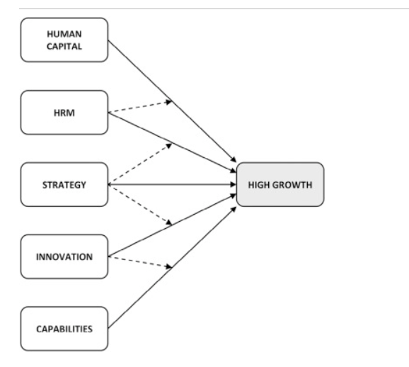
…outcome is GROWTH

Slide 58
Happy exploration!

