Slide 1

Strategies, Policies, and Planning Premises
EPBM
Instructor:
Dr. Sushil Kumar
Assistant Professor
Entrepreneurship , IIM Visakhapatnam

Slide 2
The Nature and Purpose of Strategies and Policies
Strategy
  Determination of the mission or purpose and the basic long-term objectives of an enterprise, followed by the adoption of courses of action and allocation of resources necessary to achieve these aims. Therefore, objectives are a part of strategy formulation.
Policies
  General statements or understandings that guide managers’ thinking in decision making. They ensure that decisions fall within certain boundaries. They usually do not require action but are intended to guide managers in their commitment to the decision they ultimately make.

Slide 3
The Strategic Planning Process
Inputs to the Organization
Industry Analysis: the formulation of a strategy requires the evaluation of the attractiveness of an industry by analysing the external environment. The focus should be on the kind of competition within an industry, the possibility of new firms entering the market, the availability of substitute products or services, and the bargaining position of the suppliers as well as the buyers or customers.
Enterprise Profile: The enterprise profile is usually the starting point for determining where the company is and where it should go. THUS, top managers determine the enterprises mission and clarify its geographic orientation such as whether it should operate in selected regions throughout the home country or even in different countries. In addition, managers access the competitive position of the firm.

Slide 4
The Strategic Planning Process
Orientation, Values, and Vision of Executives: the enterprise profile is shaped by people especially executives and their orientation and values are important for formulating the strategy.
They set the organizational climate and determine direction of the firm throughout their vision that answer the question “what do we want to become?” consequently, their values, their preferences, and their attitudes towards risks have to be carefully examined because they have an impact on the strategy.

Slide 5
The Strategic Planning Process
Mission (Purpose), Major Objectives, and Strategic Intent: the mission also sometimes called the purpose is the answer to question “what is our business?” the major objectives are the end points towards with the activities of the enterprise are directed.
Strategic intent is the commitment to win in the comparative environment professor Gary Hamel and CK Prahalad analyst companies that have achieved global leadership. They found that these firms had an obsession with winning not only at the top level but also throughout the organization this obsession is called strategic intent and is illustrated by Komatsu’s intent to “encircle Caterpillar”. The intent statement is stable over time and focuses on the essence of winning

Slide 6
The Strategic Planning Process
Present and Future External Environment: the present and future external environment must be assessed in terms of threats and opportunities. The evaluation focuses on the competitive situation as well as on economic,social, political, legal, demographic and geographic factors. In edition the environment is scanned for technological development, for products and services on the market, and for other pertinent factors in determining the competitive situation of the enterprise

Slide 7
The Strategic Planning Process
Internal Environment: similarly, the firm’s internal environment should be audited and evaluated with respect to its resources and its weaknesses and strengths in research and development production ,operation, procurement, marketing ,products and services. Other internal factors that are important for formulating a strategy should be assessed, including human and financial resources as well as the company image.

Slide 8
The Strategic Planning Process
Development of Alternative Strategies: strategic alternatives are developed on the basis of an analysis of external and internal environment an organization may pursue many different kinds of strategies.

Slide 9
The Strategic Planning Process
Evaluation and Choice of Strategies: various strategies have to be carefully evaluated before the choice is made strategic choices must be considered in light of the risks involved in particular decision. Some profitable opportunities may not be pursued because failure in a risky venture could result in bankruptcy of the firm.

Slide 10
Consistency Testing and Contingency Planning: the last key aspect of strategic planning process testing for consistency and preparing for contingencies full stock during all phases of the strategic planning process, consistency testing is essential. Since the future cannot be predicted with a high degree of certainty, contingency plans lead to be prepared.

Slide 11
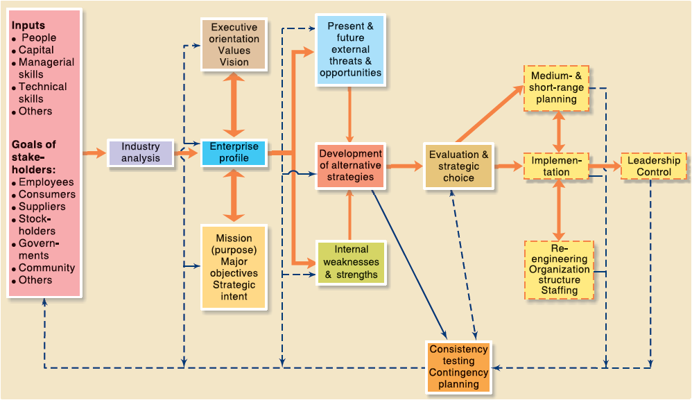
Strategic planning process model

Slide 12

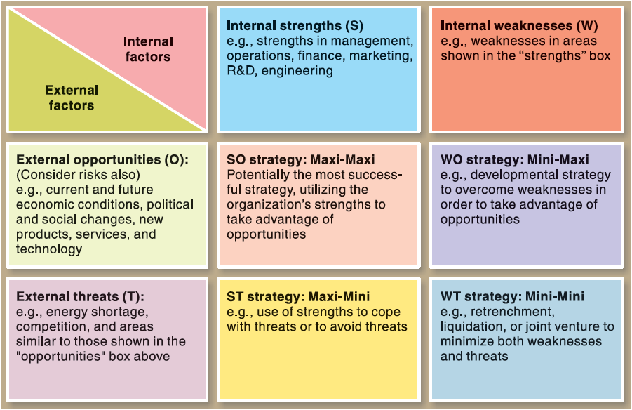
The TOWS Matrix:
A Modern Tool for Analysis of the Situation

Slide 13
The TOWS matrix a modern tool for analysis of the situation
The tows matrix has been introduced for analysing the competitive situation of the company or even of nation that leads to the development of 4 distinct set of strategic alternatives.
The toes matrix has a wider scope and a different emphasis from the business portfolio matrix.
The former does not replace the latter the tows matrix is a conceptual framework for systematic analysis that facilitates matching of external threats and opportunities with the internal weaknesses and strengths of the organization.
It is common to suggest that company should identify their strengths and weaknesses as well as the opportunities and threats in the external environment; but what is often overlooked is that combining these factors may require distinct strategic choices

Slide 14
The TOWS matrix
Four alternative strategies: The strategies are based on the analysis of the external environment and the internal environment.
The WT strategy aims to minimise both witnesses and threats and may be called the mini- mini strategy. It may require that the company, for example former joint venture retrench or even liquidate
The WO strategy attempts to minimise the weaknesses and maximise the opportunities. That's a firm with weaknesses in some areas may either develop those areas within the enterprise or acquire the needed competencies from outside, in order to enable it to take advantage of opportunities in the external environment.

Slide 15
The TOWS matrix
3. The ST strategy is based on using the organisations strengths to deal with threats in the environment. The aim is to maximise the former while minimising the latter. Thus, company may use its technological, financial, managerial or marketing strengths to cope with the threats of a new product introduced by its competitor.
4. The SO strategy, which capitalises on a company's strength to take advantages of opportunities is the most desirable. Indeed, it is the aim of enterprise to move from one positions in the matrix to this one. If they have weaknesses, they will strike to overcome them making them strength full stuff if they feel threats they will cope with them so that they can focus on opportunities.

Slide 16
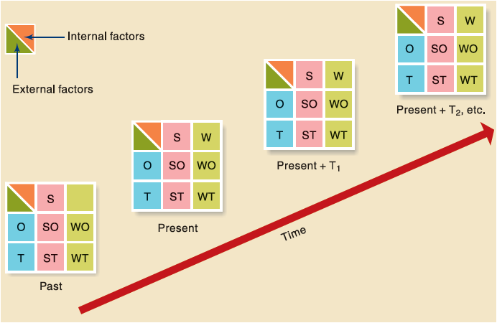
Time Dimension and the TOWS Matrix
Application of the TOWS Merger Matrix for Mergers, Acquisitions, Joint Ventures, and Alliances
Dynamics of the TOWS
Matrix

Slide 17
Blue Ocean Strategy: In Pursuit of Opportunities in an Uncontested Market
Traditional competitive strategies, operating in the red ocean, aimed at beating the competition in an existing market. Companies tried to be better than their competitors.
The blue ocean strategy, by contrast, focuses on the uncontested market by offering a product or service that is unique in a market space where there is no competitor, thus making competition irrelevant.

Slide 18
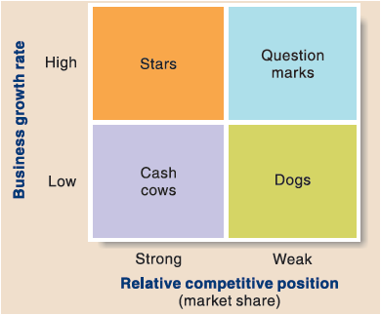
The Portfolio Matrix: A Tool for
Allocating Resources
The Boston Consulting Group developed the business portfolio matrix.

Slide 19
Major Kinds of Strategies and Policies
Products or Services: what is a business?
Who are our customers ?
what do our customers want?
How much will our customers buy and at what price? Do we wish to be a product leader?
what is a competitive advantage? do we wish to develop our own new products?
what advantages do we have in serving customer needs ?
how should be respond existing and potential competition ?
how far can we go in serving customer needs what profits can we expect?

Slide 20
Porter’s Industry Analysis and Generic
Competitive Strategies
Industry Analysis
Overall Cost Leadership Strategy
Differentiation Strategy
Focused Strategy

Slide 21

Premising and Forecasting
Environmental Forecasting
  Values and Areas of Forecasting
  Forecasting with the Delphi Technique

