Slide 1

Strategic Perspective to Analytics
Session – 1 and 2
Dr. Pooja Patnaik

Slide 2
Flowchart
Aligning HR analytics with Organizational strategies
Manpower Succession Planning
Training design, Investments, and Effectiveness
Case Study: Closed loop: The Art of Succession Planning

Slide 3
What we “HR” do?
Vis-a-Vis
How are we “HR” seen as?

Slide 4
Your help!
ABC is a financial service organization. ABC has the problem of high turnover? You get a call from ABC organization and are told that employees are leaving company and that the employees are complaining about salary issues. As a result they are leaving. How will you help ABC organization?

Slide 5
Google- Team Oxygen
To investigate
H1: Do we really need “managers”?
Methodology
    Survey Questionnaire
    FGDs
    Exit Interviews and Stay Interviews
Result
Do we really need “managers”- Discarded
Findings
Millennials don’t want to be micromanaged in terms of technical skills they need assistance with respect to career guidance

Slide 6
What are the typical Problems you face in your department?
How do you handle them?

Slide 7
HR Challenges
Recruitment and Selection
Retention
Attrition
Performance
Compensation
Talent Management
Succession Planning
Productivity
Engaging and Motivated workforce
What are the things that you take care while handling such complexities?

Slide 8
What’s the best thing that an HR can give an employee?

Slide 9
A company that can win in the Marketplace

Slide 10
The why and what of strategic perspective of analytics?

Slide 11
Need to learn about the Strategic Perspective of Analytics
VUCA and BANI → Decision Making
Transformation
In light of the rapid changes in technology and the environment, traditional HR metrics have become unsuitable for many situations (Fink, 2010; Handa and Garima, 2014; Sharif, 2015).
Root cause of the problem is that HR today is mostly doing descriptive analysis by presenting transactional measurements of HR functional tasks which lacks analytical insight
The HR department has data but are unable to make the best use of the data that can take the company to the next level
Using the data, we need to apply the required tools and techniques to get the output and derive meaning from it.

Slide 12
1. What is Strategy?
Delivering the right results
Making Data Driven Decisions
Understanding the business
Identifying the key issues
Assessing business readiness
Unraveling the measures of success
Are you giving VALUE to the company!

Slide 13
2. What is Strategic Perspective of Analytics?
“In God we trust. All others bring data.” — Edward Deming
Integrating data in decision-making!
→ Strategic Decision-Making
Using the immense power and potential of HR analytics, which can provide predictive and prescriptive insights by using its knowledge and experience of the workforce demographics, skill, competency and performance profiles. It not only helps the hiring managers to source the right talent but also identify employees who are at risk of leaving, especially the key performers, conduct TNA, conduct manpower planning and check the effectiveness of the HR activities

Slide 14
The Paradigm Shift
FROM
delivery of clerical and administrative services
satisfying legal requirements
administrative compliance requirements
TO
HR in Strategic Decision-making

Slide 15
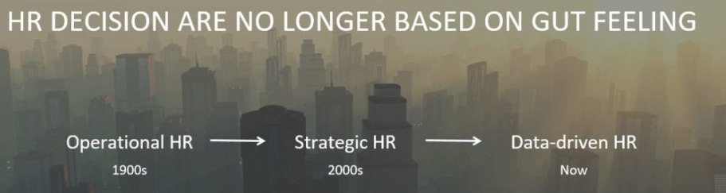
From Intuition to Data Fusion

Slide 16
Overview and Introduction to HR Analytics
HR analytics, also referred to as people analytics, workforce analytics, or talent analytics, involves gathering together, analyzing, and reporting HR data.
HR analytics is a data-driven approach toward Human Resources Management.
From Recruitment- Attrition
  Data to derive better outcomes.

Slide 17
Understand Business Problem
Gather Data
Data Preparation
Model Building
Model Evaluation

Slide 18
Inshorts!
Business Problem
1. Understand project objectives
2. Define your problem
3. Investigate questions
4. Convert into statistical problem
1. Identify sources of data 2. Define Variables
3. Collect Data
Data preparation
1.Regression analysis,
2. Factor analysis
Gather Data
Model Building
1. Data Cleaning
-Missing values. Outliers, Normalize the data
2. Slicing and dicing the data
Model Evaluation
1. Generate Output
Robustness Check
3. Use various Fit Indices

Slide 19
HR Analytics- Informed Decision
Quantitative and qualitative data and information management that aims to gain insight and support decision-making processes with regard to managing people in organizations (Fitz-enz, 2000; Handa and Garima, 2014; Zhao and Carlton, 2015).
“A HR practice enabled by information technology that uses descriptive, visual and statistical analyses of data related to HR processes, human capital, organizational performance and external economic benchmarks to establish business impact and to enable data-driven decision-making” (p. 15).

Slide 20
Goals of HR Analytics
To gather and maintain data for predicting short and long-term trends in the supply and demands of workers in different industries and occupations and to help global organizations make decisions relating to optimal acquisition, development and retention of their human capital” (Kapoor and Sherif, 2012, p. 1627).
To provide an organization with insights for effectively managing employees in order to achieve business goals quickly and efficiently” (Davenport et al., 2010; Hota and Ghosh, 2013, p. 169).
To positively influence the successful execution of an organization’s strategy (Heuvel and Bondarouk, 2016; Huselid, 2015; Kapoor and Sherif, 2012; Levenson, 2005; Levenson, 2011; Zang and Ye, 2015).

Slide 21
Data Points for HR Problems!-General
Absenteeism
Disciplinary procedure
Grievance procedure
Authority and accountability
Functions
Teams
Workplace cultures (OCTAPACE)
Compensation, Incentives
Contracts of employment
Job descriptions
Health and Safety at workplaces
Retention
Recruitment
Turnover

Slide 22
What happens when you go to a doctor?

Slide 23
Types of HR Analytics
Descriptive
Diagnostics
Predictive
Prescriptive

Slide 24
Descriptive analytics
Frequently used
Historical data and summarizing it into something that is understandable.
For example, a headcount report of all employees within the organization is a form of descriptive analytics. More sophisticated metrics like turnover rates or time-to-fill would be descriptive as well.

Slide 25
Diagnostics analytics
Why Certain things happened?
When there is a single root cause of the problem then diagnostics analysis can be quick and simple.
It involves multiple steps to probe a business question or an issue. This analysis is performed as a sequence of questions that the management would like to know about an event or an anomaly.

Slide 26
Predictive Analytics
Where descriptive analytics look backward, predictive analytics work to look ahead.
Statistical models and forecasts are used to answer the question of what could happen.
Models are built on patterns that were found within the descriptive analytics.
The goal is to proactively find the needs of the organization.
Predictive analytics can help talent acquisition teams determine if someone will be a good cultural fit for the organization before they’re hired.
It could even provide estimations on how long the person will stay with the company.

Slide 27
Prescriptive Analytics
Once the future is predicted, the next question is what can we do about it.
Prescriptive analytics provides recommendations on what to do based on predictions and what has occurred in the past.
This analytical approach can be highly beneficial for organizations with peak or busy seasons.
A retailer will want to know how many people to staff during the holidays. Or a park might need to know how many to staff during the summer months.
Prescriptive analytics could even help determine how to properly onboard a new hire, based on their skills and strengths, and across the employee life cycle.

Slide 28
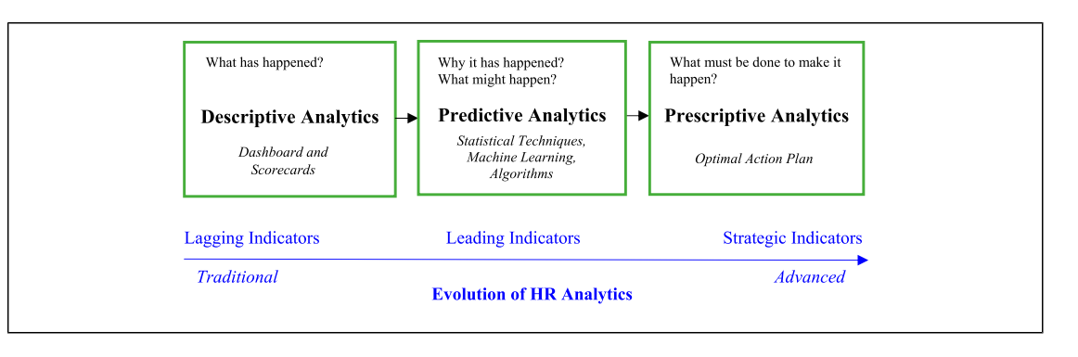
Evolution of HR Analytics

Slide 29
Application…
Human resources metrics report employee churn rate (what happened? i.e., descriptive analytics) and describe why employees leave (Why did this happen? i.e., diagnostic analytics) by using exit surveys or termination reason c HR managers to predict which employees are most likely to leave the company (What might happen? i.e., predictive analytics) and then provide data-driven insights to implement the action plan and prevent talent loss (i.e., prescriptive analytics).

Slide 30
Pause and Think
You happen to work in an organization where Business Performance has declined, Revenue growth plans is not as per target, last three quarters your organizations has not done well. But, from HR perspective things are fine. Employee attrition is under control, Employee cost is within control, Employee satisfaction is reasonably good!
But, there is a business problem? As an HR employee how can you solve this business problem

Slide 31
Solution: my perspective
Where is the problem occurring (Zone and Area)
Which Segment (Specific business units or teams)
What influences this-
  5 W and 1 H
  Is it related to HR activity
  Are the guys who are not working also the ones who got less ratings?
  Are the guys newly hired?
  Are the guys related to same leadership person
  Are thy coming from the same education background/work ex background
  What influences employee behavior- safety, compensation, work stress, well being
  Linking HR to business performance

Slide 32
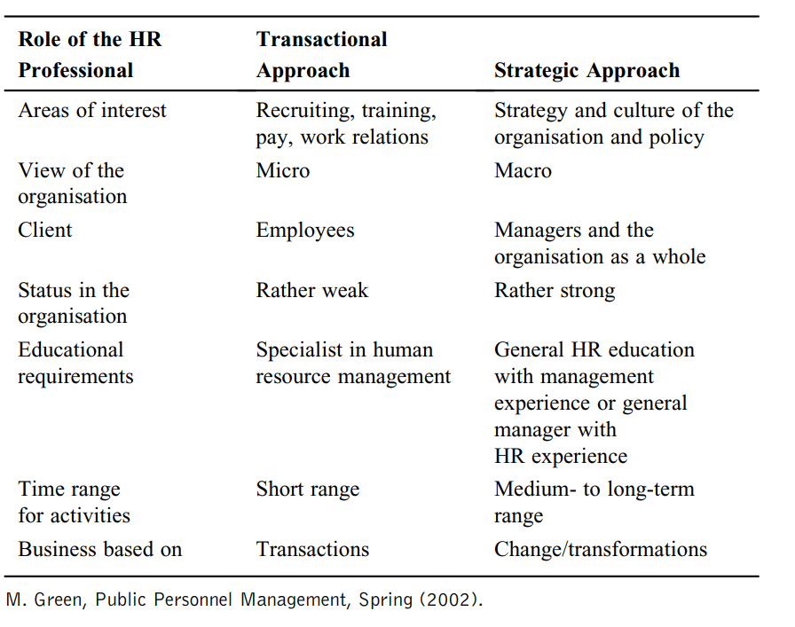

Slide 33
What is the outcome ?
As HR experts how we can effectively integrate
  Analytics + Business Strategy + HR Strategy→ Strategic Decision Making

Slide 34
Reflection

Slide 35
Diving deeper
Application:
  Identify and manage critical talent (e.g., high performers, high potentials, pivotal workers)
  Manage critical workforce segments accordingly (e.g., underperforming units are identified and helped to improve)
  Predict employee preferences and behaviors and tailor HR practices to attract and retain talent
  Forecast business requirements and staffing requirements (e.g., workforce skills needed in different business scenarios)
  Adapt rapidly and scale recruiting supply channels and targets to meet changing business conditions, objectives, and competitive threats.

Slide 36
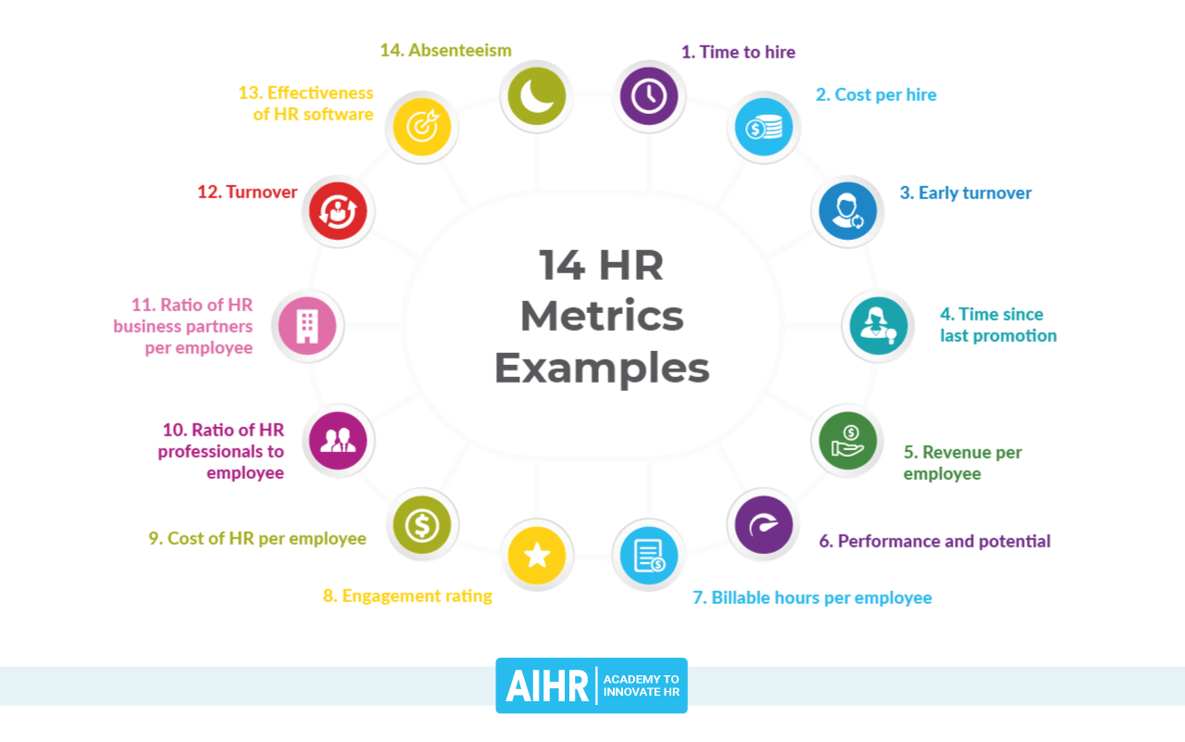
Linking HR Metrics

Slide 37
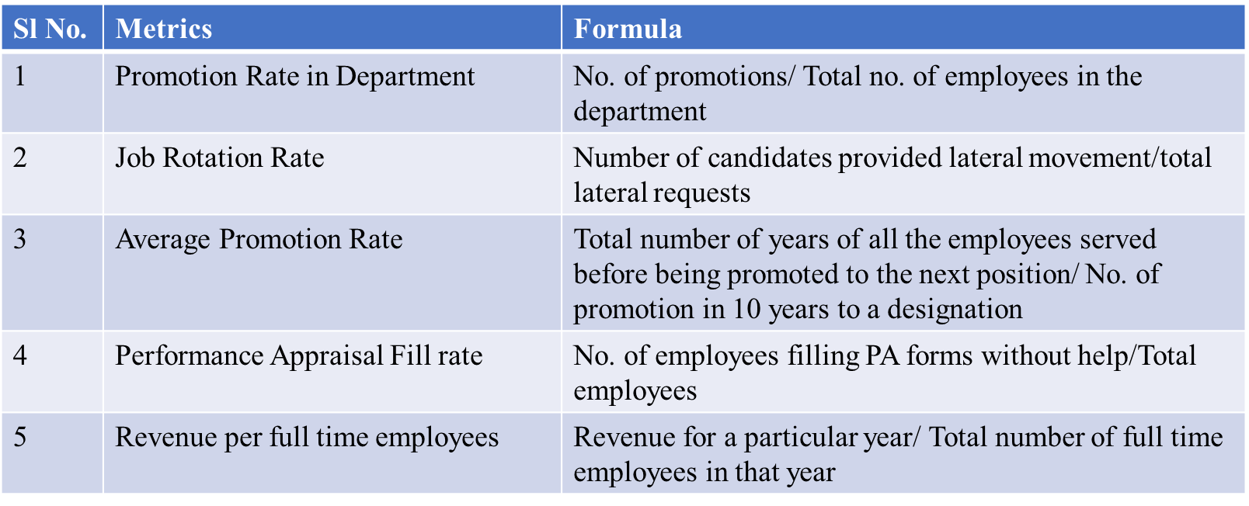
What we know so far? -Few metrics

Slide 38
Absence rate = workdays missed / total workdays scheduled x 100
Acceptance rate = (acceptances / offers) x 100
Average performance rating = (sum of all performance ratings / number of employees) x 100
Cost of HR per employee = total HR compensation / number of employees
Cost per hire = total cost of recruiting and HR staffing / number of new hires
Diversity rate = (total number of employees / number of employees from a diverse background) x 100
Employee referral program success = number of referrals hired / number of open jobs resulting in referrals
Health care costs per employee = total health care costs / number of employees enrolled in health care
Percentage of vacation days used = (number of vacation days used / number of vacation days offered) x 100
Retention rate = number employees staying across time period / number of employees at start of time period x 100

Slide 39
Training completion rate = number of employees who completed training / total number of employees x 100
Training cost per employee = total training costs / number of employees
Training participation rate = (number of participants / number of eligible employees) x 100
Training ROI = (value of increased performance - cost of employee training) / cost of employee training x 100
Turnover rate = number of departures during a specific time period / average number of employees during the same period) x 100

Slide 40
What we need to know?
HR Metrics versus HR Analytics
HR Analytics focuses on = Metrics + Analytics
HR Analytics focuses on how to improve the metrics for enhancing business performance
HR Analytics is interdisciplinary and strategic and hence deploys data not only from HR department but also from other functions inside and outside the organization
HR Metrics focuses on what to measure on Human Capital

Slide 41
HR Analytics will help in more sophisticated and in-depth analysis of all relevant data
HR Analytics can transform data into evidence through organizational capability leading to improved organizational performance
HR Analytics focuses on understanding, quantifying, managing, an improving the role of HR in execution of strategy and creation of value

Slide 42
…Connecting the dots….
HOW HR ANALYTICS IS THEN RELATED TO STRATEGIC DECISION MAKING?
  HR analytics can provide timely insight to HR managers to better justify, prioritize, and improve HR Investments and align them with business performance.
  McKinsey (2021), HR Analytics help organizations to increasing recruiting efficiency by 80%, decrease attrition by 50% and increase business productivity by 25%.

Slide 43
What reports can you get?
  HR analytics generate reports on key performance indicators (KPIs), predict short- and long-term workforce trends and their impact on business performance, and build strategic capability for implementing the action plan.
With HR analytics, HR departments rely on data to execute activities that were traditionally performed in a somewhat intuitive manner. HR needs a detailed understanding of how the organization currently meets the needs of customers, investors, vendors and those areas where there is an opportunity, through its people, to enhance the value the organization is delivering.

Slide 44
As HR experts how we can effectively integrate
  Analytics + Business Strategy + HR Strategy→ Evidenced-Based Strategic Decision Making

Slide 45
Advanced HR analytics integrates with other departments’ teams (marketing, finance, operations, etc.), to become part of cross-functional/end-to-end business analytics to discover the roles of human capital elements in the entire value chain. Advanced HR analytics typically yields truly new insights as it combines multiple functional perspectives (customers, technology, safety, investor perspective, etc.).

Slide 46
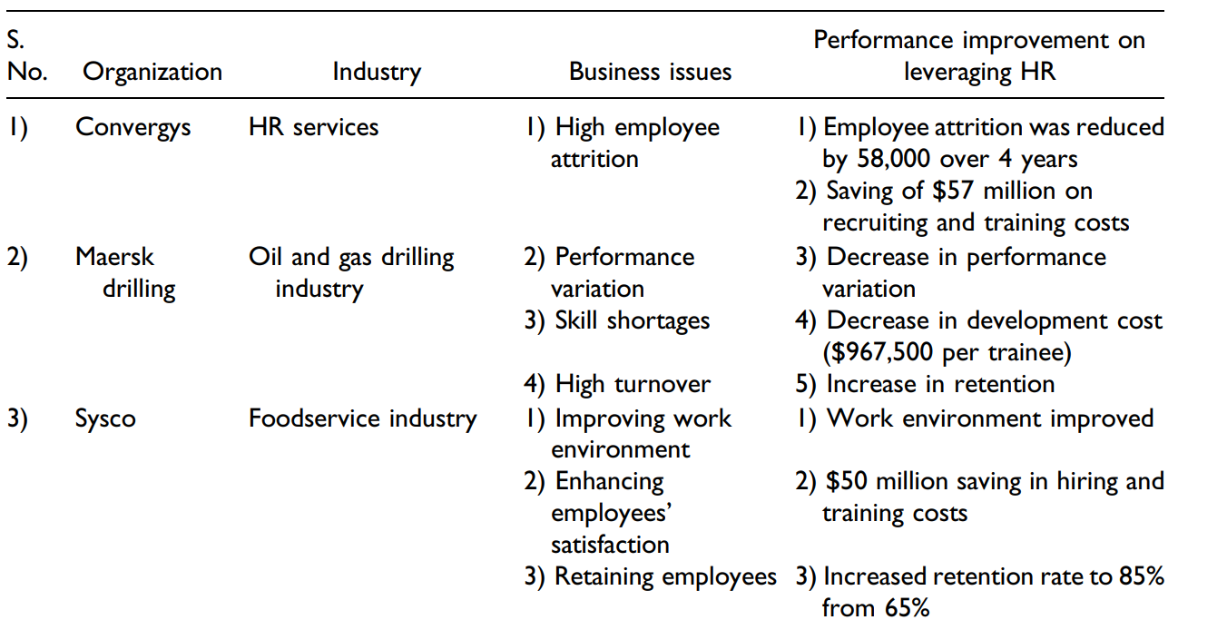
HR Analytics: Successful Deployment in Various Industries
You tell-
What will be the organization strategy?

Slide 47
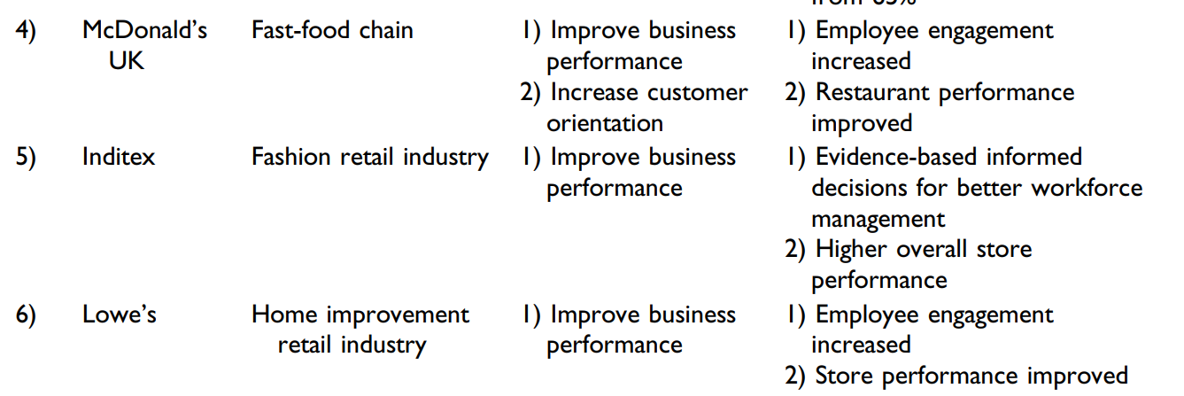

Slide 48
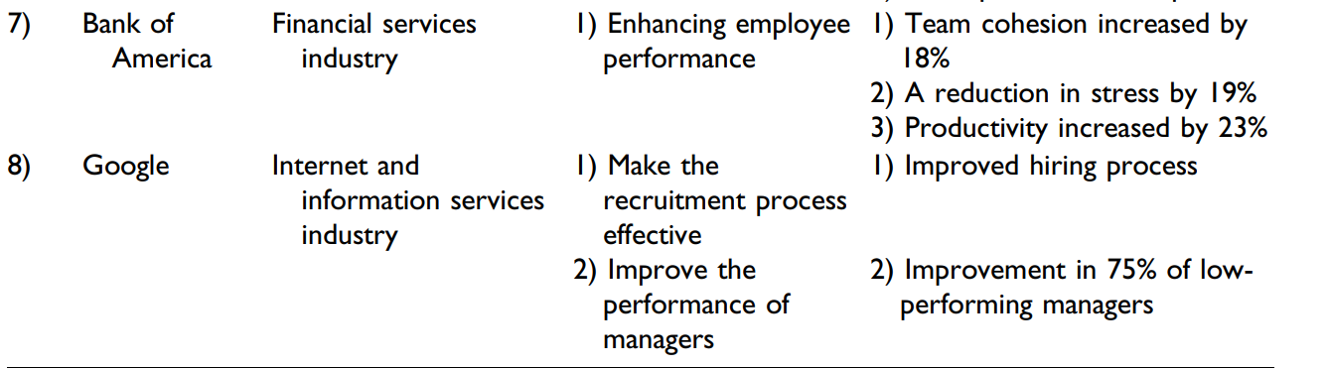

Slide 49
Example of Maersk Drilling
With help of HR analytics, the HR department was interested in identifying: (1) How is the performance between similar drilling rigs operating under similar conditions compared? (descriptive analytics). (2) What explains the variance in operating performance between rigs? (diagnostic analytics) (3) How can that existing knowledge and expertise effectively be deployed to new rigs brought into operation? (prescriptive analytics), and (4) How can the operating results be used to help convince prospective clients that the company will deliver on promised performance standards while growing considerably in a hot market? (predictive analytics)
Maersk Drilling found strong and significant links between leadership quality (measured via a yearly people survey), crew competence (documented according to the industry standards and requirements), safety performance (from the company’s safety system), and environmental performance (documented in the company’s health, safety, and environment (HSE) system according to the offshore industry standards)
Maersk Drilling established a relationship between leadership quality and lower turnover levels, which resulted in higher levels of operator competence which in turn fed through to fewer accidents, less maintenance time, and higher customer satisfaction.
At Maersk Drilling, customer satisfaction was found to depend on the operational performance of business units (i.e., drilling performance/uptime), also company success depends: managers assessed more positively (on various standard leadership tasks) by their subordinates or direct reports have lower crew turnover, and lower turnover is associated with higher crew competence (fewer new people to train), which in turn is related to better safety performance, fewer spills, and fewer maintenance hours outstanding (i.e., the time it takes to fix stuff) which impacts customer satisfaction.

Slide 50
Leadership (or managerial) quality has a positive impact on retention (i.e., employee turnover). Turnover has a negative impact on crew competence. Crew competence has a positive impact on safety as it reduces spills. Also, spills (poor safety performance) have a negative impact on customer satisfaction. Operational performance (measured in uptime) has a direct positive impact on customer satisfaction. Thus, as the final outcome leadership quality also has a positive impact on customer satisfaction.
Thus, following action plan was recommended: (1) Enhancing leadership quality with proper training and an effective selection process, (2) Building crew competence with proper training budget and controls, (3) Using scorecards for maintenance hours outstanding across the fleet (4) Effectively communicating the findings throughout the company to all managers and employees and existing and prospective clients.
Maersk Drilling faced challenges in filling lead specialist positions due to talent shortage in the job market and high industry growth. HR analytics was used to identify that the “company graduate program (for Specialist Trainees)” experimented by Maersk Drilling, showed desirable results on key business outcomes compared with their peer group. The strategic impact of the technical trainee acceleration program was positive as it increased the retention rate, reduced the overall time required to develop into a lead specialist, and reduced total cost prior to the Lead Specialist position ($967,500 per trainee).
Based on these findings enabled by HR analytics, Maersk Drilling decided to double the “company graduate program” intake to sustain its future growth plans. With HR analytics, Maersk Drilling identified the critical role of off-shore drilling managers in managing their teams.
Managers who received more positive evaluations from their employees managed off-shore drilling teams more effectively with lower levels of turnover and absenteeism. Such better-trained teams operated their drilling rigs more efficiently with fewer accidents and maintenance time. The analysis led Maersk to focus more attention on the selection, training, and development of its key managerial talent. HR analytics was treated like a change management process that paved the way for the results to have a positive business impact.
Decision Making evidenced based

Slide 51
Google | Google has a highly analytical culture and practices to support HR analytics in the organization. Google has deployed HR analytics to systematically and rigorously identify critical talents such as key recruiting targets, high-potential employees, and top performers.
 | Google’s Project Oxygen was established to determine the attributes of successful managers (Shrivastava, Nagdev, & Rajesh, 2018).
 | This insight has been incorporated into the managerial training and development programs at Google and has become a part of the day-to-day working style of managers.
 | A year after the HR analytics team shared its findings, Google found significant improvement in 75% of low-performing managers
 | Google uses HR Analytics to predict employee performance using its large database
 | By using HR analytics, the data for individual job seekers are matched against a list of the best predictors of performance generated from the current employees’ data. Google then applies an algorithm that calculates a score to predict the likelihood that applicants will succeed at the company. HR analytics has helped Google manage the rapid growth of its workforce.
 | It also ensured that the company does not overlook potential employees who may not have made it through the previous process. Google’s HR analytics team has developed an evidence-based datadriven approach to improve its recruitment and selection process.

Slide 52
What we need to explore?
As HR people you have a role in strategy but do you work as a partner?
Explore which all Business Strategy Activities are you engaged in?
No Role | Implementation Role | Input Role | Full Partner
SL No | Strategic Activities
1 | Identify or design strategy options
2 | Decide among the best strategy options
3 | Plan the implementation of strategy
4 | Design the organization structure to implement strategy
5 | Identify new business opportunities
6 | Assess possible merger, acquisition or divestiture stratégies

Slide 53
Do you explore the efficiency, effectiveness and impact using metrics and analytics?
Effectiveness | Efficiency | Impact
Use HR dashboards or scorecards | Measure the financial efficiency of HR operations (eg- cost per hire, time to fill, training costs) | Measure the business impact of HR programs and processes?
Measure the specific effects of HR programs (learning from training, motivation from rewards, validity of tests) | Collect metrics that measures the cost of providing HR programs and processes? | Measure the quality of the talent decisions made by non-HR leaders?
Have the capability to conduct CBA/Utility analysis of HR programs | Benchmark analytics and measures against data from outside organizations | Measure the business impact of high versus low performance in jobs?

Slide 54
Do you engage in decision-making?
Do you keep on sharpening the following skills
Sl No. | Decision-making
1 | HR leaders identify unique strategy insights by connecting human capital issues to business strategy
2 | HR leaders have a good understanding about where and why human capital makes the biggest difference in their business
3 | HR adds value by insuring compliance with rules, laws and guidelines
4 | HR adds value by delivering high quality professional practices and services
5 | HR adds value by improving talent decisions inside and outside the HR function
SL No | Skills
1 | HR Technical Skills
2 | Interpersonal Dynamics
3 | Business Partner Skills
4 | Metrics Skills
5 | Managing outsourcing

Slide 55
Where is HR Headed?
Traditional HR →moving “Inside-Out”- Visibility
Analytical HR →Outside-in perspective
HR is not only limited to employees only! Its also how we value our customers, investors, communities
It’s not HR Yesterday! Its HR Today- VALUE

Slide 56
But we should also be aware of
The HR department should have the right knowledge and skills to collect the correct data, perform the right statistical analyses, and then communicate the results in a meaningful way
The basic skills required for the successful deployment of HR analytics are data analyses, multivariate models, root cause analysis, research design, survey design, and quantitative data collection and analysis.
Analytics should start with business challenges and not with the data that is readily available to yield new insights.

Slide 57
HR professionals need to gain access to the organizational cross-functional data (spread across functions, geographies, or divisions) to perform their analyses, and other functions must be willing to provide access and also be involved in the process.
HR Analytics team must involve key stakeholders in the process ahead of conducting the analyses to get acceptance of the outcome
HR Analytics team must involve key stakeholders in the process ahead of conducting the analyses to get acceptance of the outcome

Slide 58
Challenges
There are various challenges in collecting required data for HR analytics as it requires training in areas of data gathering, reporting, analytical tools, analytical thinking, business analytics and statistics, effective communication, business and financial acumen, tactical and strategic planning, and storytelling.
Human resources analytics requires professionals with IT acumen (how to use analytics software tools) and financial skills (how to access and use measures of business results).
A successful HR analytics program requires senior executive support, IT resources and technical support, and a strong, business-focused leader

Slide 59
CASE
This two-part case follows the small insurance software company Closed Loop as it transitions from a founder-run start-up to a manager-run company. Case A puts readers in the shoes of entrepreneur and founder Alex Martin who, at 55 years old, is making plans to step down as CEO and usher in a new executive leader. Alex performs a measured succession planning analysis that eventually leads him to promote from within the company. Neevan Chattry is the 33-year-old head of business development who has been with the company for ten years and shows promise as a rising leader. Over the course of 18 months, Alex and Neevan embark on a structured preparation and handover process that ends in June 2017 with Neevan taking over as CEO and Alex stepping into the role of board chairperson

Slide 60
Case A leaves Alex in the wake of the transition as he contemplates his new role, his changed decision-making power, and how he and Neevan will ensure Closed Loop’s future in their new capacities. Internal dynamics such as the company’s high-growth performance in recent years, their employee development philosophy and practices, the generational composition of the team, and their tech-based competencies feature as key variables in understanding the company’s position. Participants are prompted to consider possible weaknesses or risks in the succession planning process up to this point.
Case B finds Alex two years later, reeling from the news that Neevan has resigned as CEO of Closed Loop. Alex is now forced to confront the possible mistakes he made throughout the handover and Neevan’s tenure. Participants are given insight into Closed Loop’s business of developing tech-based business management solutions for the insurance industry, as well as changes in the wider industry with the rise of Insurtech, to understand the organization Neevan inherited and the decisions he made as CEO. Alex eventually decides to resume the role of CEO to lead Closed Loop in a reinvention process. Drawing on Alex’s actions throughout this period, students are prompted to expand upon his analysis of the failed succession plan to pinpoint the different reasons for its failure. The case encourages students to think about the pros and cons of succession planning, particularly in the context of owner-led organizations.

Slide 61
Key deliverables
Succession planning – the process of selecting, preparing and transitioning to a new senior leader
Leadership in a tech-based startup – the unique requirements for leaders in organizations that rely on a high-skilled workforce, employ a large pool of fresh university graduates and are subject to industry disruption
Founder versus manager mindset – the differences between the leadership approaches of founders and managers in small enterprises and the implications for strategic decision-making at different organizational phases.

Slide 62
Objective of the case
Identify the key components of a strong succession plan, including a careful selection process, mentorship of the successor, communication of the change to internal an external stakeholders, and the withdrawal of the outgoing leader.
Explore the organisational transitions that companies naturally undergo as they grow and enter different phases of operation and the implications of that change for leadership.
Discuss the compatibility of different leadership traits, styles and mindsets with the strategic objectives of the company at different points in time.
Provide suggestions and recommendations to owners contemplating succession planning in their organisations.

Slide 63
Questions to brainstorm
Question 1: Discuss the phases of leadership within the growth and success phase of a startup company. Based on the transition needs phase of Closed Loop around 2015, what leadership characteristics should Alex have used to identify a suitable candidate?
Question 2: What should Alex be looking for in a successor? What are the pros and cons of selecting an internal successor?
Question 3: How did changes in the external landscape affect Closed Loop’s leadership in terms of the traits, outlook and strategic thinking the company needed to be successful?
Question 4: Are there particular challenges for entrepreneurs/founders when they decide to relinquish their CEO role? What advice would you provide to owners of companies in a similar position to Alex?

Slide 64
Happy Exploration

Slide 65
Tools to use
SPSS
STATA
EVIEWS
ServiceNow

