Slide 1
STRATEGIC HUMAN RESOURCE MANAGEMENT - I
GPHR

Slide 2
Historical Context
Management Theories came as a reaction to Industrial Revolution from late 1700 to late 1800
Industry means work
Revolution means rapid change
Rapid explosion of big factories. That was what happening at that time. People were moving from Farms to factories from small shops to large companies.

Slide 3
Reason for rapid expansion
Power
Machinery Innovations
Transportation
One of the major reason was power - steam power and hydro power specifically
Then came machinery innovation, example cotton gin which separated cotton from seeds.

Slide 4

Cotton Gin Machine

Slide 5
Industrial Revolution
Transportation even kept booming at that time for example : Railways, Steam boats and roads were improving
Due to the rapid expansion companies were looking for solution to their problems.
How are we going to maximise productivity
How are we going to manage all of these people

Slide 6



Three Primary Theories
Henri Fayol
Frederick Taylor
Max Weber
These are the founding fathers of the classical management theories

Slide 7
Henry Fayol
French Mining Engineer
Henri Fayol wrote the book - General and Industrial Management
(29 July 1841 – 19 November 1925)
During early part of the twentieth century, Henri Fayol French industrialist proposed that all managers perform five management activities that are:
Plan, Organize, Command, Coordinate, and Control.
But nowadays there management functions have been condensed to four: Planning, Organizing, Leading, and Controlling.

Slide 8
Frederick Taylor
American mechanical engineer who sought to improve industrial efficiency.
Used time and motion study to improve productivity
Taylor summed up his efficiency techniques in his book The Principles of Scientific Management
(March 20, 1856 – March 21, 1915)

Slide 9
Max Weber
German sociologist, jurist, and political economist
He is regarded today as one of the most important theorists on the development of modern Western society.
(21 April 1864 – 14 June 1920)
Max Weber's theory of bureaucracy, also known as the "rational-legal" model
A rigid division of labor is established that clearly identifies regular tasks and duties of the particular bureaucratic system.
Regulations describe firmly established chains of command and the duties and capacity to coerce others to comply.
Hiring people with particular, certified qualifications supports regular and continuous execution of the assigned duties

Slide 10
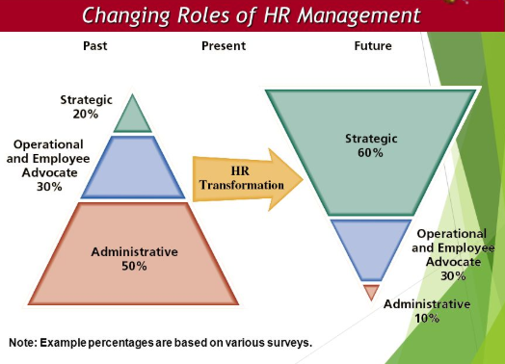
Changing Roles of HRM

Slide 11
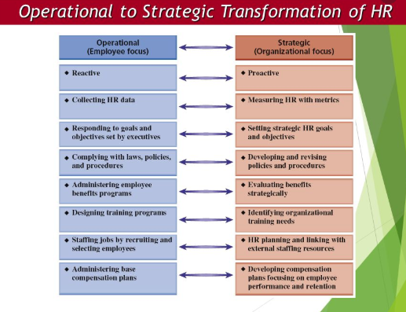
HR Transformation

Slide 12
Globalisation - Definition
Globalization is a process of interaction and integration among the people, companies, and
governments of different nations, a process driven by international trade and investment
and aided by information technology.

Slide 13
Globalisation
Globalization is the free movement of goods, services and people across the world in a seamless and integrated manner.
Globalization is grounded in the theory of comparative advantage which states that countries that are good at producing a particular good are better off exporting it to countries that are less efficient at producing that good

Slide 14
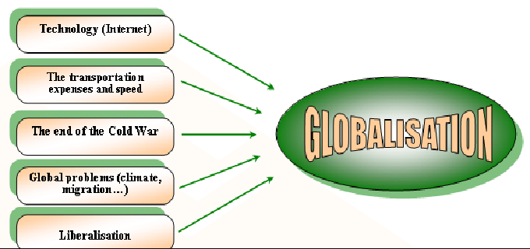
Factors for Globalisation

Slide 15
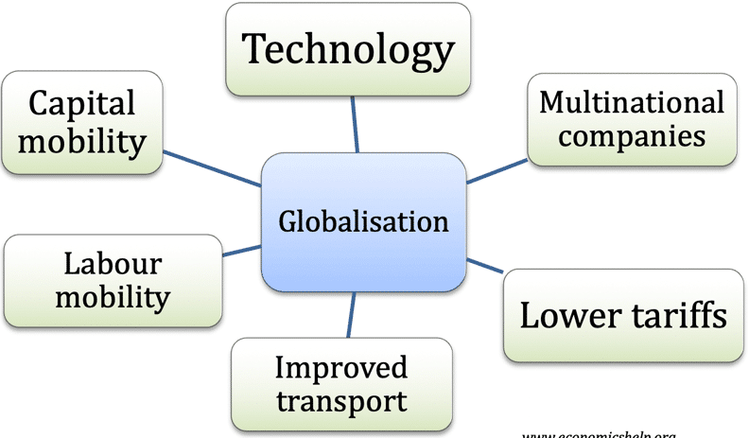
Causes of Globalisation

Slide 16
Causes of Globalisation - I
The accelerated pace toward a globalized economy has been attributed by Friedman
and other globalization experts to numerous political changes, technological
advances, removal of economic barriers, and social facilitators of change, such as
investment in telecommunication and education, advanced business process, etc.

Slide 17
Causes of Globalisation - II
Enterprises have moved toward globalization for both proactive and reactive.
search for new markets,
increased cost pressures and competition,
short falls in natural resources and labor supply, government policies, trade agreements,
greater strategic control
a globalizing supply chain

Slide 18
Causes of Globalisation - III
Supply chain consists of all parties involved, directly or indirectly, in fulfilling a customer request.
The supply chain not only includes the manufacturer and suppliers, but also transporters, warehouses, retailers, and customers themselves.
Supply chain globalization is the natural outcome of today’s expanding consumer markets as companies struggle to meet the dynamic needs of growing markets and new consumer segments.

Slide 19
Causes of Globalisation - IV
the underlying factors behind Supply Chain
reducing the costs of procurement
decreasing the risks related to purchasing activities.
The big difference is that global supply chain management involves a company's worldwide interests and suppliers rather than simply a local or national orientation.

Slide 20
Measurement of Globalisation
Economic: the extent of the flow of trade and investment across borders and reactions to that flow. (i.e., whether a country decides to restrict trade or investment)
Social: the spread of ideas, exchange of knowledge, the free passage of citizens across borders.
Political: the growth of government policies and institutions that support cross-border economic and social activity. (e.g., regulations that control corruption)

Slide 21
Advantages of globalization
lower prices
greater availability of goods
better jobs,
access to technology.

Slide 22
Disadvantages of globalization
homogeneity of culture
global warming
inadequate and unsafe water
the off-shoring of jobs to low-wage countries
growing trade deficits
slow wage growth
a lack of responsiveness to the economic effects of the process,
the potential for a “race to the bottom” in which companies and countries place downward pressure on wages and working conditions

Slide 23
International business
International business refers to business activities that involve the transfer of resources, goods, services, knowledge, skills, or information across national boundaries. The resources that make up this flow are raw materials, capital, goods, services and people.

Slide 24
Difference between Globalisation vs Internationalization
Globalization is the end result while internationalization is one of the tasks/tools/processes to achieve them.
Globalization is more with the nations and their economies while internationalization is more related to the individual, firm and corporations for doing up their businesses.
Globalization is a process and internationalization is part of it
Major factors that affect the globalization are infrastructural and logistics set up, telecommunications, etc. while internationalization gets affected by cultural tastes and preferences, local traditions, etc.
Globalization is an economic process while Internationalization is an improvisation process as it will lead in expanding of the business across the nations

Slide 25
International Business - Terms
International transactions are manifested mainly in international trade and investment.
International trade occurs when a company exports goods or services to buyers (importers) in another country.
International investment occurs when the company invests resources in business activities outside its home country.

Slide 26
International Business - Terms
Any firm, regardless of size, that is engaged in international business is defined as an international firm.
A firm that has directly invested abroad and has at least one working affiliate in a foreign country (e.g., a factory, a branch office) over which it maintains effective control is defined as a multinational enterprise (MNE) or multinational enterprise company (MNC).

Slide 27
International Business - Terms
While many firms still follow the traditional route of domestic growth first, international expansion second, we increasingly see firms that target international markets when launching their operations. These firms are called born global, global startups, or international new ventures (INVs).

Slide 28
Questions

