Slide 1
STRATEGIC GLOBAL HUMAN RESOURCES - VI
GPHR

Slide 2
HR Roles and Responsibilities
HR Outsourcing
Outsourcing Process
Follow the Sun model
Balanced Scorecard

Slide 3
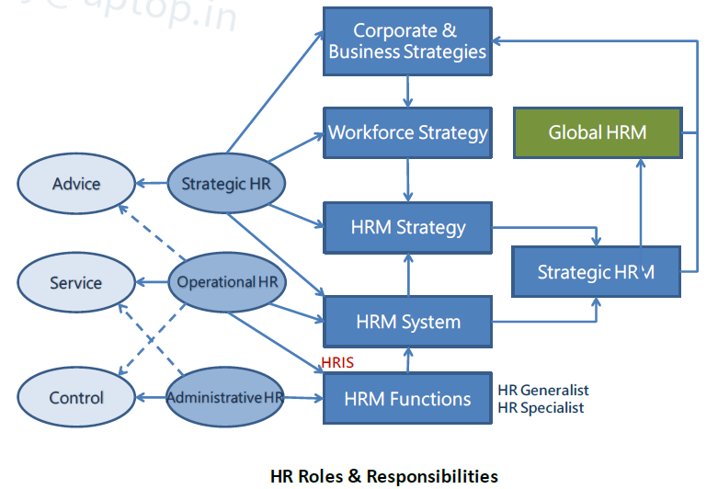
HR Roles and Responsibilities

Slide 4
HR roles
Strategic - Involved in strategy formulation/development and organizational development and change to support organization’s strategic objectives
Operational - Involved in day-to-day traditional HR tasks, such as recruiting, compensation, training, performance management, and employee relations
Administrative - Involved in compliance issues and personnel record keeping through technology, such as human resource information systems, (HRIS)

Slide 5
HR Responsibilities
Advice - Gathering information, diagnosing problems, providing solutions, and offering objective assistance and guidance on HR issues
Service - Serving personnel day-to-day administration and answering questions
Control -Designing and evaluating workforce performance management system to make sure the required objectives should be met and aligned with corporate strategy

Slide 6
Question # 1
Which of the following activities illustrates the advisory role assumed by an HR professional?
Filling out HR Audit reports
Protecting whistleblowers from discharge
Evaluating the bottom-line contribution of HR programs
Conducting an interviewing seminar for line managers

Slide 7
Answer # 1
Option D

Slide 8
HR Roles and Responsibilities
HR Outsourcing
Outsourcing Process
Follow the Sun model
Balanced Scorecard

Slide 9
HR Shared Service
The true business case for Shared Services involves providing employees and customers with the services they need at the lowest possible cost.
Shared Services have proven to reduce costs and improve processing efficiencies by up to 40%.

Slide 10
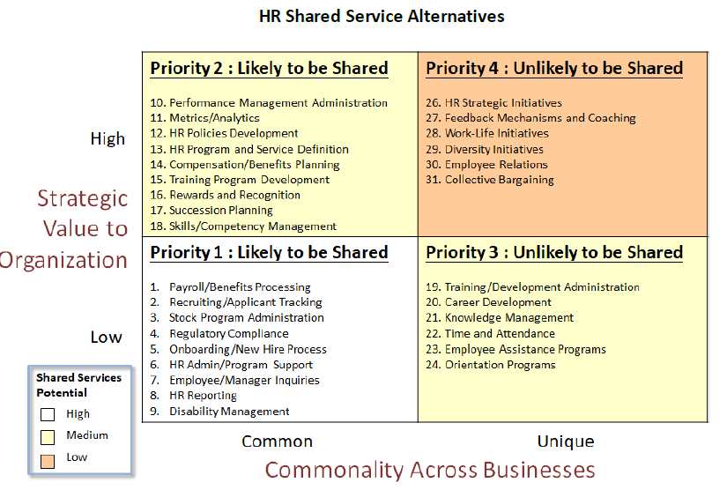
HR Shared Service Alternatives

Slide 11
HR Outsourcing
Contracting with a specialist provider
Streamlined processes to cut down costs
Costs savings for business for having fewer staff members and fewer benefits to pay out
Subcontracting some HR functions offers flexibility

Slide 12
Question # 2
What is the GREATEST advantage of using outsourced vendors?
They can accelerate process improvements within the company
They take relatively little time to manage and integrate with headquarters
They can perform poorly with a minimal impact on the company
They are not a source of liability if they violate the law

Slide 13
Answer # 2
Option A

Slide 14
What to outsource?
Many companies look to outsource non-core functions such as payroll, benefits administration, and even tax filings.
Outsourcing it allows to focus on the organization’s core competencies.

Slide 15
HR Outsourcing
HR outsourcing (also known as HRO) is the process of sub-contracting human resources functions to an external supplier.
Business process HR outsourcing (also known as BPO), where an external supplier manages discrete HR activities, such as payroll administration or recruitment, or perhaps the whole human resources function.
Shared service HR outsourcing, where only the transaction or administrative elements of HR’s activities are subcontracted to an external supplier. This may include the personal interface with employees.
Application (and facilities) service HR outsourcing, where external providers look after the technological (and physical) infrastructure to support human resources activities

Slide 16
Offshoring
Offshoring is the process of relocating a business or business process to another country in order to benefit from reduced labour costs or a more beneficial regulatory environment. A range of processes are commonly offshored, including manufacturing, IT, customer service and research & development

Slide 17
Cosourcing
Cosourcing arrangement refers to an enterprise outsources only one part of a function. Co-sourcing is a way of attacking the problem by providing a service without having to be fully outsourced RPO.

Slide 18
Insourcing
Insourcing refers to contracting a function out to another entity that manages and performs the function on-site, transferring a previously outsourced function back in-house, or the hiring of local workers by foreign companies operating subsidiaries locally. Open sourcing is a way of eliciting innovative ideas from nonemployees or contractors.

Slide 19
Professional Employment Organization (PEOs)
A Professional Employement Organization (PEO) assumes full responsibility of your company's human resources administration.
It becomes a co-employer of your company's workers by taking full legal responsibility of your employees, including having the final say in hiring, firing, and the amount of money employees make.
The PEO and business owner become partners, essentially, with the PEO handling all the HR aspects and the business handling all other aspects of the company.

Slide 20
Question # 3
Which of the following is NOT a reason to outsource?
The ability to share financial risk with a vendor
The ability to gain access to talent and resources
The ability to acquire value without a long-term investment in assets
The ability to transfer both core and non-core competencies

Slide 21
Answer # 3
Option D

Slide 22
HR Roles and Responsibilities
HR Outsourcing
Outsourcing Process
Follow the Sun model
Balanced Scorecard

Slide 23

Outsourcing Process

Slide 24
Outsourcing Process
Analyze needs and objectives : A thoughtful needs analysis is the most critical stage in which project goals and expectations of the potential third-party contractor are defined.
Plan the budget : Know what can be spent for the outsourced service and what it costs to provide that service ill-house. This information provides a look at the expected financial return on investment.

Slide 25
Outsourcing Process
Develop request for proposal (RFP) : An RFP is a written request asking contractors to propose solutions and prices that fit the customer's requirements. The purpose of all RFP is not only to ensure that responses actually meet HR's needs but also to ensure some consistency among responses so that the responses may be more easily compared.
Forward RFPs to potential vendors : Instructions on the manner and date for submission should be included in this request.

Slide 26
Outsourcing Process
Evaluate vendors : These variables differ based on the organization's size, priorities, and industry. For procuring HRIS, their ability to meet specifications, customization options, and price should be considered.
Choose vendor : Get the names of possible contractors, state contractor licensing, ask to see their certificates for insurance, and assess their business longevity.

Slide 27
Outsourcing Process
Set up contract : This written contract will describe not only the key deliverables of the project but will include additional information such as implementation time frames, payment terms, performance standards, training expectations, and upgrade costs and responsibilities.
Develop and execute project plan : Conduct an initial project planning meeting to review and refine implementation targets in the project schedule. Outsourcing may curtail loss of morale, and therefore it is important to have an employee briefing when an outsourcing partner is announced. This enables employee questions to be answered, and it provides the business rationale for the outsourcing decision in a consistent manner for all employees.

Slide 28
Outsourcing Process
Measure project performance : All payment terms are -usually settled and the contractor could ask for an evaluation of its services.
Restructure Outsourced Organization (if applicable) : It challenges management to build a more flexible organization structured around core competencies and long-term relationships.

Slide 29
Question # 4
Which of the following is NOT a valid criterion for evaluating outsourcing proposals and helping to select the most qualified partner?
Price
Family affiliations
Proven record of performance
Response times and performance clauses

Slide 30
Answer # 4
Option B

Slide 31
HR Roles and Responsibilities
HR Outsourcing
Outsourcing Process
Follow the Sun model
Balanced Scorecard

Slide 32
‘Follow the Sun’ Support Model
Follow the Sun (FTS) is a workflow model in which work is passed on to office located in different time zones. In this way work is done round the clock thereby reducing the project or support duration and increasing responsiveness. Follow the Sun model is implemented across three different time zone.
For e.g. : US passes work to Asia at the end of the day. Asia passes to Europe at end of their day and Europe passes the work to US

Slide 33

“Follow the sun” model

Slide 34
HR Roles and Responsibilities
HR Outsourcing
Outsourcing Process
Follow the Sun model
Balanced Scorecard

Slide 35
Global Measures
Balanced Scorecard
Workforce Scorecard
HR Scorecard
HR Cost Benefit Analysis
Key HR Measure and Metrics

Slide 36
Balanced Scorecard
The Balanced Scorecard Concept (BSC) was first introduced in a 1992 Harvard Business Review article.
The BSC concept is that an organization’s strategy must be translated into operational terms that can be understood and acted upon
It also used to define strategic concepts like quality, customer satisfaction and growth.
A typical balanced scorecard classified into four perspectives : financial, customer, internal business processes, and learning and growth.

Slide 37
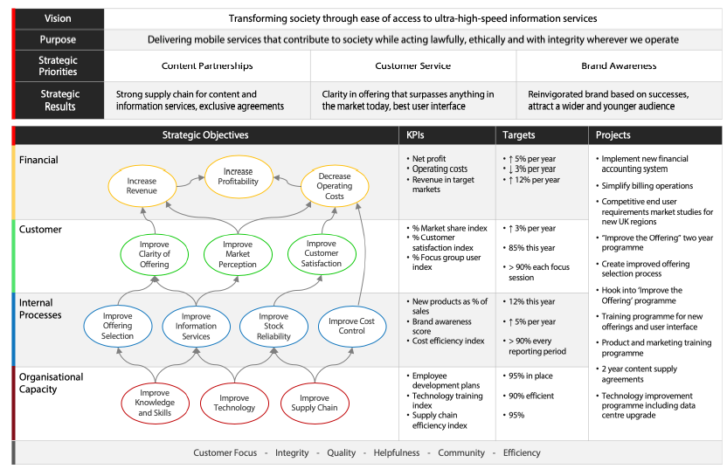
Balanced Scorecard

Slide 38
Question # 5
A consulting company is developing a balanced scorecard. One of the company’s goals is to meet or exceed customer expectations by completing projects on time and within budget. Which of the following balanced scorecard perspectives fits with this goal?
Learning and growth
Financial
Customer
Internal process.

Slide 39
Answer # 5
Option C

Slide 40
Question # 6
In the balanced scorecard, which two types of measures most directly impact financial results?
Short-term and long-term
Customer and operations
Activity and results
Strategic and tactical

Slide 41
Answer # 6
Option B

Slide 42

The Principles of a Strategy-Focused Organization

Slide 43
Mobilize Change through Executive Leadership
A successful BSC program starts with the recognition that it’s not a “metrics” project, but a “change” project. The single, most important condition for success is the ownership and active involvement of the executive team. Strategy requires change from every part of the organization.
  Establish a sense of urgency.
  Create the leadership team.
  Develop the Vision and Strategy.

Slide 44
Translate Strategy into Operating Terms
The foundation of the design is a Strategy Map, which defines the “architecture” of the strategy.
The description begins with the financial perspective of the shareholder (or appropriate key constituent in non-profits).
It defines the relevant long-term indicators of success (e.g., ROI, shareholder value) and divides it into a long-term (growth) and a short-term (productivity) component.

Slide 45

The Balanced Scorecard Strategy Map

Slide 46
Align the Organization with the Strategy
Functional silos arise and become a major barrier to strategy implementation, since most organizations have great difficulty communicating and coordinating across these functions.
For organizational performance to be more than the sum of its parts, individual strategies must be linked and integrated.
The corporate role defines the linkages expected to create synergy and ensures that the linkages actually occur.

Slide 47

Align the Organization with the Strategy

Slide 48
Make Strategy everyone’s Job
Workforce knowledge represents an asset that we are just beginning to use effectively. In this structure, strategic information and decision-making can no longer be limited to executives and senior managers.
Communication and education to create awareness
Personal alignment
Incentive compensation

Slide 49

Make Strategy everyone’s Job

Slide 50
Make Formulating Strategy a Continual Process
Companies with the BSC integrates the management of tactics with the management of strategy, using three important processes,
Organizations link strategy to the budgeting process
Making strategy formulation continual is to introduce a management meeting to review strategy.
Making strategy development continual sees a process evolve for learning and adapting the strategy.

Slide 51
Questions

