Slide 1
STRATEGIC GLOBAL HUMAN RESOURCES - V
GPHR

Slide 2
Globalisation
Stages in Globalisation
International Business
HR Outsourcing
Historical Context - Organisation
Global Organisation Structure

Slide 3
Historical Context
Management Theories came as a reaction to Industrial Revolution from late 1700 to late 1800
Industry means work
Revolution means rapid change
Rapid explosion of big factories. That was what happening at that time. People were moving from Farms to factories from small shops to large companies.

Slide 4
Reason for rapid expansion
Power
Machinery Innovations
Transportation
One of the major reason was power - steam power and hydro power specifically
Then came machinery innovation, example cotton gin which separated cotton from seeds.

Slide 5

Cotton Gin Machine

Slide 6
Industrial Revolution
Transportation even kept booming at that time for example : Railways, Steam boats and roads were improving
Due to the rapid expansion companies were looking for solution to their problems.
How are we going to maximise productivity
How are we going to manage all of these people

Slide 7



Three Primary Theories
Henri Fayol
Frederick Taylor
Max Weber
These are the founding fathers of the classical management theories

Slide 8
Henry Fayol
French Mining Engineer
Henri Fayol wrote the book - General and Industrial Management
(29 July 1841 – 19 November 1925)
During early part of the twentieth century, Henri Fayol French industrialist proposed that all managers perform five management activities that are:
Plan, Organize, Command, Coordinate, and Control.
But nowadays there management functions have been condensed to four: Planning, Organizing, Leading, and Controlling.

Slide 9


Functions of Management
Notes:
Planning - where the organization wants to be in the future and how to get there.
Organizing - how the organization tries to accomplish the plan. Organizing involves assigning tasks, grouping tasks into departments, delegating authority and allocating resources across the organization.
Leading - use of influence to motivate employees to achieve organizational goals. Leading means creating a shared culture and values, communicating goals to employees throughout the organization, and infusing employees with the desire to perform at a high level.
Controlling is monitoring employees’ activities, determining whether the organization is on target toward its goals, and making corrections as necessary.

Slide 10
Frederick Taylor
American mechanical engineer who sought to improve industrial efficiency.
Used time and motion study to improve productivity
Taylor summed up his efficiency techniques in his book The Principles of Scientific Management
(March 20, 1856 – March 21, 1915)

Slide 11
Max Weber
German sociologist, jurist, and political economist
He is regarded today as one of the most important theorists on the development of modern Western society.
(21 April 1864 – 14 June 1920)
Max Weber's theory of bureaucracy, also known as the "rational-legal" model
A rigid division of labor is established that clearly identifies regular tasks and duties of the particular bureaucratic system.
Regulations describe firmly established chains of command and the duties and capacity to coerce others to comply.
Hiring people with particular, certified qualifications supports regular and continuous execution of the assigned duties

Slide 12

Bureaucracy
Authority is the right or power assigned to a job holder in order to achieve certain organizational objectives
Responsibility indicates the duty assigned to a position.
Accountability is the liability created for the use of authority
Responsibility may be bestowed, but accountability must be taken.

Slide 13
Commonalities of the Theories
Hierarchy
Division of Labour
Standardised approach to work
Centralisation of authority
Separation of personal

Slide 14
Globalisation
Stages in Globalisation
International Business
HR Outsourcing
Historical Context - Organisation
Global Organisation Structure

Slide 15
Globalisation
Globalisation is a process of interaction and integration among the people, companies, and governments of different nations, a process driven by international trade and investment and aided by information technology.

Slide 16
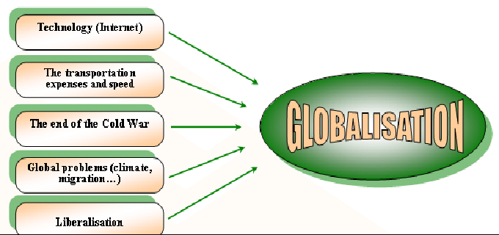
Factors for Globalisation

Slide 17
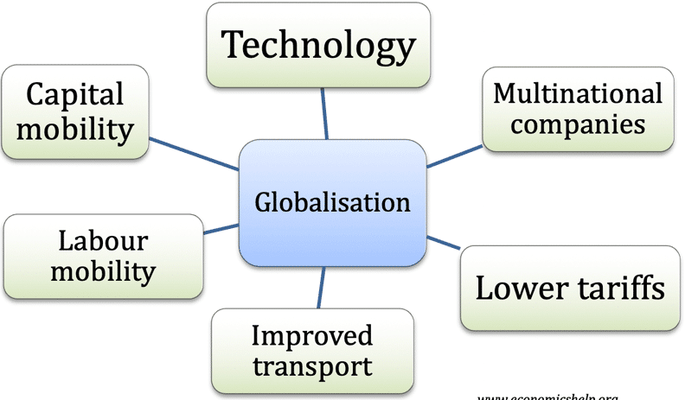
Causes of Globalisation

Slide 18
Causes of Globalisation - I
The accelerated pace toward a globalized economy has been attributed by Friedman
and other globalization experts to numerous
Political changes
Technological advances
Removal of economic barriers
Investment in telecommunication
Education
Advanced business process

Slide 19
Causes of Globalisation - II
Enterprises have moved toward globalization for both proactive and reactive.
search for new markets,
increased cost pressures and competition,
short falls in natural resources and labor supply, government policies, trade agreements,
greater strategic control
a globalizing supply chain

Slide 20
Causes of Globalisation - III
Supply chain consists of all parties involved, directly or indirectly, in fulfilling a customer request.
The supply chain not only includes the manufacturer and suppliers, but also transporters, warehouses, retailers, and customers themselves.
Supply chain globalization is the natural outcome of today’s expanding consumer markets as companies struggle to meet the dynamic needs of growing markets and new consumer segments.

Slide 21
Causes of Globalisation - IV
the underlying factors behind Supply Chain
reducing the costs of procurement
decreasing the risks related to purchasing activities.
The big difference is that global supply chain management involves a company's worldwide interests and suppliers rather than simply a local or national orientation.

Slide 22
Measurement of Globalisation
Economic: the extent of the flow of trade and investment across borders and reactions to that flow. (i.e., whether a country decides to restrict trade or investment)
Social: the spread of ideas, exchange of knowledge, the free passage of citizens across borders.
Political: the growth of government policies and institutions that support cross-border economic and social activity. (e.g., regulations that control corruption)

Slide 23
Advantages of globalization
lower prices
greater availability of goods
better jobs,
access to technology.

Slide 24
Disadvantages of globalization
homogeneity of culture
global warming
inadequate and unsafe water
the off-shoring of jobs to low-wage countries
growing trade deficits
slow wage growth
a lack of responsiveness to the economic effects of the process,
the potential for a “race to the bottom” in which companies and countries place downward pressure on wages and working conditions

Slide 25
Globalisation
Stages in Globalisation
International Business
HR Outsourcing
Historical Context - Organisation
Global Organisation Structure

Slide 26

Stages of Globalization

Slide 27
Stage 1: Domestic
The product or service is developed in the home country and produced and sold there. The strategy focuses only on the home market; the organization is mono-cultural (as defined by the home country).

Slide 28
Stage 1: Domestic
In this stage, the company is domestically oriented, but managers are aware of the global environment and may want to consider initial foreign involvement to expand production volume and realize economies of scale. Market potential is limited and is primarily in the home country. The structure of the company is domestic, typically functional or divisional, and initial foreign sales are handled through an export department. The details of freight forwarding, customs problems, and foreign exchange are handled by outsiders.

Slide 29
Stage 2: International
A company begins to export a product or service to foreign countries, call International Corporation. The company may open production facilities or service centers, but the product/service, processes, and strategy are developed in the home country.

Slide 30
Stage 2: International
In this stage, the company takes exports seriously and begins to think multi-domestically. Multi-domestic means competitive issues in each country are independent of other countries; the company deals with each country individually. The concern is with international competitive positioning compared with other firms in the industry. At this point, an international division has replaced the export department, and specialists are hired to handle sales, service, and warehousing abroad. Multiple countries are identified as a potential market.

Slide 31
Stage 3: Multinational
The Multinational Corporations (MNCs) has its facilities and other assets in at least one country other than its home country. Gradually, perhaps in response to the needs of local markets, operations in host countries become more autonomous. The organization is a decentralized portfolio of subsidiaries. Knowledge is developed within the subsidiary and remains there. Many MNCs are staffed by host-country nationals, but key managers come from headquarters. Key decisions are made at headquarters as well.

Slide 32
Stage 3: Multinational
In this stage, the company has extensive experience in a number of international markets and has established marketing, manufacturing, or research and development (R&D) facilities in several foreign countries. The organization obtains a large percentage of revenues from sales outside the home country. Explosive growth occurs as international operations take off, and the company has business units scattered around the world along with suppliers, manufacturers, and distributors

Slide 33
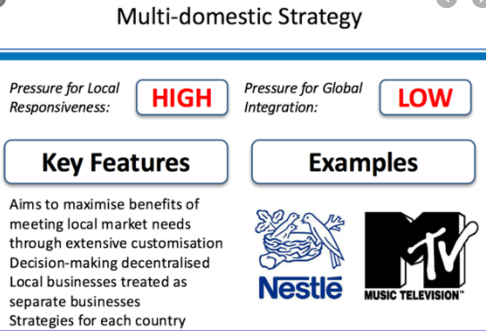
Multi Domestic Strategy

Slide 34
Stage 4: Global
The global corporation views the world as a single, global market and offers global products that have little or no national variation or that have been designed with customizable elements. Strategy, ideas, and processes emanate from headquarters.

Slide 35
Stage 4: Global
In this stage, the company transcends any single country. The business is not merely a collection of domestic industries; rather, subsidiaries are interlinked to the point where competitive position in one country significantly influences activities in other countries. Truly global companies no longer think of themselves as having a single home country, and, indeed, have been called stateless corporations. This represents a new and dramatic evolution from the multinational company of the 1960s and 1970s. Global companies operate in truly global fashion, and the entire world is their marketplace. However, the structural problem of holding together this huge complex of subsidiaries scattered thousands of miles apart is immense. Organization structure for global companies can be extremely complex and often evolves into international matrix or transnational model.

Slide 36
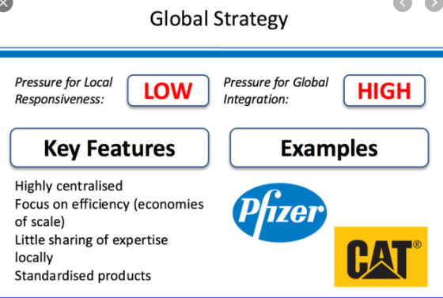
Global Strategy

Slide 37
Transnational
The transnational corporation (TNC) blends standardization used by global organizations with the localization approach of MNCs. The result is “glocalization”-an organization with a strong global image but an equally strong local identity. The organization's production or service process becomes more globally dispersed and interconnected. Some facilities may become "experts" in certain areas. Strategy is developed globally; innovation and best practices are freely exchanged among countries. Involved in strategy formulation,
development and organizational, and development and change to support organization’s strategic objectives.

Slide 38
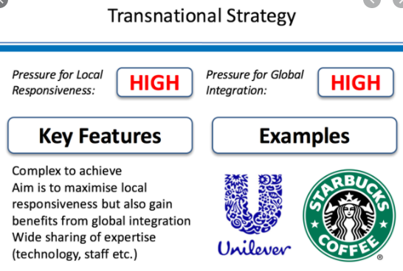
Transnational Strategy

Slide 39
Global Orientations
Global integration refers to the coordination of the firm’s value-chain activities across
countries to achieve worldwide efficiency, synergy, and cross-fertilization in order to take
maximum advantage of similarities between countries. The flexibility objective is also
called local responsiveness. Local responsiveness refers to meeting the specific needs of buyers in individual countries.

Slide 40
Global Integration Strategy
Global integration (GI) emphasizes consistency of approach, standardization of processes, and common corporate culture across global operations. The following steps help organizations achieve global integration:
1. Aligning decision making : This focus on alignment helps to ensure that even decisions made locally reflect the global perspective. Expatriates, employees sent from their home countries to work abroad, play a significant role in this global alignment, as do performance management systems.
2. Standardizing processes :Standardized processes are designed to achieve efficiencies, economies of scale, consistent expectations, and control over strategic parts of the value chain.
3. Socializing key individuals :This socialization effort ensures that top managers have a consistent perspective, whether at the headquarters or at dispersed field locations.

Slide 41
Pressures for Global Integration
1. Economies of scale : Concentrating manufacturing in a few select locations where the firm can profit from economies of mass production motivates global integration. Also, the smaller the number of manufacturing and R&D locations, the easier it is for the firm to control quality and cost.
2. Capitalize on converging consumer trends and universal needs : Standardization is appropriate for products with widespread acceptance and whose features, quality, and cost are similar worldwide. Examples include computer chips and electronic components. Companies such as Nike, Dell, ING, and Coca-Cola offer products that appeal to consumers everywhere.

Slide 42
Pressures for Global Integration
3. Uniform service to global customers :Services are easiest to standardize when firms can centralize their creation and delivery. Multinational enterprises with operations in numerous countries particularly value service inputs that are consistent worldwide.
4. Global sourcing of raw materials, components, energy, and labor :Firms face an ongoing pressure to procure high-quality input goods in a cost-efficient manner. Sourcing of inputs from large-scale, centralized suppliers provides benefits from economies of scale and more consistent performance outcomes. Sourcing from a few well-integrated suppliers is more efficient than sourcing from numerous loosely connected distributors.

Slide 43
Pressures for Global Integration
5. Global competitors : Competitors that operate in multiple markets threaten firms with purely domestic operations. Global coordination is necessary to monitor and respond to competitive threats in foreign and domestic markets.
6. Availability of media that reaches consumers in multiple markets : The availability of cost-effective communications and promotion makes it possible for firms to cater to global market segments that cross different countries. For example, firms now take advantage of the Internet and cross-national television to simultaneously advertise their offerings innumerous countries.

Slide 44
Local Responsiveness Strategy
Local responsiveness (LR) emphasizes adapting to the needs of local markets and allows subsidiaries to develop unique products, structures, and systems.
1. Understanding diversity : Local responsiveness organizations must learn the cultures and institutions (e.g., legal, economic, educational) of the areas in which they operate, but they must also become more fully aware of their own cultural perspectives and how those may affect organizational decisions and practices.

Slide 45
Local Responsiveness Strategy
2. Responding to diversity : Local culture and institutions should shape local strategy regarding where to internationalize and how to enter the local market and identifying what needs to be adapted.
3.Capitalizing on diversity : Local responsiveness strategies may blend perspectives and talents throughout the organization to create cultural synergy. They may also cluster functions geographically according to the availability of appropriate skills and resources and levels of local competition.

Slide 46
Pressures for Local Responsiveness
1. Unique natural endowments available to the firm. Each country has national endowments that the foreign firm should access.
2. Diversity of local customer needs. Businesses, such as clothing and food, require significant adaptation to local customer needs.
3. Differences in distribution channels. These vary considerably from market to market and may increase the need for local responsiveness. For example, small retailers in Japan understand local customs and needs, so locally responsive MNEs use them to distribute products in that country.

Slide 47
Pressures for Local Responsiveness
4. Local competition. When competing against numerous local rivals, centrally controlled MNEs will have difficulty gaining market share with global products that are not adapted to local needs.
5. Cultural differences. Cultural characteristics influence consumer buying decisions. The influence of cultural differences may vary considerably, depending on the type of product. For those products where cultural differences are important, such as clothing and furniture, local managers require considerable freedom from headquarters to adapt their product and marketing practices.
6. Host government requirements and regulations. When governments impose trade barriers or complex business regulations, they can halt or reverse the competitive threat of foreign firms. The MNE may establish a local subsidiary with substantial decision-making authority to minimize the effects of protectionism.

Slide 48
Global Integration vs. Local Responsiveness
Globalized company achieves greater business efficiency, uniformity, and control of its brand and image. Localized company has more ability to be customer-focused and meet legal and cultural requirements. When the company becomes part of local networks, it is more likely to enjoy the support of authorities and public opinion, becomes active in local workforce development, and benefits from lower cost of operations. Moreover, the use of a local workforce is less expensive than use of a large expatriate workforce, and it reduces tensions between different workforces.

Slide 49

The Global Integration -Local Responsiveness framework

Slide 50

Bartlett and Ghoshal Matrix

Slide 51
Globalisation
Stages in Globalisation
International Business
HR Outsourcing
Historical Context - Organisation
Global Organisation Structure

Slide 52
Type of Structures
Developing an organizational structure involves defining the framework around which the business operates and provides guidance to all employees by laying out the official reporting relationships that govern the workflow of the company. A well-structured organization chart indicates :
How an organization functions
How it is managed
How information flows and is processed within an organization
How flexible or responsive the organization is.

Slide 53

Organisational Structure

Slide 54
Functional Structure
A functional structure divides the organization into departments based on their function.
Organizations in the domestic and international stage of globalization are far more likely to have a functional structure than those in the later stages
The structure is most efficient in terms of economies of scale and fewer numbers of employees

Slide 55
Product Structure
In this framework, business is organised in separate divisions, each focusing on a different product or service and functioning as an individual unit within the company.
The decision making is dispersed and decentralized to the product groups.

Slide 56
Geographic Structure
In this framework, the company hierarchy is divided on the basis of geographic location in which company operates.
The decision making is decentralized. The region must be sufficiently large to support this structure. Being closer to markets, a geographic structure can tailor and localize products and services more easily than other organization designs

Slide 57
Hybrid Structure
A hybrid structure is an organizational model that combines two or more reporting structures. It's best suited for work environments that are dynamic, as hybrid structures can shift from project to project. Most commonly, the hybrid structure combines the functional and product organizational structures

Slide 58
Front-Back Structure
Divides an organization into two components:
  those that are oriented to the customer and/or the geographical region in which the company is doing business, called the front end
  a back end that is organized by product and technology
Advantages: focus on more than one dimension at a time, manage cross-product strategies and coordination

Slide 59
Matrix Structure
A matrix type of organisational structure combines the traditional departments seen in functional structures with project teams.
In a matrix structure, individuals work across teams and projects as well as within their own department or function.
In this structure, decision making is decentralized and an employee participating in a project may have two bosses: one from the product side and one from the geographic side.

Slide 60
Structure affects how strategic decisions are made
As the structure becomes more centralized there is a stronger probability that the strategic decision making process will be initiated by only those few dominant individuals who run the company, and that it will be the result of their proactive seeking for business opportunities
As the structure becomes more formalized the strategic decision making process is likely to become reactive rather than proactive
As the level of complexity of the structure grows, so does the probability that members will either not recognize the strategic impacts of a policy or will ignore these impacts in favor of the interests of the immediate unit in which they work

Slide 61
Different business strategies suggest different organizational structures
A company following a differentiation strategy should have an organic/enterprising design, and its structure should be organized around products, with many cross-functional teams
A company following the low-cost strategy should use the simplest possible structure, probably a functional one

Slide 62
Questions

