Slide 1
STRATEGIC GLOBAL HUMAN RESOURCES - II
GPHR

Slide 2
Vission, Mission and Values
SWOT Analysis
PESTLE Analysis
Strategy Formulation
Strategy Execution
Strategy Evaluation
Strategy Evaluation Methods

Slide 3
Vision Statement
A vision statement is a company's road map, indicating what the company wants to become by setting a defined direction for the company's growth
Big picture idea of what you want to achieve
Concise: able to be easily remembered and repeated
Clear: defines a prime goal
Time horizon: defines a time horizon
Future-oriented: describes where the company is going
Stable: offers a long-term perspective
Challenging: not something that can be easily met and discarded
Abstract: encompass all of the organization's interests and direction
Inspiring: motivates employees

Slide 4
Examples of Vision Statement
Bring inspiration and innovation to every athlete in the world ~ Nike
Our vision is to create a better everyday life for many people ~ IKEA
To be the best quick service restaurant experience. Being the best means providing outstanding quality, service, cleanliness and value, so that we make every customer in every restaurant smile ~ McDonald
Connect with friends and the world around you on Facebook
Create economic opportunity for every member of the global workforce ~ Linkedin

Slide 5
Mission Statement
A mission statement is a short statement of why an organization exists, what its overall goal is, identifying the goal of its operations: what kind of product or service it provides, its primary customers or market, and its geographical region of operation
“What do we do?” — The main purpose of the organisation
“How do we do it?” — Achieving the mission statement.
“Whom do we do it for?” — Target audience.
“What value are we bringing?” — The benefits and values

Slide 6
Examples of Mission Statement
To give people the power to share and make the world more open and connected ~ Facebook
“To connect the world’s professionals to make them more productive and successful” ~ Linkedin
“To be one of the world’s leading producers and providers of entertainment and information, using its portfolio of brands to differentiate its content, services and consumer products.” ~ Walt Disney
“To be a company that inspires and fulfils your curiosity.” ~ Sony

Slide 7


Differences in terms

Slide 8
Value Statement
A Values Statement is a message which conveys the values and priorities of the company, organization or team it represents. This lets your customers and staff know what’s important to your business and the kind of culture it has.
“what values will need to be present in the community for your vision to come to pass?”
“what values would the community need to emphasize?”
“what values would have to be the norm?”

Slide 9
Value Statement Example
American Express
Customer Commitment
Quality
Integrity
Teamwork
Respect for People
Good Citizenship
A Will to Win
Personal Accountability

Slide 10
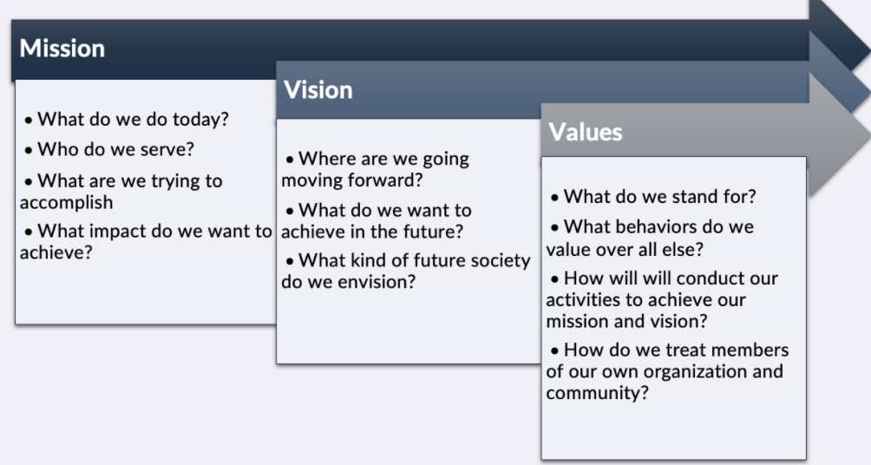
Mission, Vision and Values

Slide 11

Different Terms

Slide 12
Vission, Mission and Values
SWOT Analysis
PESTLE Analysis
Strategy Formulation
Strategy Execution
Strategy Evaluation
Strategy Evaluation Methods

Slide 13
SWOT
The primary aim of strategic planning is to bring an organization into balance with the external environment and to maintain that balance over time. Organizations accomplish this balance by evaluating new programs and services with the intent of maximizing organizational performance. SWOT analysis is a preliminary decision-making tool that sets the stage for this work.
SWOT analysis was invented in the 1960s by a management consultant named Albert Humphrey at the Stanford Research Institute.

Slide 14

SWOT Analysis

Slide 15
Strengths
They are characteristics of the business or team that give it an advantage over others in the industry. Strengths must focus upon what the firm can do with its internal resources.
Any asset that the firm owns could certainly be classified as strength,
State-of-the-art production line machinery
A strong brand-name presence
Recognized customer service excellence,
Exclusive access to a strong supply chain network

Slide 16
Weaknesses
Characteristics that place the firm at a disadvantage relative to others.
Poor product positioning
Deteriorating physical assets
Out-of-date production equipment
Poor customer service
High employee turnover that causes the firm to lose talented people can be a major weakness of the firm

Slide 17
Opportunities
In general, any changes in the external environment can be an opportunity to the firm
Changes in tax structure
Improvements in economic trends
The passage of favourable laws
Market positioning
New technologies
International trade agreements

Slide 18
Threats
They are external elements in the environment that could cause trouble for the business.
Changes in consumer preferences
New competitor innovations
Restrictive regulations
Unfavourable trade barriers
Loss of favorable distribution networks
Restrictions on the firm’s cash flows
Anything that can threaten the firm’s market position

Slide 19
Vission, Mission and Values
SWOT Analysis
PESTLE Analysis
Strategy Formulation
Strategy Execution
Strategy Evaluation
Strategy Evaluation Methods

Slide 20
PESTLE Analysis
PESTLE analysis (political, economic, social, technological, Legal and Environmental) describes a framework of macro-environmental factors used in the environmental scanning component of strategic management. It is part of an external analysis when conducting a strategic analysis or doing market research, and gives an overview of the different macro-environmental factors to be taken into consideration.

Slide 21
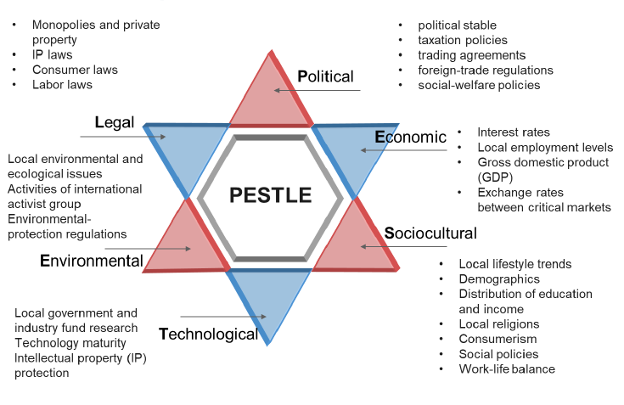
PESTLE Analysis

Slide 22
Vission, Mission and Values
SWOT Analysis
PESTLE Analysis
Strategy Formulation
Strategy Execution
Strategy Evaluation
Strategy Evaluation Methods

Slide 23

Strategy Choices

Slide 24
Corporate Strategy
Vertical integration – company grows by gaining control of inputs or outputs or both when a company acquires its input supplier it is called backward integration. When it acquires companies in its distribution chain it is called forward integration. For example, a vertically integrated oil company may end up owning oilfields, refineries, tankers, trucks, and gas (petrol) filling stations. Also called vertical merger. See also horizontal integration.

Slide 25
Corporate Strategy
Horizontal integration – grow by combining with competitors. The merger of companies at the same stage of production in the same or different industries. When the products of both companies are similar, it is a merger of competitors. When all producers of a good or service in a market merge, it is the creation of a monopoly. If only a few competitors remain, it is termed an oligopoly.

Slide 26
Strategy Formulation
As the Company’s vision, mission, core value statements, and SWOTs are defined. Businesses can secure a sustainable competitive advantage by adopting one of three generic strategies as follows:
Cost leadership Strategy
Differentiation Strategy
Focus (Niche) Strategy
"Middle of the road" strategy

Slide 27

Michael Porter
Degree in aerospace and mechanical engineering from Princeton University in 1969
MBA in 1971 from Harvard Business School
PhD in business economics from Harvard University in 1973
Five forces framework was first published in Harvard Business Review in 1979

Slide 28
Cost Leadership Strategy
Cost leadership is to drive cost down through all the elements of the production of the product from sourcing, to labor costs.
This strategy involves the organization aiming to be the lowest cost producer and/or distributor within their industry.
To achieve cost leadership a business will usually need large scale production so that they can benefit from "economies of scale".
Large scale production means that the business will need to appeal to a broad part of the market

Slide 29
Cost Leadership Strategy
A cost leadership business can create a competitive advantage:
by reducing production costs and therefore increasing the amount of profit made on each sale as the business believes that its brand can command a premium price or
by reducing production costs and passing on the cost saving to customers in the hope that it will increase sales and market share

Slide 30
Differentiation Strategy
Differentiation is to focus its effort on particular segments and charge for the added differentiated value.
To be different, is what organization striving for; companies and product ranges that appeal to customers and "stand out from the crowd" have a competitive advantage.
Porter asserts that businesses can stand out from their competitors by developing a differentiation strategy.

Slide 31
Differentiation Strategy
With a differentiation strategy the business develops product or service features which are different from competitors and appeal to customers including functionality, customer support and product quality.
New concepts which allow for differentiation can be protected through patents and other intellectual property rights.

Slide 32
Focus (Niche) Strategy
Focus or Niche is to form a competitive advantage for this niche market and either succeeds by being a low cost producer or differentiator within that particular segment.
Under a focus strategy a business focuses its effort on one particular segment of the market and aims to become well known for providing products/services for that segment.
They form a competitive advantage by catering for the specific needs and wants of their niche market.
A focus strategy is known as a narrow scope strategy because the business is focusing on a narrow (specific) segment of the market

Slide 33
"Middle of the road" strategy
Some businesses will attempt to adopt all three strategies; cost leadership, differentiation and niche (focus).
A business adopting all three strategies is known as "stuck in the middle".
They have no clear business strategy and are attempting to be everything to everyone.
This is likely to increase running costs and cause confusion, as it is difficult to please all sectors of the market.
Middle of the road businesses usually do the worst in their industry because they are not concentrating on one business strength.
In other word, try to do all three would become stuck in the middle and danger.

Slide 34

Competitive Advantage

Slide 35
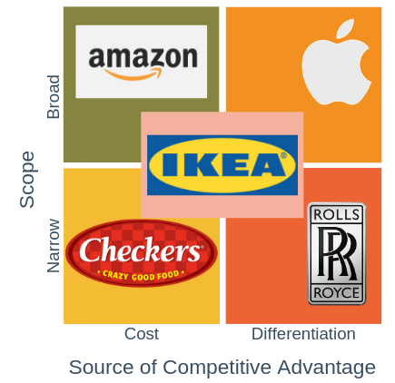
Porter Generic Strategy

Slide 36
Vission, Mission and Values
SWOT Analysis
PESTLE Analysis
Strategy Formulation
Strategy Execution
Strategy Evaluation
Strategy Evaluation Methods

Slide 37
Strategy Execution
Strategy execution is the discipline of dynamically managing and implementing strategy to achieve intended outcomes
Research after research finds that between 70-90% of strategies fail miserably or only deliver very marginal results. Fortune Magazine famously reported that just 1 out of 10 strategies were executed successfully. Research has also consistently found that failure is rarely the result of poor strategy formulation, but rather is due to an inability to execute

Slide 38
The Balanced Scorecard
The Balanced Scorecard was originally developed by Dr. Robert Kaplan of Harvard University and Dr. David Norton as a framework for measuring organizational performance using a more balanced set of performance measures.
Traditionally companies used only short-term financial performance as the measure of success. The “balanced scorecard” added additional non-financial strategic measures to the mix in order to better focus on long-term success

Slide 39

Balanced Scorecard

Slide 40
Financial Perspective
Any key objective that is related to the company’s financial health and performance may be included in this perspective
Revenue Growth
Profit
Cost Reduction
Productivity Improvement
Asset Utilization
Investments

Slide 41
Learning and Growth Perspective
This perspective includes employee training and corporate cultural attitudes related to both individual and corporate self-improvement. In a knowledge worker organization, people are the main resource.
Employee training and development
Mentoring programs
Succession planning

Slide 42
Business Process Perspective
Critical internal process in which organization must deal. These processes enable to deliver the value propositions to customers and satisfy stake holders expectations.
Innovation Process
Product Design
Product Development
Process Implementation

Slide 43
Customer perspective
This perspective focuses on performance objectives that are related to customers and the market.
Customer Retention
New Customer Acquisition
Customer Profitability
Market Share

Slide 44
Management by Objectives (MBO)
Management by objectives (MBO) is a strategic management model that aims to improve the performance of an organization by clearly defining objectives that are agreed to by both management and employees.
According to the theory, having a say in goal setting and action plans encourages participation and commitment among employees, as well as aligning objectives across the organization.
The term was first outlined by management guru Peter Drucker in his 1954 book, The Practice of Management.

Slide 45

Management by Objectives

Slide 46
Steps in MBO Process
The first step is to either determine or revise organizational objectives for the entire company. This broad overview should be derived from the firm's mission and vision.
The second step is to translate the organizational objectives to employees. Drucker used the acronym SMART (specific, measurable, acceptable, realistic, time-bound) to express the concept.

Slide 47
Steps in MBO Process
Step three is stimulating the participation of employees in setting individual objectives. After the organization's objectives are shared with employees, from the top to the bottom, employees should be encouraged to help set their own objectives to achieve these larger organizational objectives. This gives employees greater motivation since they have greater empowerment.

Slide 48
Steps in MBO Process
Step four involves monitoring the progress of employees. In step two, a key component of the objectives was that they are measurable in order for employees and managers to determine how well they are met.
The fifth step is to evaluate and reward employee progress. This step includes honest feedback on what was achieved and not achieved for each employee

Slide 49

SMART Goals

Slide 50
Budgeting
Budgeting is a essential management activities in implementing strategy. It can be used to know
Activities that are behind schedule;
Activities that are not achieving the success
Allocation or redistribution of resources to put plans back on track.
A budget is a plan that contains a quantitative statement of expected results.

Slide 51

Planning and Budgeting Process

Slide 52

Budgeting Process

Slide 53
Master Budget
The master budget, also called the comprehensive budget or annual profit plan, encompasses the organization’s operating and financial plans for a specified period
Consists of three principal parts :
  Operating budget.
  Cash budget
  Capital expenditure budget

Slide 54
Operating Budget
Revenues and associated expenses in day-to-day operations are budgeted in detail and are divided into major categories such as revenues, salaries, benefits, and non-salary expenses

Slide 55
Cash Budget
Cash budgets tie the other two budgets together and take into account the timing of payments and the timing of receipt of cash from revenues. Cash budgets help management track and manage the company’s cash flow effectively by assessing whether additional capital is required, whether the company needs to raise money, or if there is excess capital.

Slide 56
Capital Budget
Capital budgets are typically requests for purchases of large assets such as property, equipment, or IT systems that create major demands on an organization’s cash flow. The purposes of capital budgets are to allocate funds, control risks in decision-making, and set priorities.

Slide 57

Format of a Budget

Slide 58

Budgeting

Slide 59
Zero-based budgeting (ZBB)
Zero-based budgeting (ZBB) is an approach to making a budget from scratch. The budget is not based on previous budgets. Instead, the budget starts at zero.
With zero-based budgeting, there is a need to justify every expense before adding it to the official budget. The goal of zero-based budgeting is to reduce spending by looking at where costs can be cut.

Slide 60
Activity-based budgeting (ABB)
Activity-based budgeting (ABB) is a system that records, researches, and analyses activities that lead to costs for a company.
Every activity in an organization that incurs a cost is scrutinized for potential ways to create efficiencies. Budgets are then developed based on these results.
It is more rigorous than traditional budgeting processes, which tend to merely adjust previous budgets to account for inflation or business development.

Slide 61
Rolling Budget
Rolling simply means continuous. Rolling budget continuously updated by adding further accounting period when the earlier accounting period is completed. The rolling budget has a dynamic approach. Instead of a static budget of 12 months, it rolls forward by a quarter or a month.

Slide 62
Static Budget
A static budget is a type of budget that anticipates a fixed amount in sales, revenue and expenses.
Static budgets can remain unchanged, or fixed, in a company's financial records regardless of fluctuations in revenue volume.
Using a static budget can allow companies to allocate money to resources that they expect to remain the same throughout the stated period.

Slide 63
Question # 1
Budget and resource allocations are made during which stage of the strategic planning process?
a) Budgeting
b) Development
c) Implementation
d) Formulation

Slide 64
Answer # 1
Option C

Slide 65
Question # 2
A statement that describes what an organization does that is different from others is a:
A. Values statement
B. Corporate goal
C. Vision statement
D. Mission statement

Slide 66
Answer # 2
Option D

Slide 67
Questions

