Slide 1



Business Storytelling – Construct of Narratives Well Told
IIM Rohtak, November 27, 2022

Slide 2

Why Stories and Storytelling?
Why Business Storytelling?

Slide 3
Stories are need of the Hour!
We are wired for stories!
Businesses are stories told well!
Connected
Inspiring
Relatable
Convincing
Interesting
Intriguing
Empathetic
Well told
Satisfying

Slide 4

Perspectives Old and New
The era of storytellers >> The era of stories
Person focus >> Event focus
Relaxed timelines >> Immediate updates
Well-worn references >> Refreshed information
Delivered without frills >> Meticulous packaging
Long term rewards >> Instant Gratification

Slide 5
Here is a present-day story.
Meet Jeevan

Slide 6
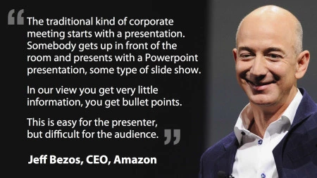
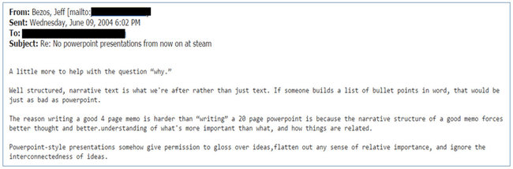



Slide 7
Build narrative not just PowerPoint.
Here’s a story.

Slide 8

What happened in the room?
Fear of Missing Out
How much is too much
Misalignment in approach
Customer Vs. Product Vs. Process
Design Vs. Discourse
Tell Vs. Show
Speak Vs. Converse
Presentation Vs. Narrative

Slide 9
Chai-Pani, Gup-Shup

Slide 10

Let’s play stories!
  Identify the most memorable aspects of the stories shared.
  Why are they memorable?

Slide 11
How do we add structure and narrative in a storyboard?

Slide 12

Beginning,
Middle and End – ​
The Quintessential Story Structure
  Beginning that inspires awe, anguish, amazement, attention >> Create Curiosity
  Middle that intrigues, interests, invites to explore >> Connect
  End that delivers impact, drives action, discovers opportunity >> Convert

Slide 13

The Struggle, Strength and
Success – Leader Led Stories
Story of origin, genesis of business, bootstrapping
(the garage story), the big idea, the conviction
Focus on Why?
Steadying the ship – acquiring skills, onboarding teams, creating products, series A funding
Focus on How?
Scale and success – market penetration, competitive positioning, revenue, recognition, customer success
Focus on impact.
Sail on headwinds – sales projections, market share,
product innovation, customer benefit.
Focus on sustainability.

Slide 14

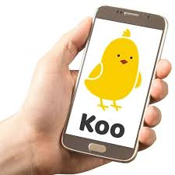
The Outcome, Process, Product – Solution Led Stories
  Start from the end – value delivered, quantified, qualified and perpetual, juxtaposed to context (market / customer)
  Explain how an why – reveal the secret sauce behind the outcome, explain process in relatable terms aligned to audience, focus on people / skill and Ips
  Demonstrate how – reveal the product /service, provide high level specs, show functionalities / features and innovation path
  Leave with validation – success stories, customer logos / testimonials, awards, recognitions

Slide 15

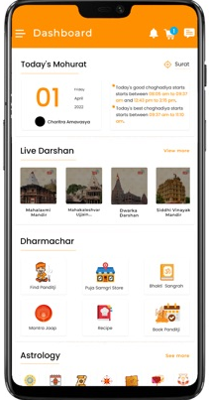

Challenger – the underdog
Lead with impact, highlight constraints, invoke empathy, drive actions
Saviour – the problem solver
Lead with context, highlight the need and opportunity, show potential, emphasize impact, drive action
Transformer – then and now
Lead with image of transformed world, create need and urgency, play on FOMO, command action
Some More Story Construct

Slide 16

Let’s play
Shark Tank.

Slide 17
Revise and Remember

Slide 18
The Story Secret
What is a Story?
Stories are facts
aligned to context,
wrapped in emotion,
seeped in empathy and,
delivered with conviction.
How to tell a story?
Converse not speak.
Show not tell.
Convey not preach.
Command not demand.
The C Formula
Clear + Consistent + Candid + Confident = Credible

Slide 19
The Cheat Sheet
Focus on customer need
Listen before speaking
Lead with impact
Put numbers in context
Be concise but convincing
Stay consistent
Clarify intent
Command action

Slide 20




We Storytellers
Storytellers_we
Get in Touch
https://www.we-storytellers.com/blog
www.we-storytellers.in
contact@we-storytellers.in

Slide 21

What you say matters.
How you say it, matters more.
Contently Yours…

